Slide 1

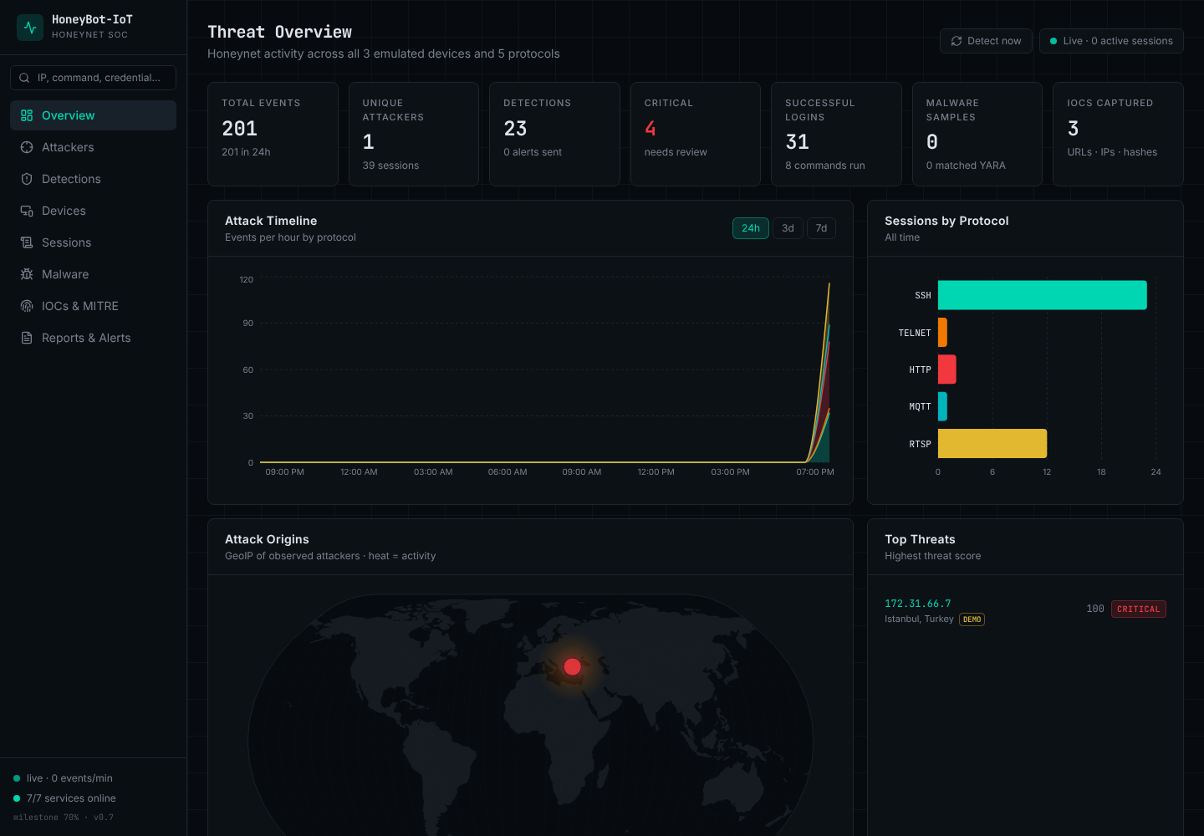
COMSATS University Islamabad
Department of Cyber Security
60% IMPLEMENTATION EVALUATION
HoneyBot-IoT
A High-Interaction Multi-Protocol IoT Honeypot for Cyber Threat Intelligence
Abdul Wadood CIIT/SP23-BCT-001/ISB
Abdul Rahman CIIT/SP23-BCT-003/ISB
Supervisor: Mrs. Sara Ali
Live SOC dashboard of the running build
BS Cyber Security (2023–2026) · October 2026
Notes:
Introduce the team, the supervisor and the project. Say that this presentation covers the 60% implementation evaluation and that the build shown live today is version 0.7.

Slide 2
Contents
OVERVIEW
01
Project Introduction
05
Automated Testing
Problem, solution, system at a glance
pytest, vitest, CI, RTM
02
Changes & Improvements
06
AI/ML Techniques
Committee feedback and what we changed
Module 8 data preparation
03
Implemented Modules
07
Next Steps
Individual work and live demos
Remaining work and challenges
04
Testing Techniques
08
Questions
Unit, functional, business rules, integration
Discussion
Notes:
Walk through the eight sections required by the evaluation guideline.

Slide 3
Project Introduction
01
A short reminder of the problem and our solution
Notes:
Keep this part to about one minute; the committee already knows the project.

Slide 4






Problem & Proposed Solution
01 — PROJECT INTRODUCTION
The problem
Our solution
IoT devices ship with default credentials, cleartext protocols and old firmware
Mirai (2016) took over 600,000+ devices using a list of 62 default passwords
Existing honeypots are low-interaction or cover one protocol and one device
3 devices × 5 protocols
One shared state per device, so every protocol tells the same story
Every action captured
Credentials, commands, URLs, files and packets in one event store
Device | Protocols | Real incident
CCTV camera | RTSP, HTTP/HTTPS | Mirai (2016), Verkada (2021)
Smart lock | SSH, HTTP REST, MQTT | Ring device attacks
Industrial sensor | Telnet, MQTT, HTTP HMI | Oldsmar water plant (2021)
Threat intelligence
16 detection classes, MITRE ATT&CK, IOCs, STIX 2.1, alerts
Live SOC dashboard
React dashboard with WebSocket push, replay and reports
Notes:
Problem: IoT devices are attacked with default passwords and old protocols, but defenders lack a multi-protocol, high-interaction honeypot for the device types that are attacked most. Solution: HoneyBot-IoT emulates three such devices over five protocols, captures everything the attacker does, classifies it and shows it live.

Slide 5
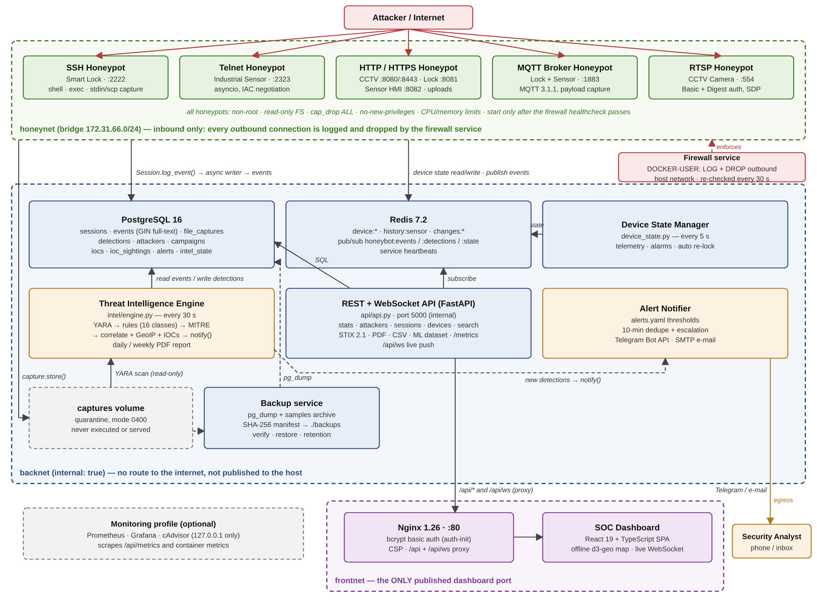
System at a Glance
01 — PROJECT INTRODUCTION
3
emulated IoT devices
5
protocols: SSH, Telnet, HTTP/S, MQTT, RTSP
13
Docker services on 4 networks
16
attack classes with MITRE ATT&CK
Notes:
Explain the three networks: attackers only reach the honeynet; the data services are on an internal network with no internet route; Nginx is the only way in for the analyst. A firewall service drops every outbound connection from the honeypots.

Slide 6
Changes & Improvements
02
Feedback from the SDS and 30% evaluations, and what we changed
Notes:
This section answers the committee's earlier comments first, then shows the main technical changes.

Slide 7

Committee Feedback and Our Response
02 — CHANGES & IMPROVEMENTS
Feedback | Source | What we changed | Evidence
Integrate AI/ML with the system | Scope / SDS evaluation | Module 8 started: every session becomes a labelled feature vector (29 features, 6 classes). The rule engine is the baseline the models will be compared to. | Section 06; /api/ml/dataset.csv
The scope is too wide — make it concise | Scope evaluation | Fixed to 3 devices × 5 protocols. Heavy tools replaced by lighter equivalents: K3s → Docker Compose, GStreamer → RTSP signalling + SDP, Celery → worker loop. | SDS §1.8 (agreed simplifications)
Isolation not enforced | Our review of the 30% build | Firewall service drops every outbound honeypot connection; honeypots start only after its health check passes. | Live: firewall.sh status
Logging split over per-protocol SQLite tables | Our review of the 30% build | One PostgreSQL 16 event store for all protocols, plus Redis for shared device state. | ER diagram, SDS §5
API published without authentication | Our review of the 30% build | API is internal only; Nginx with bcrypt basic auth is the single entry point. | Login demo (401 / 200)
How we worked: before adding any new feature, we reviewed the 30% build against the scope and fixed every defect we found. Each fix now has an automated regression test.
Notes:
Read the two committee comments and our response. Then mention the internal review: before adding features we reviewed the 30% build against the scope and fixed every defect we found. If the committee gave you any other comments, add them as rows here.

Slide 8





Major Technical Changes Since 30%
02 — CHANGES & IMPROVEMENTS
At 30% (SDS)
Now
Storage
Per-protocol SQLite tables
PostgreSQL 16 unified event store + Redis
Protocols
SSH, Telnet, HTTP, MQTT
+ RTSP camera with Basic and Digest auth
Device behaviour
Static banners
Shared device state across all protocols
Detection
4 simple counters
16 classes, MITRE ATT&CK, correlation, IOCs, STIX 2.1
Dashboard
Partial React prototype
React 19 + TypeScript, 11 pages, WebSocket push
Isolation
Manual script, often off
Automatic firewall service, re-checked every 30 s
Alerts
None
Telegram + e-mail with thresholds and de-duplication
Testing
Manual test cases
78 automated backend + 17 UI tests, CI on every push
Notes:
Each row is a before-and-after. Stress the three biggest changes: the unified event store, the shared device state across protocols, and the Threat Intelligence Engine.

Slide 9
Progress by Module
02 — CHANGES & IMPROVEMENTS
≈70%
overall, weighted by WBS effort (32.9 of 47 weeks)
Ahead of the 60% target
All non-AI scope features of M1–M7 are in place. Open items: PCAP per session, reputation feeds, and the Module 8 models.
Notes:
Coverage per scope module at the 60% review and in the build we demonstrate today. Weighted by the work-breakdown effort, the project is at about 70%. Module 8 has started with its dataset; model training is the 100% work.

Slide 10
Implemented Modules
03
Each member presents their own work with a live demo
Notes:
Member 1 covers the attacker-facing side and deployment. Member 2 covers detection, intelligence, the dashboard and alerts.

Slide 11

Abdul Wadood — Implemented Modules
03 — IMPLEMENTED MODULES
MEMBER
M1 IoT Device Emulation Engine
Abdul Wadood
CCTV camera, smart lock and industrial sensor with vendor banners, BusyBox-style fake file system and per-device default-credential profiles. Device State Manager in Redis: one state per device, live sensor simulation, alarms, auto re-lock.
CIIT/SP23-BCT-001/ISB
Attacker-facing honeypots, device emulation and secure deployment
M2 Multi-Protocol Communication Handler
SSH (Paramiko: shell, exec, stdin and scp), Telnet (asyncio, IAC negotiation), HTTP/HTTPS (camera panel, lock REST API, sensor HMI), MQTT 3.1.1 broker parser and RTSP with Basic + Digest authentication.
Contribution to the system
Everything an attacker touches is built here, and every interaction is handed to the shared logger — so all later modules work on real, consistent data.
M7 Containerized Deployment & Sandbox
Docker Compose stack of 13 services on 4 networks; firewall service with DOCKER-USER rules; non-root, read-only containers; bcrypt dashboard password; SHA-256-verified backups; Prometheus/Grafana profile.
Notes:
Present your three modules. Point out that one command on any protocol changes the same device state, which is what makes the honeypot high-interaction. Then move to the technical slide and the demo.

Slide 12
Wadood — Technical Implementation
03 — IMPLEMENTED MODULES · ABDUL WADOOD
Write on any protocol
Shared device state
Redis hash per device; changes published on honeybot:state and kept in a change log (actor, protocol, IP)
SSH
lockctl unlock
HTTP
POST /api/v1/lock
MQTT
lock/cmd unlock
SSH
Paramiko ServerInterface; shell, exec and scp channels captured; host key of a real lock model
Device State Manager
Redis hash device:smartlock · PUBLISH honeybot:state · change log
Telnet
asyncio server with IAC negotiation and a carry buffer for commands split across TCP reads
MQTT
lock/status
HTTP
GET /api/v1/status
SSH
cat /etc/lock_state
MQTT
Raw-socket parser: variable-length remaining length, QoS 1/2, wildcards; control topics change state
Read on any protocol — all report “unlocked”
RTSP
OPTIONS / DESCRIBE / SETUP; Digest + Basic challenge; valid H.264 SDP on success
Logged as a state_change event
→ ICS_UNAUTHORIZED_COMMAND detection, shown with protocol and IP on the Devices page
Isolation
Firewall service inserts LOG + DROP rules; honeypots start only after its health check passes
Notes:
Use the diagram to explain how one device command flows: authenticate, parse, update Redis, publish, log a state_change event. Then mention the protocol details and the isolation design.

Slide 13
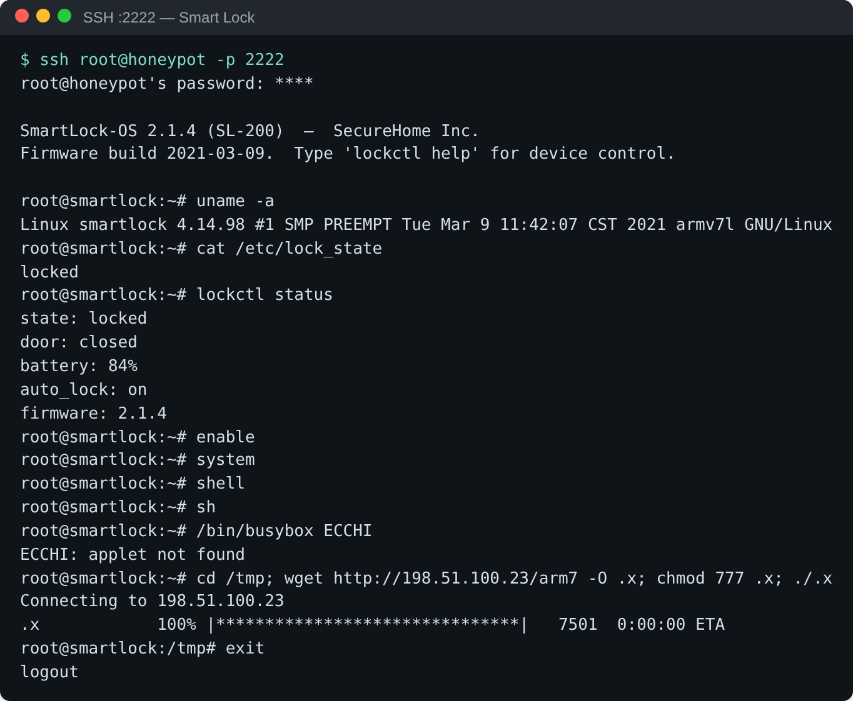
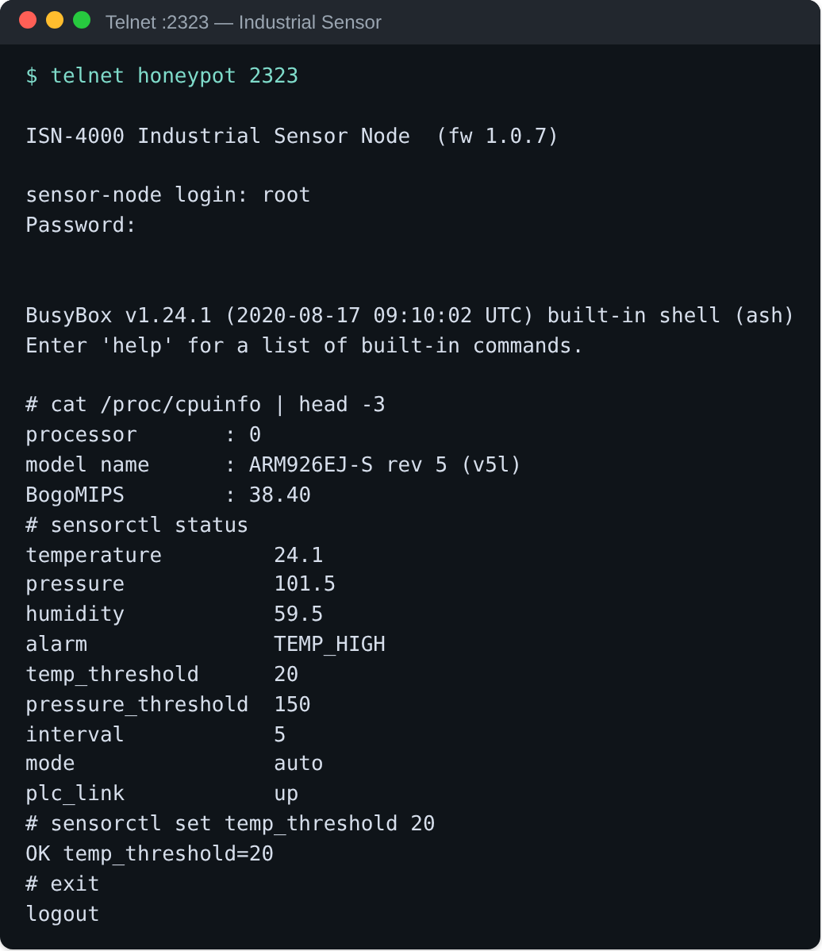
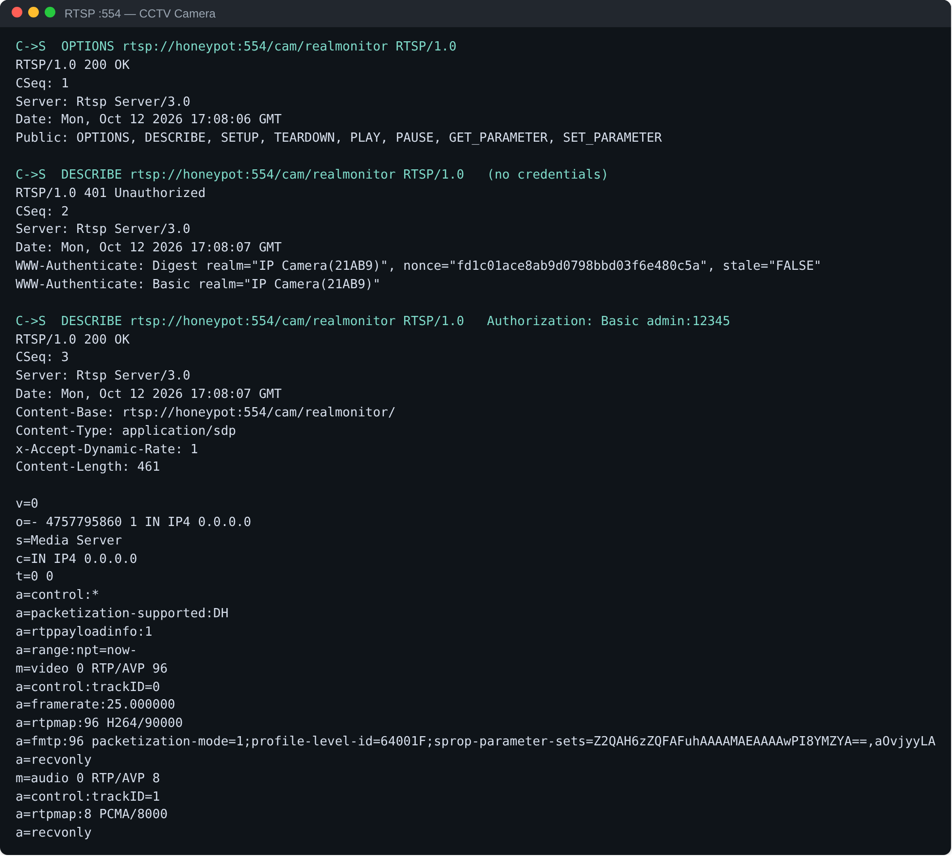
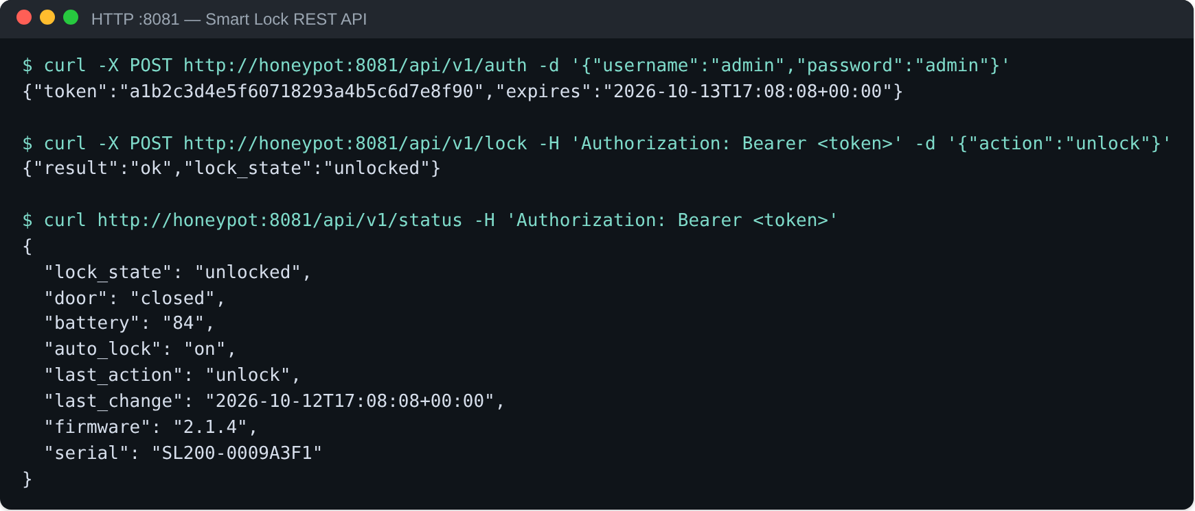
Wadood — Live Demo Plan
03 — IMPLEMENTED MODULES · ABDUL WADOOD
Demo steps
1
docker compose ps
13 services Up; db, api, firewall healthy
2
firewall.sh status
isolation rules active
3
ssh -p 2222 root@host
SSH on the smart lock (:2222)
Telnet on the sensor (:2323)
lockctl unlock on the smart lock
4
GET :8081/api/v1/status
REST API now reports unlocked
5
telnet :2323 → sensorctl
set temp_threshold 20; HMI :8082 shows it
6
RTSP DESCRIBE :554
Digest challenge, then SDP with admin:admin
RTSP exchange (:554)
Smart lock REST API (:8081)
Notes:
Run these steps live. The screenshots are a fallback only if the network or projector fails. Keep the dashboard open on a second screen so Member 2 can show the same attack arriving.

Slide 14
Abdul Rahman — Implemented Modules
03 — IMPLEMENTED MODULES
MEMBER
M3 Attack Detection & Forensic Logging
Abdul Rahman
Unified PostgreSQL event store fed by one asynchronous writer; command and URL capture (never fetched); malware quarantine (read-only, SHA-256, ELF architecture) with YARA; full-text search.
CIIT/SP23-BCT-003/ISB
Detection, threat intelligence, the SOC dashboard and alerts
M4 Threat Intelligence Engine
16 time-windowed detection classes tagged with MITRE ATT&CK (Enterprise + ICS); attacker correlation, threat score, offline GeoIP, credential campaigns, IOC store, STIX 2.1 export, PDF reports.
Contribution to the system
Turns raw attacker events into detections, intelligence and alerts the analyst can act on — the 'cyber threat intelligence' part of the title.
M5 Real-Time Monitoring Dashboard
React 19 + TypeScript SPA: overview with offline world map, attackers, detections, devices, session replay, malware, IOCs, reports; WebSocket live push behind Nginx.
M6 Alert & Notification System
Telegram and e-mail with per-type thresholds, 10-minute de-duplication, escalation and a complete alert log.
Notes:
Present your four modules. Stress that the engine only reads the events table, so every protocol is classified the same way. Then move to the technical slide and the dashboard demo.

Slide 15
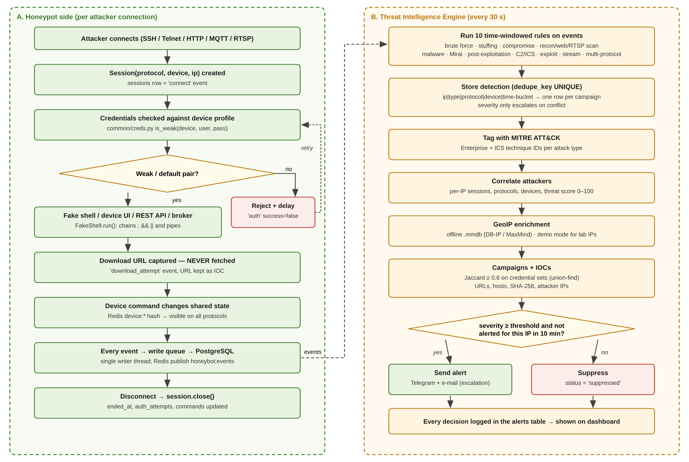
Rahman — Technical Implementation
03 — IMPLEMENTED MODULES · ABDUL RAHMAN
Single writer
Honeypots never touch the database; one background thread writes, so a slow DB never blocks an attacker
Rules
16 classes over time windows; UNIQUE dedupe_key gives one row per attack, not per pass
Intelligence
MITRE IDs, Jaccard credential campaigns, GeoIP, IOCs with idempotent sightings
Malware
Read-only quarantine (0400), YARA family match → CRITICAL MALWARE_FAMILY
Live UI
API relays Redis pub/sub to the browser over /api/ws
Notes:
Lane A is what every honeypot does per connection; lane B is one 30-second pass of the Threat Intelligence Engine. Explain dedupe_key, MITRE tagging, correlation and the alert decision.

Slide 16
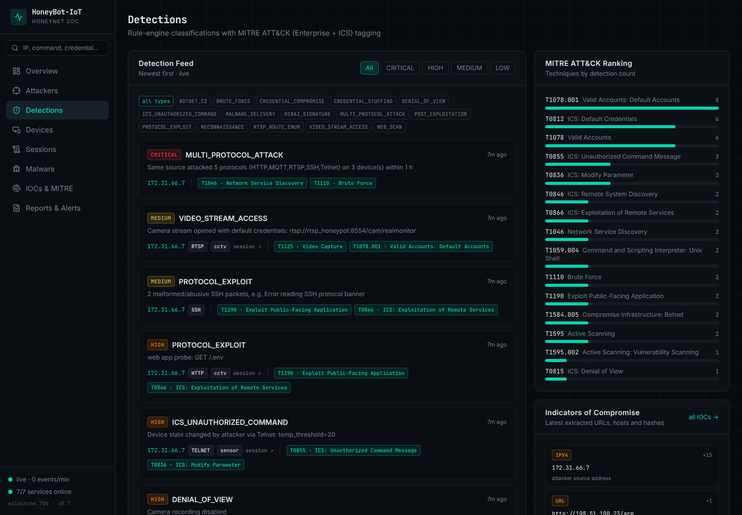
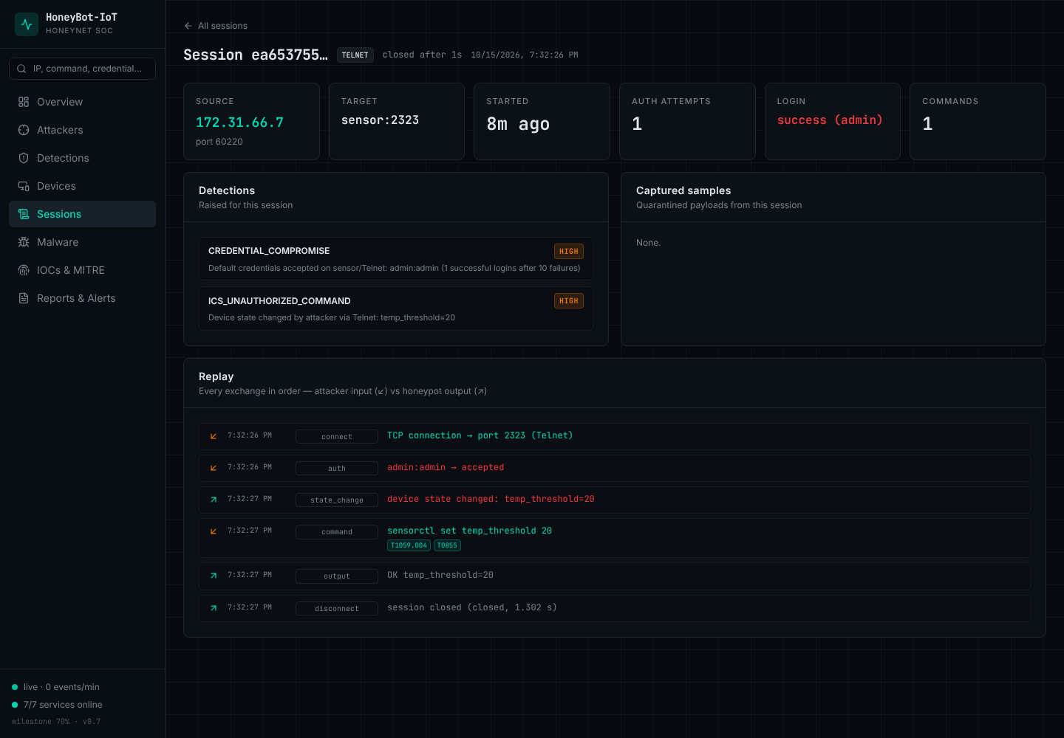
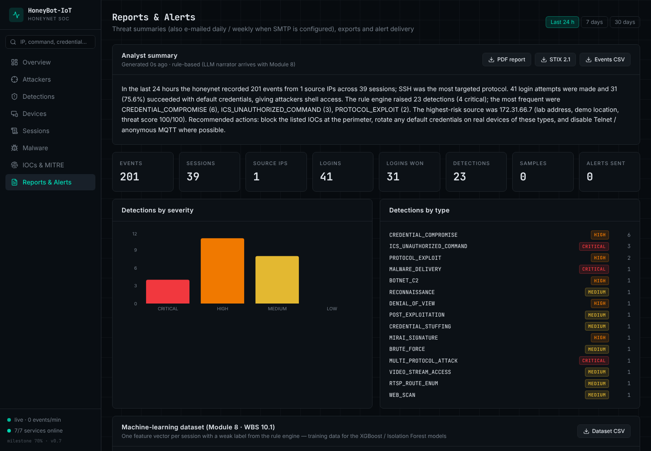
Rahman — Live Demo Plan
03 — IMPLEMENTED MODULES · ABDUL RAHMAN
Demo steps
1
Log in at http://host/
bcrypt basic auth; 401 with a wrong password
2
Overview
live feed updates over WebSocket during the attack
3
Detect now → Detections
Threat overview
Detections + MITRE ranking
classes with MITRE technique IDs
4
Attacker → session replay
input vs output, step by step
5
Upload on camera panel
Malware page: SHA-256, quarantined, YARA
6
Reports & Alerts
PDF report, STIX 2.1 bundle, alert log
Session replay
Reports, exports, alert log
Notes:
While Member 1 attacks, show the overview feed updating live. Then Detect now, open the attacker profile and the session replay, upload a file on the camera panel and show it on the Malware page, and finish with the PDF and STIX downloads.

Slide 17
Testing Techniques
04
What we tested, how, and why that technique fits
Notes:
Four techniques, each chosen for a different kind of risk.

Slide 18



Testing Techniques and Why We Chose Them
04 — TESTING TECHNIQUES
Unit testing
Functional testing
Business rules
Integration testing
White-box · pytest
Black-box
Decision tables
Grey-box
What
Parsers (MQTT, RTSP Digest, Telnet IAC), fake shell, credential profiles, MITRE mapping, YARA, STIX.
What
Each honeypot as an attacker sees it; engine classifications; every dashboard page.
What
Brute force, multi-protocol, credential stuffing, alert threshold / dedupe / escalation.
What
Honeypot → PostgreSQL → engine → alerts → API → dashboard, in Docker.
Why
Protocol parsing and security checks are exact rules — small, fast tests catch regressions on every change.
Why
The attacker never sees our code, so features are judged only by inputs and outputs.
Why
Detection depends on combinations of conditions; a decision table makes every combination explicit.
Why
Most failures happen between services (networks, auth, schema), so we test the whole path.
Notes:
Unit tests protect the parsers and security logic, functional tests check whole features from the outside, decision tables cover every combination of detection thresholds, and integration tests prove the data flows from attacker to dashboard.

Slide 19
Test Cases and Results
04 — TESTING TECHNIQUES
ID | Technique | Test case | Expected | Result
HB-SSH-001 | Functional | SSH login root/root on the smart lock | Banner, root shell | Pass
HB-RTSP-002 | Unit | RTSP DESCRIBE with wrong Digest response | 401, attempt logged | Pass
HB-INTEL-004 | Functional | 25 failed SSH logins in 10 minutes | BRUTE_FORCE, MITRE T1110 | Pass
BR-MPA-03 | Business rule | Same IP on 3 protocols within 1 hour | MULTI_PROTOCOL_ATTACK | Pass
BR-ALERT-03 | Business rule | Second HIGH alert for one IP in 10 min | Suppressed, not sent | Pass
HB-INT-002 | Integration | Unlock over REST, read over MQTT and SSH | All report unlocked | Pass
HB-INT-008 | Integration | Honeypot connects out to the internet | Dropped by the firewall | Pass
163 / 163
test cases passed · 0 failing
Notes:
Highlight a few cases from each technique, then the totals. All test cases currently pass; the next slide shows the defects that testing found and how each was resolved.

Slide 20
Failed Cases and Defects Found — Status
04 — TESTING TECHNIQUES
Issue found | Found by | Fix | Status
Telnet counter on the dashboard always 0 | Functional test (dashboard) | Protocol-key map in the UI | Fixed
Detail pages (/attackers/<ip>) showed the list page | UI unit test | List pages made index routes | Fixed
Events with a NUL byte silently lost | Integration test | sanitize() in the logger | Fixed
wget 1.2.3.4/x (no scheme) not logged as a download | Unit test | URL normalisation in the shell | Fixed
IOC hit counts grew on every engine pass | Functional test | ioc_sightings table | Fixed
Report ranked severity alphabetically | Unit test | Ranked with array_position() | Fixed
Live Telegram / SMTP delivery | — | Needs real credentials | Planned (100%)
Load test (events per second) | — | Needs public VPS data | Planned (100%)
Every fix has a regression test, so the defect cannot come back unnoticed.
Notes:
Be open about failures: each of these failed at first, was fixed, and is now covered by a test. Two areas are not testable yet and are planned for the 100% stage.

Slide 21
Automated Testing
05
Strategy, tools, examples, live run and traceability
Notes:
This section is mandatory for software engineering projects. We will run the suite live.

Slide 22

Automated Testing Strategy
05 — AUTOMATED TESTING
pytest 8
Core features selected for automation
78 backend tests: parsers, shell, capture, YARA, rules, MITRE, STIX, reports, ML labels
Protocol parsing: MQTT packets, RTSP Digest, Telnet IAC
Authentication against weak-credential profiles (accept and reject)
Fake shell: commands, chaining, Mirai preamble, device control
Capture: downloads logged but never fetched; files quarantined read-only
Detection: MITRE mapping, malware families, report severity
Intelligence exports: STIX 2.1 validity, idempotent IOC hits
API and live push: endpoints, search validation, WebSocket relay
ML dataset: weak-label priority and labels per session
FastAPI TestClient + httpx
Every REST endpoint, exports, security of responses, WebSocket relay
stix2 (OASIS)
Validates our STIX 2.1 export against the official specification library
vitest + Testing Library
17 dashboard tests: routing, session replay, helpers
GitHub Actions CI
Runs the suites and bandit security lint on every push
Notes:
Explain the layers: fast unit tests without a database, database-backed tests that skip automatically when PostgreSQL is not available, API and WebSocket tests through FastAPI's TestClient, and dashboard tests with vitest. The CI workflow runs everything on every push.

Slide 23
Positive and Negative Test Examples
05 — AUTOMATED TESTING
AT-12 Positive — RTSP accepts a valid default credential
AT-13 Negative — RTSP rejects a wrong password
def test_rtsp_digest_accepts_valid_default_credentials():
ha1 = md5(f"admin:{realm}:admin")
ha2 = md5(f"{method}:{uri}")
resp = md5(f"{ha1}:{nonce}:{ha2}")
assert digest_check(params, method) == "admin"
def test_rtsp_digest_rejects_wrong_password():
params = dict(username="admin", realm=REALM,
nonce="n0", uri="rtsp://h/cam",
response="0" * 32)
assert digest_check(params, "DESCRIBE") is None
AT-04 Negative — search without a query is rejected
AT-44 Positive — live event reaches the browser
def test_search_requires_query(client):
assert client.get("/api/search").status_code == 422
assert client.get("/api/search?q=ab").status_code == 200
# 422 = FastAPI input validation, no SQL is run
def test_websocket_relays_live_events(client):
with client.websocket_connect("/api/ws") as ws:
assert recv(ws)["channel"] == "hello"
r.publish("honeybot:events", {"ip": "192.0.2.1"})
assert recv(ws)["data"]["ip"] == "192.0.2.1"
Notes:
Show one positive and one negative case for the same feature, then a negative API case and a live-push case. These are the real test functions in the tests folder.

Slide 24
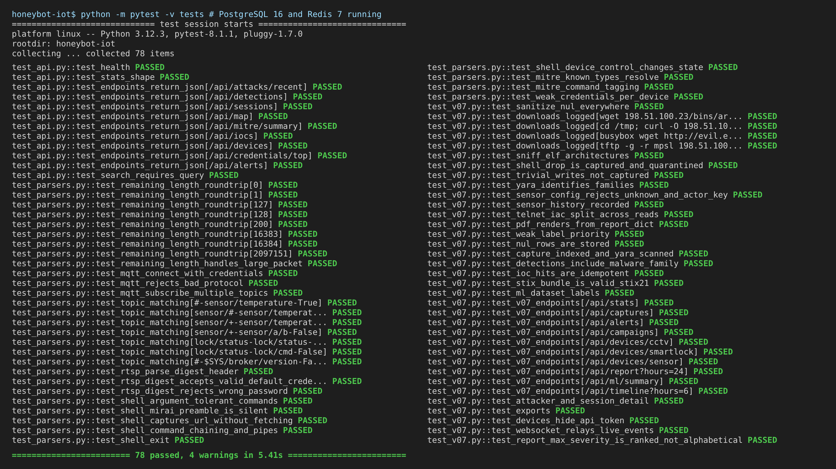
Execution Evidence and Results
05 — AUTOMATED TESTING
78
backend tests executed
78
passed · 0 failed
17 / 17
dashboard tests passed
5.4 s
full backend run
Notes:
Run 'python -m pytest -v tests' live with PostgreSQL and Redis running. If time is short, run 'pytest -q' — 78 passed in about 5 seconds. Without a database the 33 DB-backed tests are skipped, not failed.

Slide 25
Requirement Traceability Matrix (RTM)
05 — AUTOMATED TESTING
FR ID | Functional requirement (scope module) | Automated tests | Result
FR-01 | Weak-credential profiles per device (M1-FE-1..3) | AT-22, AT-12, AT-13 | Pass
FR-02 | Device State Manager shared by all protocols (M1-FE-4) | AT-19, AT-29, AT-30 | Pass
FR-03 | MQTT 3.1.1 broker parsing (M2) | AT-05 – AT-10 | Pass
FR-04 | Interactive shells over SSH / Telnet (M2) | AT-14, AT-15, AT-17, AT-18, AT-31 | Pass
FR-05 | RTSP authentication, Basic + Digest (M2) | AT-10 – AT-13 | Pass
FR-06 | Command and URL capture, never fetched (M3) | AT-16, AT-24 | Pass
FR-07 | File capture, quarantine and YARA (M3) | AT-25 – AT-28, AT-35 | Pass
FR-08 | Lossless event store (M3) | AT-23, AT-34 | Pass
FR-09 | Detection with MITRE ATT&CK tags (M4) | AT-20, AT-21, AT-36 | Pass
FR-10 | IOC store and STIX 2.1 export (M4) | AT-37, AT-38 | Pass
FR-11 | Threat reports, PDF and CSV export (M4/M5) | AT-32, AT-42, AT-45 | Pass
FR-12 | Dashboard API, search and live push (M5) | AT-01 – AT-04, AT-40, AT-41, AT-43, AT-44 | Pass
FR-13 | ML dataset with weak labels (M8-FE-1 prep) | AT-33, AT-39 | Pass
Notes:
Each functional requirement from the scope is linked to the automated tests that verify it. AT IDs map one-to-one to test functions — the full list is on the next slide.

Slide 26
Automated Test Case IDs
05 — AUTOMATED TESTING
test_api.py
AT-01 test_health
AT-02 test_stats_shape
AT-03 test_endpoints_return_json (9)
AT-04 test_search_requires_query
test_parsers.py
AT-05 test_remaining_length_roundtrip (8)
AT-06 test_remaining_length_handles_large_packet
AT-07 test_mqtt_connect_with_credentials
AT-08 test_mqtt_rejects_bad_protocol
AT-09 test_mqtt_subscribe_multiple_topics
AT-10 test_topic_matching (7)
AT-11 test_rtsp_parse_digest_header
AT-12 test_rtsp_digest_accepts_valid_default_credentials
AT-13 test_rtsp_digest_rejects_wrong_password
AT-14 test_shell_argument_tolerant_commands
AT-15 test_shell_mirai_preamble_is_silent
test_parsers.py
AT-16 test_shell_captures_url_without_fetching
AT-17 test_shell_command_chaining_and_pipes
AT-18 test_shell_exit
AT-19 test_shell_device_control_changes_state
AT-20 test_mitre_known_types_resolve
AT-21 test_mitre_command_tagging
AT-22 test_weak_credentials_per_device
test_v07.py
AT-23 test_sanitize_nul_everywhere
AT-24 test_downloads_logged (4)
AT-25 test_sniff_elf_architectures
AT-26 test_shell_drop_is_captured_and_quarantined
AT-27 test_trivial_writes_not_captured
AT-28 test_yara_identifies_families
AT-29 test_sensor_config_rejects_unknown_and_actor_key
AT-30 test_sensor_history_recorded
test_v07.py
AT-31 test_telnet_iac_split_across_reads
AT-32 test_pdf_renders_from_report_dict
AT-33 test_weak_label_priority
AT-34 test_nul_rows_are_stored
AT-35 test_capture_indexed_and_yara_scanned
AT-36 test_detections_include_malware_family
AT-37 test_ioc_hits_are_idempotent
AT-38 test_stix_bundle_is_valid_stix21
AT-39 test_ml_dataset_labels
AT-40 test_v07_endpoints (10)
AT-41 test_attacker_and_session_detail
AT-42 test_exports
AT-43 test_devices_hide_api_token
AT-44 test_websocket_relays_live_events
AT-45 test_report_max_severity_is_ranked_not_alphabetical
(n) = parametrised cases. 45 test functions = 78 executed test cases.
Notes:
This list ties every AT ID to the real test function in the project, so any ID can be opened in the code during questions.

Slide 27
AI/ML Techniques
06
What is implemented for Module 8 so far, and why
Notes:
Be precise: the models are the 100% work. What runs today is the data preparation that the models need.

Slide 28
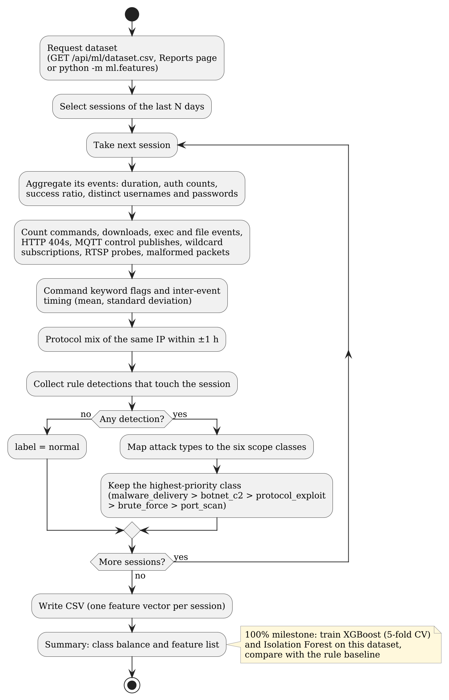
Module 8 — Data Preparation (Implemented)
06 — AI/ML TECHNIQUES
Class (scope) | Produced by rules
malware_delivery | MALWARE_DELIVERY, MALWARE_FAMILY, MIRAI
botnet_c2 | BOTNET_C2, ICS command, DENIAL_OF_VIEW
protocol_exploit | PROTOCOL_EXPLOIT
brute_force | BRUTE_FORCE, STUFFING, COMPROMISE
port_scan | RECON, WEB_SCAN, RTSP_ROUTE_ENUM
normal | no detection
Dataset
One row per session from the unified events table
29 features: duration, auth counts and success, distinct users/passwords, commands, downloads, files, HTTP 404s, MQTT control and wildcards, RTSP probes, malformed packets, keyword flags, timing mean/std, protocol mix of the IP
Weak label from rule detections, highest priority wins
Export: /api/ml/dataset.csv and the Reports page
Why these techniques
XGBoost suits small tabular data and explains itself through feature importance. Isolation Forest needs no labels, so it can flag new (zero-day) behaviour.
Notes:
Every attacker session becomes one row of 29 numeric features built from the event store. Its weak label comes from the rule engine's detections, mapped to the six classes in the scope. The rule engine is therefore also the baseline the trained models must beat.

Slide 29


Current Effectiveness and Evaluation Plan
06 — AI/ML TECHNIQUES
Working today
Next — models (100%)
How we will measure it
Rule engine detected all 15 behaviour classes in the simulator run; the 16th (MALWARE_FAMILY) is covered by an automated test
YARA identifies IoT malware families (Mirai, Gafgyt, Mozi, Tsunami …) on quarantined samples
Labelled dataset produced live; label logic verified by AT-33 and AT-39
XGBoost classifier for the six classes, 5-fold cross-validation
Isolation Forest anomaly score for unseen behaviour
Risk score and LLM threat narrative (M8-FE-3, M8-FE-4)
Served from a separate ml_api container
Accuracy, macro-F1 and a confusion matrix per class
Compared with the rule baseline on the same sessions
Features the rules do not use (timing, ratios, protocol mix) to avoid label leakage
Notes:
Today the intelligence comes from the rule engine and YARA, which already detect all 16 classes end to end. The model evaluation will use 5-fold cross-validation and compare against this baseline, using features the rules do not look at, so the model cannot simply copy the rules.

Slide 30
Next Steps & Remaining Work
07
What is left for 100% and how we will handle the risks
Notes:
Close with a concrete plan.

Slide 31
Remaining Work and Challenges
07 — NEXT STEPS
Expected challenge | How we will address it
Too little real attack data to train on | Expose on a VPS for several weeks; add simulator runs for rare classes
Model only learns the rules (label leakage) | Use features the rules ignore; compare with the rule baseline
Risk of the honeypot being used to attack others | Firewall service, passive capture, supervisor approval, PECA 2016
Limited resources on one host | Light models (scikit-learn, XGBoost) in a separate container
Alert fatigue on the internet | Per-type thresholds, de-duplication and escalation already in place
Remaining work
1
Module 8 models
XGBoost, Isolation Forest, risk score, ml_api
2
LLM threat narrative + AI panel
Summary panel on the dashboard (M5)
3
PCAP + reputation feeds
Per-session capture; GreyNoise / VirusTotal / OTX
4
Public VPS deployment
Real-internet data, after supervisor approval
5
Load and delivery tests
Events per second; live Telegram/SMTP
6
Final report and closure
User manual, final SDS, presentation
Notes:
Left: the remaining work in order. Right: the main challenges and how we plan to handle each one.

Slide 32
Thank You
Questions & Answers
Abdul Wadood (SP23-BCT-001) · Abdul Rahman (SP23-BCT-003)
Supervisor: Mrs. Sara Ali · Department of Cyber Security, COMSATS University Islamabad
Notes:
Invite questions. Each member answers questions about their own modules; either can answer about testing and the overall design.

