Slide 1

Final Year Project Mid Presentation
Title of Project : Automated Network Penetrator
Group Members : (1) Muhammad Zeeshan Ahmed
(2) Muhammad Abdul Wahab
Supervisor : Dr. Saad A. Malik
30 Sep 2021

Slide 2
Presentation Outline
Project Details
  Introduction
  Progress

Slide 3
Introduction
Automated Network Penetrator
Checks the vulnerabilities by penetration
Automates the process of penetration

Slide 4
Progress
Literature Review
Environment Setup
Vulnerable application
Manual and Automated penetration
Ports Scripts

Slide 5
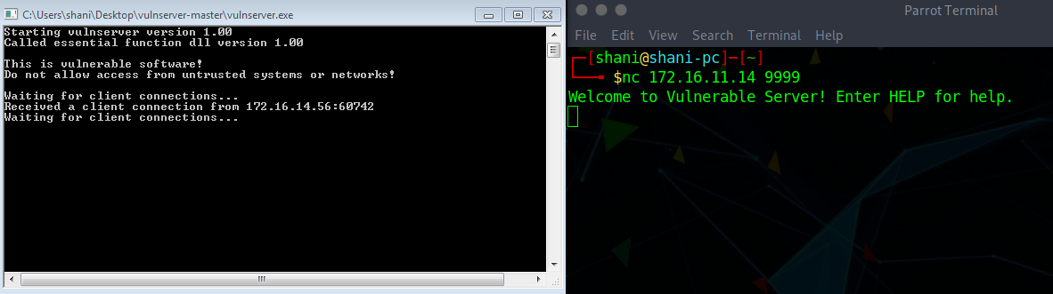
Vulnerable Application
Vulnserver

Slide 6
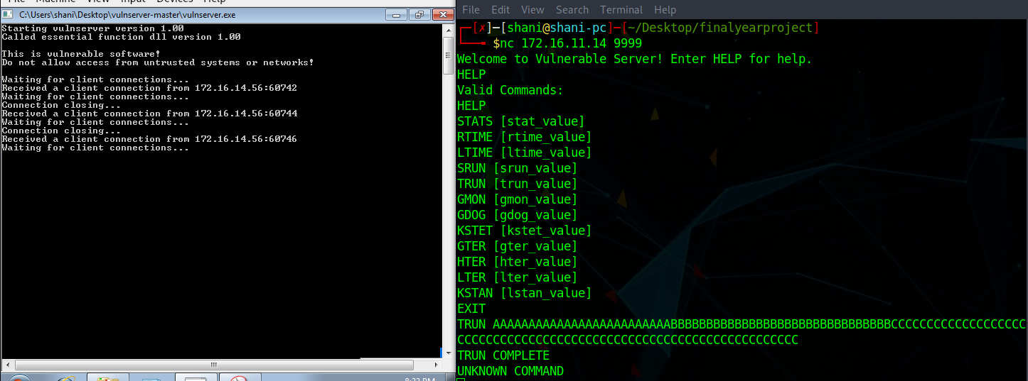
Manual Penetration
Netcat
Trun

Slide 7
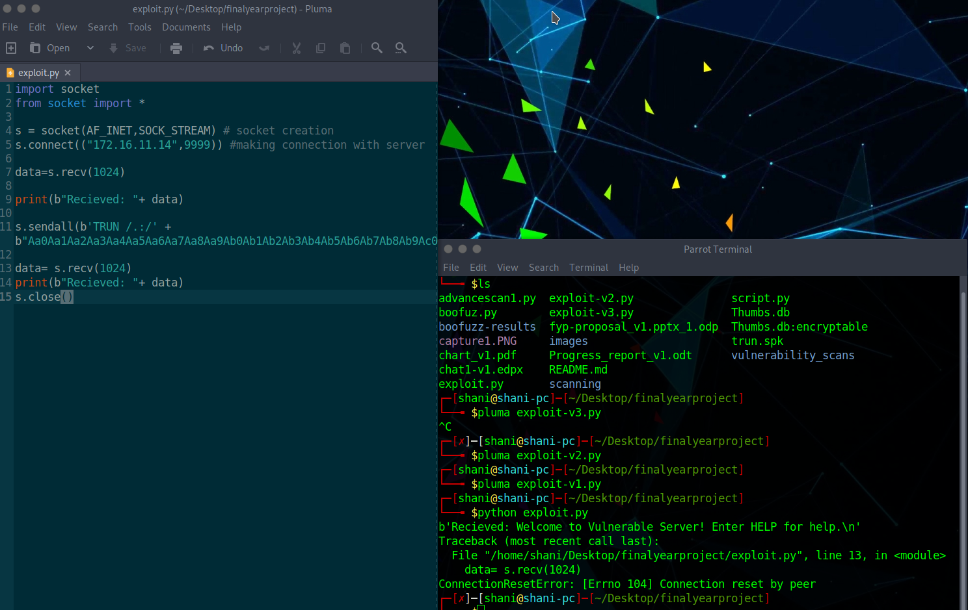
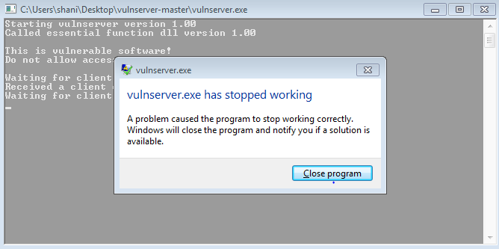
Automated Penetration
Python Scripts
Immunity Debugger
Overflow
Boofuzz

Slide 8
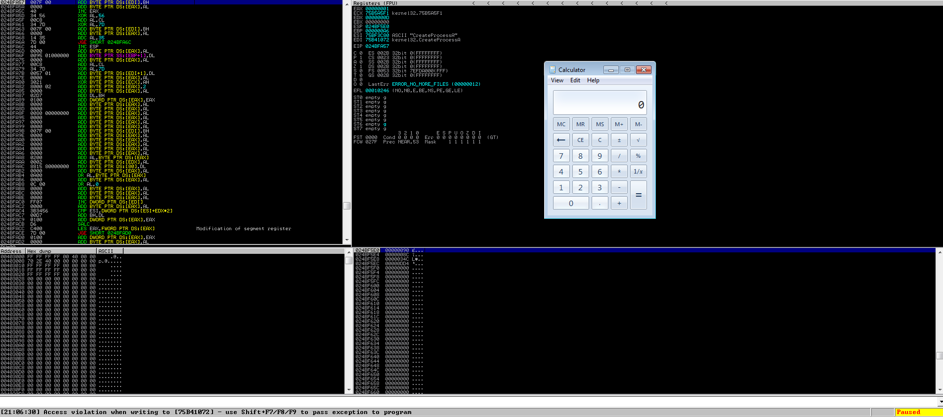
Exploitation
EIP offset
ESP through dll’s
  Mona

Slide 9
Maltego
Footprinting
Vunerable points
Shows Graphical representations

Slide 10
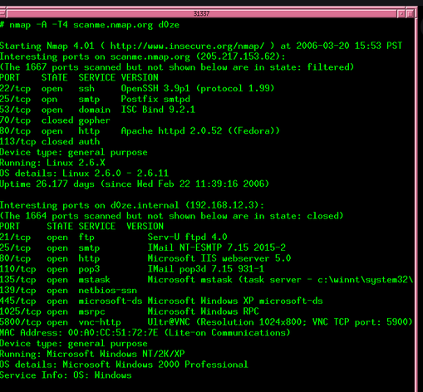

Slide 11
Flowchart
Start
Permission granted for
Network Pentesting
NW PenTest
Identified Network testing begins
Parse Results for
Vulnerabilities
Data Base of known
Vulnerabilities
Display Assessment
For Threat
Data Base of known
Threat Categories
End

Slide 12
NMAP output
Cumbersome to assess
Parser to determine the vulnerability, based on known data
  Web search vulnerability data base

Slide 13
FYP End
A tool which tells vulnerabilities, and threats by assessing the network
Automatically assess the network

Slide 14
Timelines
30 Sep
15 Dec
15 Mar
1 June
Initial Proposal
Lit. Survey
Lab Setup
Writing Parser
Vulnerability Report
FYP Report

Slide 15
Open for Suggestions !

Slide 16
Thank you!

