Slide 1
Automated Network Penetrator
Group Members : (1) Muhammad Zeeshan Ahmed
(2) Muhammad Abdul Wahab
Supervisor: Dr. Saad A. Malik

Slide 2
Outline
FYP Progress
Introduction
  Overview of FYP
Current Progress
  Live Demonstration
Future work

Slide 3
Overview of the Project

Slide 4
Introduction
What is Network Penetration?
Exploitation of vulnerabilities present in an organization’s network.
Network comprises of :
  Host
    Running OS & Apps
  Network Devices

Slide 6
Host
Typical Network
Host
Internet
Router

Slide 7
Typical Network Hacking
Internet

Slide 8
Typical Network Hacking
Internet

Slide 9
Typical Network
Penetration testing
Internet

Slide 10
Significance of PenTesting
Simulates the Hacking
Exploitation tells the degree of vulnerability
Helps to Secure the system

Slide 11
Scope of our Project
Hundreds of vulnerabilities can be exploited
  OS, Apps
  Network devices
Our scope of work is confined to one vulnerability i.e buffer overflow

Slide 12
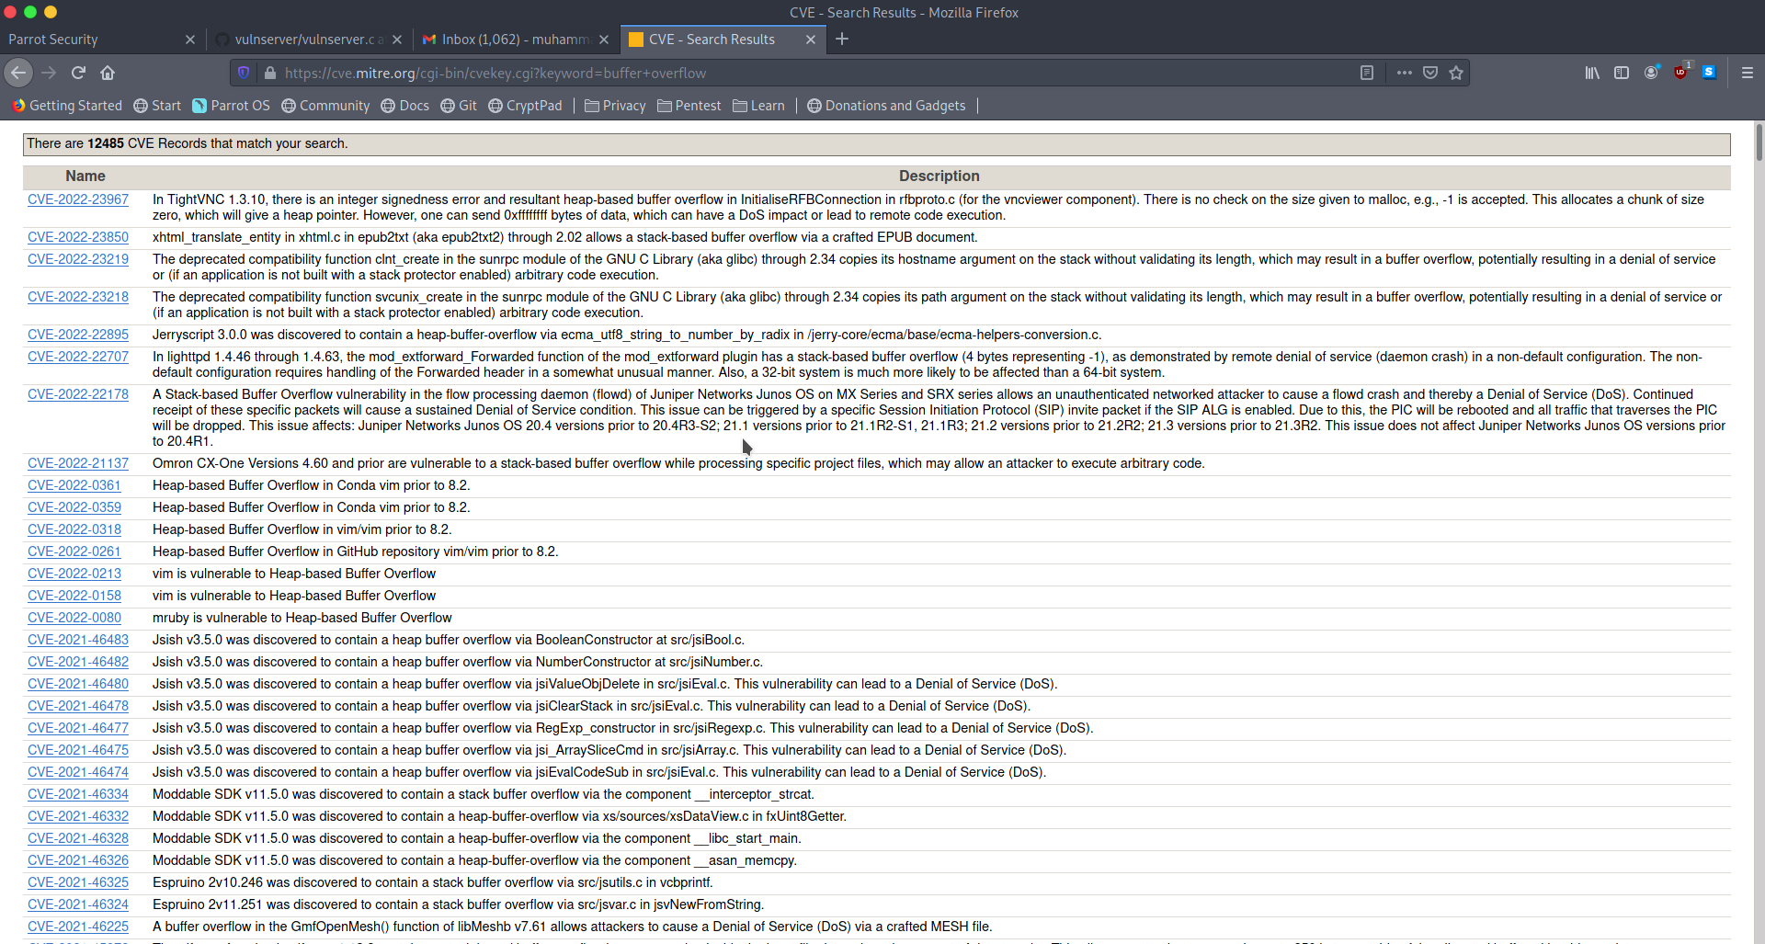

Slide 13
Buffer Overflow ?
Buffer overflow is an exploit which allows access to the host operating system either as a normal or a privalaged user

Slide 14
Background
System
Pen Tester

Slide 15
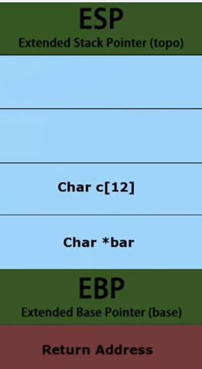
Memory Management by OS
Kernel
Stack
Heap
Data
Text

Slide 16
Memory Management by OS
Kernel
Stack
Heap
Data
Text
RAM
Process 1
Process 2

Slide 17
Buffer Overflow
Buffer overflow
Overwrite EIP
Execute Shell code

Slide 18
Progress
Vulnerable Server
Trun
if (strncmp(RecvBuf, "TRUN ", 5) == 0) {
char *TrunBuf = malloc(3000);
memset(TrunBuf, 0, 3000);
for (i = 5; i < RecvBufLen; i++) {
if ((char)RecvBuf[i] == '.') {
strncpy(TrunBuf, RecvBuf, 3000);
Function3(TrunBuf);
break;
}
}
memset(TrunBuf, 0, 3000);
SendResult = send( Client, "TRUN COMPLETE\n", 14, 0 );

Slide 19
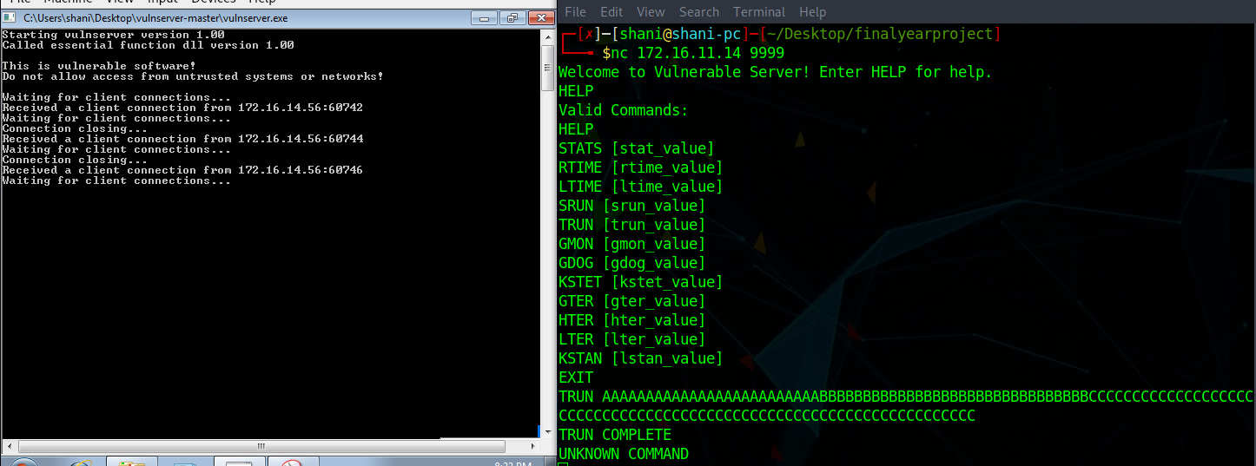

Slide 20
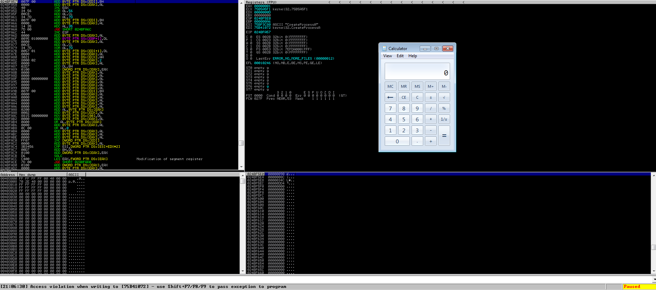
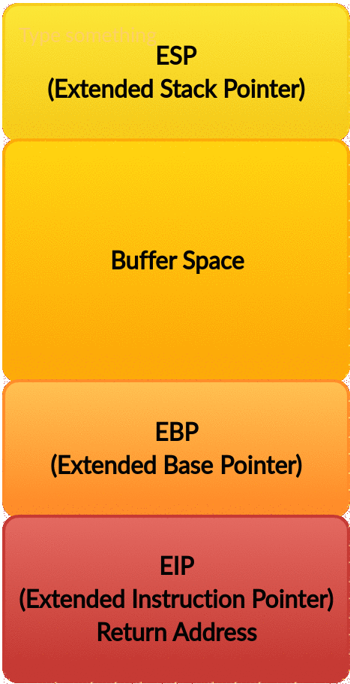
Penetration Scripts
Exploit Script
Overwriting EIP
Executing shellcode

Slide 21
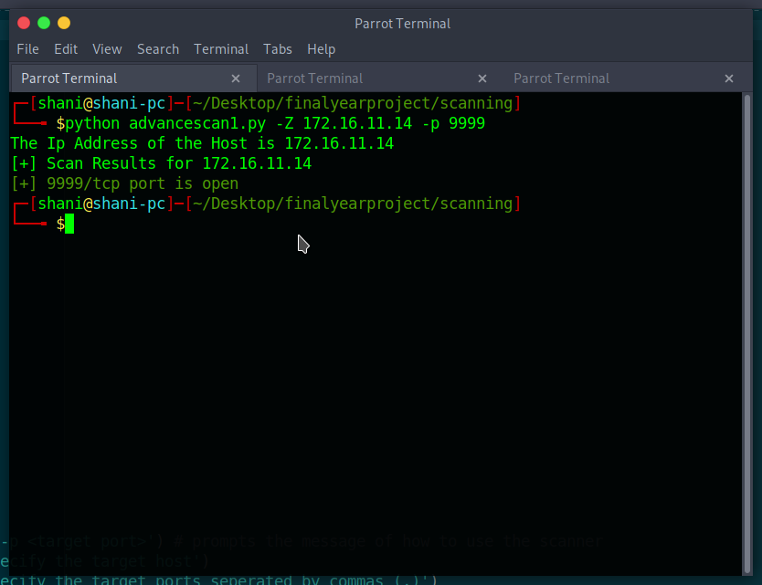
Penetration Scripts
Scanner
Connects to port

Slide 22
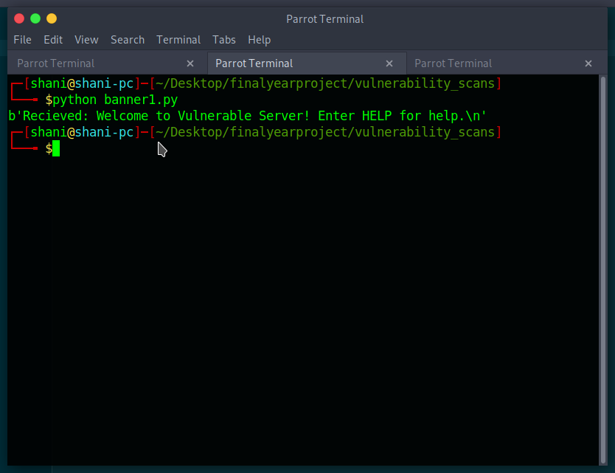
Penetration Scripts
Banner
Returns the Service

Slide 23
Future Work
Finding more vulnerability
Exploiting them Automatically
Increasing the scope up to more applications

Slide 24
Timeline
Writing
Scripts
FYP
Report
Sep 30
Mar 15
DEC 15
June 1
Literature review
Lab setup
Vulnerability
Report and
FYP report

