Slide 1
Automated Network Penetrator
Group Members : (1) Muhammad Zeeshan Ahmed
(2) Muhammad Abdul Wahab
Supervisor: Dr. Saad A. Malik

Slide 2
Outline
Introduction
Significance
Background
Progress
Future work
Timeline

Slide 3
Introduction
Penetration (Exploitation of vulnerabilities present in an organization’s network.)
Ethical and Unethical
Can be Mobile application penetration or web application penetration

Slide 4
Significance
Simulates the Hacking
Exploitation tells the degree of vulnerability
Helps to Secure the system

Slide 5


Background
switches
Host
Destination
Routers

Slide 6
Background
System
Pen Tester

Slide 7
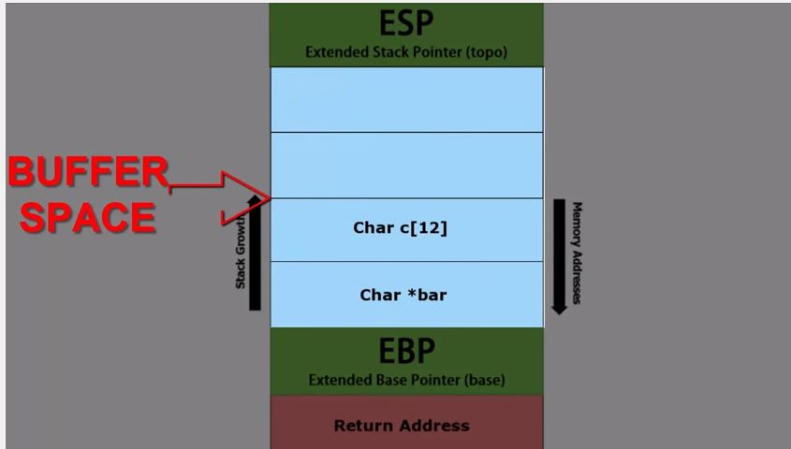
Background
Kernel
Stack
Heap
Data
Text
Applications
Own Memory

Slide 8
Background
Buffer overflow
Overwrite EIP
Execute Shell code

Slide 9
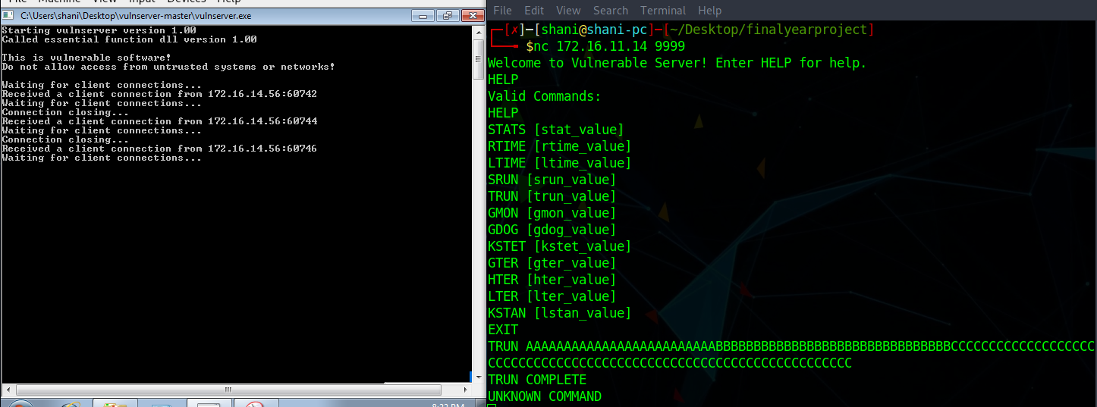
Progress
Vulnerable Server
Trun
if (strncmp(RecvBuf, "TRUN ", 5) == 0) {
char *TrunBuf = malloc(3000);
memset(TrunBuf, 0, 3000);
for (i = 5; i < RecvBufLen; i++) {
if ((char)RecvBuf[i] == '.') {
strncpy(TrunBuf, RecvBuf, 3000);
Function3(TrunBuf);
break;
}
}
memset(TrunBuf, 0, 3000);
SendResult = send( Client, "TRUN COMPLETE\n", 14, 0 );

Slide 10
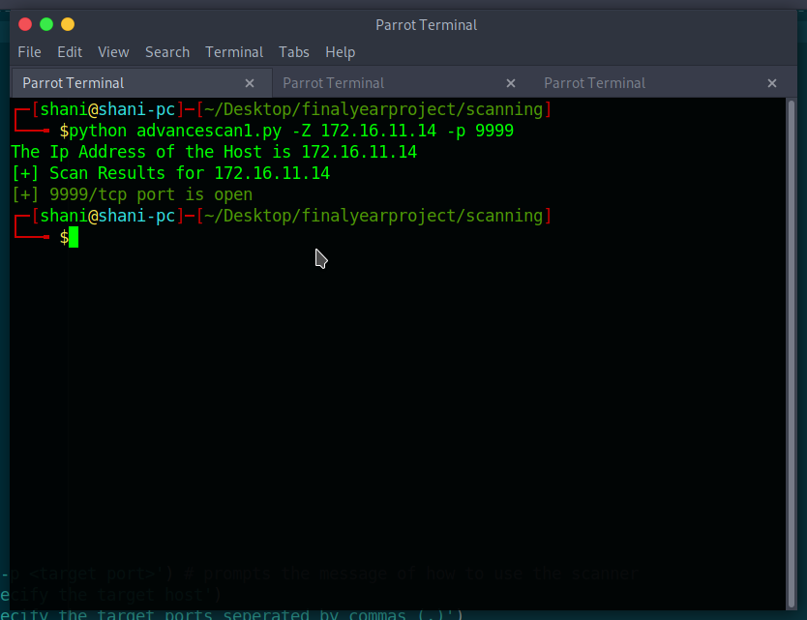
Progress
Scanner
Connects to port

Slide 11
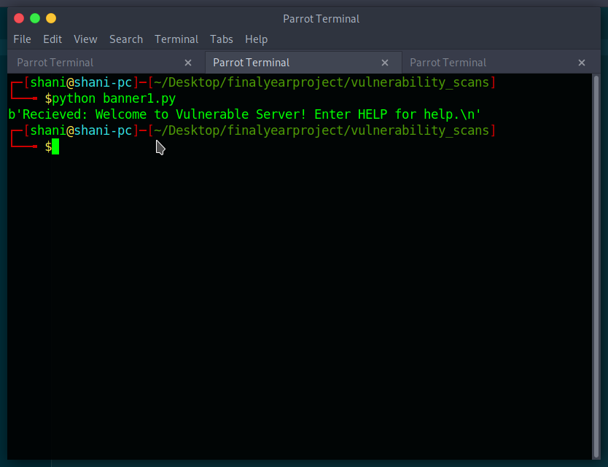
Progress
Banner
Returns the Service

Slide 12
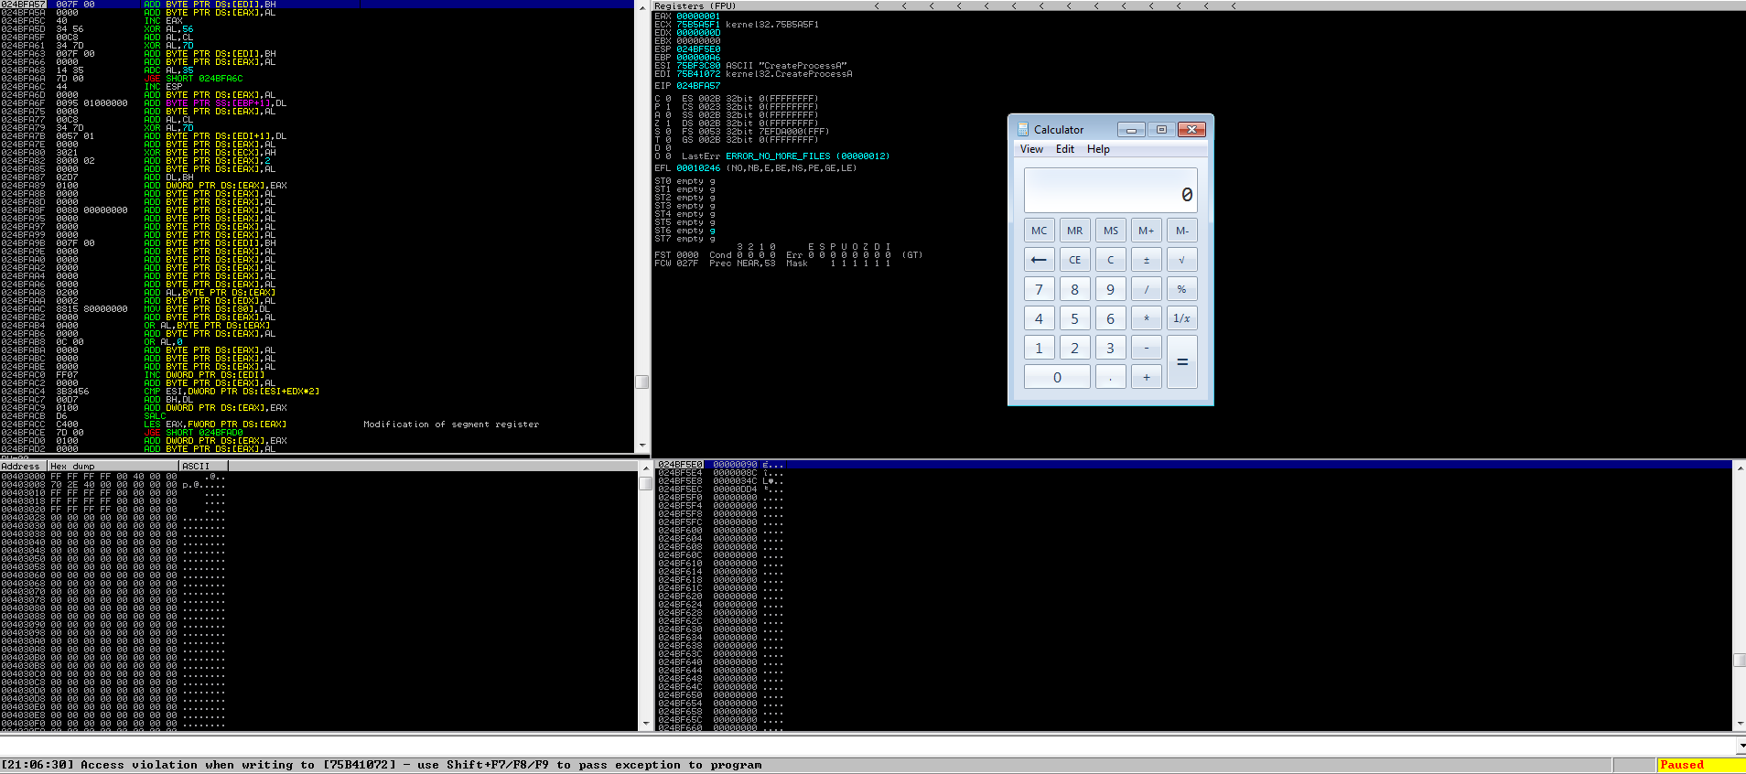
Progress
Exploit Script
Overwriting EIP
Executing shellcode

Slide 13
Future Work
Finding more vulnerability
Exploiting them Automatically
Increasing the scope up to more applications

Slide 14
Timeline
Writing
parser
FYP
Report
Sep 30
Mar 15
DEC 15
June 1
Literature review
Lab setup
Vulnerability
Report and
FYP report

