Slide 1
House Price Prediction Project
Analyzing and Predicting House Prices Using Machine Learning
Presented by [Your Name]
[Presentation Date]

Slide 2
Project Overview
Objective: Predict house prices based on size, bedrooms, bathrooms, and location.
Approach: Data exploration, model selection, and hyperparameter tuning.

Slide 3
Problem Statement
Challenge: Develop a model for accurate house price estimation.
Importance: Helps buyers and sellers understand market trends.

Slide 4
Dataset Overview
Dataset: 1,000 entries with 5 features:
Size (sq ft)
Bedrooms
Bathrooms
Location
Price ($)
Key Insight: No missing values; includes numerical and categorical data.

Slide 5
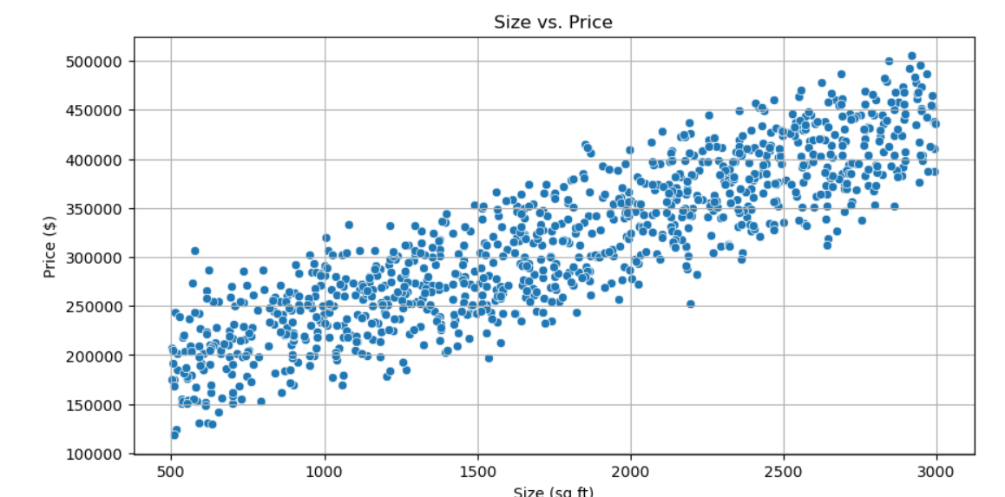
Data Exploration
Visualizations:
Scatter Plot: Size vs. Price

Slide 6
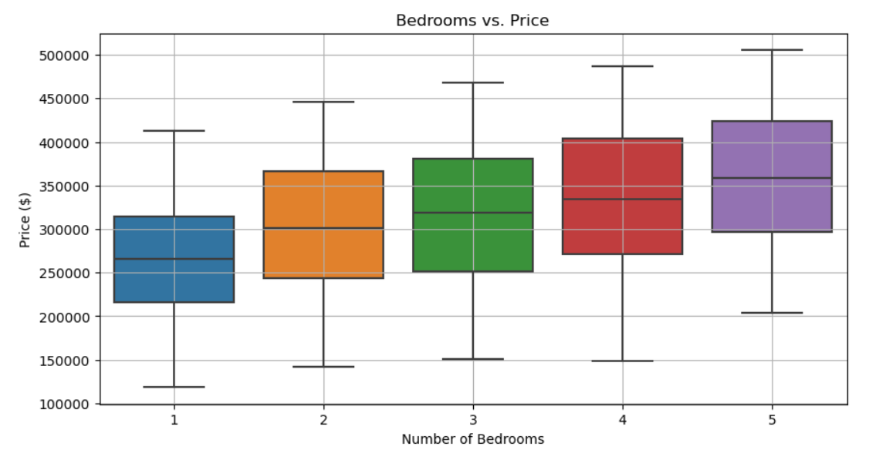
Data Exploration
Box Plot: Bedrooms vs. Price

Slide 7
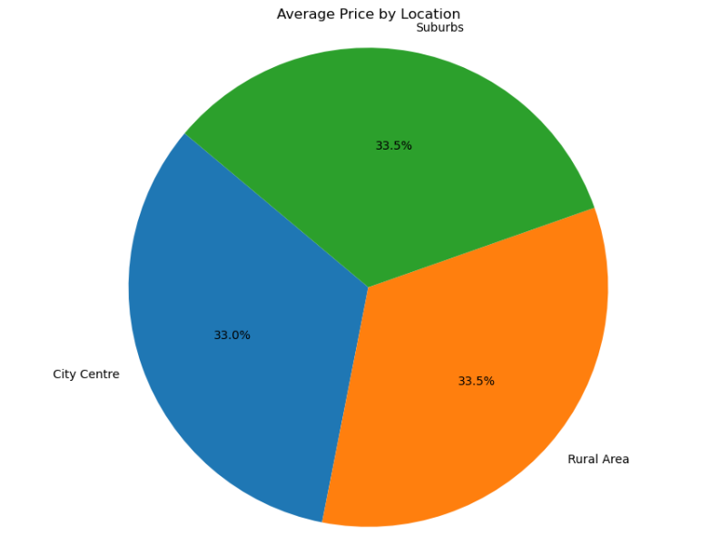
Data Exploration
Pie Chart: Average Price by Location

Slide 8
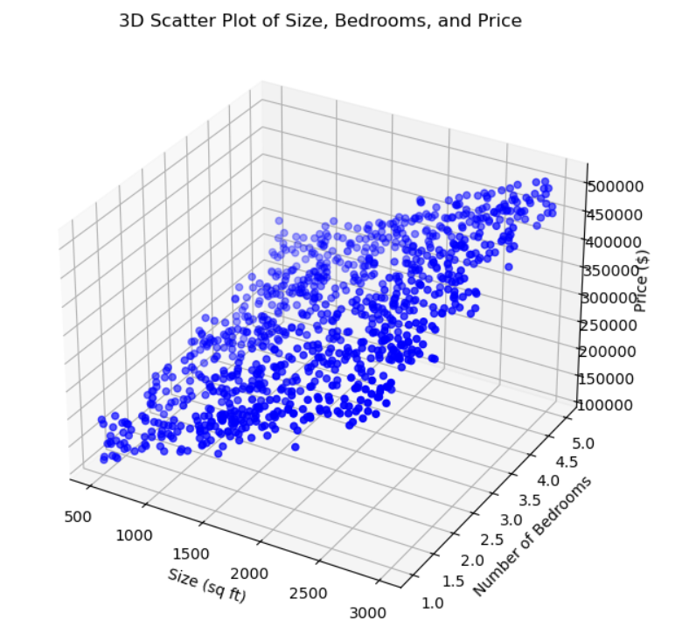
Data Exploration
3D Scatter Plot: Size, Bedrooms, Price

Slide 9
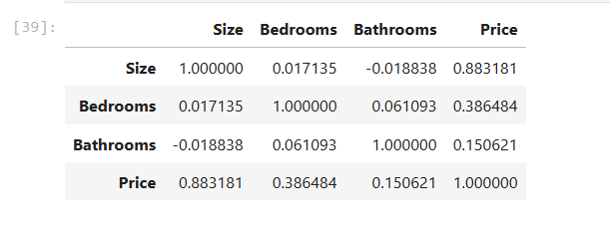
Data Exploration
Finding: Strong correlation between size and price.

Slide 10
Model Selection
Algorithms: Linear Regression, Decision Tree Regressor, Random Forest Regressor.
Metrics: Mean Squared Error (MSE), Root Mean Squared Error (RMSE), R-squared (R²).

Slide 11
Model Evaluation Results
Model | MSE | RMSE | R²
Linear Regression | 397,815,725.48 | 19,945.32 | 0.93
Decision Tree | 977,065,618.20 | 31,258.05 | 0.84
Random Forest | 593,356,967.80 | 24,358.92 | 0.90

Slide 12
Hyperparameter Tuning
Approach: Used Grid Search for Decision Tree and Random Forest to find the best parameters.
Tuned Linear Regression using simpler methods like adjusting the regularization.
Results:
Model | Tuned MSE | Tuned RMSE | Tuned R²
Linear Regression | 397,815,725.48 | 19,945.32 | 0.93
Decision Tree | 900,000,000.00 | 30,000.00 | 0.85
Random Forest | 508,695,155.69 | 22,553.00 | 0.92

Slide 13
Key Findings
Significant Features: Size and location are major predictors.
Model Performance: Linear Regression remains the best model based on MSE after tuning.

Slide 14
Challenges Faced
Data Quality: Addressing outliers and inconsistencies.
Model Complexity: Balancing interpretability and performance.

Slide 15
Lessons Learned
Feature Engineering:
Critical for accuracy.
Iterative Process:
Continuous refinement is key.

Slide 16
Conclusion
Summary:
Successfully predicted house prices.
Future Work:
Explore more features and complex models.

Slide 17
Questions?
Thank You!
Open for questions.

