Slide 1
Wells Fargo Campus Analytics Challenge
Timothy Stephenson

Slide 2
Preliminary Cleaning
23 Feature varibles
To predict one Fraud_NONFRAUD outcome variable
Fraud = 0
Non-Fraud = 1

Slide 3
Dropping from dataset (useless or duplicate)
ACTN_INTNL_TXT, ACTN_CD and TRAN_TYPE_CD
Always the same value
TRAN_DT and ACTVY_DT
Represent the same date as TRAN_TS

Slide 4
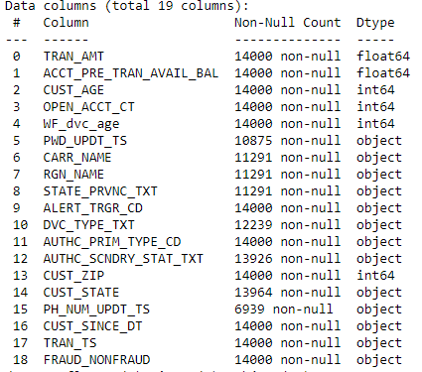
Missing variables
Number missing from “non-null” bellow dataset size (14000) represent number of variables missing for each feature variable

Slide 5
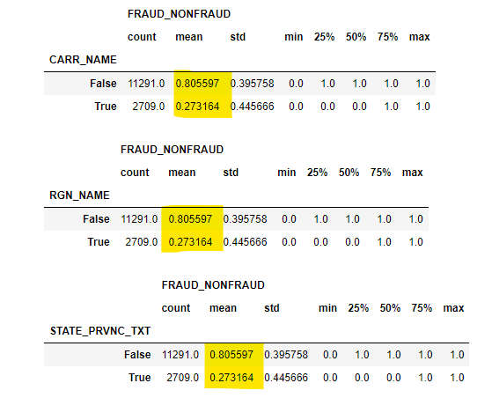
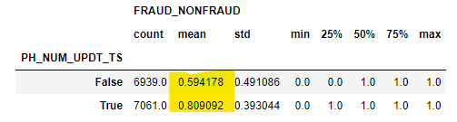
Miss Variables (con.)
Of what is missing, is it missing at random in terms of fraud percentage
Looking at how the Fraud columns mean changes based of if variables are missing, for the 8 variables with missing values
PH_NUM_UPDT_TS is missing more than half the time and has ~0.2 difference in means
CARR_NAME, RGN_NAME, STATE_PRVNC_TXT all have about a ~0.53 difference in means

Slide 6
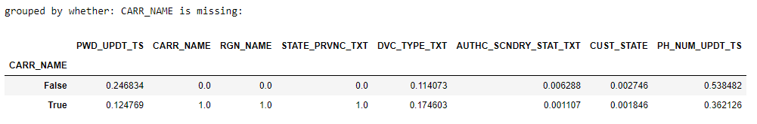
Miss Variables (conn)
Do any of these missing varibles go missing together (so we could group a missing identifier together)
It can be seen that when CARR_NAME, RGN_NAME and STATE_PRVNC_TXT are also always missing

Slide 7
Missing variables Conn
CARR_Missing
New variable
0: CARR_NAME is not missing
1: CARR_NAME is missing
PH_NUM_UPDT_TS_Missing
New variable
0: PH_NUM_UPDT_TS is not missing
1: CARR_NAME is missing

Slide 8
Harder to work with
RGN_NAME is the same information as STATE_PRVNC_TXT, but less specific
CUST_STATE is the same information as CUST_ZIP, but less specific
CARR_NAME and STATE_PRVNC_TXT will be harder to work with as they both have large amount of low count categorical variables
Will drop these for now, will come back if our algorithum is underfitting and more feature variables are needed

Slide 9
Time Data
Parsed string to python struct_time objects
For each date, create a column for each field of struct_time (7 total fields) in order to see numerical relations

Slide 10
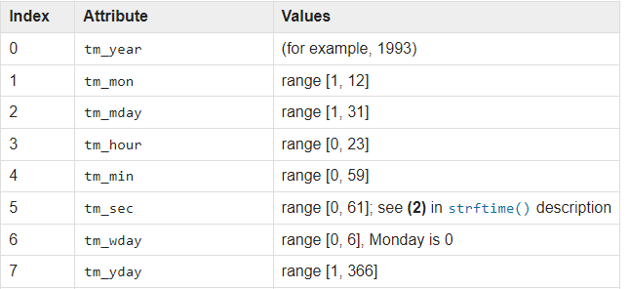
Time Data conn
I thought the extraction of many different values from a singular time value to be novel
Will go on to later test which of these 28 (4 times * 7 attributes) have correlation with fraud

Slide 11
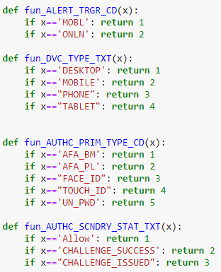
Categorical Data
For Categorical variables with a small number of unique values, map these to numbers, [1,2,3,4,5,…]

Slide 12
Location data
Use the ‘uszipcode’ python module to extract potentially useful location data from the CUST_ZIP feature variable
Will try to atrubities of:
population_density
median_home_value
median_household_income

Slide 13
Note on Location Data
I found my attempt to use zipcode in a more novel way to be unique
Unfortunately, after much testing with many different attributes, I did not fine any that had any substantial correlation with fraud

Slide 14
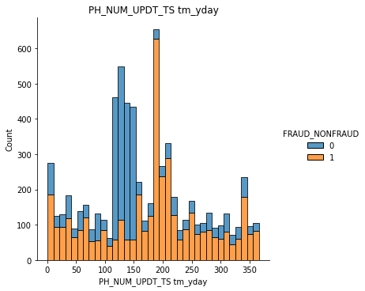
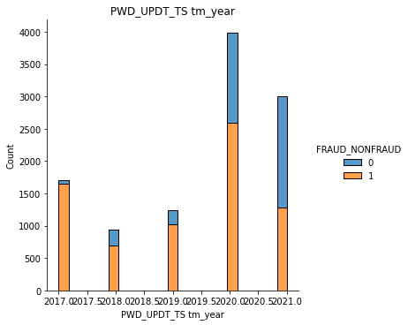
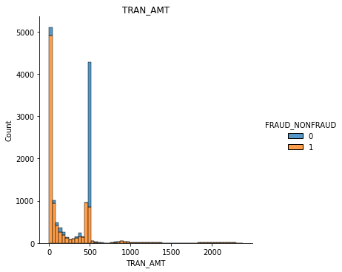
Lets see some relationships
The max of three different correlation values
Histogram plots

Slide 15
Final feature variable choices
Good correlation values:
TRAN_AMT
WF_dvc_age
ALERT_TRGR_CD
DVC_TYPE_TXT
CARR_Missing
PH_NUM_UPDT_TS_Missing
PWD_UPDT_TS tm_year
PWD_UPDT_TS tm_hour
PWD_UPDT_TS tm_min
PH_NUM_UPDT_TS tm_year
PH_NUM_UPDT_TS tm_mon
PH_NUM_UPDT_TS tm_hour
PH_NUM_UPDT_TS tm_sec
PH_NUM_UPDT_TS tm_yday
Choose only correlation values > 0.15 or with graphs showing some sort of pattern

Slide 16
Cleaning
Know what variables we would like to use, we can implement a cleaner, Cleaner.py
This will write out a new cleaned (testset or trainset)

Slide 17
Prediction Algorithum
Use a decision tree library to implement a predictor algorithum
Will use Scikit Learn’s RandomForestClassifier

Slide 18
Splitting Training data up
60% trainset
20% validationset
20% secondarytestset
Will use k-fold cross validation on the trainset with 5 subsets

Slide 19
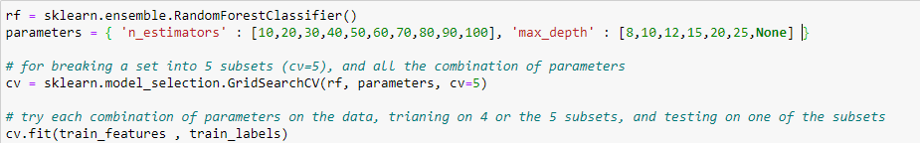
Tuning Parameters
Will tune the inputs: (for RandomForestClassifier)
max_depth
n_estimators
Trying out many different values and testing them using cross-validation

Slide 20
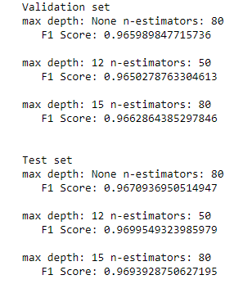
Testing on ‘unseen data’
Choosing the top three combination of max_depth and n_estimators, will try these three combination on the validation and test sets
Maximize for greatest f1 score
A max_depth=15 and n_estimators=80 was chosen

Slide 21
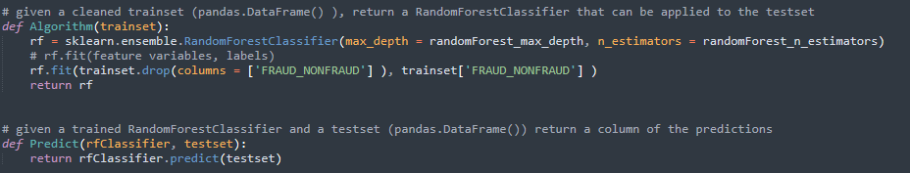
Implementing Algorithum
Developing and implementing the algorithum:

Slide 22
Pipeline
Cleaning via the methods described before
Create a predictor algorithum decision random forest based on the n_predictors and depth chosen
Apply that predictor algorithum to a cleaned testset
Return the predicted ‘FRAUD_NONFRAUD’ and data_id column in result.csv

