Slide 1
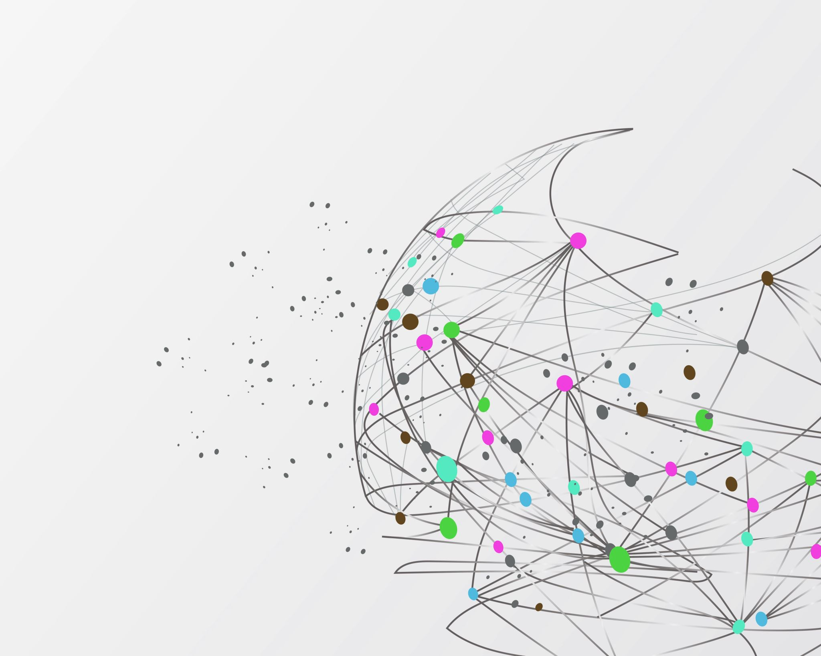
Fraud Detection
Author: Timothy Stephenson

Slide 2
Cleaning Data
ACTN_CD, ACTIN_INTNL_TXT, and TRAN_TYPE_CD are the same for every data point and can be dropped

