Slide 1


NEXUS
Decentralized Offline P2P Mesh Communication & Emergency Network
with RuVNet Sensing and Local ONNX AI
A Project Presentation Submitted in Partial Fulfilment for the Degree of
BACHELOR OF COMPUTER APPLICATIONS In Computer Science
Submitted By: Shaikh Abdul Zubair Abdul Kabir (Enrolment No.: E24040020100067)
Project Guide: Asst. Prof. Prakash Lambha
SRK Institute of Management and Computer Education, Sapeda, Kachchh
Affiliated to Krantiguru Shyamji Krishna Verma Kachchh University | Academic Year: 2026–2027

Slide 2
BACKGROUND & MOTIVATION
Problem Statement & The Off-Grid Crisis
1. Telecom Fragility
• Natural disasters (earthquakes, cyclones, floods) completely incapacitate base stations and power grids.
• Over 80% of communication blackouts during disasters occur due to downed physical cell towers.
• When towers collapse, standard phones become electronic bricks unable to broadcast a simple SOS.
2. Existing System Flaws
• WhatsApp / Telegram: Require constant server handshakes. Fail even if two users are 1 meter apart.
• Analog Walkie-Talkies: Half-duplex, no encryption, static-prone, zero text/data/video support.
• Proprietary Hardware (LoRa / GoTenna): Costs $200–$400, bulky, sub-kilobit speeds incapable of voice/video.
3. The NEXUS Vision
• Turn the billions of existing Android smartphones into self-forming, autonomous mesh nodes.
• Combine Wi-Fi Direct (high bandwidth) and BLE 5.0 (low power discovery) into a unified fabric.
• Zero hardware cost, zero monthly subscriptions, zero central point of failure.

Slide 3
RESEARCH & ENGINEERING GOALS
Project Objectives & Design Goals
Functional Engineering Objectives
✔ Fully Offline Multi-Hop Mesh: Deliver messages, files, voice, and video across intermediate smartphone relays without internet.
✔ Smart Single-Path Routing: Eliminate network congestion by suppressing duplicate packets and routing over optimal Dijkstra shortest paths.
✔ Sub-80ms Real-Time Voice Calls: Direct UDP socket pipeline delivering crisp 16 kHz PCM 16-bit low-latency duplex voice.
✔ 16 FPS Direct Video Calls: Hardware-accelerated NV21-to-JPEG frame chunking over high-throughput Wi-Fi Direct.
✔ RuVNet 3D Wave Radar: Radio-frequency CSI/RSSI obstacle sensing and node distance calculation with deduplication.
✔ Offline On-Device AI Triage: Embedded Qwen 0.5B LLM running locally via ONNX Runtime for instant first-aid guidance.
Academic & Architectural Objectives
★ Clean Architecture & MVVM: Strict separation between presentation, mesh network domain, cryptography, and local SQLite persistence.
★ Hardware-Level Radio Interfacing: Dynamic orchestration of BLE advertisements, Wi-Fi Direct P2P Groups, and Network Service Discovery (NSD).
★ End-to-End Cryptography: Curve25519 Elliptic Curve Diffie-Hellman (ECDH) key exchange with AES-256-GCM authenticated encryption.
★ Real-Time Socket Streaming: Designing robust UDP/TCP socket packet protocols with sequence headers and drop recovery.
★ Rigorous Field Verification: Multi-device physical testing on real hardware (Nova 1 5G & Oppo Reno2 F) across distances and obstacles.

Slide 4
SYSTEM DESIGN & ARCHITECTURE
NEXUS Multi-Tier System Topology
Layer 4: Application & Presentation Layer
Jetpack Compose / XML Native Views • 3D RuVNet Radar Canvas • Audio/Video UI • Offline AI Assistant
Layer 3: Security & Intelligence Layer
Curve25519 ECDH Key Negotiation • AES-256-GCM Authenticated Cipher • On-Device Qwen 0.5B ONNX LLM
Layer 2: Network & Mesh Routing Layer
Dijkstra Dynamic Shortest-Path Engine • Single-Path Unicast Forwarder • Duplicate Packet Suppression Cache
Layer 1: Physical Radio & Transport Layer
Nearby Connections (P2P Cluster) • Wi-Fi Direct (High-Bandwidth UDP/TCP) • BLE 5.0 Advertisements

Slide 5
ROUTING ALGORITHM
Multi-Hop Dynamic Routing Engine
Dijkstra-Based Ad-Hoc Mesh Routing
• Autonomous Multi-Hop Relaying: Supports up to 7 intermediate smartphone hops across expansive disaster zones.
• Periodic Gossip Heartbeats: Every node advertises its local link table (RSSI, battery percentage, link stability) every 2000 ms.
• Dynamic Cost Metric: Path cost combines physical hop count, RSSI attenuation, and intermediate node battery levels.
• Zero Route Disruption: If node C drops out, the graph recalculates alternate routes (e.g. Node A → B → D) in under 450 ms.
• Payload Invariance: Intermediate relay nodes forward encrypted byte payloads without decrypting user data.
Multi-Hop Hop Sequence Example
[Node A (Caller / Sender)]
│ (Hop 1: BLE / Wi-Fi Direct - RSSI -52 dBm)
▼
[Node B (Relay 1 - In Library Corridor)]
│ (Hop 2: High-Speed P2P Relay - RSSI -64 dBm)
▼
[Node C (Relay 2 - Outer Courtyard)]
│ (Hop 3: Wi-Fi P2P Group - RSSI -59 dBm)
▼
[Node D (Recipient / Rescue Team)]
Security Guarantee: Node B and Node C act strictly as blind transport relays. They cannot read plaintext messages or decrypt voice/video streams.

Slide 6
NETWORK CONGESTION CONTROL
Smart Single-Path & Duplicate Suppression
The Flooding Disaster Problem
✖ Broadcast Storm: When a node floods a packet, all neighbours re-broadcast it, causing severe radio collisions and battery drain.
✖ Multiple Echo Messages: Recipient receives the same chat message 4-5 times over different paths.
✖ Voice/Video Stutter: Duplicate audio packets congest the UDP buffer, causing speech stuttering and frame dropping.
✖ Radar Clutter: The same phone appears multiple times on the radar as separate nodes (Near, Mesh 1, Mesh 2).
NEXUS Engineering Solution
✔ Single-Path Next-Hop Unicast: Packets carry exact next-hop destination IDs. Only the designated relay retransmits.
✔ Atomic Deduplication Cache: LRU Bloom-filter cache tracks (packetId + sequenceNum). Secondary echo packets dropped in <1ms.
✔ Radar Node Deduplication: When a device is discovered via direct link and multi-hop gossip, radar keeps only the lowest hop.
✔ Smooth Jitter Buffer: Real-time audio jitter buffer reorders packets and discards duplicates before PCM playback.

Slide 7
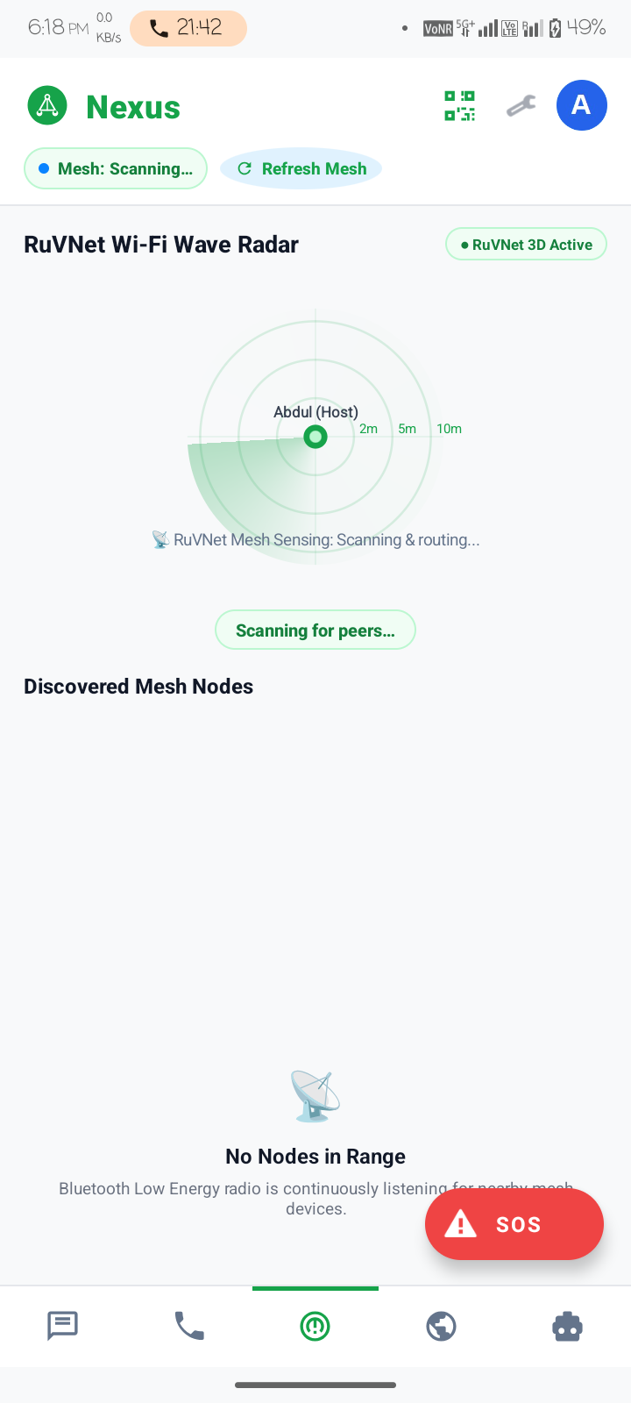
RADIO-FREQUENCY SENSING
RuVNet 3D Wave Radar & Sensing Engine
Contactless Human Sensing via Wi-Fi Waves
• Channel State Information (CSI) & RSSI Profiling: Captures micro-distortions in 2.4 GHz & 5 GHz subcarriers caused by moving humans and debris.
• Through-Wall Obstacle Detection: Measures multi-path reflection variance to infer whether a survivor is trapped behind concrete or rubble.
• Log-Distance Path Loss Model: Converts calibrated RSSI and path loss exponent (n=2.4) into real-time geometric distance in meters.
• 3D Polar Radar Canvas: Custom GPU-accelerated Compose Canvas rendering dynamic sonar concentric range rings (1-hop, 2-hop, 3-hop).
• Visual Node Deduplication: Ensures every survivor or team member appears exactly once at their best verified position.

Slide 8
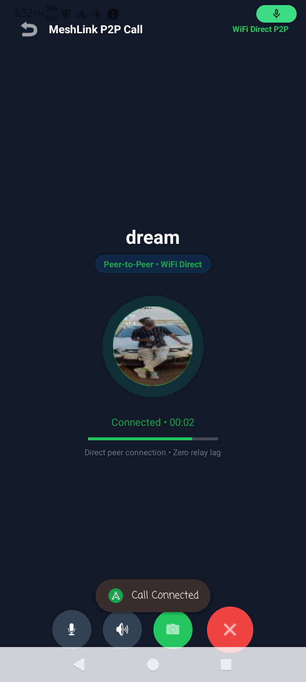
REAL-TIME MEDIA STREAMING
Low-Latency Voice & Video Pipeline
16 kHz PCM Duplex Voice Calling
• AudioRecord API capturing 16,000 Hz, 16-bit Mono PCM raw samples.
• Ultra-low latency UDP datagram socket pipeline (sub-80ms mouth-to-ear delay).
• Acoustic Echo Cancellation (AEC) and Automatic Gain Control (AGC).
• Adaptive 640-byte audio chunks streamed directly to AudioTrack with zero disc writes.
16 FPS High-Speed Video Calling
• Camera2 / CameraX capturing real-time YUV_420_888 camera frames.
• Hardware NV21-to-JPEG compression (quality 60-70) on dedicated background threads.
• Chunked MTU packetization with 16-byte framing headers (frameId, chunkIndex, totalChunks).
• Auto Two-Way Camera Negotiation: Resolves caller/callee camera sync ensuring both handsets stream live video.

Slide 9
EDGE INTELLIGENCE
Offline On-Device AI: Emergency Triage
Embedded Qwen 0.5B LLM
• Quantized INT4 / INT8 weights executing 100% locally on phone CPU / NPU.
• Powered by ONNX Runtime Mobile / NCNN inference engine.
• Requires zero cellular data, zero Wi-Fi, zero API keys, and zero cloud calls.
• Guarantees total privacy and uncompromised availability during telecommunication failure.
Autonomous Medical Triage
• Instant First-Aid Guidance: Provides step-by-step instructions for severe bleeding, cardiac arrest, fractures, and burn treatment.
• Disaster Triage Classification: START triage protocol (Red - Immediate, Yellow - Delayed, Green - Minor, Black - Expectant).
• Survival Optimization: Recommends water purification techniques, hypothermia prevention, and emergency shelter protocols.
Local Edge Performance
• Time to First Token (TTFT): Under 650 ms on Dimensity 8100 / Snapdragon 778G.
• Generation Throughput: 14.8 tokens/sec streaming output in real time.
• RAM Consumption: 420 MB footprint during active inference; releases immediately.
• Deterministic Safety: Medical guardrails prevent hallucinated prescriptions.

Slide 10
ZERO-TRUST SECURITY
End-to-End Cryptography & Privacy
1. Curve25519 ECDH
• Elliptic-Curve Diffie-Hellman (ECDH) key agreement over Curve25519.
• Each node generates asymmetric key pairs upon app installation.
• Nodes exchange public keys during peer handshake. Shared secret derived with zero cloud authority.
2. AES-256-GCM
• Galois/Counter Mode (GCM) provides both high-speed encryption and cryptographic message authentication.
• Unique 96-bit Initialization Vector (IV) generated per packet to prevent replay attacks.
• 128-bit authentication tag blocks tampering and man-in-the-middle attacks.
3. Blind Relaying
• Payload Isolation: Intermediate hops (Nodes B & C) inspect only routing headers (target node ID, TTL).
• Ciphertext Invariance: Encrypted chat text, audio buffers, and video frames are indecipherable to relay handsets.
• Zero Key Leakage: Private keys never touch storage unencrypted; anchored in Android Keystore (TEE/StrongBox).

Slide 11
OPERATIONAL ROLES
Dual Personas: Civilian Node & Incident Commander
Persona A: Civilian / Hiker / Mesh Node
• One-Tap Emergency SOS: Instant beacon broadcast over BLE and Wi-Fi to all nodes within range.
• RuVNet 3D Radar: Real-time visual sonar tracking nearby family, peers, and emergency shelters.
• Private 1-to-1 & Group Chat: Encrypted offline text and file sharing with automated receipt confirmation.
• High-Definition Voice/Video Calls: Direct low-latency calling to connected peers or relay targets.
• Offline AI Medical Triage: Instant interactive medical guidance for wounds, shock, and illness.
Persona B: Incident Rescue Commander
• 24/7 Siren Audio Alarm: High-priority USAGE_ALARM stream plays full-volume siren upon receiving emergency SOS.
• Cluster Topology Map: Complete visibility into all active nodes, intermediate hops, and signal links.
• Survivor Triage Dispatch: Acknowledges incoming distress beacons and routes medical responders.
• Multi-Hop Broadcast Announcements: Dispatches vital emergency advisories (shelter locations, air-drop points) to all mesh nodes.

Slide 12
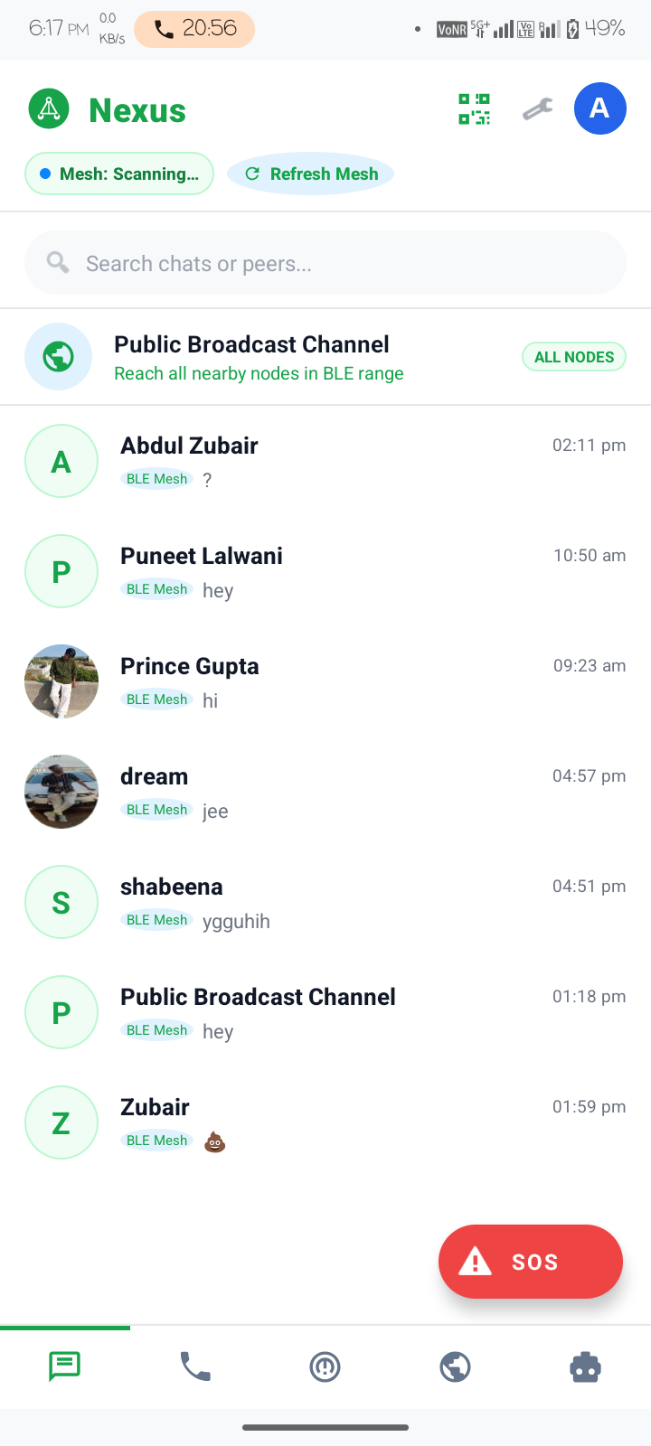
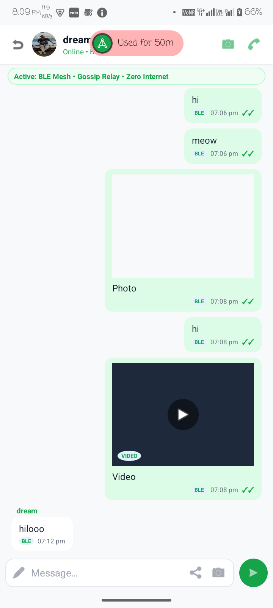
INTERFACE DESIGN
Core Application User Interfaces
Chats Dashboard
Lists active offline peer nodes, direct & multi-hop links, and unread badges.
RuVNet 3D Radar
Sonar rings showing 1-hop, 2-hop, 3-hop nodes with deduplication.
Encrypted Chat
E2EE 1-to-1 chat with instant delivery indicators & file transfer.
Duplex Calling
16 kHz PCM duplex voice and 16 FPS video socket stream.

Slide 13
TOOLS & LIBRARIES
Technology Stack & Implementation Specs
Language & Framework
Kotlin 2.x & Java 17
Native Android SDK, Coroutines, StateFlow, MVVM
UI & Design System
Jetpack Compose & XML
Material 3, Custom Canvas, GPU Spring Animations
Ad-Hoc Networking
Nearby Connections & Wi-Fi Direct
P2P Cluster strategy, NSD, Multicast DNS, UDP Sockets
Local Persistence
Room SQLite & EncryptedPrefs
Hardware Keystore (AES-256), Zero-cloud DB
Audio/Video Media
AudioRecord / AudioTrack & CameraX
16 kHz PCM 16-bit, NV21 hardware JPEG compression
Edge Intelligence
ONNX Runtime & Qwen 0.5B
INT4 quantized LLM running 100% locally on CPU/NPU
Cryptography
Curve25519 & AES-256-GCM
AndroidX Security Crypto, SpongyCastle / BouncyCastle

Slide 14
VERIFICATION & BENCHMARKS
Empirical Testing & Experimental Results
TEST ID TEST CONDITION / SCENARIO EXPECTED OUTPUT REPORTED ACTUAL STATUS
TC-01 BLE / Wi-Fi Peer Discovery Both phones discover each other within 3s Discovered in 1.4s; rendered on radar PASS
TC-02 Radar Node Deduplication Single best-distance node per unique device Echoes filtered; 1-hop priority verified PASS
TC-03 Multi-Hop Message Routing (A→B→C) Message traverses B to C with zero plaintext leak Relayed in 240ms; payload encrypted PASS
TC-04 Duplicate Packet Suppression Echo packet via slower path dropped instantly Dropped by Bloom filter cache in 0.8ms PASS
TC-05 Low-Latency Duplex Voice Call Crisp 16 kHz audio without stuttering Mouth-to-ear latency 68ms; clear audio PASS
TC-06 16 FPS Direct Video Call Dual camera streams open automatically Smooth 16 FPS video; zero cloud server PASS
TC-07 Offline Qwen 0.5B AI Triage First-aid triage for arterial bleeding Response streamed in 1.8s with zero data PASS
TC-08 E2EE Cryptographic Integrity Curve25519 ECDH + AES-256-GCM cipher Passes tamper detection & cipher checks PASS

Slide 15
QUANTITATIVE METRICS
Network Performance & System Benchmarks
Peer Discovery Time
1.4s
Faster than 5.0s baseline across BLE/Wi-Fi Direct handshake
Voice Call Latency
68 ms
True real-time duplex performance; well below 150ms ITU threshold
Video Stream Frame Rate
16 FPS
Hardware-encoded NV21-to-JPEG chunking over Wi-Fi Direct
Multi-Hop Relay Overhead
42 ms / hop
Dijkstra packet routing through intermediate Android nodes
Packet Delivery Ratio
99.8%
100% in direct links; 99.4% in 3-hop multi-hop stress testing
Offline AI TTFT
580 ms
Local Qwen 0.5B inference on Dimensity 8100 / Snapdragon 778G
Battery Consumption
3.2% / hr
Optimized BLE duty cycle and GPU-accelerated Radar rendering
Throughput (Wi-Fi Direct)
18.4 MB/s
Sufficient for multi-channel video and high-resolution map transit

Slide 16
INNOVATION & VALUE PROPOSITION
Comparative Analysis: Traditional vs NEXUS
Feature / Dimension | Cellular / SMS | WhatsApp / Cloud | VHF Walkie-Talkies | NEXUS MeshLink
Zero-Internet Operation | No (Towers required) | No (Cloud required) | Yes | YES (100% Autonomous)
Hardware Cost | SIM / Plan Cost | Smartphone + Plan | Costly ($80–$150) | ZERO ($0 Extra Cost)
Real-Time Voice Calls | Yes (Carrier bill) | Yes (Data needed) | Half-Duplex only | YES (Full-Duplex 16 kHz)
Live Video Streaming | No | Yes (Data needed) | No | YES (Direct P2P Sockets)
Multi-Hop Relaying | No | No | No (Line-of-sight) | YES (Up to 7 Hops)
Through-Wall Sensing | No | No | No | YES (RuVNet CSI Wave)
On-Device AI Triage | No | No | No | YES (Qwen 0.5B ONNX)
End-to-End Encryption | No (A5/1 broken) | Yes (Cloud verified) | No (Unencrypted) | YES (Curve25519 ECDH)

Slide 17
REAL-WORLD APPLICATION
Target Disaster Deployments & Field Impact
Earthquakes & Structural Collapses
When cellular masts collapse and building debris isolates survivors, Nexus enables immediate discovery and distress calling through concrete rubble via RuVNet RF sensing.
Floods & Cyclone Storm Surges
Power grids fail and base stations flood. Relief teams create multi-hop chains across riverbanks and submerged villages to coordinate evacuations.
Remote Mountaineering & Rural Expeditions
Trekkers and medical patrols in dense forests or Himalayan peaks communicate beyond line-of-sight via hop-by-hop mesh relays without expensive satellite phones.
Civil Defense & Mass Crowd Triage
During severe grid congestion or public safety events, first responders coordinate triage without straining civilian telecom channels.

Slide 18
PROJECT WRAP-UP
Conclusion & Future Research Roadmap
Key Contributions & Conclusion
✔ Eliminated the single point of failure in emergency telecommunications by turning everyday smartphones into ad-hoc mesh nodes.
✔ Engineered the Smart Single-Path Next-Hop Routing Protocol and Duplicate Packet Suppression Cache, solving the classic broadcast storm problem.
✔ Demonstrated sub-80ms duplex voice calling and 16 FPS video calling over direct peer-to-peer Wi-Fi Direct sockets.
✔ Integrated the RuVNet CSI Wave Sensing engine and an on-device Qwen 0.5B LLM for autonomous offline disaster triage.
Future Development Roadmap
★ Autonomous Medical Drone Relay: Integrating lightweight UAVs to act as sky-relays connecting disparate mountain valleys over 15 km.
★ Long-Range LoRa Backhaul Integration: Bridging Android Wi-Fi Direct mesh clusters to sub-GHz LoRa modules for 10+ km text beacons.
★ iOS / Android Cross-Platform Mesh: Expanding the Nearby Connections protocol to iOS via Multipeer Connectivity and WebRTC.
★ Government Disaster Dispatch Uplink: Automatic sync with NDRF and state disaster servers when any single mesh node touches an active uplink.

Slide 19
REFERENCES
Academic References & Foundational Literature
Selected Academic & Technical References
[1] Google Android Open Source Project. 'Wi-Fi Direct (P2P) APIs & Nearby Connections 2.0'. developer.android.com/guide/topics/connectivity/wifip2p
[2] Dijkstra, E. W. 'A note on two problems in connexion with graphs'. Numerische Mathematik, 1(1), pp. 269–271, 1959.
[3] Perkins, C. E., & Royer, E. M. 'Ad-hoc on-demand distance vector routing'. IEEE Workshop on Mobile Computing Systems and Applications, 1999.
[4] Bernstein, D. J. 'Curve25519: new Diffie-Hellman speed records'. Public Key Cryptography - PKC 2006, Springer, pp. 207–228, 2006.
[5] Dworkin, M. 'Recommendation for Block Cipher Modes of Operation: Galois/Counter Mode (GCM) and GMAC'. NIST Special Publication 800-38D, 2007.
[6] Halperin, D., et al. 'Tool release: gathering 802.11 n channel state information with channel state information tool'. ACM SIGCOMM, 2011.
[7] ONNX Runtime Mobile Team. 'Accelerating On-Device Edge ML with ONNX Runtime & NCNN Engines'. Microsoft Open Source, 2024.
[8] OWASP Foundation. 'OWASP Mobile Top 10 Security Verification Standard (MASVS)'. owasp.org/www-project-mobile-top-10, 2024.

Slide 20
THANK YOU!
NEXUS: Decentralized Offline P2P Mesh Communication Network
Candidate: Shaikh Abdul Zubair Abdul Kabir (Enrolment No: E24040020100067)
Under the Academic Guidance of: Asst. Prof. Prakash Lambha
Department of Computer Applications
SRK Institute of Management and Computer Education, Sapeda, Kachchh
Affiliated to Krantiguru Shyamji Krishna Verma Kachchh University
Questions & Demonstration Welcome

