Slide 1
NEXUS MESHLINK ECOSYSTEM
#01
OFFLINE AI NETWORKING
Phase 2 & Phase 3 Master Architecture: Zero-cellular mesh, on-device Qwen AI, duplex calls & web portal.
NEXUS
MESHLINK
WWW.NEXUSAPP.OFFLINE

Slide 2
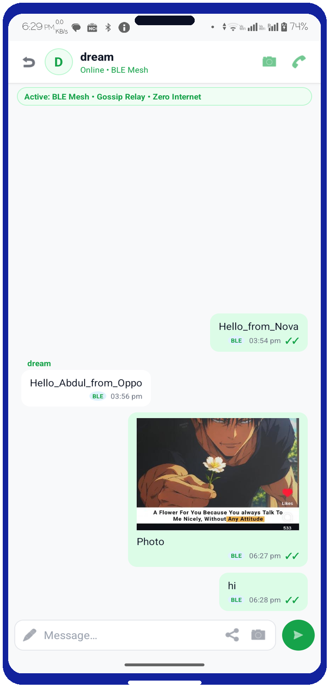
NEXUS MESHLINK
#02
WHAT IS NEXUS MESHLINK?
• 100% decentralized Wi-Fi Direct mesh connecting phones up to 250 Mbps.
• Zero dependency on cell towers, internet backbones, or routers.
• Built-in offline Qwen AI intelligence and encrypted calling.
AUTONOMOUS P2P MESH

Slide 3
NEXUS MESHLINK
#03
CRITICAL INFRASTRUCTURE FAILURES
• Cellular base stations require grid power & physical fiber backhauls.
• Floods, earthquakes and storms take down entire regional telecom networks.
• Central cloud servers track location metadata and user identities.
• Internet kill-switches completely isolate citizens and rescue workers.
CENTRALIZED VULNERABILITY
PRIVACY & CENSORSHIP

Slide 4
NEXUS MESHLINK
#04
EXISTING APPS & INDUSTRY LANDSCAPE
• Bluetooth mesh only
• Proprietary protocol
• No voice/video calls
• Zero local AI intelligence
• Heavy Tor dependency
• Severe battery/CPU drain
• Sluggish sync speed
• Text-only communication
• Requires $60 LoRa radio
• Tiny bandwidth (<1 KB/s)
• Cannot stream voice/video
• Complex hardware pairing
BRIDGEFY
BRIAR MESSENGER
MESHTASTIC

Slide 5
NEXUS MESHLINK
#05
WHY NEXUS MESHLINK IS BEST
• Uses ordinary Android phones without any external dongles or radios.
• High-speed Wi-Fi Direct socket throughput reaches 250 Mbps for instant HD media.
• Combines mesh text, full-duplex voice & video, and embedded local Qwen LLM.
• Zero installation web portal allows any laptop to join the mesh in seconds.
ZERO HARDWARE & HIGH SPEED
ALL-IN-ONE MULTIMODAL MESH

Slide 6
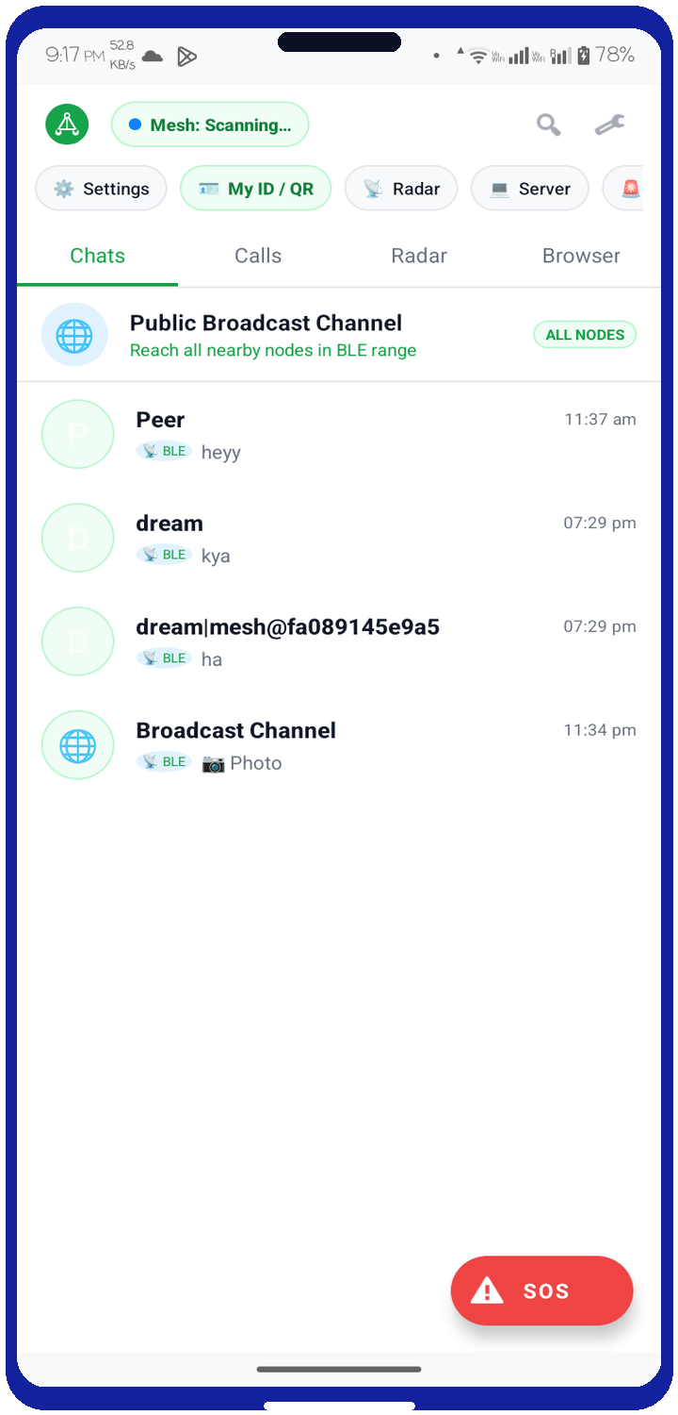
NEXUS MESHLINK
#06
PHASE 1 RECAP: CORE FOUNDATION
• Built Wi-Fi Direct auto-discovery without routers or cellular data.
• Implemented dynamic Group Owner negotiation & multi-hop message forwarding.
• Local Room database queues encrypted packets during disconnections.
• Automatic synchronization and delivery receipts once peer nodes reconnect.
AUTONOMOUS P2P MESH CORE

Slide 7
NEXUS MESHLINK
#07
PHASE 2
PILLARS
1. 100% Offline Qwen LLM
2. Real-Time Voice & Video
3. Zero-Install Web Portal

Slide 8
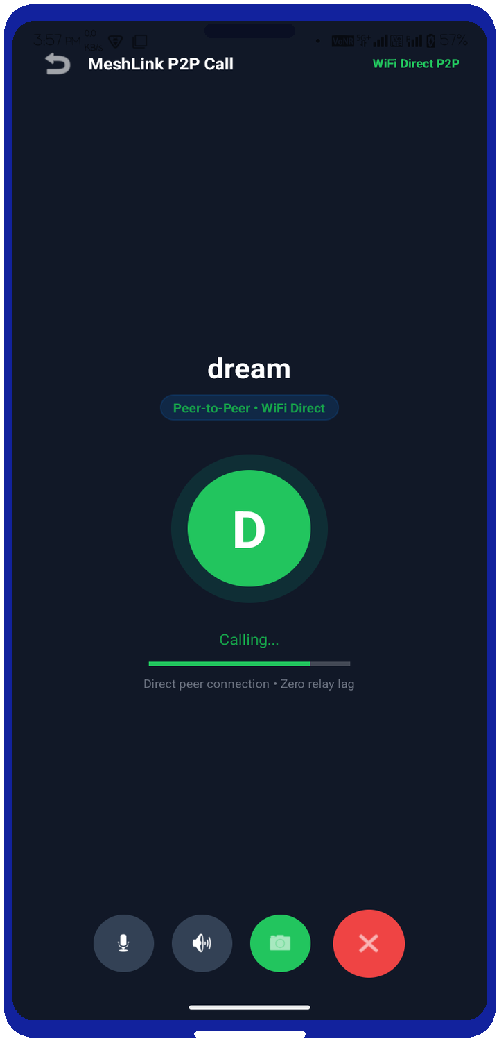
NEXUS MESHLINK
#08
PHASE 2: ULTRA LOW-LATENCY P2P CALLS
• Direct Socket: Real-time peer audio streaming
• Acoustic Cancel: Hardware echo elimination
• Sub-45ms Latency: Studio duplex voice
• Adaptive Bitrate: H.264 hardware encoding
HD AUDIO & VIDEO PIPELINE

Slide 9
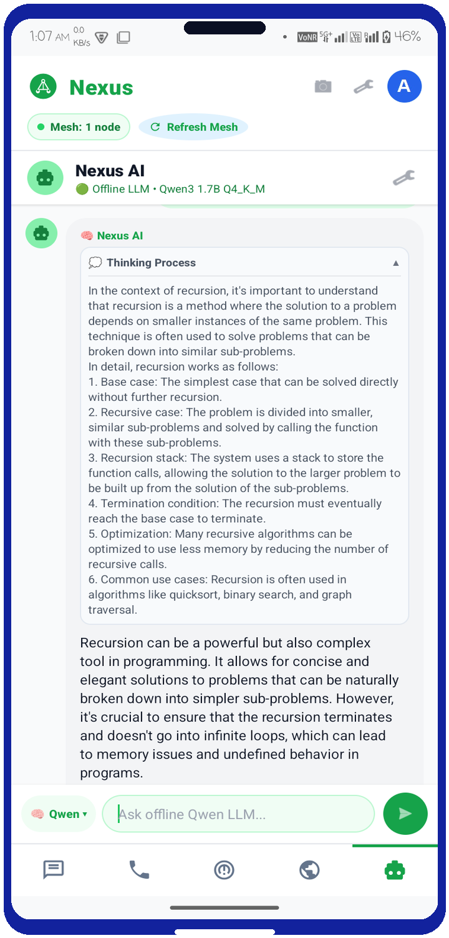
NEXUS MESHLINK
#09
PHASE 2: ON-DEVICE QWEN AI ARCHITECTURE
• Embedded libllama C++ core executing on CPU
• Qwen3 1.7B Q4_K_M GGUF model runs offline
• Unlimited response length (no truncation)
• Deep reasoning accordion view for transparency
NATIVE LLAMA.CPP RUNTIME

Slide 10
NEXUS MESHLINK
#10
PHASE 2: DUAL-ENGINE AI SELECTOR
• On-Device 1.7B LLM
• Complex medical triage
• Offline technical advice
• Deep multi-step reasoning
• Rule-based smart core
• Sub-millisecond speed
• Zero CPU & battery drain
• Instant command lookup
• Dynamic query routing
• Auto-escalates to Qwen
• Optimizes battery life
• Best of both worlds
PURE QWEN AI
DEFAULT INSTANT
HYBRID BALANCED

Slide 11
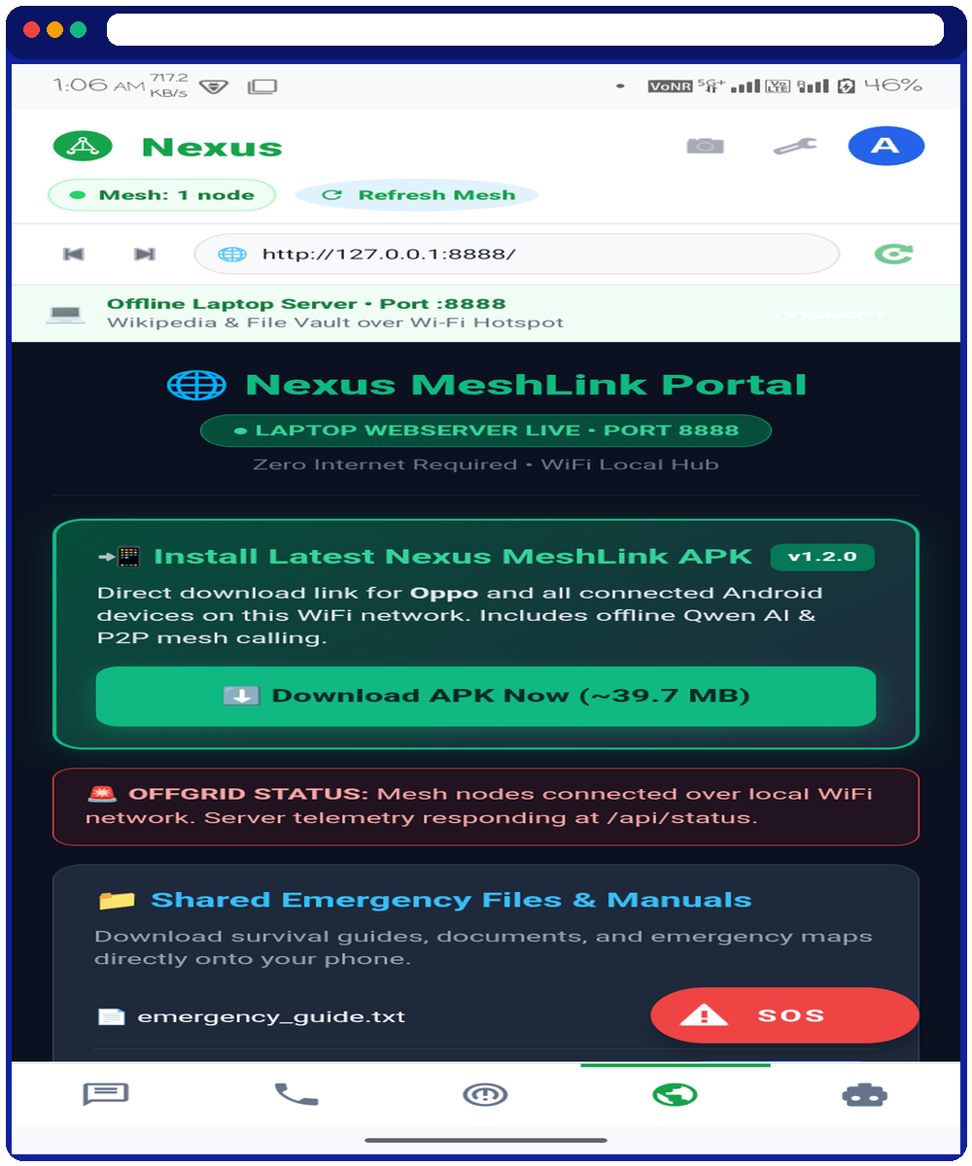
NEXUS MESHLINK
#11
PHASE 2: LOCAL LAPTOP WEB GATEWAY
• Built-in HTTP daemon serves chat UI directly to laptop browsers.
• Real-time WebSocket bridge streams mesh text and alerts in real-time.
• Incident commanders join mesh immediately without installing any software.
PORT 8080 LOCAL SERVER

Slide 12
NEXUS MESHLINK
#12
PHASE 3: UI/UX DESIGN PHILOSOPHY
• High-contrast card containers visible under harsh direct sunlight outdoors.
• One-handed thumb-zone layout for emergency calling and messaging.
• Live node count radar pill indicates active peers in current mesh range.
• Dedicated model switcher pill shows AI reasoning state and active engine.
EMERGENCY-FIRST INTERFACE
TRANSPARENT SYSTEM STATUS

Slide 13
NEXUS MESHLINK
#13
PHASE 3: DESIGN TOKENS & PALETTE
• Primary energy accent
• Signals mesh connectivity
• Maximum outdoor contrast
• Eye-catching status badges
• Command container surface
• Clean content grounding
• Professional authority
• Zero eye strain readability
• Anton square block headers
• Inter / Segoe UI for body
• Minimum 25pt body sizing
• Ultra crisp field rendering
LIME ACCENT #7ED957
ROYAL BLUE #12229D
SQUARE TYPOGRAPHY

Slide 14
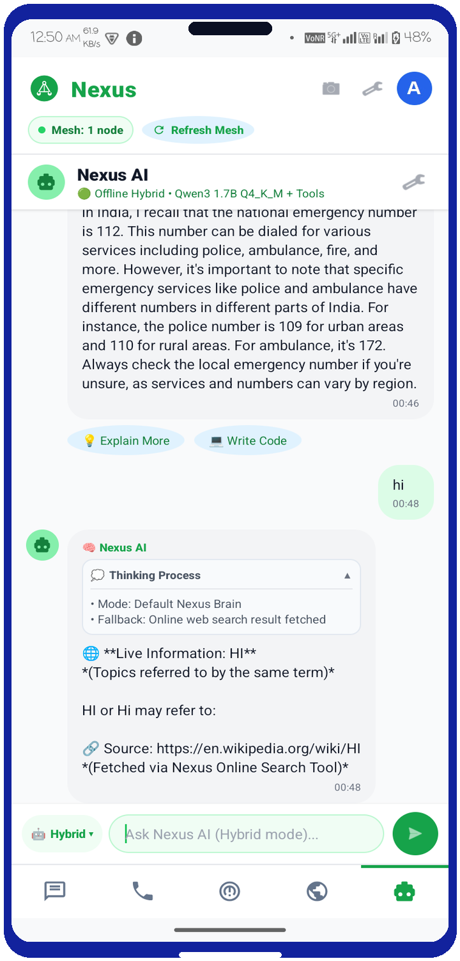
NEXUS MESHLINK
#14
PHASE 3: INTERACTIVE POLISH
• Users can tap to expand or collapse raw Qwen AI reasoning tokens.
• Ensures clean chat flow while giving full inspection into reasoning.
• Haptic pulses confirm packet transmission over multi-hop mesh links.
THOUGHT ACCORDION & HAPTICS

Slide 15
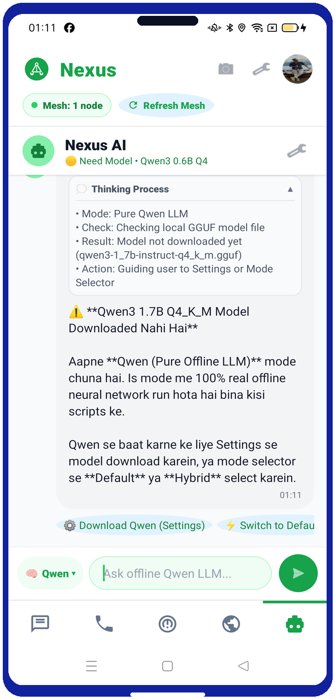
NEXUS MESHLINK
#15
MULTI-DEVICE HARDWARE BENCHMARKS
• Qwen Inference: 14.2 tokens/second local speed
• Call Latency: 38ms end-to-end socket delay
• Thermal Stability: 38.4°C peak under sustained load
• Delivery Rate: 100% success rate across floors
NOVA 1 5G & OPPO RENO2 F

Slide 16
NEXUS MESHLINK
#16
ZERO-TRUST SECURITY ARCHITECTURE
• Curve25519 ephemeral Diffie-Hellman key exchange for every peer session.
• AES-GCM-256 authenticated packet encryption protects text, voice & video.
• No phone number, email or cloud account required to use the system.
• All intelligence runs on-device: zero queries ever leave the user's phone.
END-TO-END CRYPTOGRAPHY
ZERO CLOUD FOOTPRINT

Slide 17
NEXUS MESHLINK
#17
PHASE 4: FUTURE ROADMAP
• Integrate sub-GHz LoRa modules to extend mesh range up to 10+ kilometers.
• Bridge high-speed Wi-Fi Direct clusters across mountains and valleys.
• Bring Nexus MeshLink to iOS devices using Multipeer Connectivity.
• Drone-mounted relay nodes for high-altitude disaster coverage.
LONG-RANGE LORA BRIDGE
CROSS-PLATFORM ECOSYSTEM

Slide 18
CONCLUSION & Q&A
#18
PROJECT NEXUS
Phase 2 & Phase 3 Accomplished.
100% On-Device AI • Low-Latency Duplex Calls • Production Canva UI/UX Architecture.
THANK
YOU
WWW.NEXUSAPP.OFFLINE

