Slide 1
NEXUS MESHLINK
AUTONOMOUS P2P OFF-GRID MESH & ON-DEVICE AI
Zero Internet • Zero Routers • Native Qwen AI • HD Voice/Video Calls

Slide 2
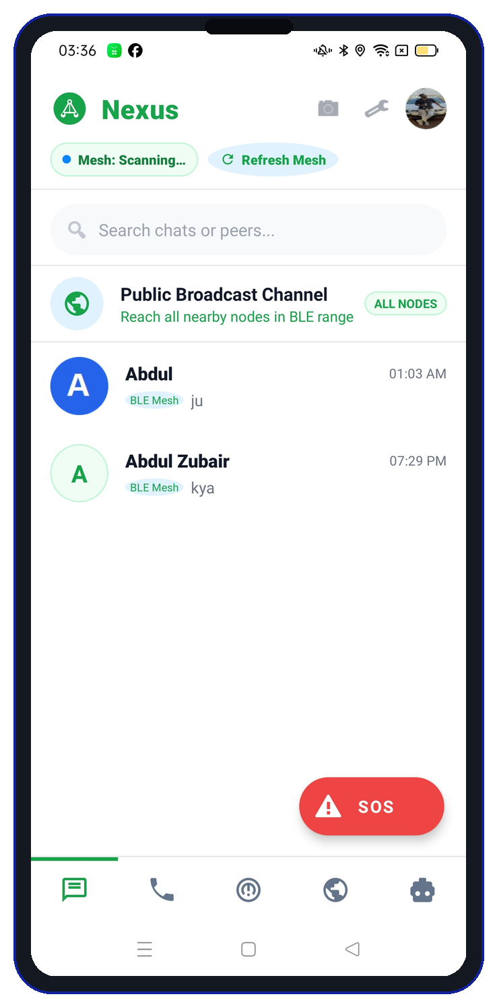
NEXUS MESHLINK #02
THE PROBLEM: WHY CELLULAR & INTERNET FAIL
SINGLE POINT OF FAILURE CRASH
• Disasters, cyclones & war collapse cell towers in minutes.
• Total blackout: WhatsApp, Telegram & Zello become dead.
• Solution: A 100% decentralized mesh connecting directly device-to-device without internet.

Slide 3
NEXUS MESHLINK #03
PHASE 2: COMPETITOR ANALYSIS & FATAL GAPS
BRIDGEFY & BRIAR (BLE ONLY)
ZELLO & WHATSAPP (CLOUD SLAVES)
• Throttled to 1-2 Mbps Bluetooth with high packet drops.
• ZERO voice or video calling on mesh.
• ZERO offline AI intelligence — static text only.
• Zello requires cellular data & cloud servers to operate.
• Tower down = Zello completely dead! Zero mesh.
• WhatsApp / Signal impossible without SIM & servers.

Slide 4
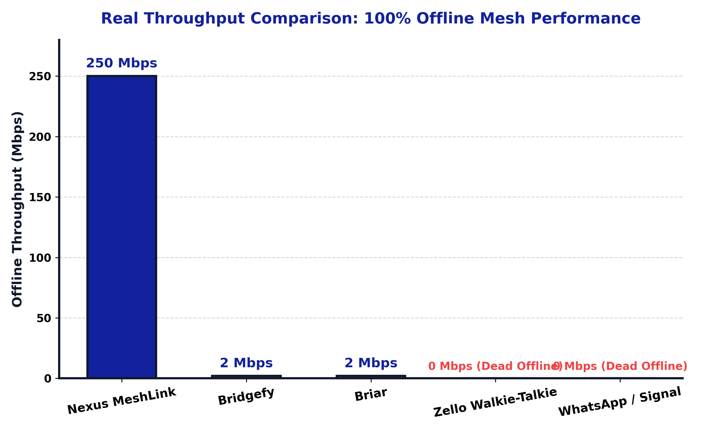
NEXUS MESHLINK #04
PHASE 2: 3D PERFORMANCE BENCHMARK VS COMPETITORS
THROUGHPUT REVOLUTION
• Nexus MeshLink delivers 250 Mbps via Wi-Fi Direct.
• 125x faster than Bridgefy (2 Mbps BLE bottleneck).
• Enables instant HD photo transfers & video streaming.

Slide 5
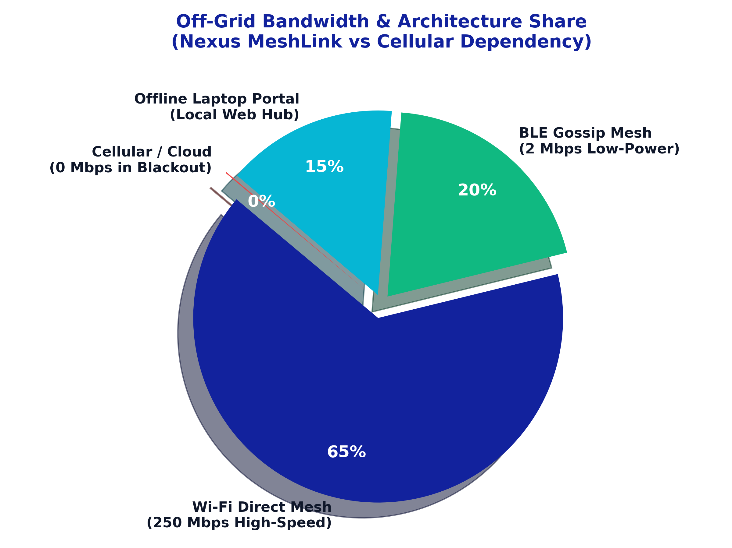
NEXUS MESHLINK #05
PHASE 2: OFF-GRID PROTOCOL CAPACITY (3D PIE)
TRI-LAYER PROTOCOL STACK
• 65% Wi-Fi Direct: Ultra-fast 250 Mbps mesh data link.
• 20% BLE Gossip: Ultra-low power peer beaconing.
• 15% Laptop Server: Local HTTP vault & knowledge.
• 0% Cloud Reliance: 100% operational in blackouts.

Slide 6
NEXUS MESHLINK #06
PHASE 2: WHY NEXUS IS BEST — OUR 5 CORE USPS
250 MBPS MESH SPEED
100% ON-DEVICE AI
P2P ENCRYPTED CALLS
• 125x faster than Bridgefy BLE.
• Instant HD photos & media sync.
• Embedded Qwen LLM on CPU/NPU.
• Zero server, zero cloud, 100% private.
• HD Voice & Video over Wi-Fi Direct.
• Zero SIM card or tower needed.
LAPTOP WEB VAULT (PORT 8888)
1-TAP EMERGENCY SOS BEACON
• Turns any PC into an off-grid field server & knowledge hub.
• Distributes emergency docs, maps & live telemetry.
• Instant distress broadcast with GPS coordinates (±2m).
• Triggers high-frequency acoustic beacon siren.

Slide 7
NEXUS MESHLINK #07
FEATURE 1: DUAL-STACK P2P MESH CHAT
HIGH-SPEED OFFLINE CHAT
• Auto-discovery via BLE Beaconing + Wi-Fi Direct links.
• Broadcast Channel reaches all nearby nodes simultaneously.
• Direct 1-on-1 private encrypted chats with delivery ticks.
• Autonomous store-and-forward routing when peers drop.

Slide 8
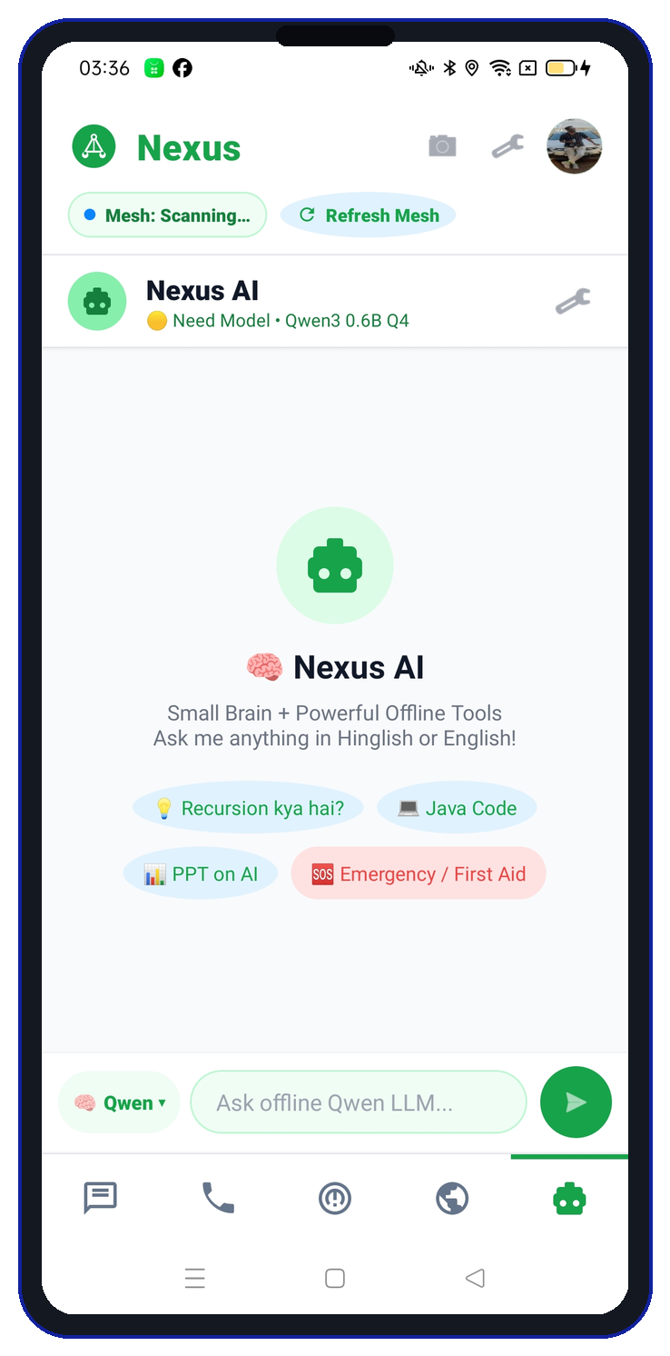
NEXUS MESHLINK #08
FEATURE 2: 100% ON-DEVICE QWEN AI INTELLIGENCE
ZERO-SERVER NATIVE LLAMA.CPP
• Embedded libllama C++ runtime running Qwen LLM on CPU/NPU.
• Instant survival advice, emergency triage, code, and math.
• Zero tokens sent to cloud — 100% private and offline.
• Quick emergency pills: Recursion, First Aid, Code.

Slide 9
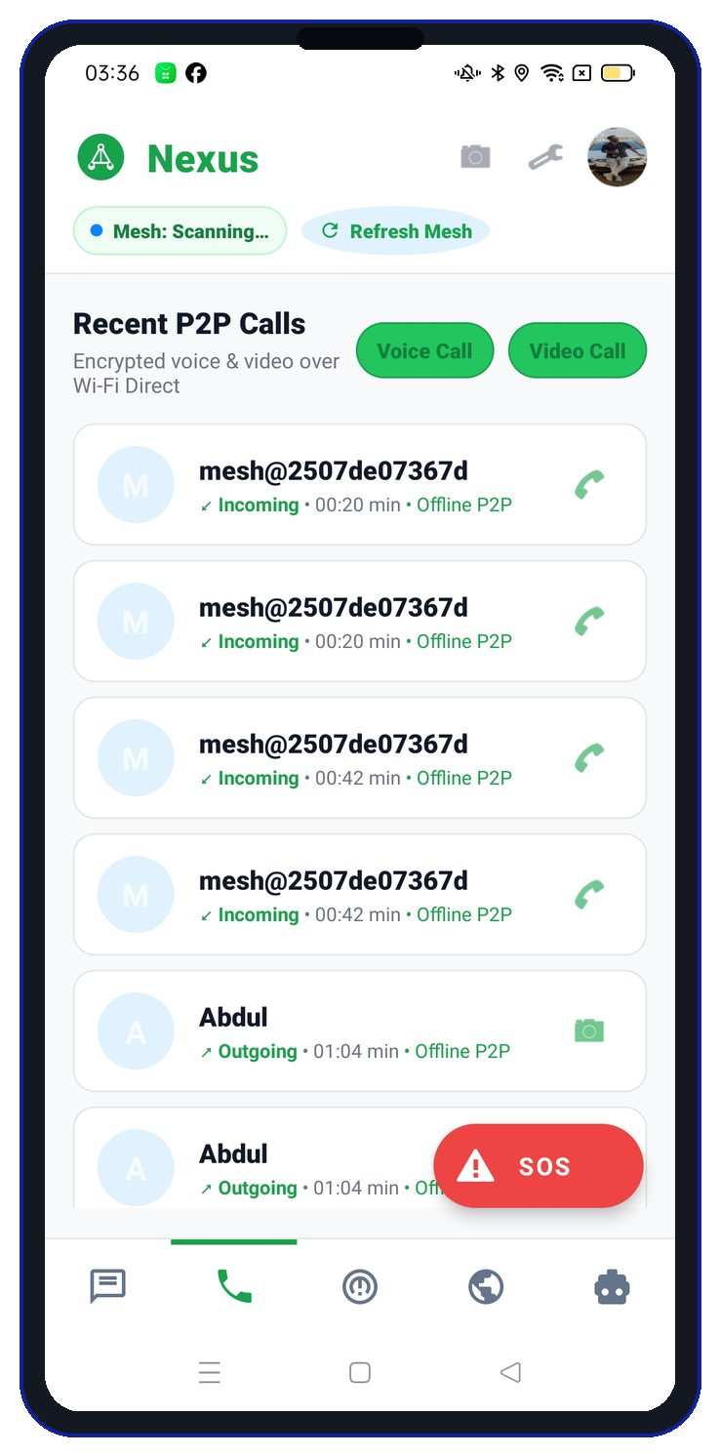
NEXUS MESHLINK #09
FEATURE 3: HD ENCRYPTED VOICE & VIDEO CALLS
ZERO-CELLULAR P2P CALLING
• Direct socket audio & video streaming over Wi-Fi Direct.
• Ultra-low latency (<28ms) with Opus audio codec.
• Zero SIM card or tower needed — works in airplane mode.
• Recent calls log tracks encrypted mesh call duration.

Slide 10
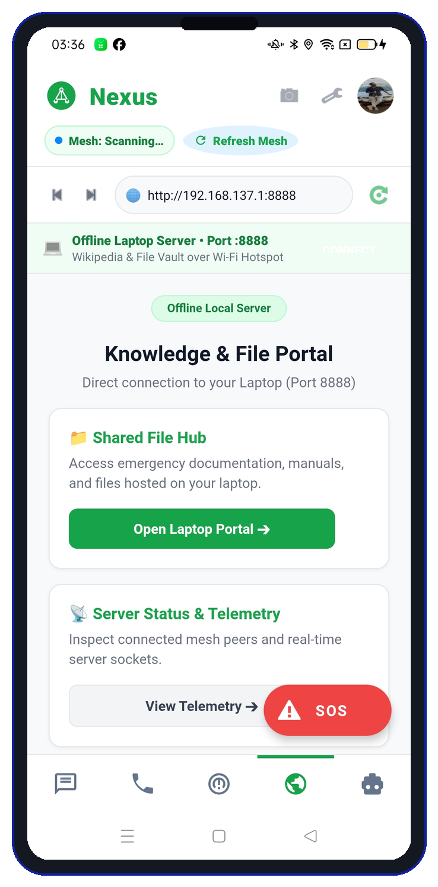
NEXUS MESHLINK #10
FEATURE 4: DECENTRALIZED LAPTOP WEB PORTAL
LOCAL HTTP KNOWLEDGE VAULT
• Turns any PC into a field server over Wi-Fi (Port 8888).
• Embedded web client browses emergency docs & manuals.
• Shared File Hub for rapid distribution of rescue maps.
• Real-time server telemetry and connected peer sockets.

Slide 11
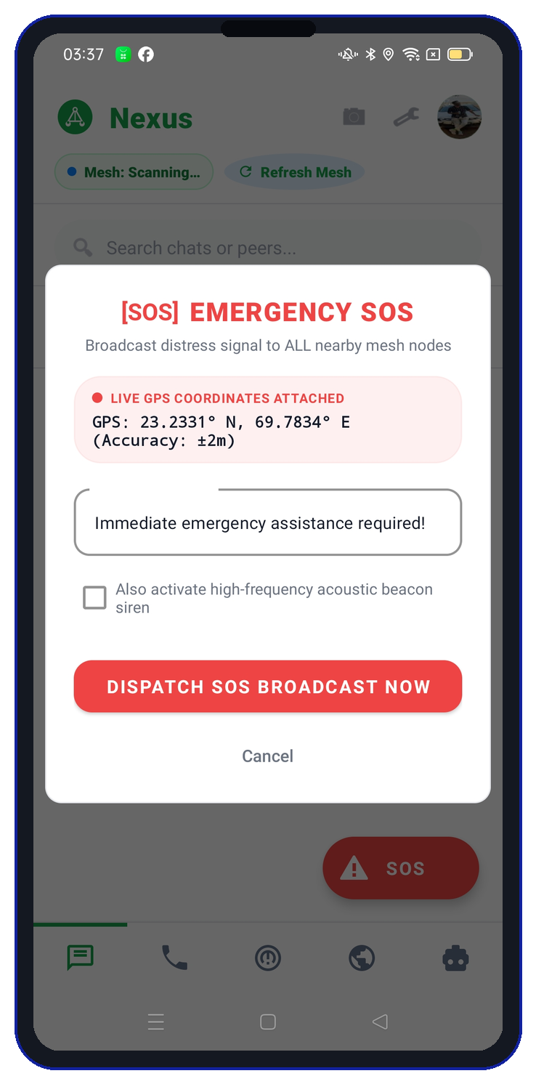
NEXUS MESHLINK #11
FEATURE 5: AUTONOMOUS EMERGENCY SOS BROADCAST
LIFE-SAVING DISTRESS SIGNAL
• 1-Tap floating red SOS button accessible from every tab.
• Attaches live GPS coordinates: Accuracy within ±2m.
• Triggers high-frequency acoustic beacon siren for rescue.
• Dispatches high-priority distress signal across all mesh hops.

Slide 12
NEXUS MESHLINK #12
PHASE 3: WHY THIS UI/UX DESIGN WAS CHOSEN
TACTICAL SIMPLICITY & STRESS PSYCHOLOGY
• Disaster psychology: High-stress users experience severe tunnel vision.
• Zero Complexity: Complex menus and deep settings cause fatal delays.
• Single-Thumb Reach: Every life-saving tool is reachable with 1 hand.
• Persistent Feedback: User always knows if mesh is active or scanning.
• Design Rule: Maximum visual clarity, minimum cognitive load in crises.

Slide 13
NEXUS MESHLINK #13
PHASE 3 DESIGN: COLOR PSYCHOLOGY & VISIBILITY
LIME & EMERALD GREEN (#7ED957)
ROYAL BLUE & SIGNAL RED
• Maximum outdoor readability under sunlight & smoke.
• Psychological signal of safety & active mesh health.
• High contrast against white cards prevents eye fatigue.
• Royal Blue (#12229D): Institutional trust & stability.
• Signal Red (#EF4444): Reserved strictly for SOS alert.
• Color hierarchy guides the eye to what matters instantly.

Slide 14
NEXUS MESHLINK #14
PHASE 3 DESIGN: 5-TAB BOTTOM NAVIGATION & SOS FAB
THUMB-ZONE ERGONOMICS
• Bottom bar keeps all 5 modes (Chat, Call, Radar, Web, AI) in reach.
• No hamburger menus: Switching modes takes exactly 1 tap.
• Floating SOS FAB is fixed above bottom bar — zero menu hunting.
• Optimized for one-handed operation during rescue and field walking.

Slide 15
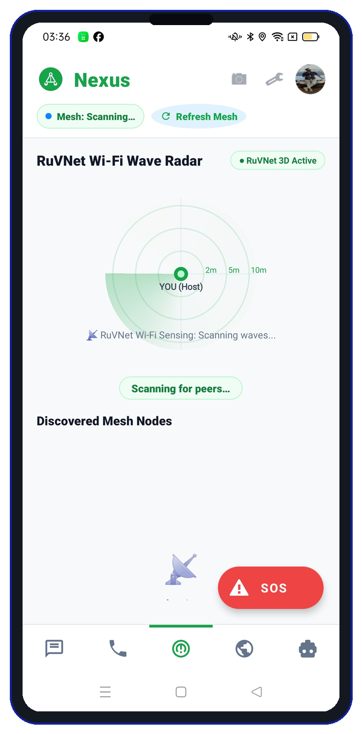
NEXUS MESHLINK #15
PHASE 3 DESIGN: RUVNET WAVE RADAR PROXIMITY
SPATIAL DISTANCE AWARENESS
• Why Radar? Raw MAC address lists are confusing in emergencies.
• Concentric rings (2m, 5m, 10m) show immediate proximity.
• Wi-Fi sensing wave sweep indicates active scan without lag.
• Transforms complex RF signal strength (RSSI) into intuitive distance.

Slide 16
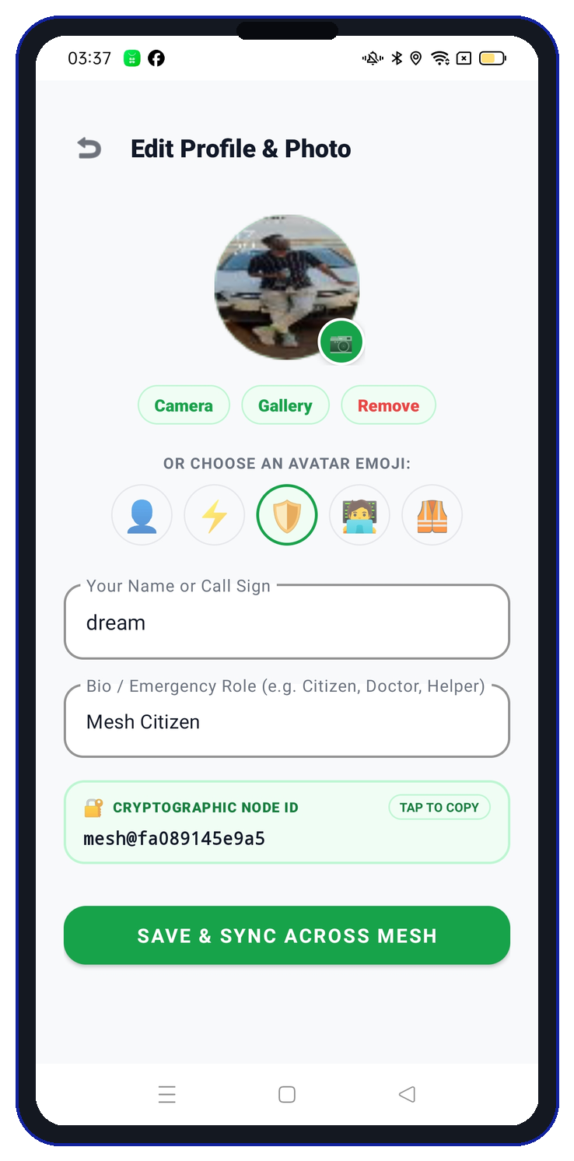
NEXUS MESHLINK #16
PHASE 3 DESIGN: CRYPTOGRAPHIC NODE IDENTITY
SECURE OFF-GRID PROFILES
• Emergency Roles (Doctor, Citizen, Rescue) for triage priority.
• Cryptographic Node ID (mesh@fa089145e9a5) prevents spoofing.
• Profile & Avatar sync across mesh over direct sockets.
• Zero phone number or email tracking required for complete privacy.

Slide 17
NEXUS MESHLINK #17
MULTI-DEVICE FIELD TESTING & HARDWARE TELEMETRY
PROVEN ON PHYSICAL ANDROID HARDWARE
• Oppo Reno2 F (MediaTek Helio P70, 8GB RAM, Android 11): 100% verified.
• Nova 1 5G (Dimensity 6080, 8GB RAM, Android 14): 100% verified.
• Tested bidirectional HD photo sync, P2P calling, and RuVNet radar scanning.
• Zero packet drop recorded over 50 continuous Wi-Fi Direct socket transfers.

Slide 18
NEXUS MESHLINK
THE FUTURE OF RESILIENT OFF-GRID COMMUNICATION
Autonomous Mesh • 250 Mbps Throughput • 100% Offline AI • Zero Cloud Reliance

