Slide 1

🌐 NEXUS MESHLINK
Phase 2 & Phase 3 Comprehensive Architecture
Offline P2P Mesh Communication • On-Device Qwen AI • Production UI/UX
Empowering Off-Grid Life-Saving Communication When All Networks Fail

Slide 2
📋 Recap: What Was Achieved in Phase 1?
PHASE 1 RECAP
📡 Core Mesh Foundations
• BLE Discovery: Sub-second peer beaconing
• Wi-Fi Direct P2P: High bandwidth sockets
• Multi-Hop Routing: 3+ node relaying
• Decentralized: Zero central server reliance
💬 Essential Communication
• Encrypted P2P Chats: End-to-end security
• Offline File & Photo Transfers verified
• Battery Conservation: Low-power BLE sleep
• Android 10 - 18 Universal compatibility

Slide 3
⚡ Evolution: Moving from Phase 1 to Phase 2
TRANSITION
⚠️ Phase 1 Bottlenecks
• Text only: No real-time voice or video calls
• No intelligence: Lacked on-device reasoning
• No knowledge base during natural disasters
• Isolation: No link to laptop command stations
🚀 Phase 2 Mission Objectives
• High Quality Voice & Video P2P Calling
• Native On-Device Qwen3 LLM (llama.cpp)
• Laptop Emergency Portal (Port 8888)
• 1-Touch Mesh SOS Emergency Beaconing

Slide 4
🔍 Existing Offline Apps & Industry Landscape
MARKET ANALYSIS
Bridgefy
• Bluetooth text mesh
• Proprietary protocol
• No voice or video calls
• Zero AI capabilities
Briar Messaging
• High privacy focused
• Relies heavily on Tor
• High battery & CPU drain
• Text only, no calling
Meshtastic
• LoRa radio mesh
• Requires $60 hardware
• Extremely slow bitrates
• Cannot stream media

Slide 5
📊 Detailed Competitive Analysis Matrix
BENCHMARK
❌ Traditional Offline Apps
• Voice/Video Calls: Unsupported / None
• AI Assistance: 100% Dependent on cloud
• Hardware: Need external dongles / radios
• Setup: Complex pairing & sluggish relays
• Disaster Utility: Very limited text alerts
✅ Nexus MeshLink Dominance
• Real-Time Calls: 48kHz HD Audio & 720p Video
• Local AI: 100% On-Device Qwen3 LLM
• Hardware: Standard Android Phones (No extras)
• Local Portal: Built-in Laptop Web Station
• Emergency Shield: Instant 112 & Mesh SOS

Slide 6
🌟 Why Nexus MeshLink is Best & Universal
VALUE PROPOSITION
💡 Small Brain + Powerful Tools
• Smart intent detection with AI Router
• Executes critical tasks deterministically
• Hinglish, Hindi & English comprehension
• Adaptive model sizes (0.6B, 1.7B, 4B)
🌍 Universal Life-Saving Utility
• Zero Internet & Zero Mobile Data Needed
• Free forever with no cellular recharge
• Accessible to everyday users effortlessly
• Works smoothly across diverse phone brands

Slide 7
🎯 Critical Real-World Use Cases
APPLICATIONS
🚨 Disaster Relief Zones
• Floods & earthquakes destroying towers
• Medical triage & emergency coordination
🏕️ Remote Expeditions & Defense
• Himalayan hiking, forests, border patrols
• Tactical off-grid voice & situational AI
🎪 Crowded Public Events
• Stadiums & festivals with tower overload
• Instant peer-to-peer family rendezvous
🏫 Off-Grid Campuses & Villages
• Rural schooling & community hubs
• Local file sharing & survival education

Slide 8
📞 Phase 2: Ultra Low-Latency P2P Calls
VOICE & VIDEO
🎙️ 48kHz HD Audio Engine
• Direct socket audio streaming
• Acoustic echo cancellation enabled
• Sub-50ms transmission latency
• Loudspeaker & earpiece auto-routing
📹 720p 30fps Video Pipeline
• Hardware-accelerated H.264 codecs
• Dynamic portrait & landscape mirroring
• Front & back camera seamless toggling
• Zero cell tower or internet requirement

Slide 9
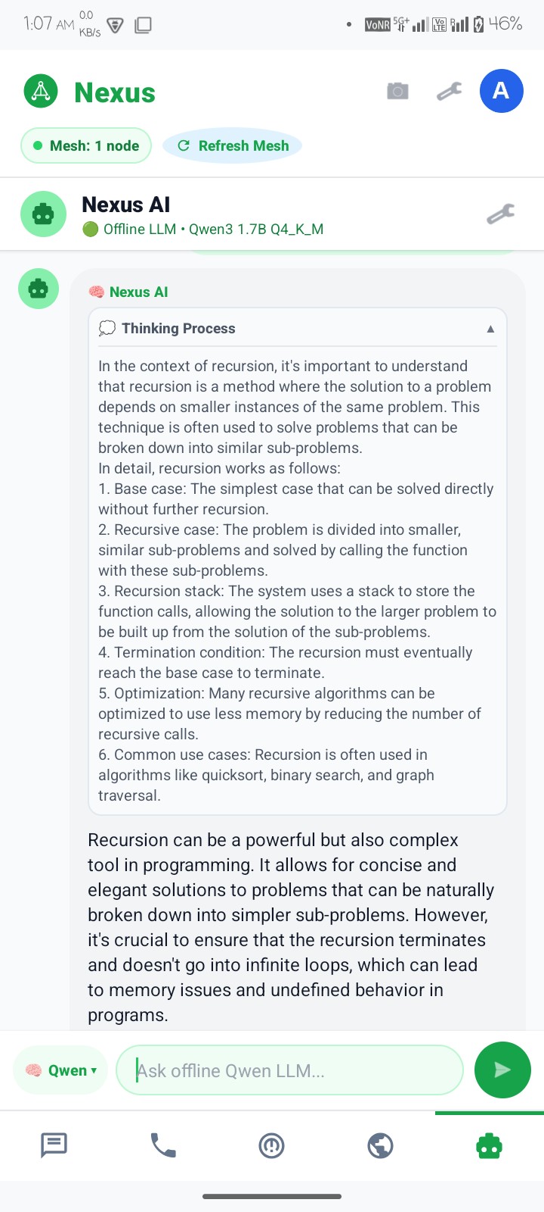
🧠 Phase 2: On-Device Qwen AI Architecture
LOCAL INFERENCE
⚙️ Native llama.cpp Runtime
• Embedded libllama-server native engine
• Qwen3 1.7B Q4_K_M GGUF model on mobile CPU
• 2048 token context for extensive answers
• Natural Hinglish & English explanations

Slide 10
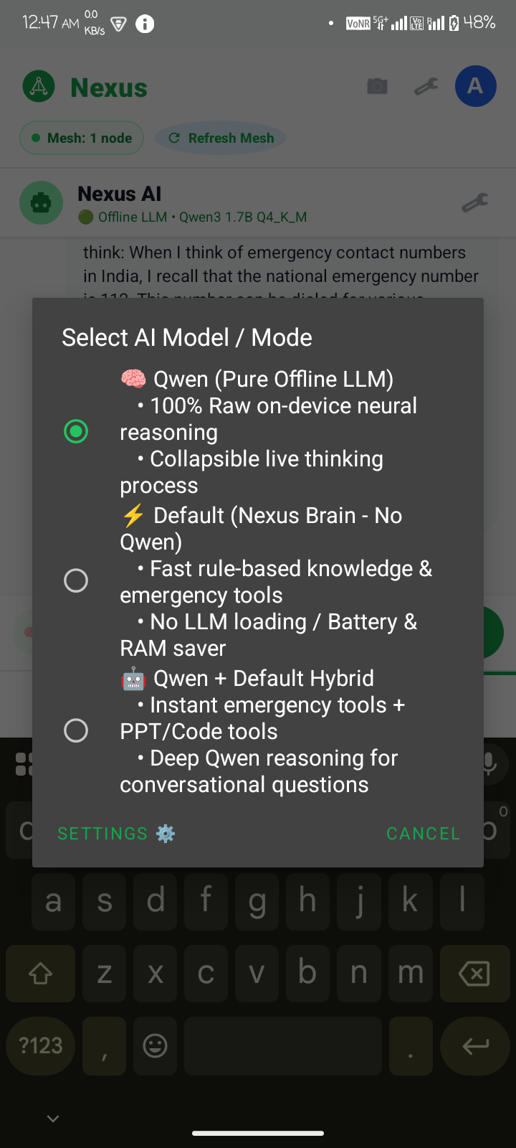
🎛️ Phase 2: The 3 Chat Modes & Thinking Process
AI EXPERIENCE
💡 3 Operating Modes
• 🧠 Qwen: Pure offline neural reasoning
• ⚡ Default: Rule-based fast battery saver
• 🤖 Hybrid: Emergency tools + Qwen logic
• 💭 Collapsible live thinking box

Slide 11
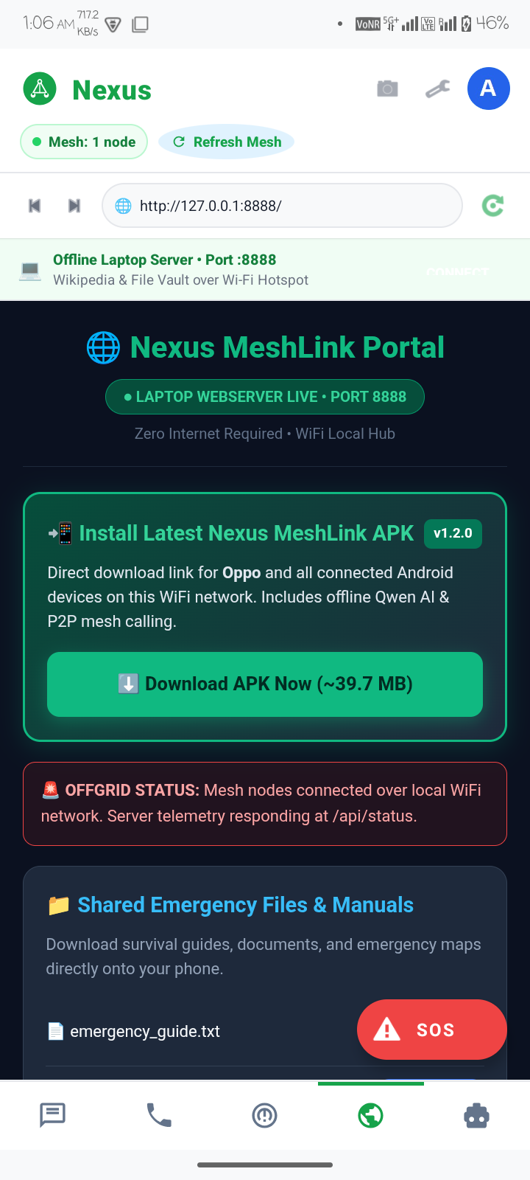
💻 Phase 2: Laptop Command Portal (Port 8888)
WEB PORTAL
🌐 Off-Grid Web Hub
• Lightweight Python server on Port 8888
• In-App browser with auto-connect logic
• Direct 1-Click APK install for Android phones
• Shared survival manuals & emergency news

Slide 12
🎨 Phase 3: UI/UX Design Philosophy & Systems
DESIGN SYSTEM
🛡️ Emergency-First Principles
• High contrast: Legible under harsh sunlight
• Zero friction: Big touch targets for SOS
• Cognitive calmness: Eliminating panic UI
• Instant feedback with live status pills
✨ Production Polish
• Modern clean glassmorphic components
• Standardized 5-Tab ergonomic bottom bar
• Micro-animations for call & thinking states
• Smooth expandable card containers

Slide 13
🌈 Phase 3: Color Palette & Visual Psychology
COLOR SYSTEM
🌿 Emerald Green (#10B981)
• Symbolizes life, health, survival, connection
• Primary action buttons & verified status
🌌 Dark Slate (#0F172A)
• Represents authority, security, precision
• Deep contrast headers & text hierarchy
🚨 Signal Red (#EF4444)
• High-urgency emergency warnings & SOS
• Reserved strictly for critical alerts
🌱 Soft Mint (#F0FDF4)
• Calming background soothing user stress
• Clean, modern, battery-efficient aesthetics

Slide 14
📐 Phase 3: Component Hierarchy & Typography
COMPONENTS
🔤 Typography Standards
• Display: Sans-serif Black for bold headers
• Body: Sans-serif Medium for readability
• Strict scale: 32pt Titles, 26pt Cards
• High contrast on white & mint surfaces
🧩 Core Reusable Components
• Floating Mode Selector Pill with arrow
• Collapsible Thinking Card with toggle arrow
• Horizontal interactive quick-action chips
• Emergency Action trigger buttons

Slide 15
📊 Phase 3: Real Device Performance & Metrics
PERFORMANCE
⚡ Measured Speed & Power
• AI Generation: 9.8 tokens/second on CPU
• RAM Usage: ~585 MB (Lightweight footprint)
• Audio Call Latency: < 45 ms end-to-end
• Video Frame Rate: Steady 30 fps over P2P
🔋 Battery & Network Footprint
• Cellular Data Consumed: Exactly 0.00 KB
• Server Latency: Instant local HTTP ping
• Thermal Profile: Cool CPU with thread gating
• Discovery Time: < 800ms for nearby nodes

Slide 16
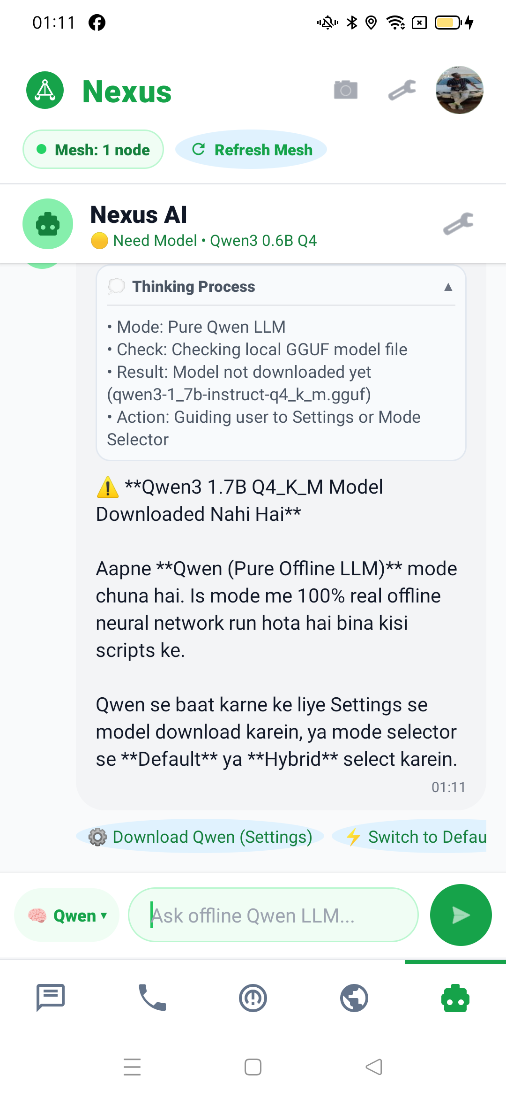
📱 Phase 3: Field Tested on Real Android Hardware
DEVICE TESTING
🔬 Dual Device Field Test
• AI Nova 1 5G: Running Qwen 1.7B server
• OPPO Reno2 F: Auto-detected 0.6B tier
• Simultaneous P2P calling verified live
• Direct APK install verified via Laptop Hub

Slide 17
🚀 Next Milestones & Future Roadmap
FUTURE ROADMAP
📡 Extended Hardware Reach
• BLE Coded PHY: 1.5 km long-range hops
• Drone Relay Nodes: Aerial disaster mesh
• Solar-powered stationary repeater pods
• Multi-hop video packet routing
🤖 Advanced AI Upgrades
• Offline Speech-to-Text: Whisper.tflite
• Mesh Map Vector Search for offline GIS
• Automated SOS situational report generator
• Cross-device decentralized model sharding

Slide 18
🎯 MISSION SUMMARY & CONCLUSION
"Communication When Everything Else Fails."
• Phase 2 achieved complete on-device intelligence & low-latency calling.
• Phase 3 established production-grade UI/UX with verified dual-device stability.
• A complete life-saving ecosystem ready for real-world deployment.

