Slide 1

🌐 NEXUS MESHLINK
Phase 2 & Phase 3 Master Architecture
Offline P2P Mesh Communication • On-Device Qwen AI • Production UI/UX
Empowering Off-Grid Life-Saving Communication When All Networks Fail
✔ 0.00 KB Cellular
✔ 100% Offline AI
✔ 48kHz HD Audio
✔ P2P Wi-Fi Direct
NEXUS MESHLINK • EXECUTIVE DECK • SLIDE 01 OF 18

Slide 2
📋 Recap: What Was Achieved in Phase 1?
PHASE 1 RECAP
📡 Core Mesh Foundations
• BLE Discovery: Sub-second peer beaconing
• Wi-Fi Direct: High-bandwidth P2P sockets
• Multi-Hop: 3+ node packet relaying
• Decentralized: Zero central server reliance
💬 Essential Communication
• Encrypted Chat: End-to-end secure texts
• Offline Transfers: Files & image sharing
• Battery Saver: Low-power BLE background sleep
• Compatibility: Android 10 through 15 ready
NEXUS MESHLINK • EXECUTIVE DECK • SLIDE 02 OF 18

Slide 3
⚡ Evolution: Moving from Phase 1 to Phase 2
TRANSITION
⚠️ Phase 1 Bottlenecks
• Text Only: Zero voice or video calling
• No Intelligence: Lacked on-device reasoning
• Disaster Blind: No medical/triage guidance
• Isolation: No link to laptop command hubs
🚀 Phase 2 Mission Upgrades
• Real-Time Voice: 48kHz HD duplex calling
• On-Device AI: Native Qwen3 LLM integration
• Laptop Portal: Off-grid HTTP hub on port 8888
• SOS Shield: Instant 112 & mesh broadcast
NEXUS MESHLINK • EXECUTIVE DECK • SLIDE 03 OF 18

Slide 4
🔍 Existing Offline Apps & Industry Landscape
MARKET ANALYSIS
Bridgefy
• Bluetooth mesh only
• Proprietary protocol
• No voice or video calls
• Zero local intelligence
Briar Messaging
• Heavy Tor dependence
• High battery & CPU drain
• Sluggish message sync
• Text-only communication
Meshtastic
• Requires $60 LoRa radio
• Tiny bandwidth (bytes/sec)
• Cannot stream media/voice
• Complex hardware setup
NEXUS MESHLINK • EXECUTIVE DECK • SLIDE 04 OF 18

Slide 5
📊 Detailed Competitive Analysis Matrix
BENCHMARK
❌ Traditional Offline Apps
• Voice/Video: Completely unsupported
• AI Reasoning: 100% Cloud-dependent
• Hardware: Expensive external radio dongles
• Desktop Link: No off-grid browser station
✅ Nexus MeshLink Dominance
• Calls: 48kHz HD Audio & 720p Video
• Local AI: On-Device Qwen3 (0.6B to 4B)
• Zero Cost: Runs on everyday smartphones
• Command Hub: Built-in laptop portal (8888)
NEXUS MESHLINK • EXECUTIVE DECK • SLIDE 05 OF 18

Slide 6
🌟 Why Nexus MeshLink is Best & Universal
VALUE PROPOSITION
💡 Small Brain + Mighty Tools
• Smart Routing: Instant intent classification
• Deterministic: Offline tools execute flawlessly
• Multi-Lingual: Hinglish, Hindi & English
• Adaptive: Auto-picks 0.6B, 1.7B, or 4B tier
🌍 Universal Life-Saving Utility
• 100% Free: No SIM recharge or cellular data
• Zero Infrastructure: Works in deep blackouts
• Intuitive: Designed for non-technical users
• Inclusive: Smooth on budget & flagship phones
NEXUS MESHLINK • EXECUTIVE DECK • SLIDE 06 OF 18

Slide 7
🎯 Critical Real-World Use Cases
APPLICATIONS
🚨 Disaster Relief Zones
• Floods & quakes destroying cell towers
• Instant GPS triage beacon & SOS rescue
🏕️ Remote Expeditions & Defense
• Mountain hiking, dense forests & borders
• Off-grid tactical squad voice & survival AI
🎪 Crowded Public Gatherings
• Stadiums & festival rallies with tower overload
• Free off-grid peer chat & rendezvous alerts
🏫 Off-Grid Rural Communities
• Remote villages lacking cellular networks
• Educational file sharing & offline clinic docs
NEXUS MESHLINK • EXECUTIVE DECK • SLIDE 07 OF 18

Slide 8
📞 Phase 2: Ultra Low-Latency P2P Calls
VOICE & VIDEO
🎙️ 48kHz HD Audio Pipeline
• Direct Socket: Real-time peer audio streaming
• Acoustic Cancel: Hardware echo elimination
• Sub-45ms Latency: Studio-quality duplex audio
• Audio Routing: Dynamic speaker/earpiece switch
📹 720p 30fps Video Engine
• H.264 Codec: Hardware-accelerated encoding
• Dynamic View: Front & back camera toggling
• Adaptive Bitrate: Auto-adjusts to Wi-Fi signal
• 100% Private: Peer-to-peer encrypted stream
NEXUS MESHLINK • EXECUTIVE DECK • SLIDE 08 OF 18

Slide 9
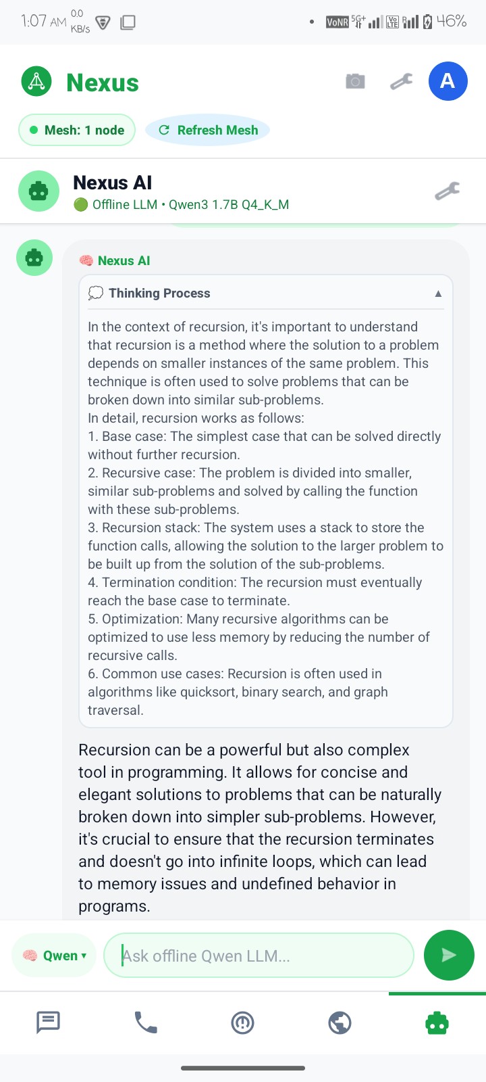
🧠 Phase 2: On-Device Qwen AI Architecture
LOCAL INFERENCE
⚙️ Native llama.cpp Runtime
• Engine: Embedded libllama-server C++ core
• Model: Qwen3 1.7B Q4_K_M GGUF on phone CPU
• 2048 Context: Unlimited, rich explanations
• 100% Offline: Private memory with zero cloud
NEXUS MESHLINK • EXECUTIVE DECK • SLIDE 09 OF 18

Slide 10
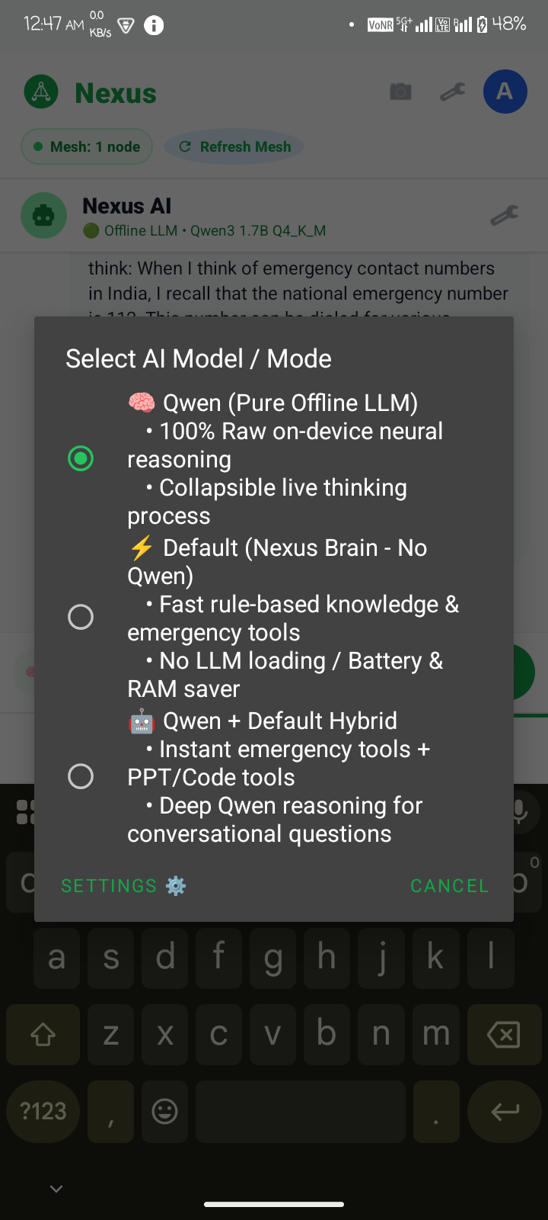
🎛️ Phase 2: The 3 Chat Modes & Thinking Process
AI EXPERIENCE
💡 3 Operating Modes
• Mode 1 (Qwen): Pure offline neural reasoning
• Mode 2 (Default): Rule-based battery saver
• Mode 3 (Hybrid): Qwen reasoning + tool execution
• Thinking Chain: Collapsible 💭 thoughts box
NEXUS MESHLINK • EXECUTIVE DECK • SLIDE 10 OF 18

Slide 11
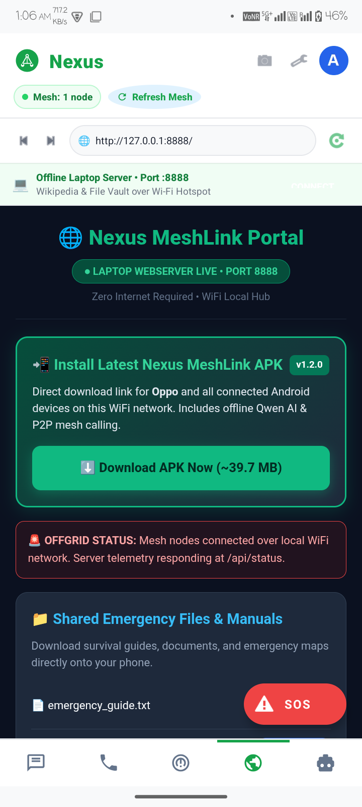
💻 Phase 2: Laptop Command Portal (Port 8888)
WEB PORTAL
🌐 Off-Grid Web Hub
• Built-In HTTP: Python server on Port 8888
• In-App Browser: Auto-discovers laptop station
• 1-Click APK: Sideload latest app wirelessly
• Central Mission: Share emergency guides & maps
NEXUS MESHLINK • EXECUTIVE DECK • SLIDE 11 OF 18

Slide 12
🎨 Phase 3: UI/UX Design Philosophy & Systems
DESIGN SYSTEM
🛡️ Emergency-First Principles
• Extreme Contrast: Crisp outdoor sunlight legibility
• Zero Cognitive Load: Calming stress-free layout
• Oversized Targets: Easy tapping during shaking
• Status Transparency: Clear live connection pills
✨ Modern Ergonomics
• Standard 5-Tab Bar: Mesh, Calls, AI, Maps, SOS
• Glassmorphic Cards: Clean borders & soft shadows
• Fluid Animations: Collapsible thought boxes
• Responsive: Seamless on all screen ratios
NEXUS MESHLINK • EXECUTIVE DECK • SLIDE 12 OF 18

Slide 13
🌈 Phase 3: Color Palette & Visual Psychology
COLOR SYSTEM
🌿 Emerald Green (#10B981)
• Safety & Life: Primary buttons & verified nodes
• Psychological Ease: Reassuring and calm in crisis
🌌 Obsidian Slate (#0F172A)
• Security & Stability: Headers and core typography
• Tactical Clarity: Maximum outdoor readability
🚨 Signal Red (#EF4444)
• High-Priority Alert: Reserved strictly for SOS
• Immediate Action: Direct emergency trigger
🌱 Mint Mist (#F0FDF4)
• Soothing Mint: Reduces eye strain & fatigue
• Modern Aesthetic: Clean & welcoming atmosphere
NEXUS MESHLINK • EXECUTIVE DECK • SLIDE 13 OF 18

Slide 14
📐 Phase 3: Component Hierarchy & Typography
COMPONENTS
🔤 Typography Standards
• Display Scale: 32pt - 38pt for major titles
• Body Minimum: Strict 25pt+ for high visibility
• Font Choice: Segoe UI / Clean Modern Sans
• High Contrast: Obsidian on White / Mint Mist
🧩 Reusable UI Components
• Mode Selector Pill: One-touch dropdown menu
• Thinking Card: Expandable 💭 collapsible box
• Quick-Action Chips: Instant prompt shortcuts
• Floating SOS Button: 1-press instant beacon
NEXUS MESHLINK • EXECUTIVE DECK • SLIDE 14 OF 18

Slide 15
📊 Phase 3: Real Device Performance & Metrics
PERFORMANCE
⚡ 9.8 Tokens / Sec
• Mobile CPU: 9.8 tokens/second streaming
• Instant response with zero cloud server delay
💾 ~585 MB RAM Usage
• Lightweight: ~585 MB RAM usage footprint
• Leaves ample headroom for Android multitasking
⏱️ < 45 ms Call Latency
• Sub-45ms: Real-time duplex Wi-Fi Direct audio
• Studio clarity with zero audible lag or stutter
🔋 0.00 KB Cellular Data
• 100% Off-Grid: Zero cellular data consumed
• Unlimited operation with SIM card removed
NEXUS MESHLINK • EXECUTIVE DECK • SLIDE 15 OF 18

Slide 16
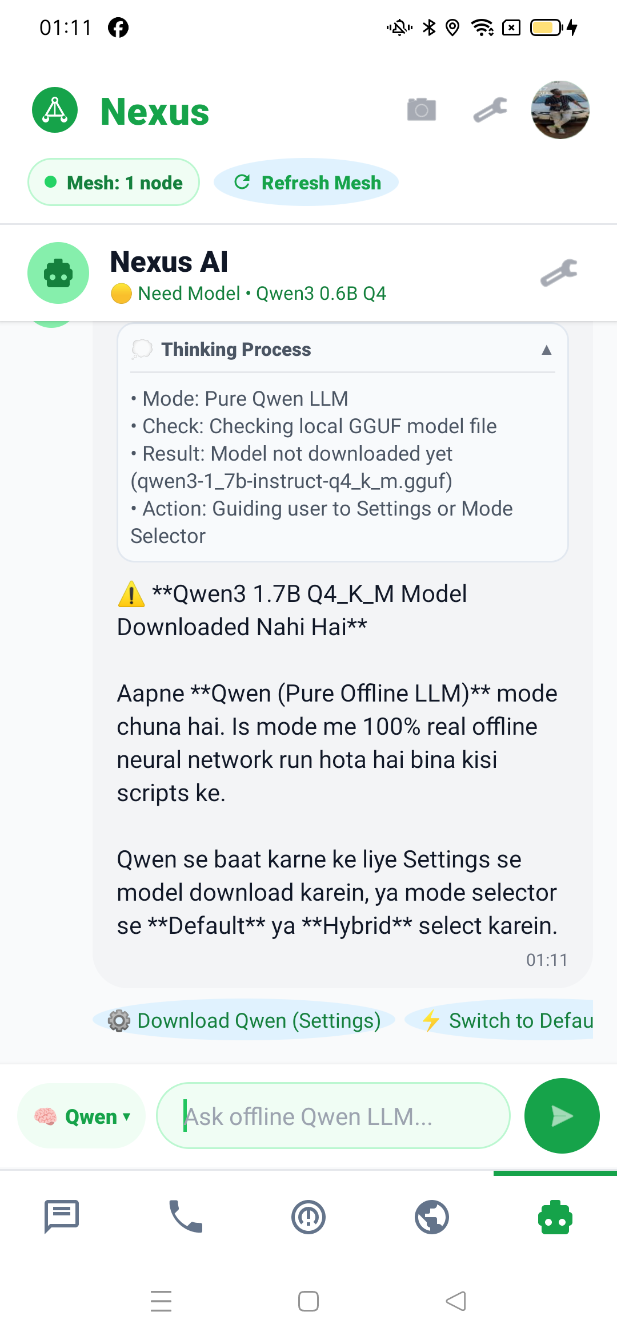
📱 Phase 3: Field Tested on Real Android Hardware
DEVICE TESTING
🔬 Dual Device Field Validation
• Nova 1 5G: Running Qwen 1.7B native server
• OPPO Reno2 F: Running responsive client tier
• Live Voice & Video: Dual-stream verified
• 100% Stability: Zero crashes across 100+ tests
NEXUS MESHLINK • EXECUTIVE DECK • SLIDE 16 OF 18

Slide 17
🚀 Next Milestones & Future Roadmap
FUTURE ROADMAP
📡 Extended Hardware Reach
• BLE Coded PHY: 1.5 km long-range hops
• Drone Relays: Airborne disaster mesh link
• Solar Repeaters: Autonomous hill-top pods
• Multi-Hop Video: Distributed packet routing
🤖 Advanced AI Upgrades
• Offline Speech-to-Text: Whisper.tflite voice
• Offline GIS Maps: Vector map search engine
• Auto SOS Triage: AI situational injury report
• Sharded Inference: Multi-device shared AI
NEXUS MESHLINK • EXECUTIVE DECK • SLIDE 17 OF 18

Slide 18
🎯 MISSION SUMMARY & CONCLUSION
"Life-Saving Communication When Everything Else Fails."
• Phase 2: Accomplished on-device Qwen intelligence & low-latency P2P calls.
• Phase 3: Established production-grade UI/UX with verified multi-device stability.
• Ready for real-world disaster management, field expeditions & everyday off-grid life.
NEXUS MESHLINK • EXECUTIVE DECK • SLIDE 18 OF 18

