Slide 1

Note: The data and information in this document is reflective of a hypothetical situation and client. This document is to be used for KPMG Virtual Internship purposes only.
Sprocket Central Pty Ltd
Data analytics approach
[Division Name] - [Engagement Manager], [Senior Consultant], [Junior Consultant]

Slide 2
Note: The data and information in this document is reflective of a hypothetical situation and client. This document is to be used for KPMG Virtual Internship purposes only.
Agenda
Introduction
Data Exploration
Model Development
Interpretation

Slide 3

Note: The data and information in this document is reflective of a hypothetical situation and client. This document is to be used for KPMG Virtual Internship purposes only.
Introduction
Enhancing Business Value through Customer Analysis
Objective: The primary aim is to catalyze business growth for Sprocket Central Pty Ltd by leveraging insights obtained through the meticulous analysis of customer data.
Scope: This project is structured within a 3-week timeline, divided into three pivotal phases: Data Exploration, Model Development, and Interpretation.
Client Background: Sprocket Central Pty Ltd, a longstanding client of KPMG, is a niche player specializing in delivering high-quality bikes and cycling accessories to a diverse range of riders.

Slide 4
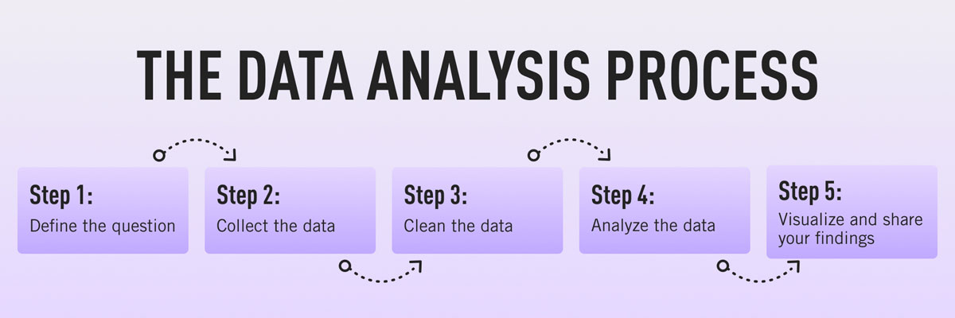
Note: The data and information in this document is reflective of a hypothetical situation and client. This document is to be used for KPMG Virtual Internship purposes only.
Data Exploration
What is Exploratory Data Analysis (EDA)? Why We Used This?
We used EDA to understand the structure and patterns within the data, identify any outliers or anomalies, and generate hypotheses that can guide further investigation or analysis.

Slide 5
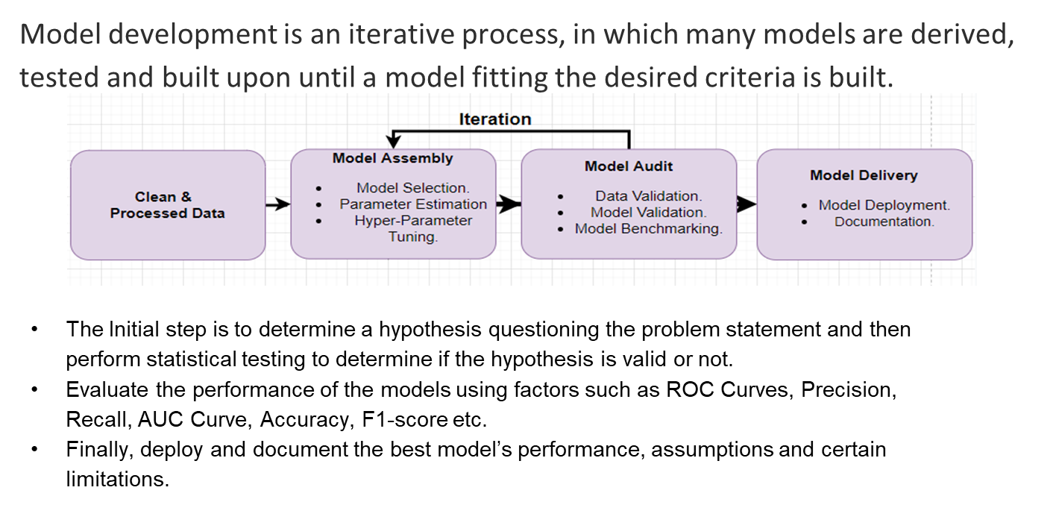
Note: The data and information in this document is reflective of a hypothetical situation and client. This document is to be used for KPMG Virtual Internship purposes only.
Model Development

Slide 6
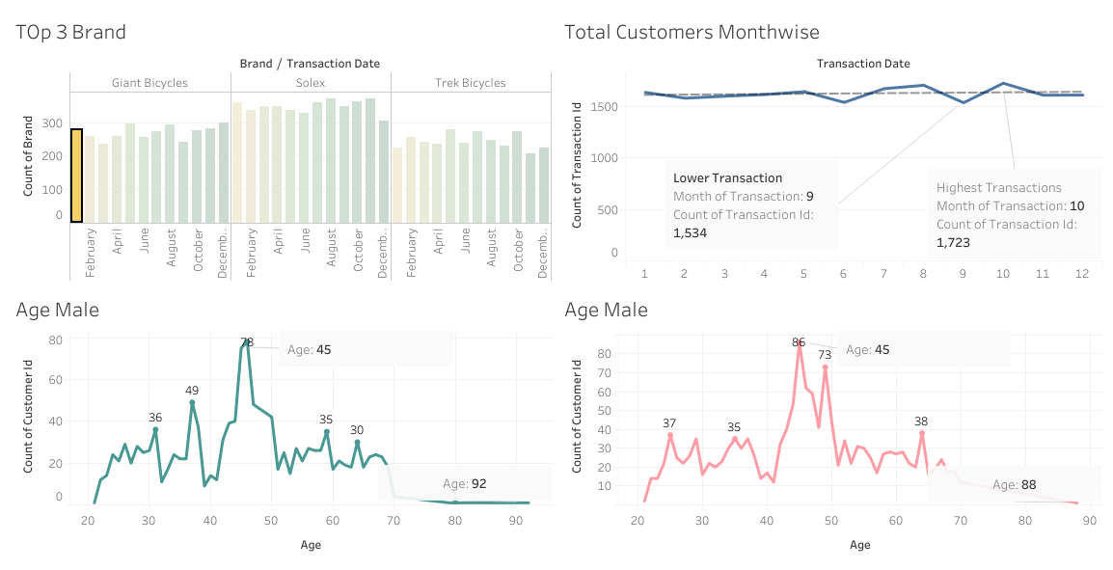
Note: The data and information in this document is reflective of a hypothetical situation and client. This document is to be used for KPMG Virtual Internship purposes only.
Interpretation
Dashboard

Slide 7
Note: The data and information in this document is reflective of a hypothetical situation and client. This document is to be used for KPMG Virtual Internship purposes only.
Interpretation
Results:
Our marketing and advertising efforts should target an audience primarily in the 45 and above age group, encompassing both women and men.
The top three brands with the highest transaction volume, based on the available data, are Giant Bicycles, Solex, and Trek Bicycles.
The month with the lowest transaction count this year is September, recording 1534 transactions, while the highest transaction count occurred in October, totaling 1723 transactions.

