Slide 1

Database Management System

Slide 2



Group : 20
Name | ID | Section
Tasfiq Jahid | 1931203 | 02
Durjoy Mrong | 2022242 | 02
Sadia Binte Jamal | 2021843 | 02
Abdun Noor Shihab | 2021871 | 06
Toki Tahmid Khan | 2022757 | 06
Sakibul Hasan Shato | 2031033 | 06

Slide 3

Customer Information Management System For Lanka Bangla Securities Limited

Slide 4
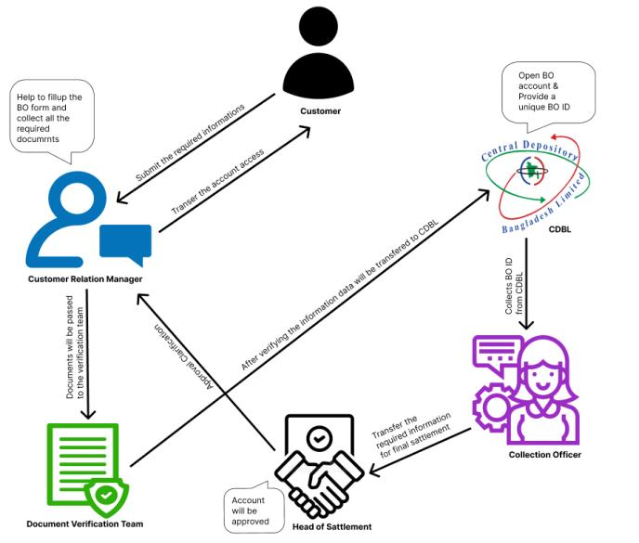
RICH PICTURE (AS-IS)

Slide 5
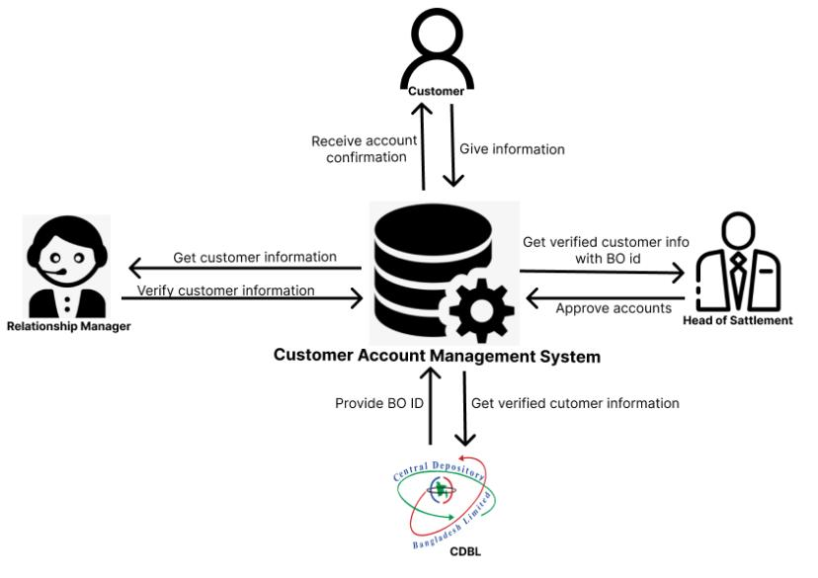
RICH PICTURE (TO-BE)

Slide 6
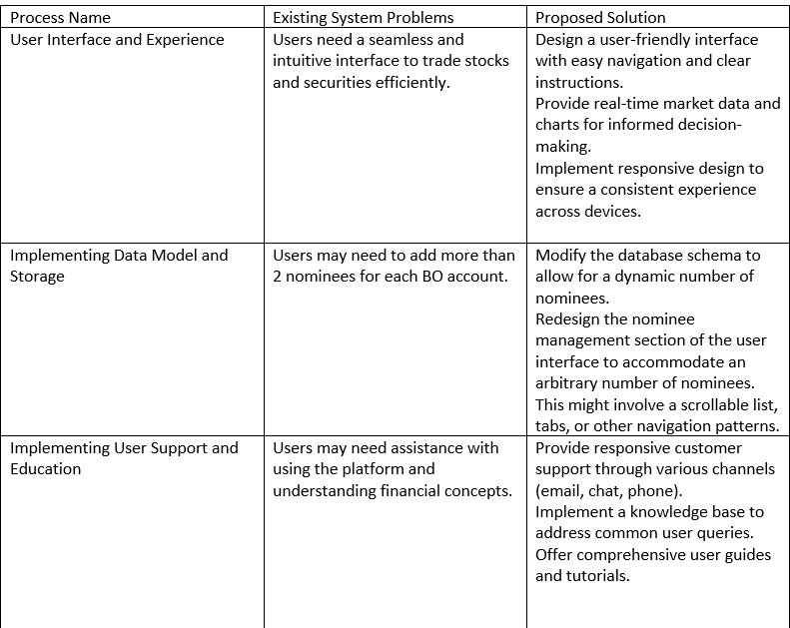
Problem Analysis

Slide 7
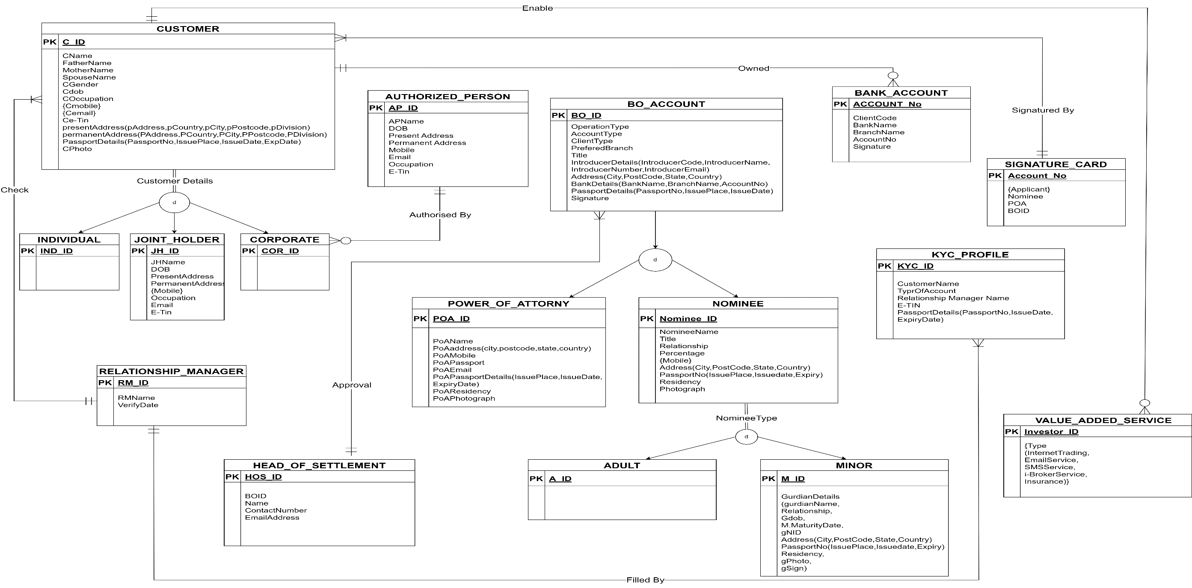
Entity Relationship Diagram
Figure : Entity relationship diagram

Slide 8
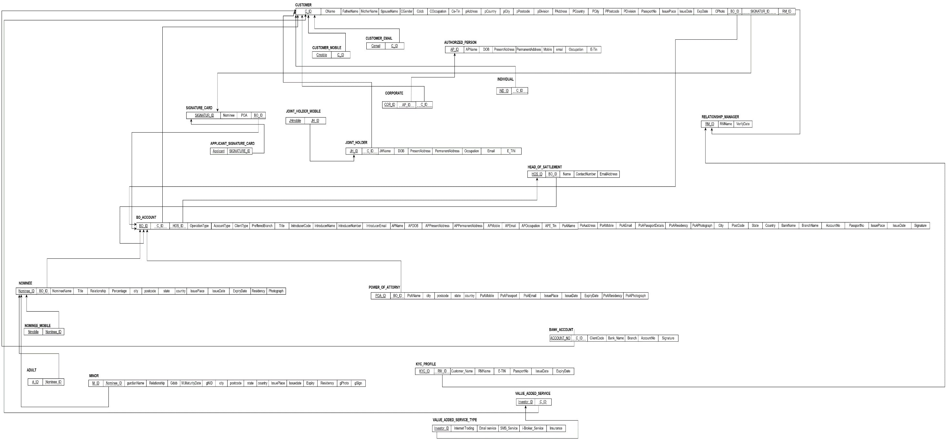
Entity Relationship Diagram To Relational Schema
Figure : Entity relationship diagram to Relational Schema

Slide 9
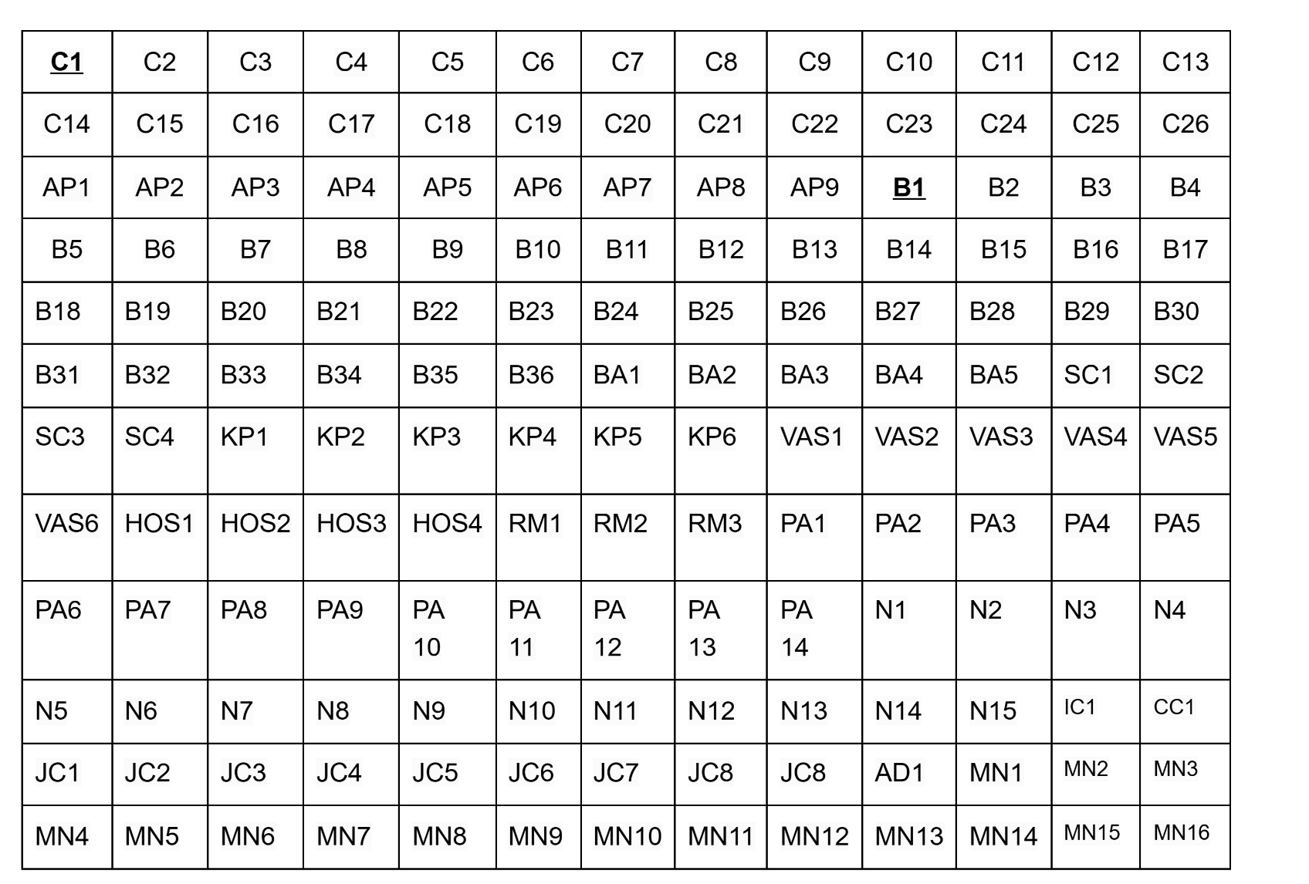
Normalization
Customer | C
Authorized Person | AP
BO | B
Bank Account | BA
Signature Card | SC
KYC Profile | KP
Value Added Service | VAS
Head of Settlement | HOS
Relationship Manager | RM
Power of Attorney | PA
Nominee | N
Joint Holder | JH
Individual Customer | IC
Joint Customer | JC
Corporate Customer | CC
Adult Nominee | AD
Minor Nominee | MN
1NF

Slide 10
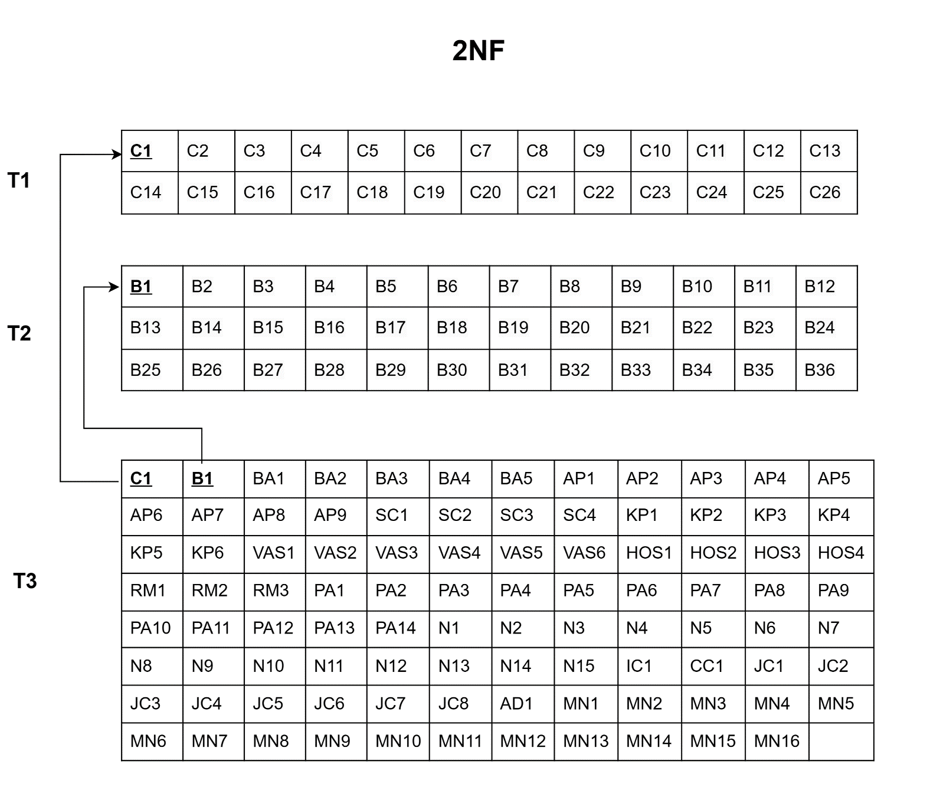
Normalization(Continued)

Slide 11

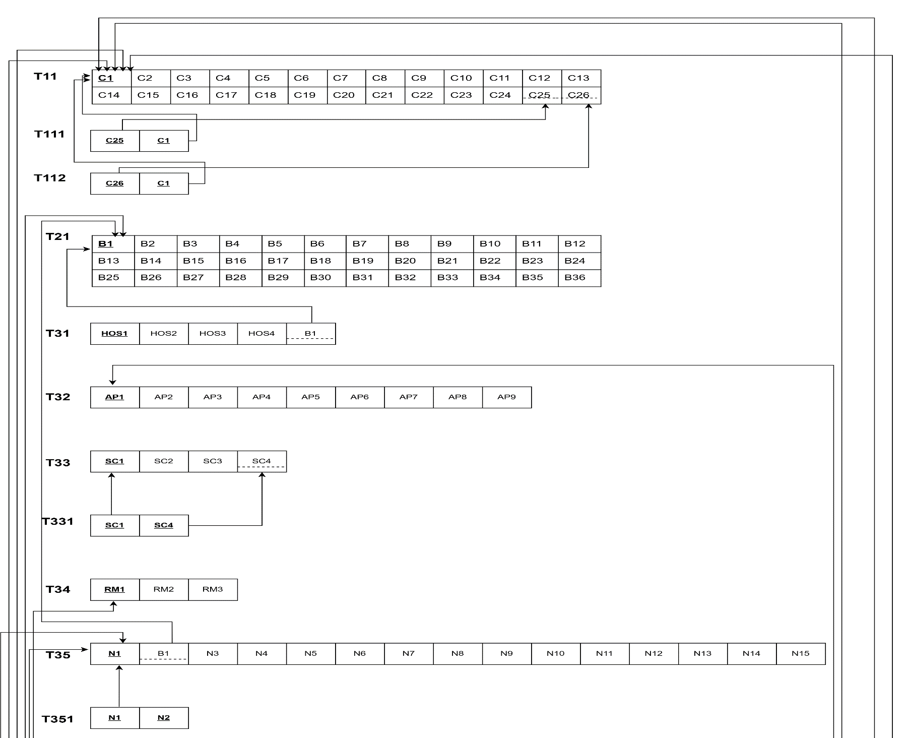
Normalization(Continued)

Slide 12
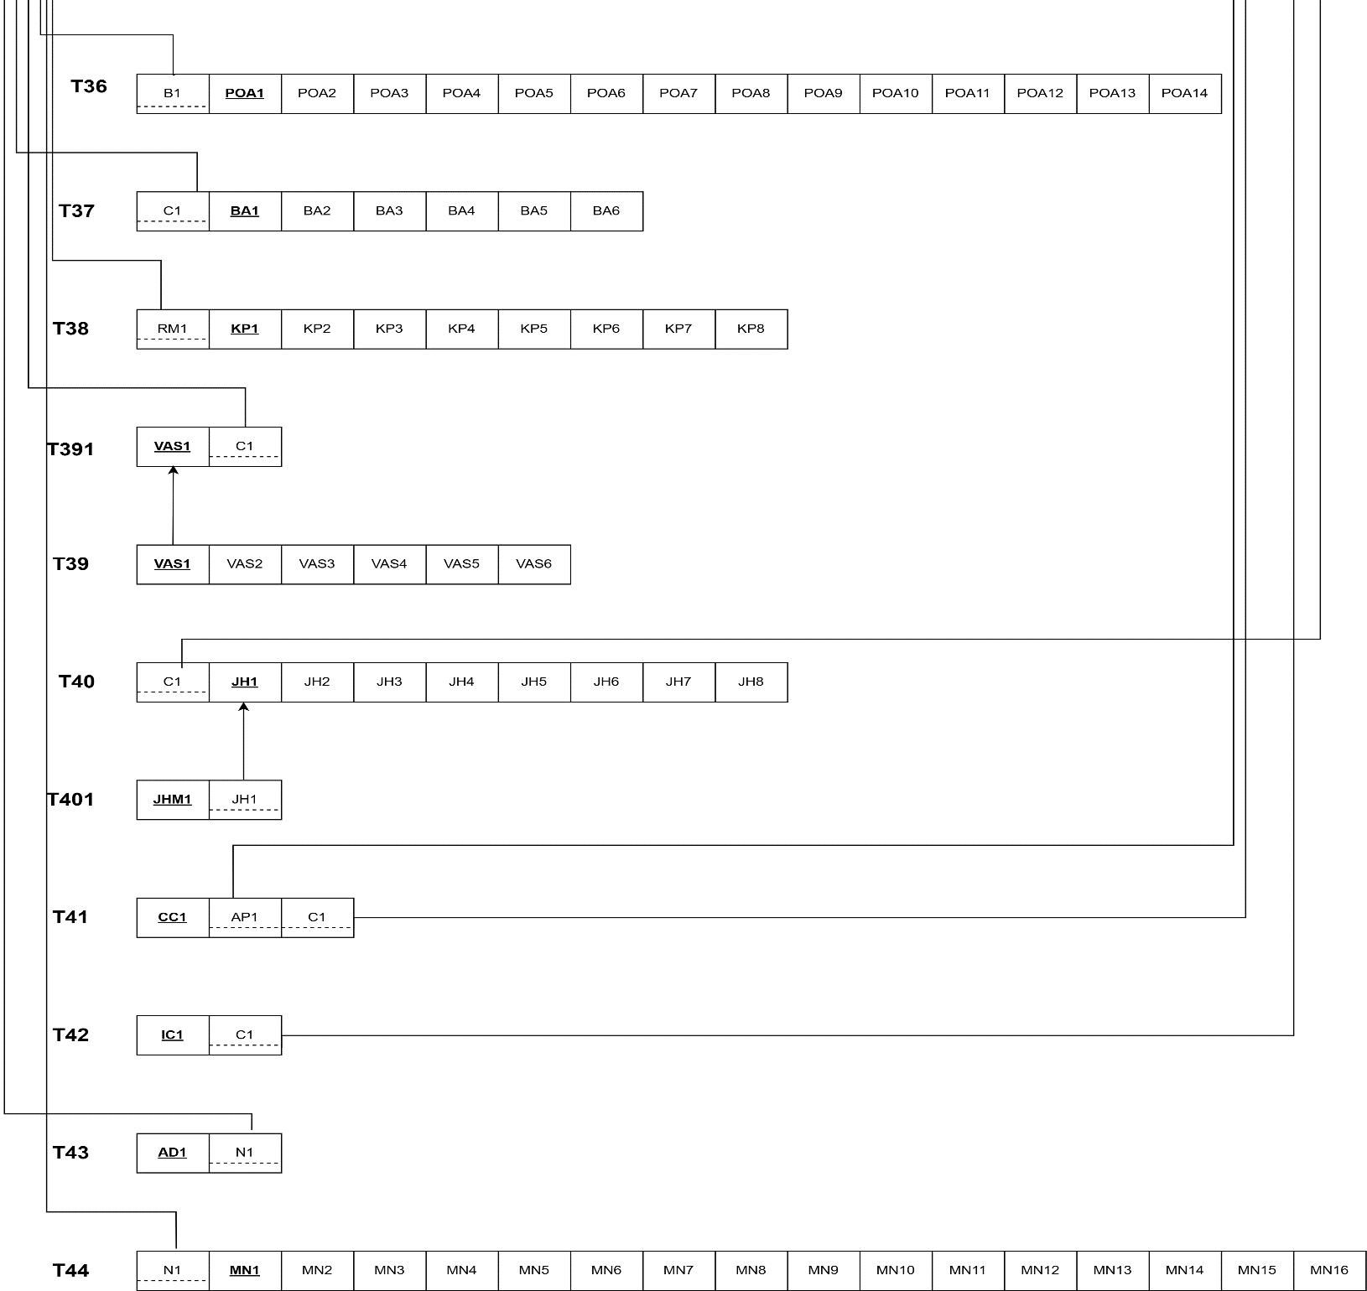
Normalization(Continued)

Slide 13
BCNF
All the relations that are in 3NF, are also in BCNF as no non-key identifies the PK or part of the PK

Slide 14
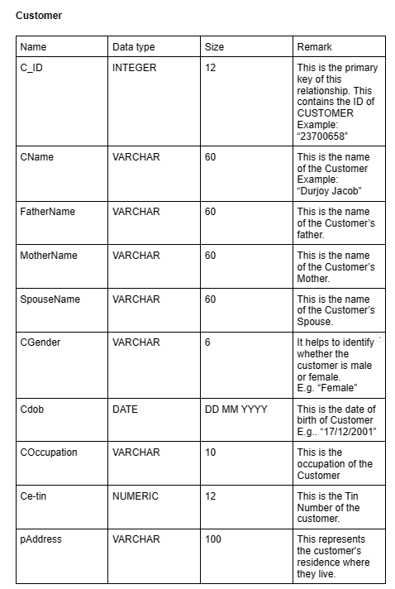
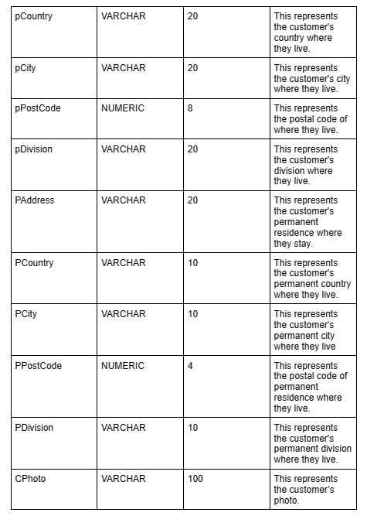
Data Dictionary

Slide 15
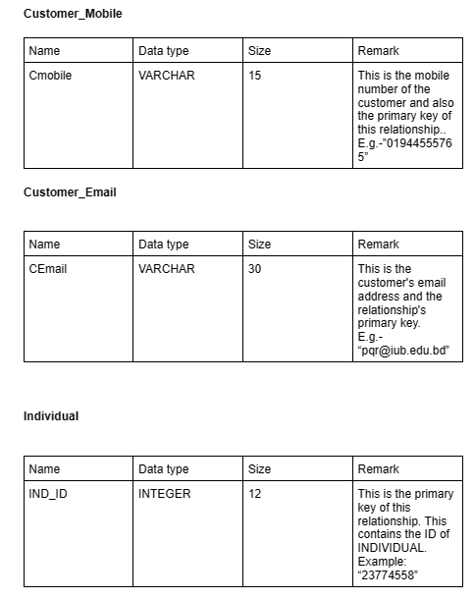
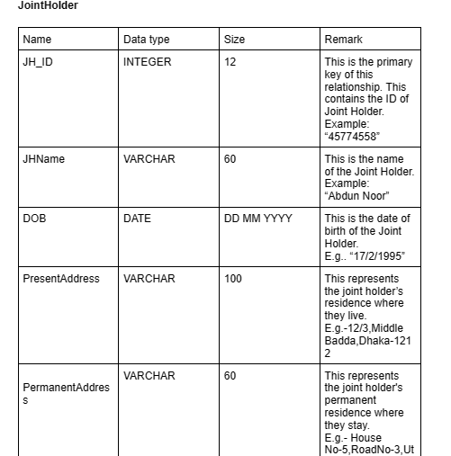
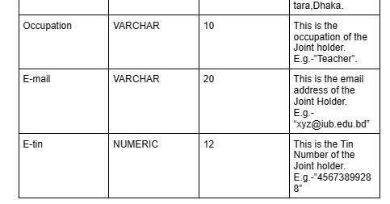
Data Dictionary(Continued)

Slide 16
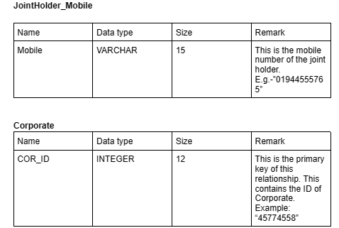
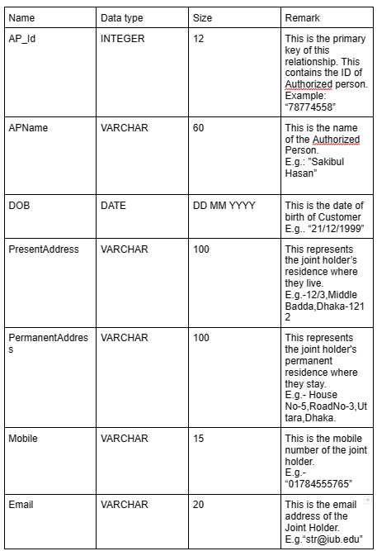
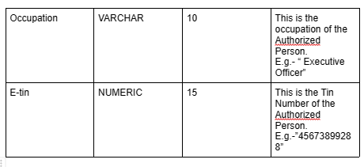
Data Dictionary(Continued)
AuthorizedPerson

Slide 17
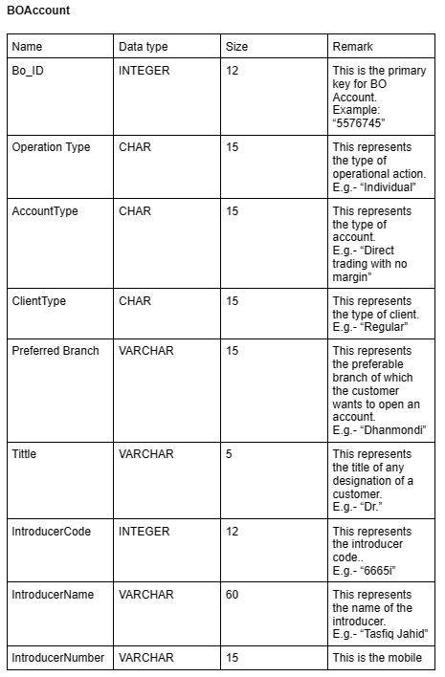
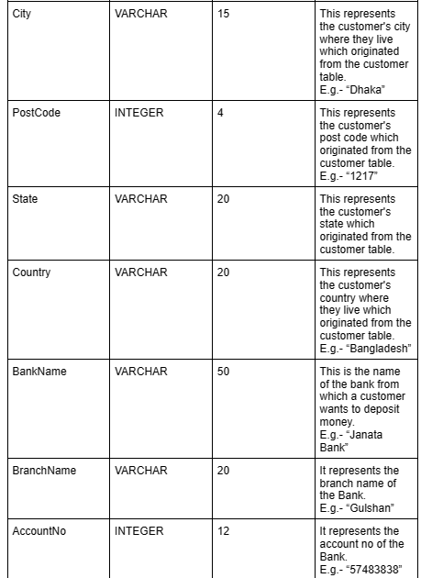
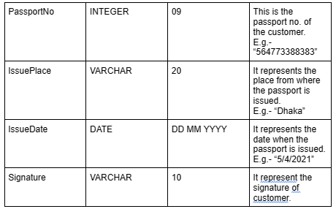
Data Dictionary(Continued)

Slide 18
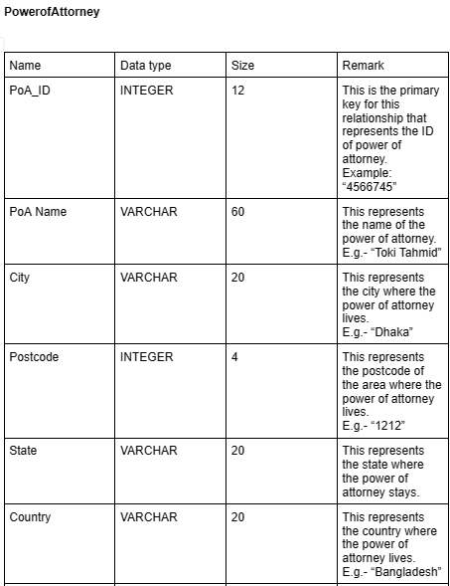
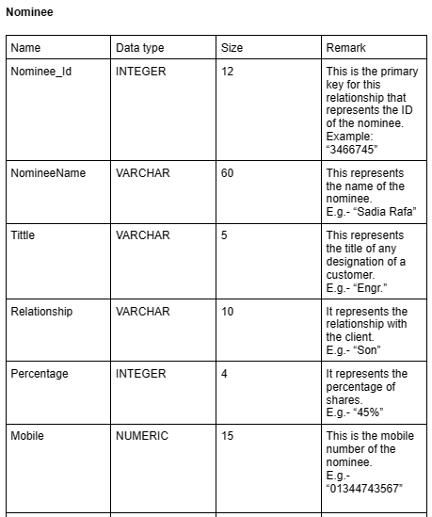
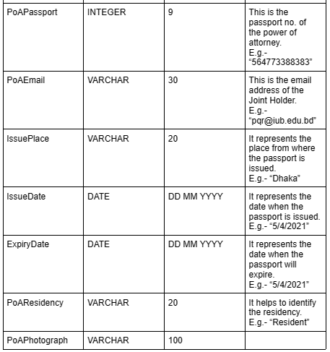
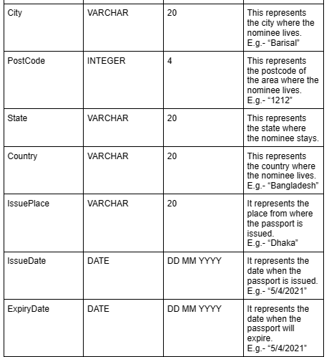
Data Dictionary(Continued)

Slide 19
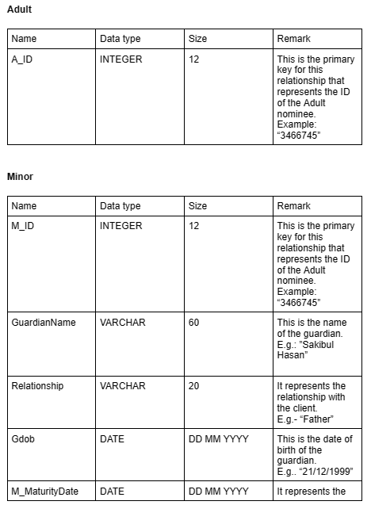
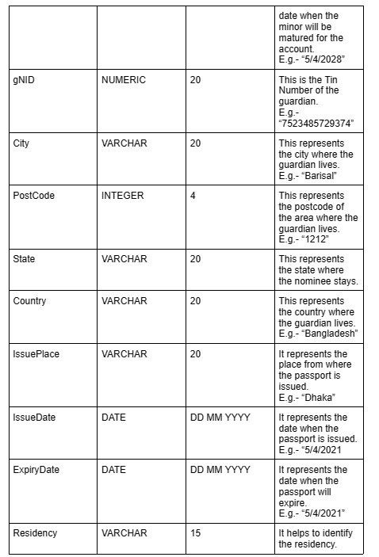
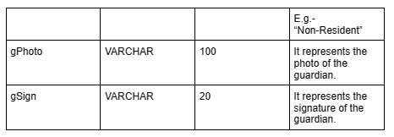
Data Dictionary(Continued)

Slide 20
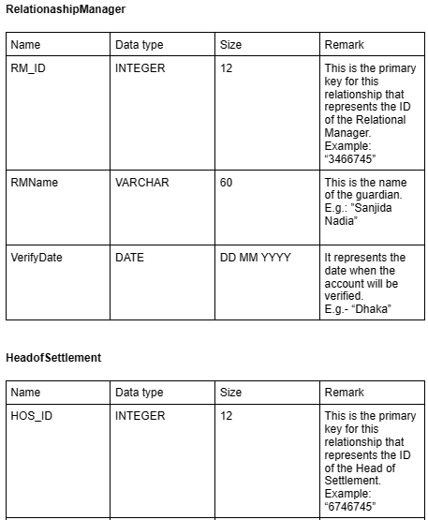
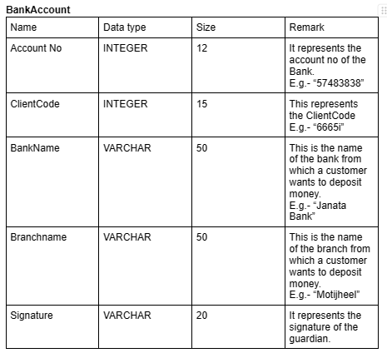
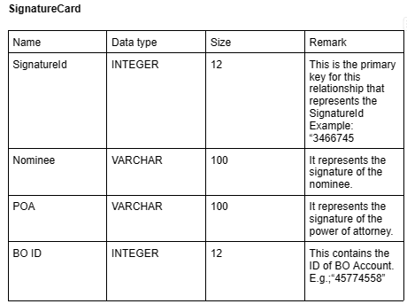
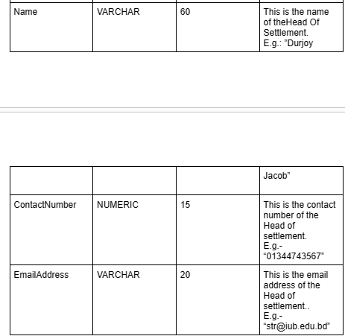
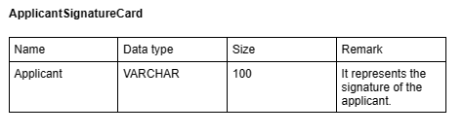
Data Dictionary(Continued)

Slide 21
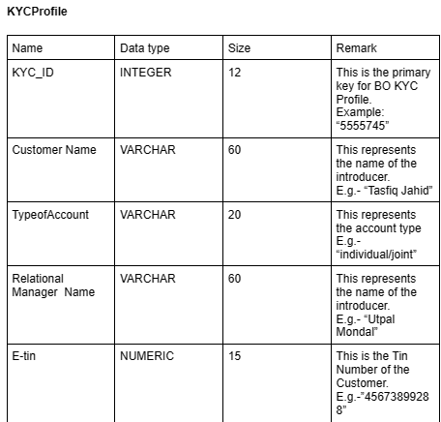
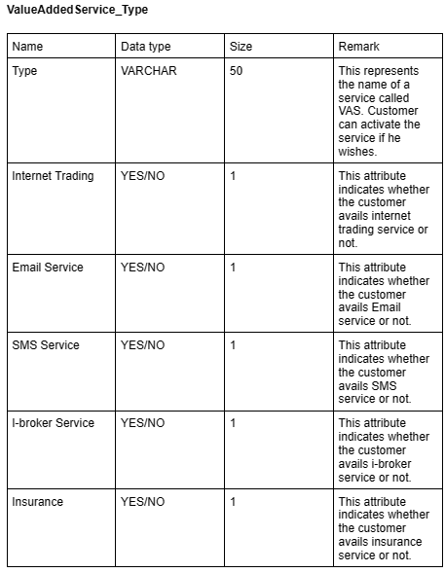
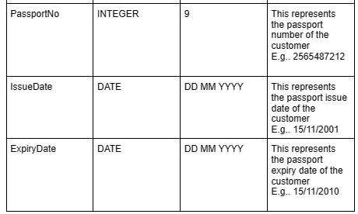
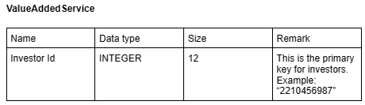
Data Dictionary(Continued)

Slide 22
Thank you

