Slide 1
WELCOME

Slide 2



OUR TEAM
Sk Samir Walid
20232073010
Abdur rahman
20232026010
Meherin afroz simi
20232104010
3rd Year, 1st Semester
Department of Computer Science and Engineering
North Western University
Khulna

Slide 3
Gym Management System
(Web Application)
Traditional gyms rely on manual systems → errors, inefficiencies, poor record-keeping
Growing need for digital management and personalized health tracking
Our solution: a web-based system automating registration, attendance, and health monitoring

Slide 4
OVERVIEW
Objective: Streamline gym operations and enhance member engagement
Type: Web Application
Users: Gym Members, Trainers, and Administrators
Key Benefits: Automation, Real-time Monitoring

Slide 5
App Interface

Slide 6
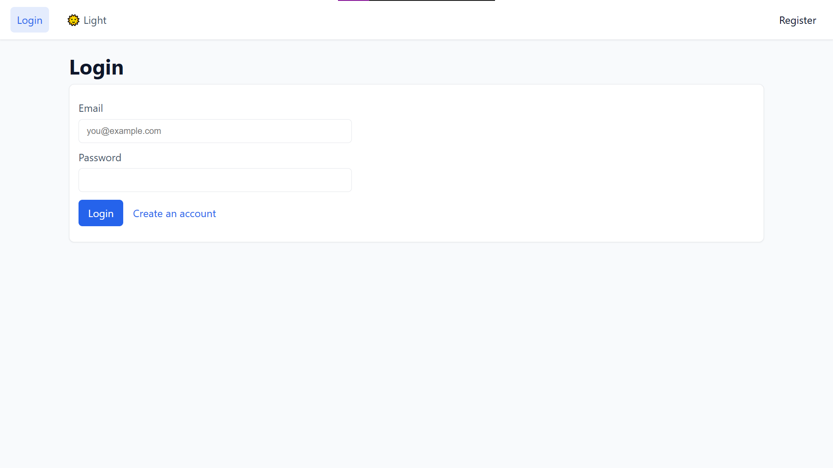
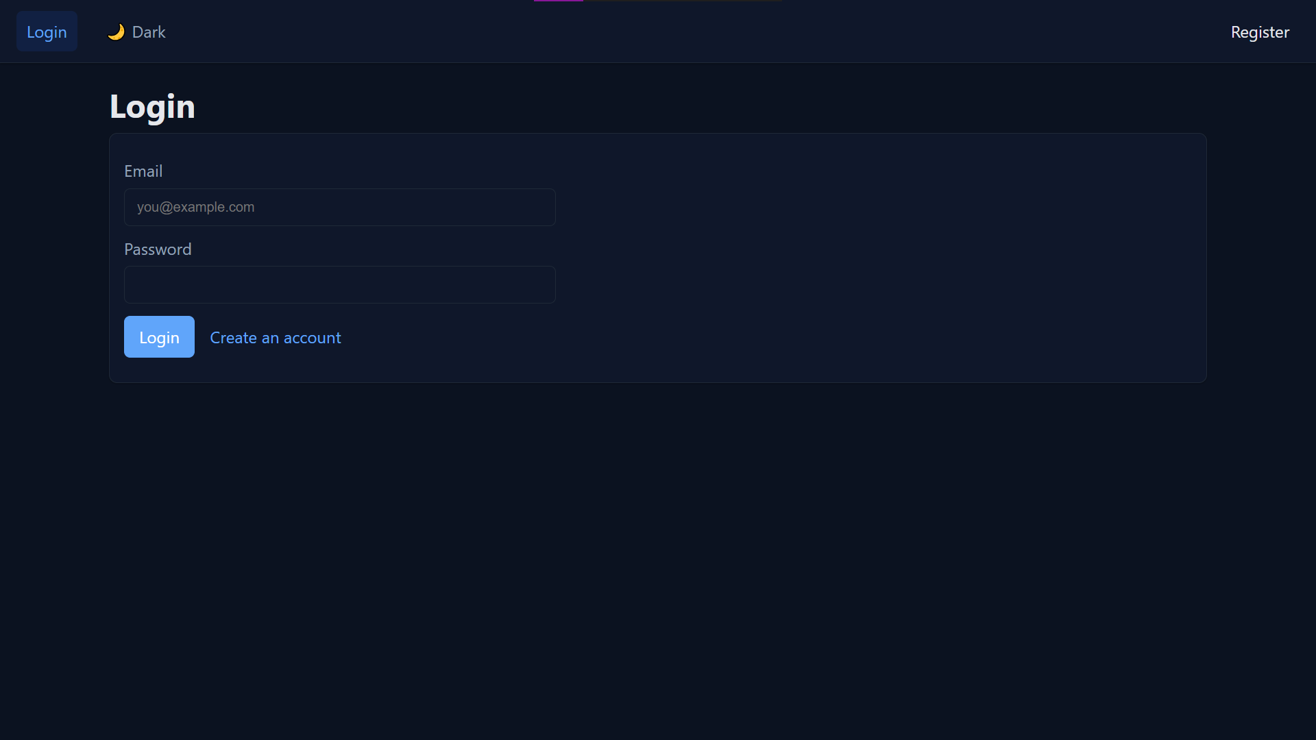
App Interface
Login

Slide 7
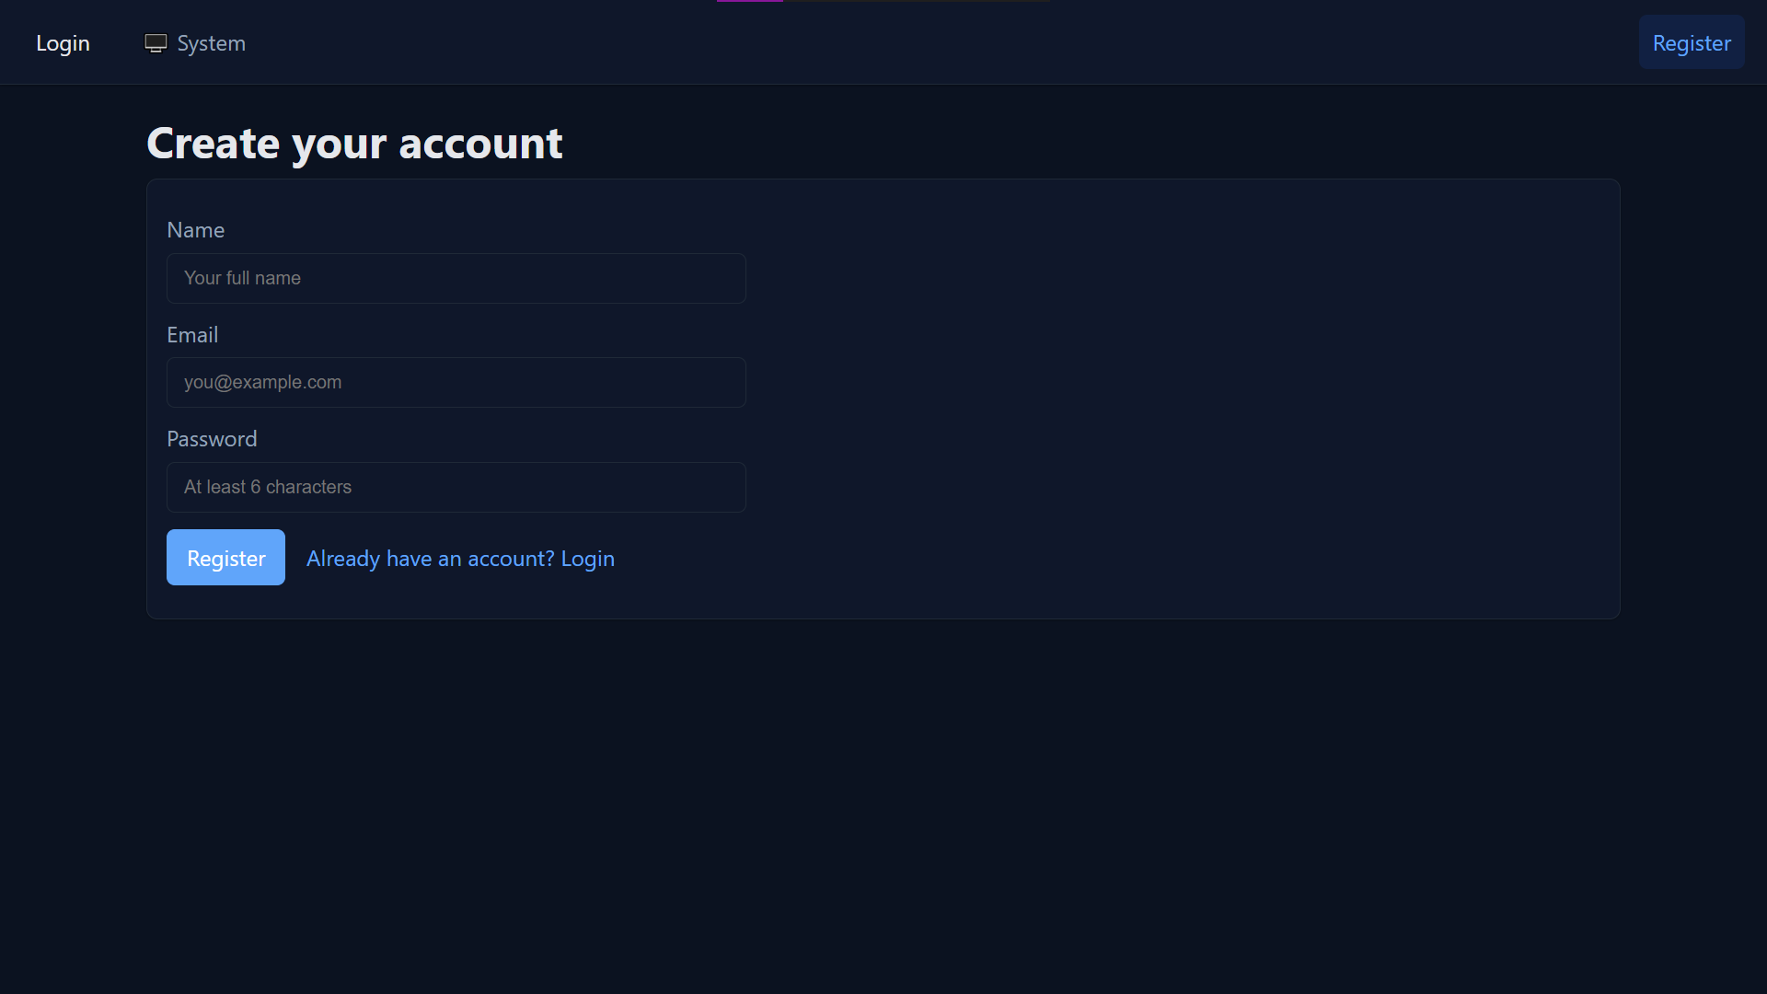
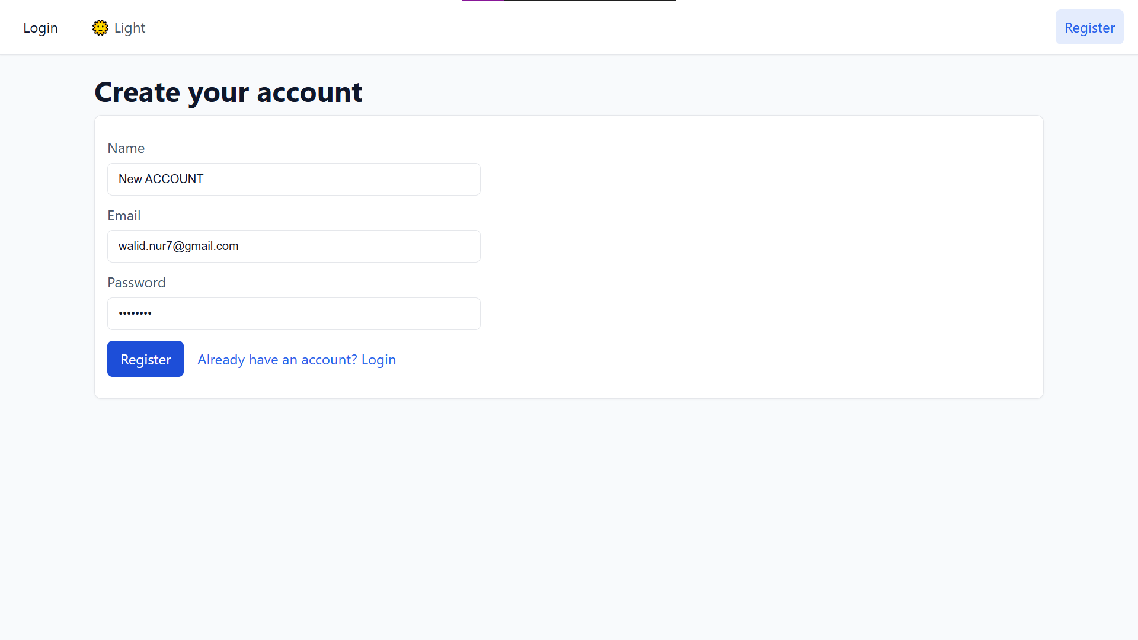
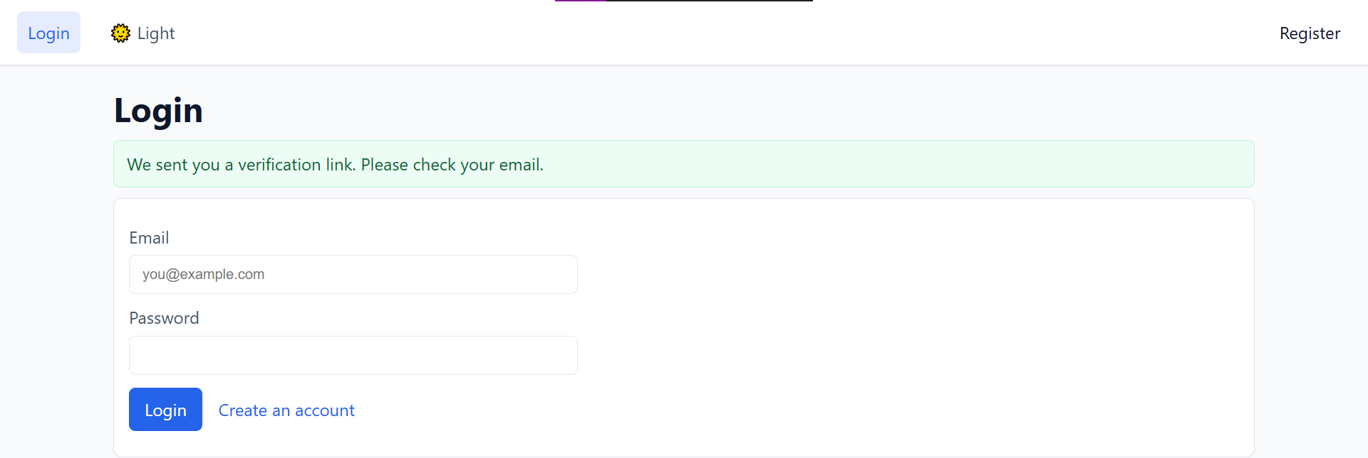
App Interface
Registration

Slide 8
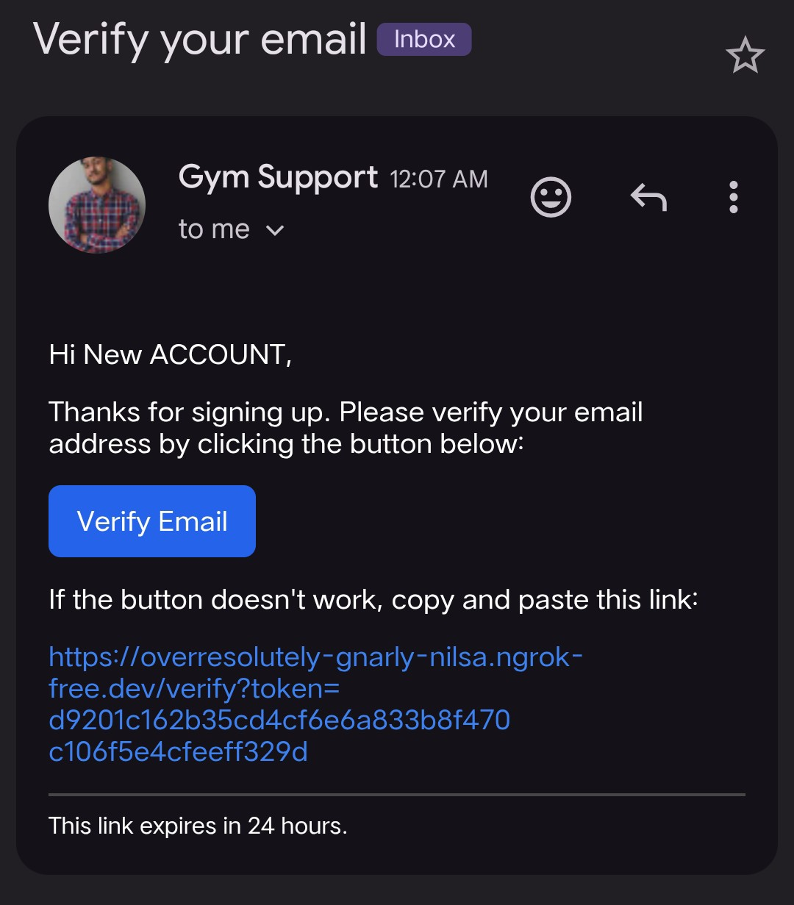
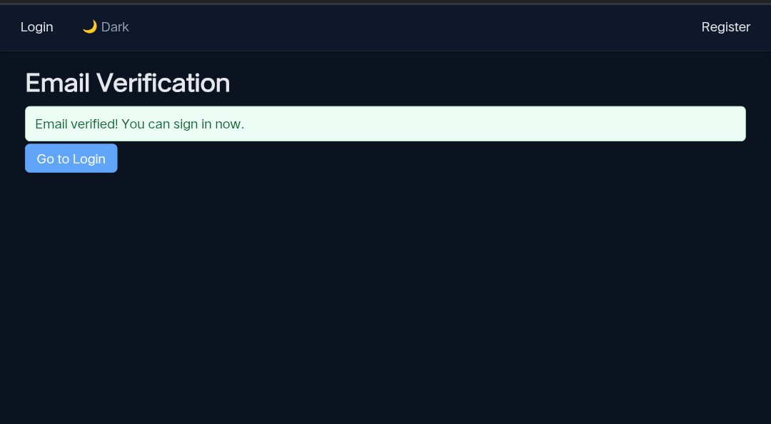
App Interface
Email Verification

Slide 9
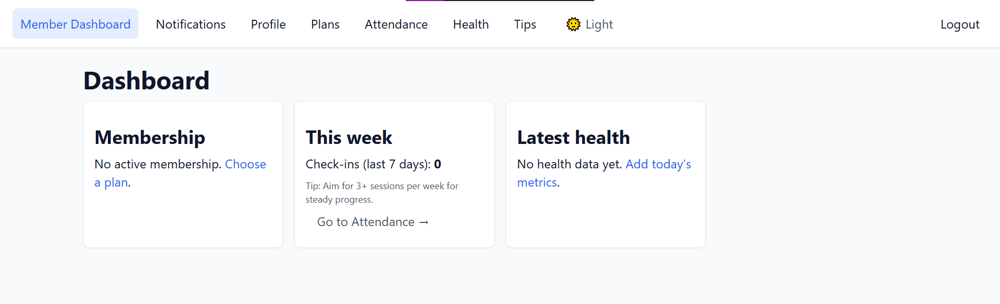
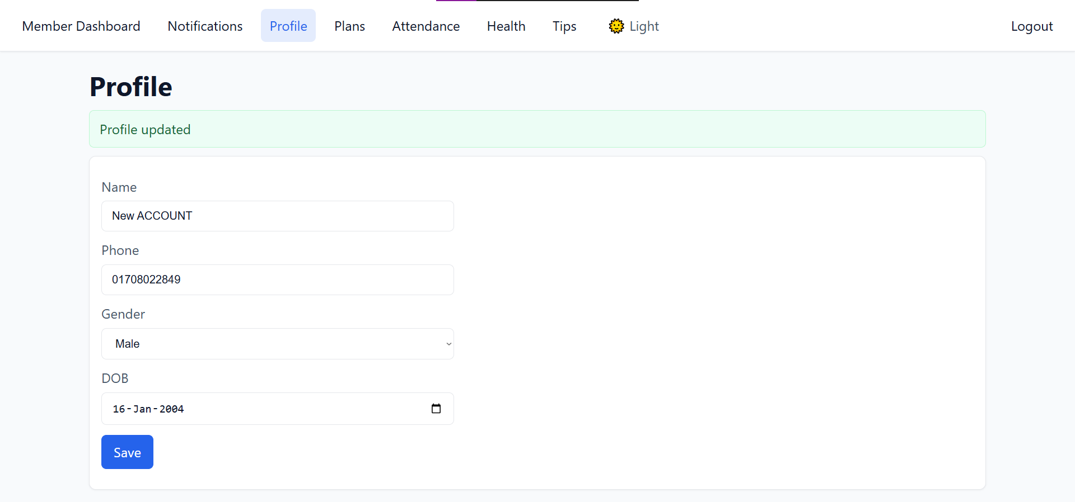
App Interface
User Dashboard

Slide 10
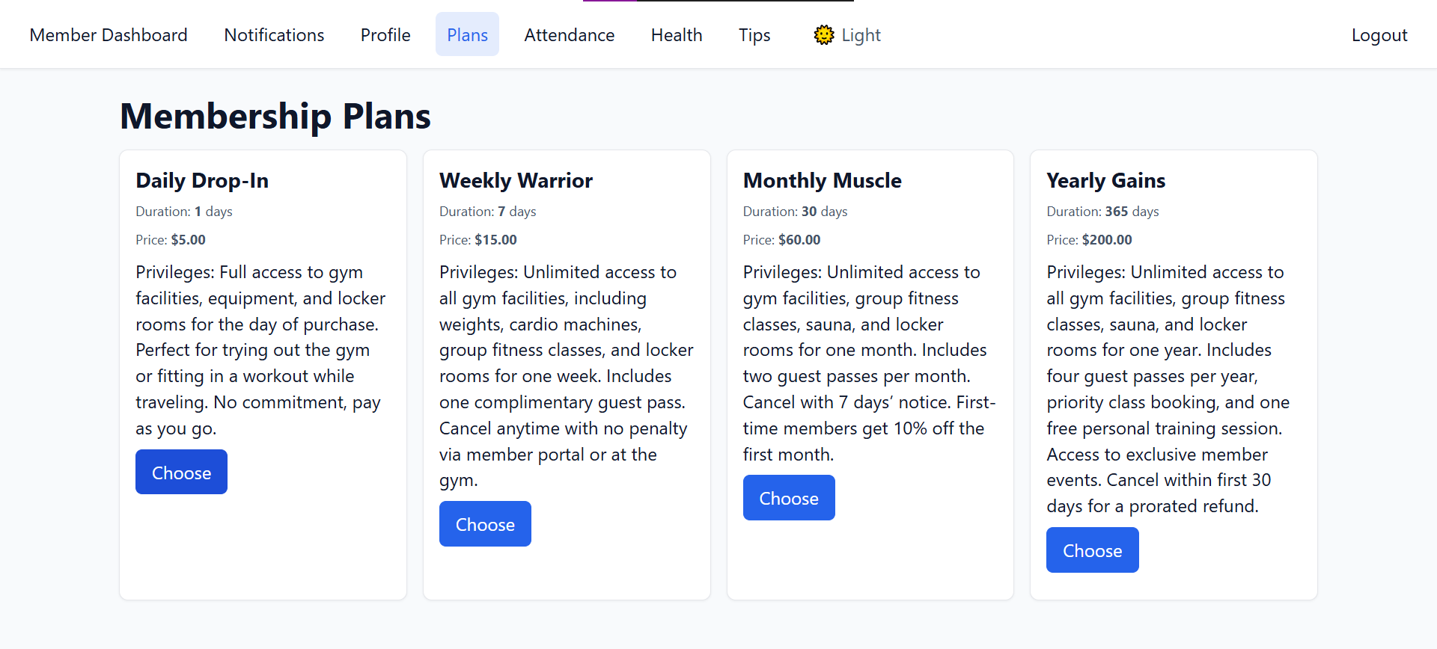
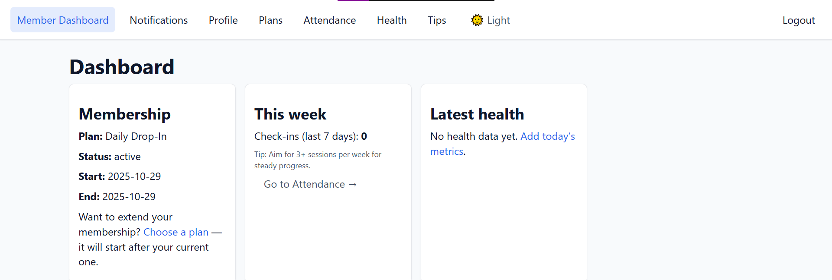
App Interface
User Dashboard

Slide 11
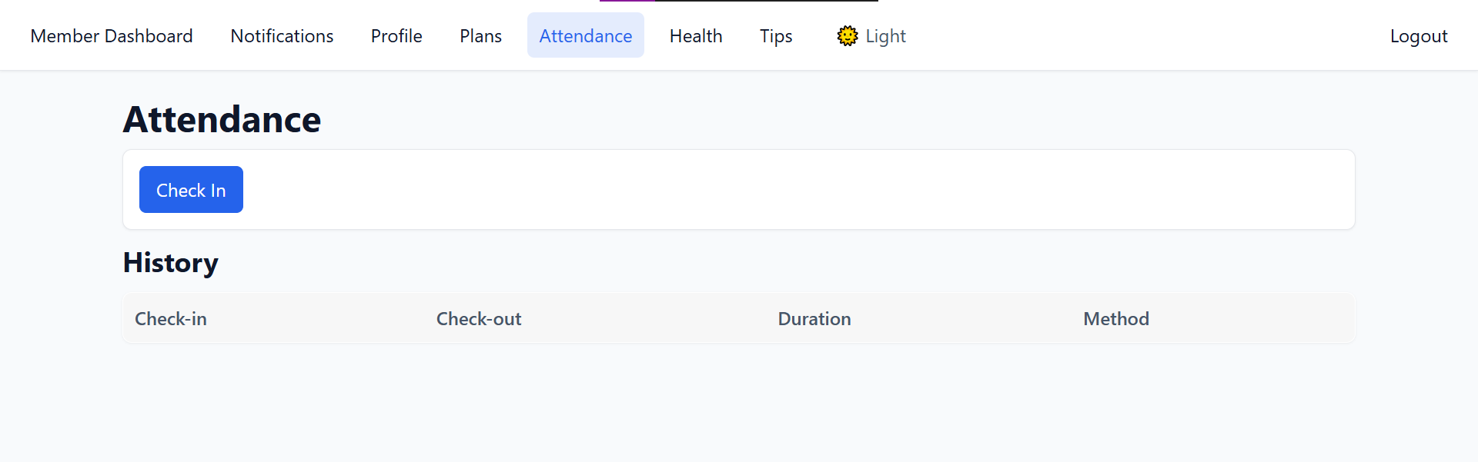
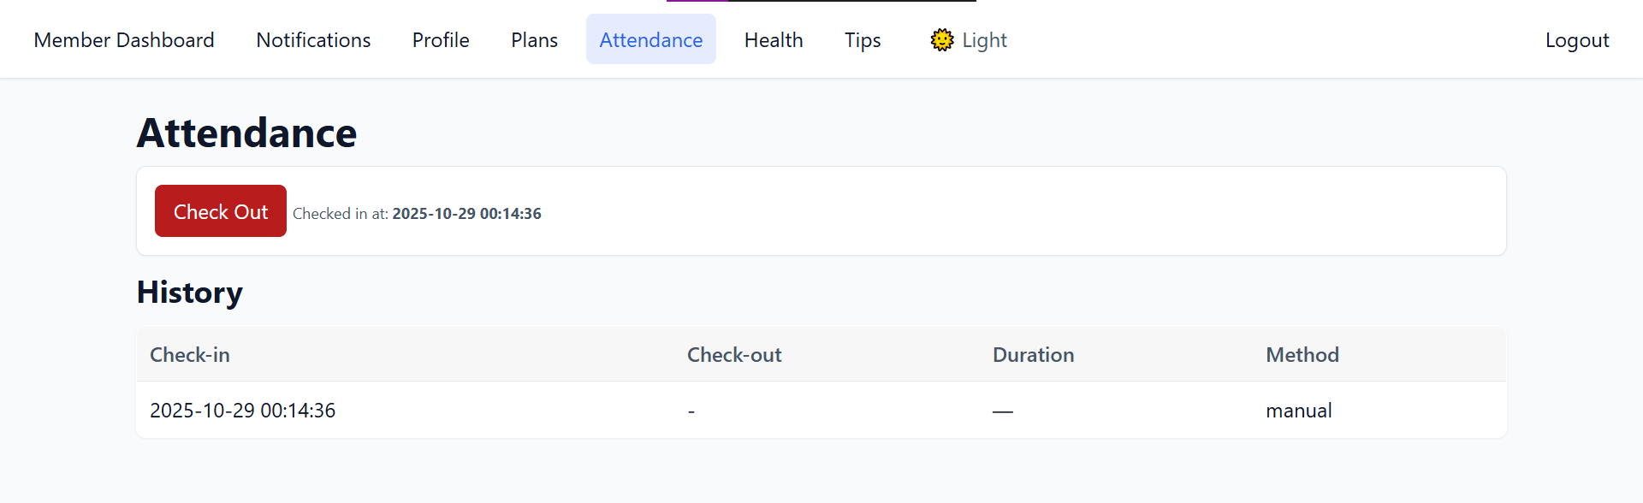
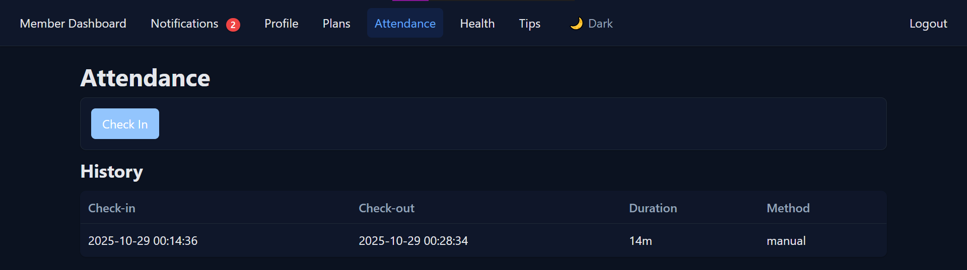
App Interface
User Dashboard

Slide 12
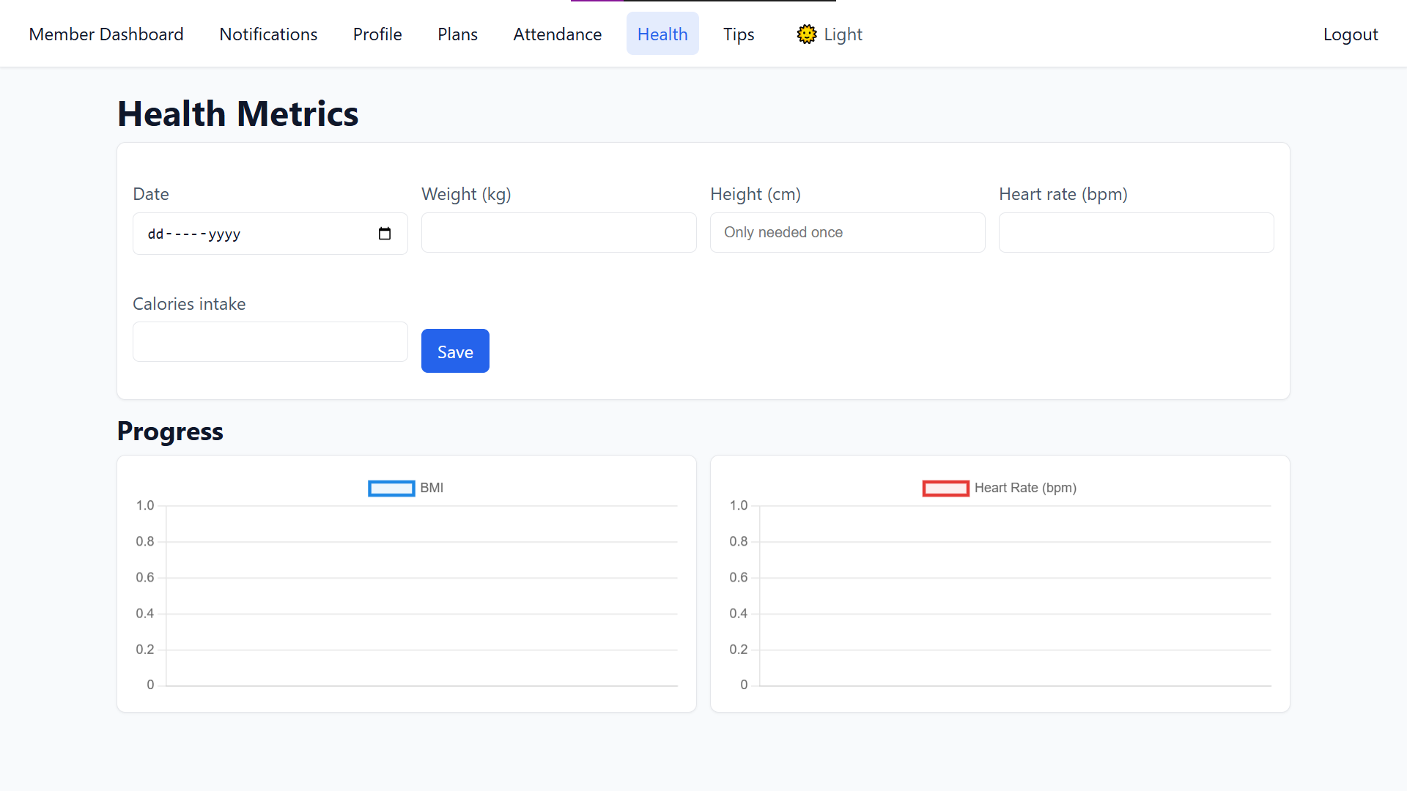
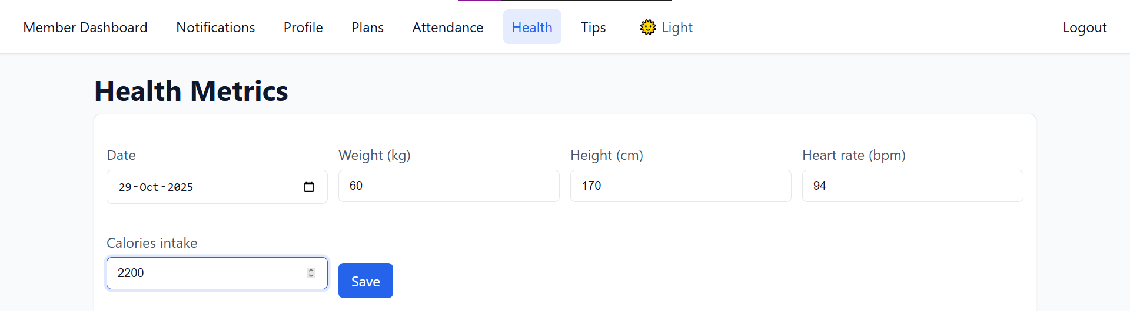
App Interface
User Dashboard

Slide 13
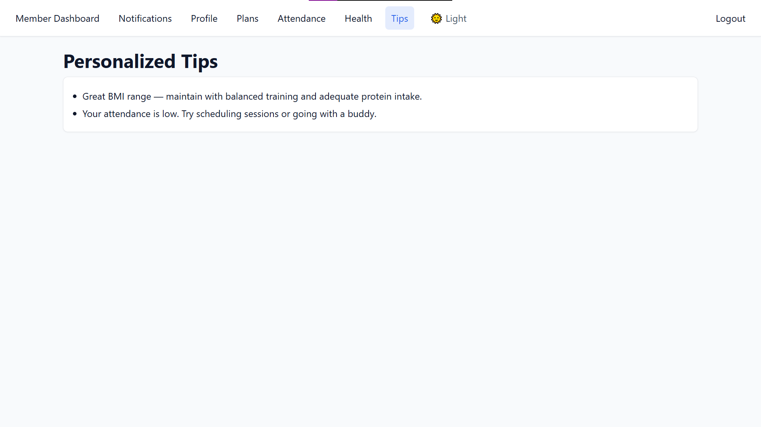
App Interface
User Dashboard

Slide 14
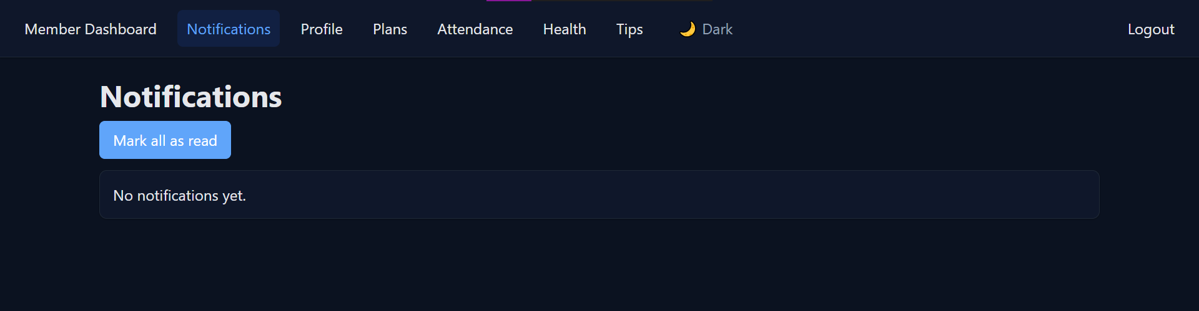
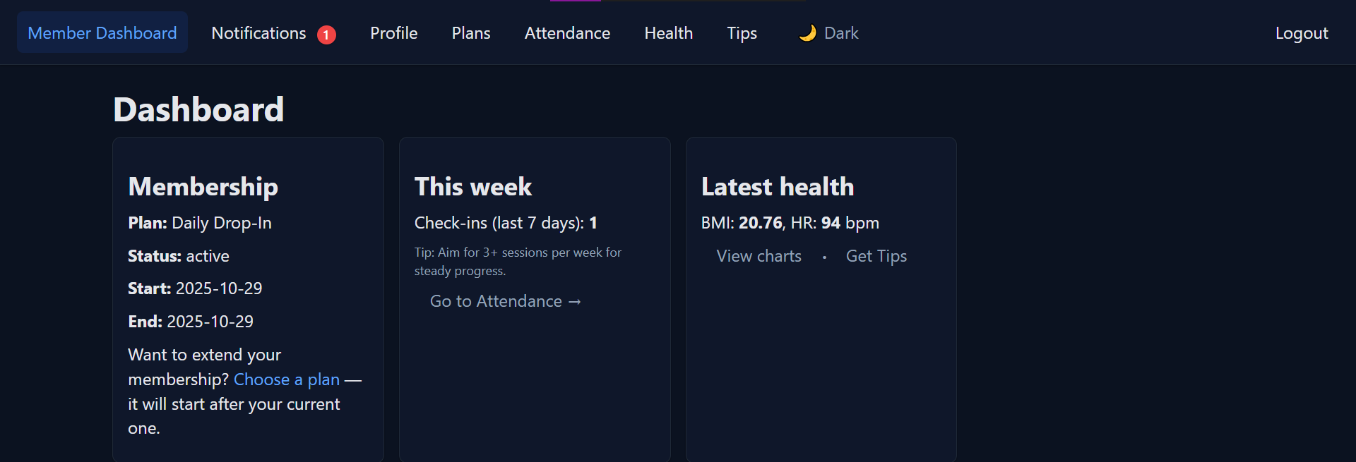
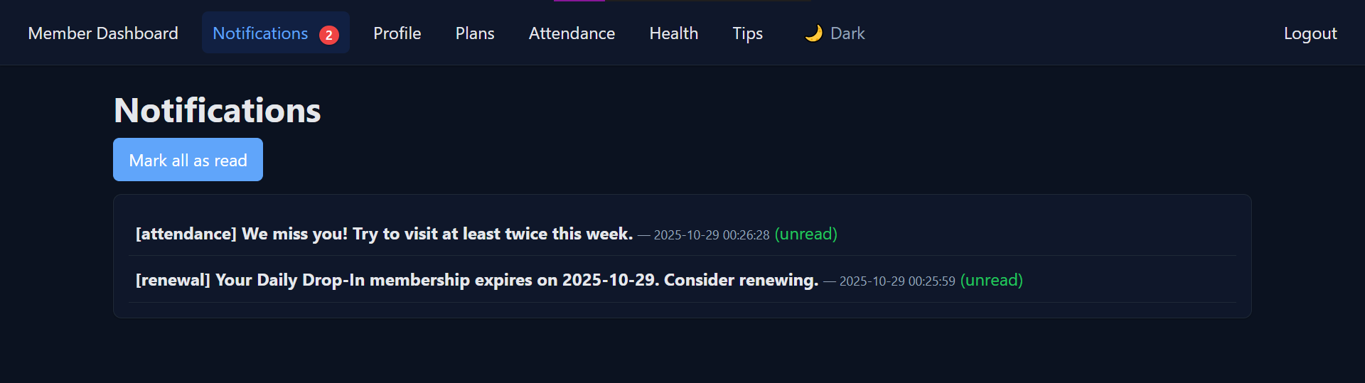
App Interface
User Dashboard

Slide 15
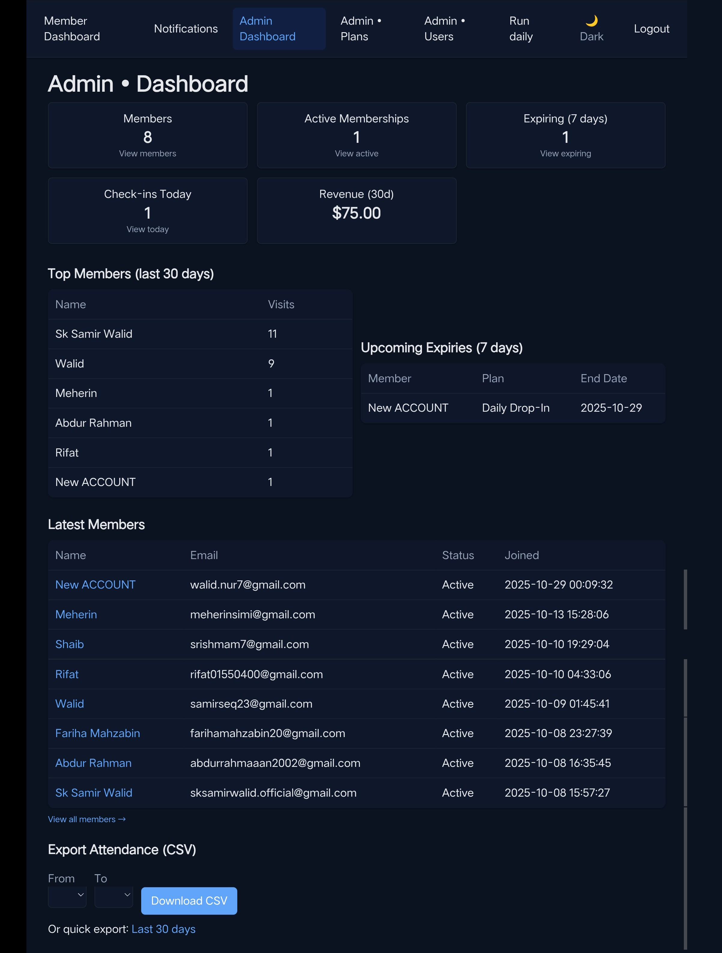
App Interface
Admin Dashboard

Slide 16
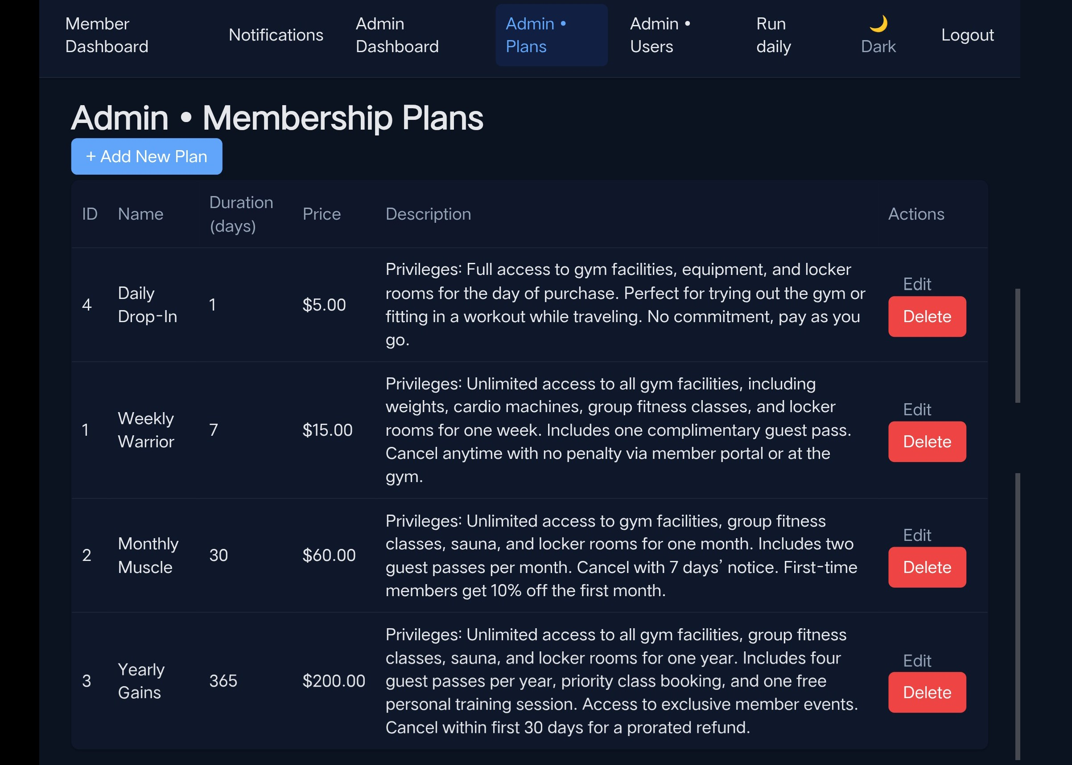
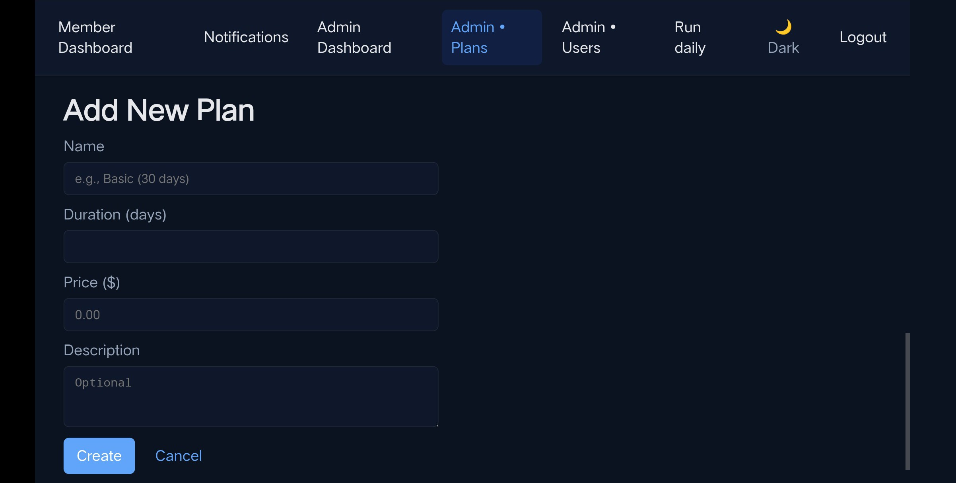
App Interface
Admin Dashboard

Slide 17
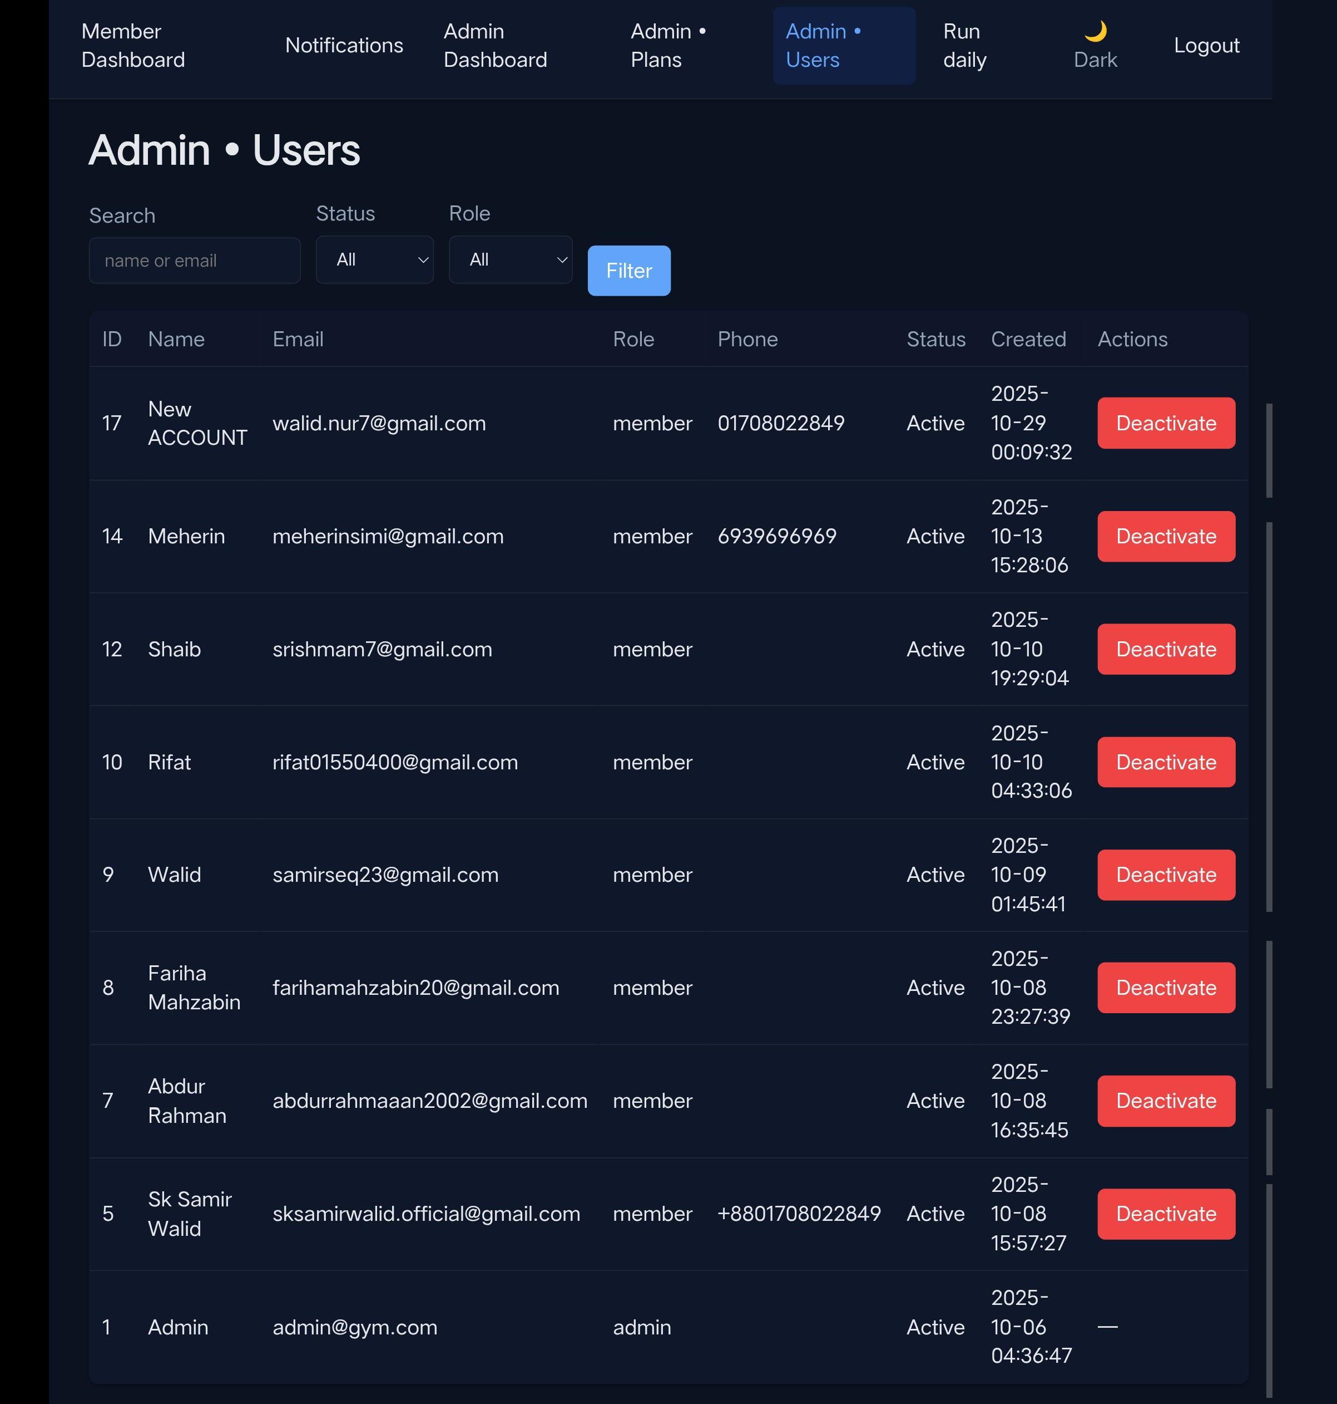
App Interface
Admin Dashboard

Slide 18
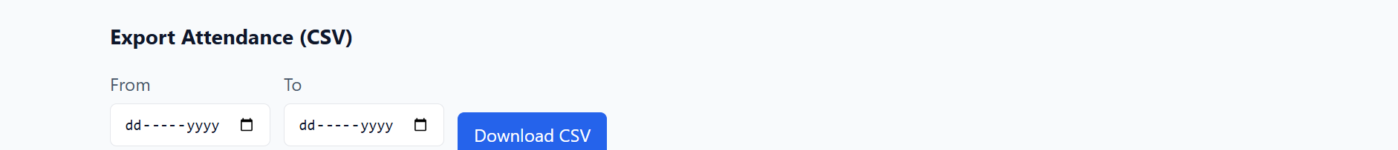
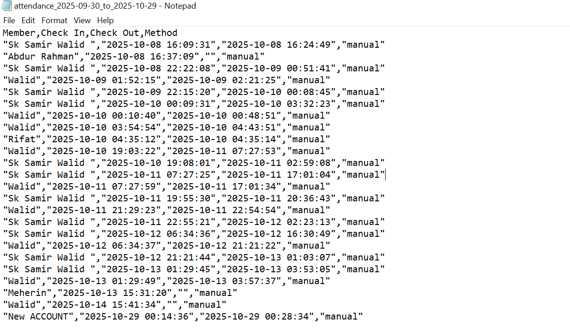
App Interface
Admin Dashboard

Slide 19
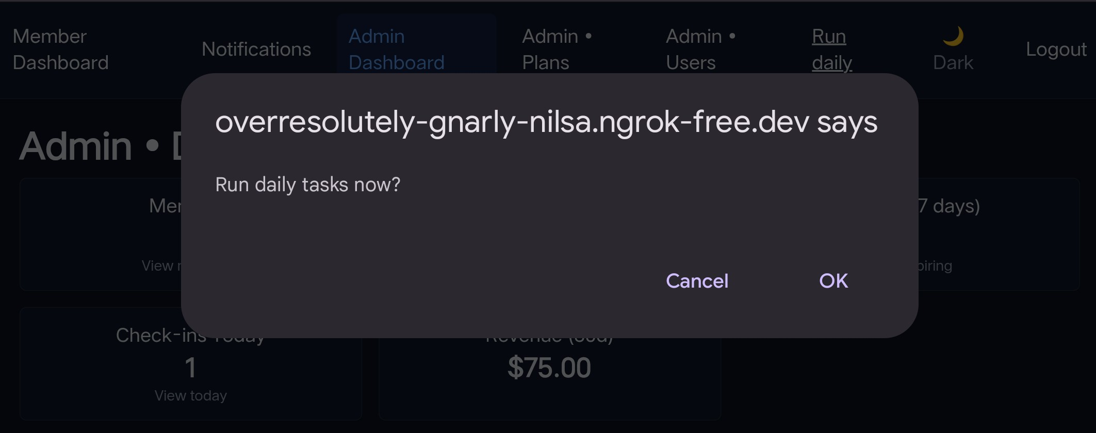
App Interface
Admin Dashboard

Slide 20
Conclusion
Gym Management System simplifies gym operations
Enhances health tracking and user engagement
Scalable platform with potential for future expansion

Slide 21
THANK YOU
We are now prepared to answer your questions.

