Slide 1
StockPilot
DEVOPS CAPSTONE
A small inventory app, delivered the way production software is: tested, scanned, containerised, deployed by GitOps and monitored.
abdur-code · github.com/abdur-code/final-devops-project
Notes:
Hi, this is my DevOps capstone, StockPilot. The app itself is deliberately small, an inventory tracker. The point of the project is everything around it: how a change gets tested, scanned, built, deployed and watched. I’ll go through the slides first, then do a live walkthrough.

Slide 2
What I built
StockPilot tracks products, stock levels and reorder points. It has a FastAPI backend, a PostgreSQL database managed with Alembic, and a small JavaScript frontend served by Nginx.
12
11
tests, 96% coverage
jobs in the CI/CD pipeline
The app is kept simple on purpose. The work is in the delivery platform: every change is tested, scanned, built into an image tagged with its commit, and deployed to Kubernetes by Argo CD.
64
14
AWS resources from Terraform
faults broken and fixed on purpose
Notes:
The application is an inventory tracker: you add products, adjust stock, and it flags what needs reordering. Backend is FastAPI with PostgreSQL and Alembic migrations; the frontend is plain JavaScript built with Vite and served by Nginx. I kept the app small so the effort went into the platform: twelve tests at 96% coverage, an eleven-job pipeline, sixty-four AWS resources from Terraform, and fourteen faults I broke and fixed on purpose.

Slide 3
Architecture overview
git push
GitHub Actions
GHCR
BUILD
images tagged with the commit SHA
PR or push to main on GitHub
tests, scans, image build, kind test
GitOps commit
Argo CD
Kubernetes
DEPLOY
CI writes the new tag into Git
pulls from Git, self-heals drift
kind locally, EKS on AWS
Prometheus · Grafana · Loki
WATCH
metrics scraped through a ServiceMonitor, a dashboard and alerts shipped with the Helm chart, logs collected by Alloy
Notes:
Here’s the whole flow. A push goes to GitHub, GitHub Actions runs the tests and every scanner, builds both images, tests them on a throwaway kind cluster and pushes them to GHCR with the commit SHA as the tag. Then the pipeline commits that tag into the GitOps folder. Argo CD, running inside the cluster, sees the commit and rolls it out. Nothing outside the cluster pushes to it. Prometheus, Grafana and Loki watch the result. The same Git repo drives my local kind cluster and EKS on AWS.

Slide 4
The stack
Layer | Tools
Application | FastAPI, SQLAlchemy, Alembic, PostgreSQL 17, Vite + Nginx
Tests and quality | pytest (12 tests, 96% coverage), ruff
Containers | Multi-stage Dockerfiles, non-root users, Docker Compose
CI/CD | GitHub Actions, GHCR, commit-SHA image tags
Security | Semgrep, Bandit, pip-audit, npm audit, Gitleaks, Trivy
Infrastructure | Terraform: VPC and EKS 1.34 on AWS (ap-south-1)
Kubernetes | Helm chart, Kustomize manifests, ingress-nginx, kind
GitOps | Argo CD, app-of-apps, automated sync with self-heal
Observability | Prometheus, Grafana, Loki, Grafana Alloy
Notes:
This is the full stack, layer by layer. Everything is open source except the AWS services, and every tool version is pinned, including the third-party GitHub Actions, which are pinned to a commit SHA rather than a tag.

Slide 5
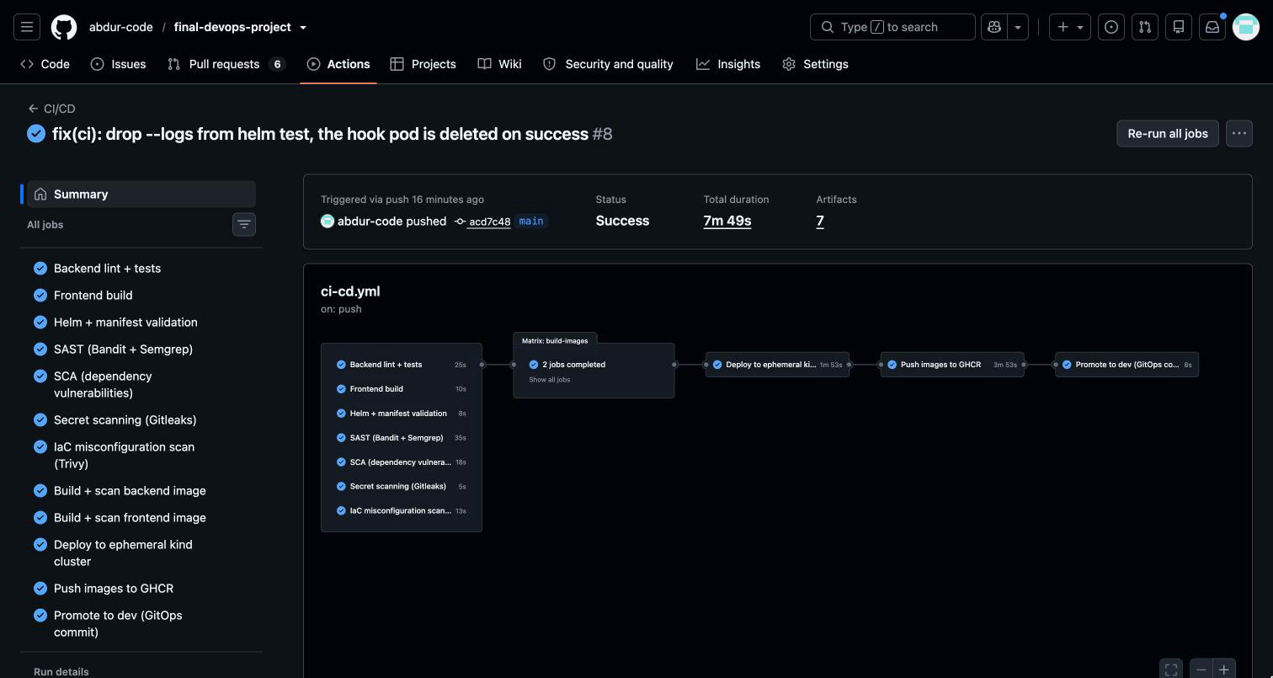
CI/CD: one pipeline, five stages
01
Seven checks in parallel: tests, frontend build, Helm and manifest validation, SAST, SCA, secret scan, IaC scan
02
Build both images and scan them with Trivy, plus an SBOM
03
Deploy to a throwaway kind cluster with the Helm chart, then run helm test
04
Push to GHCR (main only), tagged with the commit SHA
05
Commit the new tag to the GitOps folder for Argo CD
Notes:
The pipeline runs on every pull request and every push to main. Stage one is seven checks running in parallel. The image build waits for all of them through needs, so if any check fails nothing gets built. Stage two builds both images and scans them with Trivy. Stage three installs the Helm chart on a throwaway kind cluster inside the runner and runs helm test. Only on main do the last two stages run: push the images to GHCR tagged with the commit SHA, and commit that tag into the GitOps folder.

Slide 6
Security gates that stop the build
SAST
SCA
Secrets
IaC
Images
Semgrep and Bandit
pip-audit and npm audit
Gitleaks on the full history
Trivy config scan
Trivy, fails on fixable HIGH or CRITICAL
The first Trivy run was clean
The gate works when it should
0 fixable HIGH or CRITICAL CVEs in the backend image (Debian 13.7, 87 OS packages plus the Python dependencies) and the frontend image (Alpine 3.24.2, 70 OS packages).
PR #7 added requests 2.31.0. pip-audit found 6 known vulnerabilities, the SCA job failed after 17 seconds, and no image was built.
Notes:
Five kinds of scanning, and every one of them blocks the build. The image scan fails on any HIGH or CRITICAL vulnerability that has a fix available. My first scan was clean on both images, so there was no CVE to fix, but I tested the gate on purpose: PR 7 added an old version of requests, pip-audit found six known vulnerabilities, and the pipeline stopped before building anything.

Slide 7
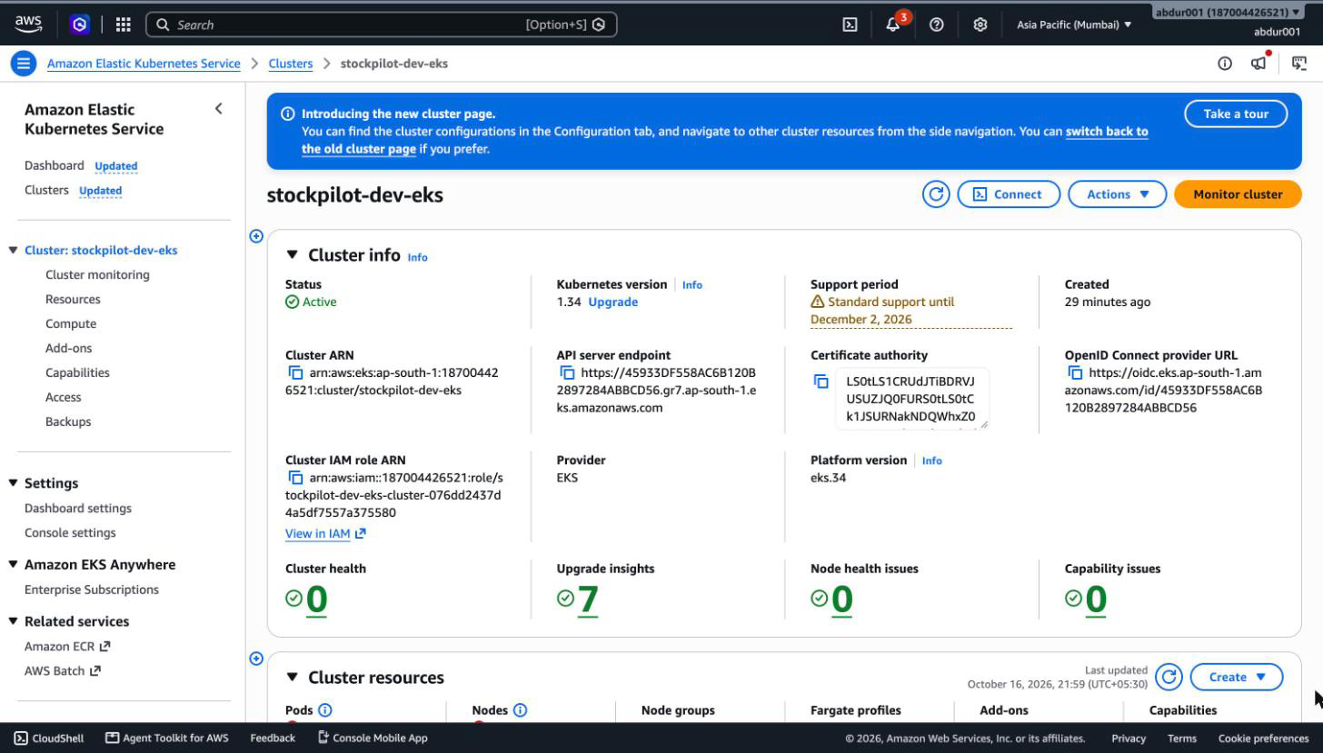
Terraform: VPC and EKS on AWS
VPC across 2 AZs in ap-south-1: 2 public and 2 private subnets, 1 NAT gateway
EKS 1.34 with a managed node group: 2 × m7i-flex.large, scaling to 4
Add-ons: VPC CNI with NetworkPolicy, CoreDNS, kube-proxy, Pod Identity, EBS CSI
GitHub OIDC role instead of stored AWS keys
plan: 64 to add
destroy: 64 destroyed
Notes:
All the AWS infrastructure is Terraform, using the community VPC and EKS modules. A VPC across two availability zones, nodes in the private subnets, one NAT gateway to keep the cost down. EKS 1.34 with a managed node group. My account is on the AWS Free plan, which doesn’t allow t3.medium, so the nodes are m7i-flex.large. The plan creates sixty-four resources. Before destroying, I delete the load balancer and EBS volumes that Kubernetes created, because Terraform doesn’t know about them. Then destroy removes all sixty-four.

Slide 8
Kubernetes, packaged as one Helm chart
Deployments
Services
Ingress
backend and frontend, 2 replicas each, rolling updates with no downtime
ClusterIP for the backend, frontend and PostgreSQL
/ goes to the frontend, /api to the backend
StatefulSet + PVC
ConfigMap + Secret
HPA
PostgreSQL on a persistent volume (gp3 on EKS)
settings in Git, the DB password generated in the cluster
scales the backend from 2 to 4 pods on CPU
Probes
NetworkPolicy
helm test
startup, liveness on /health, readiness on /ready
only backend pods can reach PostgreSQL
checks the release after every install, in CI and on the cluster
Notes:
Everything the app needs in Kubernetes is in one Helm chart, with a values file per environment. Two replicas of the backend and the frontend, ClusterIP services, an Ingress that splits slash and slash-api, PostgreSQL as a StatefulSet with a persistent volume, a ConfigMap and a Secret, an autoscaler, three kinds of probes and a NetworkPolicy so only the backend can talk to the database. Under load the HPA scaled the backend from two pods to four and back down again.

Slide 9
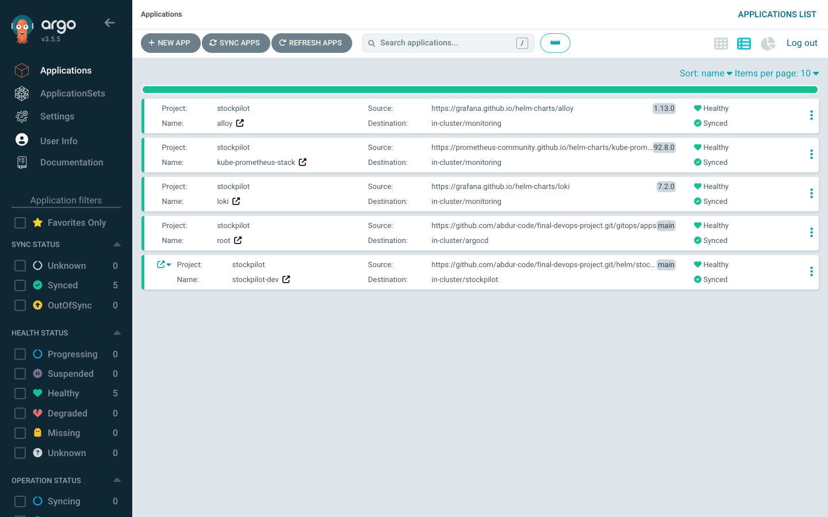
GitOps with Argo CD
App of apps: one root application installs the monitoring stack, Loki, Alloy and StockPilot itself
CI never touches the cluster. It commits the new image tag, and Argo CD pulls the change
Self-heal: a manual kubectl change is reverted to what Git says
Rollback is git revert. A bad tag merged in scenario 14 was back to Healthy within seconds of the revert
Notes:
Deployment is pull-based. The pipeline never gets credentials for the cluster; it only commits the new image tag to Git. Argo CD runs inside the cluster, watches the repo and syncs. It’s an app-of-apps setup: one root app creates the four others. Because self-heal is on, any manual change gets reverted, so the way to roll back is a git revert. I tested that in scenario fourteen: a bad tag got merged, the app went Degraded, and the revert brought it back within seconds.

Slide 10
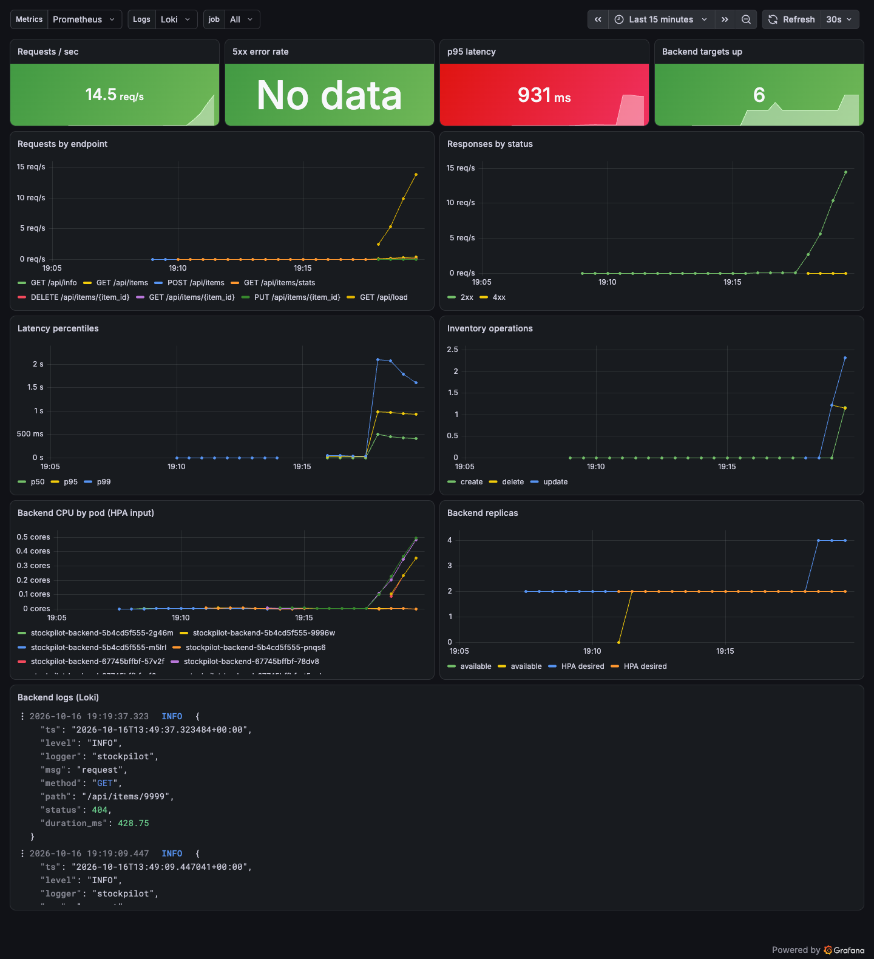
Observability
/metrics on the backend: request rate, latency, errors and an inventory counter
Prometheus finds it through a ServiceMonitor
Grafana dashboard and 5 alert rules ship with the Helm chart
Loki and Alloy collect the JSON logs from every pod
Notes:
The backend exposes Prometheus metrics: request rate, latency histograms, error counts and one business metric for inventory operations. Prometheus discovers it through a ServiceMonitor. The Grafana dashboard and the alert rules are part of the Helm chart, so every environment gets them automatically. Logs are JSON, collected by Alloy and stored in Loki, so I can search them from Grafana. This screenshot was taken during a load test.

Slide 11
Breaking it on purpose: 14 faults
Each one: identify, investigate, root cause, fix, verify. Real output for all 14 is in docs/TROUBLESHOOTING-LOG.md.
Fault | What I saw | What fixed it
03 Wrong Secret key | Postgres in CreateContainerConfigError | Fix the template, then delete the stuck pod
02 ConfigMap typo | Nothing, until the pods restarted | Fix the ConfigMap, then rollout restart
06 Memory limit 24Mi | OOMKilled, exit code 137, in seconds | Back to 256Mi (healthy pods use 64 to 72Mi)
10 NetworkPolicy | Running pods fine, new pods time out | Allow app: backend again
13 Leaked token | Caught by Gitleaks and by ruff S105 | Amend the commit, read the token from env
14 Bad GitOps tag | Progressing for 10 minutes, then Degraded | git revert, Healthy again in seconds
Notes:
I broke the project fourteen times on purpose: ten Kubernetes faults on my kind cluster and four that go through GitHub and Argo CD. A few surprised me. With the wrong Secret key, fixing the manifest wasn’t enough, because a StatefulSet won’t replace a pod that never became Ready, so I had to delete it. The NetworkPolicy fault was hidden at first because existing database connections kept working. And the leaked token was caught twice, by Gitleaks and by ruff. Every one is written up with the real command output.

Slide 12
What I learned
A check only protects anything if the build depends on it.
“Synced” doesn’t mean “working”: watch health, not just sync.
Terraform doesn’t know what Kubernetes creates in AWS, so clean that up before you destroy.
Notes:
Three things I’ll take away. First, a scanner that only reports gets ignored; it has to block the build. Second, Argo CD said Synced the whole time the bad tag was deployed, and it only showed Degraded ten minutes later, so health matters more than sync. Third, the load balancer and the EBS volumes were created by Kubernetes, not Terraform, so I had to delete them before terraform destroy could finish cleanly. The full list is in the README.

Slide 13
Live walkthrough
01
Codebase: folder structure and key files
05
Kubernetes: pods, services and ingress
02
CI/CD: push a change, watch the pipeline
06
Prometheus: the app’s target UP
03
Terraform: plan output, VPC and EKS in the AWS console
07
Grafana: live dashboard with app metrics
04
Argo CD: the new commit synced, GitOps flow
Notes:
That’s the overview. Now I’ll switch to the live walkthrough in this order: the codebase, then I’ll push a small change and follow it through the pipeline, then Terraform and the AWS console, Argo CD picking up the new commit, the pods, services and ingress in Kubernetes, and finally Prometheus and Grafana.

