Slide 1

Comparative Evaluation of Constrained and Unconstrained Deep Reinforcement Learning for Safe Robotic Grasping on a UR5e Manipulator in Simulation
Presented by,
MD ABDUR RABBI
Roll: 2031023
Supervised by,
Priyo Nath Roy
Assistant Professor
Dept. of Mechatronics Engineering
Khulna University of Engineering & Technology, Khulna
08 August, 2026

Slide 2
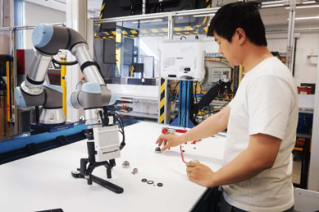
Introduction:
UR5: A collaborative arm that shares space with people
6-DOF, 5 kg payload, 850 mm reach
Max joint velocity 180 deg/s (𝜋 rad/s)
with ±360° working limit
Works next to people, not behind a fence
We use Reinforcement Learning (RL) to train robots
Fig 1: A human operator working side by side with a UR5 manipulator
2

Slide 3
Background:
Reward shapes Policy but Constrains add safety with consistency
A learned policy can't be inspected like a hand-coded controller — its behaviour is only known statistically.
Safety on this class of arm is already an active industrial requirement, not a hypothetical
Validated only by trial and error, after the fact
This thesis tests the alternative: pull safety out of the reward
Let’s not just train a polity based on reward and penalty - start adding constraints
3

Slide 4
Literature Review:
Positioning Against the Closest Work
Property | Khan et al. [8] | Shen et al. [9] | This thesis
Manipulator | Franka Panda | 4-DOF planar | UR5e
Safety expressed as | Constraint | Reward term | Constraint
Safety quantity | Collision cost | Manipulability | Manipulability + joint limit + collision
Algorithm | PPO-Lagrangian | SAC (unconstrained) | PPO-Lagrangian
Control arm | ✗ | ✗ | ✓
Seed dispersion reported | ✗ | ✓ (5 seeds) | ✓ (5 seeds)
Cost Limit (d) | ✗ (d=25 only) | n/a | ✓ (d=25 and d=15)
4

Slide 5
Research Gap:
Three gaps in the closest published work and the design response
Gap | What the literature does | This thesis's response
No control arm | Trains cPPO vs. PPO, reports the raw difference | measures the implementation term directly
No dispersion | Mostly use only 1 seed | 5 seeds for training, 3 for evaluation
One budget only | Fixes cost limit (d) = 25 only | Used cost limit d = 25 & 15 effect read against how hard the constraint
3 concrete gaps in the literature and our response to each: no control arm -- we add one; no dispersion -- we report five-seed spreads; one budget -- we test two.
5

Slide 6
Objectives:
The main objectives of this thesis are to,
Implement both the constrained and unconstrained agents
Isolate the constraint as a cost critic with lambda as a Lagrangian multiplier
Use different seeds both for training and evaluation both
6

Slide 7
Methodology:
Environment Setup
Safety Cost
Algorithm Arms
Evaluation
7

Slide 8
Methodology:
Environment Setup
Safety Cost
Algorithm Arms
Evaluation
NVIDIA IsaacSim 5.0.0
IsaacLab 2.3.1
rsl_rl framework
weld environment
4096 parallel robots for training
1500 iterations
UR5e + Robotiq 2F-85 gripper
8

Slide 9
Methodology:
Environment Setup
Safety Cost
Algorithm Arms
Evaluation
256 parallel robots
1000 episodes per arm,
total 45,000 episodes
3 different seeds
Collision keep-out -- 5 cm above table
Joint-limit margin -- 0.175 rad (10°)
Singularity floor w = √det(JJᵀ) -- w < 0.06
9

Slide 10
Methodology:
Environment Setup
Safety Cost
Algorithm Arms
Evaluation
Manipulability floor
w = √det(JJᵀ) below 0.06
Aggregate cost
c = sum of the three
one λ governs all
Episodic cost
undiscounted sum
over 250 steps
Budget
d = 25
or d = 15
Joint-limit margin
clearance under 0.175 rad
Collision keep-out
link below 0.05 m
10

Slide 11
Methodology:
Environment Setup
Safety Cost
Algorithm Arms
Evaluation
Proximal Policy Optimization (PPO)
PPO (baseline)
Constraint Proximal Policy Optimization (cPPO)
Budget Limit d = 25 & 15
11

Slide 12
Methodology:
The 3 arms, and what each one isolates
activate the budget
tighten the budget
PPO (baseline)
cost critic present
λ ceiling = 0
the unconstrained reference
cPPO
cost critic free
budget d = 25
constraint active
cPPO tightened
cost critic free
budget d = 15
binds on every seed
isolates the constraint effect — the claim of this thesis
isolates budget sensitivity — does it scale?
5 seeds per arm (1, 3, 4, 52, 54) → 15 trained policies.
Every quantity is reported with its spread across seeds.
12

Slide 13
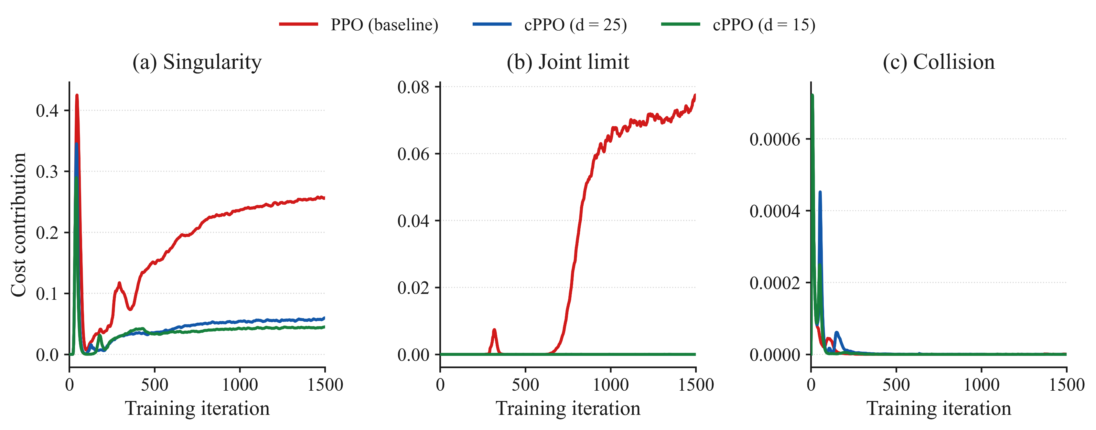
RESULT:
Mean Reward:
Lifting-object reward:
PPO(baseline) :
cPPO(d=25) :
cPPO(d=15) :
133.06
132.18
134.09
9.467
9.437
9.441
13

Slide 14
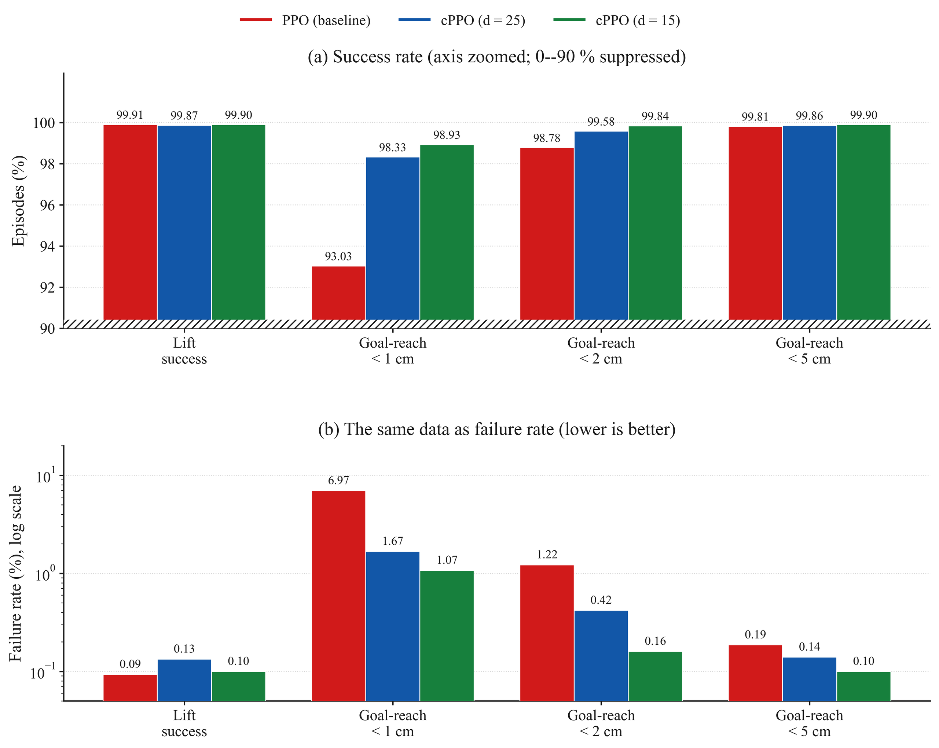
RESULT:
The constraint costs nothing measurable
Constraining the policy did not cost task performance at either budget.
*Tail mean(last 10% of the training data)
14

Slide 15
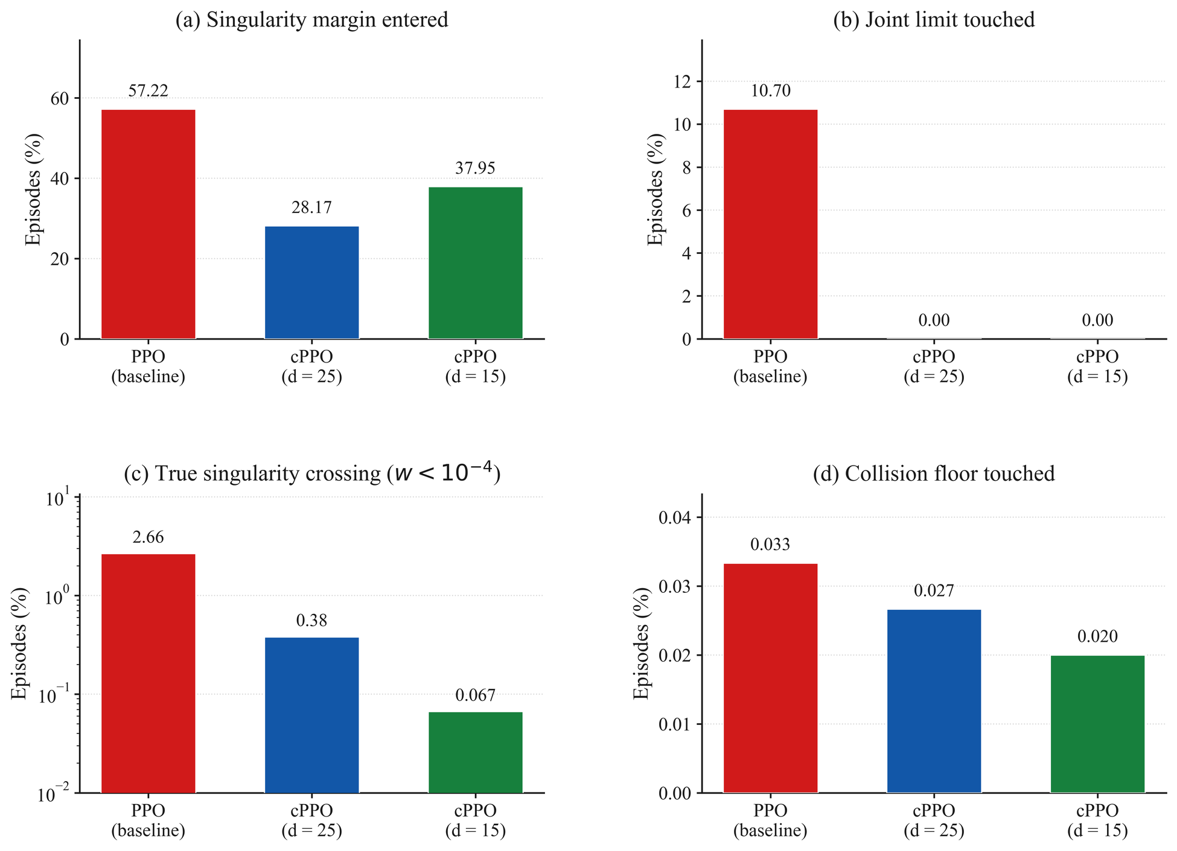
RESULT:
Safety: fewer true singularities, zero joint-limit contact
15

Slide 16
Conclusion:
A stated budget changes what a policy does — mostly by making it predictable
Constraining the policy reduces unsafe behaviour
At no measurable task cost.
An unanticipated effect is on consistency
Future Work:
IBVS systems
Sim-to-real application
PID Lagrangian
More Seeds implementations
16

Slide 17
Key Resources:
[1] Altman, E. (1999). Constrained Markov Decision Processes. Chapman & Hall/CRC.
[2] Schulman, J. et al. (2017). Proximal Policy Optimization Algorithms. arXiv:1707.06347.
[3] Achiam, J. et al. (2017). Constrained Policy Optimization. Proc. ICML, PMLR 70.
[4] Ray, A., Achiam, J., & Amodei, D. (2019). Benchmarking Safe Exploration in Deep RL. OpenAI.
[5] Stooke, A., Achiam, J., & Abbeel, P. (2020). Responsive Safety in RL by PID Lagrangian Methods. Proc. ICML, PMLR 119.
[6] Yoshikawa, T. (1985). Manipulability of Robotic Mechanisms. Int. J. Robotics Research, 4(2).
[7] Henderson, P. et al. (2018). Deep Reinforcement Learning That Matters. Proc. AAAI 32(1).
[8] Khan, F. et al. (2026). RL for Precision Grasping and Safety-Critical Coordination in a Robotic Arm. Intelligent Service Robotics, 19(16).
[9] Shen, Y. et al. (2022). RL-Based Reactive Obstacle Avoidance for Redundant Manipulators. Entropy, 24(2).
17

Slide 18
THANK YOU
18

Slide 19
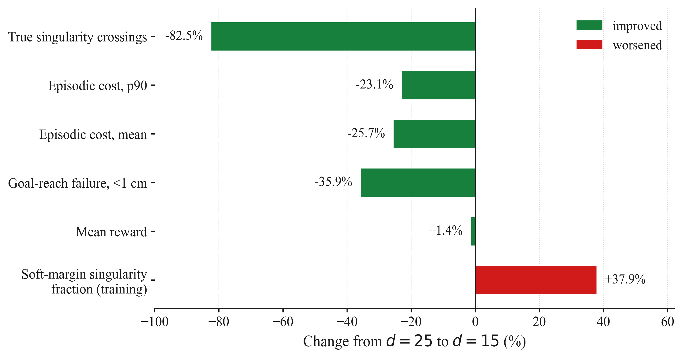
Appendix:
Fig: Effect of tightening the cost limit on the performances
19

Slide 20
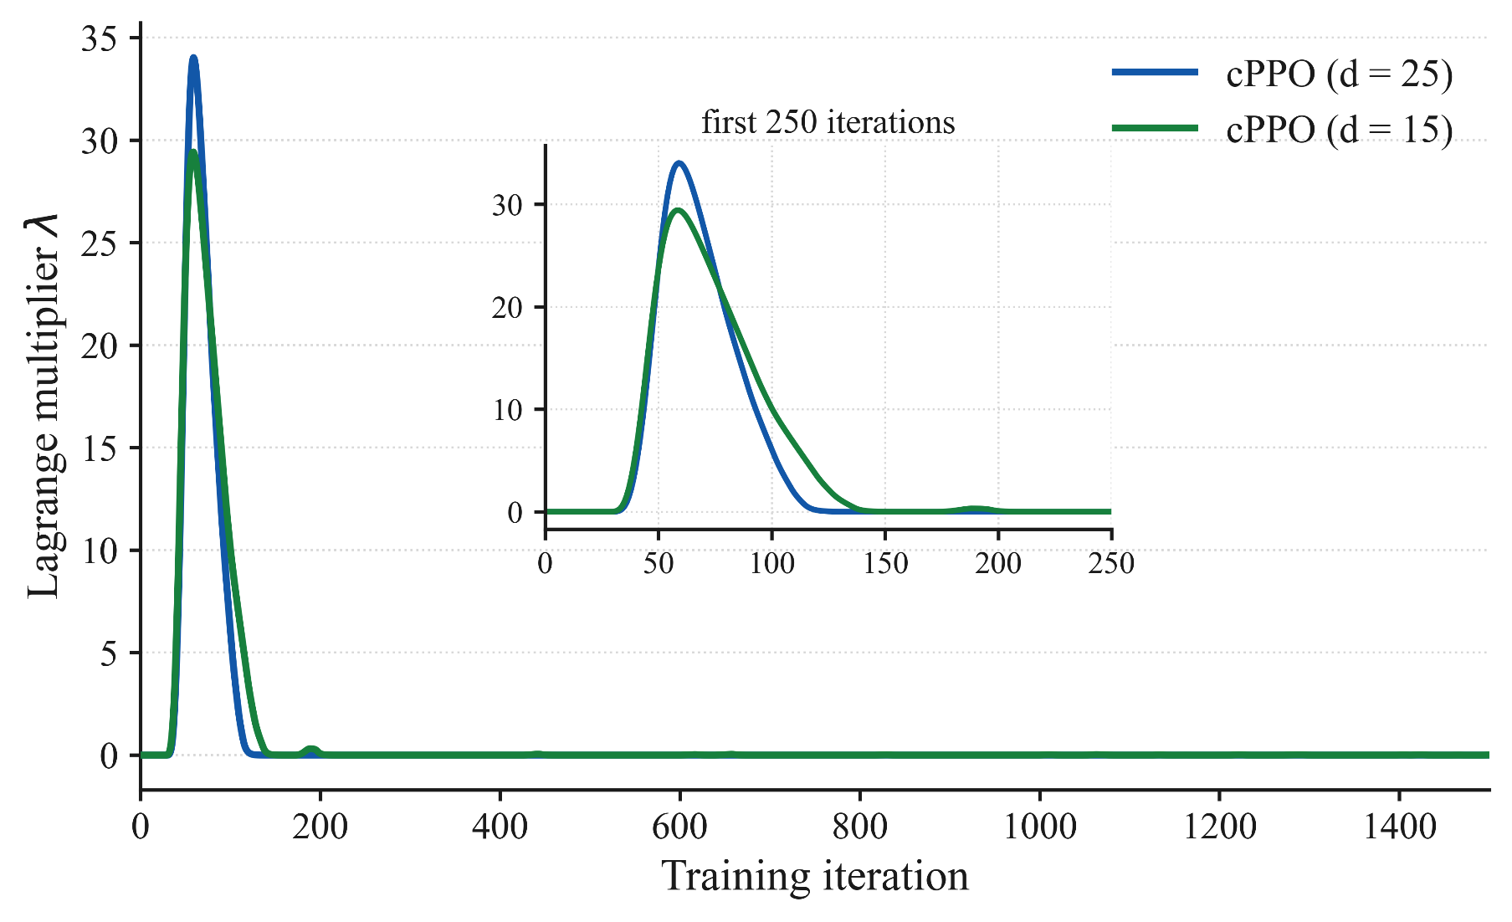
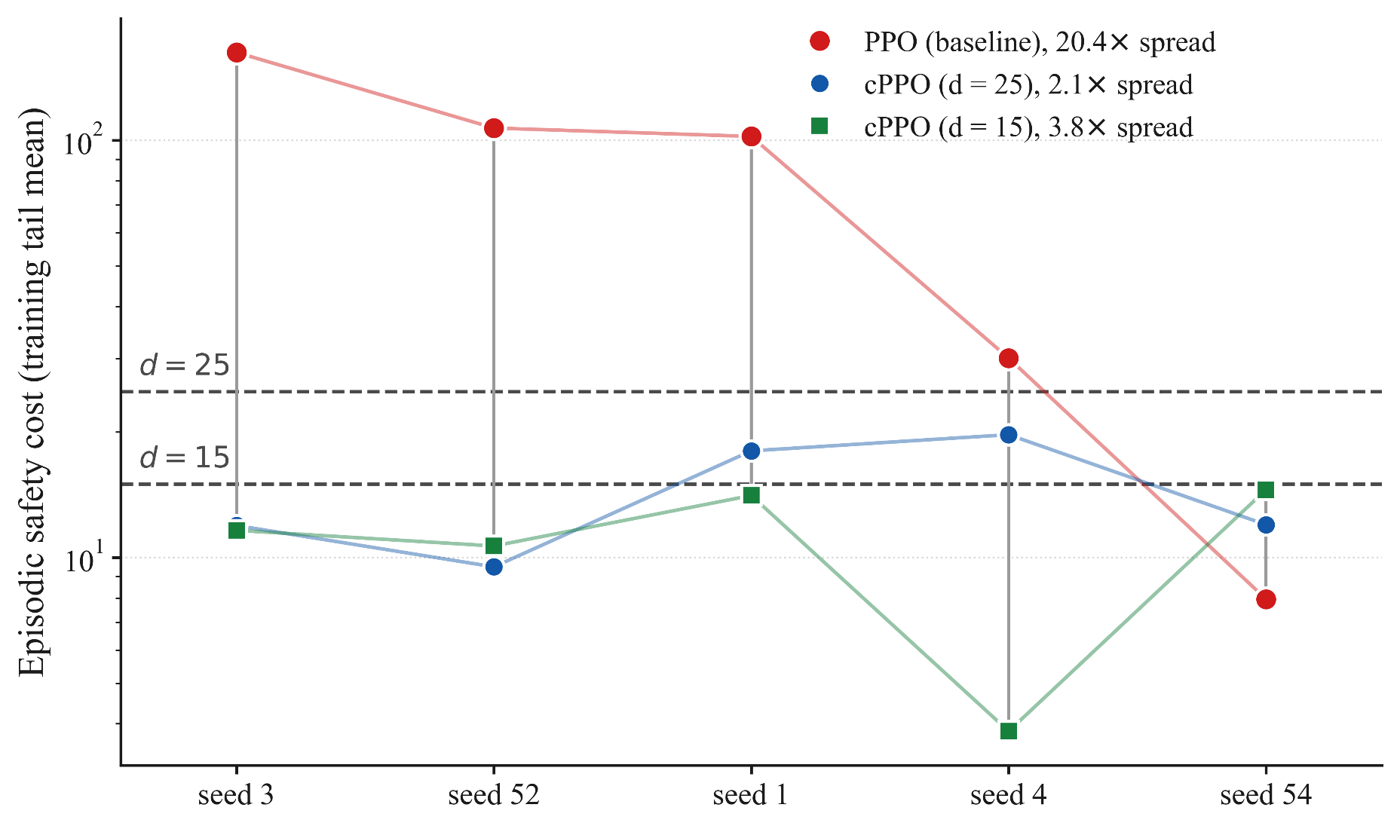
Appendix:
Fig 2: Effect of Lagragian multiplier in action
Fig 3: Safety cost varies with the seeds
20

