Slide 1

House Prices in Madrid Abdurrahim Akbulut

Slide 2
Introduction
Madrid is the capital and most populous city of Spain.
3.3 million inhabitants
Second-largest city in the European Union (EU)
21 districts and 131 neighborhoods

Slide 3
Introduction
Imagine you want to buy a house in Madrid, but you’re not sure about the location.
It would be nice if you can compare each neighborhood, right?
Let’s analyze each neighborhood in Madrid based on the house prices and venues.

Slide 4
Data Acquisition & Preparation
Neighborhood & District Names: Scraped from wikipedia
21 districts & 131 neighborhoods
House Prices: Madrid Real Estate Dataset from Kaggle
21742 rows and 58 columns
Some neighborhood names updated
Venues: Places API (Foursquare)
3280 venues from 115 neighborhoods

Slide 5
Data Acquisition & Preparation
Geojson files for district and neighborhood boundaries
To avoid error while generating a choropleth map, special characters in district names replaced (é -> e , ó -> o etc. )
Coordinates of neighborhoods: Nominatim geocoder from GeoPy
Incorrect coordinates updated and missing coordinates added manually

Slide 6
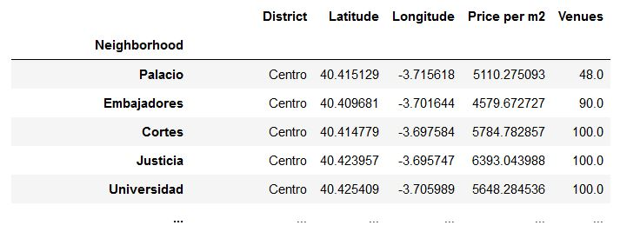
Data Acquisition & Preparation
Dataframes merged into a main dataframe

Slide 7
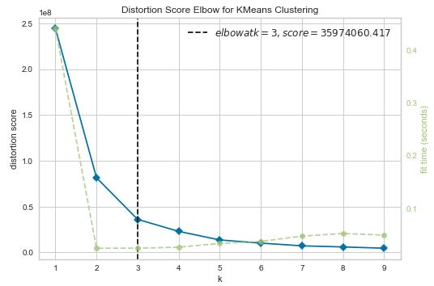
Analyzing Neighborhoods
Elbow method used to determine number of clusters

Slide 8
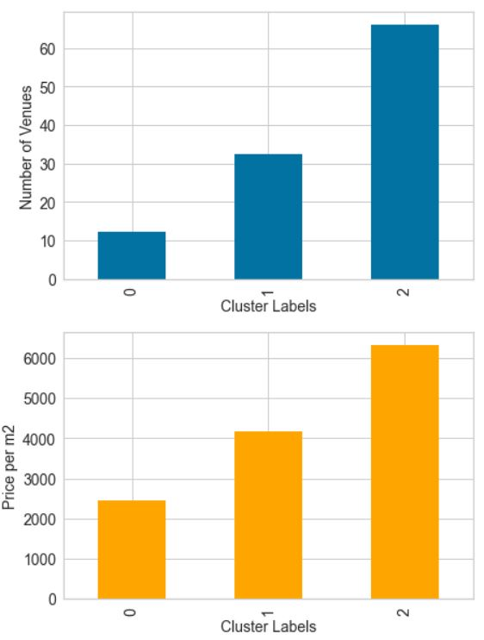
Analyzing Neighborhoods
Cluster 0 : 10 venues & 2500 EUR/m2
Cluster 1: 30 venues & 4000 EUR/m2
Cluster 2: 65 venues & 6000 EUR/m2

Slide 9
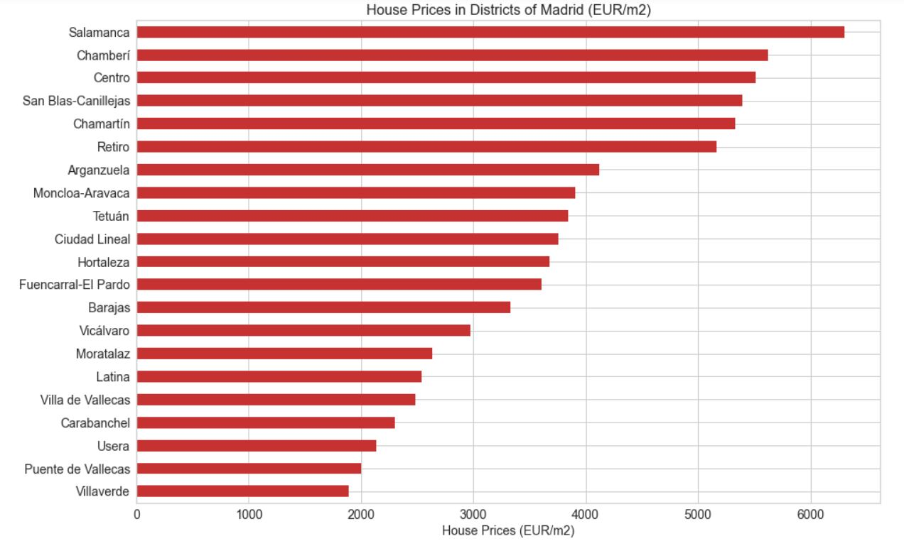
Analyzing Neighborhoods
Highest
Salamanca
Lowest
Villaverde

Slide 10
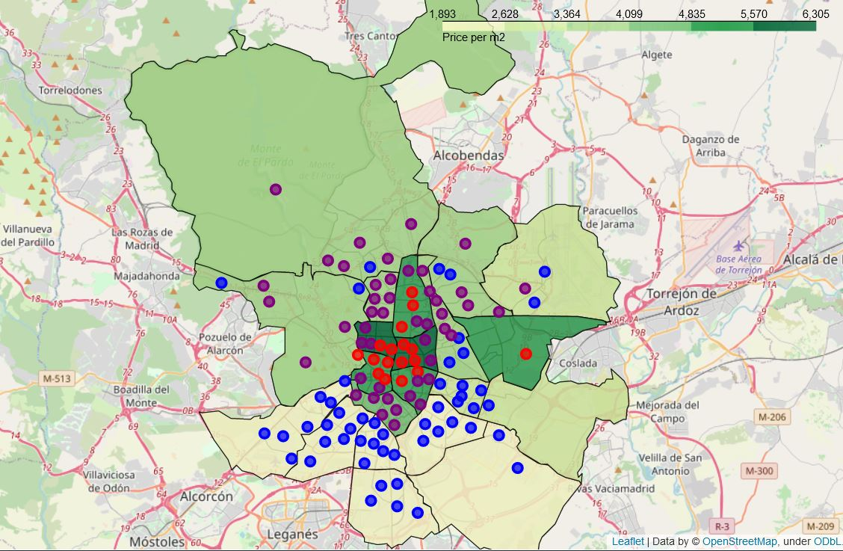
Analyzing Neighborhoods

Slide 11
Conclusion
You can select suitable neighborhood for your needs by examining the choropleth map created during this project. For example:
Medium budget (~4000 EUR/m2)
Palacio, Cuatro Caminos, Arapiles might be considered
High budget (~6000 EUR/m2)
Sol, Ibiza, El Viso might be considered

Slide 12
THANK YOU FOR YOUR TIME! ☺

