Slide 1
SONG POPULARITY PREDICTION
BIL 495
Preliminary Presentation
Abdurrahman BULUT
Project Supervisor: Dr. GÖKHAN KAYA
October 2022

Slide 2
Content
Project Definition
Related Works
Project Design Plan
Project Timeline
Project Requirements
Success Criteria
Resources

Slide 3
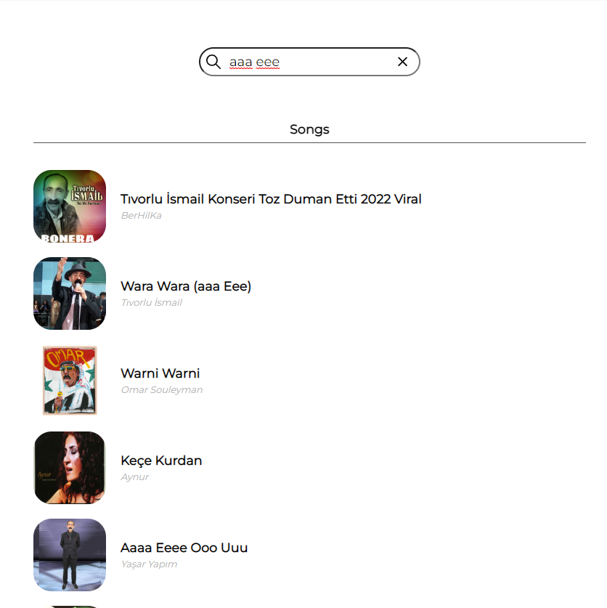
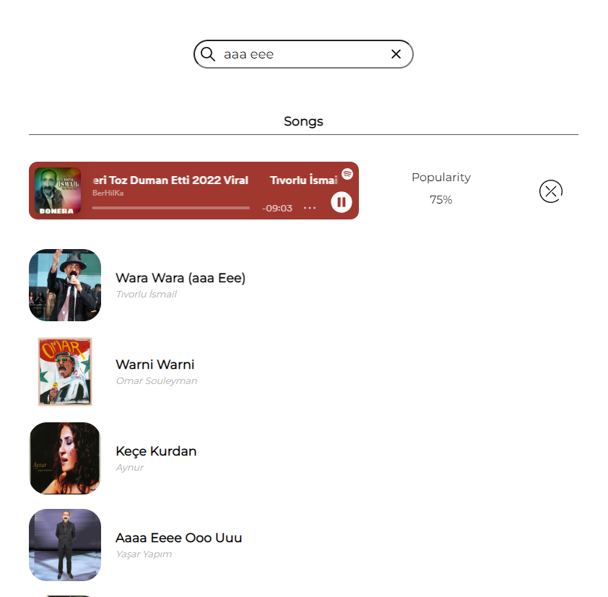
Project Definition
What is the project about?
The project is about predicting song popularity.
We will have a web page to search any song from Spotify using Spotify API.
We will be able to play the song and see the popularity.

Slide 4
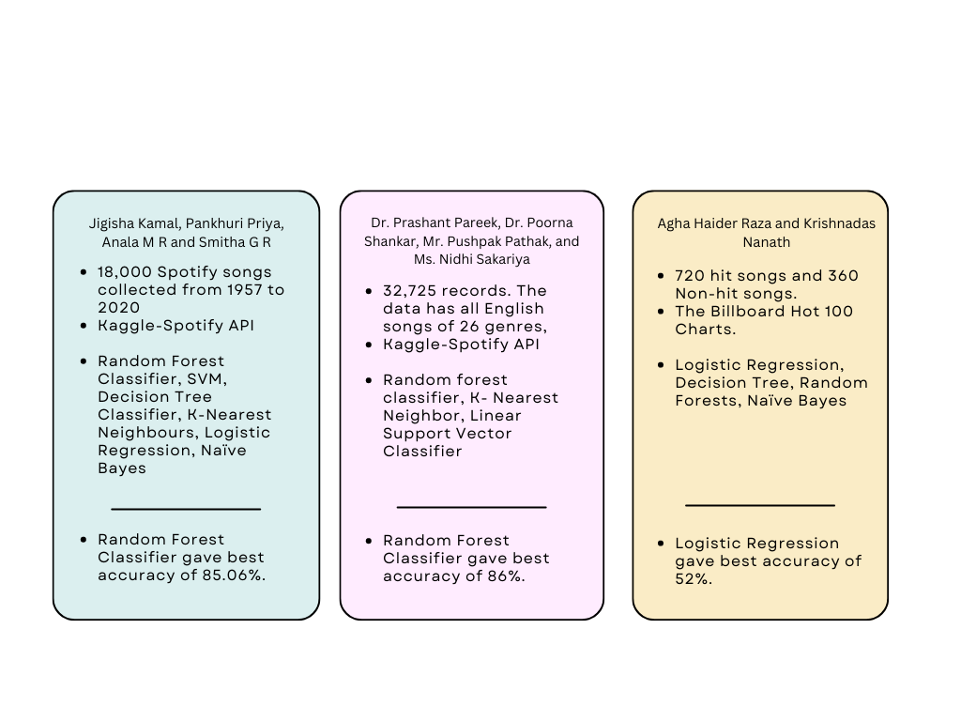
Related Works
Similar research has been done in the past in this field.
[4]
[5]
[6]

Slide 5
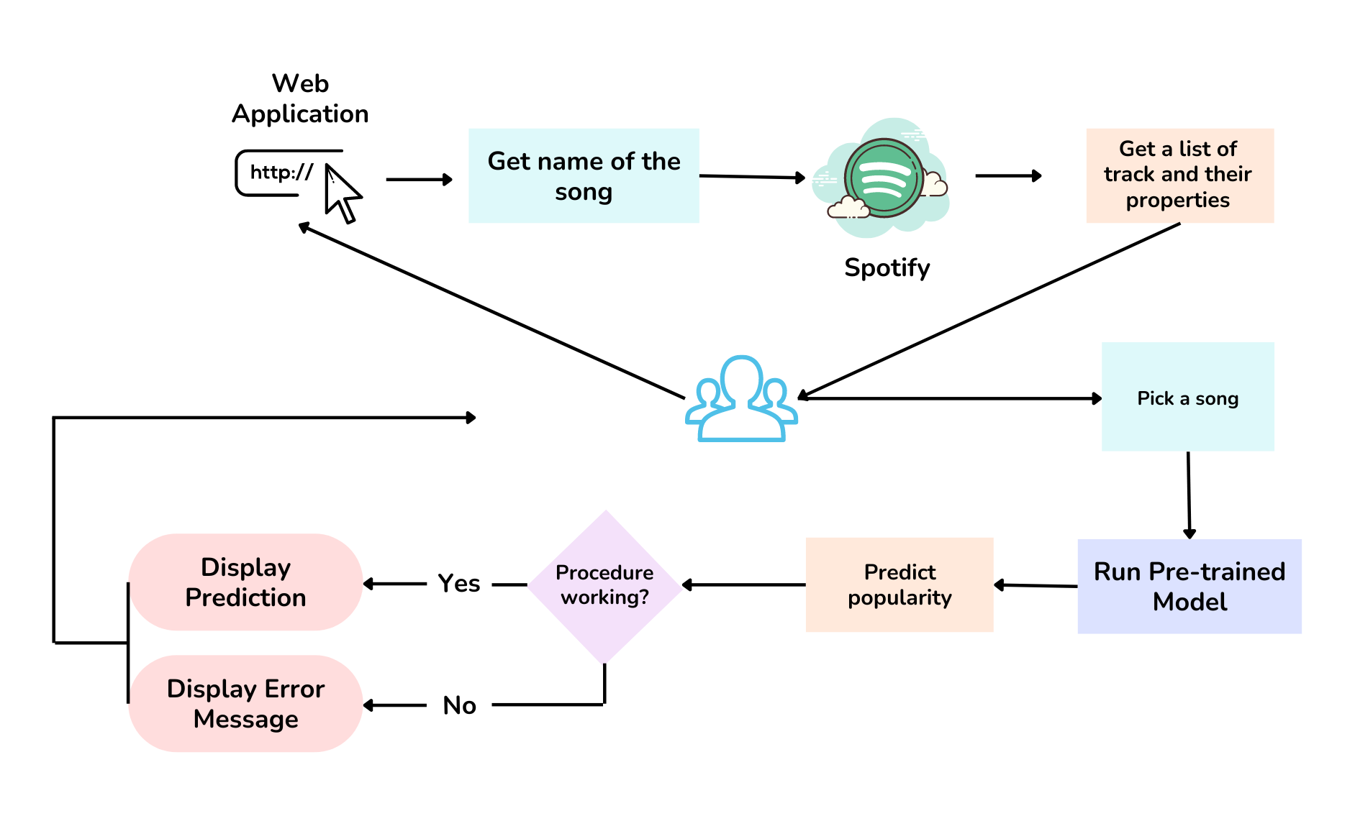
Project Design Plan

Slide 6
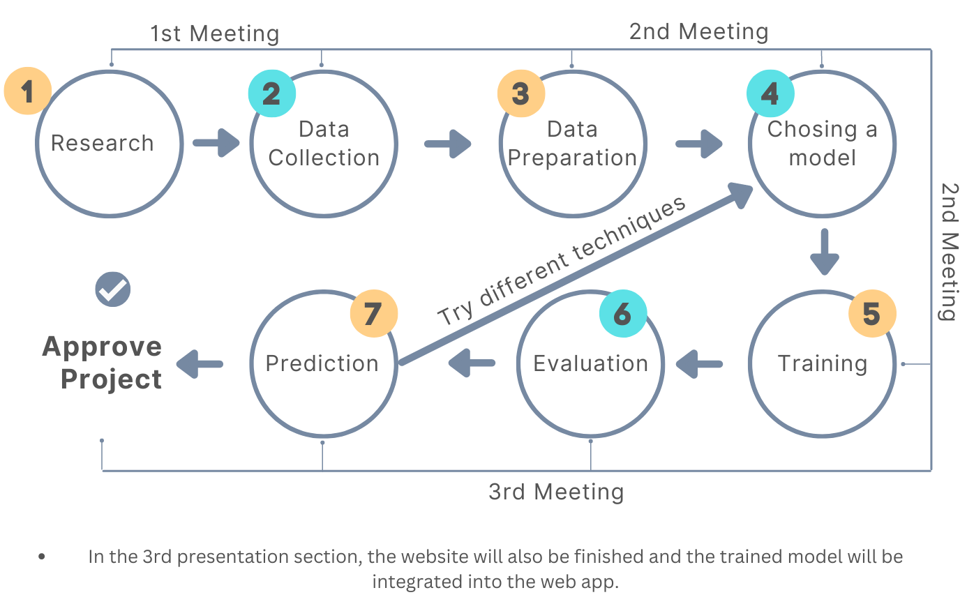
Project Timeline
First step is Literature review.
Data Collection: Spotify Dataset
Data Preparation: Columns that will not be used such as id, song name will be deleted. The popularity will be divided into two part, popular and unpopular using quantile cut.
Different ML techniques will be tried.

Slide 7
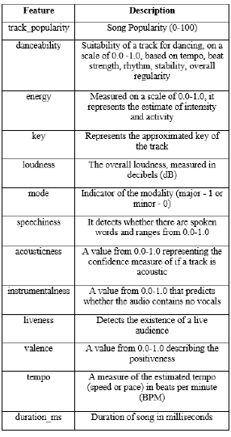
Project Requirements - 1
It is necessary to determine the parameters that affect the popularity of the songs. (energy, tempo, danceability etc.)
Finding a comprehensive dataset is very important.
It is important to analyze machine learning algorithms that are frequently used in past research.
It will be necessary to group the data. As example, the popularity of songs from the 1980s and 2000s may be different.
Table 1 : Audio Features ^{[4]}

Slide 8
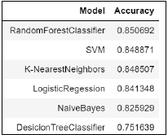
Project Requirements - 2
MSD - Spotify Datasets
“We initially wanted to include “danceability” and “energy” as attributes. Related work has shown that danceability, especially, plays an important role in song popularity, especially in recent decades. The danceability and energy of each song, unfortunately, were not analyzed in MSD.”^{[3]}
“Spotify Dataset 1921-2020, 600k+ Tracks”, Kaggle^{[2]}
The algorithms I will use are follows:
Linear regression.
Decision tree.
SVM algorithm.
Naive Bayes algorithm.
KNN algorithm.
K-means.
Random forest algorithm
Some required technologies and libraries are:
Numpy. Pandas, Scipy, Scikit-learn, TensorFlow, Matplotlib, VueJs
Table 2: Model Accuracies ^{[4]}

Slide 9
Success Criteria
Should be able to predict popularity with high success rate (at least 90%)
Should be able to predict the popularity within 1-2 milisecond

Slide 10
Resources
“Web API Reference — Spotify for Developers.”
“Spotify Dataset 1921-2020, 600k+ Tracks” Yamac Eren Ay, https://www.kaggle.com/datasets/yamaerenay/spotify-dataset-19212020-600k-tracks
“Predicting Song Popularity”, Katherine Lin, Rudolf Newman
“A Classification Based Approach to the Prediction of Song Popularity”, Jigisha Kamal, Pankhuri Priya, Anala M R and Smitha G R
“Predicting Music Popularity Using Machine Learning Algorithm and Music Metrics Available in Spotify”, Dr. Prashant Pareek, Dr. Poorna Shankar, Mr. Pushpak Pathak, and Ms. Nidhi Sakariya
“Predicting a Hit Song with Machine Learning: Is there an apriori secret formula?”, Agha Haider Raza, Krishnadas Nanath.

