Slide 1
SONG POPULARITY PREDICTION
BIL 495
Intermediate Presentation
Abdurrahman BULUT
Project Supervisor: Dr. GÖKHAN KAYA
October 2022

Slide 2
Content
The Data
Correlation
Outliers
Classification
What to do next
Website
Project Timeline
Resources

Slide 3
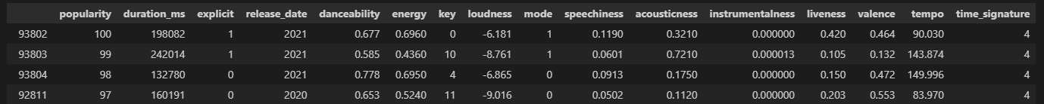
The Data
16 features for each song
Song ids, song names, artist names and artist ids were removed from dataset
Date format adjusted. Only the year will be used
(ex. 01.01.2012 becomes 2012)
Sample view of dataset

Slide 4
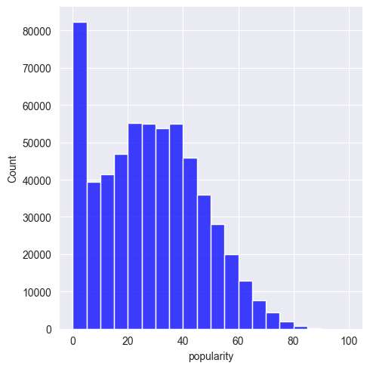
Exploring the Target Variable
Some adjustments were made to the data including dropping songs with popularity of 0.
Even so, the popularity scores are heavily weighted towards the bottom and taper at the top.
The measure of mean is very low.

Slide 5
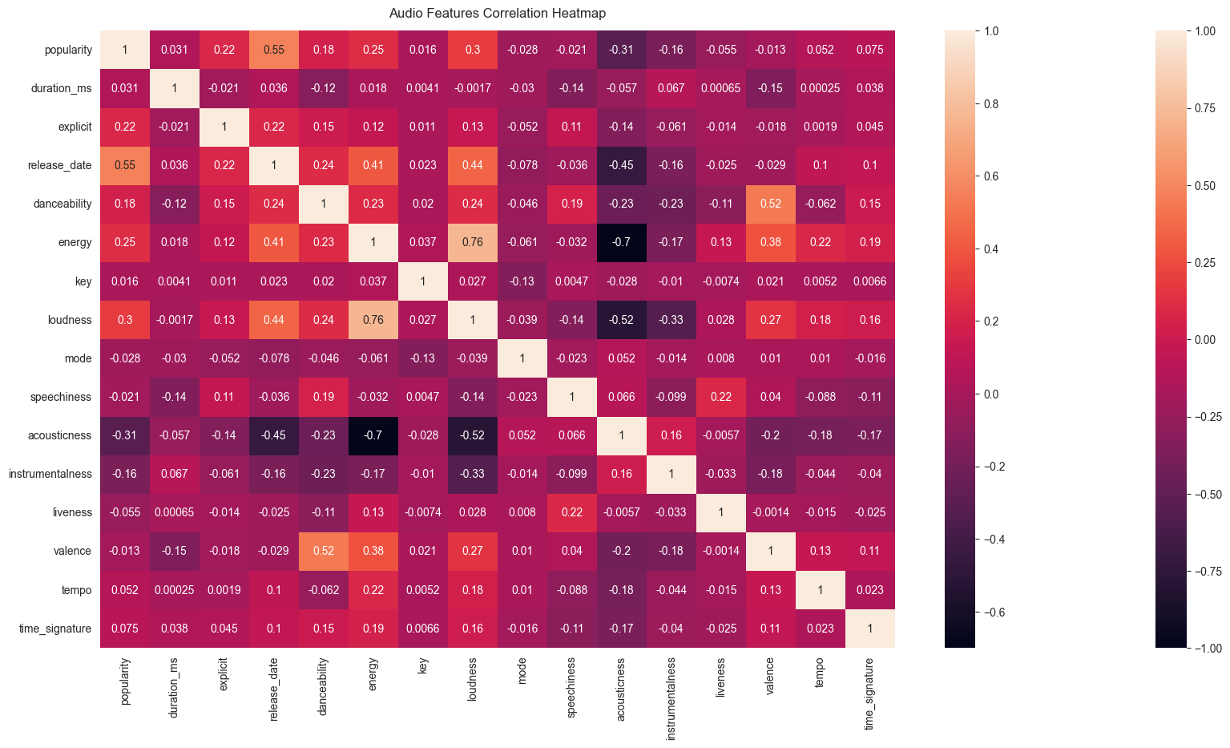
Correlation
mutual relationship or connection between two or more things.

Slide 6
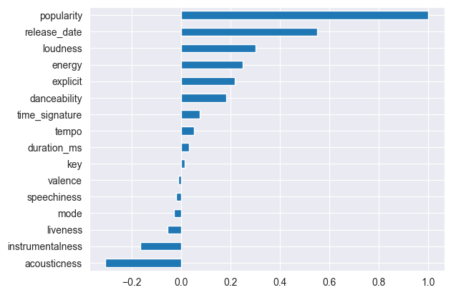
Correlation
Key and valence has weak/zero correlation on popularity.
Release date has positive correlation, but release date is not an audio feature.
I will divide the Dataset by 20 years and train each piece of set separately to obtain 5 trained models.
Models will predict how popular a song would be if it was released on another date.

Slide 7
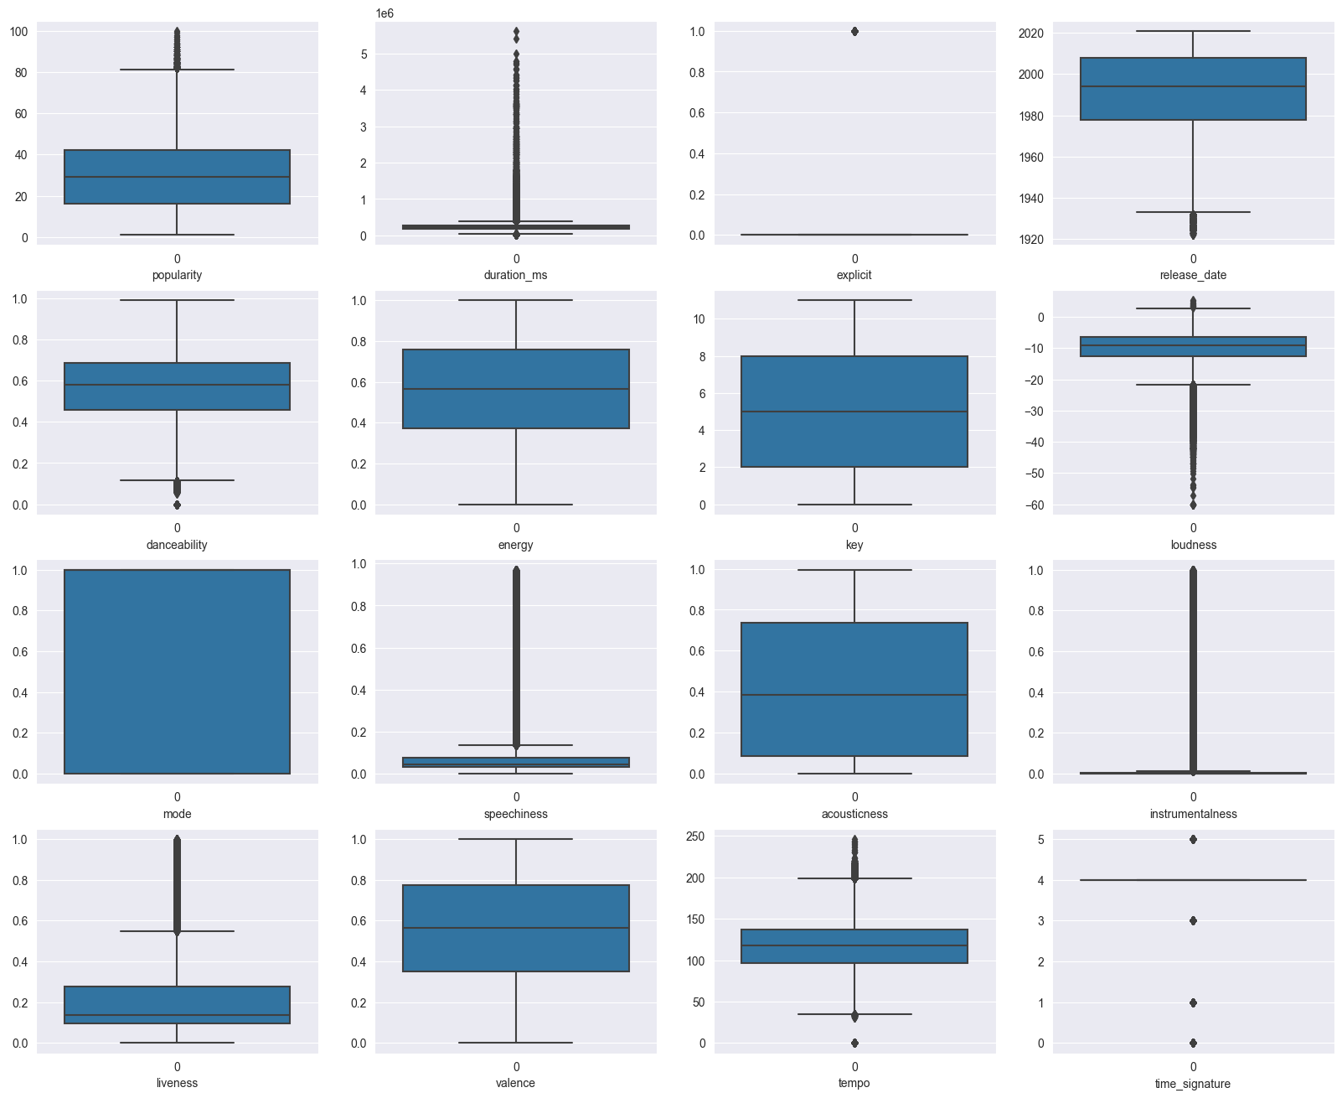
Outliers
Boxplot notation
Full box shows the quartiles.
Explicit column is just a binary column. It is not an outlier
Duration and tempo features seem to have a bit of outlier.

Slide 8
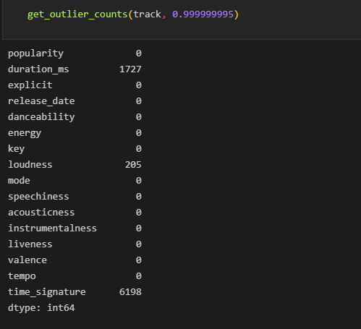
Outliers
Get the z-scores for each value in dataset and the threshold.
Rows values with z score greater than threshold's z score were deleted.
Time signature is not included because it ranges only from 3 to 7 as integer.

Slide 9
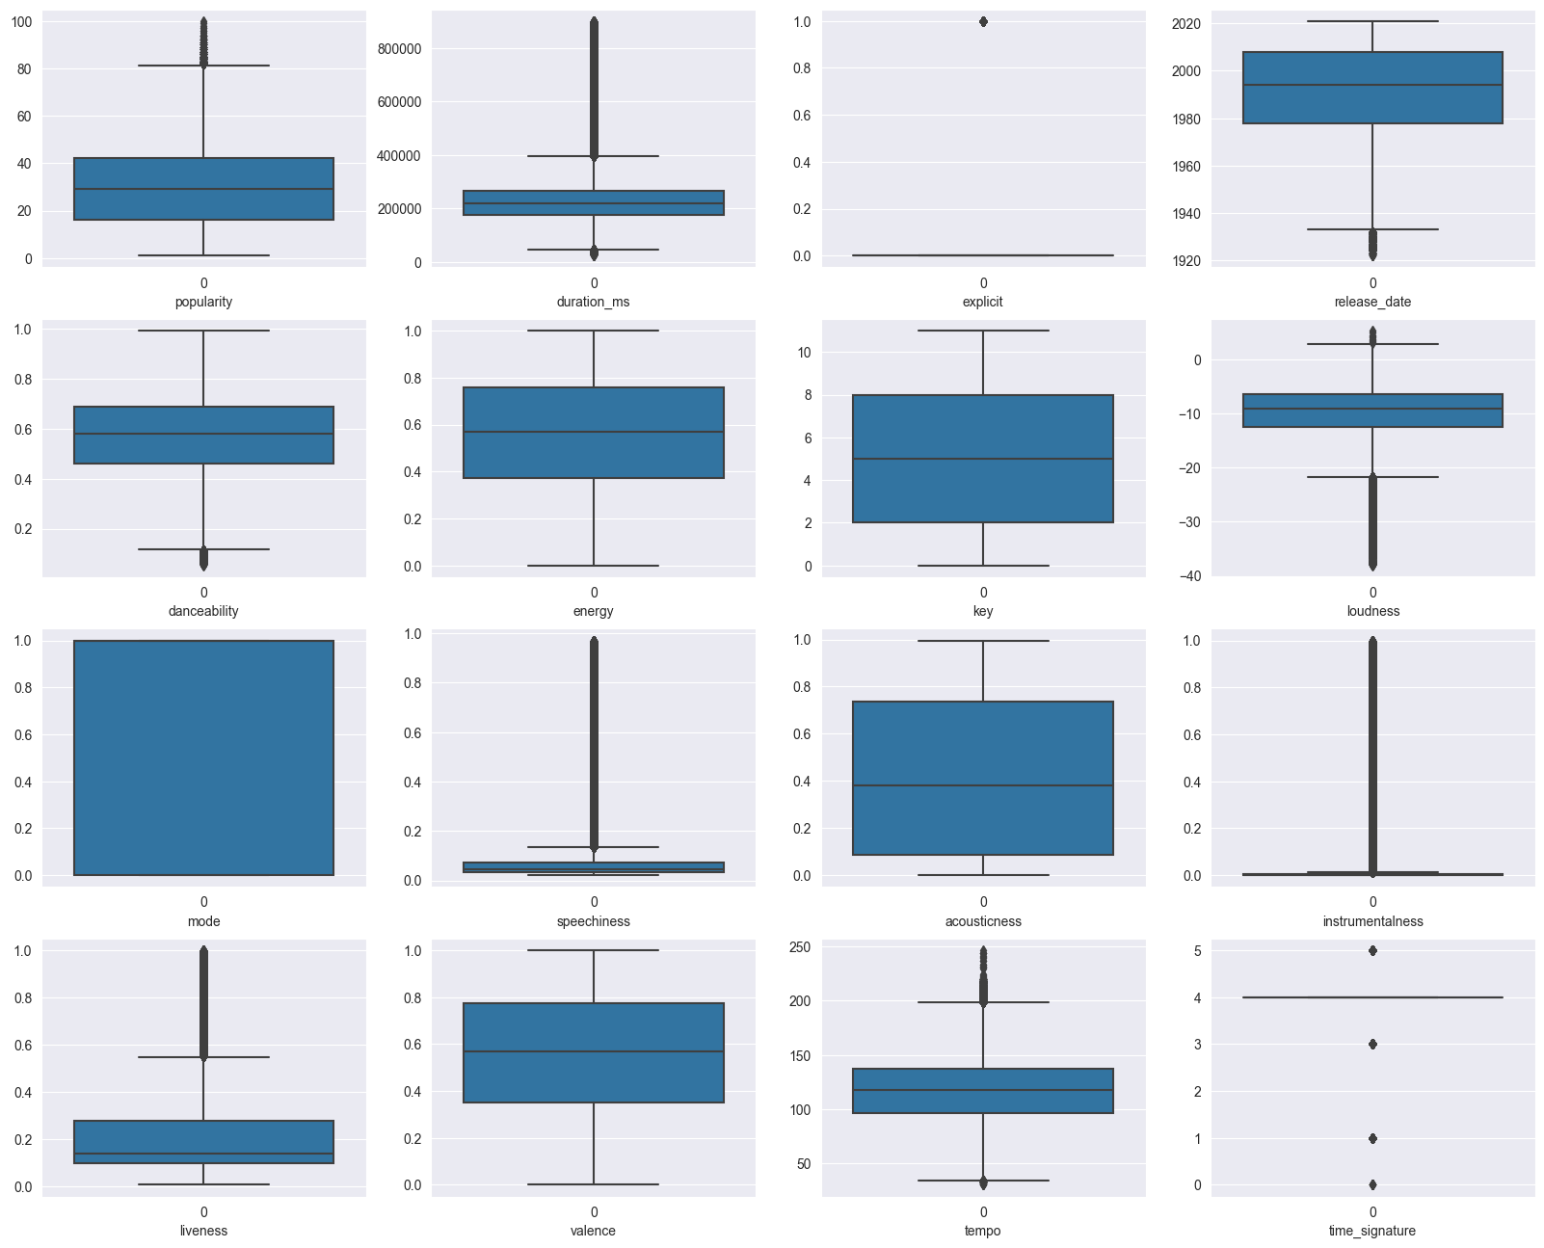
Outliers
Tempo and duration look a little better than previous as seen in the boxplot notation.

Slide 10
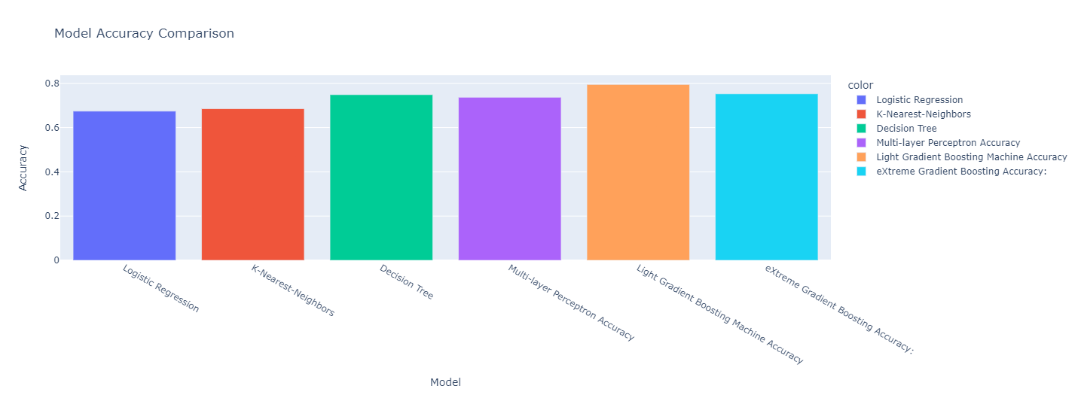
Classification
The result of outlier operations improves validation set score about 0.5 point as a percentage.

Slide 11
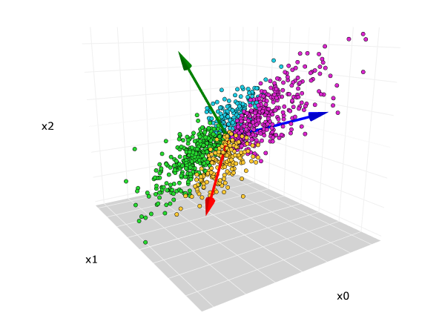
What to do next
Model
Keras Sequential Model
The class imbalance techniques
PCA (Principal Component Analysis)
Formally, PCA is a statistical technique for reducing the dimensionality of a dataset.

Slide 12
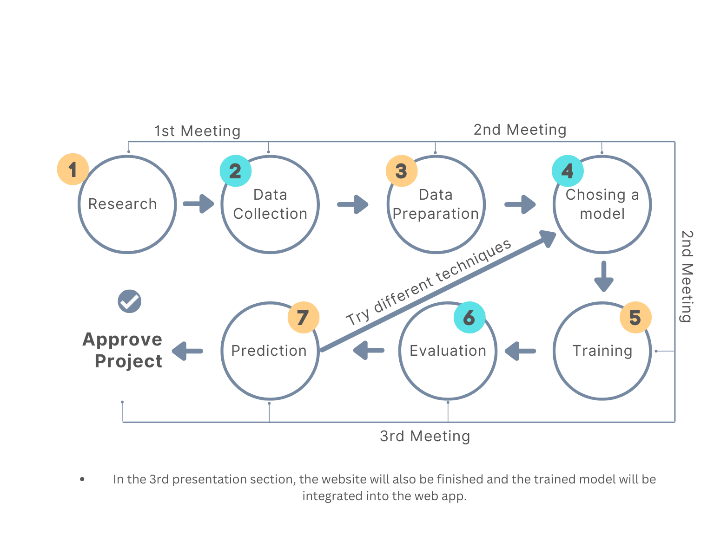
Project Timeline

Slide 13
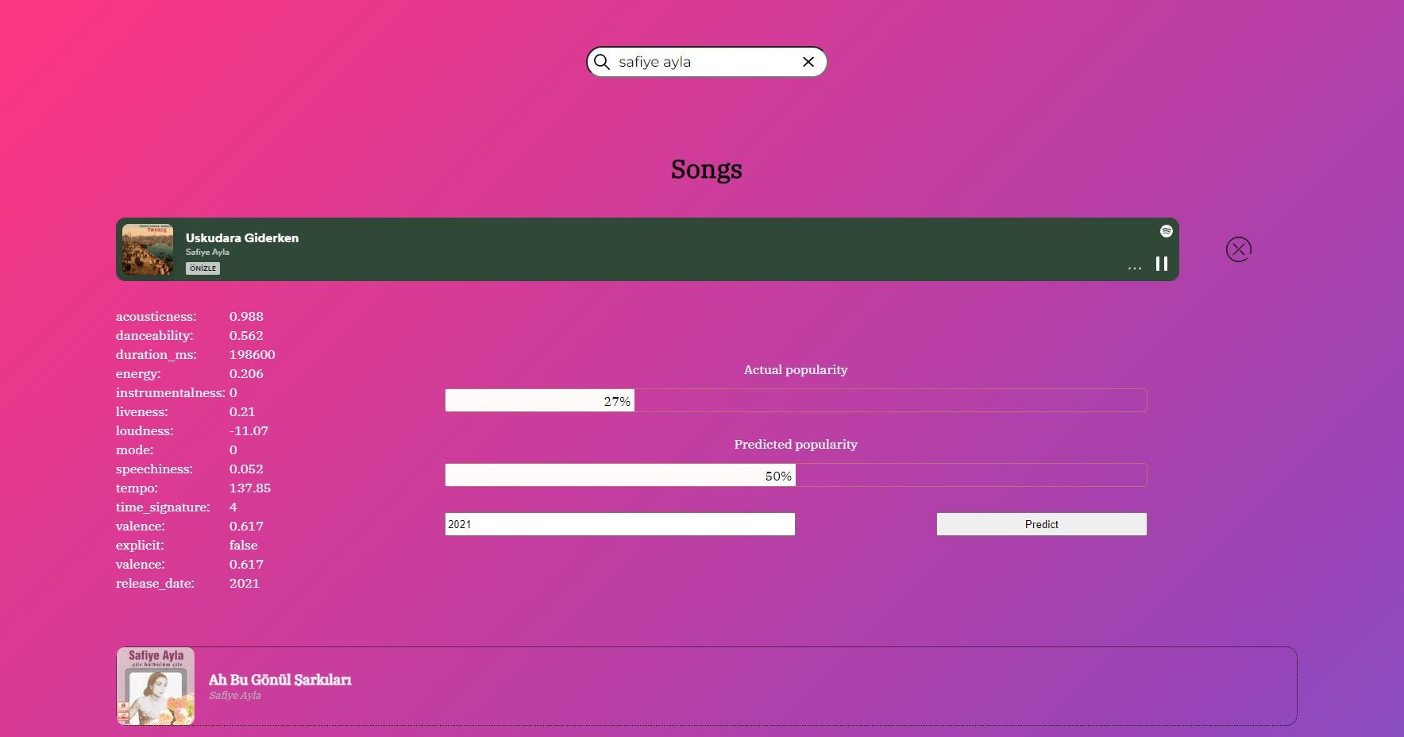
Web Page
songpopularity.netlify.app
e-mail: gtutest@mail.com
password: gtutest1

Slide 14
Resources
“Web API Reference — Spotify for Developers.”
“Spotify Dataset 1921-2020, 600k+ Tracks” Yamac Eren Ay, https://www.kaggle.com/datasets/yamaerenay/spotify-dataset-19212020-600k-tracks
“Predicting Song Popularity”, Katherine Lin, Rudolf Newman
“A Classification Based Approach to the Prediction of Song Popularity”, Jigisha Kamal, Pankhuri Priya, Anala M R and Smitha G R
“Predicting Music Popularity Using Machine Learning Algorithm and Music Metrics Available in Spotify”, Dr. Prashant Pareek, Dr. Poorna Shankar, Mr. Pushpak Pathak, and Ms. Nidhi Sakariya

