Slide 1
SONG POPULARITY PREDICTION
BIL 495
Final Presentation
Abdurrahman BULUT
Project Supervisor: Dr. GÖKHAN KAYA
January 2023

Slide 2
Content
Introduction
Data Preprocessing
Exploratory Data Analysis
Classification
Regression
Ensemble
Artificial Neural Network (ANN)
Website
Conclusions
Resources

Slide 3
Introduction
Dataset
A large dataset of nearly 586,672 songs with 15 features from the Kaggle website, which is prepared by utilizing Spotify API.
Features
popularity explicit danceability
energy key loudness
mode speechiness accousticness valence instrumentalness liveness
tempo time_signature duration
Problem statement
Given song metadata*, predict the
Song popularity score (regression)
Whether or not the song is popular (classification).

Slide 4
Data Preprocessing
One hot encoding is necessary because many fields are categorical. Every category gets its column. (Ex: key, mode)
Release year format edited.(01.12.1999 -> 1999)
Data with a ‘popularity’ value of 0 has been deleted.
Data with a ‘tempo’ value of 0 has been deleted.
Outlier detection was done with z-score.
Duration_ms converted to duration_s divided by 1000.
'name', 'artists', 'id_artists’ colums are removed.
Finally, before training the models, I applied PCA (Principal Component Analysis)

Slide 5
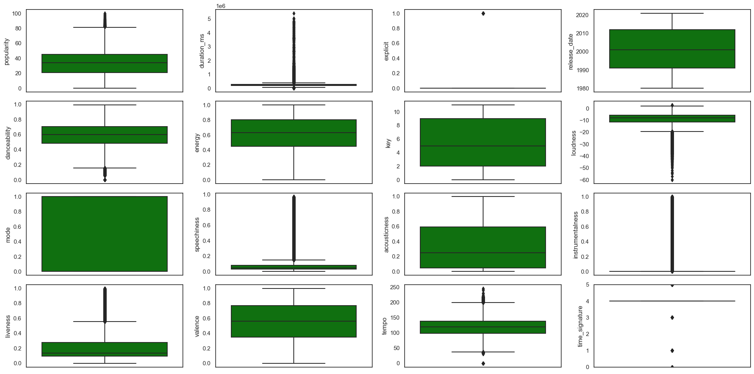
EDA -Exploring the Target Variable
Box Plots

Slide 6
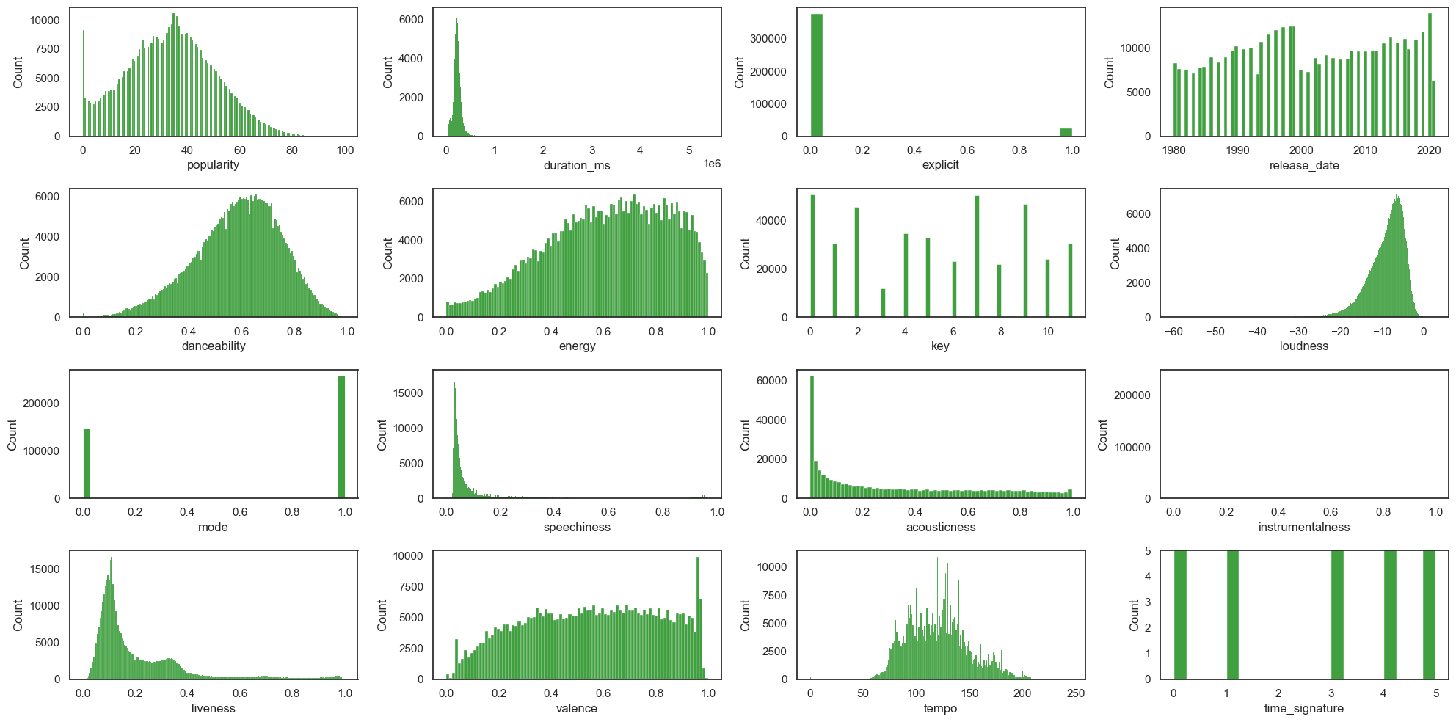
EDA -Exploring the Target Variable
Histograms

Slide 7
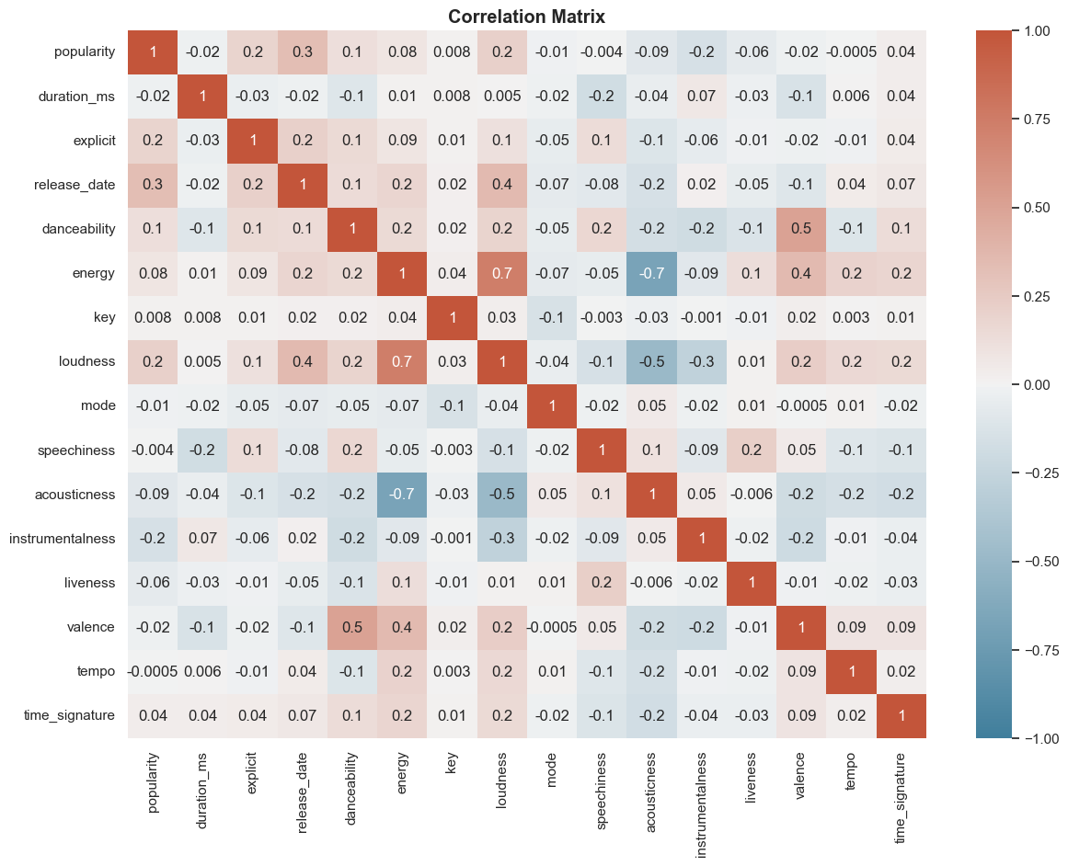
EDA -Exploring the Target Variable
Correlation Matrix
mutual relationship or connection between two or more things.

Slide 8
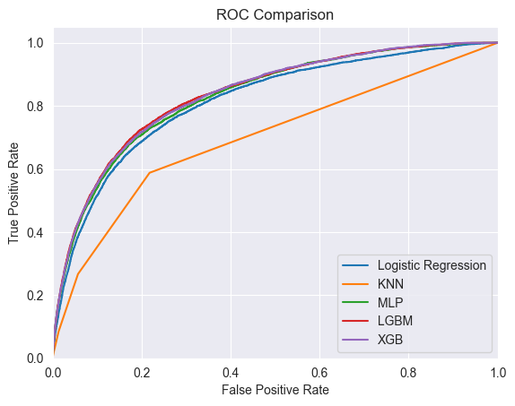
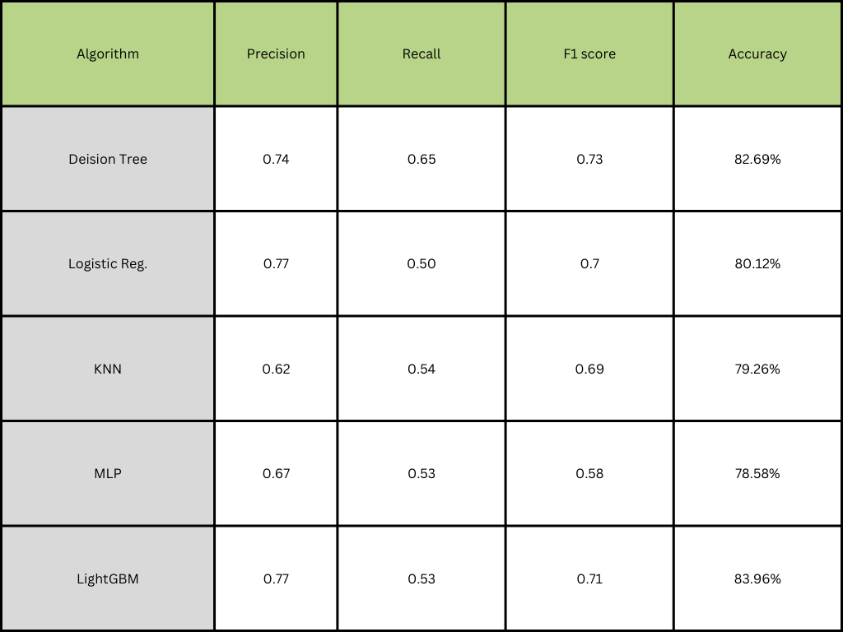
Classification

Slide 9
Regression
Decision Tree
When we divide 20% of the dataset as test and 80% as train and fit the model, the R-squared score value will be negative value.
R-squared is negative only when the chosen model does not follow the trend of the data.
With GridsearchCV, the R2 score value will be 0.17.

Slide 10
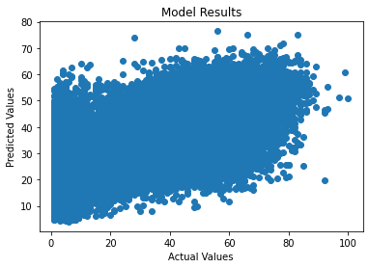
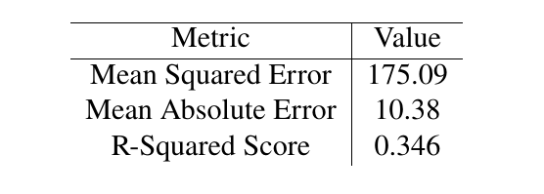
Ensemble Learning - Stacking
Base models: Random Forest Regressor, Gradient Boosting Regressor, Bagging Regressor, and AdaBoost Regressor with 10 estimators.
Meta-model, which in this case was a Linear Regression model.

Slide 11
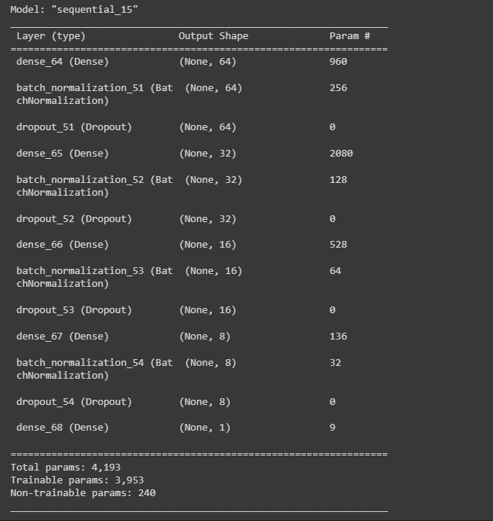
Artificial Neural Network(ANN)
Batch normalization is used to normalize the activations of the previous layer at each batch.
Batch learning: Instead of training the model on all the data at once, we can train it on small batches of data.
Dropout is a regularization technique that randomly drops out some neurons during training, which helps to prevent overfitting
Early stopping: It will stop training when the model stops improving on the validation data.

Slide 12
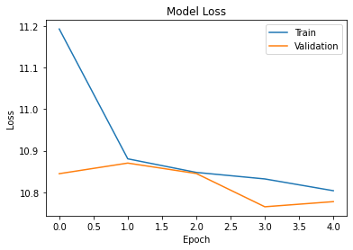
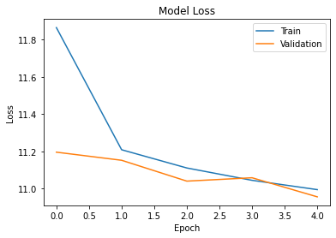
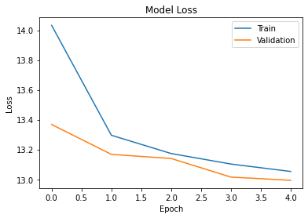
Artificial Neural Network(ANN)

Slide 13

Website
Search page

Slide 14

Website
Result page

Slide 15
Conclusion
We focused on the sound characteristics of a song. The singer, the genre of the song, the year of the song, and the lyrics also have a lot of influence.
Regression results were not sufficient due to insufficient dataset.
Classification results are not far from the literature.
Ensemble stacking method gives best result for regression.
Furthermore, The dataset used in this research could be improved by collecting more recent data from Spotify and other streaming platforms, and including more features that might affect the popularity of music.

Slide 16
Resources
“Web API Reference — Spotify for Developers.”
“Spotify Dataset 1921-2020, 600k+ Tracks” Yamac Eren Ay, https://www.kaggle.com/datasets/yamaerenay/spotify-dataset-19212020-600k-tracks
“Predicting Song Popularity”, Katherine Lin, Rudolf Newman
“A Classification Based Approach to the Prediction of Song Popularity”, Jigisha Kamal, Pankhuri Priya, Anala M R and Smitha G R
“Predicting Music Popularity Using Machine Learning Algorithm and Music Metrics Available in Spotify”, Dr. Prashant Pareek, Dr. Poorna Shankar, Mr. Pushpak Pathak, and Ms. Nidhi Sakariya

