Slide 1



Team Members
Abdur Rahman SID : 213-15-4270
Mohammad Sohaib Islam Shibly SID : 213-15-4258
Rayhan Rafin SID : 213-15-4278

Slide 2
Contributions
Mohammad Sohaib Islam Shibly
(Main + Managefood)
Abdur Rahman
(AddFoodForMenu + CustomerOrder)
Rayhan Rafin
(Admin + Password)

Slide 3
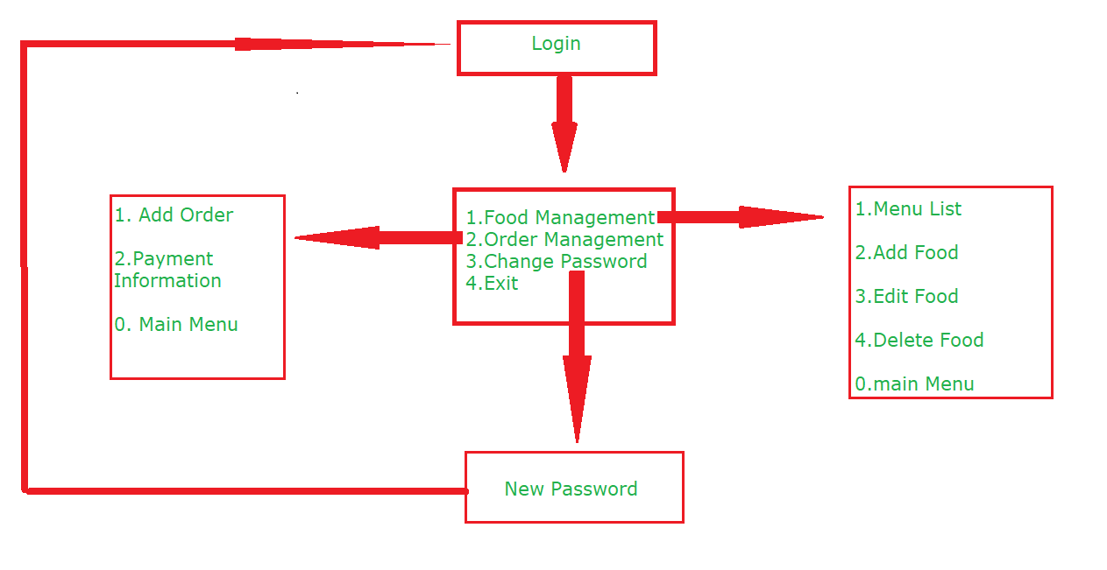
Flowchart

Slide 4
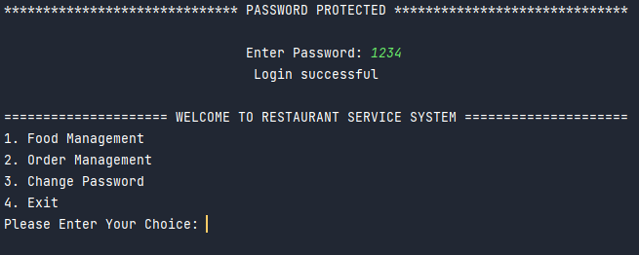
Homepage Login

Slide 5
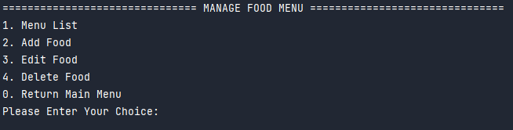
Food Management

Slide 6
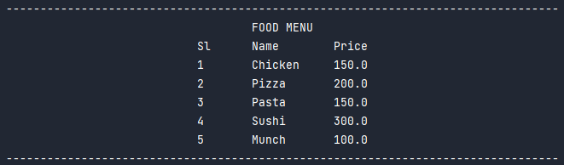
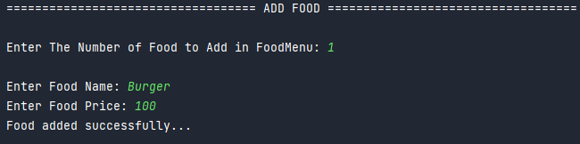
Food Menu
Add Food

Slide 7
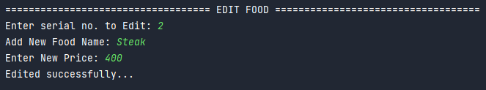

Edit Food
Delete Food

Slide 8

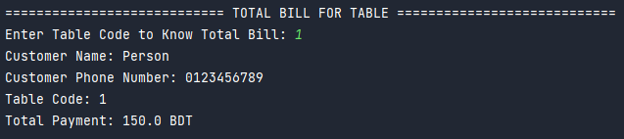
Order Management
Payment Information

Slide 9
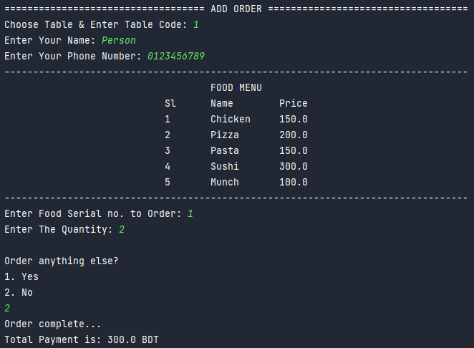
Add Order

Slide 10
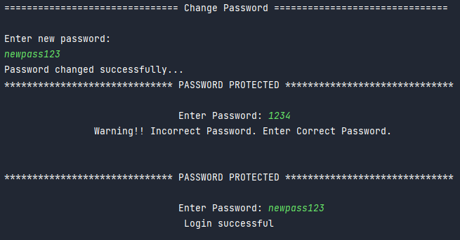
Change Password

Slide 11

THANK YOU

