Slide 1

Introduction to ARM Cortex-M Processors
CDAC ACTS, Pune

Slide 2
My promise !
I am confident that this course will save you many, many hours of studying/experimenting/googling time to learn about this processor.
I stand behind this course 100% and am committed to helping you .
A Promise that I need from you !
Daily 30Mins of Revision of what is taught in the class

Slide 3
Cortex M3 @ S/W Developer point of View
Programming Model
How exceptions are handled
The Memory Map
Peripheral Interfacing
How to use software driver libraries from Microcontroller Vendor.
CMSIS Core API’s
STM32CUBE Libraries

Slide 4

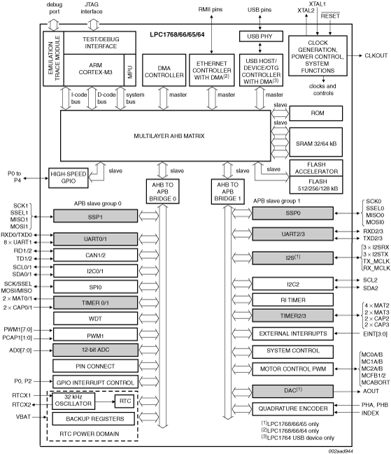
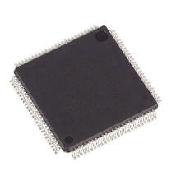

What’s Happening in Microcontrollers?
Microcontrollers are getting cheap
  32-bit ARM Cortex-M3 Microcontrollers @ INR 1200
  Some microcontrollers sell for as little as INR 400
Microcontrollers are getting powerful
  Lots of processing, memory, I/O in one package
  Floating-point is even available in some!
Microcontrollers are getting interactive
  Internet connectivity, new sensors and actuators
  LCD and display controllers are common
Creates new opportunities for microcontrollers

Slide 5
Why ARM here ???
ARM is one of the most licensed and thus widespread processor cores in the world
Used especially in portable devices due to low power consumption and reasonable performance
Several interesting extensions available like Thumb instruction set and Jazelle Java machine

Slide 6
ARM History
ARM – Acorn RISC Machine(1983–1985)
  Acorn Computers Limited, Cambridge, England
ARM – Advanced RISC Machine 1990
  ARM Limited, 1990
  ARM has been licensed to many semiconductor manufacturers

Slide 7
ARM History
Key component of many 32 – bit embedded systems
Portable Consumer devices
ARM1 prototype in 1985
One of the ARM’s most successful cores is the ARM7TDMI,provides high code density and low power consumption
Notes:
ARM is one of the leading processor in the industry among many 32 bit embedded systems.It has been widely used in mobile phones, handheld organizers, portable consumer devices etc.
ARM designers introduced the first prototype(ARM1) in the year 1985. ARM is originally developed at Acorn Computers Limited, Cambridge England. During this time it has been referred as Acorn RISC Machine. The ARM project was led by Roger Wilson and Steve Furber. Steve Furber is known as Father of ARM.Later in the year 1990 Acorn RISC Machine has been reformed as ARM Limited. So ARM refers to Advanced RISC Machine.
ARM is just giving out the cores. Other companies make processors based on its cores. One of the most successful core is ARM7TDMI. This is the first core introduced with Thumb 16 bit decoder which provides high code density and low power consumption.

Slide 8
Advanced RISC Machines
ARM Core uses a ________ architecture
ARM is Physical hardware design company.
ARM licenses its cores out and other companies make processors based on its cores
Notes:
As the name tells ARM makes use of RISC architecture. ARM is Intellectual Property Company. Other partners of ARM make use of ARM’s IP core and make processors based on these cores.
Many of the top semiconductor companies around the world produce products based around the ARM processor

Slide 9
RISC vs. CISC Architecture
RISC
CISC
Fixed width instructions
Variable length instructions
Few formats of instructions
Several formats of instructions
Load/Store Architecture
Memory values can be used as operands in instructions
Large Register bank
Small Register Bank
Instructions are pipelinable
Pipelining is Complex

Slide 10
RISC
Advantage(s)
  A Smaller Die Size
  A Shorter Development Time
  Higher Performance (Bit Tricky)
Disadvantage
  Generally poor code density (Fixed Length Instruction)

Slide 11
CISC vs. RISC
CISC
RISC
Greater
Complexity
Compiler
Compiler
Code Generation
Code Generation
Processor
Greater
Complexity
Processor
Notes:
As mentioned, In RISC there is a greater complexity in the compiler but processor architecture is simpler.
In CISC there is greater complexity in processor Architecture.
RISC processors are simpler and core can operate at higher clock frequencies. CISC processors are complex and operate at lower clock frequencies.

Slide 12
Features used from RISC
A Load/Store Architecture
Fixed Length 32-bit Instructions
3- Address Instruction Formats

Slide 13
Load Store Architecture
Memory can be accessed only through two dedicated instructions
  LDR ; move word from memory to register
  STR ; move word from register to memory
All other instructions have to work on registers only.

Slide 14
3 Address Instruction Format
f bits n bits n bits n bits
Function op 1 addr. op 2 addr. dest. addr.
Example
Add d, s1, s2 ; d =s1+s2

Slide 15
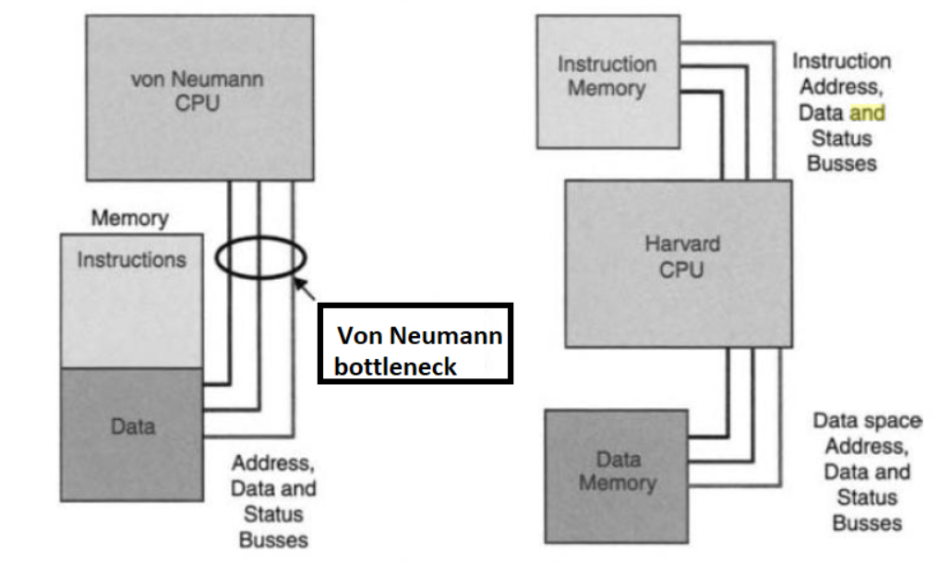
Von Neumann vs Harvard Architecture

Slide 16
What are ARM Cortex M processors?
The Cortex-M3 and Cortex-M4 are processors designed by ARM. The Cortex-M3 processor was the first of the Cortex generation of processors, released by ARM in 2005 (silicon products released in 2006). The Cortex-M4 processor was released in 2010 (released products also in 2010).
The Cortex-M3 and Cortex-M4 processors use a 32-bit architecture.
Internal registers in the register bank, the data path, and the bus interfaces are all 32 bits wide. The Instruction Set Architecture (ISA) in the Cortex-M processors is called the Thumb ISA and is based on Thumb-2 Technology which supports a mixture of 16-bit and 32-bit instructions.

Slide 17
ARM Cortex-M3 Microcontroller
▪
▪
▪
▪
▪
▪
18 x 32-bit registers Excellent compiler target
Reduced pin count requirements Efficient interrupt handling Power management
Efficient debug and development support features
Breakpoints, Watchpoints,
Flash Patch support,
Instruction Trace Strong OS support
User/Supervisor model
OS support features
Designed to be fully programmed in C (even reset, interrupts and exceptions)
▪
▪

Slide 18
ARM Cortex-M3 Microcontroller
▪
▪
▪
▪
▪
▪
▪
▪
▪
▪
▪
▪
▪
ARMv7M Architecture No Cache - No MMU
Debug is optimized for microcontroller applications Vector table contains addresses, not instructions
DIV instruction
Interrupts automatically save/restore state
Exceptions programmed in C (No Coprocessor 15 - All registers are memory-mapped) Interrupt controller is part of Cortex-M3 macrocell
Fixed memory map Bit-banding
Non-Maskable Interrupt (NMI) Only one processor status reg Thumb-2 processing core
▪
▪
Mix of 16 and 32 bit instructions for very high code density Gives complete Thumb compatibility

Slide 19
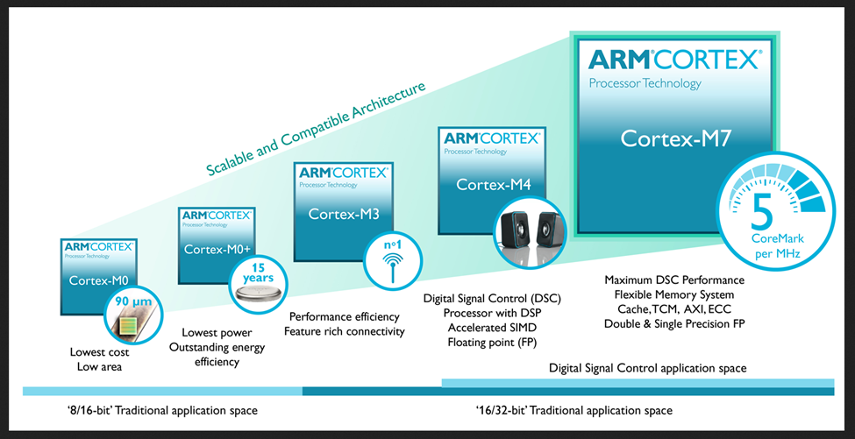
The Cortex M Processor Family

Slide 20
Advantage of Cortex –M Processor
Low Power
Currently, many Cortex-M microcontrollers have power consumption of less than 200 mA/MHz, with some of them well under 100 mA/MHz. In addition, the Cortex-M processors also include support for sleep mode features and can be used with various advanced ultra-low power design technologies.
Performance
The Cortex-M3 and Cortex-M4 processors can deliver over 3 CoreMark/MHz & 1.25 DMIPS
Energy Efficiency
Code Density
Interrupts
Ease of use, C friendly

Slide 21
Features Cont.
Scalability
Debug Friendly
OS Support
Versatile system features
    Bit Banding
    MPU
Software portability and reusability
    CMSIS
Application of Cortex M Processors
Microcontrollers
Automotive
Industrial Control
Consumer Products
DSP

Slide 22
Architecture Version and Thumb ISA
The successful ARM7TDMI is based on the architecture version ARMv4T (The “T” means Thumb instruction support).
Note that architecture version numbers are independent of processor names.
The Architecture version 7 is divided into three profiles
  Cortex-A Processors: ARMv7-A Architecture
  Cortex-R Processors: ARMv7-R Architecture
  Cortex-M Processors: ARMv7-M & ARMv6-M Architectures

Slide 23
Introduction to Embedded Software Development
CDAC ACTS, Pune

Slide 24
What are inside typical ARM µC.
In many microcontrollers, the processor takes less than 10% of the silicon area, and the rest of the silicon die is occupied by other components such as:
Program memory (e.g., flash memory)
SRAM
Peripherals
Internal bus infrastructure
Clock generator (including Phase Locked Loop), reset generator, and distribution network for these signals
Voltage regulator and power control circuits
Other analog components (e.g., ADC, DAC, voltage reference circuits)
I/O pads

Slide 25
What you need to start
Development suites
  STM32CubeIDE
Development Board
  STM32F4 Discovery Board- IoT
Real Time Variable Viewer
  STM32CUBE Monitor
Debug Adaptor
  STLinkv2 -IoT
Documents and other Resources
  Link to Resources

Slide 26
Software Development Flow
Select microcontroller in STM32CUBE IDE
Select peripherals
Configure setting
Set debug option and clock configuration
Modify your main.c file in src folder
Open template code using IDE
Generate template code
Set IDE
(STM32CUBE IDE)
Compile and build the code
Flash the code to microcontroller or debug the code
O/P

Slide 27
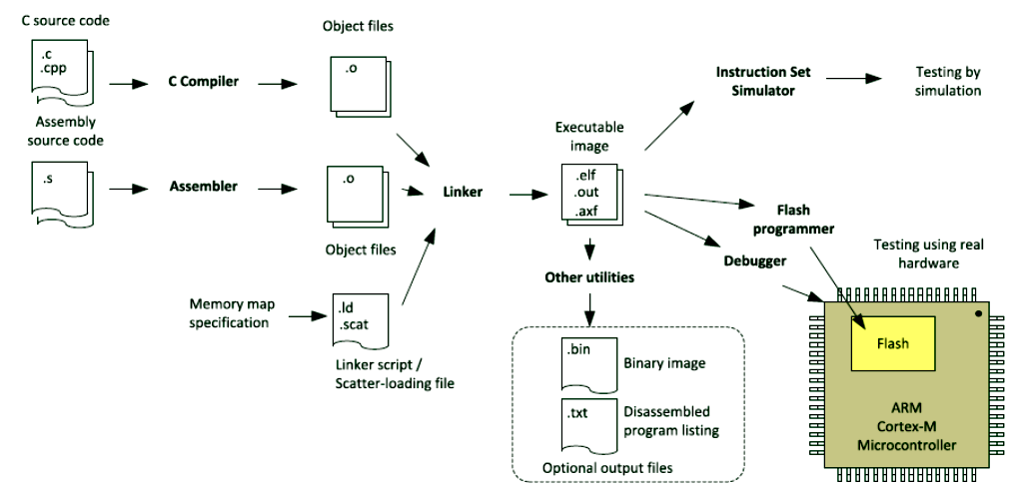
Software Compiling Flow

Slide 28
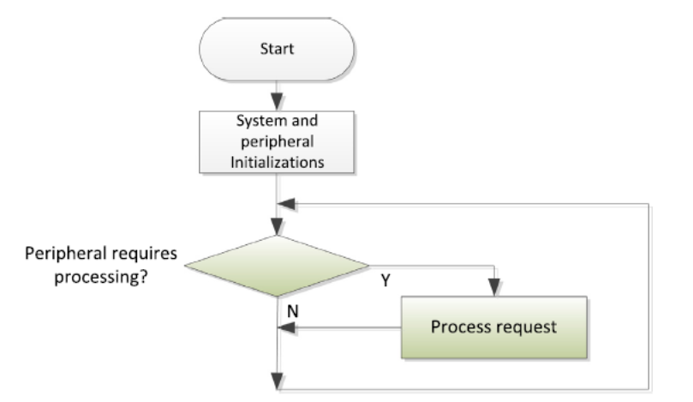
Polling Flow

Slide 29
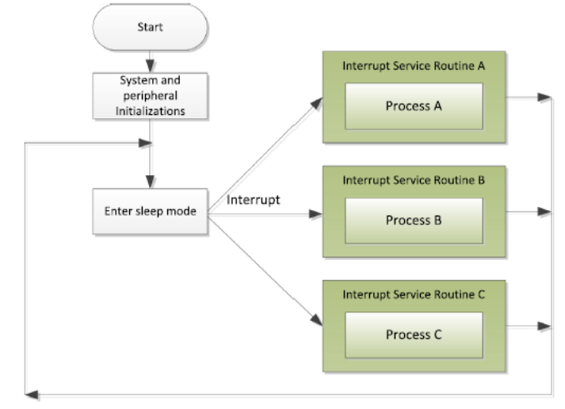
Interrupt Driven

Slide 30
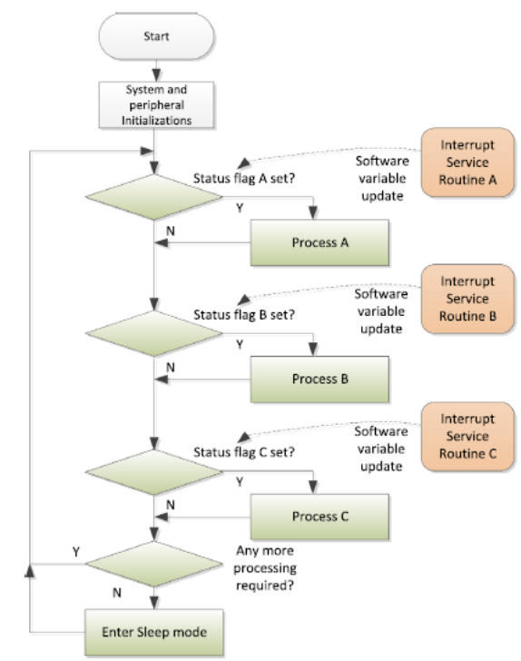
Multi Tasking System
In these applications, a Real-Time Operating System(RTOS) can be used to handle the task scheduling.
An RTOS allows multiple processes to be executed
concurrently, by dividing the processor’s time into time slots and allocating the time
slots to the processes that require services.

Slide 31
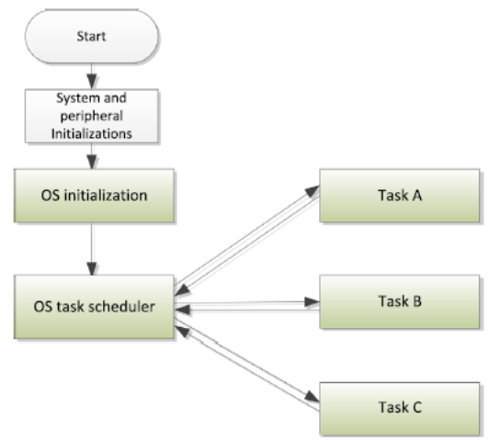
RTOS to Handle Multiple Task

Slide 32
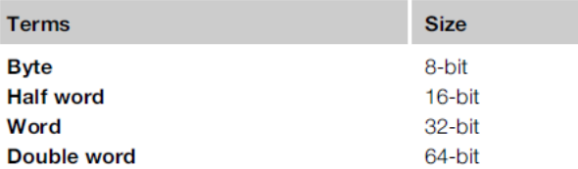
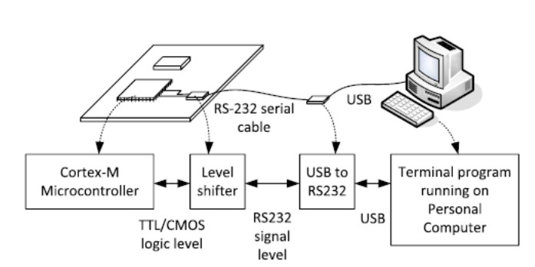
ARM Data Size Definition & Interfaces

Slide 33
Technical Overview
CDAC ACTS, Pune

Slide 34
Processor type and Architecture
All the ARM Cortex-M processors are 32-bit RISC (Reduced Instruction Set Computing) processors. They have:
32-bit registers
32-bit internal data path
32-bit bus interface
3 Stage Pipelining (FDE)
Harvard Bus Arch.(Simul. Instrn. Fetch & Data Access)
32-bit Addressing which allow 4GB address space
Load and Store Arch.
Processor Arch. ARMv7M

Slide 35
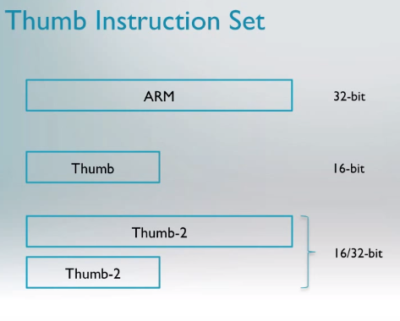

Instruction Set - Thumb2
High Performance
High Performance & High Code Density

Slide 36



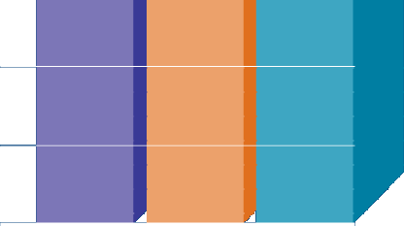





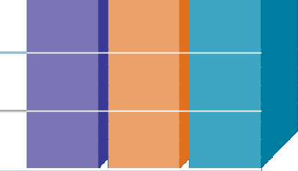


The Thumb-2 instruction set
▪
Variable-length instructions
ARM instructions are a fixed length of 32 bits
Thumb instructions are a fixed length of 16 bits
Thumb-2 instructions can be either 16-bit or 32-bit
Thumb-2 gives approximately 26% improvement in code density over ARM
Thumb-2 gives approximately 25% improvement in performance over Thumb

Slide 37
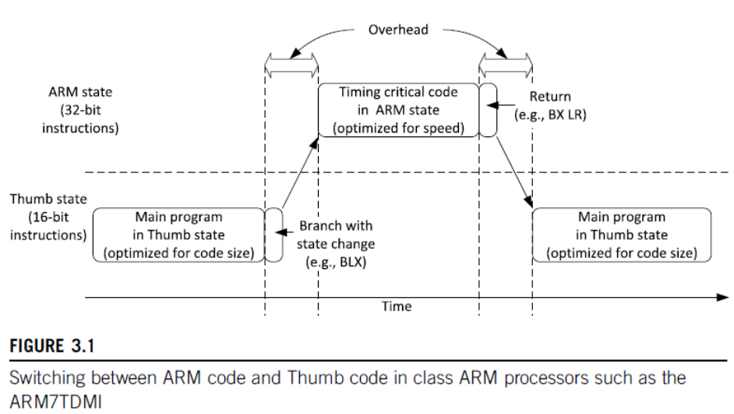
ARM and Thumb Mode Switching

Slide 38
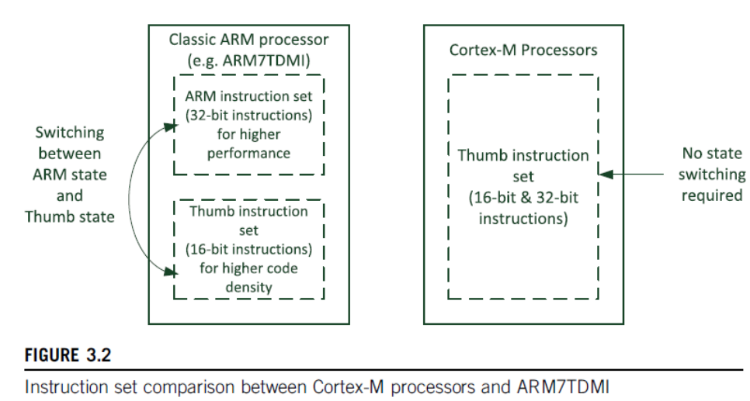
Thumb2 No Switching Req.

Slide 39
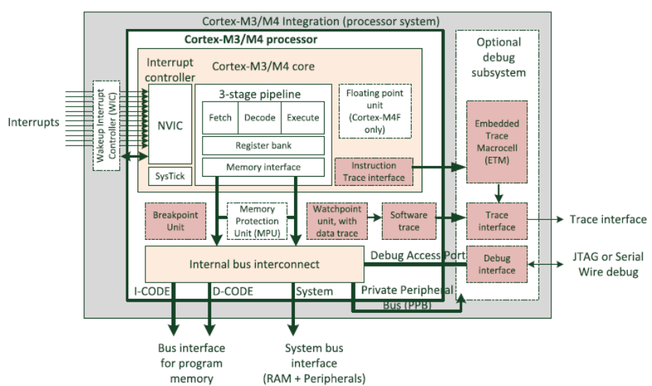
Block Diagram

Slide 40
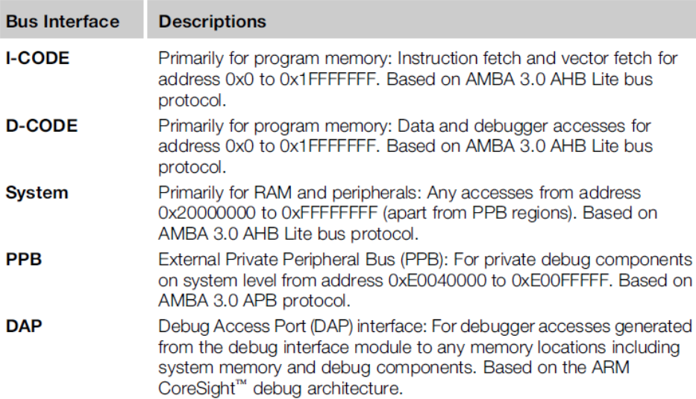
Various Bus Interfaces on Cortex M3

Slide 41
AMBA 3.0 System
High Performance ARM processor
APB
UART
High Bandwidth External Memory Interface
Timer
AHB
APB
Bridge
Keypad
High-bandwidth on-chip RAM
DMA
Bus Master
PIO
Low Power
Non-pipelined Simple Interface
High Performance Pipelined
Burst Support Multiple Bus Masters

Slide 42
STM32F407 Block Diagram

Slide 43
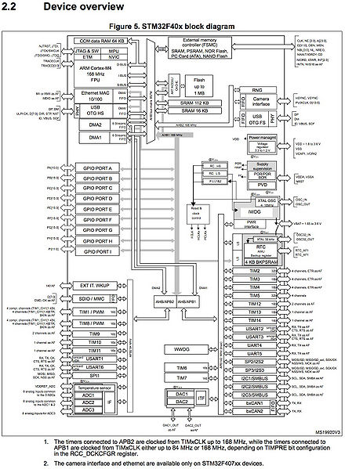
Link

Slide 44
Architecture
CDAC ACTS, Pune

Slide 45
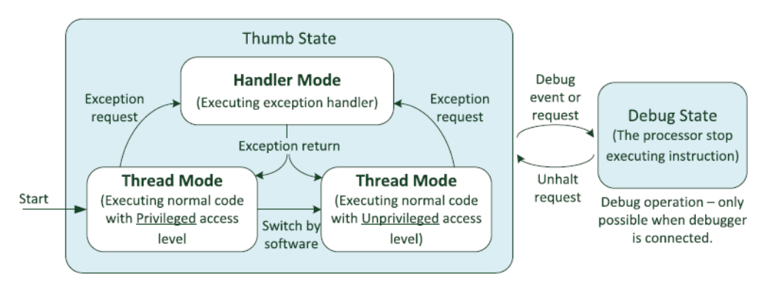
Programmer’s Model
Operation states and Modes

Slide 46
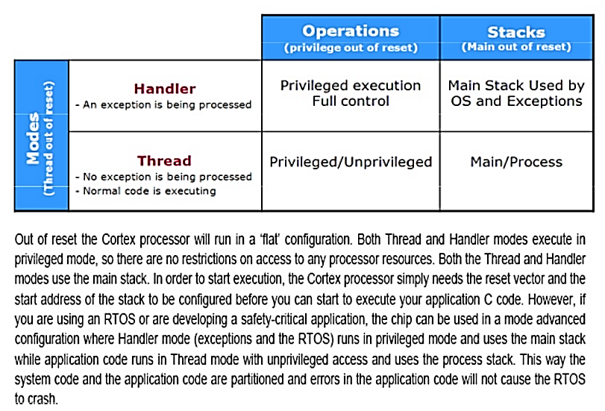
CPU Operating Modes – Cont.
Operation modes
• Handler mode: When executing an exception handler such as an Interrupt Service
Routine (ISR). When in handler mode, the processor always has privileged
access level.
• Thread mode: When executing normal application code, the processor can be
either in privileged access level or unprivileged access level. This is controlled by
a special register called “CONTROL.”

Slide 47
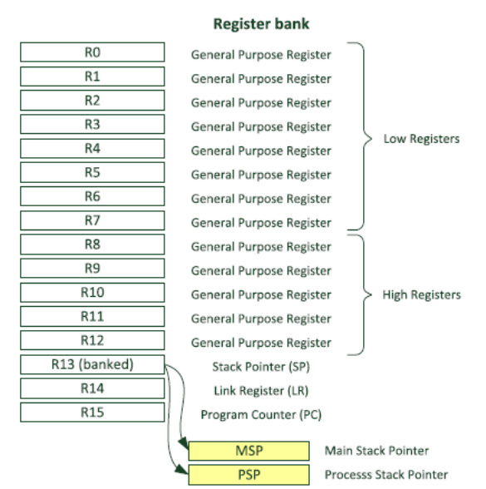
Register Set
  R0-R12
  General Purpose registers
  R0-R7 low registers due to limited space available in IS , many 16 bit instruction can only access the low registers.
  R8-R12 high registers can be used by 32-bit instruction
  Initial Value of R0-R12 are undefined.
  R13 Stack Pointer
  R14 Link Register
  R15 Program Counter

Slide 48
Stack Pointer –R13
Physically there are two different Stack Pointers:
Main Stack Pointer is the default Stack Pointer. It is selected after reset, or when the processor is in Handler Mode.
The other Stack Pointer is called the Process Stack Pointer. The PSP can only be used in Thread Mode. The selection of Stack Pointer is determined by a special register called CONTROL.
The PSP is normally used when an embedded OS is involved, where the stack for the OS kernel and application tasks are separated.

Slide 49
Link Register – R14
This is used for holding the return address when calling a function, subroutine or Exceptions.
At the end of the function or subroutine, the program control can return to the calling program and resume by loading the value of LR into the Program Counter (PC).
When a function or subroutine call is made, the value of LR is updated automatically.
If a function needs to call another function or subroutine, it needs to save the value of LR in the stack first. Otherwise, the current value in LR will be lost when the function call is made.

Slide 50
Program Counter – R15
It is readable and writeable:
a read returns the current instruction address plus 4 (this is due to the pipeline nature of the design, and compatibility requirement with the ARM7TDMI processor).
Writing to PC (e.g., using data transfer/processing instructions) causes a branch operation.

Slide 51
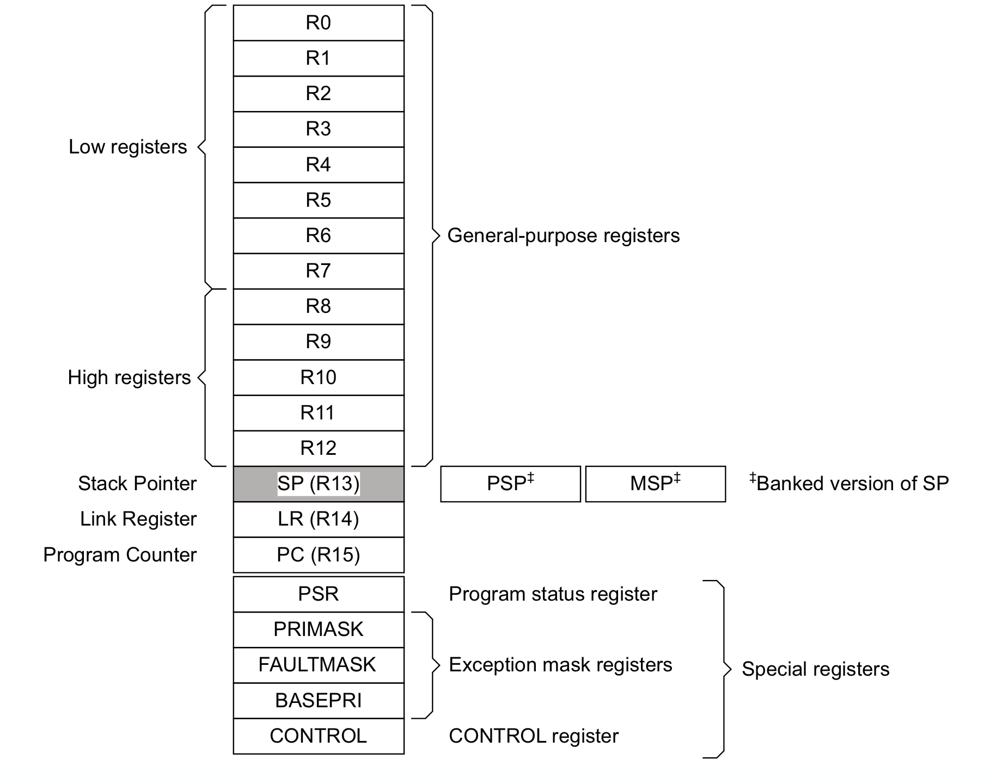
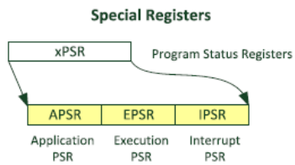
Special Registers
They are needed for development
of an embedded OS, or when advanced interrupt masking features are needed.
Special registers are not memory mapped, and can be accessed using special register
access instructions such as MSR and MRS(Move to ARM register from system coprocessor register).

Slide 52

Program Status Register
31
28 27 26 25 24 23
16 15
10
7
0
N Z C V
Q IT T
IT/ICI
ISR Number
One Status Register consisting of
APSR - Application Program Status Register – ALU flags
IPSR - Interrupt Program Status Register – Interrupt/Exception No.
EPSR - Execution Program Status Register
IT field – If/Then block information
ICI field – Interruptible-Continuable Instruction information
Please note:
• The ERSR cannot be accessed by software code directly using MRS (read as zero) or MSR
• The IPSR is read only and can be read from combined PSR (xPSR).

Slide 53
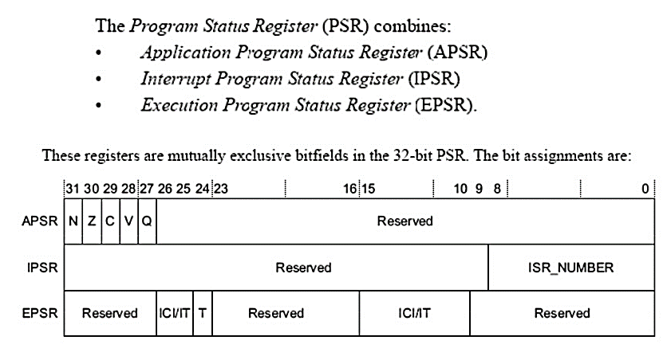
Program Status Register: xPSR

Slide 54
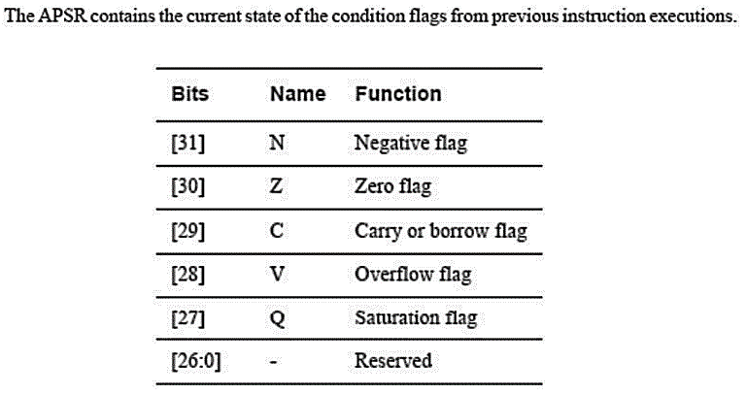
APSR
Bits 28 to 31 are alu condition code flags.
Q bit – sticky overflow flag , used by saturating instructions.
These alu are the only one you can modify in thread mode

Slide 55

Q Flag – Signed & Unsigned Saturation

Slide 56
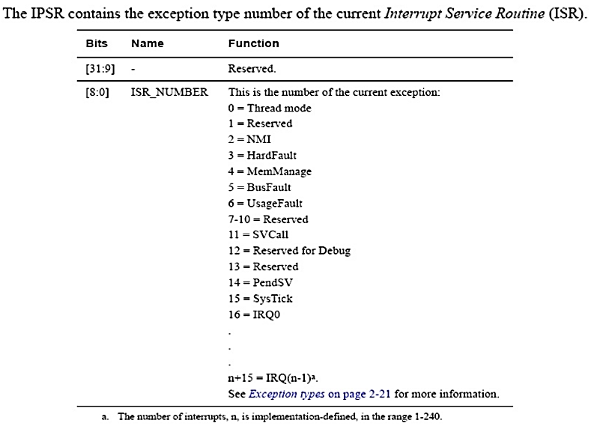
IPSR

Slide 57
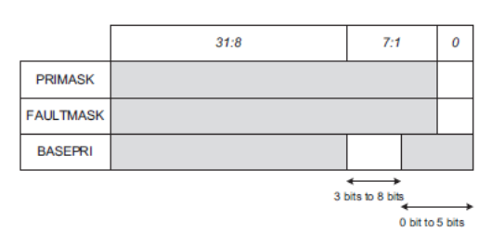
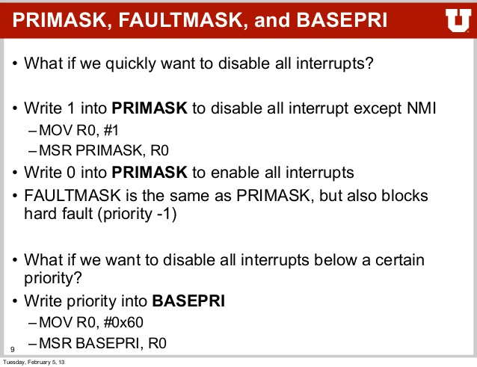
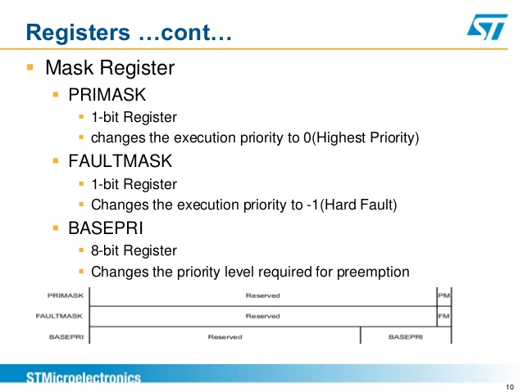
Mask registers

Slide 58
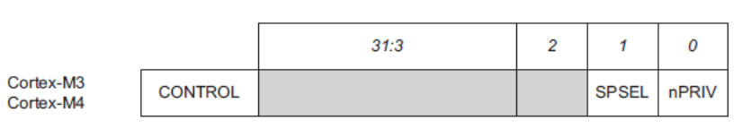
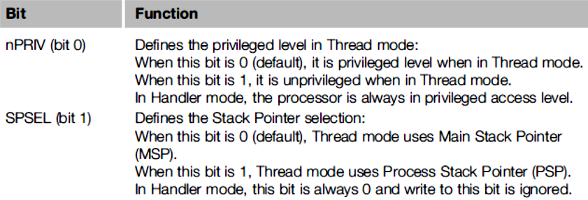
CONTROL register
The CONTROL register controls the stack used and the privilege level for software execution when the processor is in Thread mode.

Slide 59
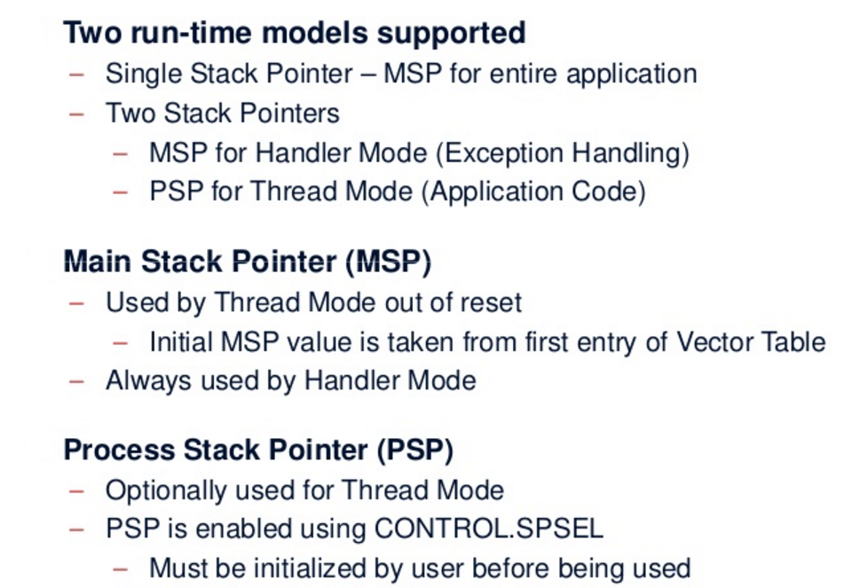
Stacks

Slide 60
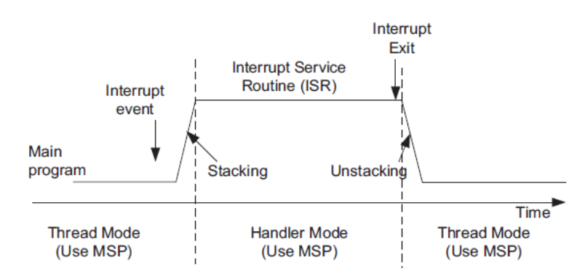
Both Thread and Handler using MSP

Slide 61
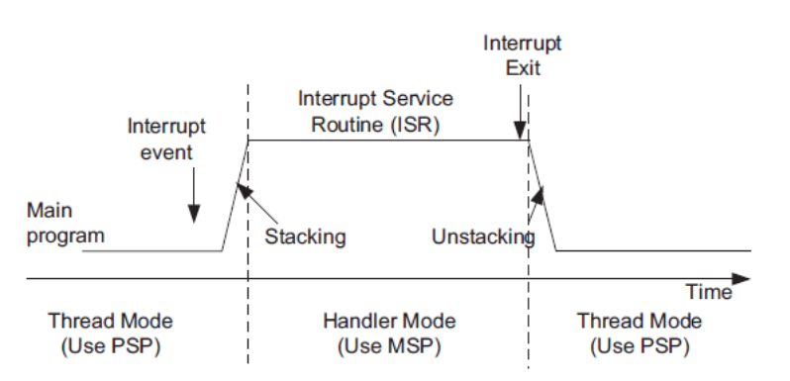
Thread uses PSP & Handler uses MSP

Slide 62
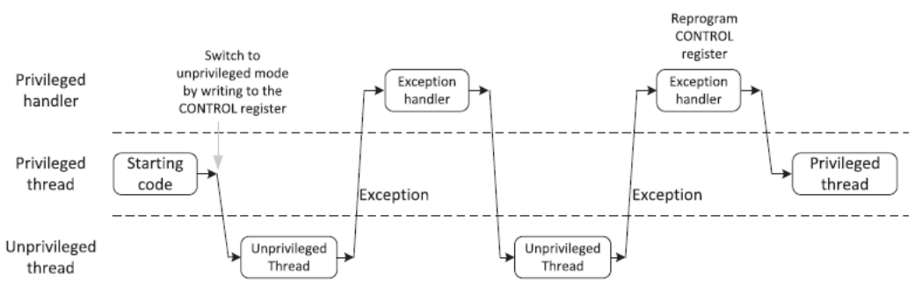
Switching Privileged & Unprivileged

Slide 63
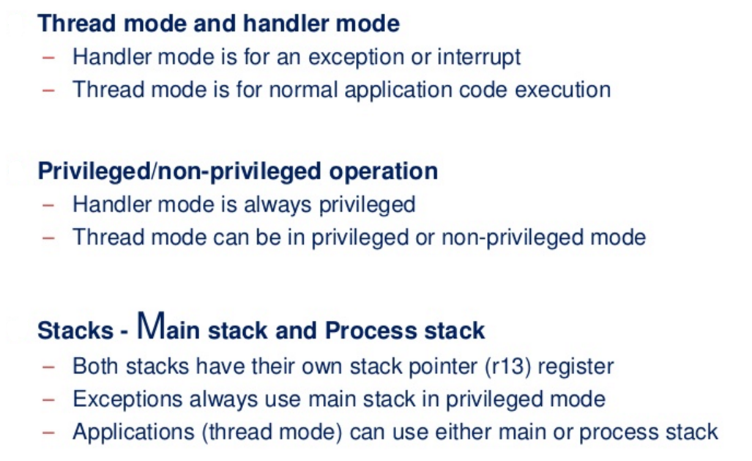
Privilege, Modes and Stacks

Slide 64
Memory System
Memory System features
  4GB linear address space
  Architecturally defined memory map
  Support for little endian and big endian memory systems
  Bit band accesses (optional)
  Write buffer - When a write transfer to a buffered memory region will take multiple cycles, the transfer can be buffered by the internal write buffer in the Cortex-M3 or Cortex-M4 processor so that the processor can continue to execute the next instruction, if possible. This allows higher program execution speed.
  Memory Protection Unit (Optional)
  Unaligned transfer support

Slide 65
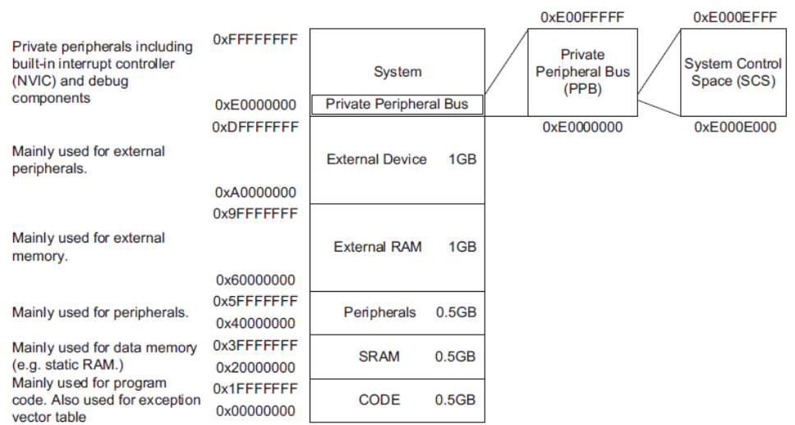
Memory Map

Slide 66
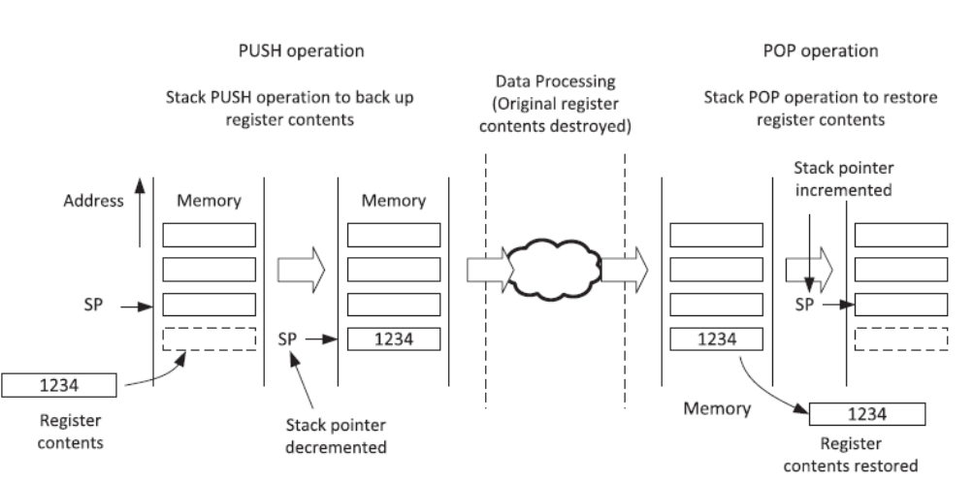
Stack Memory

Slide 67
Exceptions and Interrupts
What are exceptions?
  Exceptions are events that cause changes to program flow. When one happens, the processor suspends the current executing task and executes a part of the program called the exception handler.
  After the execution of the exception handler is completed, the processor then resumes normal program execution.
  In the ARM architecture, interrupts are one type of exception. Interrupts are usually generated from peripheral or external inputs, and in some cases they can be triggered by software.
  The exception handlers for interrupts are also referred to as Interrupt Service Routines (ISR).

Slide 68
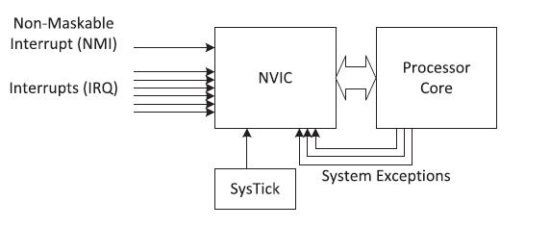
Various Exception sources

Slide 69
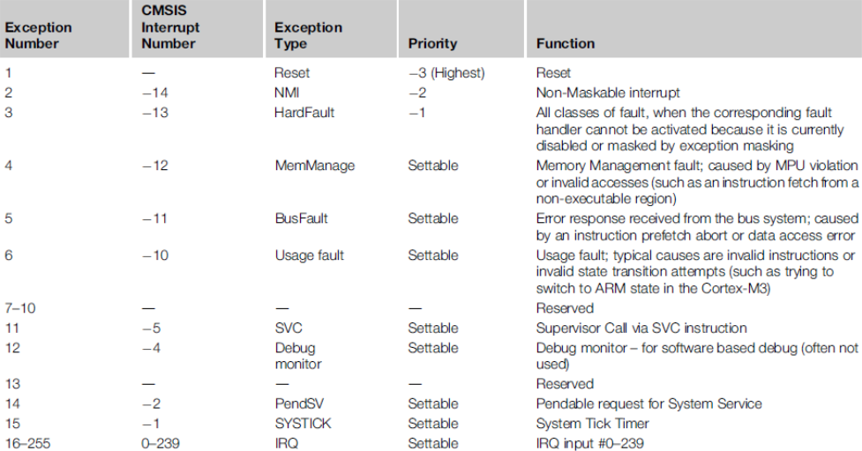
Exception Types

Slide 70
Nested Vectored Interrupt Controller
Features
  Flexible exception and interrupt management
    Each interrupt (apart from the NMI) can be enabled or disabled and can have its pending status set or cleared by software.
  Nested exception/interrupt support
    Each exception has a priority level. Some exceptions, such as interrupts, have programmable priority levels and some others (e.g., NMI) have a fixed priority level. When an exception occurs, the NVIC will compare the priority level of this exception to the current level. If the new exception has a higher priority, the current running task will be suspended.
  Vectored exception/interrupt entry
    The Cortex-M processors automatically locate the starting point of the exception handler from a vector table in the memory. As a result, the delays from the start of the exception to the execution of the exception handlers are reduced.
  Interrupt masking

Slide 71
Starting Address of Exception Handler
To determine the starting address of the exception handler, a vector table mechanism is used.
The vector table is an array of word data inside the system memory, each representing the starting address of one exception type.
Example :The vector table is located at address 0x0 after reset.
if the reset is exception type 1, the address of the reset vector is 1 times 4 (each word is 4 bytes), which equals 0x00000004, and the NMI vector (type 2) is located at 2 x 4 = 0x00000008.
The address 0x00000000 is used to store the starting value of the MSP.
The LSB of each exception vector indicates whether the exception is to be executed in the Thumb state. Since the Cortex-M processors can support only Thumb instructions, the LSB of all the exception vectors should be set to 1.

Slide 72
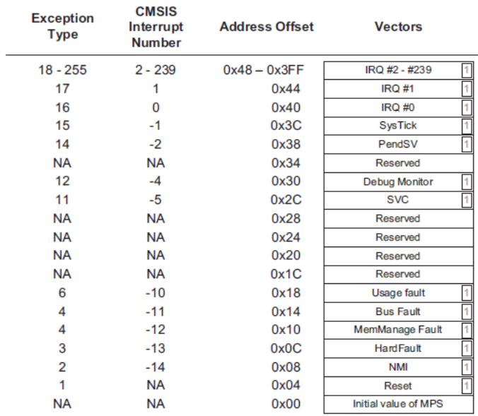
Vector Table
LSB of exception vectors should be set to 1 to indicate Thumb state

Slide 73
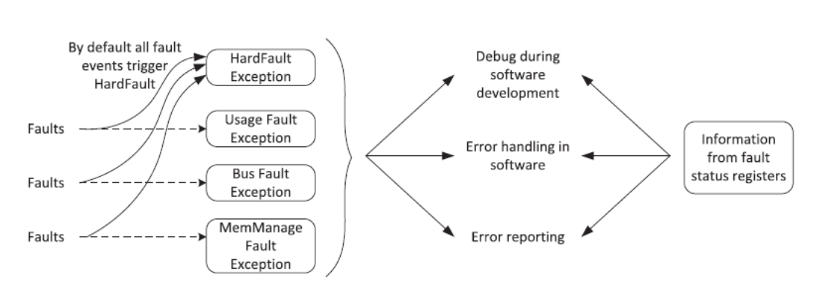
Fault Handling

Slide 74
System Control Block (SCB)
One part of the processor that is merged into the NVIC unit is the SCB. The SCB contains various registers for:
  Controlling processor configurations (e.g., low power modes)
  Providing fault status information (fault status registers)
  Vector table relocation (VTOR)
The SCB is memory-mapped. Similar to the NVIC registers, the SCB registers are accessible from the System Control Space (SCS).

Slide 75
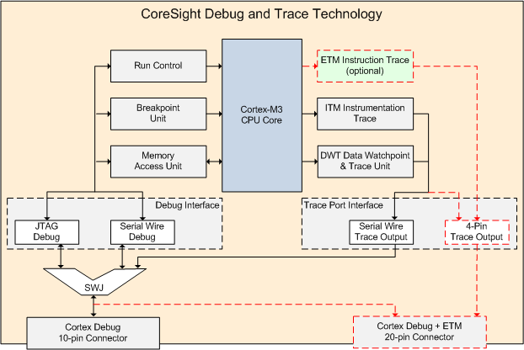
Core Sight Debug and Trace Technology

Slide 76
Core Sight features
Core Sight features can be accessed through a JTAG or Serial Wire interface. Debugging in JTAG and Serial Wire mode at the same time is not possible. Cortex-M processor-based devices can include a:
Debug Interface
The debug interface offers two modes:
JTAG Debug is the industry-standard interface that allows device chaining.
Serial Wire Debug is a 2-pin interface with an optional Serial Wire Trace Output. In contrast to JTAG, devices cannot be chained.
The Debug Interface communicates with the following units:
Run Control: allows the user to start, stop, and single-step through the source code.
Breakpoint Unit: allows the user to set breakpoints even while the processor is running.
Memory Access Unit: allows the user to read or write to memory and peripheral registers even while the program is running.

Slide 77
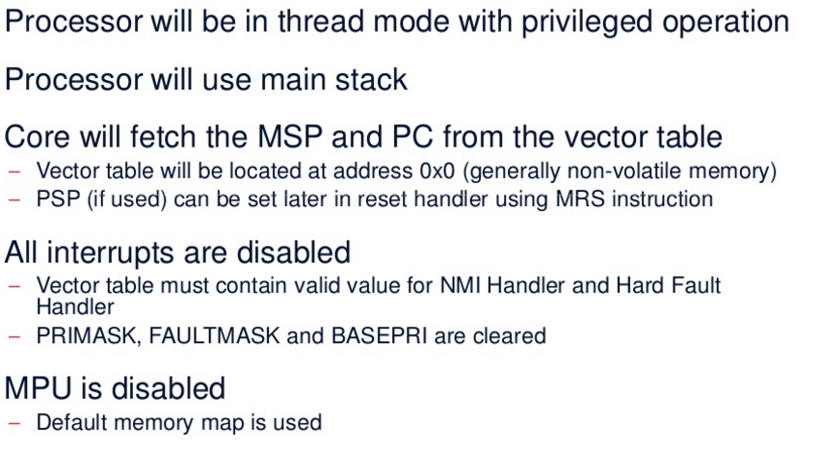
Cortex Reset Sequence & Startup

Slide 78
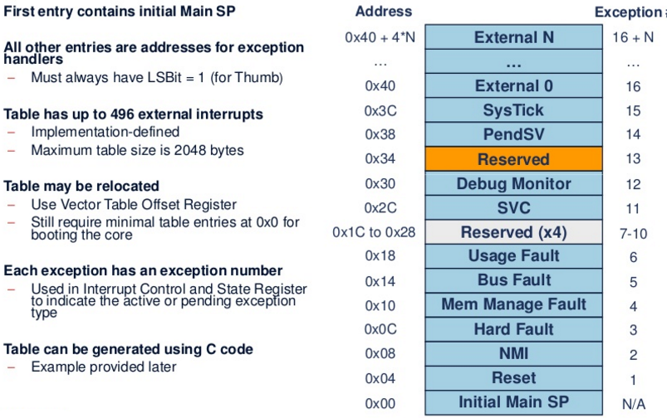
Vector Table at Startup

Slide 79
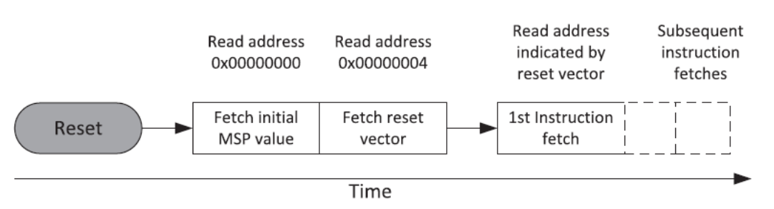
Reset Sequence

Slide 80
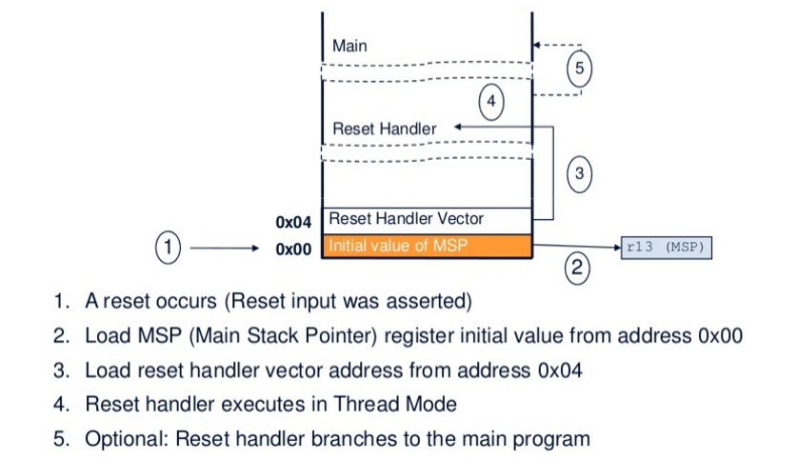
Reset Behavior

Slide 81
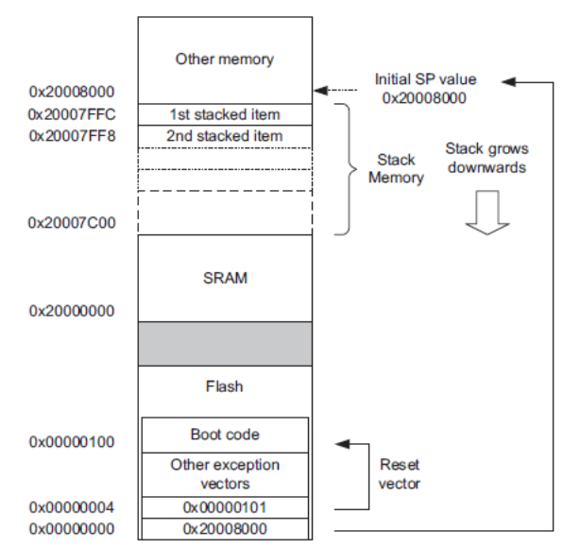
Status of SP and PC during reset

Slide 82
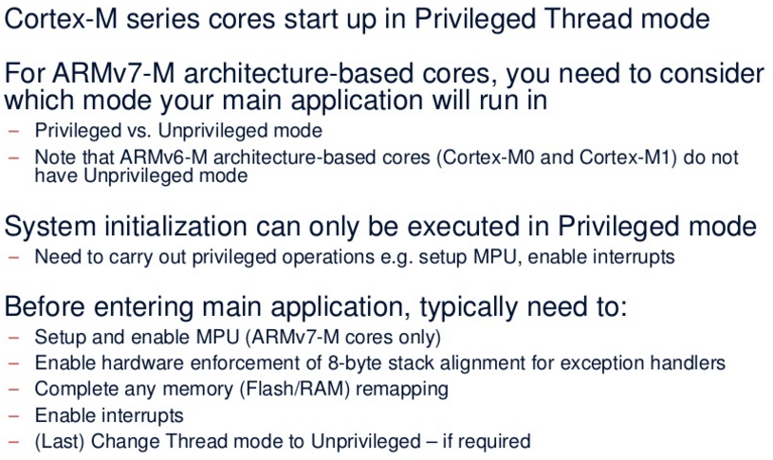
Initialization Summary

Slide 83
Memory System
CDAC ACTS, Pune

Slide 84
Agenda
Memory Map
Connecting the processor to memory and peripheral
Memory Requirements
Memory Endianness
Data alignment and Unaligned data access
Bit-band operations
Default Memory Access permissions
Exclusive access
Memory Barrier
Memory System in a microcontroller

Slide 85
Memory Map

Slide 86


Slide 87


Memory Endianness
The Cortex-M3 (byte-invariant big-endian, BE-8) – Data on
the AHB Bus
Little Endian – Data on the AHB Bus

Slide 88

Data alignment and unaligned data access

Slide 89
Memory Access attributes
Bufferable: Write to memory can be carried out by a write buffer while the processor continues on to next instruction execution.
Cacheable: Data obtained from memory read can be copied to a memory cache so that next time it is accessed the value can be obtained from the cache to speed up program execution.
Executable: The processor can fetch and execute program code from this memory region.
Sharable: Data in this memory region could be shared by multiple bus masters. The memory system needs to ensure coherency of data between different bus masters in the shareable memory region.

Slide 90

Exclusive Access in MUTEX semaphore

Slide 91
Memory system in a Microcontroller
In many microcontroller devices, the designs integrate additional memory system features such as:
Boot loader
Memory remapping
Memory alias
There are many different reasons why chip designers put a boot loader into the system. For example, to:
Provide a flash programming utility, so that you can program the flash using a simple UART interface, or even program some parts of the flash memory dynamically.
Provide Built-In Self Test (BIST) for the chip.

Slide 92
Bootloaders and Memory Remapping
For chips with a boot loader ROM, the boot loader is executed when the system is started, so it has to be located in address 0 when the system starts at power up.
However, the next time the system starts, it might not need to execute the boot loader again and can run the application in the flash directly, so the memory map needs to be changed.
In order to do this, the address decoder needs to be programmable. A hardware register (e.g., a peripheral register in a system control unit) can be used.
The operation to switch the memory map is called “Memory Remap.” This operation is done by the boot loader.

Slide 93


Slide 94

Memory remap implementation with boot loader

Slide 95
Possibilities of Re-mapping
Normally the boot loader is accessible from address 0 using a memory address alias, and the alias can be turned off. There are many possible memory system configurations. What is shown in prev. slide is just one of the possibilities.
In some microcontrollers, memory remapping is not needed as the boot loaders present in address 0 are executed every time the system starts up.
The vector table is then relocated using the vector table relocation feature provided by the processor, so there is no need to use any remap to handle vector fetches.

Slide 96
Exceptions and Interrupts
CDAC ACTS, Pune

Slide 97
Exception Type

Slide 98

Exception types

Slide 99


Slide 100

List of Interrupts

Slide 101


Definition of Priority
A priority-level register with 3 bits implemented (8 programmable priority levels)
A priority-level register with 4 bits implemented (16 programmable priority levels)

Slide 102


Slide 103
Group Priority
if the priority-level configuration registers are 8-bits wide, there are only 128 pre-emption levels?
This is because the 8-bit register is further divided into two parts: group priority and sub-priority.
Using a configuration register in the System Control Block (SCB) called Priority Group
the priority-level configuration registers for each exception with programmable priority levels is divided into two halves.
The group priority level defines whether an interrupt can take place when the processor is already running another interrupt handler.
The sub-priority level is used only when two exceptions with same group-priority level occur at the same time.

Slide 104

Group Priority

Slide 105
Vector Table and its Relocation
When the Cortex-M processor accepts an exception request, the processor needs to determine the starting address of the exception handler (or ISR if the exception is an interrupt).
This information is stored in the vector table in the memory. By default, the vector table starts at memory address 0.
The vector table is normally defined in the startup codes provided by the microcontroller vendors.
Usually, the starting address (0x00000000) should be boot memory, and it will usually be either flash memory or ROM devices.
The Vector Table Relocation feature provides a programmable register called the Vector Table Offset Register (VTOR)

Slide 106

Vector Table Offset Register

Slide 107

Vector Table Relocation for Boot Rom

Slide 108

Booting from Pen Drive or SD Card

Slide 109
Interrupt Inputs and Pending Behavior
There are various status attributes applicable to each interrupt:
• Each interrupt can either be disabled (default) or enabled
• Each interrupt can either be pending (a request is waiting to be served) or not pending
• Each interrupt can either be in an active (being served) or inactive state
An interrupt request can be accepted
by the processor if:
• The pending status is set,
• The interrupt is enabled, and
• The priority of the interrupt is higher than the current level

Slide 110

Interrupt pending and activation behavior

Slide 111
Exceptions Handling In Detail
CDAC ACTS, Pune

Slide 112

Exception entrance and stacking

Slide 113

Nested Interrupt Stacking

Slide 114
Interrupt Handling
▪
▪
One Non-Maskable Interrupt (INTNMI) supported 1-240 prioritizable interrupts supported
▪
▪
Interrupts can be masked
Implementation option selects number of interrupts supported
▪
▪
Nested Vectored Interrupt Controller (NVIC) is tightly coupled with processor core Interrupt inputs are active HIGH
INTNMI
1-240 Interrupts INTISR[239:0]
NVIC
Cortex-M3 Processor Core
…
Cortex-M3

Slide 115

NVIC Operations Exception Entry/Exit

Slide 116

Interrupt Preemption

Slide 117
Low Power and System Control Features
CDAC ACTS, Pune

Slide 118
Power Management
▪
Multiple sleep modes supported
Controlled by NVIC
Sleep Now – Wait for Interrupt/Event instructions
Sleep On Exit – Sleep immediately on return from last ISR
Deep Sleep
  Long duration sleep, so PLL can be stopped
  Exports additional output signal SLEEPDEEP
▪
Cortex-M3 system is clock gated in all sleep modes
Sleep signal is exported allowing external system to be clock gated also
NVIC interrupt Interface stays awake
▪
Wake-Up Interrupt Controller (WIC)
External wake-up detector allows Cortex-M3 to be fully powered down
Effective with State-Retention / Power Gating (SRPG) methodology

Slide 119
The Cortex microcontroller software interface standard (CMSIS)
• CMSIS was developed by ARM to allow microcontroller and software vendors to use a consistent software infrastructure to develop software solutions for Cortex-M microcontrollers.
• Many software products for Cortex-M microcontrollers are CMSIS-compliant.
Currently the Cortex-M microcontroller market comprises:
• More than 15 microcontroller vendors shipping Cortex-M microcontroller
products, with some other silicon vendors providing Cortex-M based
FPGA and ASICs
• More than 10 toolchain vendors
• More than 30 embedded operating systems
• Additional Cortex-M middleware software providers for codecs, communication
protocol stacks, etc.
With such a large ecosystem, some form of standardization of the way the software
infrastructure works becomes necessary to ensure software compatibility with
various development tools and between different software solutions.

Slide 120
CMSIS
To Increase the interoperability of various software components , ARM worked with various microcontroller vendors, tools vendors, and software solution providers to develop CMSIS, a software framework covering most Cortex-M processors and Cortex-M microcontroller products.
The aims of CMSIS include:
• Enhanced software reusability - makes it easier to reuse software code in
different Cortex-M projects, reducing time to market and verification efforts.
• Enhanced software compatibility - by having a consistent software infrastructure
(e.g., API for processor core access functions, system initialization method,
common style for defining peripherals), software from various sources can work
together, reducing the risk in integration.
• Easy to learn - the CMSIS allows easy access to processor core features
from the C language. In addition, once you learn to use one Cortex-M
microcontroller product, starting to use another Cortex-M product is much easier
because of the consistency in software setup.
• Toolchain independent - CMSIS-compliant device drivers can be used with
various compilation tools, providing much greater freedom.
• Openness - the source code for CMSIS core files can be downloaded and
accessed by everyone, and everyone can develop software products with CMSIS.

Slide 121
CMSIS Projects
• CMSIS-Core (Cortex-M processor support)
• CMSIS-DSP library
• CMSIS-SVD - the CMSIS System View Description
• CMSIS-RTOS - the CMSIS-RTOS is an API specification for embedded OS
• CMSIS-DAP - the CMSIS-DAP (Debug Access Port)

Slide 122
Standardization in CMSIS-Core
Standardized access functions to access processor’s features - These include various functions for interrupt control using NVIC, and functions for accessing special registers in the processors.
Standardized functions for system initialization - Most modern feature-rich microcontroller products require some configuration of clock circuitry and power management registers before the application starts. In CMSIS-compliant
device-driver libraries, these configuration steps are placed in a function called “SystemInit().” However, having a standardized function name and a standardized location where this function can be found makes it much easier for a designer to pick up and start using a new Cortex-M microcontroller device.
Standardized software variables for clock speed information - This might not be obvious, but often our application code does need to know what clock frequency the system is running at. For example, such information might be needed for setting up the baud rate divider in a UART, or to initialize the SysTick timer for an embedded OS. A software variable called “SystemCoreClock” is defined in the CMSIS-Core.

Slide 123
Organization of CMSIS-Core
In a general sense, we can define the CMSIS into multiple layers:
• Core Peripheral Access Layer - Name definitions, address definitions, and helper functions to access core registers and core peripherals. This is processor specific and is provided by ARM.
• Device Peripheral Access Layer - Name definitions, address definitions of peripheral registers, as well as system implementations including interrupt assignments, exception vector definitions, etc. This is device specific (note: multiple devices from the same vendor might use the same file set).
• Access Functions for Peripherals - The driver code for peripheral accesses. This is vendor specific and is optional. You can choose to develop your application using the peripheral driver code provided by the microcontroller vendor, or you can program the peripherals directly if you prefer.
There is also a proposed additional layer for peripheral accesses:
Middleware Access Layer - This layer does not exist in current version of CMSIS. The idea is to develop a set of APIs for interfacing common peripherals such as UART, SPI, and Ethernet. If this layer exists, developers of middleware can develop their applications based on this layer to allow software to be ported between devices easily.

Slide 124

CMSIS-Core structure

