Slide 1
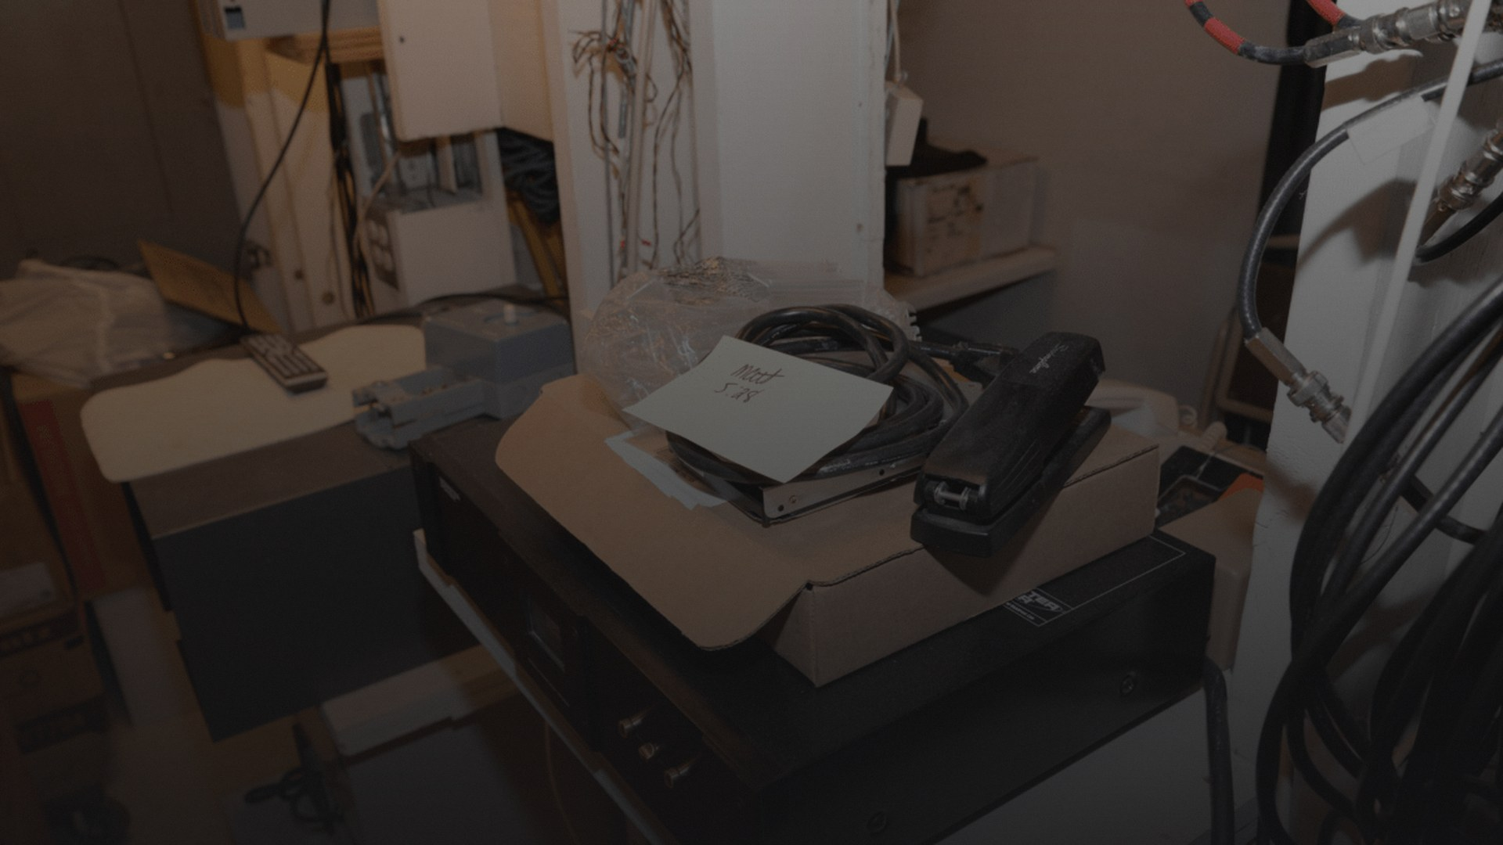
THE DRAWER WE ALL HAVE.
you know which one._
3.4 dead devices per household. Sitting. Waiting. Leaking.
01
Notes:
I want you to picture a specific place in your home. The junk drawer. The shoebox on the top shelf. The plastic bin in the garage you haven't opened in two years.
It's full of cables you don't recognize anymore, phones that won't power on, chargers for devices you sold three years ago, earbuds with one dead side. The average American household has 3.4 unused electronic devices just sitting there — according to the EPA's 2021 consumer electronics data.
That drawer is not harmless. It's not neutral. It is the opening scene of an environmental catastrophe that spans continents. And the fact that we all have one — that's exactly why this problem is both universal and invisible.

Slide 2
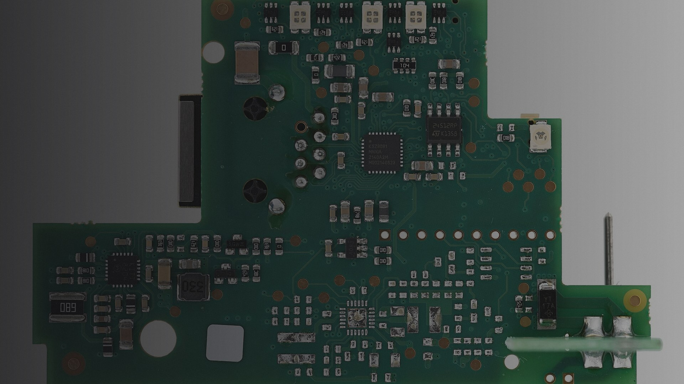
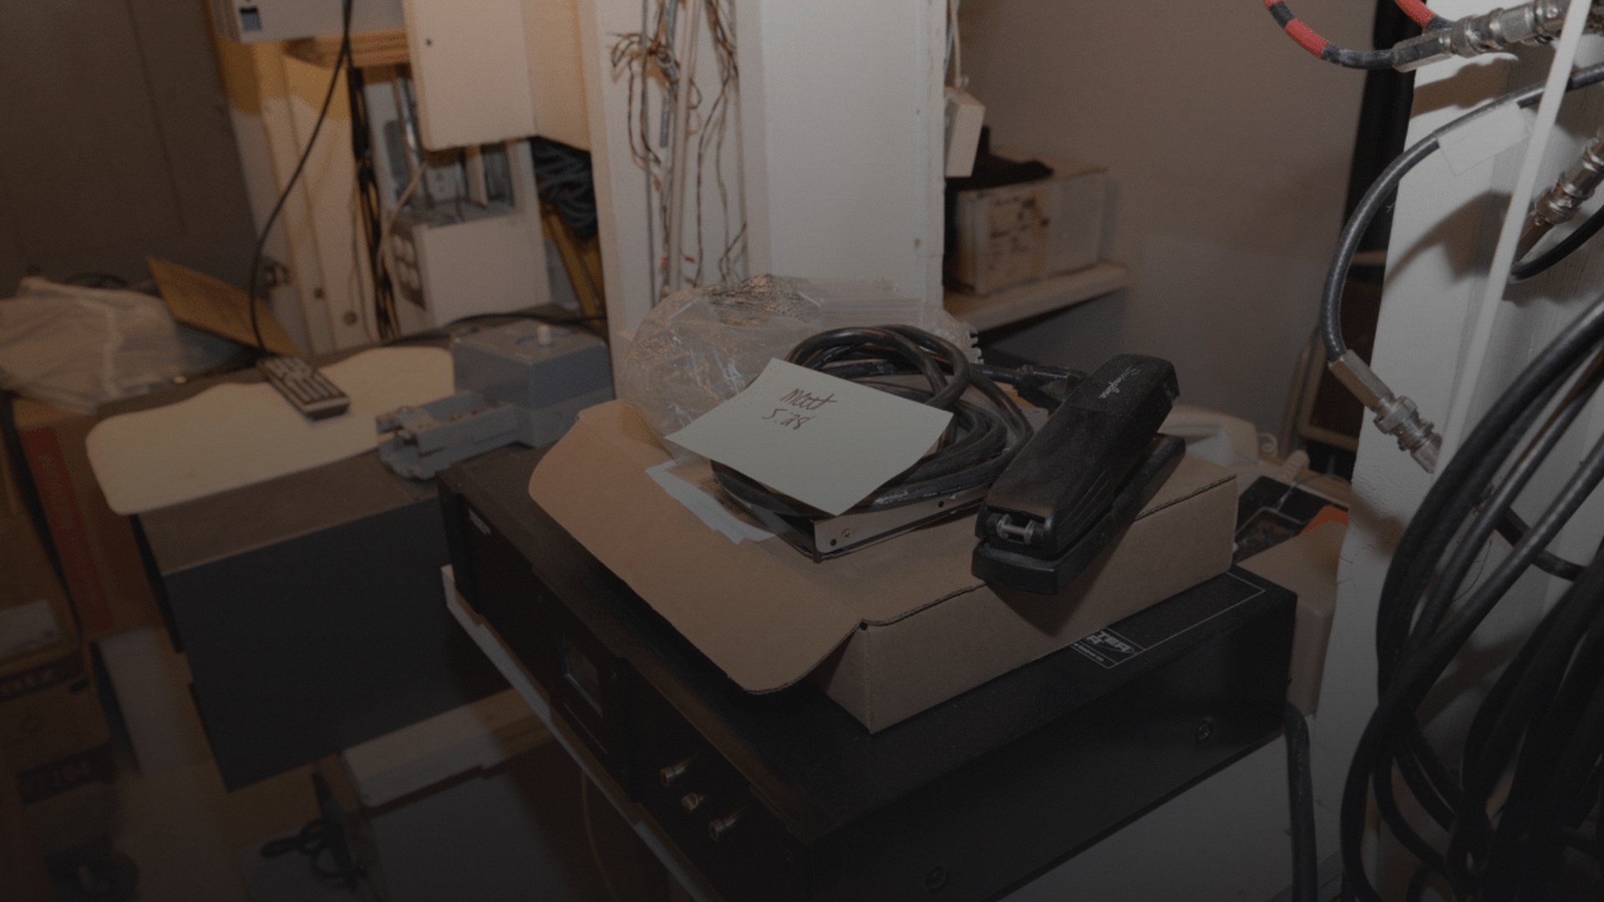
EVERY UPGRADE LEAVES SOMETHING BEHIND.
Planned obsolescence is not a bug. It's the business model.
Average smartphone lifespan: 2.5 years. Designed lifespan: 7+ years.
02
Notes:
Here's the ugly math. The average smartphone is kept for about 2.5 years before replacement — not because it broke, but because the manufacturer stopped supporting it, the battery degraded past usefulness (and they glued it in so you can't replace it), or the new model made yours feel slow by comparison.
This isn't accidental. Planned obsolescence — the deliberate engineering of a product's end-of-life — has been a documented corporate strategy since the 1920s (look up the Phoebus cartel and lightbulbs). Today it manifests as: software updates that brick older hardware, proprietary pentalobe screws, serialized parts that refuse to work if swapped, and warranty stickers that say 'opening this voids everything.'
The result: ~1.5 billion phones sold every year. Not because 1.5 billion phones broke.

Slide 3
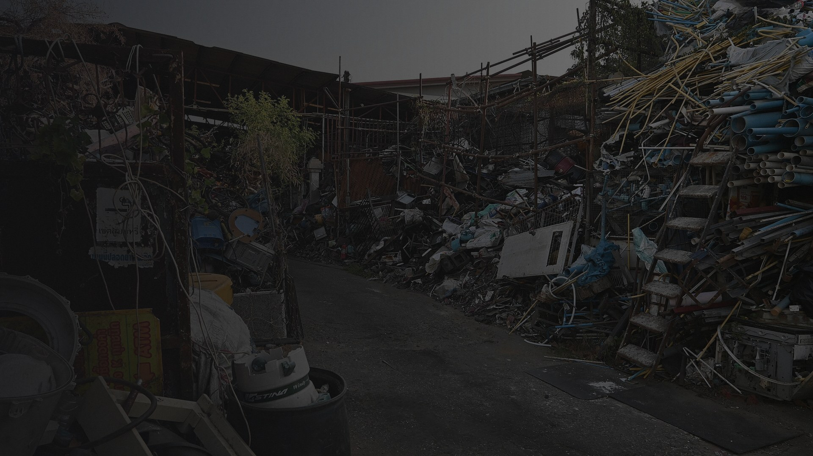
LOCAL LANDFILLS.
LOCAL TOXINS.
LOCAL CONSEQUENCES.
Pb · Hg · Cd · BFRs
These aren't abstract chemicals.
They're in the soil. The water.
The kids playing outside.
70% of heavy metals in U.S. landfills
come from discarded electronics.
03
Notes:
Let's get local. Let's get uncomfortable.
According to the EPA, electronic waste constitutes only 2% of what's in American landfills — but accounts for 70% of the heavy metals. Lead from solder joints. Mercury from flat-panel backlights. Cadmium from NiCd batteries. Brominated flame retardants from plastic housings.
And here's what makes this an environmental justice issue, not just an environmental issue: the communities that live nearest to landfills and informal recycling sites are disproportionately low-income and communities of color. A 2019 study in Environmental Health Perspectives found blood lead levels in children living within 2km of e-waste processing sites were 30-50% higher than regional averages.
This isn't happening 'somewhere else.' It's happening in specific ZIP codes, to specific families, right now.

Slide 4
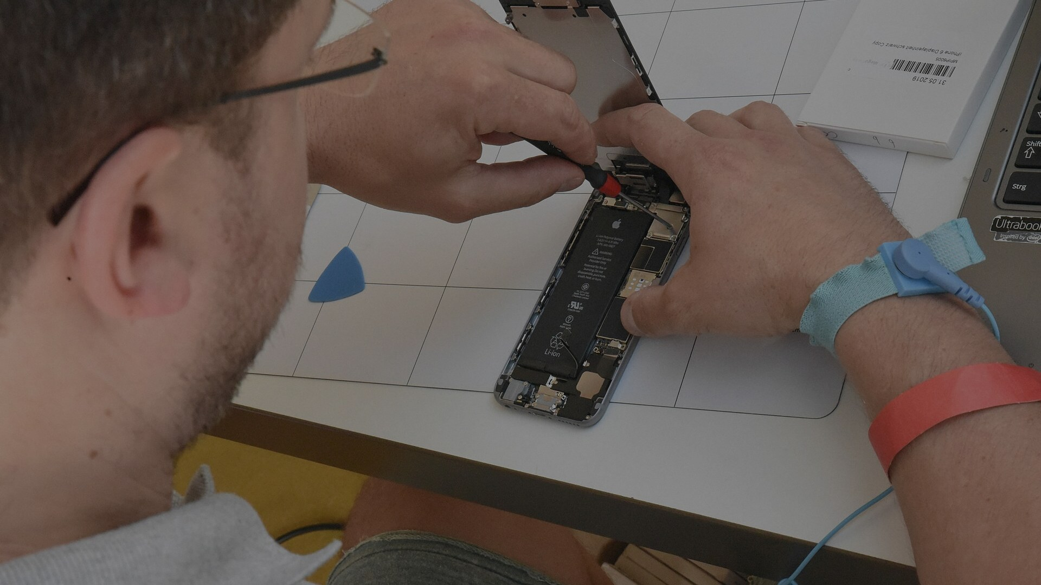
YOUR DEVICE.
YOUR CHOICE.
YOUR RIGHT.
the repair movement begins here.
40+ U.S. states introduced repair bills (2023)
EU mandated 10-year spare parts access (2021)
iFixit repairability scores now influence FTC action
04
Notes:
The Right to Repair movement is the direct, grassroots answer to planned obsolescence.
It argues a simple principle: if you bought it, you own it — and you should have the legal right to fix it. That means access to spare parts at fair prices, diagnostic tools and schematics, and freedom from software locks that brick a device when you replace a component.
This isn't fringe anymore. By 2023, over 40 U.S. states had introduced some form of repair legislation. The EU passed regulations in 2021 requiring manufacturers to provide spare parts for up to 10 years. Apple — the poster child for anti-repair practices — was forced to launch a Self Service Repair program in 2022 after years of public pressure and FTC scrutiny.
On the ground: repair cafes have exploded. There are now over 2,500 registered repair cafes globally, staffed by volunteers who'll fix your toaster, your laptop, your jacket zipper. Community tool libraries lend out iFixit kits. YouTube teardown channels have millions of subscribers.
This is what a movement looks like before it wins.

Slide 5
53.6M
METRIC TONNES. ONE YEAR. ONE PLANET.
The fastest-growing waste stream on Earth.
generated — 53.6 Mt
recycled — only 17.4%
That gap — 44 million tonnes — is heavier than every
commercial aircraft ever built. Combined.
Global E-Waste Monitor 2020
Forti, Balde, Kuehr & Bel
UNU/UNITAR-SCYCLE | ITU | ISWA
05
Notes:
Numbers time. Let them land.
53.6 million metric tonnes. That's how much electronic waste the world generated in 2019 alone, according to the Global E-Waste Monitor 2020 — the most comprehensive study ever conducted on this topic, published by the United Nations University.
Of that: only 17.4% was formally collected, tracked, and recycled in an environmentally sound way. The rest — 44.3 million tonnes — was dumped in landfills, burned in open pits, exported under false documentation, or simply lost into informal economies with no environmental oversight.
For scale: 44 million tonnes is heavier than the combined weight of every commercial aircraft ever manufactured in human history. Every Boeing. Every Airbus. Every regional jet. All of it. That's ONE YEAR of unrecycled e-waste.
And the number is growing at 3-5% annually. By 2030 it's projected to hit 74 million tonnes.
The drawer you saw on slide one? It exists in roughly one billion homes worldwide. Almost none of it has somewhere safe to go.

Slide 6

WHAT WE DISCARD,
OTHERS INHERIT.
Agbogbloshie, Ghana — children burn circuit boards for copper. No masks. No gloves.
Guiyu, China — groundwater lead: 190x safe limits. Cancer clusters documented.
New Delhi, India — acid baths in residential streets to extract gold from motherboards.
06
Notes:
This is where it goes. This is 'away.'
Despite international agreements like the Basel Convention — which explicitly bans the export of hazardous waste from developed to developing nations — e-waste still flows freely through loopholes labeled 'secondhand goods' or 'donations.'
Agbogbloshie in Accra, Ghana became infamous as one of the world's largest informal e-waste processing sites. Workers — many of them children as young as 5 — burn insulation off copper wiring, crack open CRT monitors with hammers, and melt solder off circuit boards over open fires. The air is thick with dioxins. A 2011 Blacksmith Institute report ranked it among the world's 10 most polluted places.
Guiyu, China processed e-waste for decades until the government cracked down. By then, groundwater lead levels were measured at 190 times WHO safe limits. Miscarriage rates were six times the national average.
This is not recycling. This is cost externalization at a civilizational scale. We get the shiny upgrade. They get the cancer.

Slide 7
ONE REPAIR. ONE LESS DEVICE. ONE LESS TON.
the local-global feedback loop
LOCAL REPAIR
CULTURE GROWS
GLOBAL E-WASTE
LOAD REDUCED
DEMAND FOR NEW
DEVICES DROPS
PRODUCTION &
MINING DECREASE
MANUFACTURERS FACE
MARKET PRESSURE
individual action → systemic pressure → structural change
07
Notes:
This is the intellectual core of the argument. This is why repair isn't just a nice consumer-rights thing — it's an environmental systems intervention.
Follow the loop:
1. Local repair culture grows — repair cafes, independent shops, DIY YouTube culture
2. Aggregate demand for new devices drops — people keep phones 4 years instead of 2
3. Manufacturers face market pressure — Samsung, Apple see sales plateaus, investor pressure
4. Production and mining decrease — less coltan from DRC, less lithium from Chile, less cobalt from child mines
5. Global e-waste load reduces — fewer devices manufactured = fewer devices discarded 3 years later
And then the loop reinforces: as manufacturers build more repairable products (because the market demands it), repair becomes easier, more people repair, demand drops further.
This is not idealism. The EU's Right to Repair regulations are already measurably extending appliance lifespans. France's repairability index — mandatory on all electronics since 2021 — shifted consumer purchasing patterns within 18 months of implementation.
The local fix IS the global fix. They are the same conversation.

Slide 8
REIMAGINE THE DRAWER.
Repair it. Reuse it. Demand the right to.
"The most sustainable device is the one you already own."
The local fix is the global fix._
support repair legislation | find your local repair cafe | choose repairable products
08
Notes:
We opened with a drawer. Let's close with it.
But imagine it different. Imagine opening that drawer and finding: two devices you actually use, cables that are labeled, a small iFixit toolkit, and space. Actual space. Because you didn't replace things that weren't broken. Because when something broke, you fixed it — or someone in your community helped you fix it.
That transformation — from overflowing to intentional — is the whole argument in miniature.
What you can do, concretely, starting today:
- Support right-to-repair legislation in your state (repair.org tracks every bill)
- Find your nearest repair cafe (repaircafe.org — there are 2,500+ globally)
- When buying new, choose products with high repairability scores (ifixit.com/repairability)
- Before replacing a device, search '[device name] iFixit' — you might be surprised what's fixable
The drawer in your home connects directly to a landfill down the road and a burning scrapyard across the ocean. But it also connects to the solution. Every device you repair is one less in the waste stream. Every repair is a vote.
The local fix is the global fix. Thank you.

