Slide 1
Language as a Cognitive Tool to Imagine
Goals in Curiosity-Driven Exploration
Notes:
Welcome.
The title is a mouthful, we will dissect it together.

Slide 2
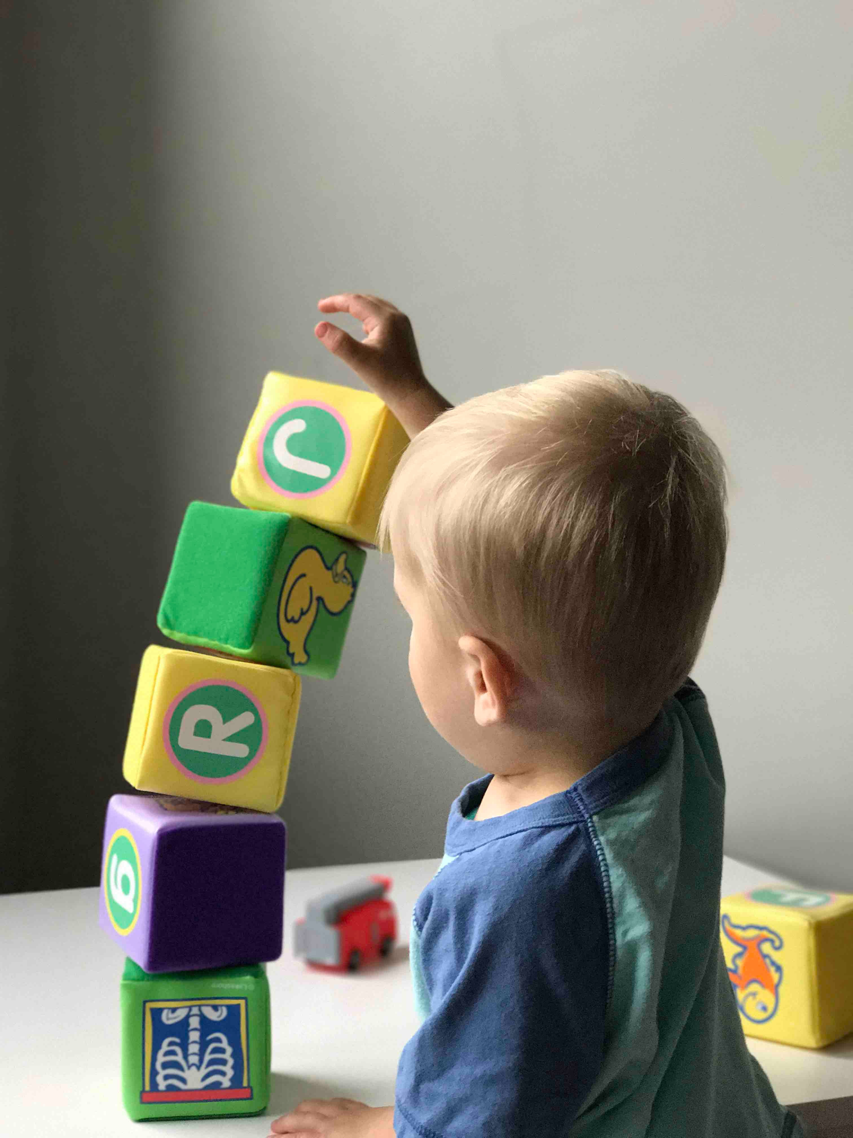
Inspiration and Motivation
To build an open ended skill learning agent.
Inspiration - Developmental machine learning.
A child’s reward comes from accomplishing novel goals.
Curiosity
Mimicking this in
Curiosity-Driven Exploration
Intrinsic Motivation
[1]
Notes:
Normal Reinforcement Learning agents are specific skill learning agent.
The specific skill is learnt through a reward function.
The authors, on the contrary, want build an agent that can learn open ended skills.
Inspiration comes from “Developmental machine learning” - branch of machine learning that mimics skill learning process from infants.
According to psychologist – Novelty is the key for the internal satisfaction of infants.
After accomplishing a goal it is no longer interesting for the child to accomplish the same goal.
Example after stacking blocks in the picture, it becomes less interesting for the child to stack books.
They always try to do new tasks/goals →
They are intrinsically motivated to learn new skills
They are inherently curiosity.
The authors try to mimic this aspect of child development in their agent.

Slide 3
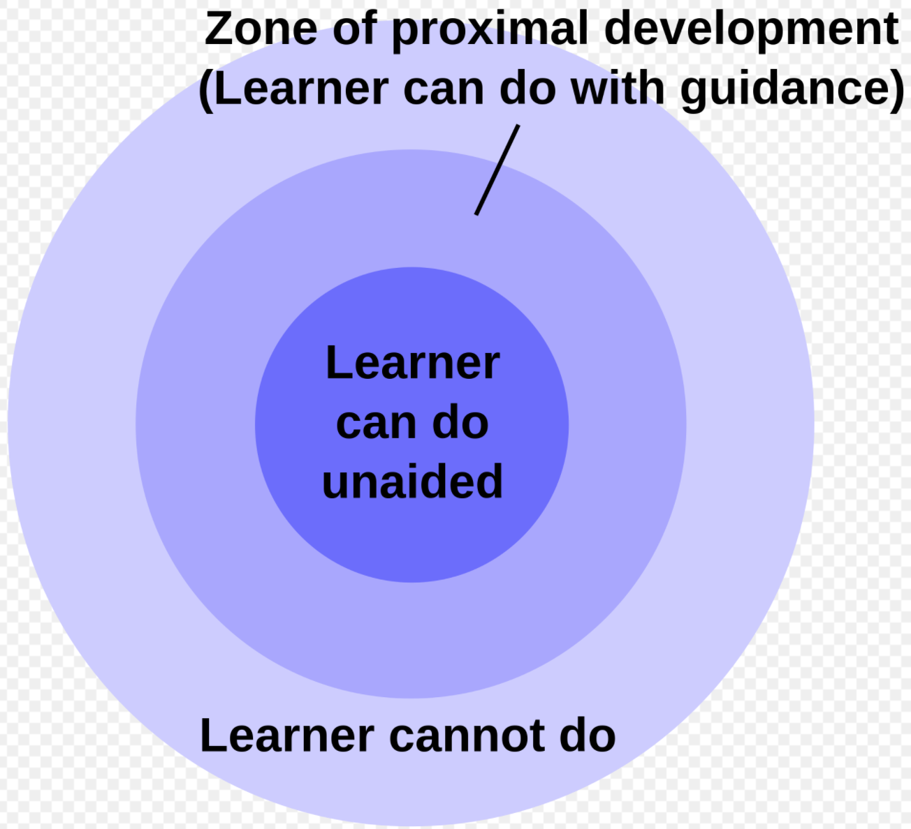
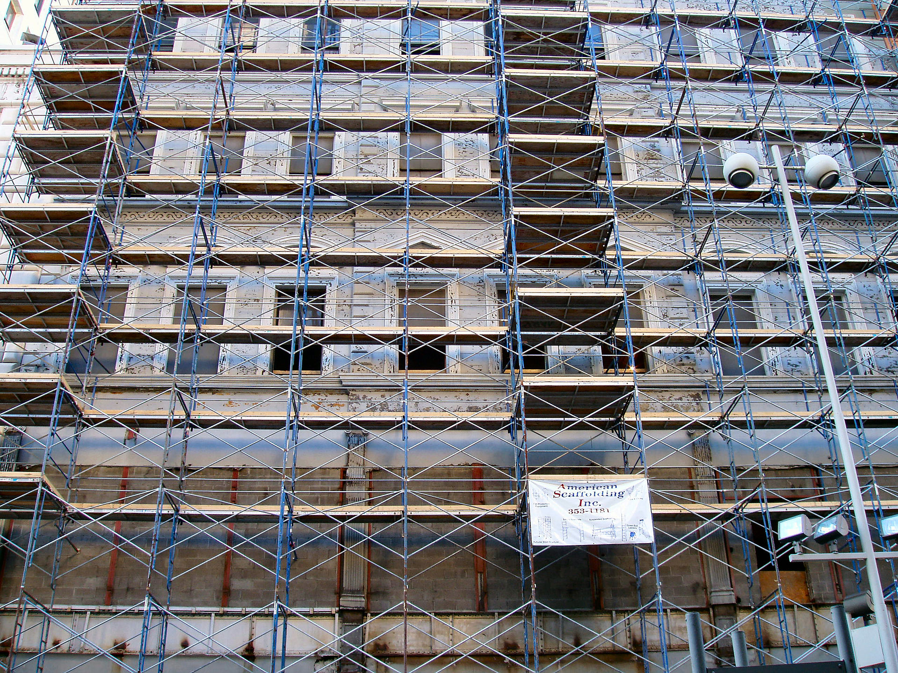
Inspiration and Motivation
[2]
Inspiration from the work of Psychologist Vygotsky.
Scaffolded learning aided by a social
partner.
Parent-Child learning dynamics is
mimicked.
Mimicking -
Language is used as a medium of Scaffolding
[3] – A building scaffolded for construction or repair
Notes:
The next motivation comes from the work of psychologist Vygotsky.
Let us look at the picture on the right here.
There are 3 zones of skills for a child –
Inner skill zone. These are trivial zones. For example if a child know how to stack blocks, he will know how to stack books.
Middle skill zone. This is learnable using some guidance. Example, stacking a different shape instead of a tower
Outer skill zone. This are non-trivial accomplishable goals. For example for a child that has just learnt to stack blocks, it is almost impossible to
to create a complex Lego machine.
In summary, according to Vygotsky, in his theory “Zone of proximal development”, a child requires some guidance to increase the zone of development.
This is provided by guidance/scaffolding from some partner.
Scaffolding can be thought of like this picture of a building construction. The framework is laid out first which guides the building that is constructed.
The medium of scaffolding is language in the parent-child scenario. The parent becomes the social partner giving guidance to the child.
Hence the authors use language as a medium of aid.
Other reasons authors use language is
Collective knowledge of 1000s of years is embedded in our languages.
Combinatorial compositionality of language makes it good for describing/formulating and imagining new goals.
Next question – What does it mean to be curious?

Slide 4
What is being solved
Accomplishing a goal is a 2 step process. (Simplified)
2 types (levels) of generalization of a Multi Skilled agent
  Goal Generalization. (G-G)
  State-Space Generalization. (SS-G)
  Eg: When the state of an evironment is its object location in the (x,y) plane
Both require exploration in their respective spaces.
Understand what “Task” to do.
(Main Focus of the paper)
Complete the objective Task.
(Done by Deep RL)
Move Chair
(1,0) → (3,3)
SS - G
Move Chair
(4,5) → (0,0)
Move Chair
(1,0) → (3,3)
G - G
Move Table
(1,0) → (3,3)
Notes:
So lets move forward to define our problem. What exactly is being solved here?
Accomplishing a task can be divided into 2 stages. – Understand the Task. Complete the task.
The paper talks about the first part – goal discovery. This is the main focus.
Because of these 2 stages we have 2 stages/levels of generalization.
This concept is essential to understand –
State space generalization. → This is talked about and handled in vanilla RL policies.
Goal generalization. → This is a generalization at a higher abstraction.
The first is policy generalization within a goal.
The second is policy generalization across a goals.
Take for example moving objects in the x-y plane.
If an agent after learning to move an object from (1,0) to (3,3) does the same job moving object from (4,5) to (0,0) This is called state space generalization.
If on the other hand it can also move a table from (1,0) to (3,3) this is goal generalization.
To generalize we need to explore in both cases.

Slide 5
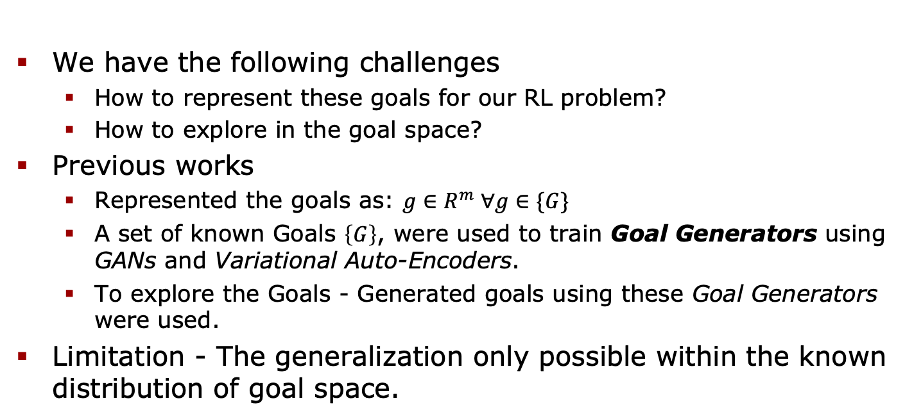
Goal exploration (Previous work)
Imagination
We have the following challenges
  How to represent these goals for our RL problem?
  How to explore in the goal space?
Previous works
  Represented the goals as: $g∈R^{m} ∀g∈\{G\}$
  A set of known Goals $\left\{G\right\}$, were used to train Goal Generators using GANs and Variational Auto-Encoders.
  To explore the Goals - Generated goals using these Goal Generators were used.
Limitation - The generalization only possible within the known distribution of goal space.
Curiosity
Notes:
As state space generalization is trivial, we talk about goal generalization.
Traditional RL does not have this problem because the goals are given in terms of reward functions.
What I would like you to observe is that the problem of generalization and exploration essentially is the same -- it only differs in the level of abstraction.
What are the previous works that have tried goal generalization?
Firstly they represented the goals as a Euclidean vector.
They used generation mechanisms like Generative Adversarial Networks or Variational auto encoder to generate the goals.
Up until this point we have discussed things quite abstractly so lets jump right into the proposed agent by the authors.

Slide 6
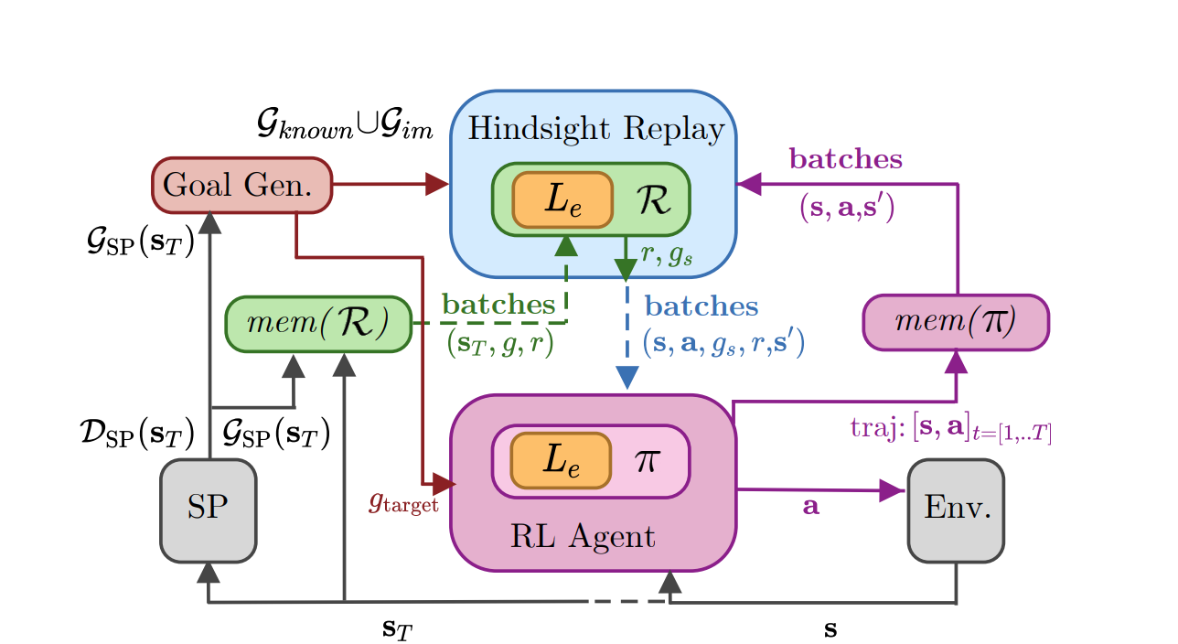
Proposed agent architecture [4]
IMAGINE - Intrinsic Motivations And Goal INvention for Exploration
Encoder
eASPP
Decoder
Intrinsic Motivations
Skip Connections
Social Partner
Notes:
Comment - Consider showing the left half.
This is the proposed agent by the authors. They call it IMAGINE.
We will come back to this again at the end.
But let us break things one by one to understand the components
Social Partner - We have a social partner as discussed previously.
There is a Goal Generation (Which we will talk in a little while)
What you have to observe is that the Goal generation is an inherent module in the agent. Hence the name – Intrinsic motivation.
Also you will be able to recognize Social partner.

Slide 7
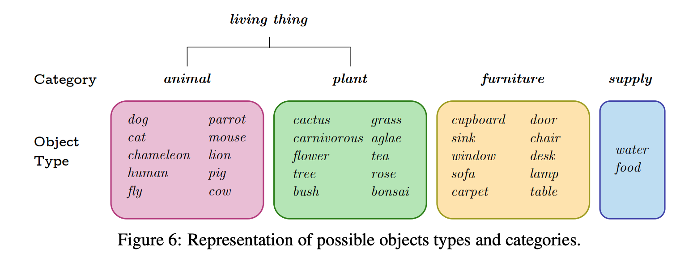
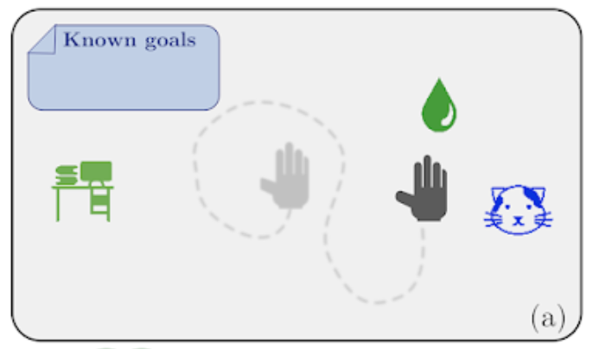
Environment
The authors do not train a full blown Natural Language or Perception agent.
They use a specialized environment called Playground.
Playground can be understood as a little farm.
Predicate Hierarchy
3 Main Actions
[4]
Go
Grasp
Grow
Notes:
A 2 dimensional limited space containing different objects.
List of objects are listed on the right bottom.
Each object is represented as a circle. With a radius.
Even the agent is represented by a circle with an agent. (For showing the authors show the different objects)
There is predicate hierarchy which is not told to our agent
This helps for testing the generalization, the agent has to generalize based on predicates.
Observe the main categories – Living things, furniture and food/water supply.
This can be viewed as a farm.
There are 3 basic commands that can be executed by the agent – Go Grasp Grow.

Slide 8
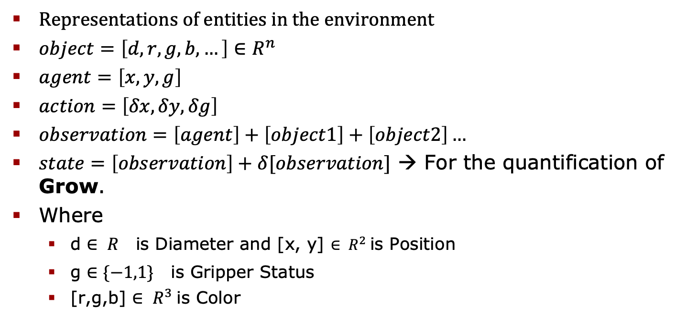
Environment
Representations of entities in the environment
$object=\left[d,r,g,b, …\right]∈R^{n}$
$agent=\left[x,y, g\right]$
$action=\left[δx,δy, δg\right]$
$observation=\left[agent\right]+\left[object1\right]+\left[object2\right]…$
$state=\left[observation\right]+δ[observation]$ → For the quantification of Grow.
Where
  d ${∈ R}^{}$is Diameter and [x, y] ${∈ R}^{2}$is Position
  g ${∈\{−1,1\}}^{}$is Gripper Status
  [r,g,b] ${∈ R}^{3}$is Color
[4]
Notes:
To Give you an idea of how the environment is quantified, I have put this slide here.
Explain object, agent action and observation
The state is a combination of observation and delta observation.
This helps us quantify and account for the growth of an object in the environment

Slide 9
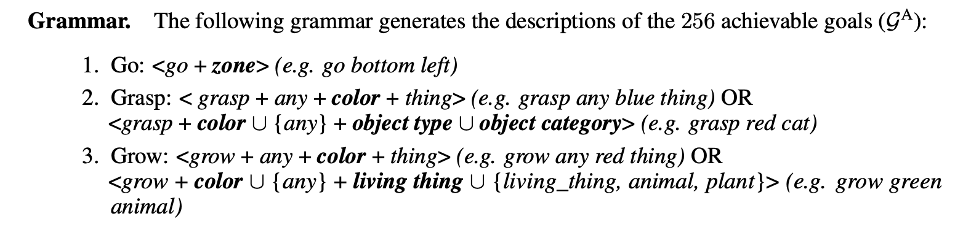
Goal Generation Mechanism
Goals are generated using Construction Grammar.
Out of the known-distribution goals are generated using the compositionality.
Grasp
Red
Cat
Atom 1
Atom 2
Atom 3
Grasp Red Cat
Compound / Goal
[4]
Notes:
Fundamental Idea – Use language compositionality to generate new goals.
How is language compositionality actually utilized.
Lets first talk about the jargon.
An atom is a word (Which makes sense because it is semantically unbreakable)
A Compound is a obtained using the composition of atoms.
This is also called a goal.
I have listed the grammar at the bottom.
Observer the main actions that an agent can do –
Go
Grasp
Grow

Slide 10
Goal Generation : “Curiosity” algorithm
Essence of the IMAGINE algorithm:
  Compute sets of equivalent atoms.
  Atoms are equivalent if the edit distance between the compounds is 1
    E.g. “Move Red Table” and “Move Red Chair” → Table and Chair are equivalent.
  Use substitution to generate new goals.
    E.g. If known goal = “Break Red Chair”, new goal = “Break Red Table.”
  Return Imagined Compounds.
Notes:
It starts by taking all the known goals (Compounds).
Calculate the the atom equivalence.
If 2 compounds have an edit distance = 1, then their differing atoms are equivalent.
For all the goal template do all the substitutions of words one by one to generate the resulting compounds.
Filter out the compounds from the known compounds.
Return the imagined compounds.

Slide 11
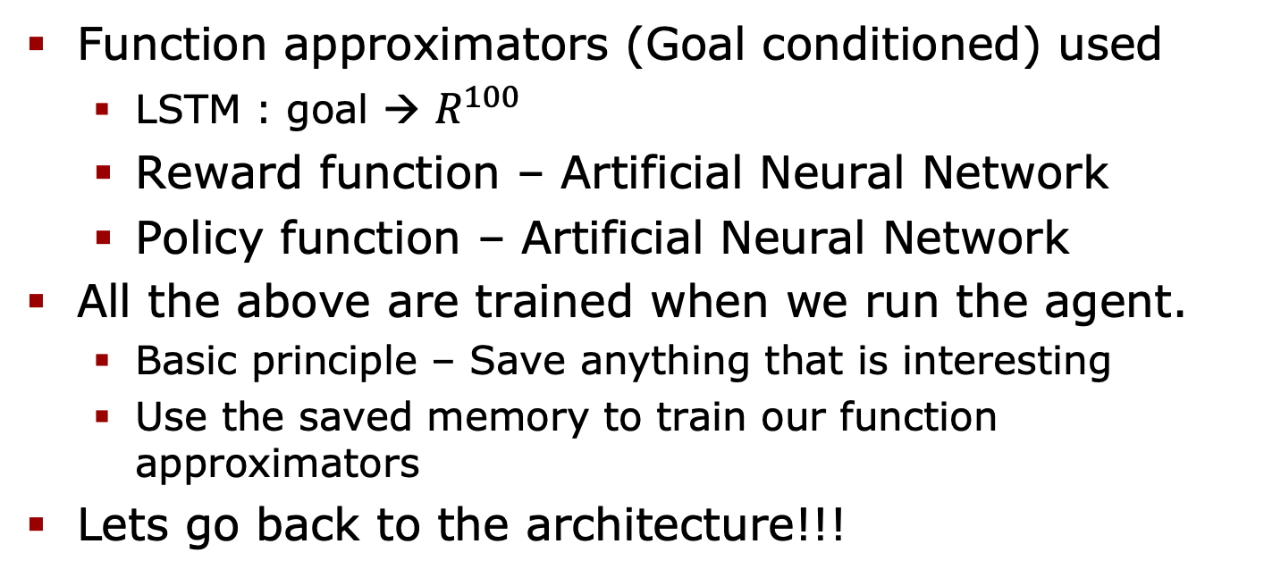
Language Encoder, Reward and Policy
Function approximators (Goal conditioned) used
  LSTM : goal → $R^{100}$
  Reward function – Artificial Neural Network
  Policy function – Artificial Neural Network
All the above are trained when we run the agent.
  Basic principle – Save anything that is interesting
  Use the saved memory to train our function approximators
Lets go back to the architecture!!!
Notes:
Lets look at the other components briefly before we get into the details of the architecture.
<Mention the components>
How are they trained.
Basic principle is that anything that is of interest is saved.
Use the saved data to train the components.
One important thing – The function approximators are goal conditioned.
It will become more clear if we go to through the architecture one by one.

Slide 12

Proposed agent architecture [4]
IMAGINE - Intrinsic Motivations And Goal INvention for Exploration
Encoder
eASPP
Decoder
$L_{e}$ = LSTM Language encoder
Intrinsic Motivations
Skip Connections
Social Partner
Playground environment
Notes:
Let us come back to our architecture so see how much we have understood.
Here we can see some of the basic principles of what we discussed previous slides.
We see the playground environment on the right had corner
We have understood the Goal Generation mechanism.
Now lets put all the things together and understand everything in sequence with the algorithm.

Slide 13
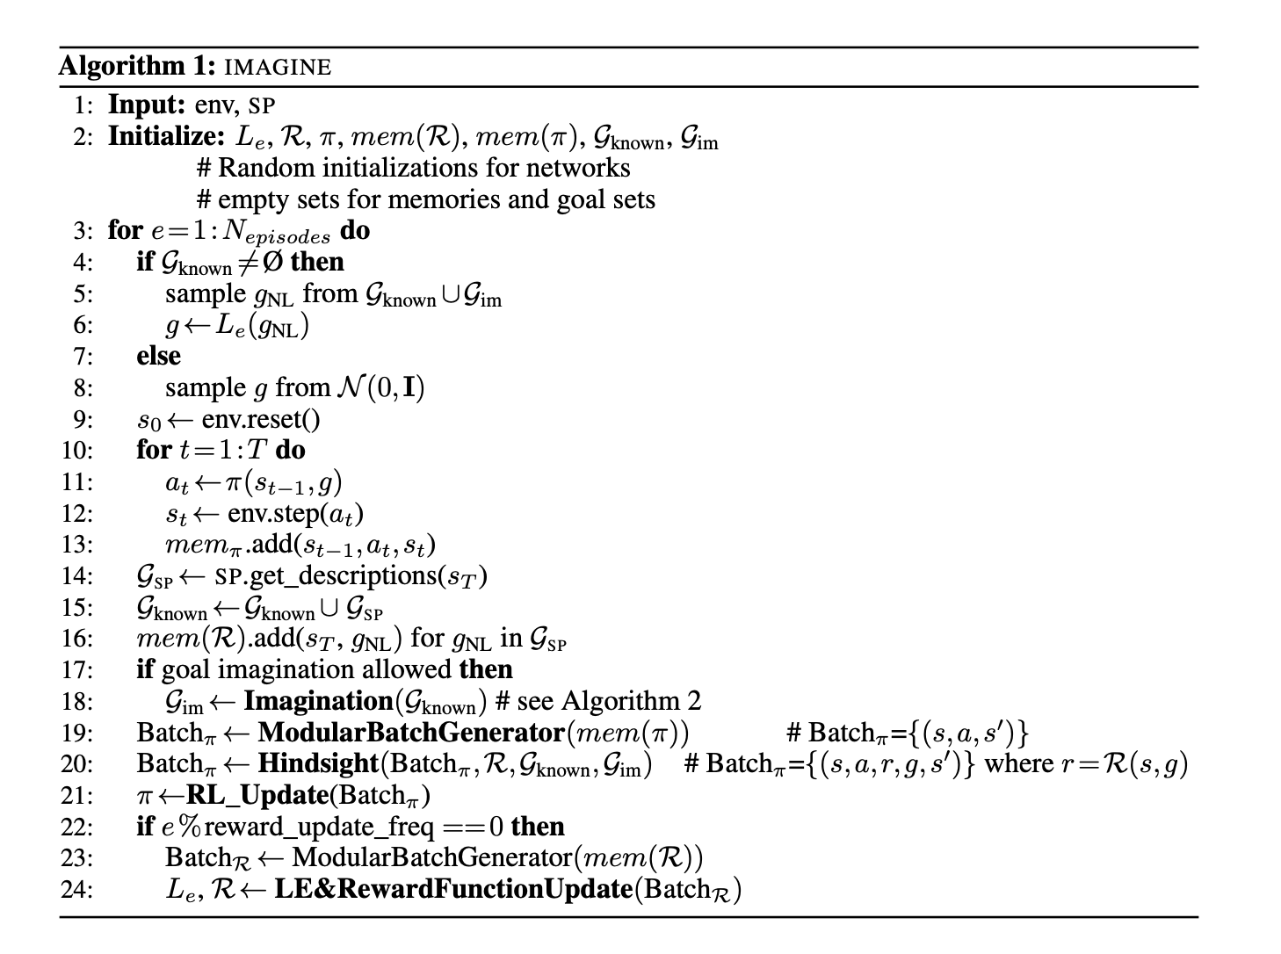
IMAGINE algorithm [4]
Notes:
Going through the algorithm step by step to help understand the algorithm.
We do
Random initialization for our function approximators.
Initialize empty sets for our memories (both known goals and imaginary goals)
Sample weights from the set of known or imaginary goals.
Convert the goal to the real valued vector using LSTM.
If sets are empty we take a random vector out of a gaussian distribution.
Run our policy and add save the whole trajectory to the memory.
The last step of our trajectory is explained by the social partner.
This is stored in our reward memory with the corresponding state.
If Goal generation (here referred to as imagination) is enabled → We run the imagine algorithm.
Using batch of trajectories stored in the memory, essentially hindsight experience replay, our policity is updated.
Modularbatch is due to modular trajectories – see appendix.
Lastly from the stored rewards the La guage encoder and the reward function are trained
Language encoder training is clear. A supervised function approximater that maps words to real valued vector.
For training the memory reward, (g, s_t) → 1 and all other known goals with St are mapped to zero.
There is addition of r,s so that we learn the reward function
Very important for the behavior adaption.

Slide 14
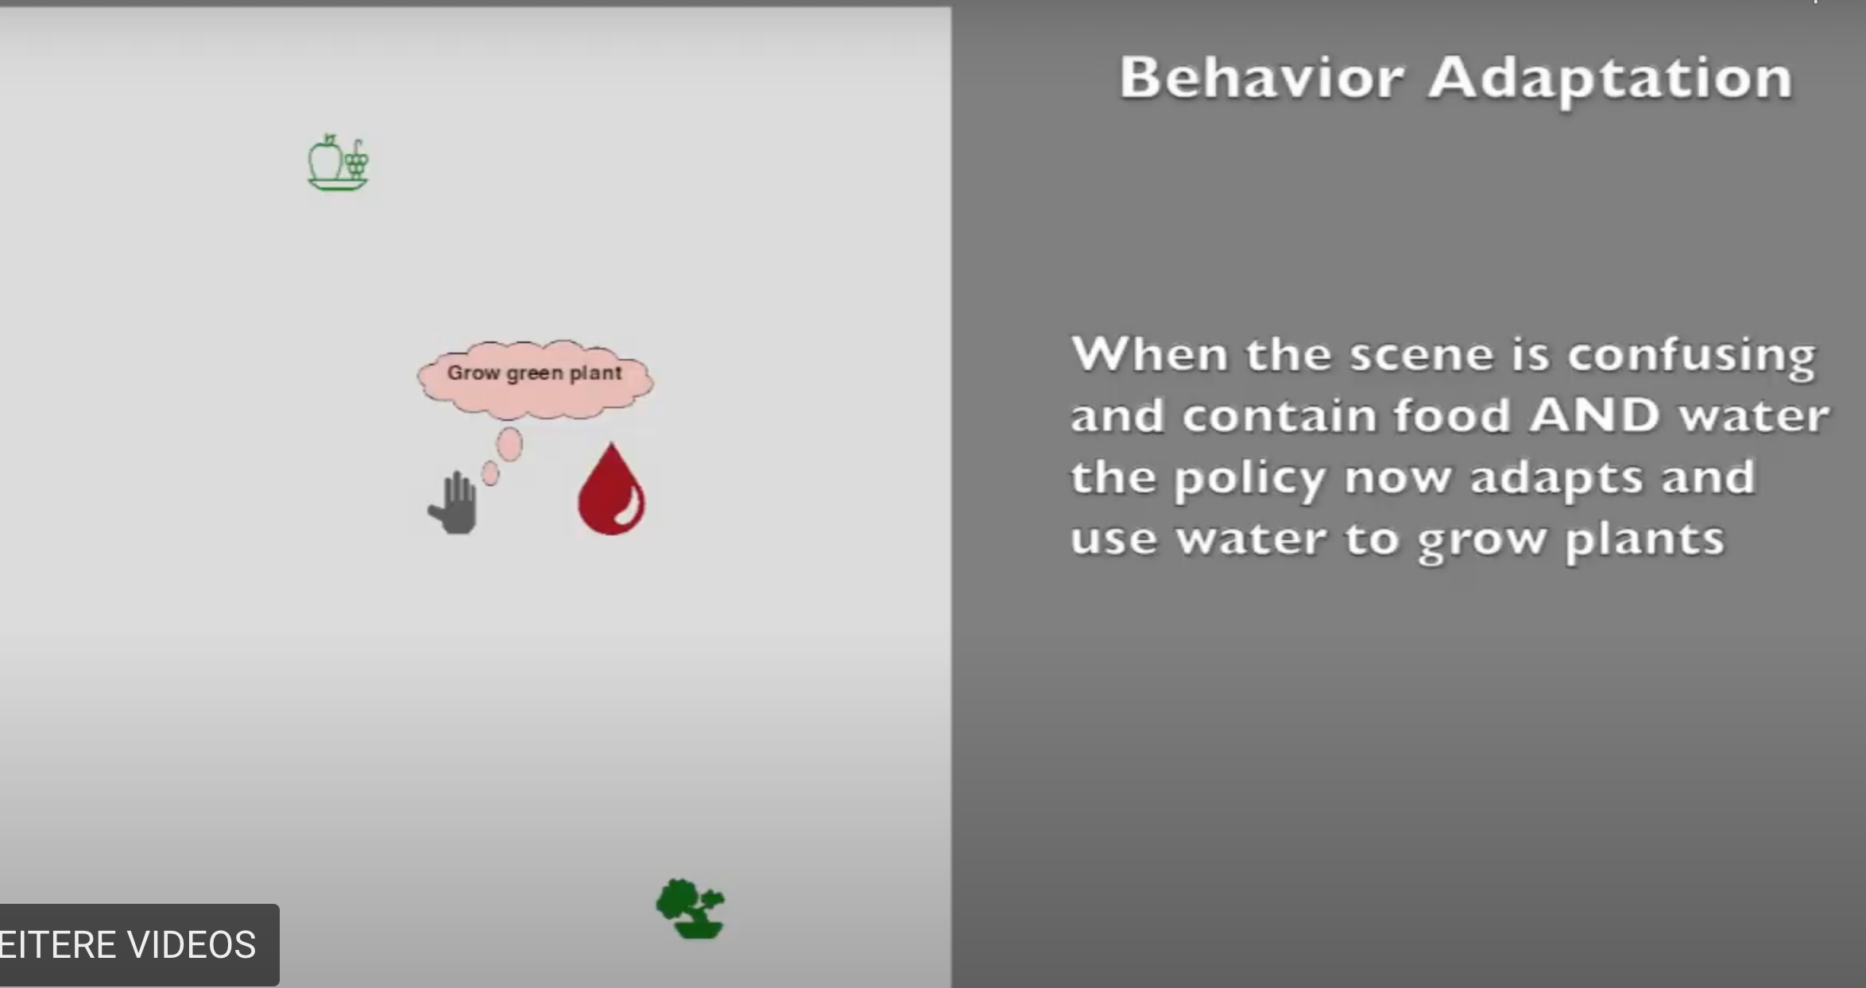
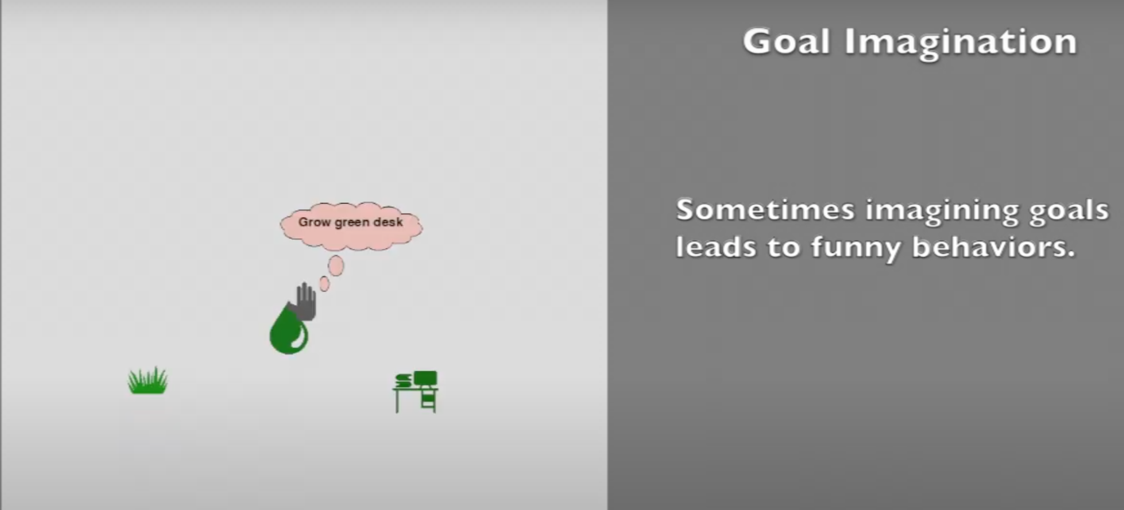
Generalization (Goal generalization)
Through imagination, 2 Types of “Interesting” generalizations were found
  “Grow” generalization to non-living things
  Behaviors adaptation to growing plants [5]
Notes:
The state space generalization is almost perfect.
So the focus is on goal generalization.
There were 2 types of interesting behaviors observed
Grow imagination to non living things. This is clearly because of the power of language compositionality.
Hence the imagination of out of distribution goals is shown in this case.
Second is a behavior adaption which is more subtle
First the social partner in its description of goals, never describes that plants can grow. But this is got through goal imagination trivially
It also does not state that plants only grow through water.
How is behavior adaption accomplished
First we have to remember that ”Grow” goal is only accomplished when the object is grown.
How does the agent get to know that it has accomplished a goal without the help of the social partner? → Reward function.
So the steps are
First image to grow a plant.
Explore the statespace by following the policy
When the object (tree) is grown, the reward signals the goal is accomplished
This trajectory is stored in the trajectories memory of policies.
From now on the policy on the goal of growing the tree is trained on this trajectory
Hence the behavior adaption.

Slide 15
Ablation studies

Slide 16
Model improvement

Slide 17
Limitations and Future works
The work is done on synthetic environment.
Language grammar used is very primitive.
Very high computational cost i.e. ~2.5 CPU years for training.
Future work proposed by the authors
  More complex grammar can be utilized for scaffolding of the agent
  Reduce the assumption on the agent (Reducing presence and reducing precision of description)
  Guiding the agent by showing how to accomplish a goal.
Notes:
There are some limitations as per my understanding of the paper
The environment they used to test/train their architecture is synthetic and very simple.
The language grammar they used is very primitive.
Very high computational costs. They had to use ~2.5 CPU years for a single train of their architecture.
They had to train with multiple seeds to account for the high variations in their function approximators.
In Future works –
A more complex language could be introduced. E.g having relative positions in the grammar. E.g Move chair left of the table.
Scaling the construction grammar to real langauages.
They would like to further reduce the burden on the social partner – by reducing the requirement of presence and perfect description of the agent.

Slide 18
Thank you for your attention!
References:
[1] - https://unsplash.com/s/photos/children-playing
[2] - By Dcoetzee - Own work, CC0, https://commons.wikimedia.org/w/index.php?curid=20903046
[3] - By Tysto - Own work, Public Domain, https://commons.wikimedia.org/w/index.php?curid=304059
[4] – The research paper
[5] - https://sites.google.com/view/imagine-drl

Slide 19
Appendix
In Further slides – Extra details about the research paper.
Notes:
-

Slide 20
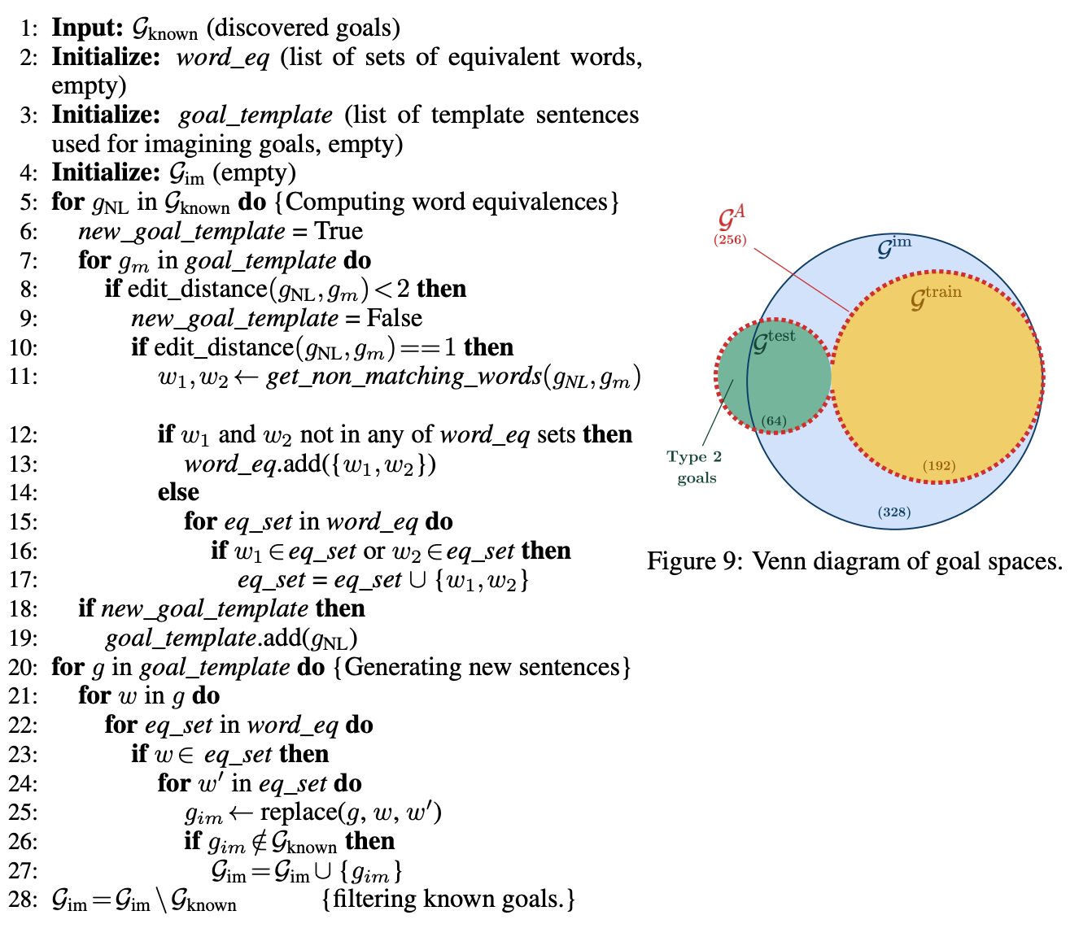
Goal Generation : “Curiosity” algorithm
[4]
Essence of the algorithm:
Compute sets of equivalent
atoms
Atoms are equivalent if the edit
distance between them is 1
By substituting the equivalent
words, compute all possible
new goals (Compounds).
Filter out Compounds that are
known
Return Imagined Compounds.
Notes:
It starts by taking all the known goals (Compounds).
Find out any goal or compound templates
All goal templates are having edit distance > 2. They cannot be reached by simple substitution.
Calculate the the atom equivalance.
For all the goal template do all the substitutions of words one by one to generate the resulting compounds.
Filter out the compounds from the known compounds.
Return the imagined compounds.

Slide 21
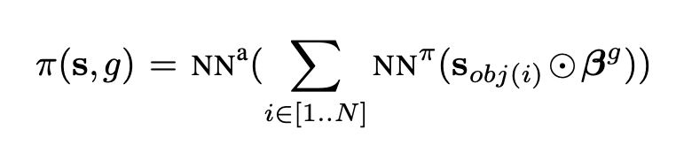
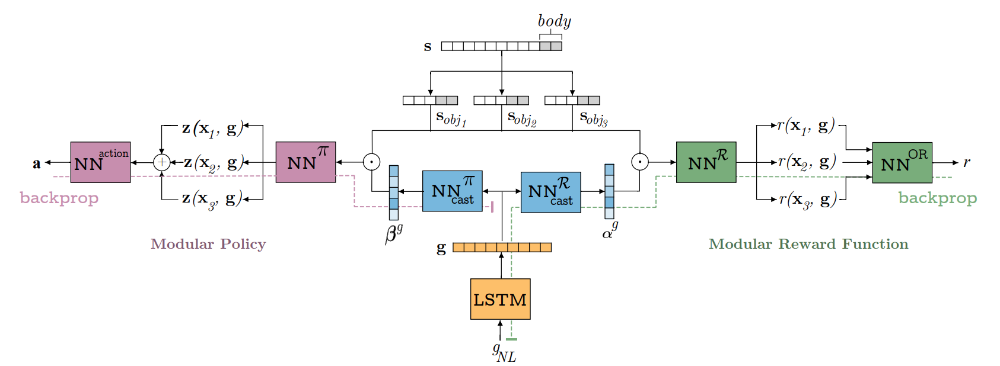
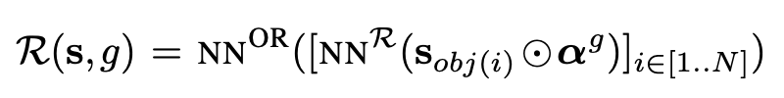
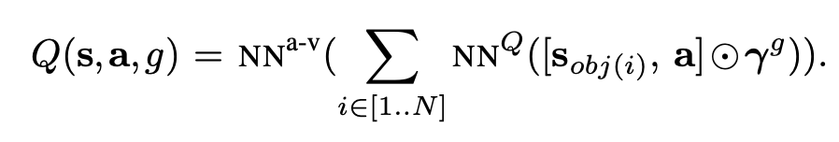
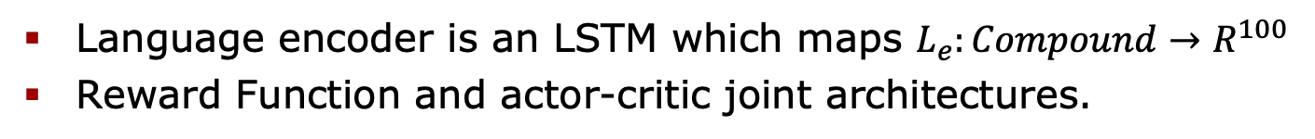
Modular achitectures
Language encoder is an LSTM which maps $L_{e}:Compound→R^{100}$
Reward Function and actor-critic joint architectures.
[4]
Notes:
There is still a discussion about the type of function approximators used inside the whole architecture
Explain the subdivision of the state to objects.
Why is OR and addition taken?
To make the function permutation invariant.
Very essential because the objects in the state may not be in the same order everytime.
Second thing – goal conditioning is embedded in an attention vector !!!! (Which is quite beautiful).
Action also put at the end of object for the critic.

