Slide 1
Maven overview

Slide 2
Maven(what and why?)
Maven is a build automation tool used primarily for Java projects.
Maven addresses two aspects of building software:
First, it describes how software is built
second, it describes its dependencies.
Maven provides a way to help with managing:
Builds
Documentation
Reporting
Dependencies
SCMs
Releases
Distribution

Slide 3
Ant vs Maven Configuration vs Convention
Ant doesn't have formal conventions like a common project directory structure, you have to tell Ant exactly where to find the source and where to put the output. Informal conventions have emerged over time, but they haven't been codified into the product.
Ant is procedural, you have to tell Ant exactly what to do and when to do it. You had to tell it to compile, then copy, then compress.
Ant doesn't have a lifecycle, you had to define goals and goal dependencies. You had to attach a sequence of tasks to each goal manually.
Maven has conventions, it already knew where your source code was because you followed the convention. It put the bytecode in target/classes, and it produced a JAR file in target.
Maven is declarative. All you had to do was create a pom.xml file and put your source in the default directory. Maven took care of the rest.
Maven has a lifecycle, which you invoked when you executed mvn install. This command told Maven to execute a series of sequence steps until it reached the lifecycle. As a side-effect of this journey through the lifecycle, Maven executed a number of default plugin goals which did things like compile and create a JAR.

Slide 4
Ant vs Maven Configuration vs Convention
build.xml
please look into the SourceCodeUI’s build.xml
- the whole UI is build on Ant
pom.xml
Please look at the pom.xml of bdc-project (parent POM),bdc-app,bdc-arch,bdc-common

Slide 5
Maven(POM.XML)
An XML file describes the software project being built, its dependencies on other external modules and components, the build order, directories, and required plug-ins.
It comes with pre-defined targets for performing certain well-defined tasks such as compilation of code and its packaging.
Maven dynamically downloads Java libraries and Maven plug-ins from one or more repositories such as the Maven 2 Central Repository, and stores them in a local cache(C:\Documents and Settings\<your_commit_id>\.m2\repository).

Slide 6
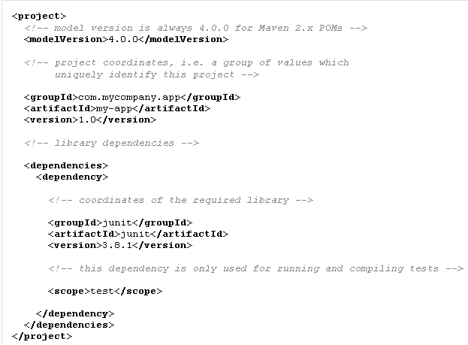
Maven(POM.XML)

Slide 7
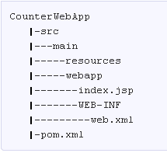
Maven(project structure)
Based on the project type (Java Project,Web Project,Spring project etc) when we create a new project either by maven command or by eclipse IDE below is the typical maven project structure.
Directory structure of a web project is given below

Slide 8
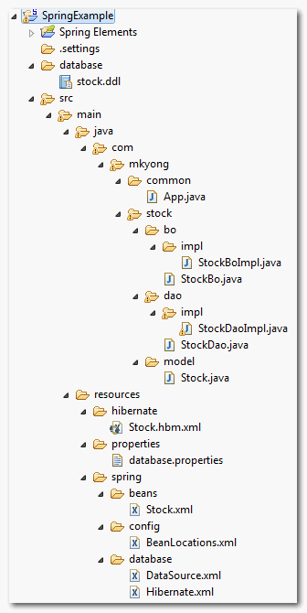
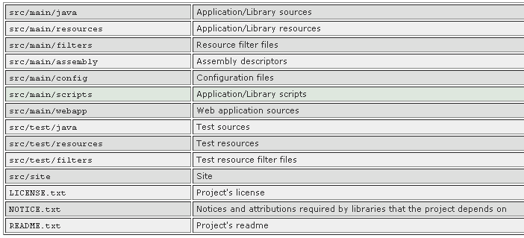
Maven(project structure
Maven +Spring+hibernate+mySQL)

Slide 9
Maven(commands)
How the folder structure is created?
Answer -> Either by maven command or by IDE like Eclipse. Example -
abc098@dd091$mvn archetype:generate -DgroupId=com.mycompany.app -DartifactId=my-app -DarchetypeArtifactId=maven-archetype-quickstart -DinteractiveMode=false

Slide 10
Maven(execution)
Maven has three lifecycles:
clean
default (build)
site.

Slide 11
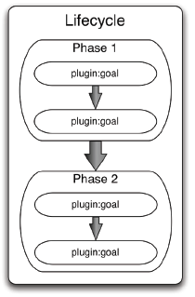
Maven(execution)
Maven divides execution into four nested hierarchies, they are: Lifecycle, Phase, Plugin, and Goal.
Each step in a lifecycle flow is called a phase. Zero or more plugin goals are bound to a phase.
A plugin is a logical grouping and distribution (often a single JAR) of related goals
A goal, the most granular step in Maven, is a single executable task within a plugin.
For example, discrete goals in the jar plugin include packaging the jar (jar:jar), signing the jar(jar:sign), and verifying the signature (jar:sign-verify)

Slide 12
Maven(execution)
Maven can be run by specifying a goal or a lifecycle phase
mvn <phase>
mvn <plugin>:<goal>
When Maven runs a specific plugin goal, then only that goal is run.
mvn compile:compile jar:jar
(This example runs two plugin goals: compilation of code, then JARing the result )
When Maven executes a phase, all phases and bound plugin goals up to that point in the lifecycle are also executed..
mvn deploy
(This example requests the deploy lifecycle phase, which will also execute the verification, compilation, testing and packaging phases)

Slide 13
Maven(clean life cycle :3 phases)
pre-clean | executes processes needed prior to the actual project cleaning
clean | remove all files generated by the previous build
post-clean | executes processes needed to finalize the project cleaning

Slide 14
Maven(default life cycle)
Lifecycle Phases
validate
compile
test-compile
test
package
verify
install
deploy

Slide 15
Maven(default life cycle)
validate - validate the project is correct and all necessary information is available
compile - compile the source code of the project
test - test the compiled source code using a suitable unit testing framework. These tests should not require the code be packaged or deployed
package - take the compiled code and package it in its distributable format, such as a JAR.
integration-test - process and deploy the package if necessary into an environment where integration tests can be run
verify - run any checks to verify the package is valid and meets quality criteria
install - install the package into the local repository, for use as a dependency in other projects locally
deploy - done in an integration or release environment, copies the final package to the remote repository for sharing with other developers and projects.

Slide 16
Maven(site life cycle)
pre-site | executes processes needed prior to the actual project site generation
site | generates the project's site documentation
post-site | executes processes needed to finalize the site generation, and to prepare for site deployment
site-deploy | deploys the generated site documentation to the specified web server

Slide 17
Maven(mostly used phases)
mvn clean - remove all files generated by the previous build
mvn compile - compile the source code of the project.
mvn install - install the package into the local repository, for use as a dependency in other projects locally.
mvn package - take the compiled code and package it in its distributable format, such as a JAR.
mvn site - generates the project's site documentation

Slide 18
Maven(mostly used phases)
mvn clean
mvn compile
mvn package - take the compiled code and package it in its distributable format, such as a JAR.
mvn install –DskipTests - install the package into the local repository, for use as a dependency in other projects locally.
mvn site - generates the project's site documentation
Xxx. 1.0-SNAPSHOT .jar: The idea is that before a 1.0 release (or any other release) is done, there exists a 1.0-SNAPSHOT. That version is what might become 1.0. It's basically "1.0 under development". This might be close to a real 1.0 release, or pretty far (right after the 0.9 release, for example).
The difference between a "real" version an a snapshot version is that snapshots might get updates. Usually, snapshot dependencies should only exist during development and no released version (i.e. no non-snapshot) should have a dependency on a snapshot version.

Slide 19
Maven(Reference)
Concept:
http://www.tutorialspoint.com/maven/index.htm
http://maven.apache.org/guides/getting-started/index.html
Plugin:
http://maven.apache.org/plugins/index.html
Repository : https://nexus.codehaus.org/index.html#welcome
http://www.sonatype.com/

Slide 20
Maven(Reference)
END
Q&A

