Slide 1
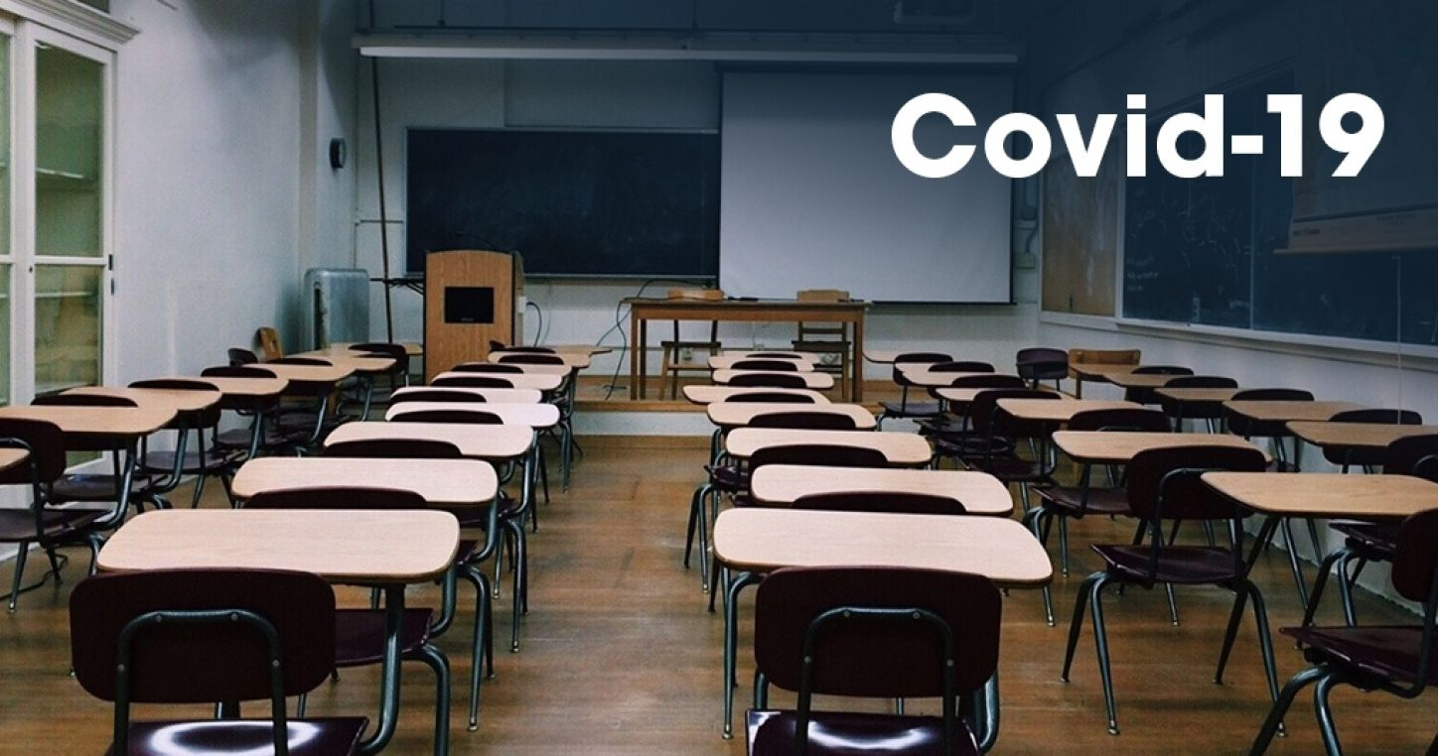
THE IMPACT OF COVID-19 ON EDUCATION BY REGION

Slide 2
The virus as known as Covid-19 we are facing today has created many problems.
One of these problems is experienced in education. Due to the pandemic caused by the virus, many students around the world receive inadequate education.
Because of Covid-19 , schools for more than 168 million children globally have been closed for almost a full year .

Slide 3
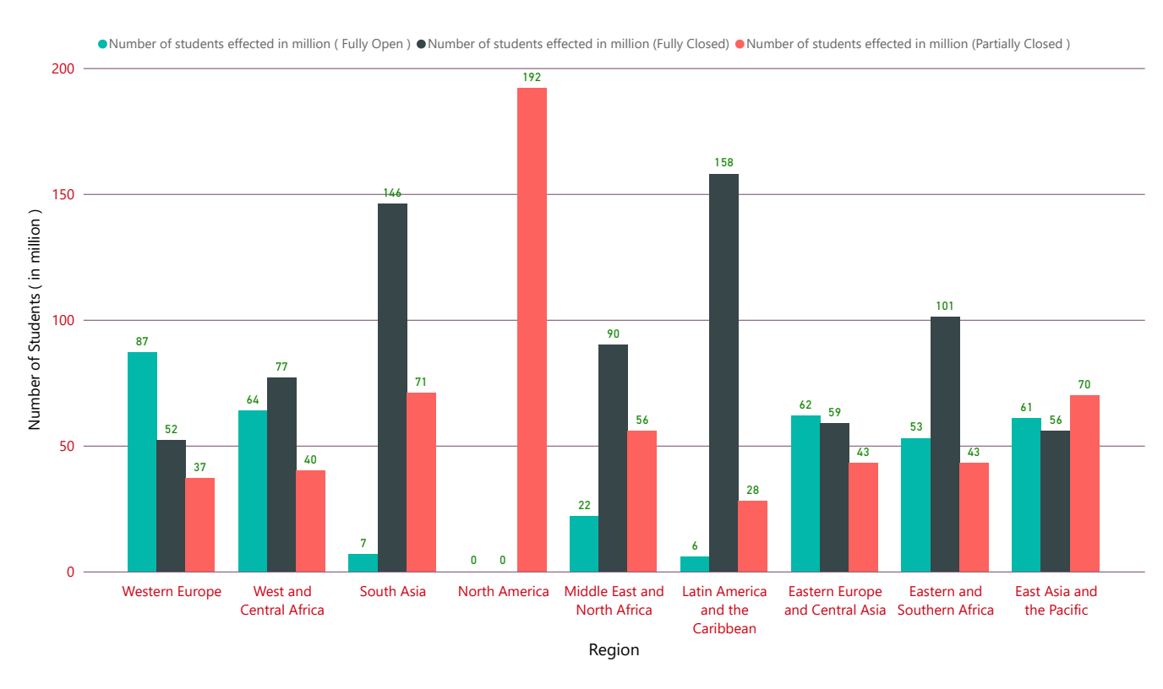
NUMBER OF STUDENTS EFFECTED BY REGION

Slide 4
Different regions were affected disproportionally in terms of the magnitude of school closures .
The highest number of students impacted when classroom instruction was disrupted was seen in the Latin America and the Caribbean region.
On the other hand , the highest number of students impacted when classroom instruction was partially closed was seen in the North America. They never completely closed the schools .
Because of the schools closed, students are connected to the lessons from home. Now let's look at the percentage of students accessing the internet from home .

Slide 5
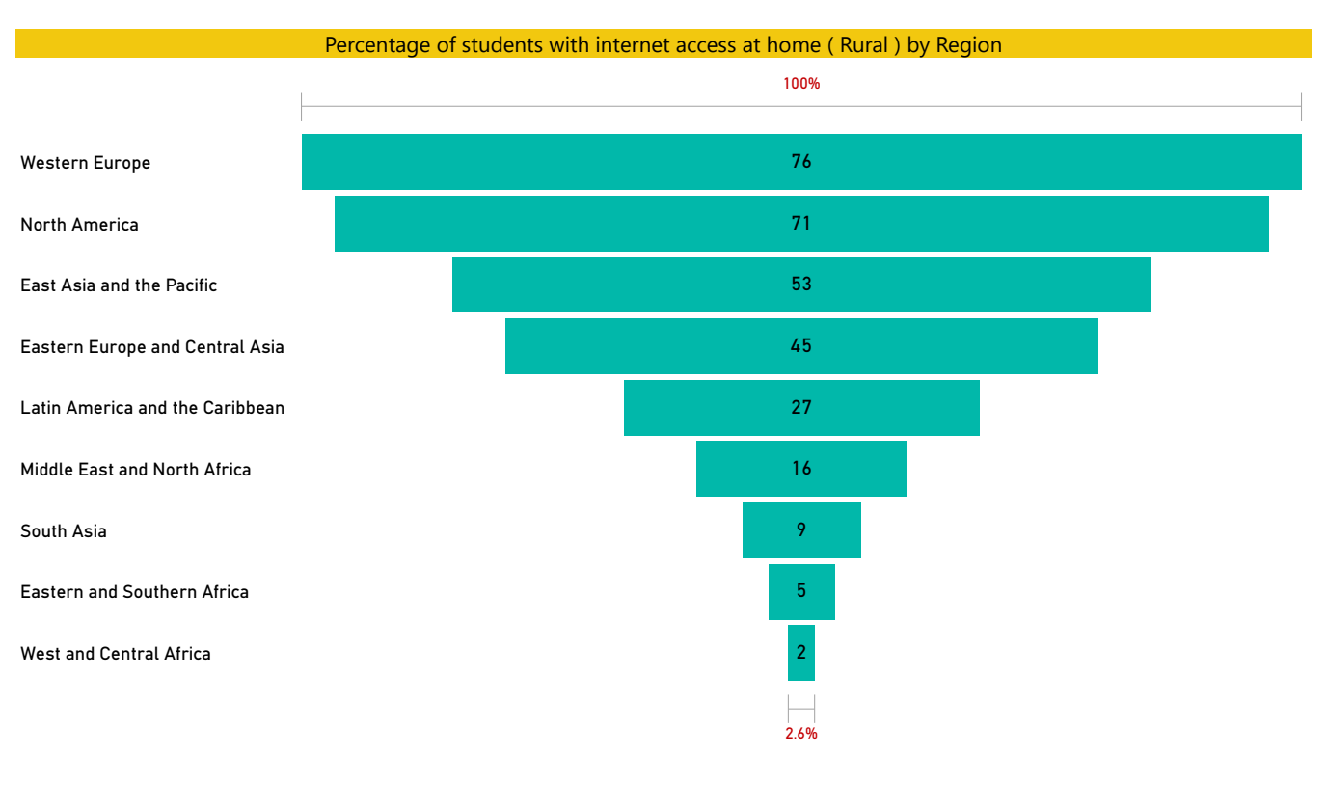
PERCENTAGE OF STUDENTS WITH INTERNET ACCESS AT HOME (RURAL) BY REGION

Slide 6
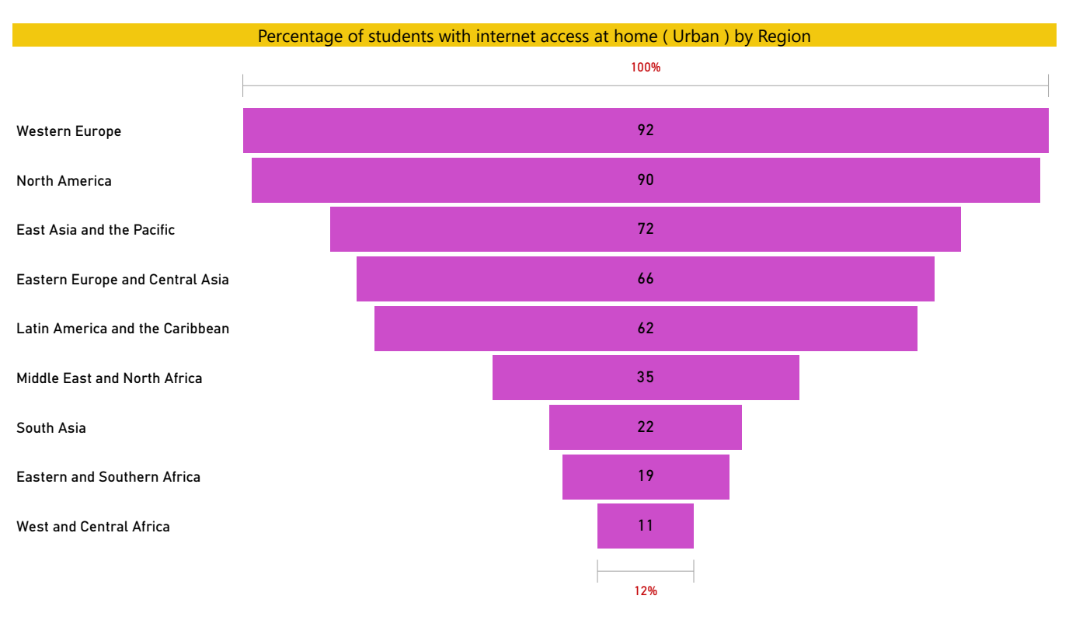
PERCENTAGE OF STUDENTS WITH INTERNET ACCESS AT HOME (URBAN) BY REGION

Slide 7
According to the graph , both in the rural and urban , highest percentage of students who can access internet at home seen in the Western Europa and North America.
On the other hand , both in the rural and urban , lowest percentage of students who can access internet at home seen in the West and Central Africa.
According to these informations , in regions with developing countries, students can access the internet at home easily.

Slide 8
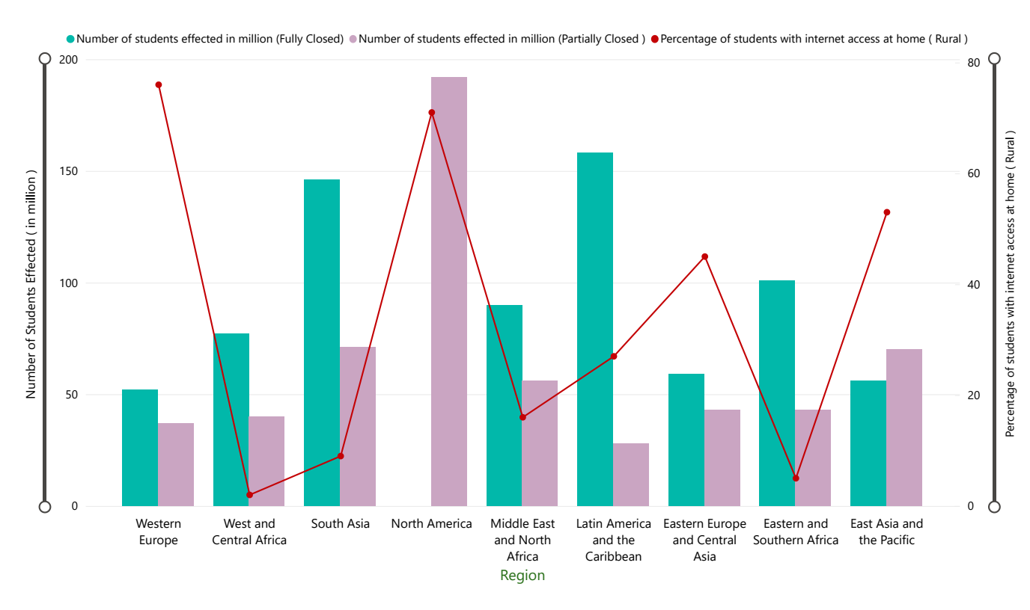
SCHOOL CLOSURE & ACCESS THE INTERNET AT HOME ( RURAL )

Slide 9
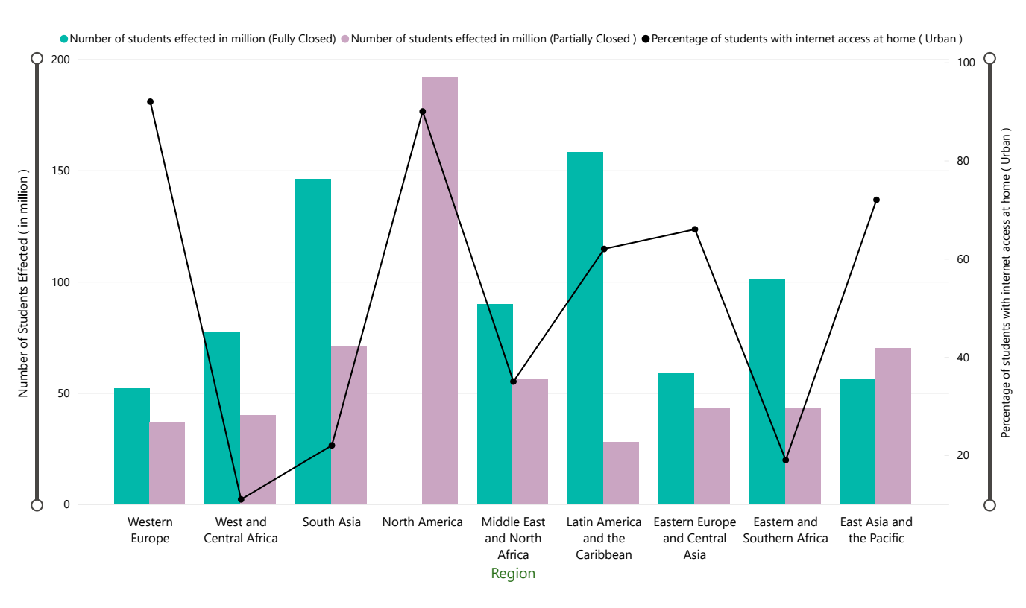
SCHOOL CLOSURE & ACCESS THE INTERNET AT HOME ( URBAN )

Slide 10
Students living in Western Europe, both rural and urban, are less affected by the pandemic's impact on education. There may be several reasons , but according to the these datas , we can say one of these reasons is access the internet at home .
On the other hand , students living in South Asia , both rural and urban, are more affected by the pandemic's impact on education. When we look at the low percentage of students' internet access at home, we consider that it is difficult for students to receive quality education.

