Slide 1
Garments Worker Productivity Analysis
Exploring Key Factors Affecting Productivity in Garment Manufacturing
Presented by: [Abdulfetah Adem ]
Course: AD450-Data Science development
Date: [Date of Presentation]

Slide 2
Project Overview
Objective: This analysis investigates the impact of various factors such as overtime, incentives, and departmental performance on worker productivity in a garment manufacturing environment.
Dataset:
- Rows: 1197
- Columns: 15
- Key Columns: targeted_productivity, actual_productivity, overtime, incentive, SMV, WIP, idle_time, etc.

Slide 3

Key Analytical Questions
1. How does `targeted_productivity` compare to `actual_productivity` across departments?
2. What is the relationship between `overtime` and `actual_productivity`?
3. How do `incentives` affect `actual_productivity`?
4. Which departments have the highest and lowest `actual_productivity`?

Slide 4

Data Cleaning and Transformation
Handling Missing Data:
Filled missing `WIP` values with the median.
Data Type Correction:
Converted `date` column to `datetime` format for time-series analysis.
Outlier Removal:
Removed outliers using the IQR method for numeric columns.
Creating New Columns:
Added `efficiency_ratio` = `actual_productivity / targeted_productivity`.

Slide 5

Exploratory Data Analysis
Summarized Data:
Used descriptive statistics to get an overview of numeric columns.
Histograms and Correlations:
- Histogram: Visualized the distribution of targeted_productivity, SMV, and overtime.
- Correlation Matrix: Showed the relationships between key variables like overtime, incentive, and productivity.

Slide 6
Key Findings from the Analysis
1. Targeted vs Actual Productivity: Some departments consistently outperform or underperform relative to their targets.
2. Overtime and Productivity: A positive correlation exists, but diminishing returns are observed as overtime increases.
3. Incentives and Productivity: Incentives show a moderate positive effect on productivity; higher incentives are linked to higher productivity.
4. Departmental Performance: The `Sewing` and `Finishing` departments had the highest average productivity, but `Finishing` showed some fluctuation.

Slide 7
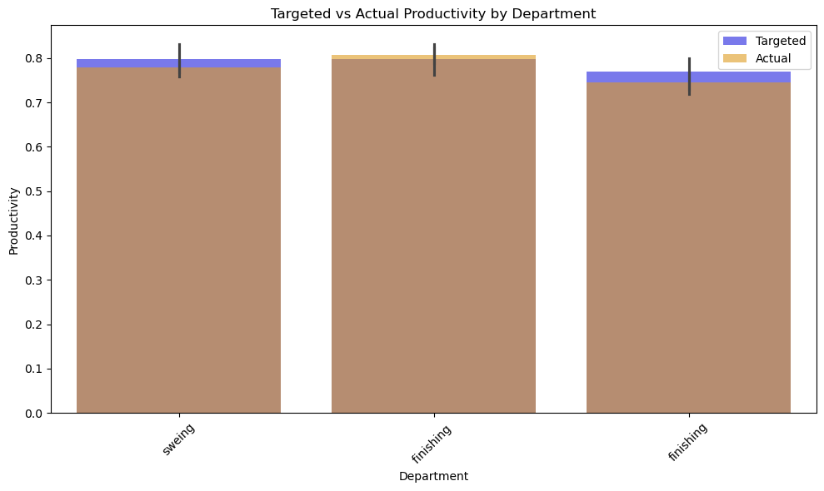
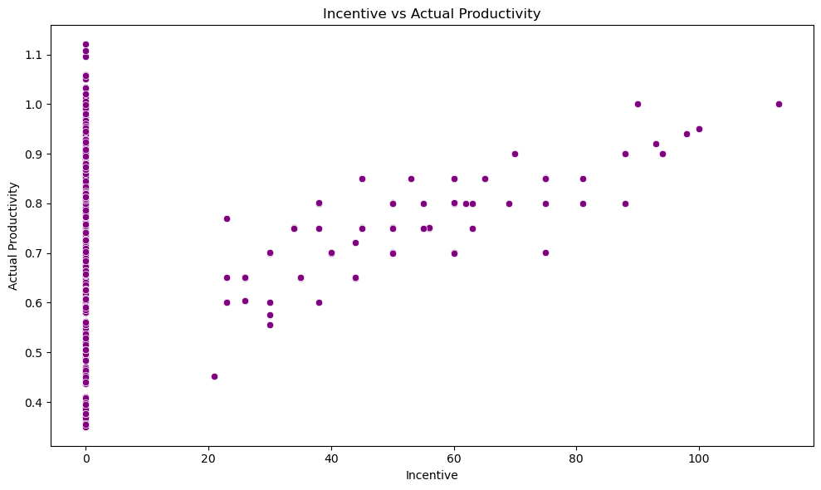
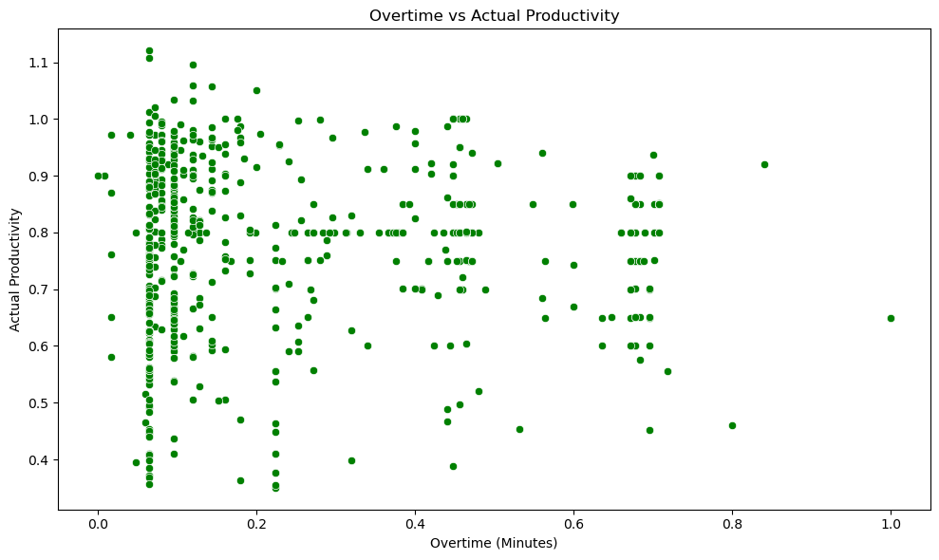
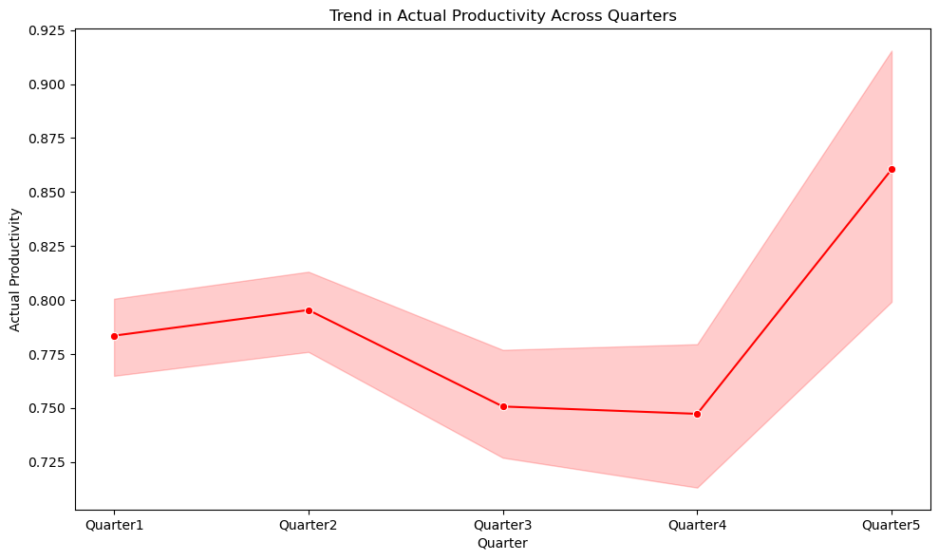
Visualizing Key Insights

Slide 8
Departmental Performance
Average Actual Productivity by Department:

Slide 9
Productivity Trends Over Time

Slide 10
Conclusion & Recommendations
Conclusion:
Overtime and incentives are key drivers of productivity, but careful management is required to avoid diminishing returns.
Recommendations:
1. **Optimize Overtime**: Limit excessive overtime to prevent worker burnout.
2. **Incentive Structuring**: Adjust incentives to maximize impact on productivity without creating imbalance.

