Slide 1
Garment Worker Productivity Analysis
The objective of this project is to identify key factors that influence productivity among garment factory workers by applying Exploratory Data Analysis, data transformation, aggregation, and visualization techniques
Some of the questions we will answer in this analysis include: How does overtime impact productivity?
Are incentives effective in increasing output?
What are the variations in productivity by department and time

Slide 2
1. Exploratory Data Analysis (EDA)
It is the process of analyzing and summarizing datasets that involves using statistics and visualizations to understand patterns, and gain insights before applying formal models.

Slide 3
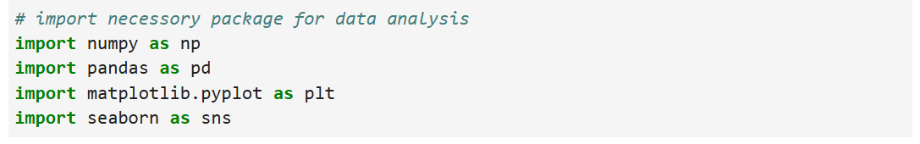
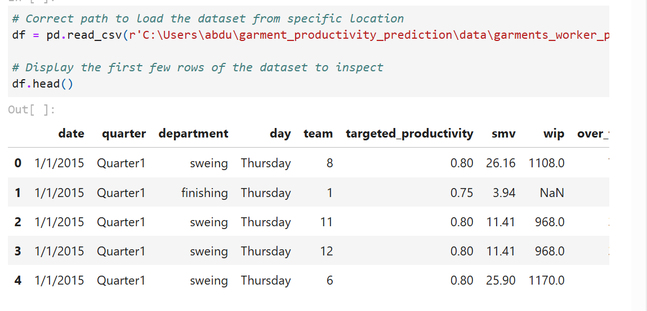

Slide 4
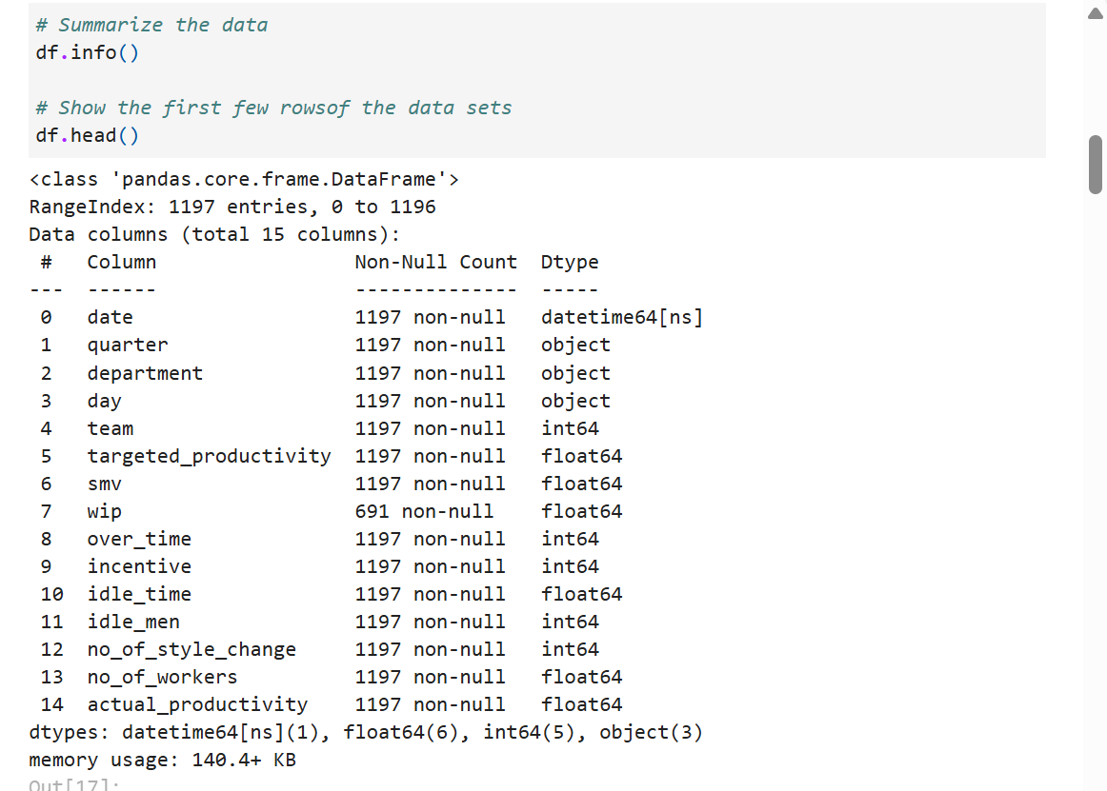
Data summarization

Slide 5
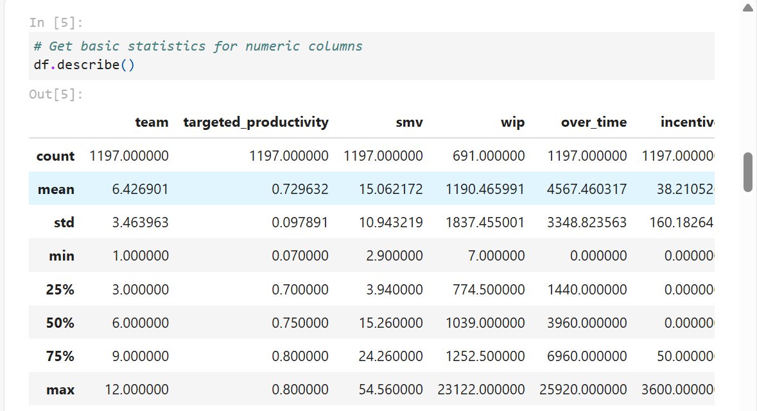
Basic statics of the data set

Slide 6
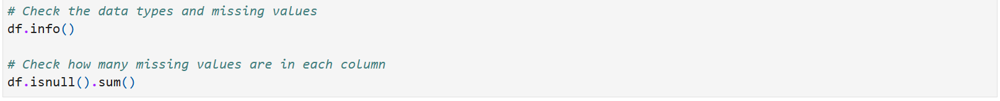
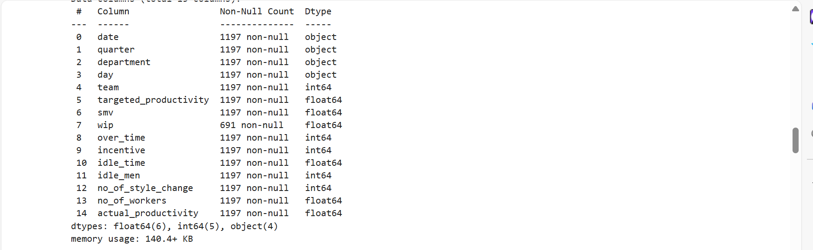
2. Data cleaning and data transformation:

Slide 7
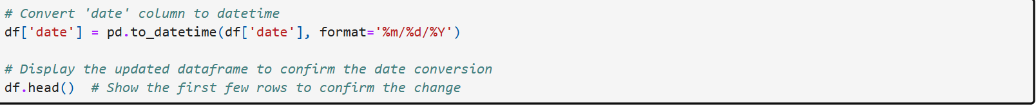
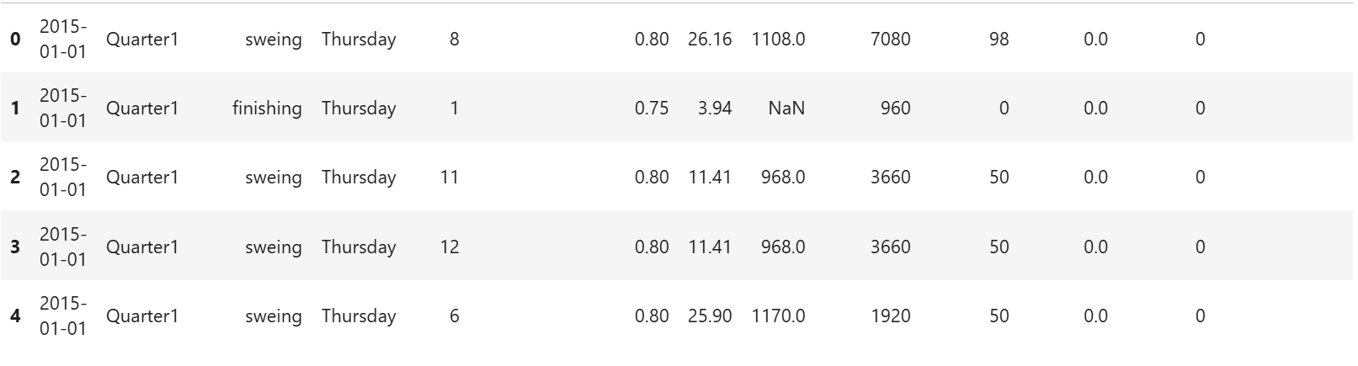
The date column from the data set was string so we need to convert it to date time

Slide 8
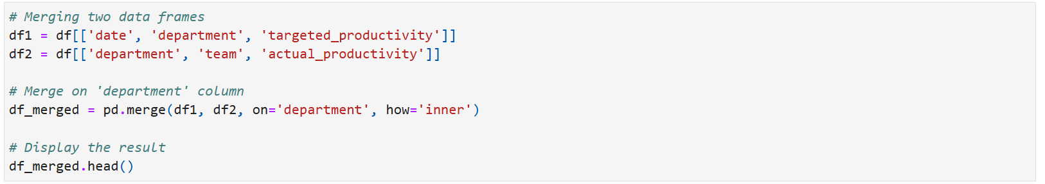
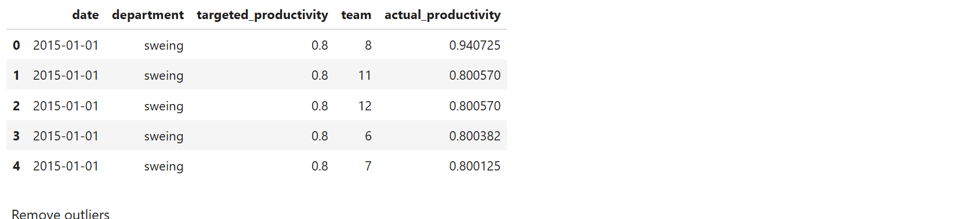
3.Data joining : Merging two data frame

Slide 9
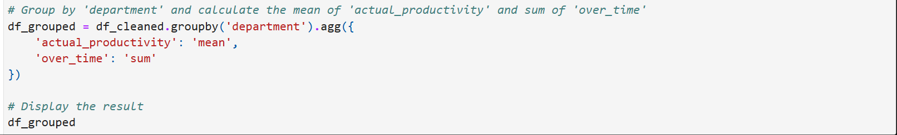
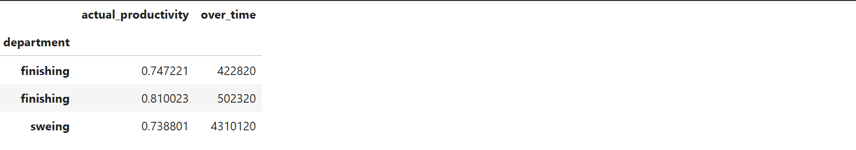
4. Aggregation and Grouping Operations

Slide 10
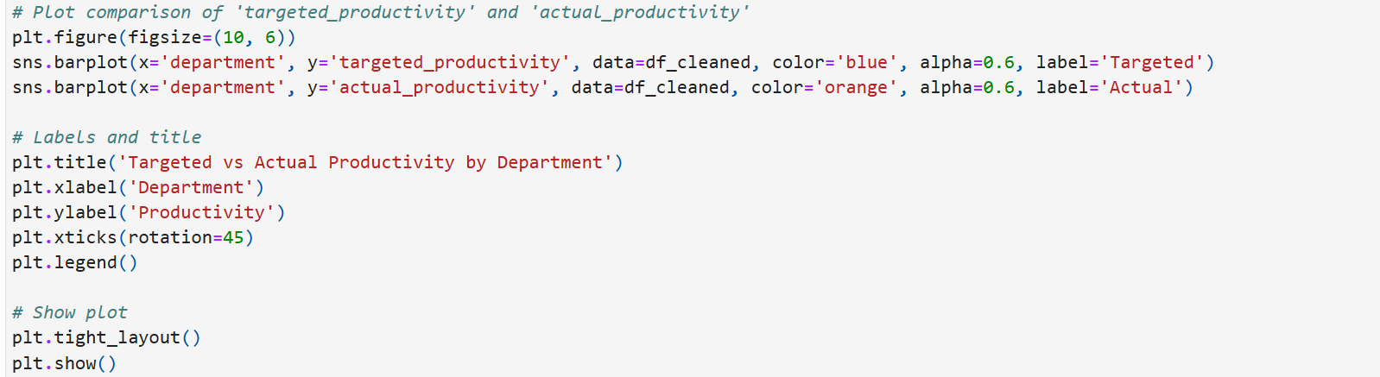
5. Data Visualization: How does targeted_productivity compare to actual_productivity across different departments?”

Slide 11
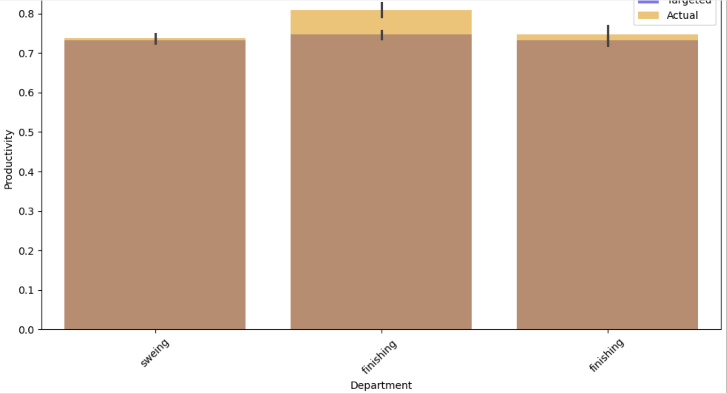
Targeted vs actual productivity by department bar chart compares targeted activity vs actual activities

Slide 12
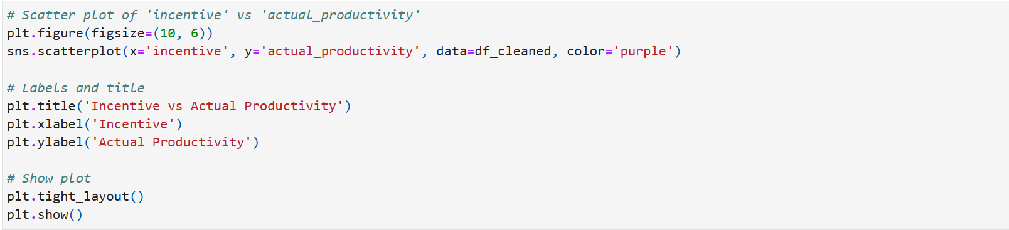
How does incentive affect actual productivity?

Slide 13
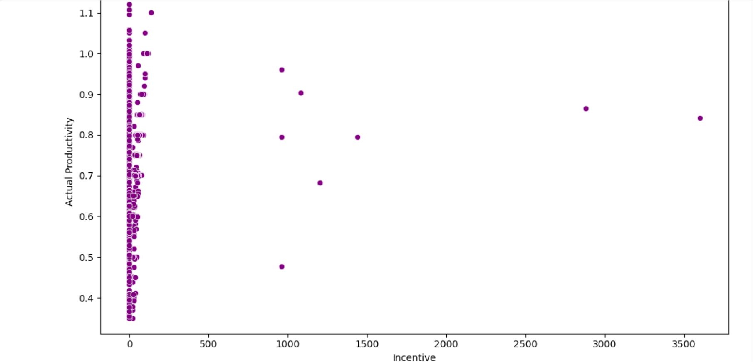
Incentive vs actual productivity

Slide 14
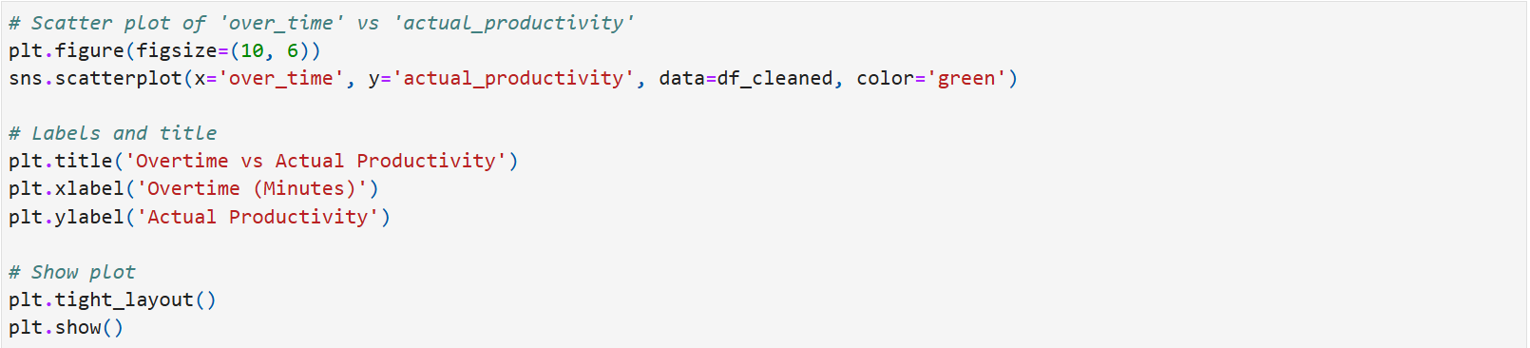
Overtime vs actual productivity

Slide 15
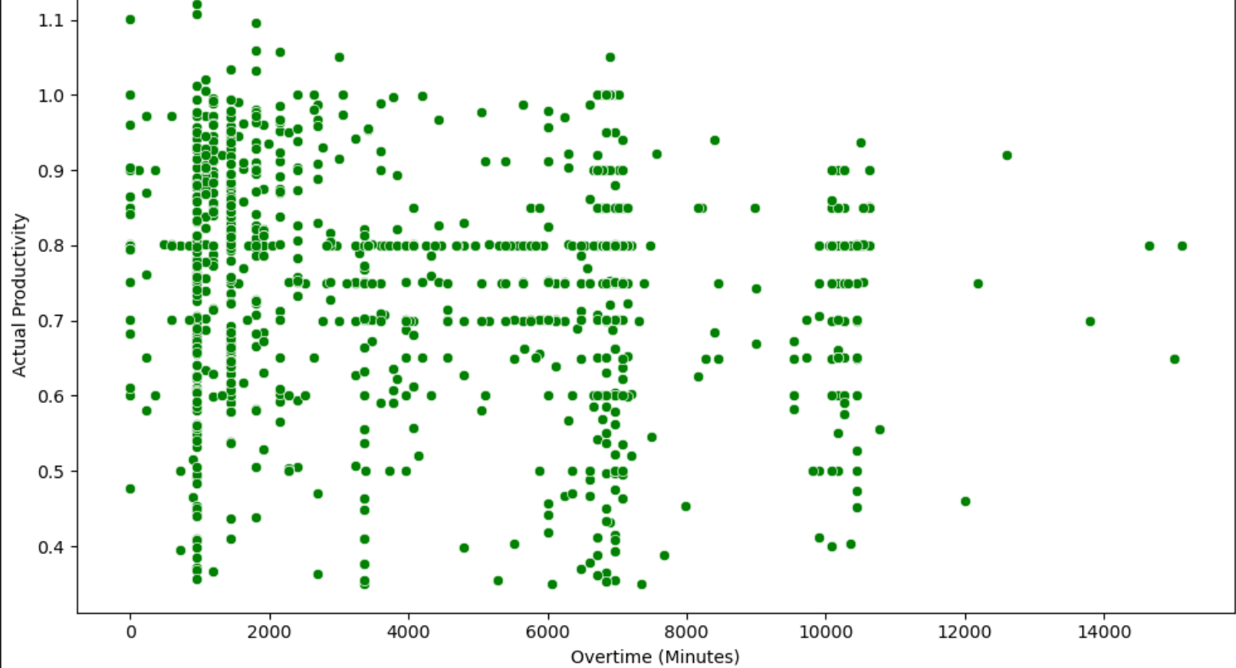
Overtime vs actual productivity

