Slide 1
Garment Worker Productivity Analysis
Thesis: what factors significantly impact garment productivity?
•Research Questions: How does overtime influence productivity?
•Are incentives effective in increasing output?
•What are the variations in productivity by department and time?
The data set contains 1,197 rows and 15 columns, including numeric, categorical, and datetime data types.

Slide 2
1. Exploratory Data Analysis (EDA)

Slide 3
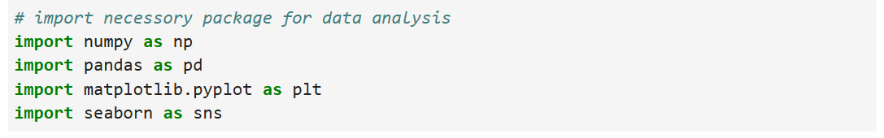
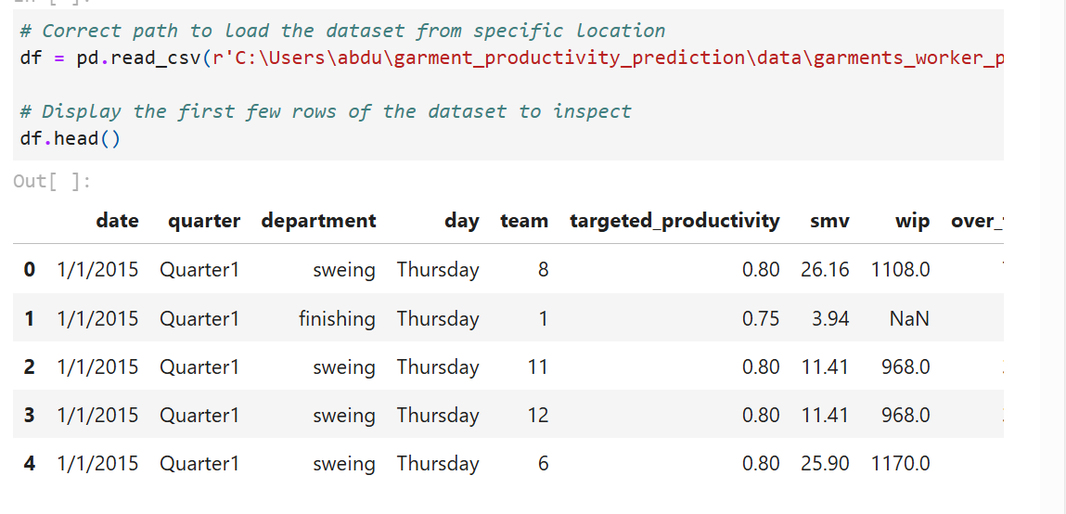

Slide 4
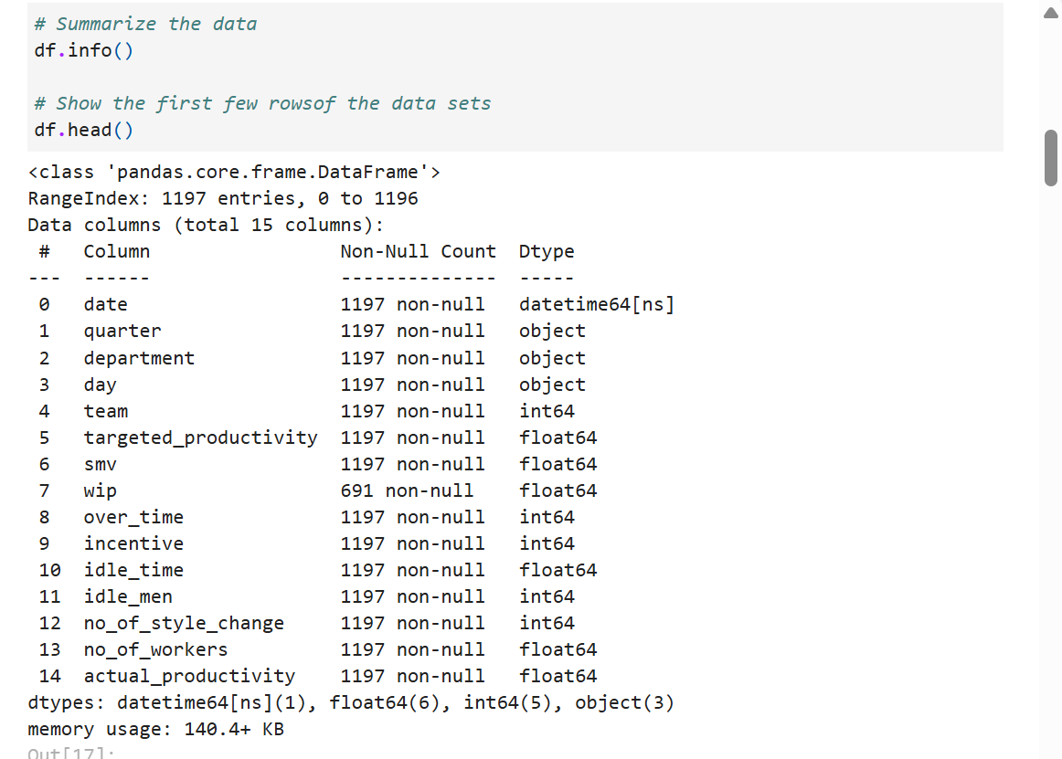
Data summarization

Slide 5
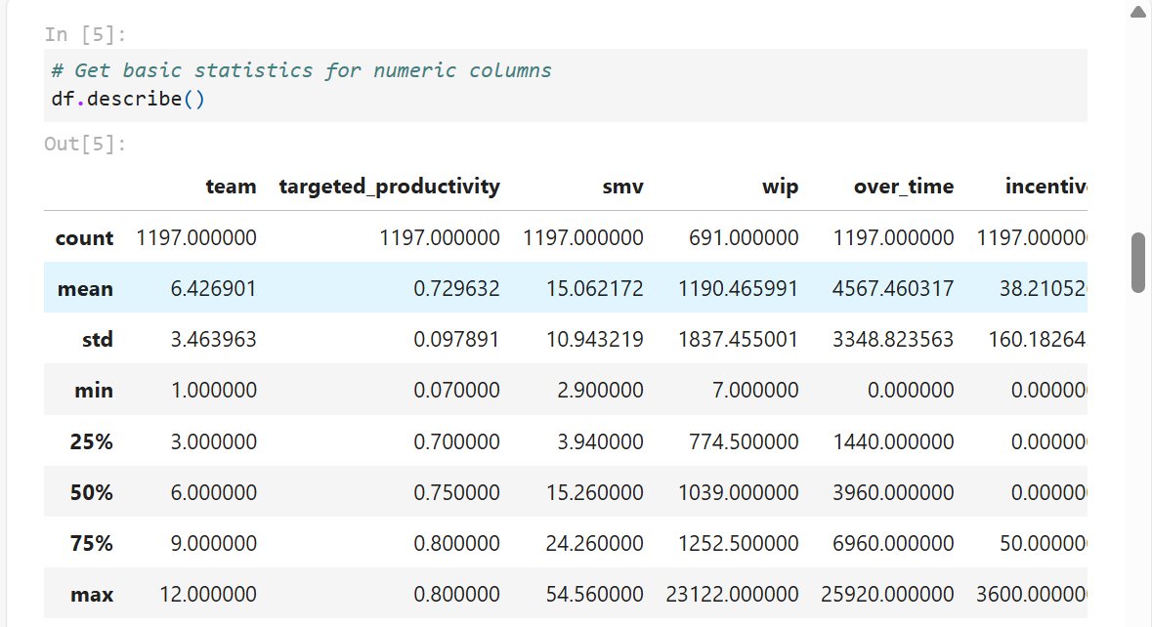
Basic statics of the data set

Slide 6
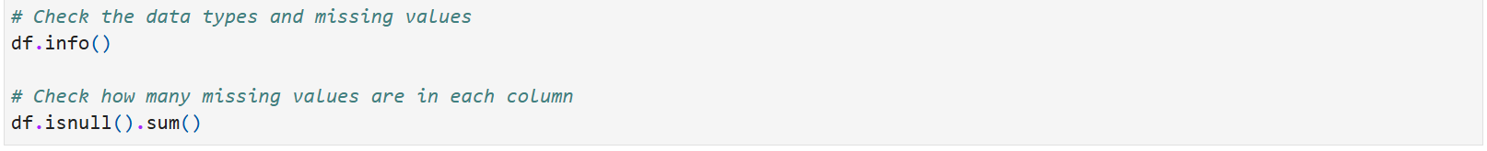
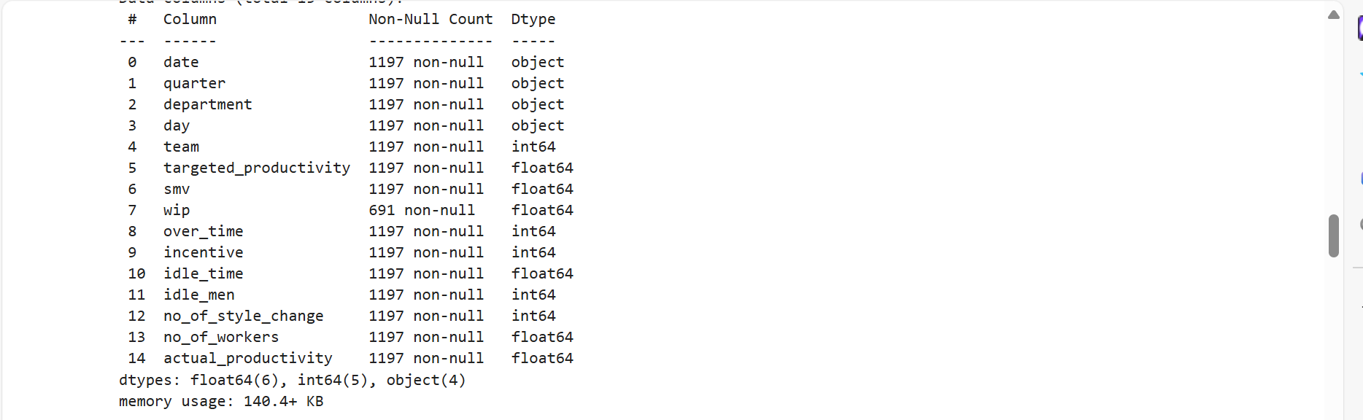
2. Data cleaning and data transformation:

Slide 7
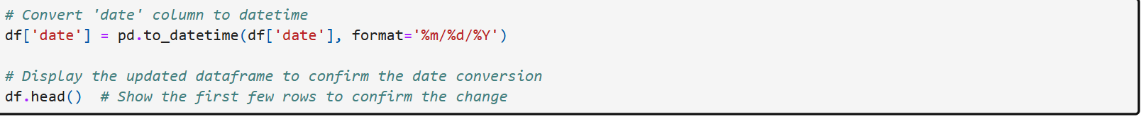
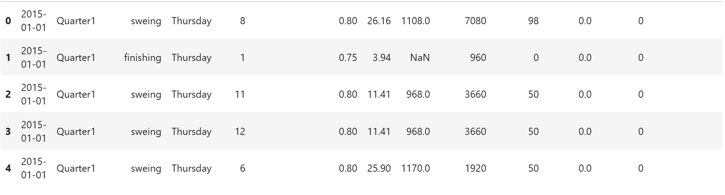
The date column from the data set is string we need to convert it date time

Slide 8
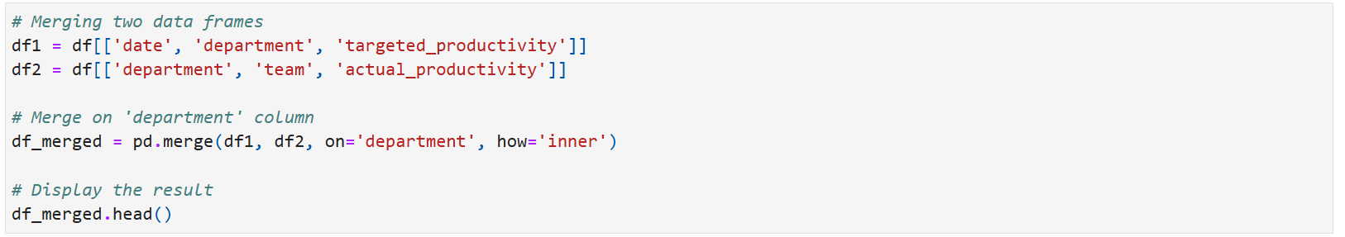
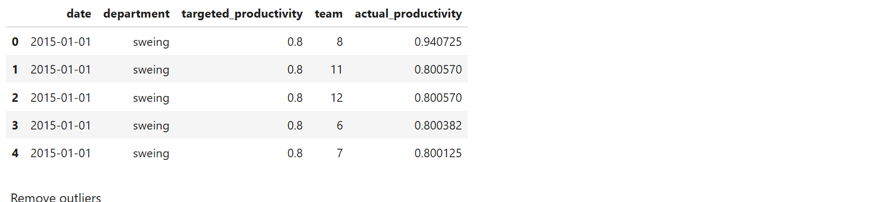
3.Data joining : Merging two data frame

Slide 9
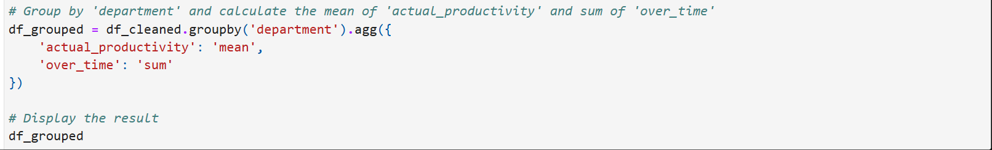
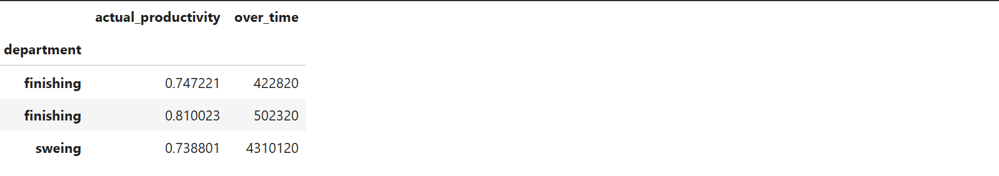
4.Aggregation and Grouping Operations

Slide 10
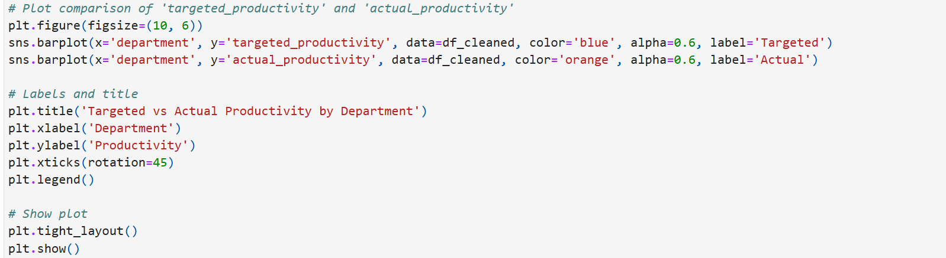
5. Data Visualization: Question: How does targeted_productivity compare to actual_productivity across different departments?”

Slide 11
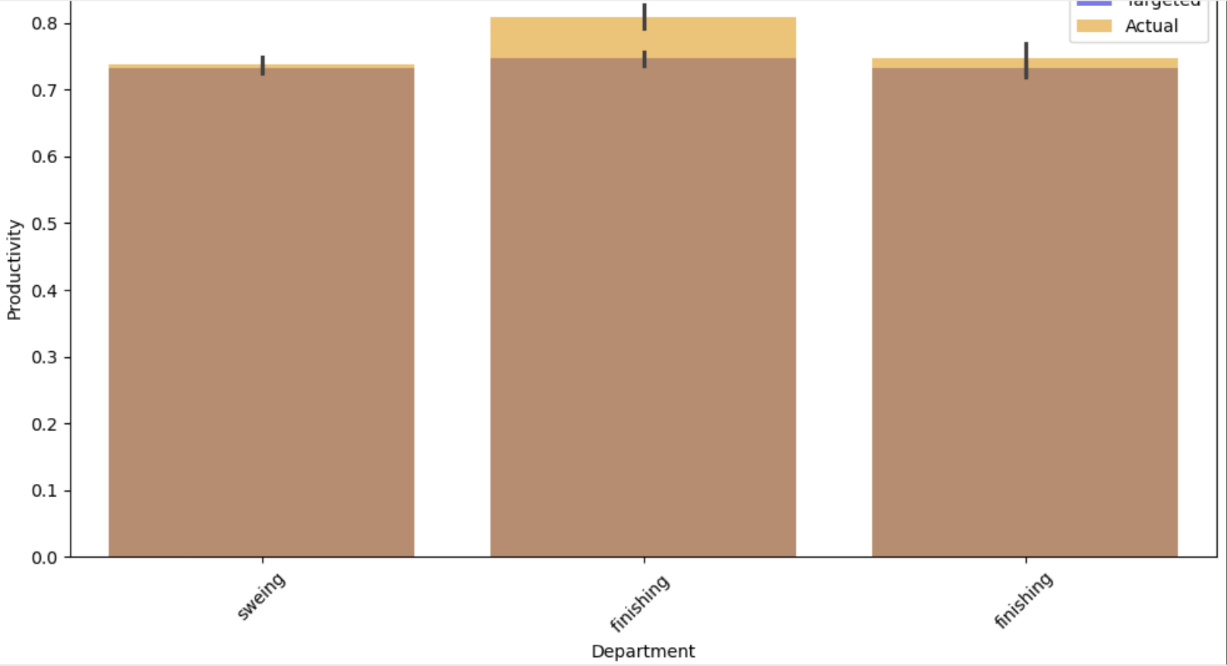
Targeted vs actual productivity by department

Slide 12
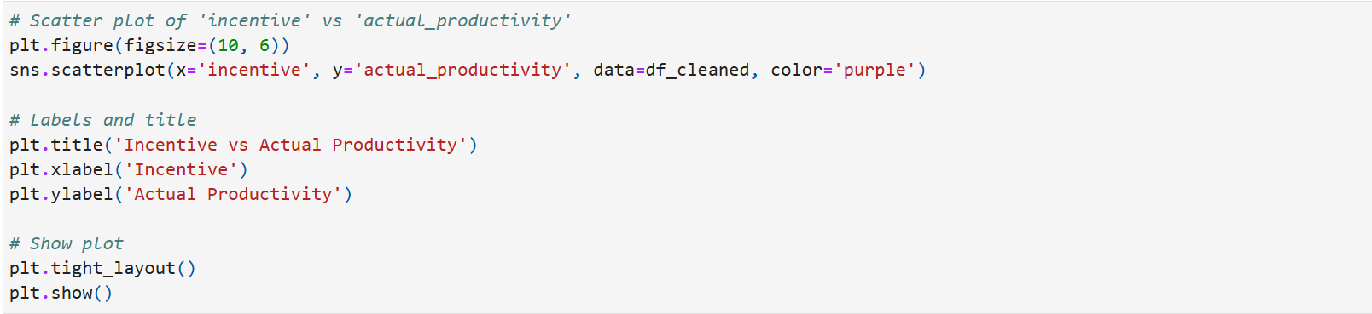
How does incentive affect actual productivity?

Slide 13
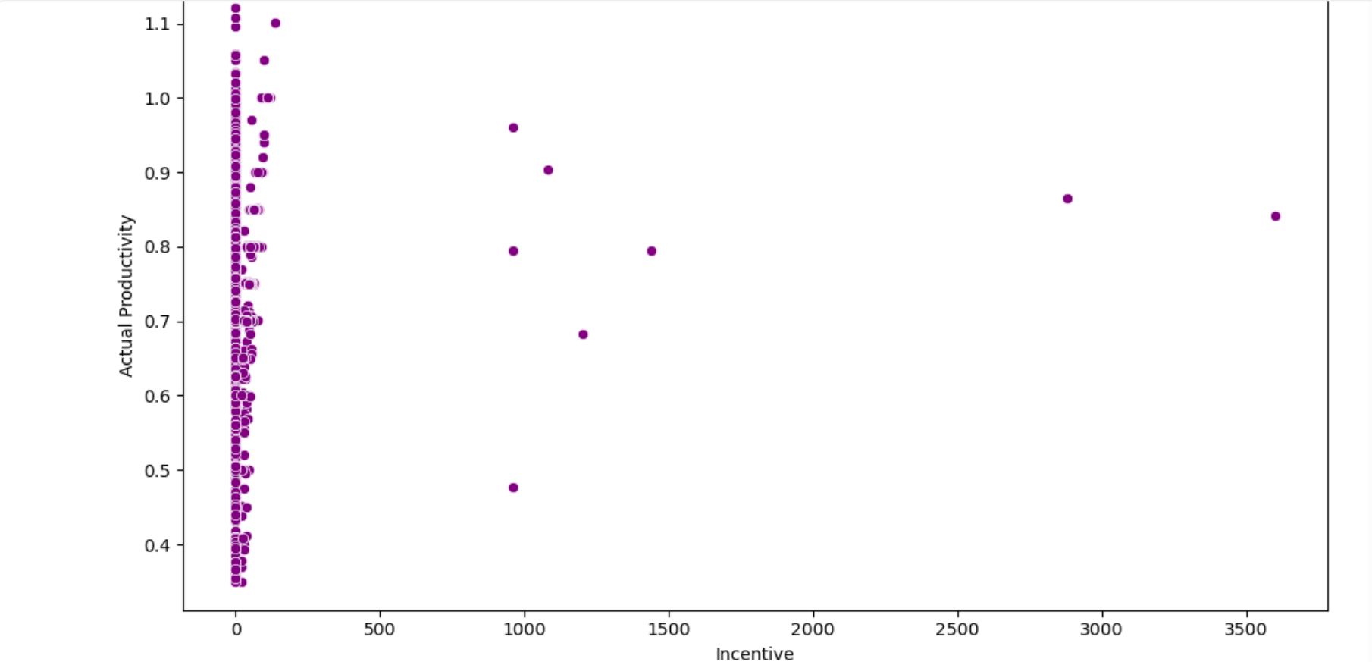
Incentive vs actual productivity

Slide 14
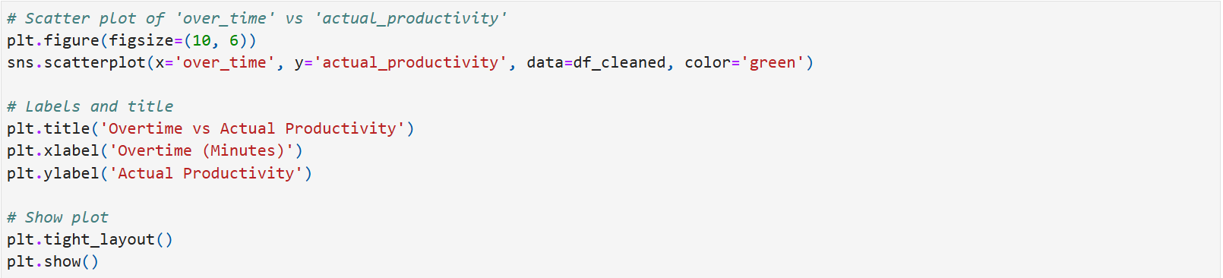
Overtime vs actual productivity

Slide 15
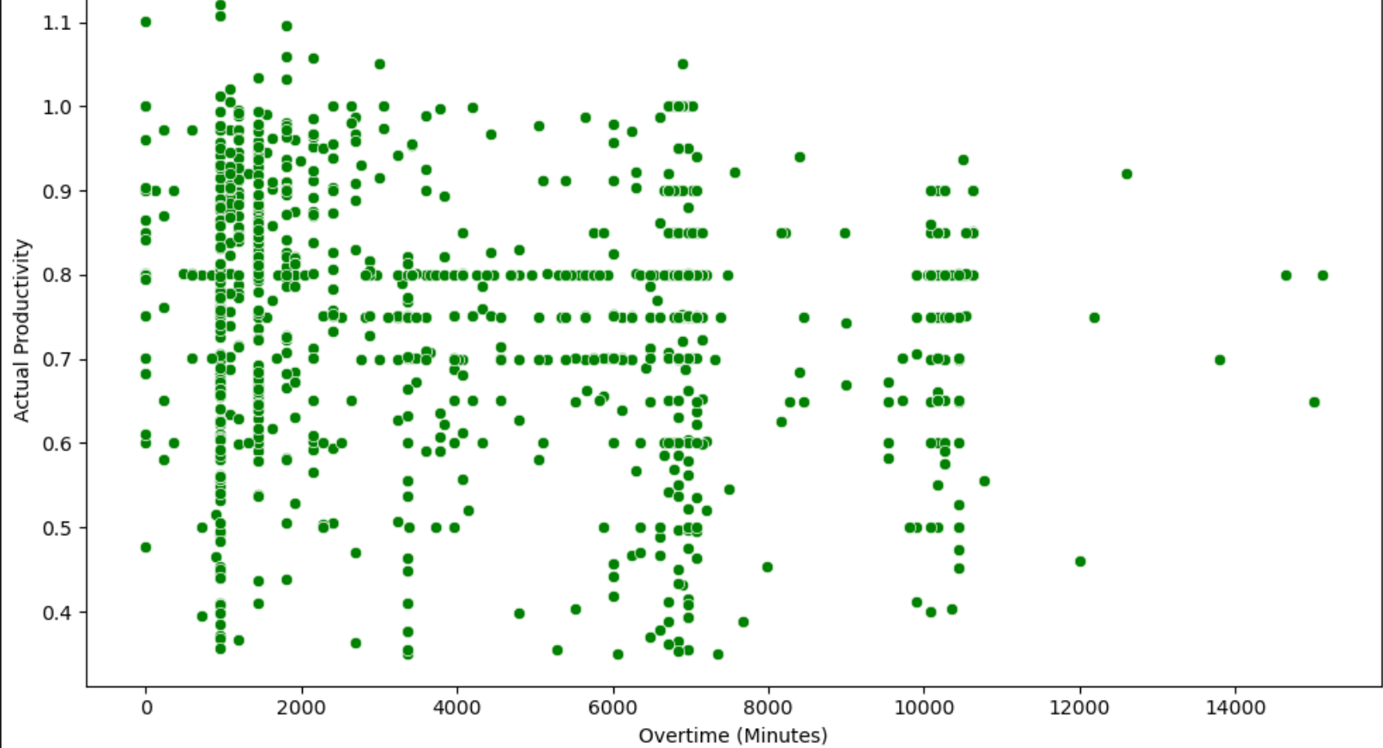
Overtime vs actual productivity

