Slide 1
Business Recommendations for Timeless Transport Models
Maximizing Profits from June 2005 to December 2005
Abdulfetah Adem
March 2025

Slide 2
Project Overview
Objective: Maximize profits for Timeless Transport Models between June 2005 and December 2005 by focusing on key strategies:
Optimizing Sales: Improve email marketing campaigns and customer engagement.
Optimizing Production: Adjust schedules for peak demand in November.
Targeting Products and Regions: Focus on top-performing products and regions.

Slide 3
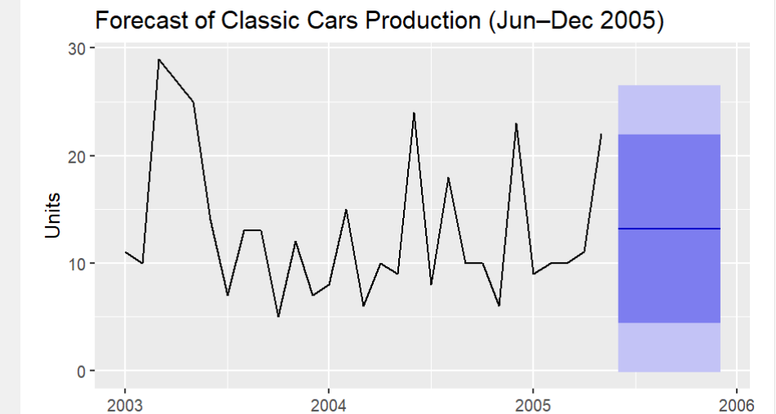
Key Insights from Engineering Resource Analysis
Actionable Plan:
Adjust production plans to meet high demand in November.
Maximize resource efficiency and minimize production costs.
forecasts of production costs derived from engineering resource planning data

Slide 4
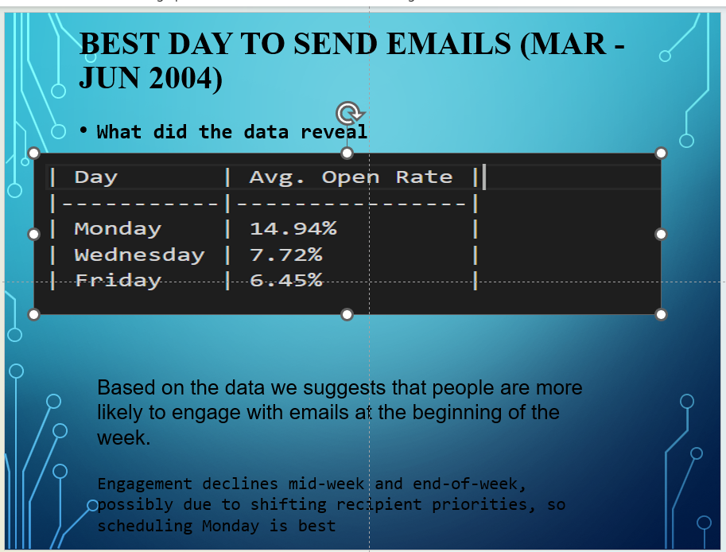

Key Insights from Marketing Email Campaign
Actionable Plan:
- Use urgent-tone emails to maximize open and click rates.
- Schedule emails on Mondays for optimal engagement.
- Focus on high-performing regions: USA, Australia.
Visual: Open rates by email tone and day of the week.

Slide 5
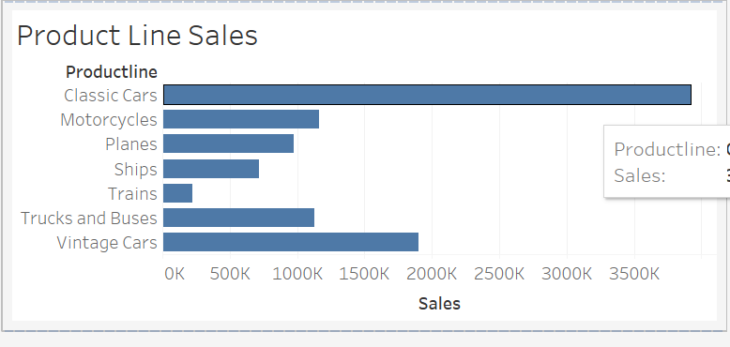
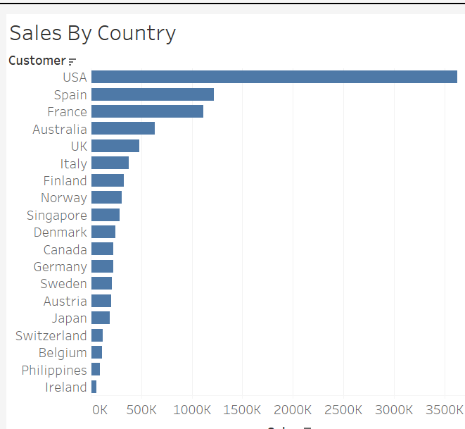
Key Insights from the Sales Tracking Dashboard
Sales Breakdown:
- Top products: Classic Cars, Vintage Cars lead in revenue generation
- High-performing regions: USA, Australia, France show strongest sales performance
- Mondays perform best for sales engagement.
Actionable Plan:
- Target top products and regions for marketing campaigns.

Slide 6
Recommendation 1: Maximize Email Marketing
Actionable Plan:
- Focus on urgent-tone emails to increase engagement.
- Send emails(schedule ) on Mondays to align with the highest engagement period.
- Target regions: USA, Australia.
Data Insight:
- Urgent-tone emails outperform conversational ones.
- Mondays have the best engagement based on sales data.

Slide 7

Recommendation 2: Target Product Sales to Match Demand
Actionable Plan:
- Promote Classic Cars, Vintage Cars during peak season.
- Align promotions with sales trends.
Data Insight:
- Classic Cars, Vintage Cars have the highest sales.
- Best-selling products should be promoted during peak months.

Slide 8
Recommendation 3: Optimize Production Schedules
Actionable Plan:
- Adjust production schedules for Classic Cars, Vintage Cars.
- Focus production on high-demand regions: USA, APAC, EMEA.
Data Insight:
- APAC and EMEA regions require more production due to higher sales in these areas.

Slide 9

Conclusion :
Conclusion Statement
To boost growth and performance, three key strategies are recommended:
Enhance email marketing with urgent-tone messages sent on Mondays in top regions (USA, Australia).
Promote high-demand products like Classic and Vintage Cars during peak seasons.
Adjust production to meet demand in key markets (APAC, EMEA).
These data-driven actions will improve engagement, increase sales, and streamline operations.

