Slide 1

Business Recommendations for Timeless Transport Models
Abdulfetah Adem
March 2025

Slide 2
Project Overview
Objective: Maximize profits for Timeless Transport Models between June 2005 and December 2005 by focusing on key strategies:
Strategies:
- Improve email marketing campaigns
- Optimize production schedules for peak season
- Focus on top-performing products and key regions

Slide 3
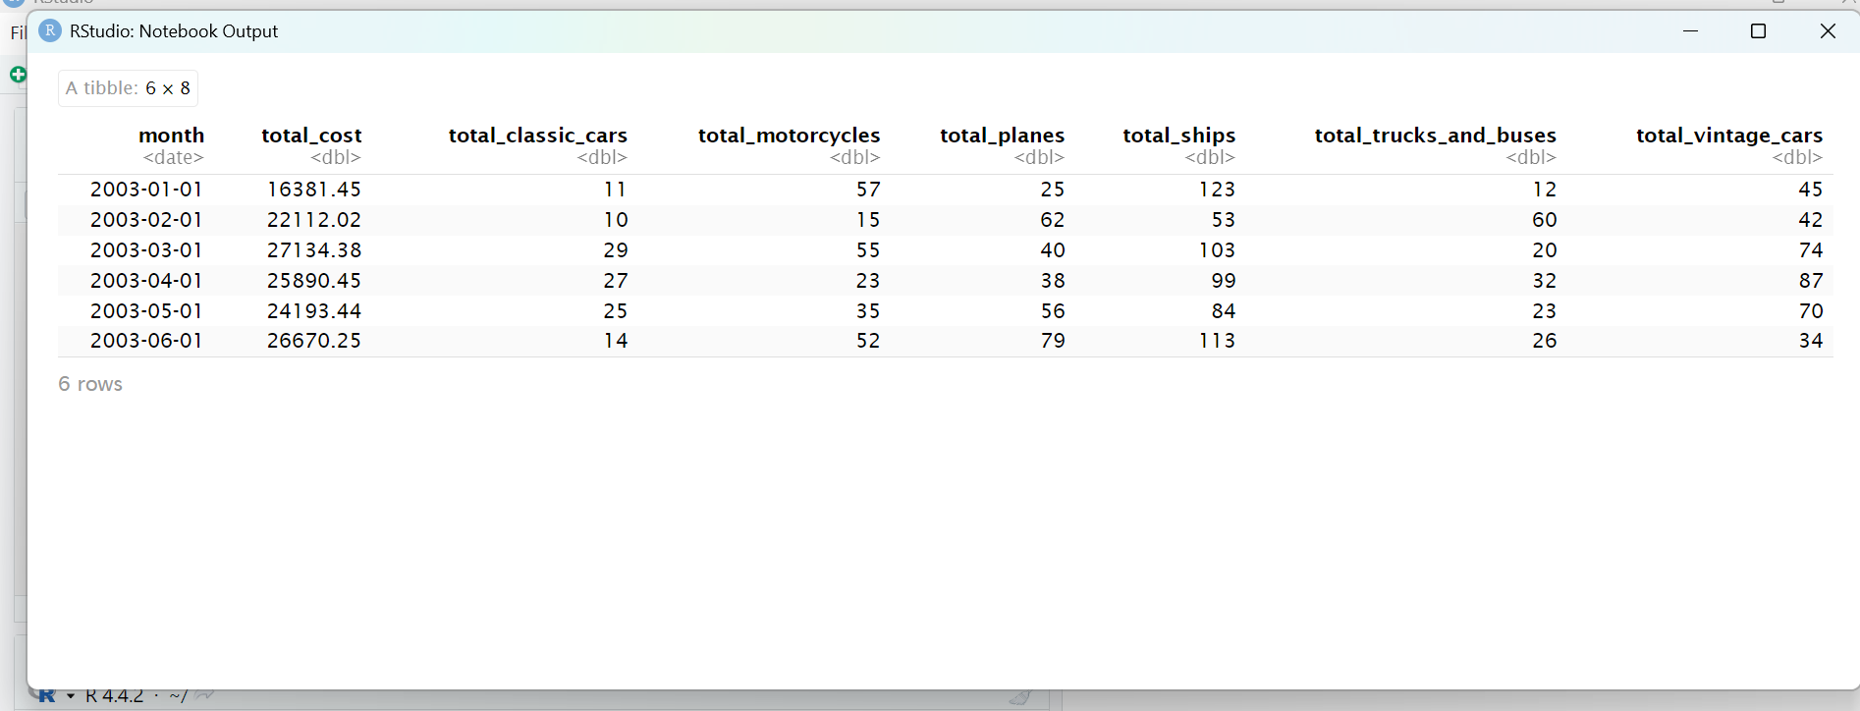
Engineering Resource Analysis Insights
Actionable Plan:
- Adjust production to meet peak demand in November
- Forecast production costs accurately
- Maximize efficiency and minimize overall production costs

Slide 4
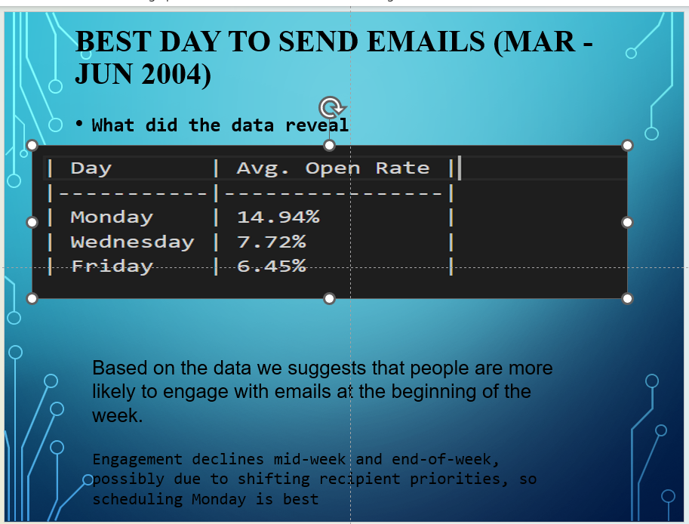
Marketing Email Campaign Insights
Actionable Plan:
- Use urgent-tone emails for higher engagement
- Send marketing emails on Mondays
- Prioritize regions with highest engagement (USA, Australia)
Data Insight:
- Urgent-tone emails achieve higher open rates
- Engagement peaks at the beginning of the week

Slide 5
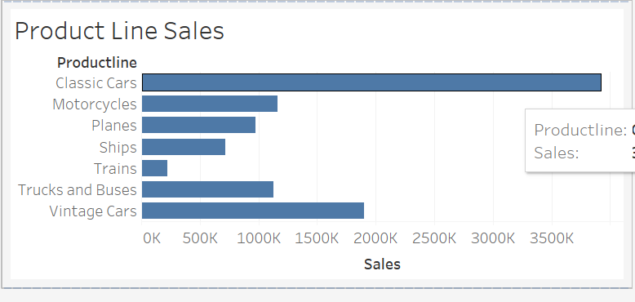
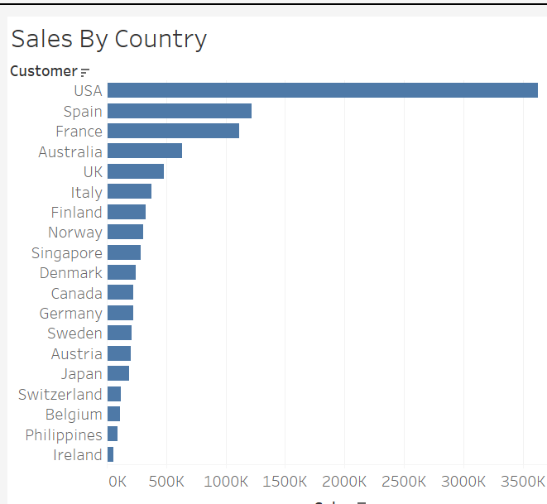
Sales Tracking Dashboard Insights
Actionable Plan:
- Target top-selling products: Classic Cars, Vintage Cars
- Focus marketing and sales efforts on high-performing regions (USA, Australia, France)
- Leverage Monday for optimal sales engagement

Slide 6
Recommendation 1: Maximize Email Marketing
Plan:
- Send urgent-tone marketing emails
- Schedule communications for Monday mornings
- Concentrate marketing efforts on USA and Australia
Supported by data:
- Urgent-tone emails drive higher engagement
- Monday emails consistently outperform other days

Slide 7
Recommendation 2: Align Product Sales with Demand
Plan:
- Increase promotional activities for Classic Cars and Vintage Cars
- Align product marketing to sales trends and peak demand periods
Supported by data:
- Highest sales are from Classic and Vintage Cars
- Sales peak in alignment with seasonal demands

Slide 8
Recommendation 3: Optimize Production Schedules
Plan:
- Schedule production for Classic Cars and Vintage Cars to match demand
- Increase production capacity for APAC and EMEA regions
Supported by data:
- High demand identified in APAC and EMEA regions
- Efficient production alignment can significantly reduce costs

Slide 9
Final Strategic Summary
To maximize profits:
- Implement urgent-tone email marketing on Mondays
- Promote and produce top-selling Classic and Vintage Cars according to market demand
- Optimize production schedules in key regions (APAC, EMEA)
Expected Outcomes:
- Enhanced customer engagement
- Increased sales revenues
- Greater operational efficiency

