Slide 1
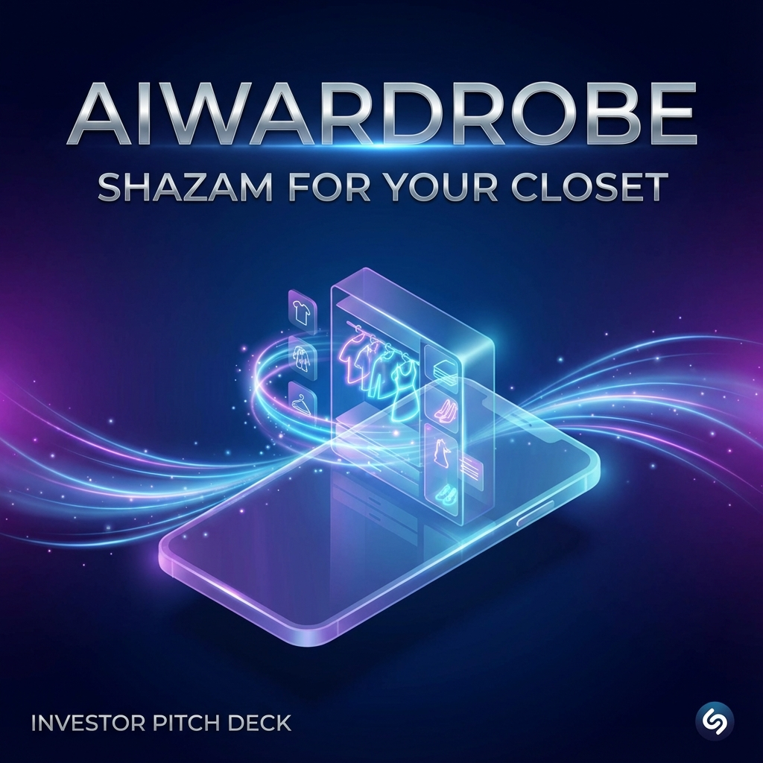
AIWardrobe
"Shazam for Your Closet"
AI That Turns Any Wardrobe Into a Personal Stylist in 30 Seconds
Zohid Vohidjonov, Founder & CEO
Raising: $1.5M Pre-Seed

Slide 2
🎯 THE ONE-LINER
AIWardrobe is an AI-powered personal styling app that scans your closet in 30 seconds via video and acts as your personal stylist—suggesting outfits based on weather, occasion, and what you already own.
📱 30-second video scan digitizes your entire wardrobe
🤖 AI suggests outfits from YOUR existing clothes
🌤️ Weather-aware, occasion-smart recommendations
💰 $5/month vs $100/hour personal stylist

Slide 3
📊 MARKET VALIDATION: THIS ALREADY WORKS
AltaDaily (Europe/US)
Serca Trove (Russia)
Unicorn valuation ($1B+) Same concept: AI wardrobe Focus: Europe & US
Fashion blogger 3 boutiques in 1 year Lines at every location
🎯 The Gap: NOBODY OWNS CIS
No major player in Central Asia We are FIRST MOVERS 20M-user market

Slide 4
💔 THE PROBLEM: Meet Anna
32 years old • Marketing Manager • $2,500/month • 200+ items
⏰ Morning Chaos
💸 Shopping Guilt
20 min wasted EVERY morning "I have nothing to wear"
$1,800/yr on duplicates Bought same dress twice
😤 Zero Trust
📦 Hidden Waste
Consultants want commission Stylists cost $100/hr
60% zombie clothes 2.5 hrs/week deciding
Anna represents 20 MILLION office professionals in CIS.

Slide 5
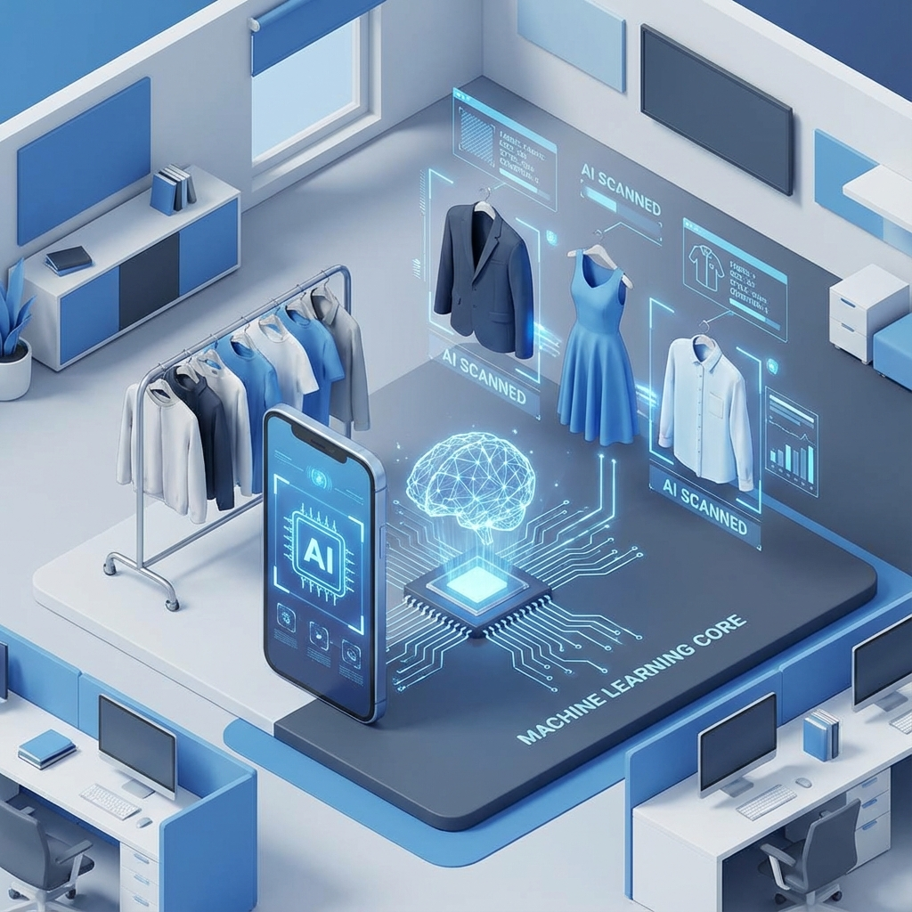
✨ THE SOLUTION: 30-Second Magic
STEP 1: Scan (10 sec)
Open closet → Record → Film 30 sec
STEP 2: AI Catalogs (15 sec)
Multi-AI analyzes every frame Detects items, extracts style Creates pro photos
STEP 3: Ask AI Stylist (5 sec)
"Meeting at 3pm, 18°C" → 3 outfit suggestions
STEP 4: Smart Shopping
AI: "You have 2 similar But need navy heels"

Slide 6
🎨 KEY FEATURES & TECHNICAL MOAT
📹 Video Scanning
📸 Pro Photos
👗 AI Outfits
30 sec digitize closet
AI background removal
Weather + Occasion
🪞 Virtual Try-On
💬 Smart Chat
🌍 Multi-Language
See before buying
AI fashion assistant
EN, RU, UZ
🔒 TECHNICAL MOAT: No Competitor Can Replicate
Multi-AI Stack: Gemini + GPT-4 • 18-Category Segmentation • E-commerce Quality Photos

Slide 7

🎯 BEACHHEAD MARKET: CIS Professionals
TARGET CUSTOMER (18 Months)
Uzbekistan, Kazakhstan, Russia Ages 25-45, office professionals Income: $1,500-$5,000/month
2M
3M
Uzbekistan
Kazakhstan
15M
20M
Russia T1
Total

Slide 8
🚀 TRACTION: Distribution Locked
12+
500K+
$5
36:1
Influencers
Reach
CAC
LTV:CAC
Pre-Launch Distribution
Why This Works
• 12+ bloggers & stylists • Instagram, Telegram, TikTok • Affiliate revenue model • Serca Trove playbook
• CAC: $5 vs $50+ ads • Fashion is shareable • Credibility from day 1 • Viral potential

Slide 9
👥 THE TEAM: AI Experts
Zohid Vohidjonov
Co-Founder
Lead Dev
Designer
Founder & CEO
AI Vision
React Native
UX/UI
AI CV Specialist Built multi-AI pipeline
Segmentation expert 18-category model
Cross-platform Millions of users
Premium design Investor-ready UI
"We're AI experts who fell in love with fashion."
✓ Technical moat • ✓ We ARE the customer • ✓ MVP built

Slide 10
💰 BUSINESS MODEL: Freemium SaaS
FREE TIER
PREMIUM $4.99/mo
UNIT ECONOMICS
• Up to 50 items • Basic outfits • Weather suggestions
• Unlimited scanning • Virtual try-on • Designer styles
CAC: $5 LTV: $180 LTV:CAC: 36:1
REVENUE PROJECTIONS
Mo 3
Mo 9
Mo 18
10K users → $5K MRR
50K users → $25K MRR
200K users → $100K MRR

Slide 11
💵 THE ASK: $1.5M Pre-Seed
Milestone 1: Launch
Milestone 2: Growth
Milestone 3: Series A
$400K
$600K
$500K
Mo 1-3
Mo 4-9
Mo 10-18
iOS + Android AI infrastructure → 10K users
50+ influencers Kazakhstan → $25K MRR
Russia entry B2B pilots → $100K MRR
Each milestone DE-RISKS the investment

Slide 12
🏆 WHY WE WIN
✅ Market Validated
✅ First Mover CIS
✅ Technical Moat
AltaDaily $1B+ Serca Trove 3 boutiques
No competition 20M market
Multi-AI stack 18-category seg
✅ Distribution
✅ Strong Team
500K reach $5 CAC
AI experts MVP built

Slide 13
⚡ COMPETITIVE LANDSCAPE
Competitor
Geo
Our Advantage
AltaDaily
US/EU
We own CIS exclusively
Whering
UK
Manual entry - we do 30-sec video
Cladwell
US
Text-based - we do visual AI
Smart Closet
Global
Basic - we have pro photos
Stylists
All
$100/hr - we're $5/mo
Best features + regional exclusivity + superior tech

Slide 14
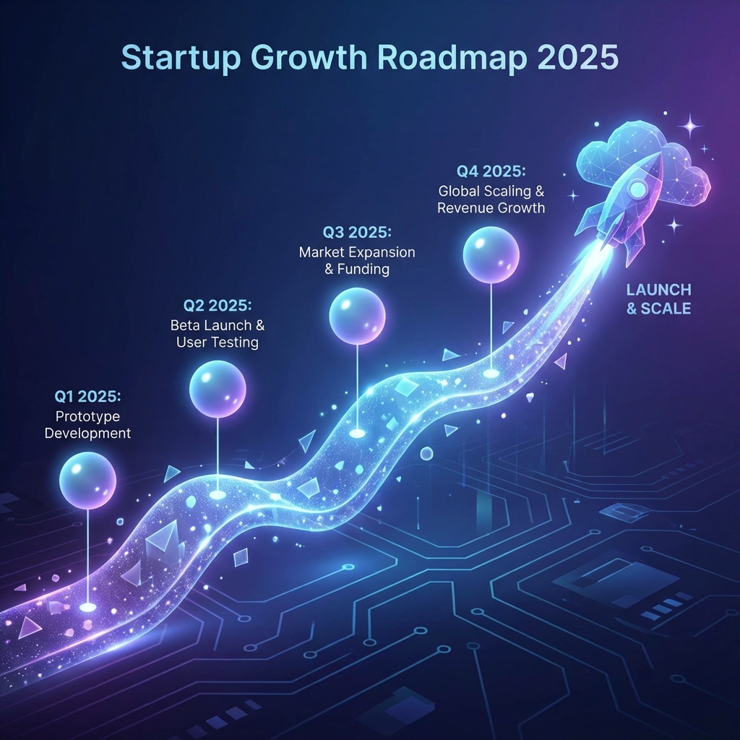
📈 18-MONTH ROADMAP
Q1 2025: LAUNCH
iOS + Android • 10K users
Q2 2025: MONETIZE
Premium launch • $25K MRR
Q3 2025: SCALE
100K users • 50+ influencers
Q4 2025: EXPAND
Russia entry • $100K MRR
2026: DOMINATE
500K users • B2B • Europe

Slide 15
🚂 THE TRAIN IS LEAVING
Why Invest NOW:
INVESTMENT
✓ Market timing: Post-COVID decision fatigue
$1.5M Pre-Seed SAFE / Priced Round
✓ Tech timing: AI is finally accurate
✓ Geo timing: CIS market is open
"Own a piece of digital closets"
✓ Validation: AltaDaily = unicorn model
LET'S TALK
Zohid Vohidjonov • Founder & CEO
📧 zohid@aiwardrobe.app
December 2025 • Confidential

