Slide 1
1. Introduction and Project Objectives
Air Quality Analytics and Pollution Hotspot Detection in India
Study question
Which monitoring stations repeatedly experience high pollution, and how much observed data supports the result?
▸
Analyze historical CPCB observations for the complete year 2024.
▸
Select a pollutant, state, city and period in the dashboard.
▸
Identify persistent hotspots and inspect monthly patterns.
▸
Execute SQL in BigQuery and validate outputs independently.
Project contribution
Persistence screening with visible coverage, pollutant-specific averaging rules and explicit missing-data limitations.
India Air Quality Analytics 1/10
Notes:
Source: project methodology and audited 2024 outputs. Data source: https://airquality.xkdr.org/. Historical batch analysis, no prediction.

Slide 2
2. Dataset and Big Data Scope
Verified measure | Count
Monthly source files | 12
All acquired source measurements | 46,937,170
Selected CPCB measurements | 27,021,875
Stations in the selected subset | 533
Eligible pollutant-station-days | 1,115,522
Combined station-days | 165,652
▸
One record means one pollutant at one station and time.
▸
PM2.5, PM10, NO2, SO2, O3, CO and NH3.
▸
Source: XKDR Forum CPCB compilation, CC BY 4.0 [1].
Why BigQuery helps
Cloud SQL processes the measurements and returns filtered summaries. This demonstrates warehouse analytics without claiming a laptop cannot process the data.
India Air Quality Analytics 2/10
Notes:
Source: data/india/audit/pipeline_run.json and download_manifest.json. XKDR Forum, CC BY 4.0, https://airquality.xkdr.org/. A record is one pollutant-station-time observation.

Slide 3
3. System Design and Data Lifecycle
Original monthly files and station metadata
Quality and provenance
Checksums and row reconciliation. IST dates with unique UTC keys. No missing-value filling.
Python acquisition and bronze selection
Independent check
BigQuery cleaning, windows and joins
DuckDB reference outputs verify cloud results. It is a separate validation path.
Daily gold tables and filtered SQL
Application access
Streamlit dashboard / app.py
Read-only viewer credentials, bound parameters and a ten-minute cache.
India Air Quality Analytics 3/10
Notes:
Source: implemented scripts, sql/bigquery and src/repository.py. DuckDB is an independent reference and is not a dashboard backend. No Airflow, Spark or Hadoop execution is claimed.

Slide 4
4. Pollutant Rules and Combined Pollution Level
Pollutant | Reference | Daily comparison
PM2.5 / PM10 | 60 / 100 ug/m3 | 24-hour mean
NO2 / SO2 | 80 / 80 ug/m3 | 24-hour mean
NH3 | 400 ug/m3 | 24-hour mean
O3 | 100 ug/m3 | Highest eligible 8-hour mean
CO | 2 mg/m3 | Highest eligible 8-hour mean
▸
Each day needs at least 16 valid hourly observations.
▸
An 8-hour window needs six readings and stays within the IST day.
▸
Combined level is the worst CPCB band, from 0 Good to 5 Severe.
▸
Require at least three valid pollutants, including PM2.5 or PM10 [2].
Interpretation
Derived ordinal screening, not official numeric AQI. Missing pollutants can hide a worse band. O3 upper bands use the source table’s one-hour convention.
India Air Quality Analytics 4/10
Notes:
Sources: docs/METHODOLOGY.md, src/india_bands.py and https://ies.gov.in/arthapedia/concept/national-air-quality-index. The linked standards provide individual concentration references. Upper ozone bands use observed one-hour maxima above 208 and 748 ug/m3. Classification inputs round to eight decimals only. This is not official numeric AQI.

Slide 5
5. Coverage and Persistent Hotspot Detection
Coverage (%)
Default persistence rule
100 x valid days / calendar days
▸
Overall day coverage at least 75%.
▸
Counted months have at least 75% coverage.
High-day fraction (%)
▸
At least 10% high days in a counted month.
100 x high days / valid days
▸
At least three high-pollution months.
Missing days never count as clean days.
Transparent project choices
PM2.5 persistent counts: 370 at 60% coverage, 342 at 75% and 250 at 90%. This changes eligibility, not measured air quality.
India Air Quality Analytics 5/10
Notes:
Source: src/analytics.py, src/repository.py and output/india/coverage_sensitivity.csv. These are adjustable project screening definitions, not official hotspot classifications. Sensitivity varies both overall and monthly coverage.

Slide 6
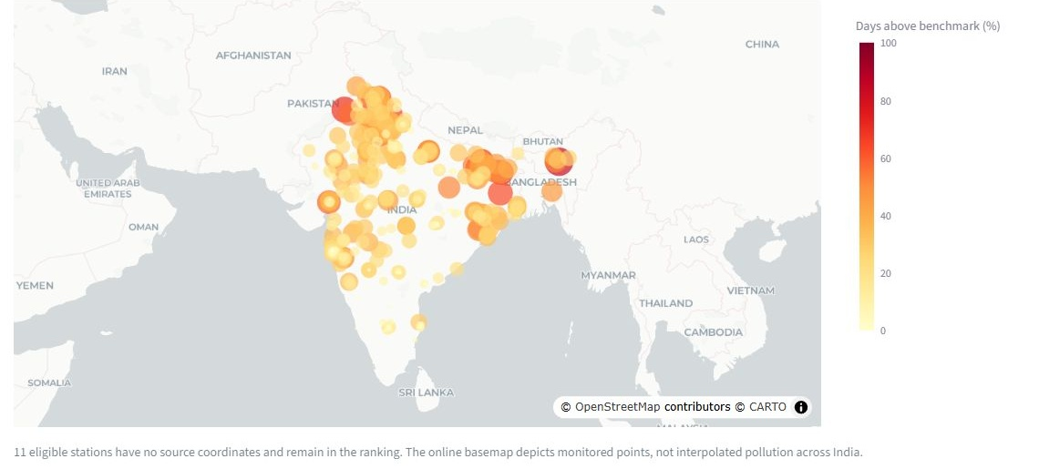
6. Dashboard Output: Pollution Hotspots
▸
PM2.5: 416 coverage-eligible stations and 342 persistent hotspots.
▸
Sector-51, Gurugram: 84.2% high days from 330 valid days.
▸
Eleven eligible stations lack coordinates and remain in the ranking.
India Air Quality Analytics 6/10
Notes:
Actual dashboard screenshot: PM2.5, all states, 1 Jan to 31 Dec 2024, 75% coverage, 10% high days in at least 3 months. Source: output/india/station_rankings.csv. Map background attribution remains visible in screenshot. High fractions represent monitored stations, not whole cities.

Slide 7
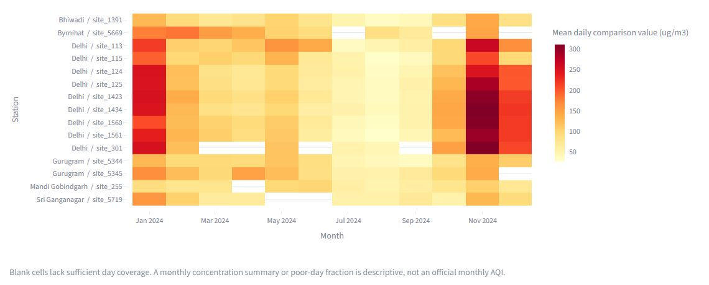
7. Dashboard Output: Monthly Patterns
▸
Means of daily PM2.5 values for the top 15 ranked stations.
▸
Blank cells fall below the coverage rule. A second heatmap shows coverage.
▸
One year describes monthly differences, not recurring seasonality or causes.
India Air Quality Analytics 7/10
Notes:
Actual dashboard screenshot: default annual PM2.5 view, top 15 ranked stations. Low-coverage months are masked. This is a selected subset, not a representative national sample. A separate coverage heatmap is in the report. No causal or multi-year seasonal inference is established.

Slide 8
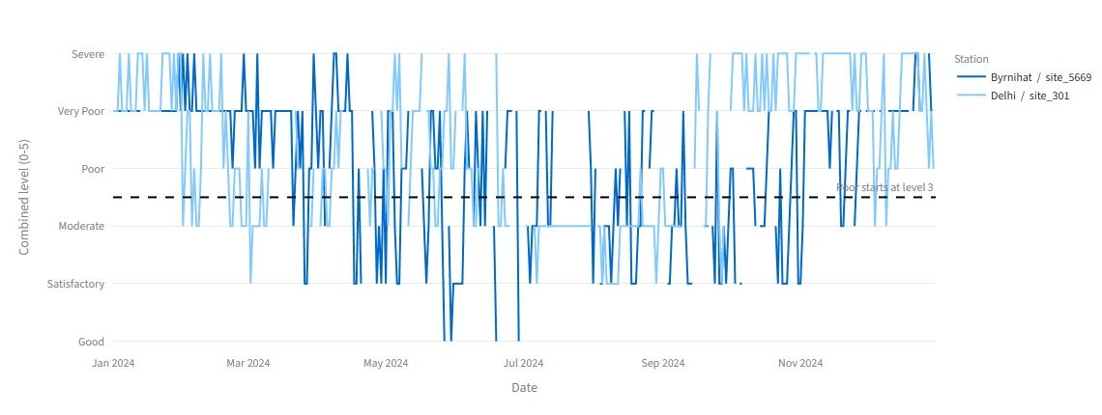
8. Dashboard Output: Combined Level and Comparison
432 coverage-eligible stations and 222 persistent hotspots
▸
Derived combined level from 0 Good to 5 Severe. Poor starts at level 3.
▸
Daily details show available pollutants. Compare up to three stations and export CSV.
India Air Quality Analytics 8/10
Notes:
Actual combined-view screenshots, all states and full 2024, with default thresholds. Source: output/india/combined_rankings.csv and app.py. Combined high days mean level >=3, whereas individual high days exceed a pollutant benchmark. Score is ordinal, not official numeric AQI.

Slide 9
9. Results, Validation and Course Alignment
Default annual screening
Validation evidence
View | Eligible | Persistent
PM2.5 | 416 | 342
PM10 | 412 | 372
NO2 | 425 | 35
SO2 | 432 | 4
O3 | 421 | 167
CO | 435 | 172
NH3 | 389 | 0
▸
32 tests passed after cleanup.
▸
Four cloud tables match the local reference.
▸
Three dashboard aggregation scenarios match.
ED547 connection
Modules IV and V: ETL, BigQuery, SQL and Python. Modules I and II: lifecycle, data quality and warehouse storage.
Verified execution
Real BigQuery jobs and processing records are retained. Hadoop, Spark and Airflow are not implemented. No controlled speed benchmark is claimed.
India Air Quality Analytics 9/10
Notes:
Sources: output/india/station_rankings.csv, output/india/verification.txt, data/india/audit/cloud_execution.json and dashboard_cloud_parity.json. Course: supplied ED547 syllabus. Results use default full-year coverage and persistence definitions. Four cloud-output parity checks use numeric tolerance 1e-8 and exact flags. Tests do not prove sensor accuracy or scientific validity of every assumption.

Slide 10
10. Conclusion, Limitations and References
Conclusion
Large-scale cloud processing linked to station-level evidence, coverage-aware persistence and reproducible outputs.
Limitations
▸
Historical 2024 data only. No prediction or attribution of causes.
▸
Uneven monitoring, missing pollutants and 53 missing-coordinate stations.
▸
Derived combined level and adjustable project thresholds.
▸
Sandbox tables expire after 60 days. Internet and credentials are required [3].
References
[1] XKDR Forum. India Air Quality Database. https://airquality.xkdr.org/
[2] Indian Economic Service. National Air Quality Index.
https://ies.gov.in/arthapedia/concept/national-air-quality-index
[3] Google Cloud. BigQuery sandbox. https://docs.cloud.google.com/bigquery/docs/sandbox
India Air Quality Analytics 10/10
Notes:
References accessed 1 November 2026. [1] https://airquality.xkdr.org/ [2] https://ies.gov.in/arthapedia/concept/national-air-quality-index [3] https://docs.cloud.google.com/bigquery/docs/sandbox. Project results derive from retained audit and result files. All dashboard images are original captures of this project.

