Slide 1
TalentChain
Kiyari Abbas - Graphics designer
Ahmad Abdurrahman Yahaya - Frontend developer/UI designer Gab - Business developer Muhammad - Backend developer

Slide 2
Current & Proposed System
Presently, the funding problem of rising stars is usually solved by agencies. Talent agents/agencies are considered gatekeepers to their client's careers. They have the ability to reshape and reconstruct their client's image. They are dealmakers and assist their client by orchestrating deals within the entertainment industry, more specifically in the Hollywood entertainment industry.¹ Our vision is to become a full-cycle talent management agency with decentralized talent management and decentralized talent promotion processes that's why we are trying to facilitate decentralized peer-to-peer (P2P) data networking, thereby eliminating the need for central control and diminishing the value of aggregator-distributor platforms.

Slide 3
Prototype

Slide 4


Slide 5
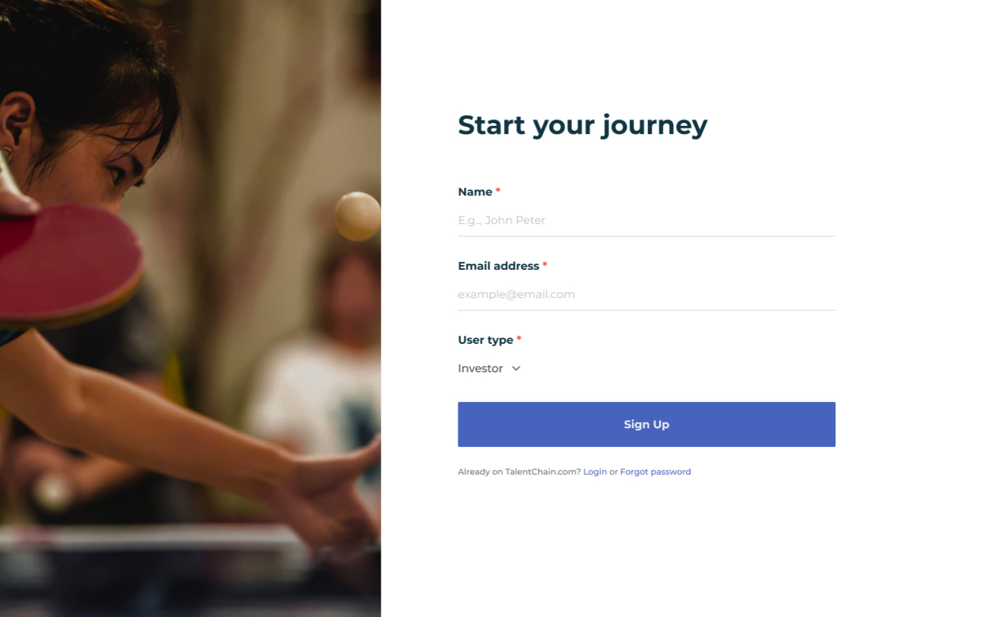

Slide 6
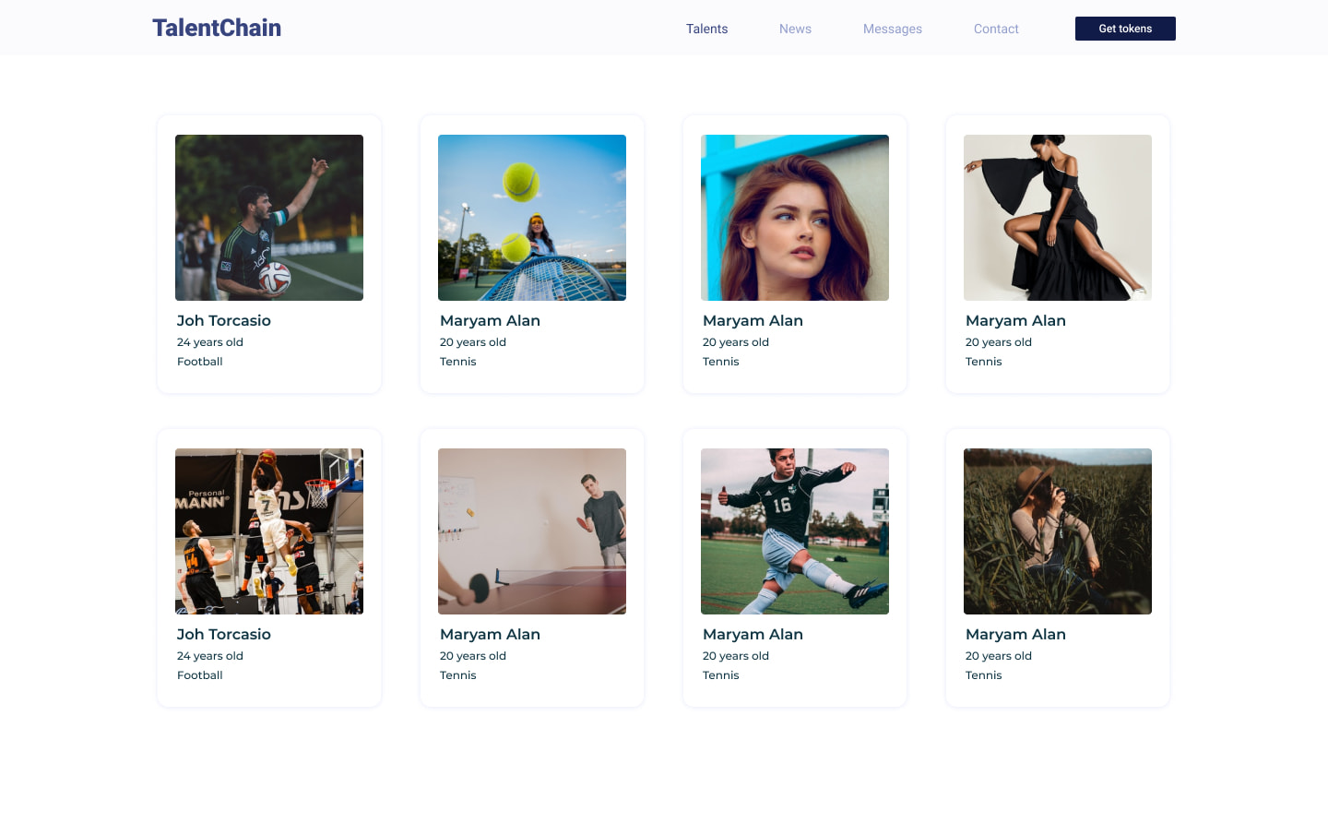

Slide 7
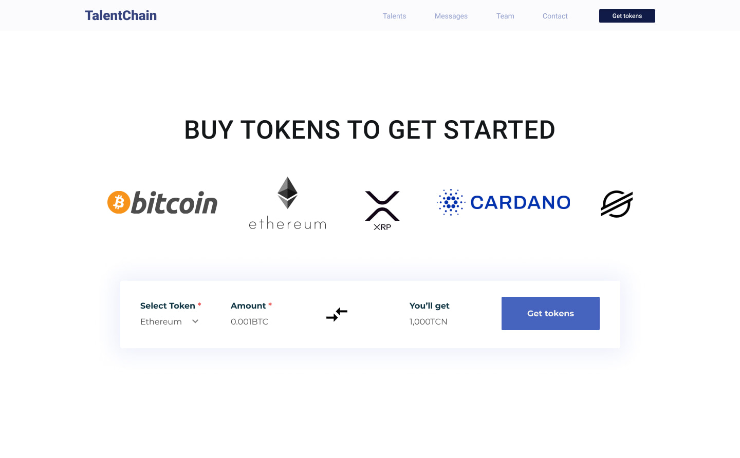

Slide 8
Token
The tokens is responsible for the functions of the our platform. The full functionality of the platform is available only for token holders. We plan to place the tokens on cryptographic token exchanges, giving an opportunity to openly buy them by swapping. A user seeking to enter the platform will have tobuy the tokens. Conversely, the tokens could be sold at an exchange if their holderwould like to exit the ACE ecosystem.

Slide 9
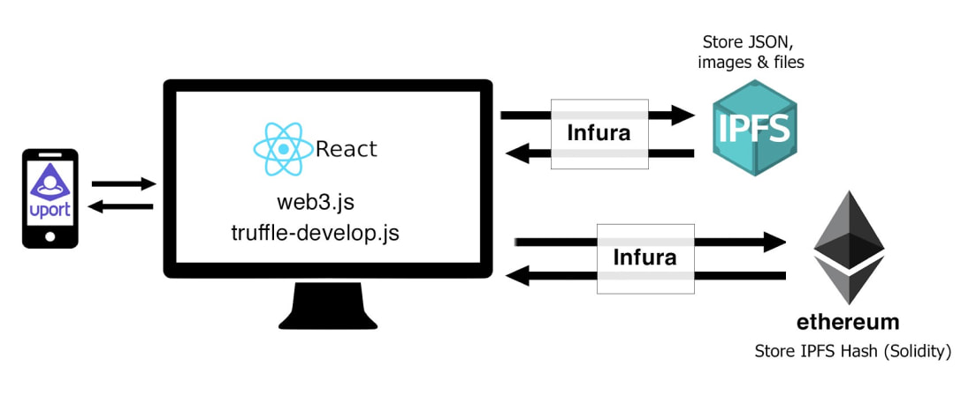
Project Architecture

