Slide 1
SDU ADMISSIONS PORTAL
Sprint 6
Admissions planning
24–30 October 2026
Implementation review · 29 October
Notes:
Sprint 6 adds practical planning and personal help to the existing SDU catalogue, comparison, assistant and account features. This deck describes implementation and recorded local verification; live acceptance remains open.
[Sources]
- Project source: docs/sprint-6-review.md (implementation / local QA record, 29 October 2026).
- Project source: docs/sprint-6-tasks.md (scope and story contacts).
[/Sources]

Slide 2
Five features for admission planning
Help applicants choose a programme and understand their next steps.
Story | Feature | What the applicant can do
US27 | Eligibility check | Check published entry requirements.
US28 | Tuition calculator | Estimate professional and MDE course costs.
US5 | Programme recommendations | Explore up to three matching programmes.
US29 | Grants and scholarships | Find funding information with official sources.
US30 | Admissions handoff | Ask staff and read a private reply.
SDU Admissions Portal / Sprint 6
02
Notes:
The sprint builds on Sprints 1–5. The five user stories are implemented; no story is presented as accepted by the Product Owner. Uploads, online application forms and application-status processing remain outside this sprint.
[Sources]
- Project source: docs/sprint-6-review.md (implementation / local QA record, 29 October 2026).
- Project source: docs/sprint-6-tasks.md (scope and story contacts).
[/Sources]

Slide 3
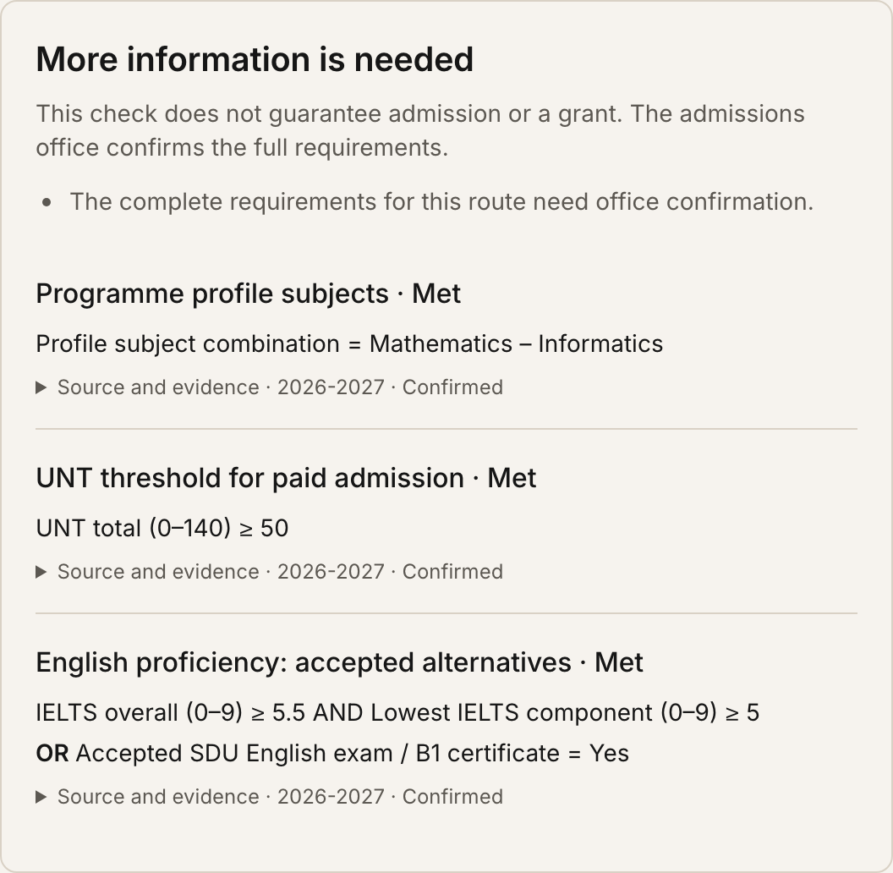
Check published
requirements
US27 · Eligibility check
Applicants enter results and select
their programme and admission route.
The check distinguishes:
• requirements met
• a known requirement not met
• insufficient information
Sources and missing requirements stay
visible. Admission is never guaranteed.
SDU Admissions Portal / Sprint 6
03
Notes:
Eligibility supports applicant category, previous education, paid/grant basis, published subject combinations, academic results and accepted certificate alternatives. Known failed applicable rules are distinct from missing evidence. Only office-confirmed complete routes can produce a positive overall result; the seed deliberately declares no route complete. The screenshot uses 6B06102 with UNT 50, Mathematics–Informatics and an accepted SDU English alternative; full route confirmation remains outstanding.
[Sources]
- Project source: backend/docs/api/guidance.md.
- Project source: docs/sprint-6-data-review.md and backend/app/data/guidance.json.
- Project source: docs/sprint-6-review.md (implementation / local QA record, 29 October 2026).
- Product asset: read-only local /eligibility screenshot captured 29 October 2026.
[/Sources]

Slide 4
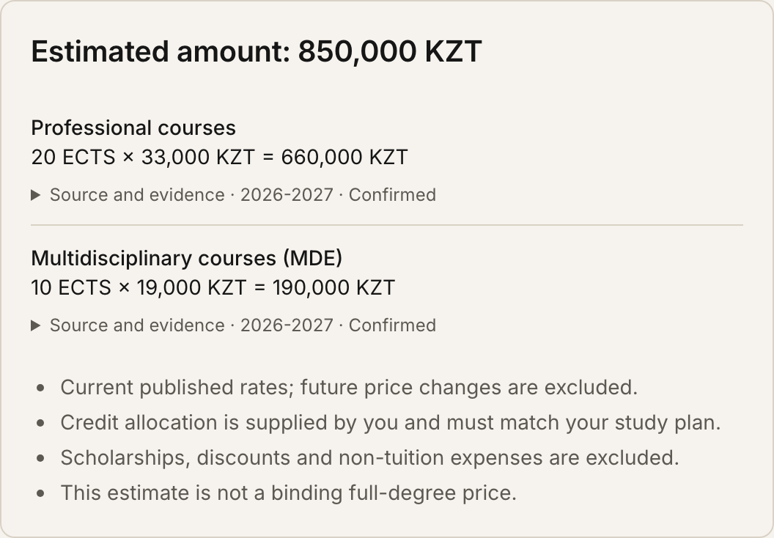
Estimate tuition from the right rates
US28 · Tuition calculator
Computer Science · 6B06102
20 professional credits × 33,000 KZT
10 MDE credits × 19,000 KZT
850,000 KZT
Estimate for this credit bundle.
The study plan and future rates matter.
SDU Admissions Portal / Sprint 6
04
Notes:
Illustrative calculation recorded and verified locally: 20 × 33,000 = 660,000 KZT, plus 10 × 19,000 = 190,000 KZT, giving 850,000 KZT. These are the sprint snapshot rates. The calculator supports KZT/USD and language-specific tariffs, requires an actual credit split and returns a partial known subtotal when a required tariff is missing. It excludes future increases, funding and non-tuition expenses; this is not a binding whole-degree price.
[Sources]
- Project source: backend/docs/api/guidance.md.
- Project source: docs/sprint-6-review.md (implementation / local QA record, 29 October 2026).
- Project source: docs/sprint-6-data-review.md and backend/app/data/guidance.json.
- Product asset: read-only local /cost-calculator screenshot captured 29 October 2026.
- Official source cited by the implementation: https://sdu.edu.kz/en/tuition-fees/
[/Sources]

Slide 5
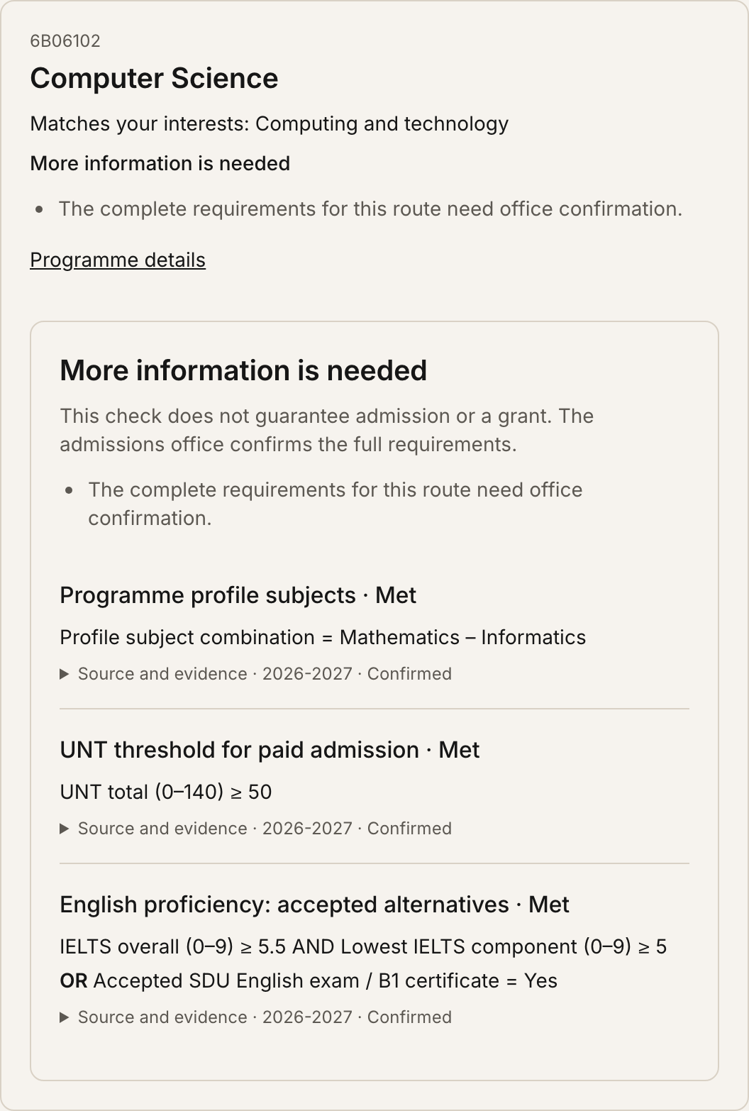
Find programmes
that fit
US5 · Recommendations
An interest and results questionnaire
returns up to three active programmes.
Known requirement failures are excluded.
Missing information remains explicit.
Each result links to programme details
and the existing comparison page.
Gemini selects allowed explanation labels;
template explanations provide a fallback.
SDU Admissions Portal / Sprint 6
05
Notes:
Filtering and ranking are deterministic. The model cannot introduce new programmes, requirements or numeric claims: it selects only allowed reason labels for already-selected programmes. Personal scores and e-mail are not sent to the explanation prompt. Actual keyed Gemini use was not performed during this sprint verification; controlled model responses and unavailable/invalid-model fallbacks were tested.
[Sources]
- Project source: backend/docs/api/guidance.md.
- Project source: docs/sprint-6-review.md (implementation / local QA record, 29 October 2026).
- Product asset: read-only local /recommendations screenshot captured 29 October 2026.
[/Sources]

Slide 6
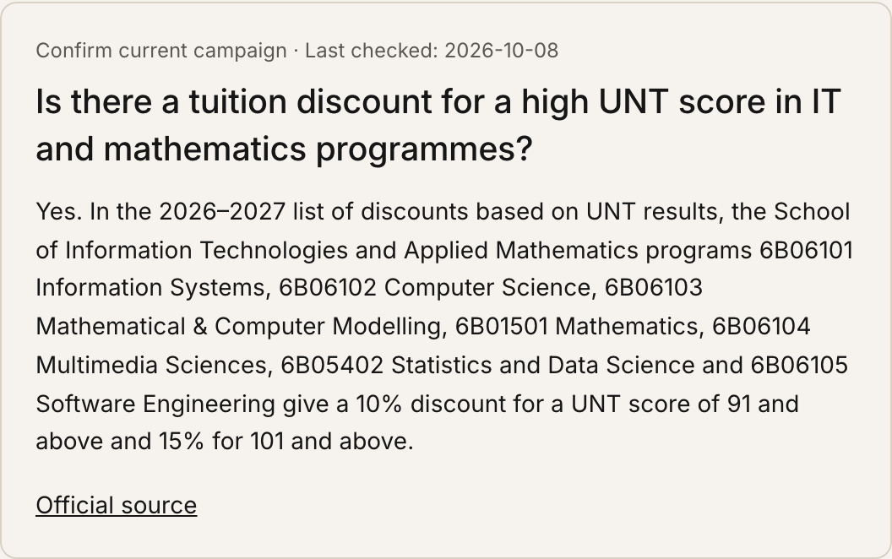
Funding information keeps its source
US29 · Grants and scholarships
Make funding easier to explore
Read published grants and discounts.
Filter by degree and applicant category.
See source links, check dates and
translation or campaign warnings.
Awards and current availability require
confirmation by the admissions office.
SDU Admissions Portal / Sprint 6
06
Notes:
The guide reads published funding FAQ records from the database, so staff updates and retirement apply on the next API request. Missing official translations visibly fall back to the English source. The screenshot is a project FAQ example; it does not establish a new award or guarantee that an offer is currently available. The displayed last-check date is retained from the source record.
[Sources]
- Project source: backend/docs/api/guidance.md.
- Project source: docs/sprint-6-review.md (implementation / local QA record, 29 October 2026).
- Product asset: read-only local /funding screenshot captured 29 October 2026.
- Official page cited by this FAQ: https://sdu.edu.kz/en/admission-3-2/
[/Sources]

Slide 7
A question can reach a real person
US30 · Private admissions handoff
01 · Applicant
02 · Staff
03 · Applicant
Submit a question
Answer the question
Get notified
Send from a verified
account and keep the
question private.
An officer answers
through the existing
staff area.
Read the answer in
your account; e-mail
links back to it.
SDU Admissions Portal / Sprint 6
07
Notes:
This flow describes the implemented account-based handoff, not a live chat or guest e-mail form. The question and answer are private to the verified owner and authorized staff. The answer commits before notification; failed SMTP delivery stays retryable. Repeated submissions deduplicate and account deletion cascades through requests and delivery state. Transactional notifications contain only an account link. Production accounts still depend on the existing hosting/SMTP decision.
[Sources]
- Project source: backend/docs/api/requests.md.
- Project source: docs/sprint-6-review.md (implementation / local QA record, 29 October 2026).
- Project source: docs/applicant-hosting.md.
[/Sources]

Slide 8
All 64 programmes have a source audit
Coverage makes missing or conflicting data visible.
Office confirmation is still needed before a route is declared complete.
64
32
3
Programme records
Paid UNT thresholds
Portal languages
Every catalogue programme
has a documented source
and a list of open gaps.
Published bachelor thresholds
are scoped to the correct
applicant route.
English, Russian and Kazakh
labels support the new
public planning pages.
SDU Admissions Portal / Sprint 6
08
Notes:
A source audit is not a claim that every university requirement is known or approved. Unresolved programme-specific requirements, master-track applicability, credit splits, conflicting sources and some master/PhD facts remain explicit blockers to full data completeness. No route is declared complete by the baseline seed. The implementation also includes scoped local PhD rules and programme-specific master credit references where official evidence exists.
[Sources]
- Project source: docs/sprint-6-data-review.md and backend/app/data/guidance.json.
- Project source: docs/sprint-6-review.md (implementation / local QA record, 29 October 2026).
- Project source: README.md (portal language support).
[/Sources]

Slide 9
Staff can keep the guidance current
Admissions office
Operational foundation
Edit requirements and alternatives.
Maintain fee and source evidence.
Confirm complete admission routes.
Startup preserves staff changes.
Assessments do not store scores.
New APIs and migration 0019 are documented.
Guidance lives in the database and can be maintained without a new release.
SDU Admissions Portal / Sprint 6
09
Notes:
Structured rule/tariff editing is integrated into the existing staff programme editor. Startup inserts only missing guidance rows and does not overwrite staff changes. Migration 0019 adds guidance and private-request tables and was tested from an empty database, downgraded to 0018 and upgraded again. Public assessments do not persist profiles or scores. The new browser matrix is configured in Backend CI; this deck does not claim that a remote GitHub CI run was executed.
[Sources]
- Project source: backend/docs/api/guidance.md.
- Project source: backend/migrations/versions/0019_program_guidance_and_requests.py.
- Project source: docs/sprint-6-review.md (implementation / local QA record, 29 October 2026).
[/Sources]

Slide 10
Local checks passed
The final local verification covers the new features and existing portal flows.
632
539
192/192
Backend tests passed
Browser checks passed
Catalogue answers matched
Chromium + Firefox · 360 / 768 / 1280 px · migration rollback and build passed
Assistant baseline: 63/70; seven existing evaluation misses remain.
SDU Admissions Portal / Sprint 6
10
Notes:
The 539 browser checks comprise 72 new guidance/request checks plus 60 comparison, 144 language, 78 widget, 88 staff and 97 applicant checks. The full backend run passed 632 tests; 40 targeted checks and three focused UI checks also passed after final adjustments. A separate 64/64 API pass covered every programme. The existing assistant v3 evaluation remained 63/70 (90%), with 9/9 correct fallbacks and zero invented facts in that evaluation. All results are local, not production or PO acceptance.
[Sources]
- Project source: docs/sprint-6-review.md (implementation / local QA record, 29 October 2026).
- Project sources: backend/docs/qa/US5-QA.md and US27-QA.md through US30-QA.md.
[/Sources]

Slide 11
NEXT STEP · LIVE ACCEPTANCE
Ready for review.
Live acceptance next.
Confirm official data and review the PR.
Configure live hosting and SMTP.
Run deployed QA and record PO acceptance.
SDU Admissions Portal / Sprint 6
11
Notes:
The implementation is ready for review; full live acceptance remains open. Required next actions are official confirmation of the named source gaps, PR review and required CI, recording the hosting/SMTP decision for personal data including questions/replies, deployment through the normal workflow, live scenario checks and actual Product Owner acceptance. Accounts remain disabled by default on the VM until the prerequisite is met. Previous sprint acceptance carry-over is not silently closed.
[Sources]
- Project source: docs/sprint-6-review.md (implementation / local QA record, 29 October 2026).
- Project source: docs/applicant-hosting.md.
- Project source: docs/sprint-6-tasks.md (scope and story contacts).
[/Sources]

