Slide 1
Facebook location data analysis
Final project for the Big Data training stream at QA Consulting
Jamie Dalley, Wade Garrett, Abelether Germa, Joseph Gordon, Edward Sibert

Slide 2
Project Aims
To predict which place a person would like to check in to, given their location.
Create a full pipeline for cleaning the data, analysing it, and using it to train predictive algorithms.
Create solution to stream location and output solutions in real time.
Introduction
Section 2
Section 3
Section 4
Section 5

Slide 3
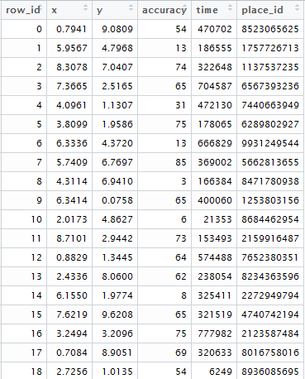
Data
6 columns
row_id
x
y
accuracy
time
place_id
29,118,021 rows
Introduction
Section 2
Section 3
Section 4
Section 5

Slide 4
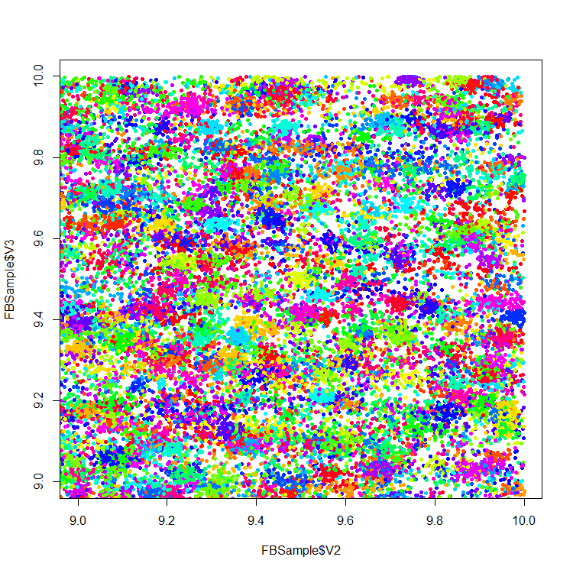
Data – Visualisation
Inaccuracies in GPS create messy data
Many co-ordinates can represent the same location
The same co-ordinates can represent multiple locations

Slide 5
Technologies - Overview
Cluster setup
Vagrant
others
Machine Learning
TensorFlow
Others

Slide 6

Technologies - TensorFlow
Machine Learning library
Interfaced with python code to execute efficient back-end C++ code.
Constructs a computational graph to convert inputs into answers

Slide 7
TensorFlow - Limitations
Huge amount of data:
29 million data points
Large range of possible outputs:
108 thousand unique check-in locations are possible
Weak correlation between input co-ordinates and location
Difficult to load, process and learn

