Slide 1
QA Big Data Stream
An overview of the learning projects completed on the training course for the Big Data stream at QA Consulting
Jamie Dalley, Wade Garrett, Abelether Germa, Joseph Gordon, Edward Sibert

Slide 2
Introduction
12 week course
Designed to teach the fundamentals of what is needed to work with Big Data
Highlights:
Database Querying (SQL, Spark etc.)
Machine Learning
SCRUM Methodology
Week | Learning Topic
1 | Python
2 | R
3 | SQL/Scala
4 | AWS & Cluster Administration
5 | Continuous Integration & MongoDB
6 | Continuous Integration
7 | Hadoop with Hive & Impala
8 | Scala & Spark
9 | Scala & Spark
10 | Pentaho
11 | Agile/SCRUM & Final Project
12 | Final Project
Introduction
Week 1
Week 2
Week 3
Week 4
Week 5
Week 6
Week 7
Week 8
Week 9
Week 10
Week 11
Week 12
Conclusions

Slide 3


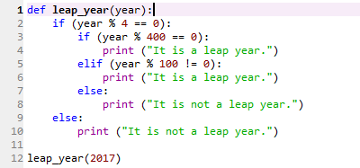
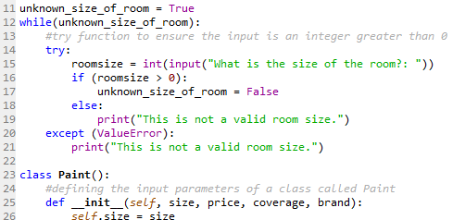
Python
Introduction to programming using Python Language
Began with basic structure and syntax
Created simple programs with basic logic
For, if/else, while etc.
Introduction
Week 1
Week 2
Week 3
Week 4
Week 5
Week 6
Week 7
Week 8
Week 9
Week 10
Week 11
Week 12
Conclusions

Slide 4
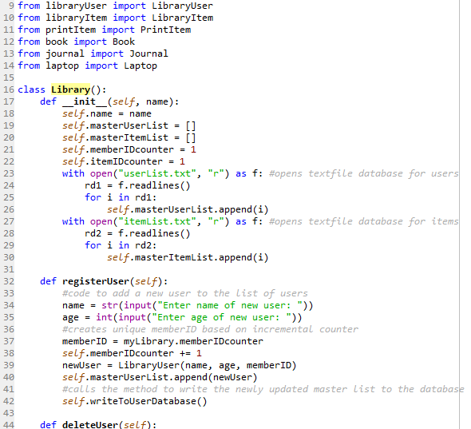
Python
Used as an introduction to the principles of OOP
Inheritance, Encapsulation, Abstraction, Polymorphism
Created simple library program to utilise principles of inheritance and encapsulation
Introduction
Week 1
Week 2
Week 3
Week 4
Week 5
Week 6
Week 7
Week 8
Week 9
Week 10
Week 11
Week 12
Conclusions

Slide 5
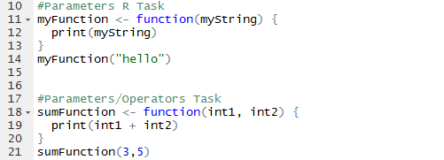
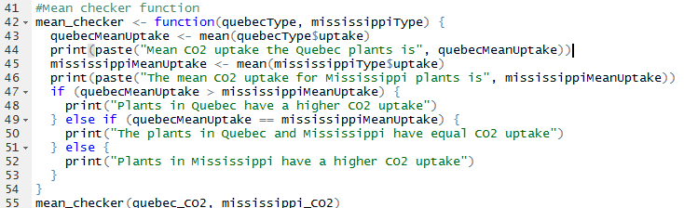
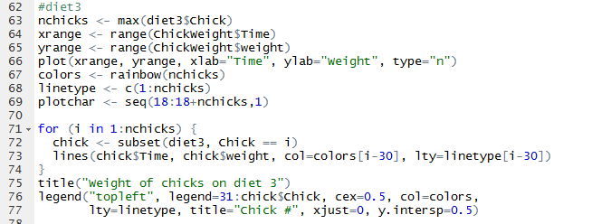
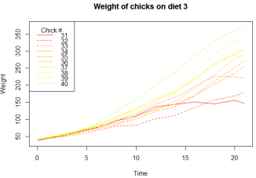
R
Introduction to R programming language
Began with basic syntax and structure
Developed into creating simple analytical programs in order to learn the language
Introduction
Week 1
Week 2
Week 3
Week 4
Week 5
Week 6
Week 7
Week 8
Week 9
Week 10
Week 11
Week 12
Conclusions

Slide 6
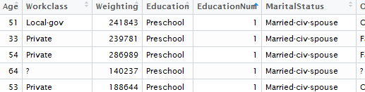
R
Introduction of Machine Learning techniques using R
Firstly using a set of USA census data to predict salaries
Cleaned data into more useful formats and categories
Introduction
Week 1
Week 2
Week 3
Week 4
Week 5
Week 6
Week 7
Week 8
Week 9
Week 10
Week 11
Week 12
Conclusions

Slide 7
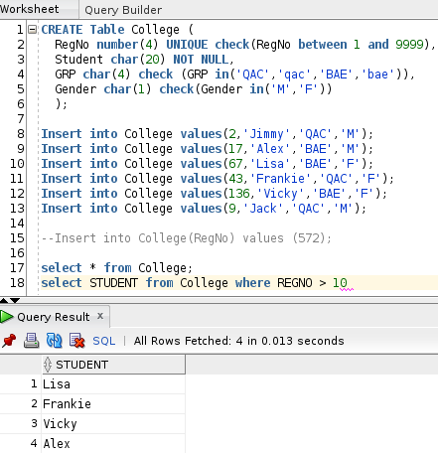
SQL (Oracle)
Brief introduction to database management via Oracle SQL
Creating, inserting, and querying databases and tables
Introduction
Week 1
Week 2
Week 3
Week 4
Week 5
Week 6
Week 7
Week 8
Week 9
Week 10
Week 11
Week 12
Conclusions

Slide 8
SQL (Oracle)
Using subqueries to retrieve more specific data subsets
Introduction
Week 1
Week 2
Week 3
Week 4
Week 5
Week 6
Week 7
Week 8
Week 9
Week 10
Week 11
Week 12
Conclusions

Slide 9
Cluster Administration via AWS
Introduction
Week 1
Week 2
Week 3
Week 4
Week 5
Week 6
Week 7
Week 8
Week 9
Week 10
Week 11
Week 12
Conclusions

Slide 10
NoSQL (MongoDB)
Introduction
Week 1
Week 2
Week 3
Week 4
Week 5
Week 6
Week 7
Week 8
Week 9
Week 10
Week 11
Week 12
Conclusions

Slide 11
Continuous integration
Introduction
Week 1
Week 2
Week 3
Week 4
Week 5
Week 6
Week 7
Week 8
Week 9
Week 10
Week 11
Week 12
Conclusions

Slide 12
Hadoop (Hive/Impala)
Introduction
Week 1
Week 2
Week 3
Week 4
Week 5
Week 6
Week 7
Week 8
Week 9
Week 10
Week 11
Week 12
Conclusions

Slide 13
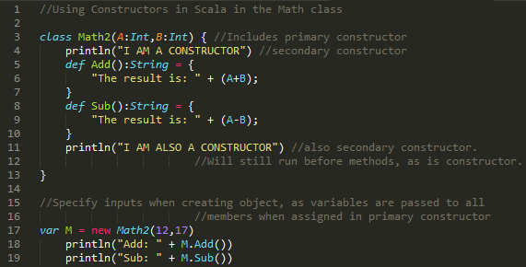
Scala
Introduction
Week 1
Week 2
Week 3
Week 4
Week 5
Week 6
Week 7
Week 8
Week 9
Week 10
Week 11
Week 12
Conclusions

Slide 14
spark
Introduction
Week 1
Week 2
Week 3
Week 4
Week 5
Week 6
Week 7
Week 8
Week 9
Week 10
Week 11
Week 12
Conclusions

Slide 15
Pentaho
Introduction
Week 1
Week 2
Week 3
Week 4
Week 5
Week 6
Week 7
Week 8
Week 9
Week 10
Week 11
Week 12
Conclusions

Slide 16
Scrum/Agile
Introduction
Week 1
Week 2
Week 3
Week 4
Week 5
Week 6
Week 7
Week 8
Week 9
Week 10
Week 11
Week 12
Conclusions

Slide 17
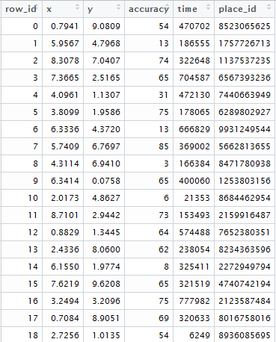
Final Project - Data
6 columns
row_id
x
y
accuracy
time
place_id
29,118,021 rows
Introduction
Week 1
Week 2
Week 3
Week 4
Week 5
Week 6
Week 7
Week 8
Week 9
Week 10
Week 11
Week 12
Conclusions

Slide 18
R
Introduction
Week 1
Week 2
Week 3
Week 4
Week 5
Week 6
Week 7
Week 8
Week 9
Week 10
Week 11
Week 12
Conclusions

Slide 19
Week
Final project for the Big Data training stream at QA Consulting
Facebook data

Slide 20
Project Aims
To predict which place a person would like to check in to, given their location.
Create a full pipeline for cleaning the data, analysing it, and using it to train predictive algorithms.
Create solution to stream location and output solutions in real time.

Slide 21
Data
6 columns
row_id
x
y
accuracy
time
place_id
29,118,021 rows

Slide 22
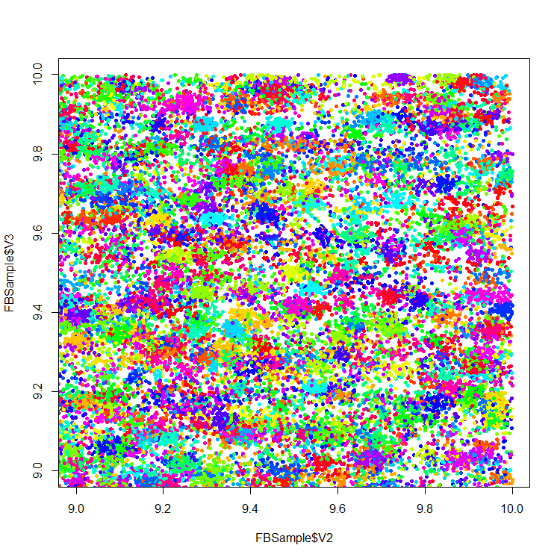
Data – Visualisation
Inaccuracies in GPS create messy data
Many co-ordinates can represent the same location
The same co-ordinates can represent multiple locations

Slide 23
Technologies - Overview
Cluster setup
Vagrant
others
Machine Learning
TensorFlow
Others

Slide 24

Technologies - TensorFlow
Machine Learning library
Interfaced with python code to execute efficient back-end C++ code.
Constructs a computational graph to convert inputs into answers

Slide 25
TensorFlow - Limitations
Huge amount of data:
29 million data points
Large range of possible outputs:
108 thousand unique check-in locations are possible
Weak correlation between input co-ordinates and location
Difficult to load, process and learn

