Slide 1
Facebook location data analysis
Final project for the Big Data training stream at QA Consulting
Jamie Dalley, Wade Garrett, Abelether Germa, Joseph Gordon, Edward Sibert

Slide 2
Project Aims
To predict which place a person would like to check in to, given their location.
Create a full pipeline for cleaning the data, analysing it, and using it to train predictive algorithms.
Create solution to stream location and output solutions in real time.
Introduction
Section 2
Section 3
Section 4
Section 5

Slide 3
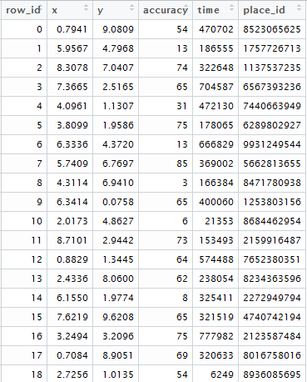
Data
6 columns
row_id
x
y
accuracy
time
place_id
29,118,021 rows
Introduction
Section 2
Section 3
Section 4
Section 5

