Slide 1
QA Academy Big Data Stream
An overview of the learning projects completed on the training course for the Big Data stream at QA Consulting
Jamie Dalley, Wade Garrett, Abelether Germa, Joseph Gordon, Edward Sibert

Slide 2
Introduction
12 week course
Designed to teach the fundamentals of what is needed to work with Big Data
Highlights:
Database Querying (SQL, Spark etc.)
Machine Learning
Agile/SCRUM Methodology
Week | Learning Topic
1 | Python
2 | R
3 | SQL/Scala
4 | AWS & Cluster Administration
5 | Continuous Integration & MongoDB
6 | Continuous Integration
7 | Hadoop with Hive & Impala
8 | Scala & Spark
9 | Scala & Spark
10 | Pentaho
11 | Agile/SCRUM & Final Project
12 | Final Project
Introduction
Python
R
SQL
Hadoop Cluster
Mongo DB
CI
Hive Impala
Scala
Spark
Pentaho
Agile SCRUM
Final Project
Conclusions

Slide 3
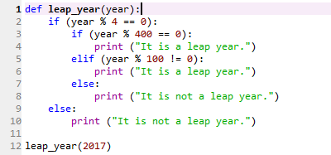
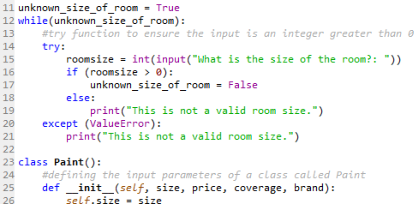
Python
Introduction to programming using Python Language
Began with basic structure and syntax
Created simple programs with basic logic
For, if/else, while etc.
Introduction
Python
R
SQL
Hadoop Cluster
Mongo DB
CI
Hive Impala
Scala
Spark
Pentaho
Agile SCRUM
Final Project
Conclusions

Slide 4
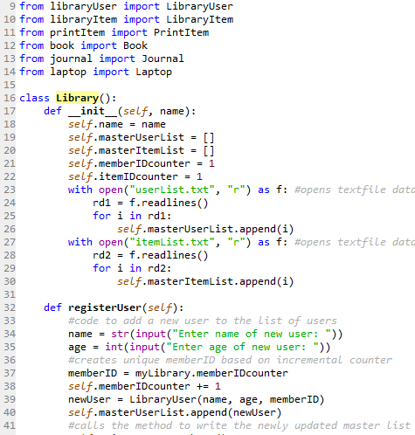
Python
Used as an introduction to the principles of OOP
Inheritance, Encapsulation, Abstraction, Polymorphism
Created simple library program to utilise principles of inheritance and encapsulation
Introduction
Python
R
SQL
Hadoop Cluster
Mongo DB
CI
Hive Impala
Scala
Spark
Pentaho
Agile SCRUM
Final Project
Conclusions

Slide 5
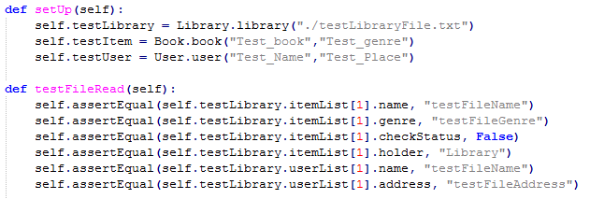
Python
Began development in a test-driven manner.
Write the tests before you write the functionality.
Then write the code to pass the tests.
Created unit tests for our library program to test it’s functionality.
Introduction
Python
R
SQL
Hadoop Cluster
Mongo DB
CI
Hive Impala
Scala
Spark
Pentaho
Agile SCRUM
Final Project
Conclusions

Slide 6
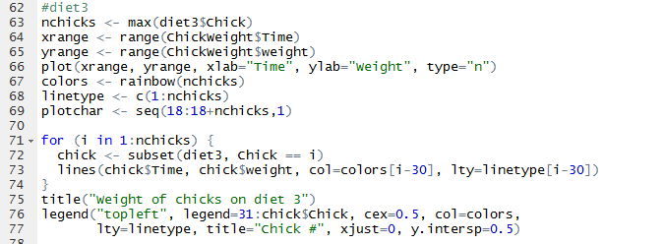
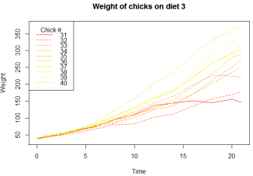
R
Introduction to R programming language, beginning with basic syntax and structure
Developed into creating simple analytical programs in order to learn the language
Used graphing functions
Introduction
Python
R
SQL
Hadoop Cluster
Mongo DB
CI
Hive Impala
Scala
Spark
Pentaho
Agile SCRUM
Final Project
Conclusions

Slide 7

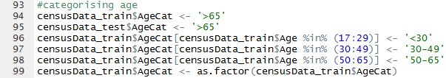
R (Machine Learning)
Introduction of Machine Learning techniques using R
Firstly using a set of USA census data to predict salaries
Split into train and test data
Cleaned data into more useful formats and categories based on real-world logic
Introduction
Python
R
SQL
Hadoop Cluster
Mongo DB
CI
Hive Impala
Scala
Spark
Pentaho
Agile SCRUM
Final Project
Conclusions

Slide 8


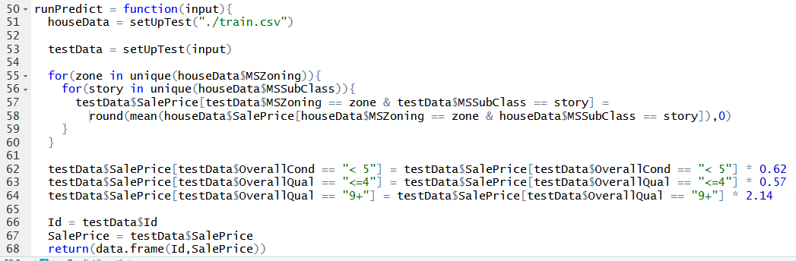
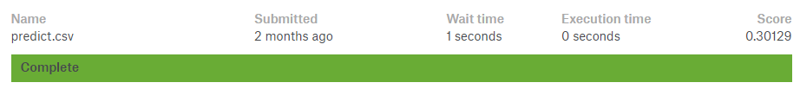
R (Machine Learning)
Final day project
Using large database of house information to predict sale prices
Most time spent cleaning and categorising data into more useful formats
Developed a final prediction and submitted to Kaggle to check its accuracy
Introduction
Python
R
SQL
Hadoop Cluster
Mongo DB
CI
Hive Impala
Scala
Spark
Pentaho
Agile SCRUM
Final Project
Conclusions

Slide 9
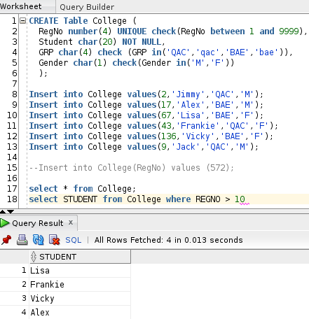
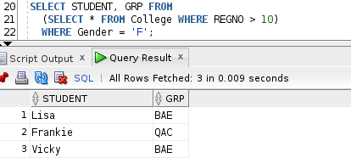
SQL (Oracle)
Introduction to database management via Oracle SQL
Creating tables and inserting data
Learning keywords for query functions, and testing them on our own and some pre-built tables
Using subqueries to retrieve more specific data subsets
Introduction
Python
R
SQL
Hadoop Cluster
Mongo DB
CI
Hive Impala
Scala
Spark
Pentaho
Agile SCRUM
Final Project
Conclusions

Slide 10
Cluster Administration via AWS
Manually set up a computing cluster using AWS instances
Set up 4 VMs and edited the hostfiles to be able to refer them by their hostname
Named blue, green, orange, pink
Testing by pinging each VM from the others
Installed various packages
Zookeeper, Hadoop etc.
Starting NameNode, DataNode, YARN, NodeManager, HistoryServer etc. daemons
Introduction
Python
R
SQL
Hadoop Cluster
Mongo DB
CI
Hive Impala
Scala
Spark
Pentaho
Agile SCRUM
Final Project
Conclusions

Slide 11
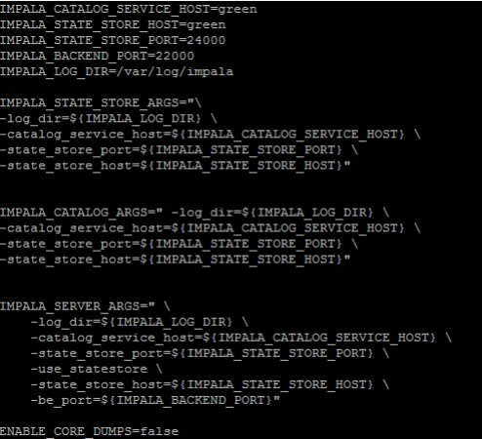
Cluster Administration via AWS
Manually editing config .xml files to form communication between the VMs
core-site, hdfs-site, yarn-site, mapred-site
Ensuring all VMs have access to the .pem to get through the security
Installing and configuring Hive and Impala on the completed cluster
Testing with a Shakespeare word count program
Introduction
Python
R
SQL
Hadoop Cluster
Mongo DB
CI
Hive Impala
Scala
Spark
Pentaho
Agile SCRUM
Final Project
Conclusions

Slide 12
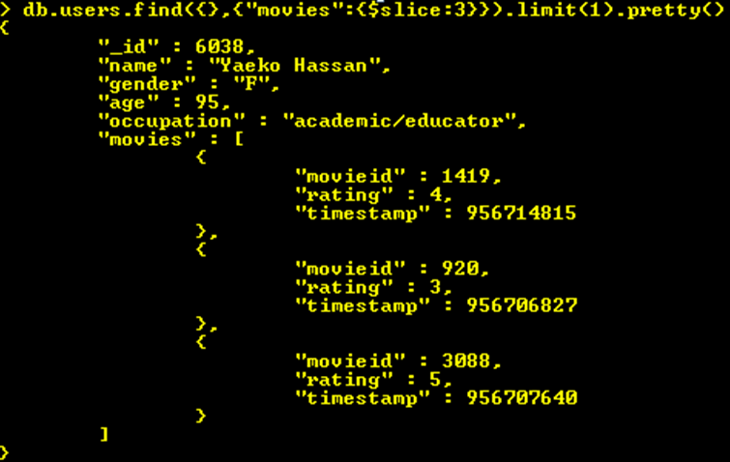
NoSQL (MongoDB)
Brief introduction to NoSQL databases using MongoDB
Used storing dynamically structured data, where format does not need to be consistent across all entries
Inconsistent entries very common in Big Data systems
Great for partition tolerance and data availability
Introduction
Python
R
SQL
Hadoop Cluster
Mongo DB
CI
Hive Impala
Scala
Spark
Pentaho
Agile SCRUM
Final Project
Conclusions

Slide 13
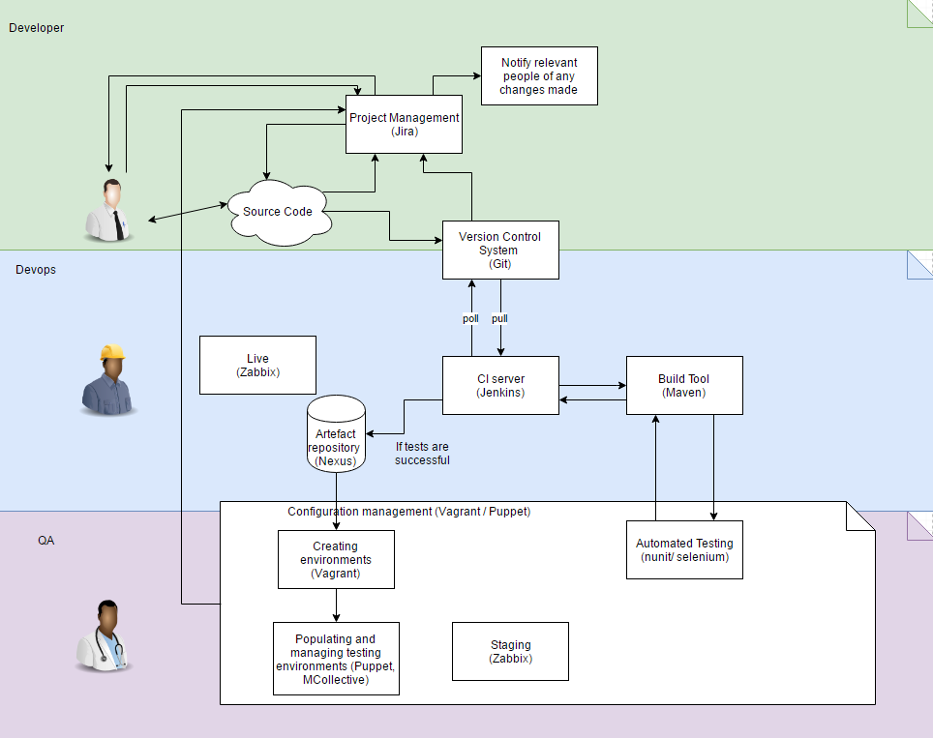
Continuous integration
Set up a CI pipeline to explore how the technologies work
How they work together
Its major principles and how it relate to Big Data workflows
Automation
Repeatability
Shared Repository
Introduction
Python
R
SQL
Hadoop Cluster
Mongo DB
CI
Hive Impala
Scala
Spark
Pentaho
Agile SCRUM
Final Project
Conclusions

Slide 14
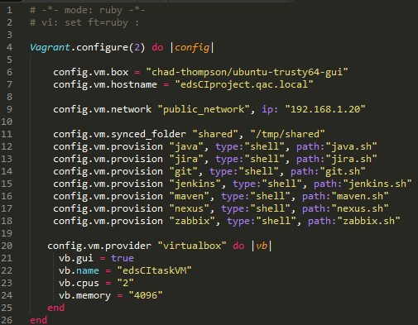
Continuous integration
Used the chad thompson virtualbox to set up a vagrantbox VM
Manually configured the vagrantfile to install and configure the software required
Java, JIRA, Git, Jenkins, Maven, Nexus, Zabbix
Configure settings for the VM itself for automatic setup
Introduction
Python
R
SQL
Hadoop Cluster
Mongo DB
CI
Hive Impala
Scala
Spark
Pentaho
Agile SCRUM
Final Project
Conclusions

Slide 15
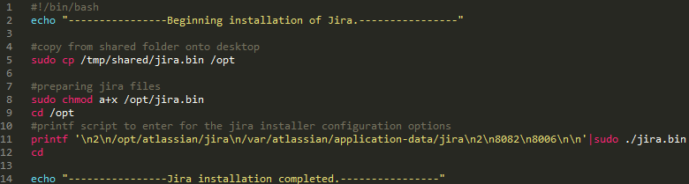
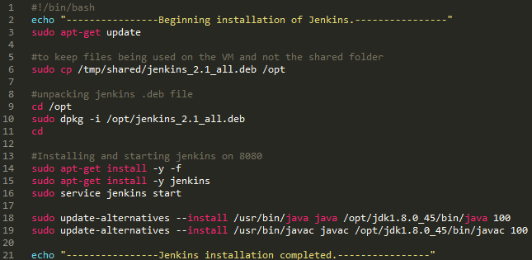
Continuous integration
Examples of the provisioning files linked in the vagrantfile
Introduction
Python
R
SQL
Hadoop Cluster
Mongo DB
CI
Hive Impala
Scala
Spark
Pentaho
Agile SCRUM
Final Project
Conclusions

Slide 16
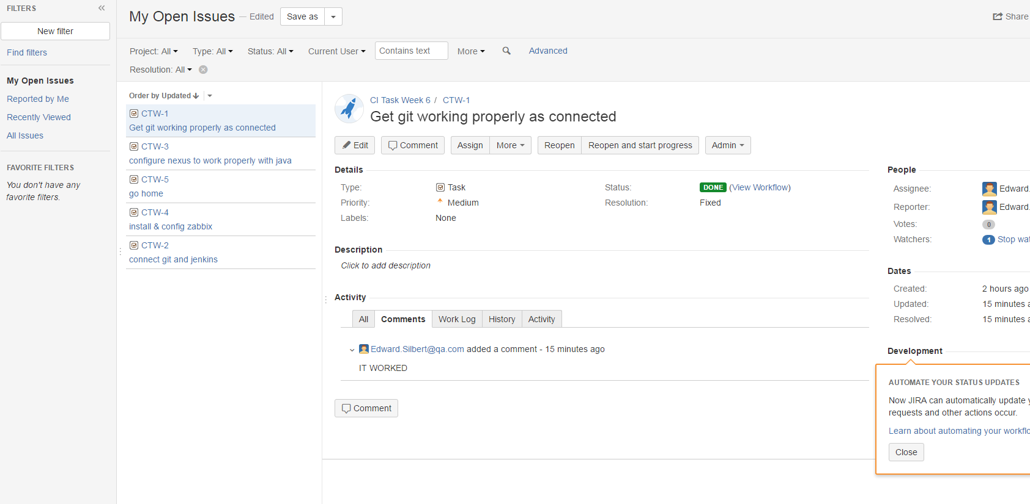

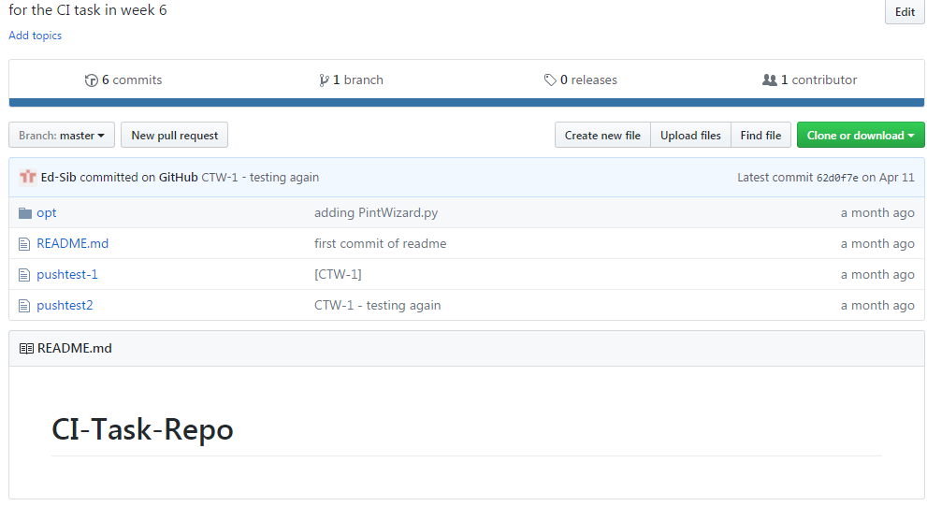
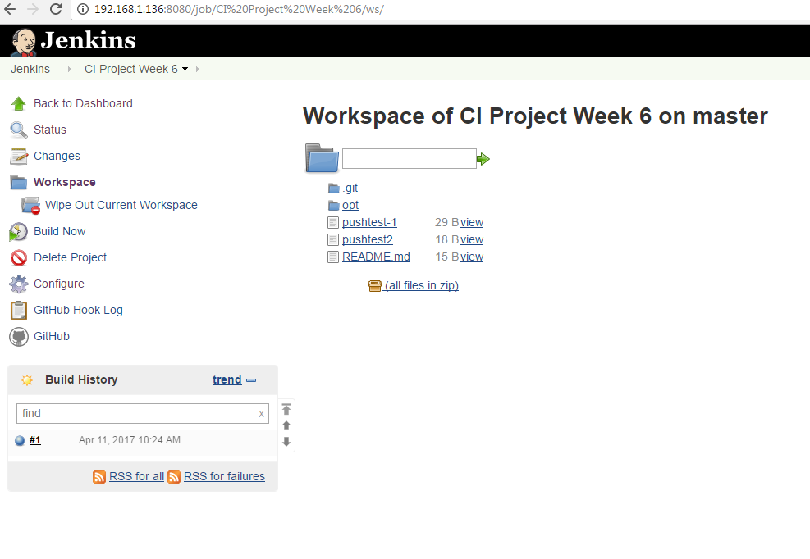

Continuous integration
Used webUIs of Git, Jenkins, and JIRA to link them together
Works to integrate the pipeline into a project management environment
Introduction
Python
R
SQL
Hadoop Cluster
Mongo DB
CI
Hive Impala
Scala
Spark
Pentaho
Agile SCRUM
Final Project
Conclusions

Slide 17




Hadoop (Hive/Impala)
Completed a large group project using Apache Hive and Impala with Hadoop
Maintained a GitHub server as a version control system
Considered the differences between the technologies and when to use each
Introduction
Python
R
SQL
Hadoop Cluster
Mongo DB
CI
Hive Impala
Scala
Spark
Pentaho
Agile SCRUM
Final Project
Conclusions

Slide 18
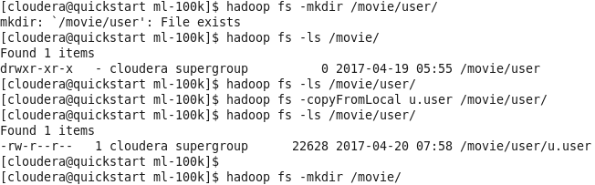
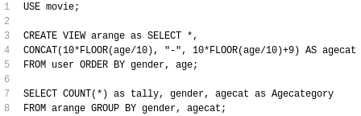
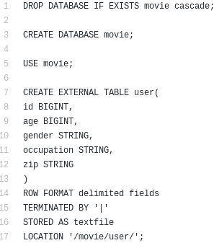
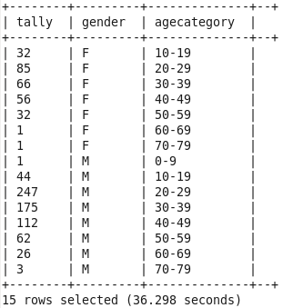
Hadoop (Hive)
Importing the HDFS directory from an external file
Creating the database, defining table format, pointing to external data location
Using HiveQL to query the database via Hadoop
Introduction
Python
R
SQL
Hadoop Cluster
Mongo DB
CI
Hive Impala
Scala
Spark
Pentaho
Agile SCRUM
Final Project
Conclusions

Slide 19

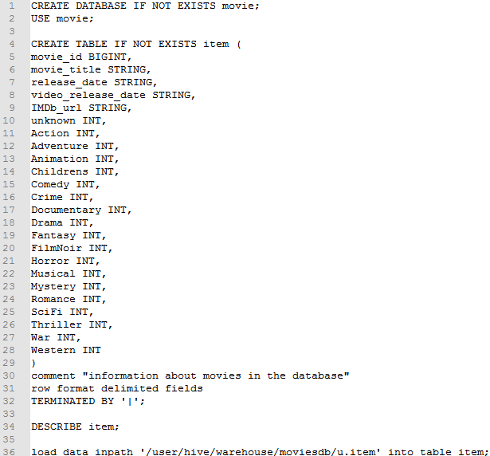
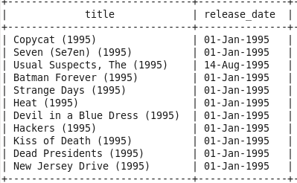
Hadoop (Hive)
Can also use internal databases for import the data, which stores the data slightly differently
End result is the same, with HiveQL queries returning data tables
Introduction
Python
R
SQL
Hadoop Cluster
Mongo DB
CI
Hive Impala
Scala
Spark
Pentaho
Agile SCRUM
Final Project
Conclusions

Slide 20
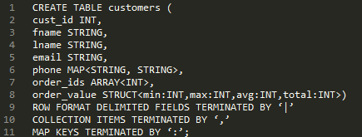
Hadoop (Hive/Impala)
Complex Fields
Can use <> syntax for importing more complex data formats
Introduction
Python
R
SQL
Hadoop Cluster
Mongo DB
CI
Hive Impala
Scala
Spark
Pentaho
Agile SCRUM
Final Project
Conclusions

Slide 21
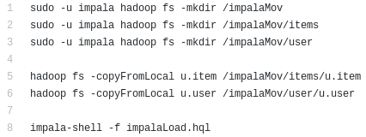
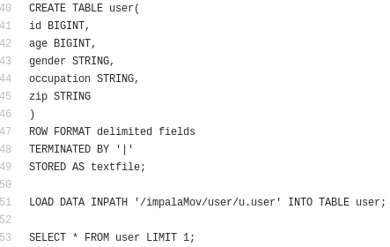
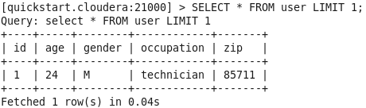
Hadoop (IMPALA)
Impala works similarly on the surface when importing data and setting up the database
Some differences in keywords
Introduction
Python
R
SQL
Hadoop Cluster
Mongo DB
CI
Hive Impala
Scala
Spark
Pentaho
Agile SCRUM
Final Project
Conclusions

Slide 22

Hadoop (HIVE/IMPALA)
Hive and Impala are different technologies which aim to do the same thing through Hadoop
Hive converts queries to MapReduce jobs and runs through them
Initially slow but consistent and scales well
Impala runs queries straight through RAM
Initially very fast but scales poorly with large amounts of data
The same query
(SELECT COUNT(*) FROM user;)
in Hive and Impala:
HIVE
IMPALA
Introduction
Python
R
SQL
Hadoop Cluster
Mongo DB
CI
Hive Impala
Scala
Spark
Pentaho
Agile SCRUM
Final Project
Conclusions

Slide 23
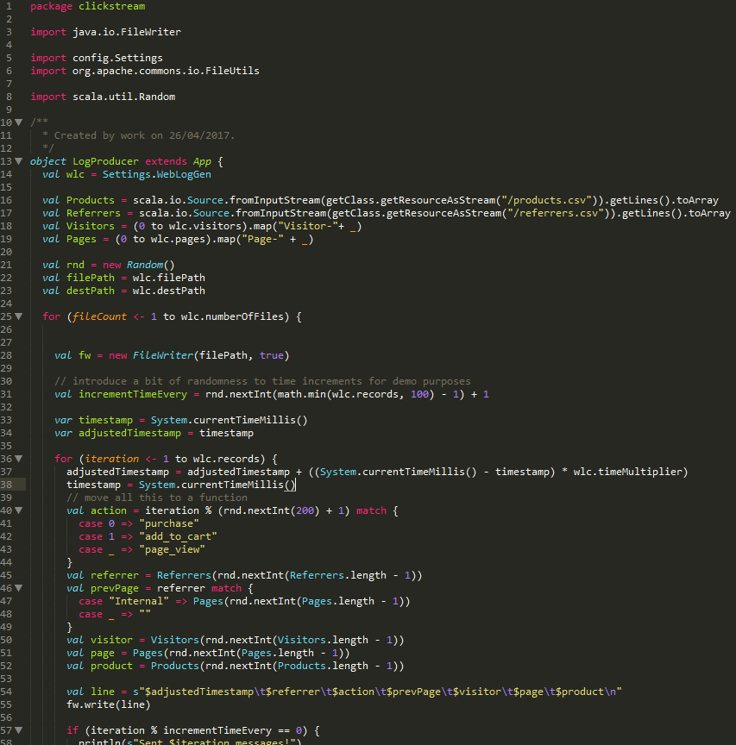
Scala
Covered the Scala language in much more detail
Similarities and improvements relative to Java
A focus on functional programming for use in Spark
Most practice completed in the REPL environment of a Cloudera Quickstart VM for immediate testing
Watched some in-detail tutorial videos (e.g. Pluralsight)
Introduction
Python
R
SQL
Hadoop Cluster
Mongo DB
CI
Hive Impala
Scala
Spark
Pentaho
Agile SCRUM
Final Project
Conclusions

Slide 24
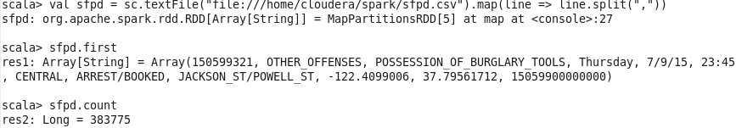
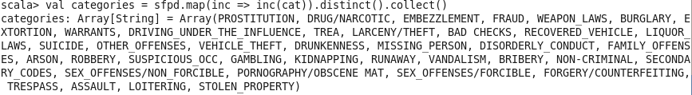
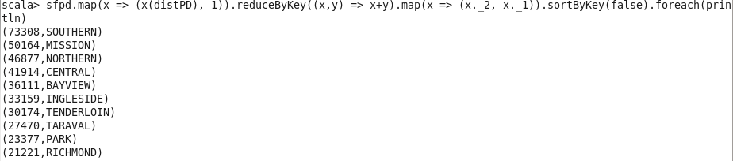
spark
Used the REPL for practice
spark-shell within the Cloudera Quickstart VM
Spark version 1.6
Importing data from textfiles, cleaning and formatting it
Worked with RDDs, pairs, joins, partitions
Introduction
Python
R
SQL
Hadoop Cluster
Mongo DB
CI
Hive Impala
Scala
Spark
Pentaho
Agile SCRUM
Final Project
Conclusions

Slide 25
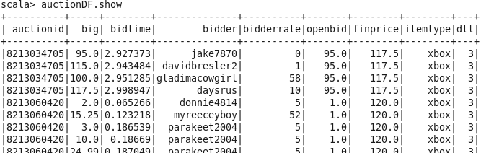

Spark (Dataframes)
Worked with dataframes in the spark-shell
Created case class and mapped the RDD to column names to set up the schema
Used .toDF function to query the database
Also registerTempTable to better data viewing
Introduction
Python
R
SQL
Hadoop Cluster
Mongo DB
CI
Hive Impala
Scala
Spark
Pentaho
Agile SCRUM
Final Project
Conclusions

Slide 26
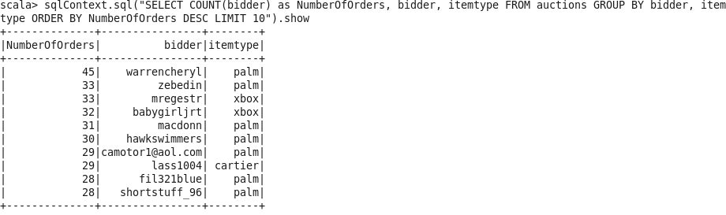
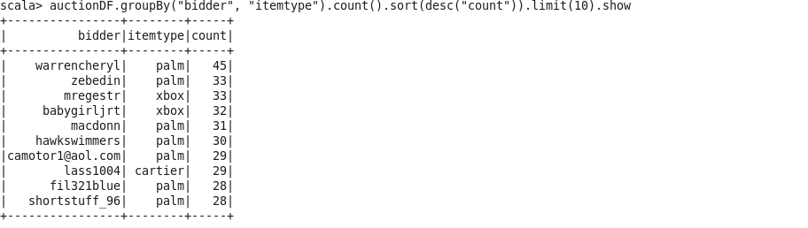
Spark (Dataframes)
Can also use SQL Context within the spark-shell
Allows use of standard MySQL queries on the generated dataframe
Both these queries show exactly the same result
SQL Context
Scala
Introduction
Python
R
SQL
Hadoop Cluster
Mongo DB
CI
Hive Impala
Scala
Spark
Pentaho
Agile SCRUM
Final Project
Conclusions

Slide 27
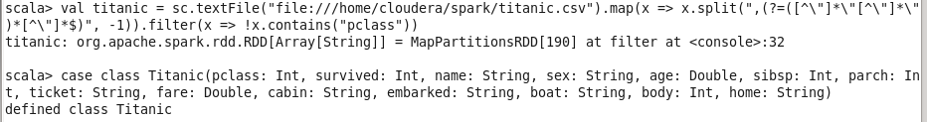
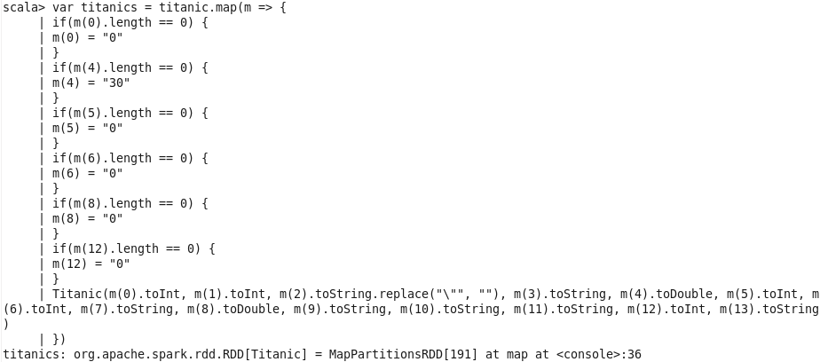
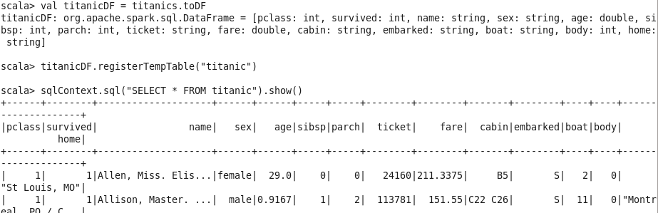
Spark (Data cleaning)
A large issue during this task was importing the Titanic dataset into spark
Problems included:
Extra commas within several of the columns
Final column containing 0, 1, or 2 pieces of data
Quotation marks around some fields
A header record
Multiple columns with many empty fields
Introduction
Python
R
SQL
Hadoop Cluster
Mongo DB
CI
Hive Impala
Scala
Spark
Pentaho
Agile SCRUM
Final Project
Conclusions

Slide 28
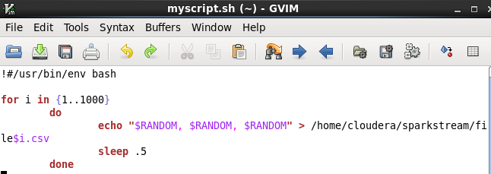
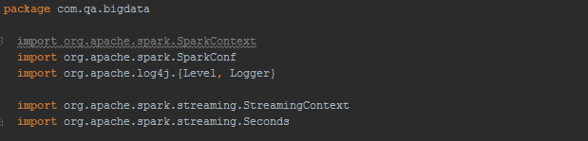
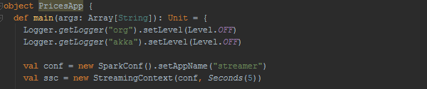
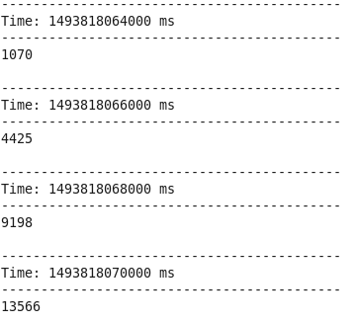
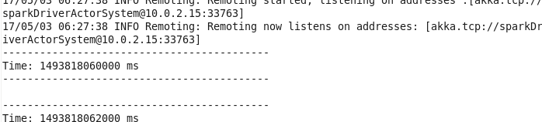
Spark (Streaming)
Used IntelliJ and the CQ VM to set up a spark streaming context
Analyses the dataset live as it is imported to the program
Takes average of all data input to the source location
Introduction
Python
R
SQL
Hadoop Cluster
Mongo DB
CI
Hive Impala
Scala
Spark
Pentaho
Agile SCRUM
Final Project
Conclusions

Slide 29
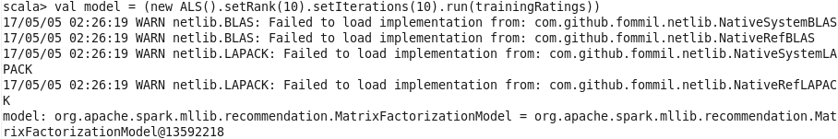
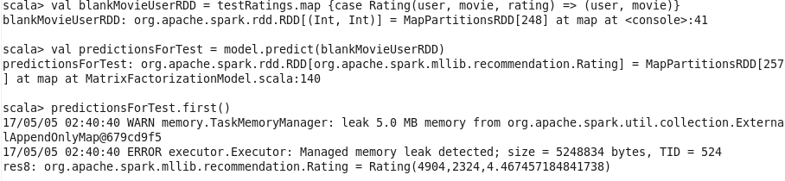
Spark (Machine Learning)
Split movielens database into training and test
Created a very simple ALS (Alternating Least Squares) model
Attempted to predict the rating a user would give to a movie
Introduction
Python
R
SQL
Hadoop Cluster
Mongo DB
CI
Hive Impala
Scala
Spark
Pentaho
Agile SCRUM
Final Project
Conclusions

Slide 30
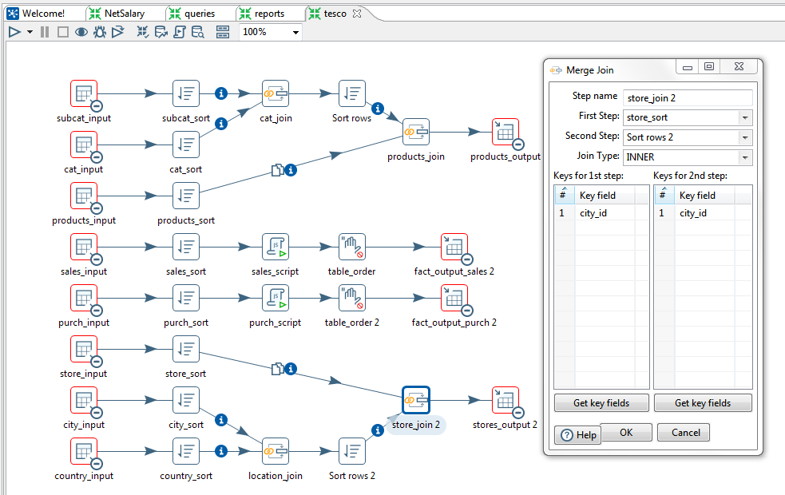
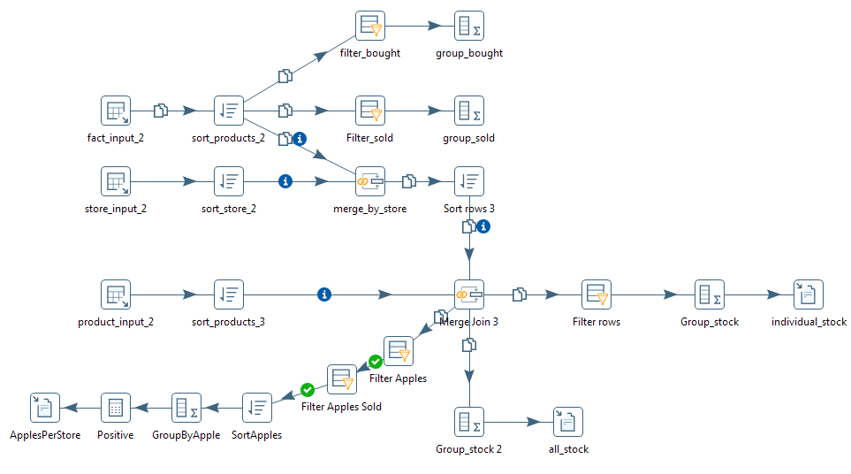
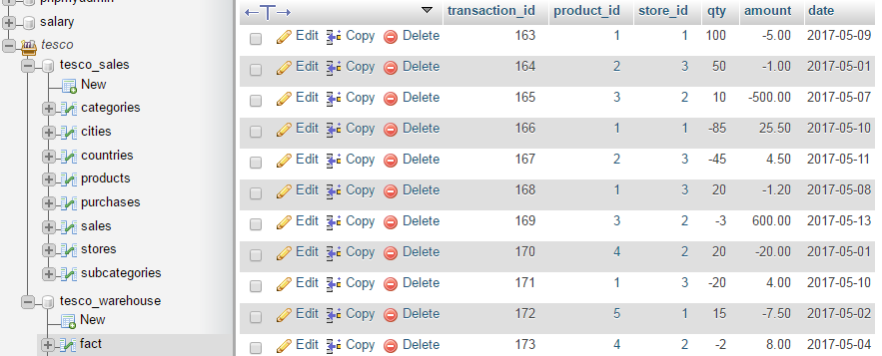
Pentaho
Used Pentaho as a graphical alternative to SQL, using a web-hosted MySQL server
Easy way of simply displaying the logic of database manipulation
Good for automating database management
Introduction
Python
R
SQL
Hadoop Cluster
Mongo DB
CI
Hive Impala
Scala
Spark
Pentaho
Agile SCRUM
Final Project
Conclusions

Slide 31

Tensorflow
Machine Learning library
Interfaced with python code to execute efficient back-end C++ code.
Constructs a computational graph to convert inputs into answers
Introduction
Python
R
SQL
Hadoop Cluster
Mongo DB
CI
Hive Impala
Scala
Spark
Pentaho
Agile SCRUM
Final Project
Conclusions

Slide 32



Tensorflow
Introduction to the TensorFlow library and neural network architecture
Built a simple image recognition model to classify images of 3 types:
Airplanes
Motorbikes
Faces
Final result was a convolutional network with around 70% accuracy
Numbers show the evidence score for the 3 classes
Introduction
Python
R
SQL
Hadoop Cluster
Mongo DB
CI
Hive Impala
Scala
Spark
Pentaho
Agile SCRUM
Final Project
Conclusions

Slide 33

Scrum/Agile
Learned the basics of the Scrum methodology.
Implemented Scrum with our final project
Defined our deliverables using user stories
Conducted daily meetings to co-ordinate the team
Introduction
Python
R
SQL
Hadoop Cluster
Mongo DB
CI
Hive Impala
Scala
Spark
Pentaho
Agile SCRUM
Final Project
Conclusions

Slide 34
Final Project - Introduction
Given a .csv containing Facebook check-in location data
Aims:
Link machines in a computing cluster for faster processing
To predict which place a person would like to check in to, given their location.
Create a full pipeline for cleaning the data, analysing it, and using it to train predictive algorithms.
Create solution to stream location and output solutions in real time.
Introduction
Python
R
SQL
Hadoop Cluster
Mongo DB
CI
Hive Impala
Scala
Spark
Pentaho
Agile SCRUM
Final Project
Conclusions

Slide 35

Final Project - Data
6 columns
row_id
x
y
accuracy
time
place_id
29,118,021 rows
Introduction
Python
R
SQL
Hadoop Cluster
Mongo DB
CI
Hive Impala
Scala
Spark
Pentaho
Agile SCRUM
Final Project
Conclusions

Slide 36
Final Project – User stories
Created a set of user stories to guide our progress through the project
Following Agile/Scrum methology
Daily Scrum meetings helped keep track of project progress and each member’s tasks
Introduction
Python
R
SQL
Hadoop Cluster
Mongo DB
CI
Hive Impala
Scala
Spark
Pentaho
Agile SCRUM
Final Project
Conclusions

Slide 37
Final Project - Technologies
Data manipulation and analysis
R Studio, Spark, IntelliJ
Cluster setup
Vagrant, Cloudera Quickstart, Cloudera Manager, AWS, VirtualBox Manager
Hadoop
Machine Learning
TensorFlow, Spark, R
GitHub and Google Drive
Introduction
Python
R
SQL
Hadoop Cluster
Mongo DB
CI
Hive Impala
Scala
Spark
Pentaho
Agile SCRUM
Final Project
Conclusions

Slide 38

Final Project – Clustering
Wanted to create a computing cluster to increase processing speed
Began by researching how to link our machines together
Settled on using vagrantbox to set up VMs on each host machine and linking them via Cloudera Manager
Introduction
Python
R
SQL
Hadoop Cluster
Mongo DB
CI
Hive Impala
Scala
Spark
Pentaho
Agile SCRUM
Final Project
Conclusions

Slide 39


Final Project – Clustering
Installing all the dependancies and making sure all agents are running and healthy
Introduction
Python
R
SQL
Hadoop Cluster
Mongo DB
CI
Hive Impala
Scala
Spark
Pentaho
Agile SCRUM
Final Project
Conclusions

Slide 40

Final Project – Clustering
The applications available from Cloudera Manager
The applications we selected to install are
HDFS
Hbase
MapReduce
Solr
Spark
YARN
ZooKeeper
Introduction
Python
R
SQL
Hadoop Cluster
Mongo DB
CI
Hive Impala
Scala
Spark
Pentaho
Agile SCRUM
Final Project
Conclusions

Slide 41


Final Project – Clustering
Some issues with memory allocation preventing Spark from being properly installed, so we added an extra agent to the cluster
Everything was then running and properly linked
Introduction
Python
R
SQL
Hadoop Cluster
Mongo DB
CI
Hive Impala
Scala
Spark
Pentaho
Agile SCRUM
Final Project
Conclusions

Slide 42
Final Project – Clustering PROBLEMS aws
With VM None of the services were able to start correctly
Attempted to use AWS free-tier EC2 (1GB RAM) VMs
Minimum requirement for Cloudera Manager is 2GB
Tried to use AWS EC2 instances as agents
Due to the master being in a private network the agents cannot communicate with it
It was possible to set up the cluster manually without Cloudera Manager, but we decided to re-try with vagrantboxes as we had new ideas on how to solve our previous problems
Introduction
Python
R
SQL
Hadoop Cluster
Mongo DB
CI
Hive Impala
Scala
Spark
Pentaho
Agile SCRUM
Final Project
Conclusions

Slide 43

Final Project – Clustering PROBLEMS VM
Master could not connect to NTP server
Due to the internet connection dropping on the master VM (required resetting)
Heartbeat issues with the agents due to errors in the /etc/hosts file
Download speed timeout
Running R machine learning along with VMS

Slide 44

Final Project (Tensorflow)
WADE NEEDS TO INTRODUCE THE TENSORFLOW STUFF HERE
Introduction
Python
R
SQL
Hadoop Cluster
Mongo DB
CI
Hive Impala
Scala
Spark
Pentaho
Agile SCRUM
Final Project
Conclusions

Slide 45

Final Project (Tensorflow Limitations)
Huge amount of data:
29 million data points
Large range of possible outputs:
108 thousand unique check-in locations are possible
Weak correlation between input co-ordinates and location
Difficult to load, process and learn
Introduction
Python
R
SQL
Hadoop Cluster
Mongo DB
CI
Hive Impala
Scala
Spark
Pentaho
Agile SCRUM
Final Project
Conclusions

Slide 46


Final Project (Tensorflow Results)
Solutions:
Add more layers to the network
Run the network only on small batches of the data at a time
Use only subsets that represent the data as a whole
Should improve accuracy of results:
Introduction
Python
R
SQL
Hadoop Cluster
Mongo DB
CI
Hive Impala
Scala
Spark
Pentaho
Agile SCRUM
Final Project
Conclusions

Slide 47

Final Project – Data Visualisation
Inaccuracies in GPS create messy data
Many co-ordinates can represent the same location
The same co-ordinates can represent multiple locations
Data hard to visualise
This is 1 of 100 grid squares with a 10% sample of the data
Introduction
Python
R
SQL
Hadoop Cluster
Mongo DB
CI
Hive Impala
Scala
Spark
Pentaho
Agile SCRUM
Final Project
Conclusions

Slide 48

Final Project – Data Visualisation
A quick histogram shows significant clustering of the accuracy data
Introduction
Python
R
SQL
Hadoop Cluster
Mongo DB
CI
Hive Impala
Scala
Spark
Pentaho
Agile SCRUM
Final Project
Conclusions

Slide 49


Final Project – Data Visualisation
Looking at only data with accuracy <200 shows a distinct pattern
Introduction
Python
R
SQL
Hadoop Cluster
Mongo DB
CI
Hive Impala
Scala
Spark
Pentaho
Agile SCRUM
Final Project
Conclusions

Slide 50

Final Project – Data Visualisation
Introduction
Python
R
SQL
Hadoop Cluster
Mongo DB
CI
Hive Impala
Scala
Spark
Pentaho
Agile SCRUM
Final Project
Conclusions

Slide 51

Final Project – Spark MlLIb
Can be used in Java, Scala, R and Python
Claims to perform 100x faster than MapReduce
It is easy to scale. Code can be written and tested on a single machine before being used with a large cluster, without any changes needed
Introduction
Python
R
SQL
Hadoop Cluster
Mongo DB
CI
Hive Impala
Scala
Spark
Pentaho
Agile SCRUM
Final Project
Conclusions

Slide 52

Final Project – Spark MlLIb
Naïve Bayes
Simple to use and learns fast compared to other algorithms
Meant we could get something working quickly
Assumes all inputs are independent and not related
Isn’t the case for our data, since x and y coordinates are given as separate inputs
Introduction
Python
R
SQL
Hadoop Cluster
Mongo DB
CI
Hive Impala
Scala
Spark
Pentaho
Agile SCRUM
Final Project
Conclusions

Slide 53


Final Project – Spark MlLIb
Multilayer Perceptron
Based on a feedforward neural network, with an input layer, hidden layer(s) and an output layer
Take a lot of training data and tuning to train effectively,
Can be hard to determine how effective they will be even once trained
Simpler and faster methods can often perform better
Introduction
Python
R
SQL
Hadoop Cluster
Mongo DB
CI
Hive Impala
Scala
Spark
Pentaho
Agile SCRUM
Final Project
Conclusions

Slide 54

Final Project – Spark MlLIb
Random Forests
Creates multiple decision trees and uses them all to make a more accurate model
Good for predictive modelling
Fast to train, but slow to make predictions once trained
Introduction
Python
R
SQL
Hadoop Cluster
Mongo DB
CI
Hive Impala
Scala
Spark
Pentaho
Agile SCRUM
Final Project
Conclusions

Slide 55

Final Project – ML Algorithms
Nearest Neighbour algorithm
Object is classified by a majority vote of its neighbours
Influence of neighbours weighted by distance
Flexible and easy to implement
Struggles with sparsely populated areas
Introduction
Python
R
SQL
Hadoop Cluster
Mongo DB
CI
Hive Impala
Scala
Spark
Pentaho
Agile SCRUM
Final Project
Conclusions

Slide 56
Final Project – Results
Clustering – much more difficult than anticipated due to various factors
Success, but far too late to be useful to the project
Assessment of the machine learning/predictions
Achieved some level of predicting the data, however accuracy was very low
Progress of automated pipeline systems for adding new data & training the models
Very little progress due to focus still on making the learning work more effectively
Assessment of the data streaming capabilities
No progress due to time constraints
Did we achieve all the user stories?
No, largely due to time constraints
Some stories were extremely ambitious given the amount of work that would be required
Introduction
Python
R
SQL
Hadoop Cluster
Mongo DB
CI
Hive Impala
Scala
Spark
Pentaho
Agile SCRUM
Final Project
Conclusions

Slide 57
Conclusions
12 week course covered a series of linked topics designed to enable us to be productive in a Big Data working environment
Several larger projects worked on in small teams, giving useful practice in collaboration and communication, as well as presenting results to others
Technologies built up towards a final project, in which most of them were used in some capacity to increase the accuracy of or streamline it
Introduction
Python
R
SQL
Hadoop Cluster
Mongo DB
CI
Hive Impala
Scala
Spark
Pentaho
Agile SCRUM
Final Project
Conclusions

