Slide 1
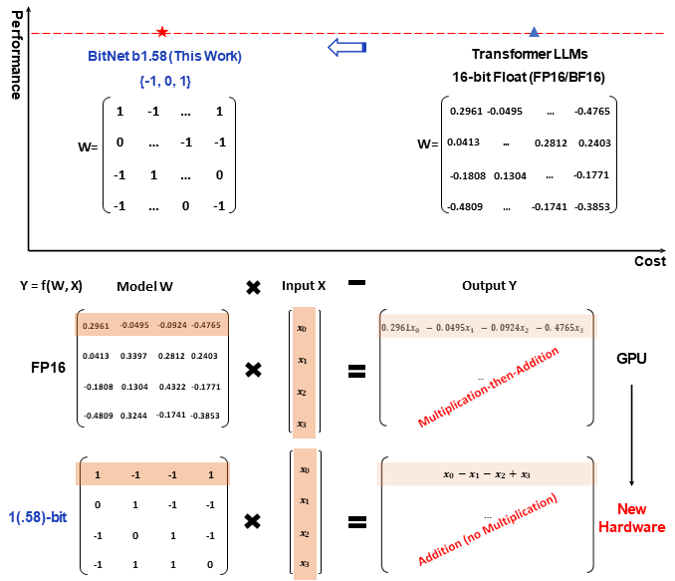
The Era of 1-bit LLMs : All Large Language Models are in 1.58 Bits

Slide 2
The Era of 1-bit LLMs : All Large Language Models are in 1.58 Bits
Table 1: Perplexity as well as the cost of BitNet b1.58 and LLaMA LLM.
Models | Size | Memory (GB)↓ | Latency (ms)↓ | PPL↓
LLaMA LLM | 700M | 2.08 (1.00x) | 1.18 (1.00x) | 12.33
BitNet b1.58 | 700M | 0.80 (2.60x) | 0.96 (1.23x) | 12.87
LLaMA LLM | 1.3B | 3.34 (1.00x) | 1.62 (1.00x) | 11.25
BitNet b1.58 | 1.3B | 1.14 (2.93x) | 0.97 (1.67x) | 11.29
LLaMA LLM | 3B | 7.89 (1.00x) | 5.07 (1.00x) | 10.04
BitNet b1.58 | 3B | 2.22 (3.55x) | 1.87 (2.71x) | 9.91
BitNet b1.58 | 3.9B | 2.38 (3.32x) | 2.11 (2.40x) | 9.62
これだと
家のGPUでもやれる…

Slide 3
The Era of 1-bit LLMs : All Large Language Models are in 1.58 Bits
Table 2: Zero-shot accuracy of BitNet b1.58 and LLaMA LLM on the end tasks.
Models | Size | ARCe | ARCc | HS | BQ | OQ | PQ | WGe | Avg.
LLaMA LLM | 700M | 54.7 | 23.0 | 37.0 | 60.0 | 20.2 | 68.9 | 54.8 | 45.5
BitNet b1.58 | 700M | 51.8 | 21.4 | 35.1 | 58.2 | 20.0 | 68.1 | 55.2 | 44.3
LLaMA LLM | 1.3B | 56.9 | 23.5 | 38.5 | 59.1 | 21.6 | 70.0 | 53.9 | 46.2
BitNet b1.58 | 1.3B | 54.9 | 24.2 | 37.7 | 56.7 | 19.6 | 68.8 | 55.8 | 45.4
LLaMA LLM | 3B | 62.1 | 25.6 | 43.3 | 61.8 | 24.6 | 72.1 | 58.2 | 49.7
BitNet b1.58 | 3B | 61.4 | 28.3 | 42.9 | 61.5 | 26.6 | 71.5 | 59.3 | 50.2
BitNet b1.58 | 3.9B | 64.2 | 28.7 | 44.2 | 63.5 | 24.2 | 73.2 | 60.5 | 51.2

Slide 4
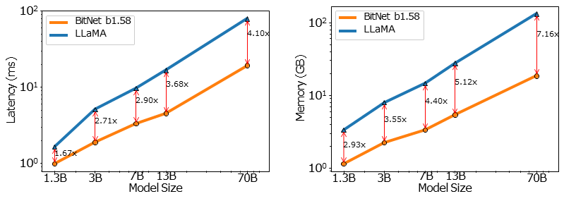
The Era of 1-bit LLMs : All Large Language Models are in 1.58 Bits
Figure 2: Decoding latency (Left) and memory consumption (Right) of BitNet b1.58 varying the model size.

Slide 5
The Era of 1-bit LLMs : All Large Language Models are in 1.58 Bits
Table 3: Comparison of the throughput between BitNet b1.58 70B and LLaMA LLM 70B.
Models | Size | Max Batch Size | Throughput (tokens/s)
LLaMA LLM | 70B | 16 (1.0x) | 333 (1.0x)
BitNet b1.58 | 70B | 176 (11.0x) | 2977 (8.9x)

