Slide 1
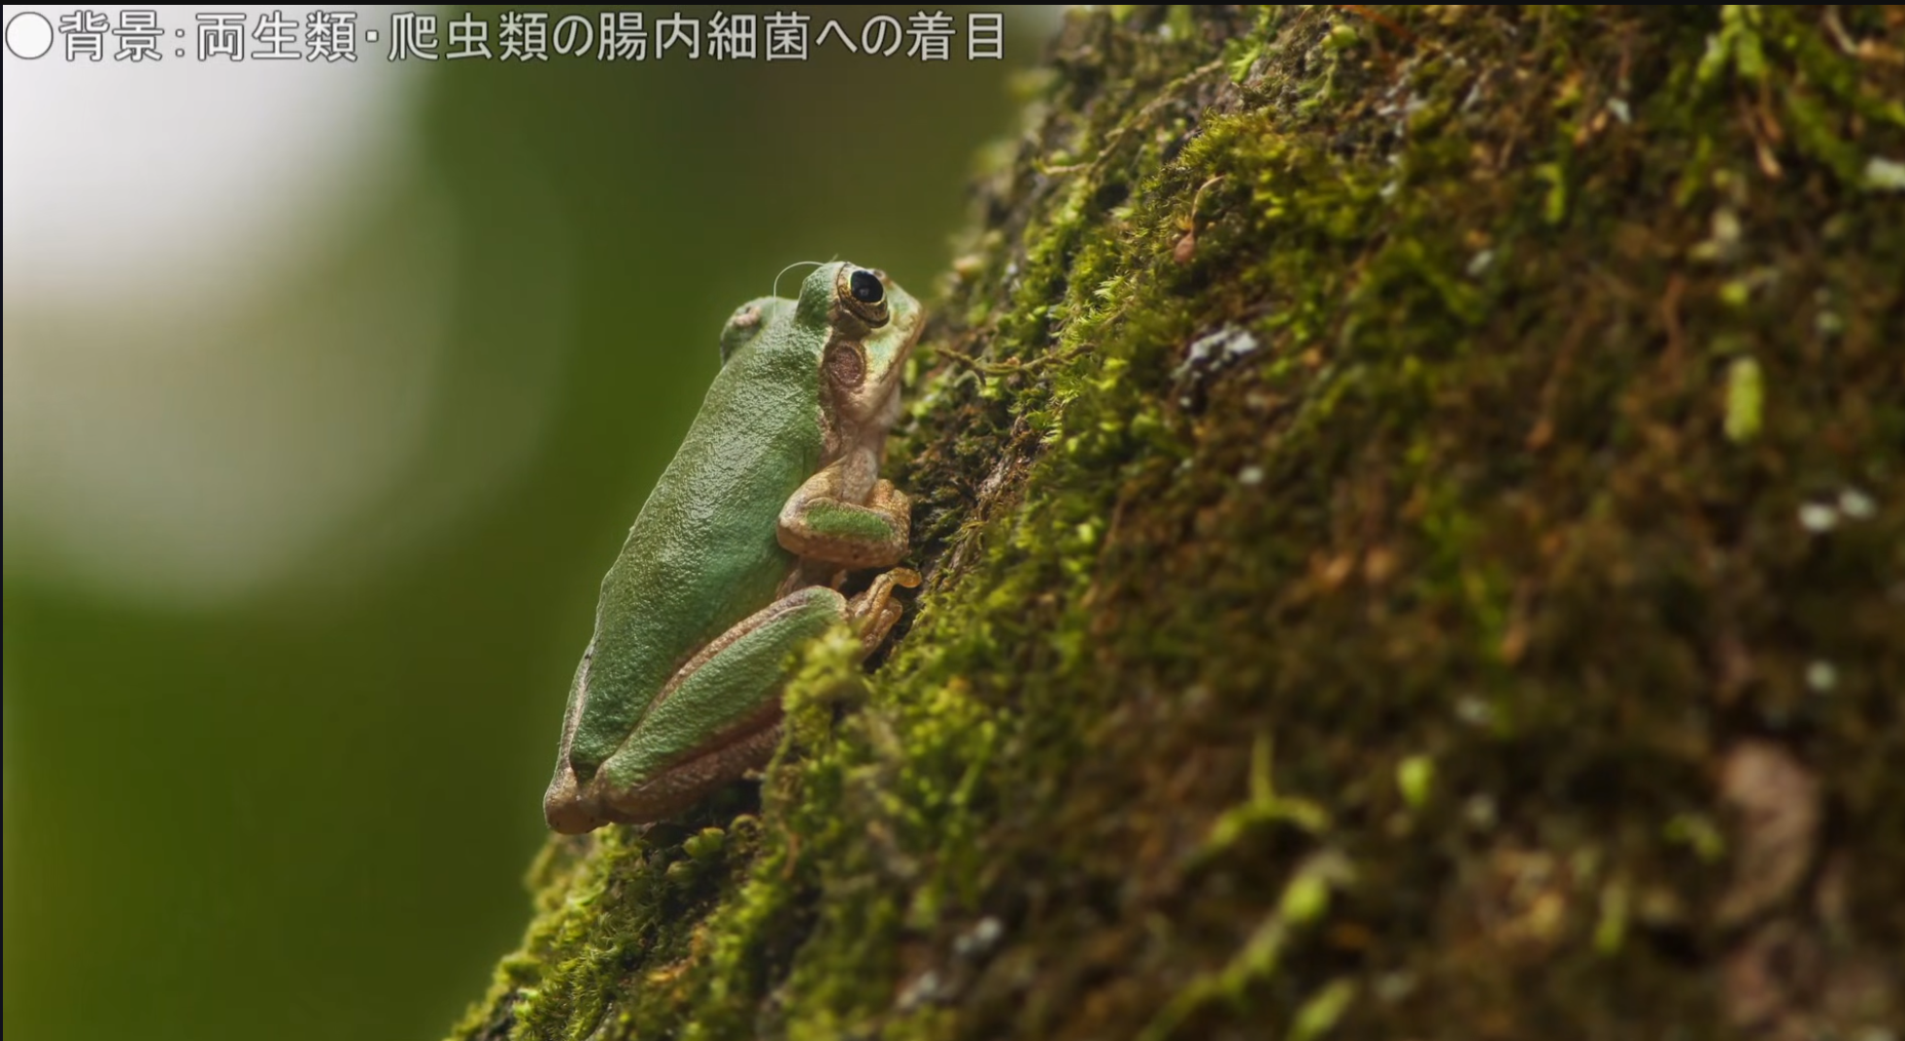

Slide 2
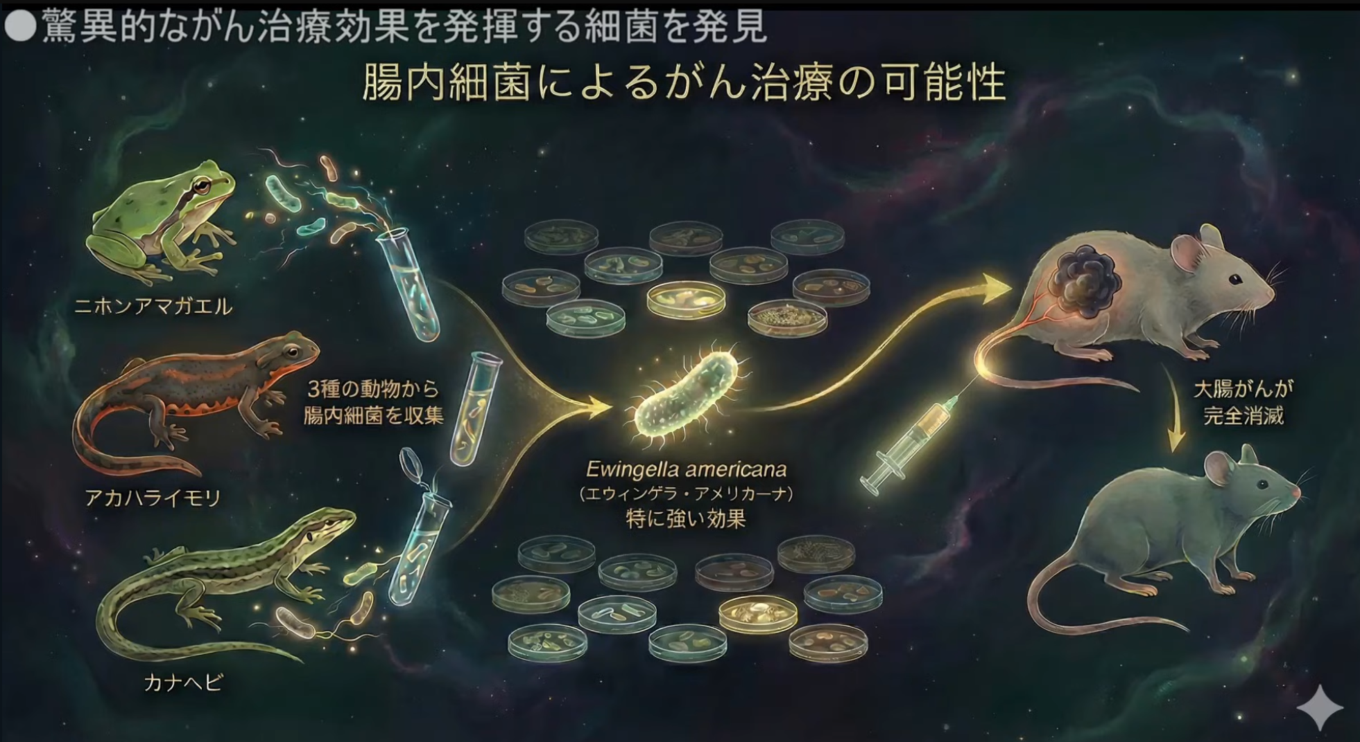

Slide 3
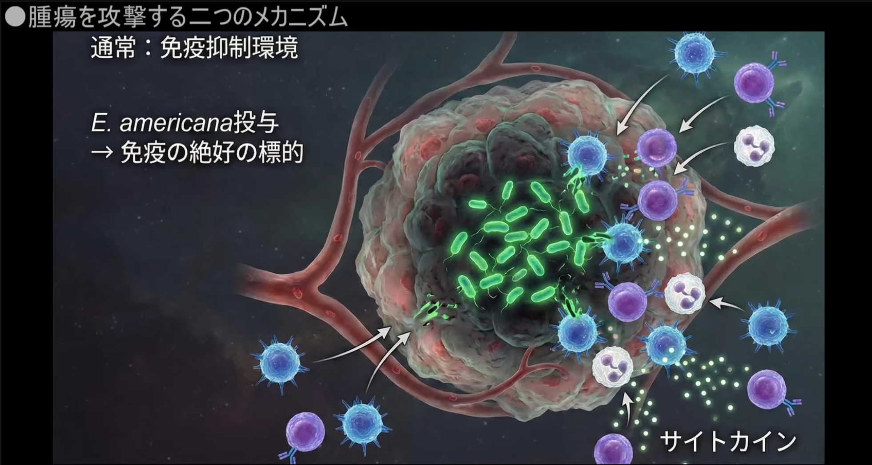

Slide 4
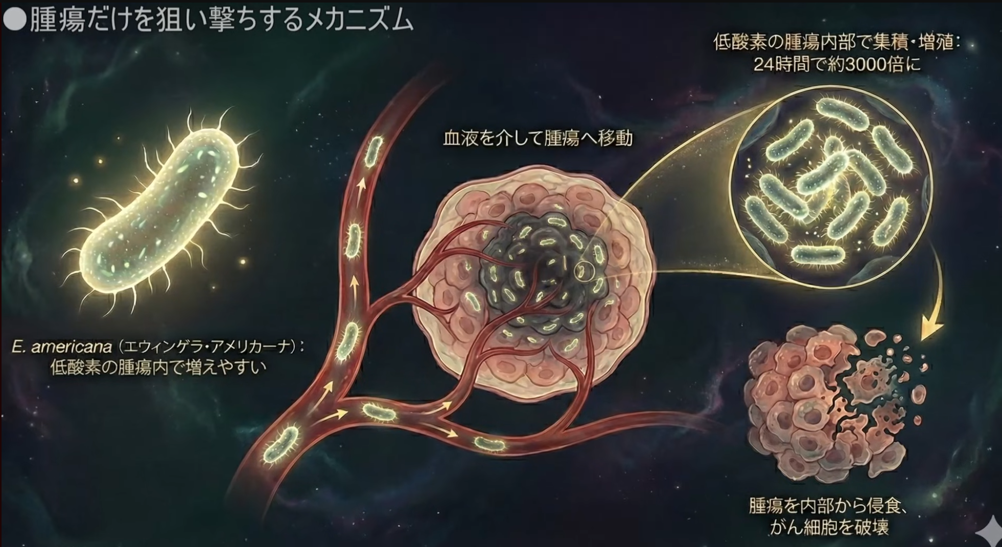

Slide 5
https://medicalxpress.com/news/2025-12-gut-bacteria-amphibians-reptiles-tumor.html
https://www.tandfonline.com/doi/full/10.1080/19490976.2025.2599562
https://www.jaist.ac.jp/whatsnew/press/2025/12/15-1.html

