Slide 1
FogLAMP Overview – Embedded World

Slide 2
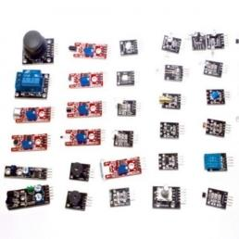

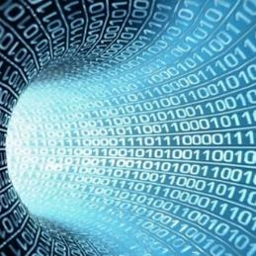
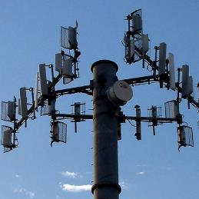
IIoT Enables Digital Transformation
Cheap, and tiny sensors
Decreasing compute and storage costs
New abilities to process and analyze data
Ubiquitous connectivity
Sensors on the Entire Supply Chain will Automate and Transform Business

Slide 3
What is it?
Dianomic in partnership with Google & Nexcom is delivering open source software framework called FogLAMP and associated community for the industrial edge focused on critical operations
FogLAMP delivers connective software tissue for todays IIoT workplace, providing middleware for applications
FogLAMP Leverages the robustness of the Nexcom MVS 2623 GCIoT to Integrate machine data with diverse data across various devices, combined with ML/AI tools from Google Cloud
Delivered via a secure, account-controlled, web-based interface
Leverages internet communications capabilities of IOT devices that can provide information while at the same time maintaining cybersecurity and regulatory compliance

Slide 4
Why do you care?
FogLAMP is architected to remove the complexity and silos for rapid integration of IIoT sensors and modern machines all sharing a common set of administration and application APIs with industrial “brown field” systems
FogLAMP + Nexcom + Coral helps developers build smarter, better, cheaper industrial solutions for:
Condition-based monitoring
Predictive maintenance
Smarter/Autonomous machines
Situational Awareness for security and safety
Using FogLAMP APIs, and the power of GCP you can move faster to drive engagements and shorten time to value.
Using FogLAMP and GCP Tools industrial users instantly have a more comprehensive situational awareness view of their non-control operational data sets

Slide 5
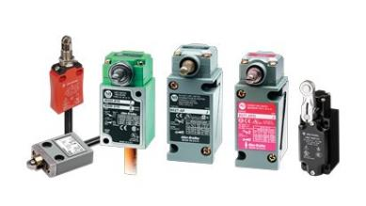
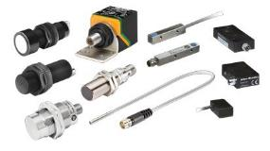
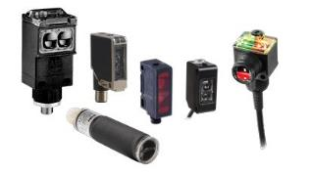
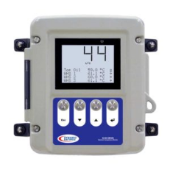
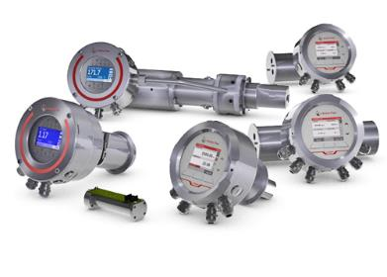
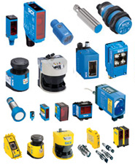
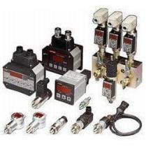
Collect Any Data
Many Existing South Plugins
Temperature, Humidity, Current, etc.
Modbus, OPC/UA, MQTT, HTTPS
Pluggable – Create Your Own
Easy APIs and sample code
Build your own
Customize existing plugins
Python or C++
Polled or Async
Open Source Community – many plugins in time

Slide 6
Available on Nexcom MVS 2623 GCIoT
Built-in Google Edge TPU ML accelerator coprocessor
FogLAMP loaded and developer ready
Modular design for flexible I/O expansion
Three SIM cards + dual WWAN modules support
8 x 10/100/1000 Mbps 802.3af PoE ports
Built-in u-blox NEO-M8N module, optional dead reckoning support
Intel Atom® x7, 4c, 2.0GHz E3950
Dual removable SATA 3.0 2.5” SSD/HDD
iButton for driver ID identification
Built-in CAN 2.0B optional OBDII function (SAE J1939/J1708)
Pattern number M531607 registered, an easy way to expand diverse I/O cards

Slide 7



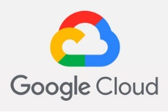





ARCHITECTURE
GUI
REST API
Orchestrator
Event Engine
Storage
Layer
North Service
Rules
OMF
Filters
Value Threshold
Compress
HTTPS
Config Mgmt
Diff Threshold
Delta
Actions
Kafka
Updates
Create Data
Conditional
Monitoring
Splunk
External App
Scheduling
Email
…
Backup
User Mgmt
South Service
Enhancers
RMS/Peak
Security
FFT
ML / AI
OPC-UA
Micro Service
Modbus
HTTPS
MQTT
CoAP
Direct
…
…
Plugin
REST API
Notes:
Light blue boxes are plugins:
South plugins
North plugins
Storage Data plugins
Event plugins
Filter/pre-processing plugins
Pink boxes are REST APIs
Green boxes are micro services - They start at startup and they stay on until a shutdown request occurs. There are 4 types of services:
Core (one for each FogLAMP instance)
Storage (one for each FogLAMP instance)
South (one to many for each FogLAMP instance)
North (one to many for each FogLAMP instance)
Event Notification Engine

Slide 8
FogLAMP and Google Tensorflow Edge ML/AI for Industrial Applications

Slide 9


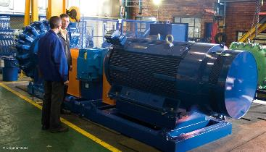
Machine Learning
Is this weld
high quality?
Are there people
in this
dangerous area?
Is this machine
healthy?
Google TensorFlow - Run ML Models at the Edge powering -
Image Recognition / Object Detection / Anomaly Detection /Quality control, Make edge inferences in real time

