Slide 1
CSE 301
History of Computing
The Dawn of Commercial Computing in the 1950s

Slide 2
1950s
Computer makes a transition
  from a mathematical instrument
  to an electronic data-processing machine
  transition led mainly by:
    computer manufacturers
    business leaders
    defense industry
If you are a business major, you should learn this story
  more business lessons than a season of The Apprentice

Slide 3
The Commercial Computer
Soon:
  30 American computer companies
  10 British computer companies
Who was properly positioned to take foster and benefit most from this transition?
  IBM of course
    in 1950, they had a 0% share in computer market
    by 1960, they would have a 70% share in computer market

Slide 4
The Cold War
For US Government, replaced technological competition of WW II
  U.S. vs. U.S.S.R.
  made US Government, military, & military contractors perennial cutting edge computer customers
  continually fed competition & progress in private sector

Slide 5
EMCC
1946 - Eckert and Mauchly left the Moore School
Start the Eckert & Mauchly Computer Company
Financial problems early on
Parallel Projects:
  UNIVAC
  BINAC
First customer: Bureau of the Census
  Paid $300K up front
  Actual cost to build the first UNIVAC was $1M

Slide 6
BINAC
Completed in 1949 for Northrop Aircraft
First operational American stored-program computer
Smaller than UNIVAC
Scientific Computer, for researchers
  bought by defense companies

Slide 7
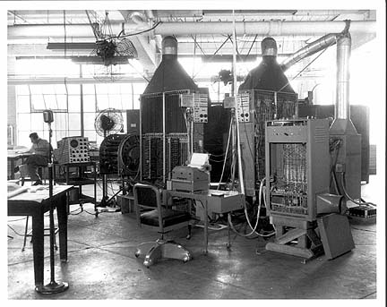
BINAC

Slide 8
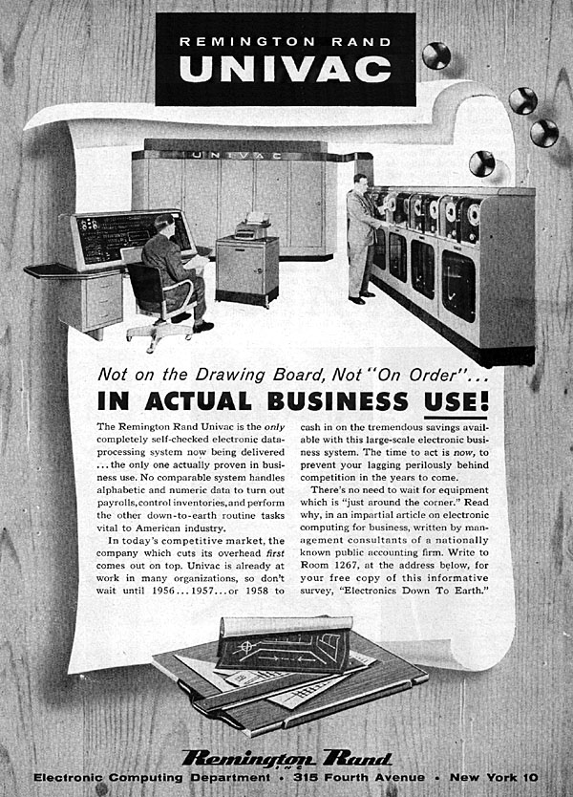
UNIVAC
Remington Rand buys EMCC in 1950
Eckert & Mauchly envisioned a general purpose computer (UNIVAC)
Government receives delivery of first UNIVAC in 1951 after U.S. Census processing started
By 1954, 20 had been built and delivered for $1 million each
Notes:
resignation of Eckert and Mauchly from University of Pennsylvania on a patent conflict

Slide 9
Some UNIVAC Features
Used magnetic tape to store data rather than punched cards
  Transfer rate 12800 characters/second
  Read in speed 100 inch/second
  Card-to-tape 240 cards/minute
Processing times:
  Addition 120 microseconds
  Multiplication 1800 microseconds
  Division 3600 microseconds
Output
  High speed printer 600 lines/minute
Notes:
In many ways, the UNIVAC was quite a technological advancement from the design of the earlier ENIAC. Among the most notable of these improvements include the usage of Von Neuman's stored program concept (as opposed to the manual wire panels of ENIAC), the main memory size of 1,000 words, secondary memory upon magnetic tape (as opposed to ENIAC's function tables), and the improved input/output devices, including a typewriter, cards, and a printer. The performance was radically faster as well, with a clock rate of 2.25 MHz compared to ENIAC's snail's pace of 60-125 KHz, and the time required for a division operation six times faster (3.89 ms vs. 24.0 ms in ENIAC). While UNIVAC continued to use vacuum tubes, which were often prone to burn out in the middle of number crunching, the UNIVAC's tube count of 5,4000 was more than adequate as an improvement over ENIAC's 18,000 tubes. The floor space that UNIVAC occupied was also more modest at only 352 square feet, opposed to ENIAC's massive bulk of 1,8000 square feet. While UNIVAC was still a dinosuar compared to today's pentiums and workstations, it was the next best thing since sliced bread in 1951, when it was used to tally part of the 1950 U.S. population census, drastically reducing the workload of the human tabulators usually required to work excrutiatingly long hours on the job.

Slide 10
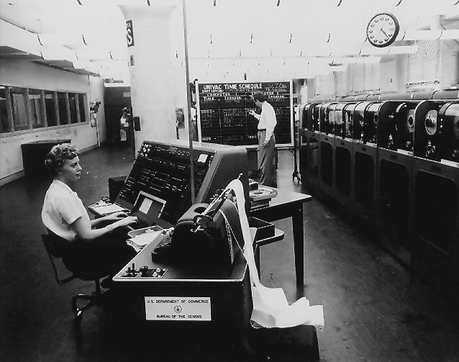
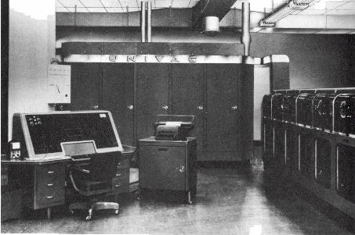
UNIVAC
UNIVAC I, from
IEEE Computer Society

Slide 11
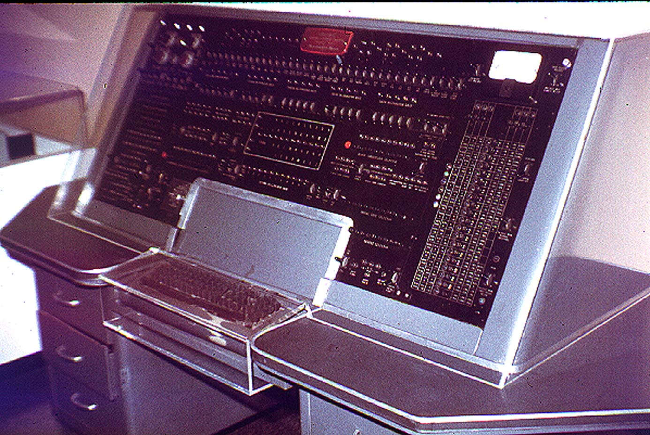
UNIVAC
The UNIVAC I
console,
from Virginia Tech

Slide 12
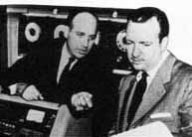
The UNIVAC Stunt
J. Presper Eckert and
Walter Cronkite
next to the UNIVAC
(Center for the Study of
Technology and Society)
Used to predict the winner of the 1952 U.S. Presidential Election based on ~3.4M votes
  predicted an electoral vote of 438 for Eisenhower and 93 for Stevenson.
  official count was 442 to 89 -- an error of less than 1%.
  UNIVAC became synonymous with computer
Notes:
The UNIVAC has an unusual claim to fame too. In the 1952 US elections, the CBS network had fake panels on the set lit with Christmas tree lights, and was claimed to be a UNIVAC calculating the predicted outcome of the election. On early, small data, a real UNIVAC had predicted a landslide victory for Eisenhower. On receiving this prediction, the network decided it couldn't transmit it, as it was so biased. They went back and inserted a fudge factor to even the odds a bit more. After two new fudge factors were introduced, the computer finally predicted a marginal Eisenhower victory, which the network decided they could air.
Eisenhower eventually won by almost exactly the landslide the machine originally predicted.

Slide 13
IBM’s Entry into Computers
After Northrop ordered a UNIVAC from EMCC, defense companies asked IBM for similar machines
  IBM would be a little slow
First 4 IBM computers:
  SSEC
  Defense Calculator (701)
  Tape Processing Machine (702)
  Magnetic Drum Computer (650)

Slide 14
IBM & Columbia’s Selective Sequence Electronic Calculator
Following ENIAC, IBM looked to incorporate electronics into their existing machines
Led by Columbia’s Wallace Eckert
Watson’s objective:
  thumb his nose at Aiken
  ensure IBM had a test bed for new ideas & devices
SSEC Completed in 1948
  Not a stored-program computer
  the most powerful & advance machine available when it was completed
  not commercially viable, it went on display
  it’s real importance was that its production trained IBM engineers

Slide 15
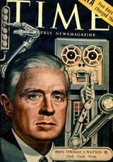
IBM 701 (1952)
(Defense Calculator)
Designed as a response to get government
contracts during the Korean War in 1950
Advocated by Thomas J. Watson Jr.
Stored program computer
  optimized for scientific calculations.
Design used parallel architecture
  Made performance much faster than UNIVAC
  Would subsequently be adopted by Remington Rand computers
  Designed out of modular components for
  easy transport and configuration
“Clink, clank, think”
Notes:
The Model 701 Defense Calculator was IBM's first production computer designed for scientific calculation. It rented for about $16,000 per month. In all, 19 units were manufactured, most of them for US national laboratories, the US Weather Bureau, aircraft manufacturers, etc. The first unit was installed in 1952 at IBM Headquarters in New York City, replacing the SSEC. The 701 came in eleven pieces:
Two electrostatic storage units held 72 cathode-ray tubes (CRTs), sufficient to provide 2048 36-bit words.
Three power supply and distribution units.
The electronic analytical and control unit (CPU).
Plus card punches, readers, and recorders, a printer, a magnetic tape unit (the world's first), and a drum.
The IBM 700 series were binary (as opposed to decimal) vacuum-tube logic computers with 36-bit words. The 704 was a 701 with core (rather than CRT) memory, floating-point arithmetic, and a bunch of new instructions. 123 of them were sold from 1955 to 1960. There was also a 705, but it had a 35-bit (not 36-bit) word. The 709 succeeded the 704, adding overlapped i/o, indirect addressing, and decimal instructions. The 7090 was a 709 with transistor, rather than vacuum-tube, logic. The 7040 and 7094 were scaled-down and -up 7090 variations. The 36-bit 700- and 7000-series were IBM's scientific computers from 1952 until the appearance of the 32-bit 360 in 1964.
The 36-bit architecture was adopted by Digital Equipment Corporation for its PDP-6 and PDP-10 computers from 1964 to 1988 and by other manufacturers including Honeywell and Sperry; the Sperry/UNIVAC 1100 survives to this day as the Unisys Clearpath IX and IE series.
PICTURE INFO: Time magazine ran the cover story "The Brain Builders" on Tom Watson, Jr., and IBM on March 28, 1955. IBM had just installed a model 702 Electronic Data Processing Machine in its Monsanto HQ in St. Louis, called "the giant brain." It had 2500 tubes, did 7200 logical operations per sec., with punch card and magnetic tape storage. It was the result of IBM slogan "Think" and Tom Watson, Jr., who took over presidency of IBM in 1952, and who led the battle to automate American business. IBM had orders for 14 model 702s at a monthly rental of $20,000, and had delivered 19 of the earlier model 701. The AEC had 3 model 701 machines, the Weather Bureau had one model 701. IBM had just delivered the NORC computer to the Navy, and had 109 orders for the new 704 and 705 models that will cost IBM $1 million each to build.

Slide 16
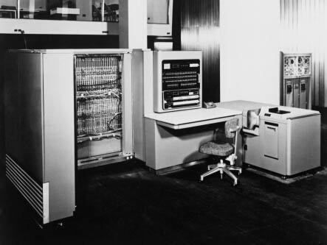
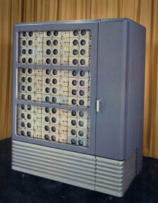
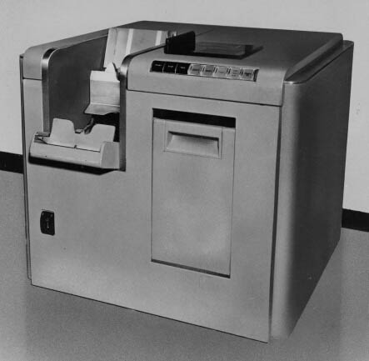
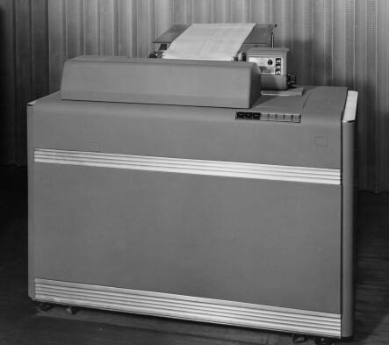
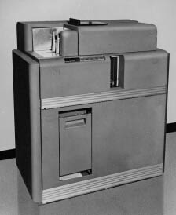
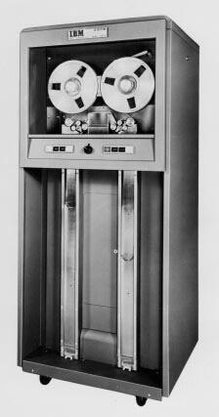
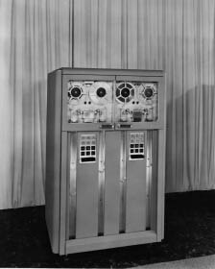
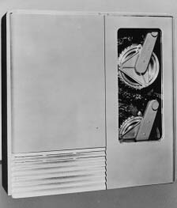
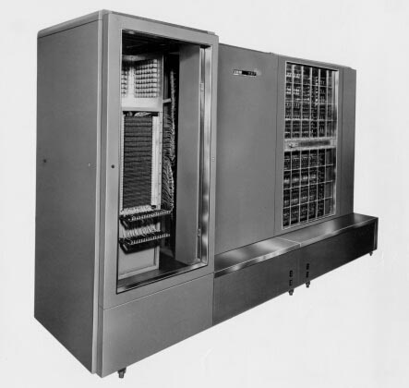
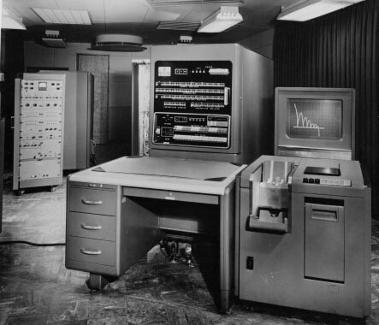
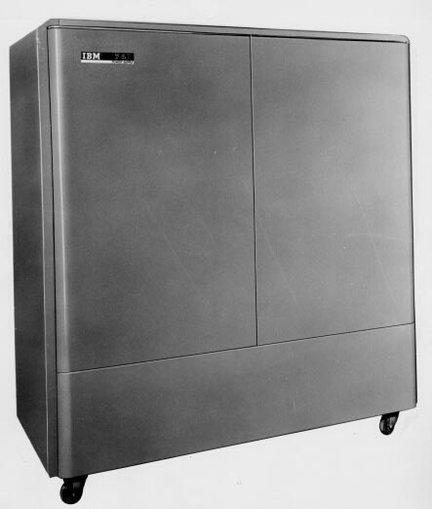
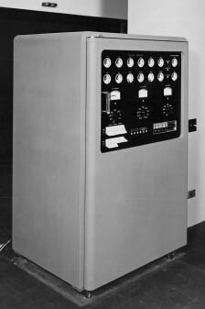
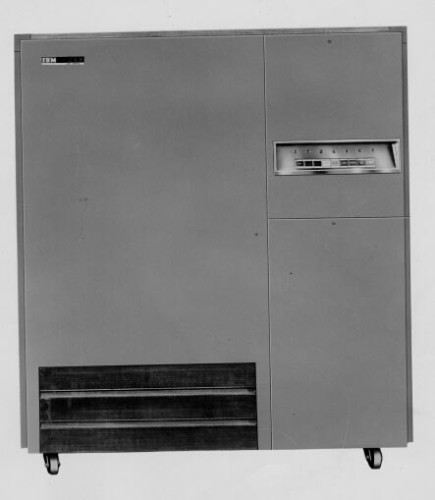
IBM 701 Components
·IBM 701 Electronic analytical control unit
·IBM 706 Electrostatic storage unit
·IBM 711 Punched card reader
·IBM 716 Printer
·IBM 721 Punched card recorder
·IBM 726 Magnetic tape reader/recorder
·IBM 727 Magnetic tape unit
·IBM 731 Magnetic drum reader/recorder
·IBM 736 Power frame #1 (not shown)
·IBM 737 Magnetic core storage unit
·IBM 740 Cathode ray tube output recorder
·IBM 741 Power frame #2
·IBM 746 Power distribution unit
·IBM 753 Magnetic tape control unit
Notes:
The 701 was formally announced on May 21, 1952. It was the unit of the overall 701 Data Processing System in which actual calculations were performed. That activity involved 274 assemblies executing all the system's computing and control functions by means of electronic pulses emitted at speeds ranging up to one million a second.
The IBM 706 was formally announced on May 21, 1954. The banks of cathode ray tubes, similar in principle to television tubes, were the heart of the IBM 701 Data Processing System. They gave the machine much of its tremendous speed and flexibility. The 72 cathode ray tubes in the Electrostatic Storage Unit could store 10,240 digits, any of which could be obtained for processing at other points of the machine in 12 microseconds. The principal advantages of Electrostatic Storage was the short time required to refer to information at any given location and send it to the computing unit, and the random access to any 706 location afforded the programmer.
The IBM 711 was announced May 21, 1952. Located to the immediate right of the operator's station, the card reader was used to transfer information on IBM punched cards into the IBM 701 Data Processing System. It could read 150 cards a minute. The card-feeding mechanism in the 711 was similar to that in the IBM 402 Accounting Machine and included two sets of reading brushes. Any 72 columns of the punched card could be selected through control panel wiring to read into 72 positions of Electrostatic Storage. The cards could be punched with any desirable code. Users had to provide a suitable program so that the particular code used on the card could be translated into the binary code used by the 701.
The IBM 716, used for printing the answers from problems calculated on the 701 Data Processing System, was formally announced on May 21, 1952. It could print 150 lines of numeric, alphabetic or special characters a minute or 180 letters or numbers per second.
The IBM 721 card punch was formally announced on May 21, 1952. It was used for punching answers to problems and other data onto IBM punched cards for processing by the IBM 701 Data Processing System. Punched card input was at 600 digits per second and 100 cards a minute.
The IBM 726 was formally announced on May 21, 1952. Magnetic tapes used with the 701 Data Processing System provided a high-speed method of introducing and recording greater masses of data than were possible through either cathode ray tube or drum storage. The magnetic tape could read or write at a rate of 12,500 digits a second and had a capacity in excess of 2 million digits a tape.
The IBM 727 Magnetic Tape Unit was announced on September 25, 1953. It provided intermediate speed, large capacity storage for programs and data, and it was also used as a high-speed input unit for information previously recorded on magnetic tape.
The IBM 731 was formally announced on May 21, 1952. It was the intermediate storage device of the 701 Data Processing System because it offered greater capacity than the cathode ray tubes in the IBM 706 Electrostatic Storage Unit but it had a slower access speed. Each of the two drums in the Magnetic Drum Reader and Recorder stored 40,960 digits, for a total capacity of 81,920 digits.
The IBM 736, a power supply unit for the IBM 701 Data Processing System, was announced on May 7, 1954. The unit was also used with the IBM 709 Data Processing System, which was introduced in January 1957.
The IBM 737 was formally announced on October 1, 1954. Users of the IBM 701 Data Processing System could specify the 737 in lieu of the IBM 706 Electrostatic Storage Unit to gain the advantage of magnetic core storage, viz., the elimination of regeneration time and the reduction of processing time in many applications. For example, the 737 reduced the time needed to perform additions, including access, from 60 microseconds to 36 microseconds. This faster processing speed was especially beneficial in problems involving large amounts of logic.
Formally announced on October 12, 1954, the 740 CRT output recorder was an electronic device attached to the IBM 701 Data Processing System. It provided output which recorded data points on the faces of a pair of television-like tubes at the rate of 8,000 per second. The larger tube, used for visual display and inspection, was a 21-inch tube. The smaller tube, used in conjunction with a camera, was a 7-inch tube. A customer-furnished camera was controlled by the 701 and automatically photographed information directed by the program. The 740 allowed decision making and possible intervention by the operator as the computation progressed. The device provided scientists and engineers with greater speed and accuracy in designing many types of equipment. For example, the shape of a cam could be computed and the shape, together with successive positions of the cam, could be displayed on the 740 at electronic speeds, inspected and then photographed for a permanent record.
The IBM 741 power frame and operator's panel was formally announced on May 21, 1952. It was one of three power supply units for the IBM 701 Data Processing System.
The IBM 746 was formally announced on May 21, 1952, and was used for power control and distribution on the IBM 701 Data Processing System.

Slide 17
IBM 701 Customers
1 IBM World Headquarters, New York, N.Y. Dec. 20, 1952
2 University of California., Los Alamos, N.M. Mar. 23, 1953 (a)
3 Lockheed Aircraft Company, Glendale, Cal. Apr. 24, 1953 (b)
4 National Security Agency, Washington, D.C. Apr. 28, 1953
5 Douglas Aircraft Company, Santa Monica, Cal. May 20,1953 (c)
6 General Electric Company., Lockland, Ohio May 27, 1953
7 Convair, Fort Worth, Tex. Jul. 22, 1953
8 U.S. Navy, Inyokern, Cal. Aug. 27, 1953 (d)
9 United Aircraft, East Hartford, Conn. Sep. 18, 1953
10 North American Aviation, Santa Monica, Cal. Oct. 9, 1953 (e)
11 Rand Corporation., Santa Monica, Cal. Oct. 30, 1953 (f)
12 Boeing Corporation, Seattle, Wash. Nov. 20, 1953 (g)
13 University of California, Los Alamos, N.M. Dec. 19, 1953
14 Douglas Aircraft Company, El Segundo, Cal. Jan. 8, 1954 (h)
15 Naval Aviation Supply, Philadelphia, Pa. Feb. 19, 1954
16 University of California, Livermore, Cal. Apr. 9, 1954
17 General Motors Corporation, Detroit, Mich. Apr. 23, 1954
18 Lockheed Aircraft Company, Glendale, Cal. Jun. 30, 1954 (b)
19 U.S. Weather Bureau, Washington, D.C. Feb. 28, 1955 (i)
Notes:
Notes: (a) Used for hydrodynamics calculations. (b) Mathematics Analysis Department used the 701 for problems in aircraft design, such as aerodynamic performance and stability, thermal dynamics and structural and flight dynamics. Production data handled on 701s by Lockheed's Factory Data Processing Group included project base schedule preparation, parts scheduling, shop order writing, direct labor hour forecasting and parts activity ledgers. (c) Arrived on May 23, 1953, aboard a DC-6A aircraft. The 701 was used to get the DC-7 into production months ahead of schedule. It solved engineering and scientific problems on all Douglas commercial aircraft, including the DC-6B, DC-7, DC-7C and the development of DC-8. (d) Used to calculate rocket and missile performance and to simulate flight conditions of these devices at the U.S. Naval Ordnance Test Station China Lake. (e) Handled engineering problems, from basic configuration selection through aerodynamic and structural design to the analysis of flight test data. (f) Used to solve wide variety of problems in economics, mathematics, aircraft, missiles, electronics, nuclear energy and social sciences. Later moved to West Los Angeles. (g) Used to assist engineers and designers in solving problems in aerodynamics, stress and structural development, and flight testing of supersonic and jet aircraft and guided missiles. (h) Solved engineering problems on U.S. Navy A3D Skywarrior, A4D Skyhawk and F4D Skyray programs, and USAF C-133 and RB-66 programs. (i) Produced from spare parts.

Slide 18
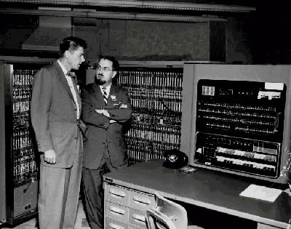
IBM 701
Ronald Reagan and IBM’s Herb Grosch in 1956

Slide 19
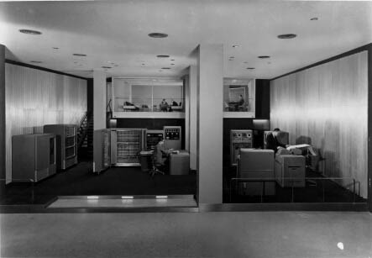
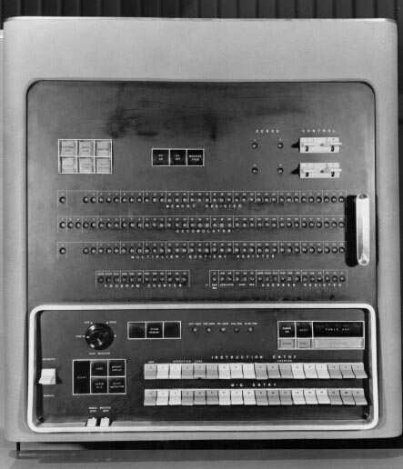
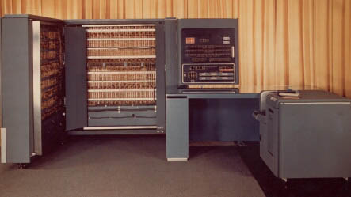
IBM 701
Views of the IBM 701
(from IBM Archives)

Slide 20
IBM 702
(Tape Processing Machine)
First shipped in 1955
The first large IBM computer designed for business data processing
15 are eventually installed
  a bit of a financial flop
First commercially available computer to use transistors
The machine developed some new standards for subsequent machines. Ex:
  Very high speed magnetic tape machines
Notes:
The IBM 702 Electronic Data Processing Machine, designed particularly for business use, also handled scientific and engineering applications. For example, an electric firm used it to solve scientific problems and process its business accounts; a machinery manufacturer prepared cam design reference tables on it, and the 702 was used in classified government projects that involved complicated scientific problems.
The first 702 was demonstrated in l954, with the first production model installed in July 1955. Accompanying the 702 was the IBM 712, a newly developed, 1000-line-a-minute, high-speed printer, that used the principle of wire printing and provided more than six times the printing speed of previous units.
The 702, which operated on the decimal system, incorporated a central arithmetical and logical unit capable of performing more than 10 million operations in an hour. The memory unit of the 702 contained a bank of 84 cathode ray tubes, on the faces of which thousands of decimal digits could be stored through the presence or absence of charged spots. Reels of magnetic tape fed data to the machine and recorded answers at the rate of 15,000 letters or numbers a second. One 2,400-foot reel of tape held information from 25,000 fully punched cards.
From magnetic tape: 900,000 characters per minute (a character is a letter, digit, or symbol)
From punched cards: 250 cards per input machine per minute
Processing rate per minute237,000 additions or subtractions (5 digits)
50,000 multiplications (5 digits X 5 digits)
24,000 divisions (4 digit divisor divided by 6 digit dividend)
434,000 logical decisions
Capacity Electrostatic storage - - cathode ray tubes: 10,000 characters - alphabetical, numerical or symbolic available at the rate of 2.6 million characters per minute. Magnetic Drum: 60,000 characters per drum -- available at the speed of 1.5 million characters per minute. Output Rate per minute per machine: To tape900,000 characters To printer150 lines To cards100 cards To high-speed printer1,000 lines OperationsThe IBM 702 was developed after intensive study of the requirements of IBM's commercial customers. It consisted of versatile units merged into a flexible, high-speed system that could perform the complete series of operations required for any data handling task. Fast input and output, large capacity electrostatic memory, and complete automatic control were characteristic of the 702. IBM 727 magnetic tape input-output units permitted masses of data to rapidly enter and leave the internal memory of the machine. Permanent files of records could be stored on magnetic tape at a great reduction in file space requirements. Card reading and card punching units offered an alternative means of input and output. Punched cards serving other areas of a business could thus be incorporated readily into 702 procedures. For preparing final reports, line printers were used. They could write reports directly from the 702, or could be used independently with tape units as tape-operated printers. All functions of the operating units were displayed at an operator's console, enabling the operator to inspect and observe any stage of procedure at will. A further operational aid was a typewriter printing unit which permitted communication from the machine to the operator.
Associated equipment IBM 702Central Processing Unit IBM 712 & IBM 756Card Reader and Card Reader Control Unit, respectively IBM 712 & IBM 757Printer and Printer Control Unit, respectively IBM 722 & IBM 758Card Punch and Card Punch Control Unit IBM 727Magnetic Tape Unit IBM 752Tape Control Unit IBM 732Magnetic Drum Storage Unit

Slide 21
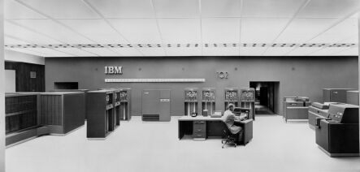
IBM 702
(Tape Processing Machine)
The IBM 702 is seen in 1952 at IBM's new Data Processing Center in its
headquarters at 590 Madison Avenue in New York City. (IBM Archives)
Notes:
The equipment shown in the image (left to right): arithmetical and logical unit, eight magnetic tape units and power supply, console (foreground), card punch, printer, and card reader. Several units of the 702 system are not shown, including the magnetic drum memory, auxiliary magnetic tape units, and control and electrostatic storage facilities.

Slide 22
IBM 650
(Magnetic Drum Computer)
First IBM 650 delivered in 1954
Inexpensive, punch-card oriented computer
  "Model-T of computing“
2,000 are eventually produced
Applications:
  Calculation of insurance sales personnel commissions, market research analysis, payroll processing, missile design, customer billing for a utility, oil refinery design and engineering calculations, analyses of flight tests made by supersonic aircraft, actuarial computations, centralized branch store accounting.
Discounts of 60% provided to universities in exchange for courses in data processing
Notes:
The IBM RAMAC 650 electronic data processing system combines the capabilities of the world's most widely-used computer with the flexibility of random-sequence data availability. Two basic elements make up the RAMAC 650- --an IBM 650 data processing system and an IBM 355 magnetic disk memory file.
The basic 650 is a stored program, magnetic drum computer with logical ability. It remembers instructions and follows them as the need arises during the solution of a problem. Routine or complex calculations are solved with equal facility in accounting and technical applications. More 650's are in use today than any other type of computer. The system may be expanded, building-block fashion, when growing business volume creates a need for greater capacity and speed.
SPECIAL NOTE about university program: IBM recognized an opportunity. By providing the equipment cheaply and getting data processing courses set up, they would get the major pool of graduates that were ready to use their machines or work on new ones.

Slide 23
IBM 650 Customers
ACF Industries Inc.*·ALCO Products, Jamestown*·Allied Chemical, Richmond*·Allis Chalmers, Milwaukee, Wisconsin*·Atlantic Refining, Philadelphia, Pennsylvania.*·Avco Manufacturing, Cincinnati, Ohio*·Avco Manufacturing Corp., Cambridge, Massachusetts·Belknap Hardware & Manufacturing Company, December 13, 1955·Bell Aircraft Corporation, Buffalo, New York*·Bell Telephone, Elizabeth (3)*·Bell Telephone, Philadelphia, Pennsylvania*·Bethlehem Steel, Baltimore, Maryland*·Boeing Airplane Company, August 11, 1955*·Bonneville Power Administration, April 24, 1956·Budd Company, Philadelphia, Pennsylvania*·Business Men's Assurance Company·Carnegie Institute of Technology, August 28, 1956*·Carrier Corp., Syracuse, New York*·Carter Oil, Tulsa, Oklahoma*·Case Institute, Cleveland, Ohio*·Chance Vought Aircraft, Dallas, Texas (2)*·Chrysler, Detroit, Michigan, May 1955*·Clarke Brothers, Jamestown*·Colorado River Association, February 17, 1958·Combustion Engineering Inc., New York, New York*·Cornell University, Elmira, New York, February 3, 1957*·Datamatic Corp., Cambridge, Massachusetts*·Detroit Edison Company, May 10, 1955·Doane Agricultural Service, Inc.·Drexel Institute of Technology, November 20, 1958·E. I. duPont de Nemours & Company, February 15, 1955·Francis I. duPont & Company, November 22, 1955·El Paso National*·Equitable Life, New York, New York, April 1955·Esso Research, Elizabeth*·Esso Standard Oil Co., Baton Rouge Refinery, February 14, 1955·Fairchild Engineering, Garden City, New York*·Fairchild Engineering, Hagerstown, Maryland·General Dynamics, Tyler*·General Dynamics Corporation, Electric Boat Division, August 11, 1955 (for design of USS Seawolf (SSN-575), the U.S. Navy's second nuclear-powered submarine)*·General Electric, Boise*·General Electric Aircraft, Cincinnati, Ohio (2)*·General Electric Analytical, Schenectady, New York (2)*·General Electric Apparatus Sales Division, January 26, 1955·General Electric Engineering Lab, Schenectady, New York*·General Electric Heavy Military Electronic Equipment, Syracuse, New York*·General Electric Knolls Atomic Power Lab., Schenectady, New York*·General Electric Large Motor & Generator, Schenectady, New York*·General Electric Medium Induction Motor, Schenectady, New York*·General Electric Missile & Ordnance Systems Department, June 16, 1957·General Electric Special Products, Philadelphia, Pennsylvania*·General Electric Switchgear, Philadelphia, Pennsylvania*·Georgia Institute of Technology, Atlanta, Georgia.*·Goodyear Atomic, Huntington*·Grumman Aircraft Engineering Corporation, Garden City, New York, May 26, 1955 (2)*·Gulf Life Insurance Co., July 14, 1959·Gulf Oil Corporation, September 10, 1956 and June 10, 1957 (2)·Harrison Radiator, Buffalo, New York*·Hartfield Stores, Inc., July 30, 1957·H.P. Hood & Sons·Hughes Aircraft Company, February 19, 1955 (3)*·Humble Oil, Houston (2)*·IBM de Venezuela, February 19, 1957·Illinois Institute of Technology, Chicago, Illinois*·Indiana University, Indianapolis, Indiana*·Interstate Life & Accident Insurance Company, August 16, 1957·Iowa Mutual Insurance Company·Iowa State College Statistical Laboratory, March 9, 1957·John Hancock Mutual Life Insurance Company, December 8, 1954 (2)·Johns Hopkins, Baltimore, Maryland*·Jones & Laughlin Steel Corporation, Aliquippa and Pittsburgh Works Divisions, December 22, 1955·Lockheed Aircraft Corporation, Missile Systems Division, February 11, 1955 (2)*·Los Angeles (city of), June 14, 1956·Massachusetts Institute of Technology, Cambridge, Massachusetts, February 29, 1960*·McDonnell Aircraft Corporation, June 19, 1955*·McLean Trucking Company, April 24, 1959·Mellon National Bank & Trust Company, November 11, 1955·Montgomery Ward & Company, April 2, 1955·National Advisory Committee for Aeronautics [NASA], Ames Aeronautical Laboratory, May 14, 1955*·National Advisory Committee for Aeronautics [NASA], Langley Aeronautical Laboratory, March 16, 1955·National Bureau of Standards, Boulder Laboratories·Nationwide Insurance·New York City Department of Public Works, December 31, 1959·New York University College of Engineering, January 22, 1957·Newport News Shipbuilding, Norfolk, Virginia*·A. C. Nielson, Chicago, Illinois, January 1955·North American Aviation, Columbus*·North Carolina State College, Raleigh*·Northern Pacific Railroad, June 20, 1957·Ohio Oil Company, February 10, 1956·Ohio State University, June 21, 1956*·Oklahoma A & M College, Stillwater*·Olin Mathieson, Buffalo, New York*·Ordnance Aerophysics Laboratory·Charles Pfizer & Company, Inc.·Pennsylvania Railroad, Philadelphia, Pennsylvania*·Phillips Petroleum, Boise*·Pittsburgh Pirates, March 15, 1955·RCA, Trenton*·Republic Aviation, Garden City, New York*·Ryan Aero Co., San Diego*·Shell Oil, Houston (2)*·Society of the Divine Savior·Standard Oil Company (Ohio), April 4, 1955·Stanford University*·State Farm Mutual, December 7, 1956·State Mutual Life Assurance Company·Union Carbon & Carbide, February 3, 1955·Union Carbide, Knoxville (2)*·University of California (3)*·University of Houston, Houston, Texas*·University of Michigan, Ann Arbor, Michigan*·University of Pittsburgh, Pittsburgh, Pennsylvania*·University of Rochester*·University of Wisconsin, Madison*·U.S. Air Force Air Weather, Asheville*·U.S. Air Force Marquardt Jet Laboratory, Van Nuys·U.S. Air Force Proving, Mobile, Alabama*·U.S. Army Guided Missile Division Computational Lab (2)*·U.S. Army Signal Corps, Trenton*·U.S. Navy, July 20, 1955·U.S. Navy Aero Research, February 23, 1955·U.S. Steel, American Bridge Div., Pittsburgh, Pennsylvania, April 1955·Vertol Aircraft Corporation, August 28, 1956*·Washington University, St. Louis, Missouri*·Wayne University, Detroit, Michigan*·Westinghouse Electric, Baltimore. Maryland, May 1955*·Westinghouse Electric Corporation, Analytical Section, E. Pittsburgh Works, March 15, 1955*·Westinghouse Electric Corporation, Steam Turbine Division, December 18, 1956·Wisconsin (state of), Madison*·Yale University, November 17, 1958

Slide 24
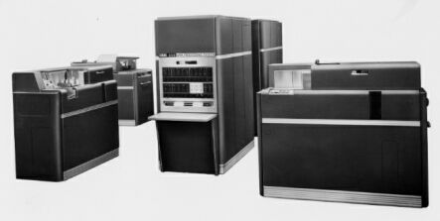
IBM 650
(Magnetic Drum Computer)
This "white room" view of a 650 installation shows an
IBM 533 Card Read Punch in the foreground at left;
the 650 Console Unit at center, with an IBM 655 Power Unit behind it;
and an IBM 537 Card Read Punch at right. (IBM Archives)
Notes:
The IBM RAMAC 650 electronic data processing system combines the capabilities of the world's most widely-used computer with the flexibility of random-sequence data availability. Two basic elements make up the RAMAC 650- --an IBM 650 data processing system and an IBM 355 magnetic disk memory file.
The basic 650 is a stored program, magnetic drum computer with logical ability. It remembers instructions and follows them as the need arises during the solution of a problem. Routine or complex calculations are solved with equal facility in accounting and technical applications. More 650's are in use today than any other type of computer. The system may be expanded, building-block fashion, when growing business volume creates a need for greater capacity and speed.

Slide 25
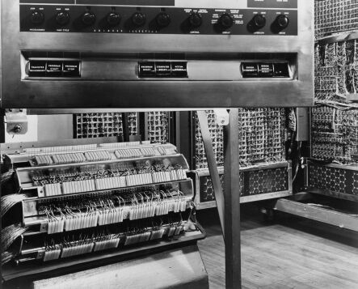
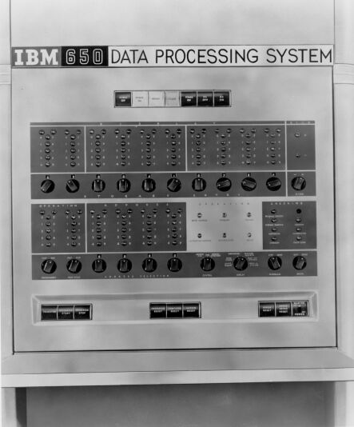
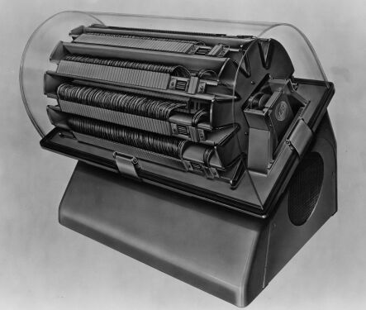
IBM 650
(Magnetic Drum Computer)
The console of the IBM 650,
the 650 with its cover off,
and the magnetic drum. (IBM Archives)

Slide 26
IBM advantages over UNIVAC
IBM’s computers soon outdistanced UNIVAC in the marketplace
1955 – IBM’s 700 series sales first surpassed UNIVAC
Better technologies?
  Williams Tube memory rather than mercury delay lines?
    both had shortcomings speed vs. reliability
  Superior magnetic tape system
  Forrester core memory
Modular designs
  pluggable components
  flexibility
Superior training & service infrastructure
Rentals vs. Sales

Slide 27
Was it Remington Rand’s fault?
What do the business majors think?
Many would later comment that Remington-Rand had
snatched defeat from the jaws of victory
  Sperry Rand?
RR was criticized for not investing enough in further development of the machine

Slide 28
Was it inevitable?
For IBM:
  timing is everything
  being the biggest doesn’t hurt either
    great resources
    large margin for error
    large customer base
  strong leadership with Watsons
    they made a commitment to change with the times
  “losing is not an option” culture at IBM
    culture of fear (reminiscent of NY Yankees)

Slide 29
Evolution of Circuitry & Memory in the 1940s and 1950s
vacuum tubes used by 1st generation computers
transistors used by 2nd generation computers
how about 3rd generation computers?
Other technological developments:
  magnetic tape
  magnetic drum
  core memory

Slide 30

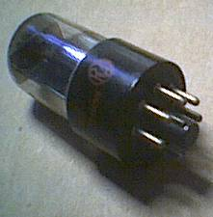
Invention of Vacuum Tubes
1879 – Edison invents incandescent electric light bulb
  air removed from bulbs causing vacuum
1883 – Edison discovers he could detect electrons flowing through his vacuum bulbs
  placed second electrode in bulb
  known as the Edison Effect
1904 – English physicist John Fleming extends the Edison Effect, and invents two-element vacuum tube called a diode
  One-way current
  Converts AC to DC
1906 – American inventor Lee de Forest introduced a third electrode called the grid into the vacuum tube
  allowing into to act as an amplifier and a switch

Slide 31
Vacuum Tubes
A glass tube from which all gas has been removed
  contained electrodes for controlling electron flow
  commonly used in early computers as switch or amplifier
  poor reliability: burned out easily
Vacuum tubes are no longer used and were replaced by transistors

Slide 32
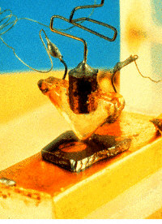
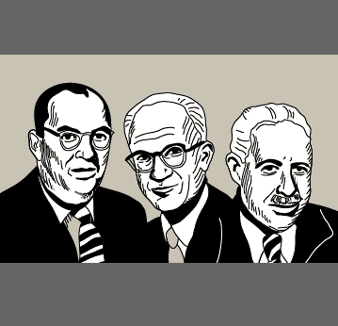
Transistors
First invented & tested in 1947 by William Shockley, Walter Brattain, and John Bardeen for AT&T Bell Labs in New Jersey
  Awarded Nobel Prize in Physics in 1956
    http://nobelprize.org/physics/laureates/1956/
One of the most important inventions of the 20th Century
  Certainly for modern computers
Started the trend towards miniaturization

Slide 33
So what’s a transistor?
Uses semiconductor materials like silicon
  Semiconductors are in between electrical conductors & insulators
  Can function as one or the other
  It’s ability to change states is what allows it to switch (for computers) or amplify (for radios)
  Transistor switches can be cascaded together to build up complicated logical control circuits
Today’s computers still use transistors (ex: CPU)
For complete technical answer (and fun & games):
  http://nobelprize.org/physics/educational/transistor/function/intro.html
  http://www.lucent.com/minds/transistor/history.html

Slide 34
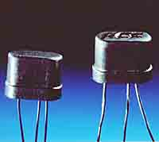
Silicon Junction Transistor
perfected by Gordon Teal of Texas Instruments Inc
brought the price of this component down to $2.50
These are not terribly complicated devices
  Combine a whole bunch of them and you can create something complicated
Other advances by Philco
IBM started designing computers with transistors in the late 1950s

Slide 35
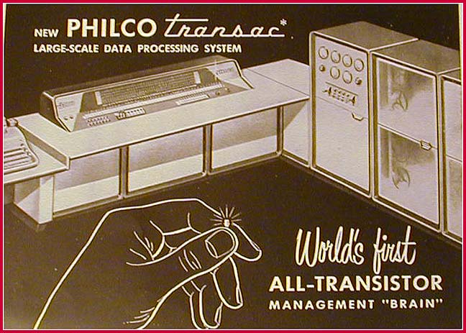
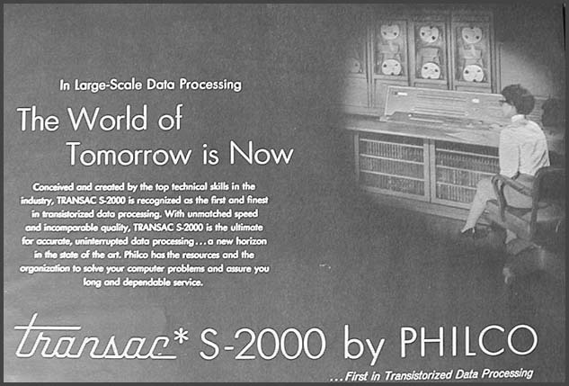
TRANSAC S-2000
from www.luminquest.com/HOC
Notes:
“Created and conceived by the top technical skills in the industry, TRANSAC S-2000 is recognized as the first and finest in transistorized data processing. With unmatched speed and incomparable quality, TRANSAC S-2000 is the ultimate for accounts, uninterrupted data processing... a new horizon in the state of the art. Philco has the resources and the organization to solve your computer problems and assure you long and dependable service.”

Slide 36
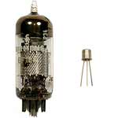
The Transistor vs the Vacuum Tube
Vacuum tubes
  Generate a lot of heat (like light bulbs)
  Burn out
  Slow, big, & bulky
Transistor
  Small
  Fast
  Reliable
  Require less energy

