Slide 1
INTERNATIONAL CONFLICT
AND
COOPERATION
POLI 388

Slide 2
INTERNATIONAL CONFLICT AND COOPERATION
Why do nations (and other actors) sometimes play “chicken”?
Why do rational actors often pursue self-defeating courses of action? And why is it sometimes rational to appear to be “irrational”?
Why do nations (and other actors) sometimes engage in “brinksmanship”? (And why is “brinksmanship” an inappropriate metaphor?)
Why do statesman (and others) sometimes have to lie in order to tell the truth? And why does telling the truth sometimes deceive others?
Why do nations (and other actors) often sink so many resources into trying to win a conflict that the value of the resources expended far exceed the value of what is at stake in the conflict?
What is the difference between “defense” and “deterrence”? Between “deterrence” and “compellence”? Between “preventive” and “pre-emptive” action?
What determines which “commitments” the U.S. (or other nations) will honor and which it will not?

Slide 3
INTERNATIONAL CONFLICT AND COOPERATION
Why did it make sense for the U.S. to keep 5,000 lightly armed soldiers in West Berlin during the Cold War, even though they were surrounded by dozens of heavily armed Soviet and Warsaw Pact divisions?
Why is “credibility” especially important in international politics and how is credibility protected or lost?
How do “bargaining chips” work in international arms control (and many other) negotiations?
Why has nuclear proliferation proceeded so slowly (at least until recently)?
Why was nuclear war between the U.S. and the Soviet Union a bit more probable in the last decade of the Cold War than in the mid-1960s but much less probable than in the mid-1950s?
Is civil defense ever effective in the nuclear age? Is it ever dangerous?

Slide 4
INTERNATIONAL CONFLICT AND COOPERATION
Why is it possible to extract advantages by holding hostages but also inherently difficult to realize these advantages?
In what sense does the U.S. [still] hold a large portion of the Russian population “hostage” (and vice versa), and how might these international hostages be “freed”?
What was the evolution of the strategic relationship between the U.S. and the Soviet Union over the course of Cold War?
Why did the U.S. rely on “strategic deterrence” throughout the Cold War? Is this posture now obsolete?
What is the meaning of strategic “superiority” or “parity” or “sufficiency” in the nuclear age and what factors determine these relationship between adversaries?
What are the strategic consequences of spy satellites, MIRVs (Multiple Independently-targetable Re-entry Vehicles), ABMs (Anti-Ballistic Missile systems), and the SALT (Strategic Arms Limitation Treaty) agreements?
Why is “arms control” an aspect of military strategy and how would “deterrence” operate in a “disarmed” world?

Slide 5
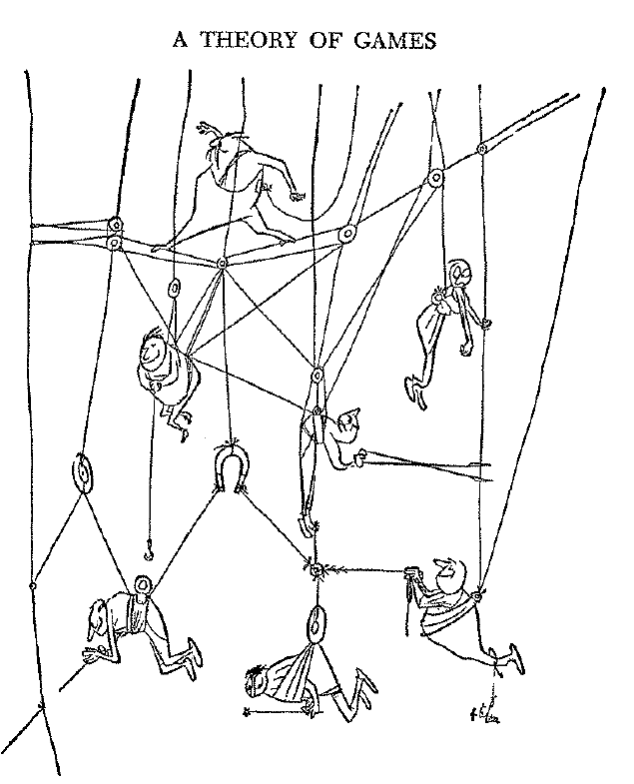
What is Game Theory?
It is part of the theory of purposeful behavior commonly known as rational choice theory.
It specifically focuses on situations with two or more interdependent decision makers.
The name game theory may be unfortunate, as it suggests frivolity
It might better be called the conceptual analysis of
  interdependent decision making, or
  conflict and cooperation, or
  strategy and coalitions.

Slide 6
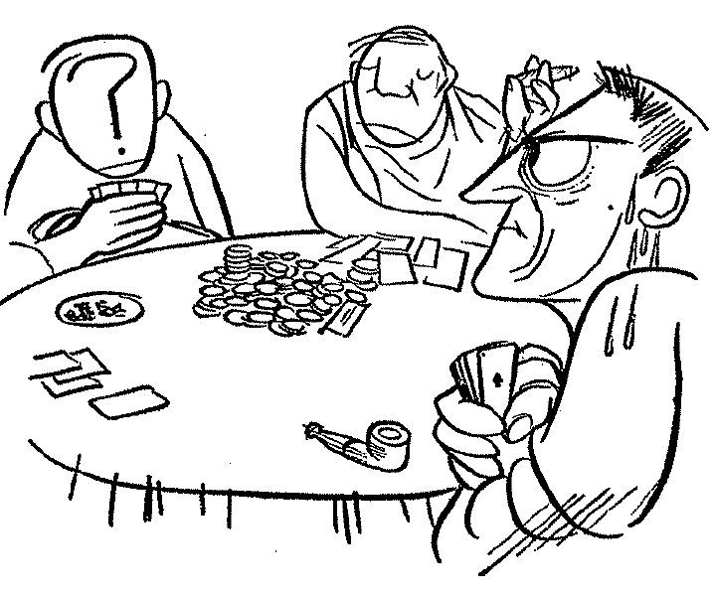
What is Game Theory? (cont.)
In any case the “games” referred are not:
  games of physical or mental skill, or
  games of pure chance, or
  “games people play.”
The games referred to are games of strategy, i.e., “parlor games” (though not solitaire) such as
  board games (tic-tac-toe, checkers, chess, etc.), or
  card games (bridge, poker, etc.).

Slide 7
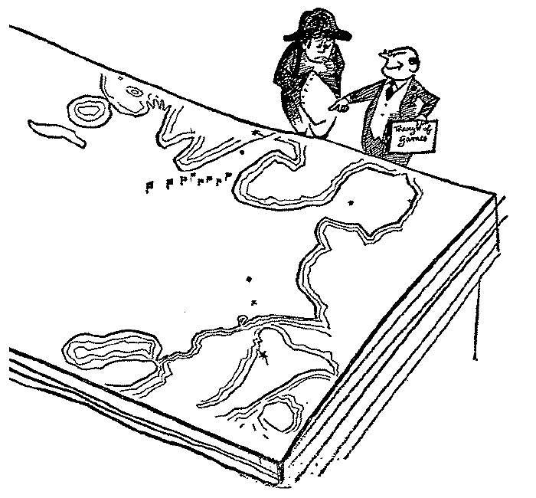
What is Game Theory? (cont.)
Why do serious people go about trying to construct a “theory of [such] games”?
“The typical problems of economic [and many problems of social, political, and military] behavior become strictly identical with the mathematical notions of suitable games of strategy.”
Von Neumann & Morgenstern, p. 2

Slide 8
What Are Games of Strategy (Considered Abstractly)?
Games of strategy are defined by a set of
  two or more players, and
  each player is assigned a set of possible strategies (or actions or moves or choices)
Each possible combination of strategies, one for each player, produces an outcome.
Each player has preferences (or interests, values, utilities, etc.), which may be more or less conflicting, over the possible outcomes.

Slide 9
What Are Games of Strategy? (cont.)
Game theory develops important insights concerning games of strategy, and addresses questions such as the following:
  In a board game (like chess) at least, once the “end game” (last few moves) is reached it becomes clear that one player has a “winning position” and the other player may as well resign, so we ask: Is there (at least in principle) a best way to play that will guarantee victory (or a draw) from the very first move?
  Under what circumstance does it make a difference whether players can communicate among themselves before making their choices?

Slide 10
What Are Games of Strategy? (cont.)
  Under what circumstances does it make a difference whether players can make binding agreements among themselves before making their choices?
  Under what circumstances might players “gang up” on each others by forming coalitions?
  Under what circumstance does it make a difference whether or not the players engage in repeated play of the same game?
What general characteristics of games determine the answers to these questions, by determining their inherent logic?

Slide 11
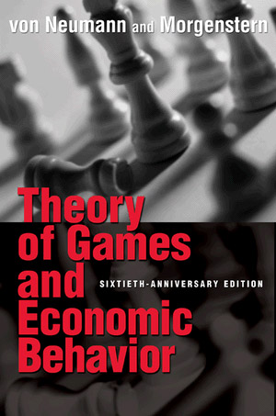
History of Game Theory
Early papers by
  Zermelo (1912, perfect information),
  Borel (1927, mixed strategies),
  von Neumann (1928, minimax theorem)
Von Neumann and Morgenstern, Theory of Games and Economic Behavior (1944)
http://www.archive.org/details/theoryofgamesand030098mbp

Slide 12
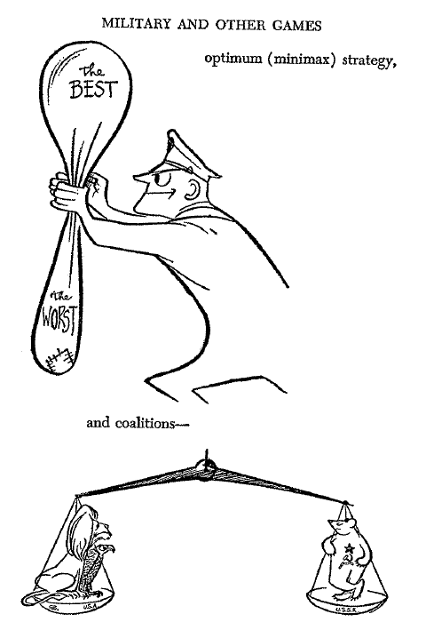
History of Game Theory (cont.)
General development of mathematical theory of games (at Fine Hall [Princeton Mathematics Department] and RAND Corporation), late 1940s onwards (especially work of John Nash on non-cooperative games and [Nash] equilibrium), with possible applications to Cold War nuclear strategy

Slide 13
History of Game Theory (cont.)
Game theory was brought to attention of social scientists in mid-1950s:
  Luce and Raiffa, Games and Decisions, 1957
Some political applications by non-political scientists at this time:
  Arrow, Social Choice and Individual Values, 1951
  Black, Theory of Committees and Elections, 1958
  Downs, An Economic Theory of Democracy, 1957
  Schelling, The Strategy of Conflict, 1960
  Buchanan & Tullock, The Calculus of Consent, 1962

Slide 14
History of Game Theory (cont.)
Earliest work by a political scientist:
  Riker, The Theory of Political Coalitions (1962)
  Followed by much further work by Riker and his students who constituted the “Rochester school” (late 1960s to early 1970s)
Game theory enters mainline political science in the late-1970s
Game theory (and “number crunching”) allegedly dominates mainstream political science, provoking the “Perestroika movement” within the discipline

Slide 15
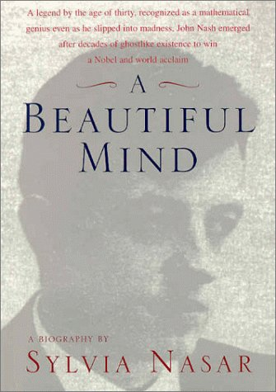
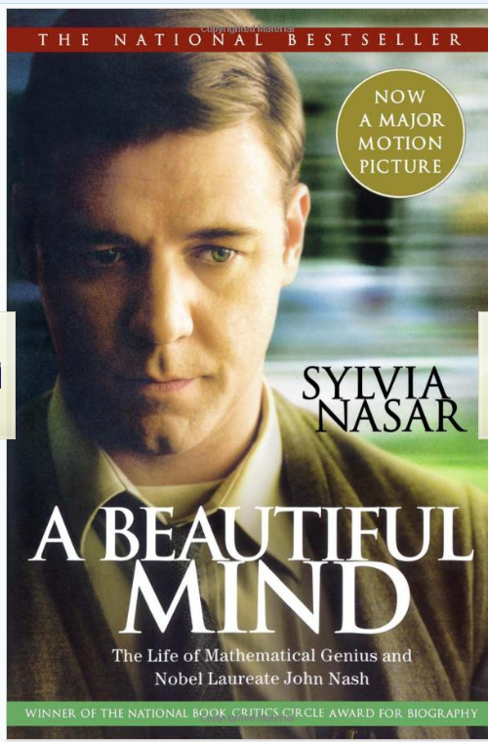
Game theory publicized by A Beautiful Mind biography (and later movie) about John Nash

Slide 16
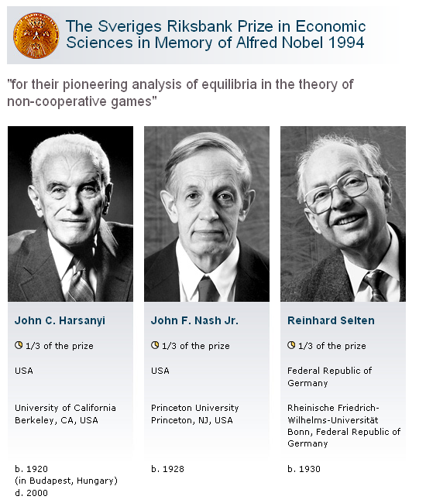

Slide 17
