Slide 1
LSTM Reproducibility of Multimodal Distribution
2024. 05. 31
T. Miyao

Slide 2
Issues
LSTM or chemical language models are good to reproduce the distributions of the chemical compounds used for its training.
Are LSTM models able to reproduce multimodal distribution of chemical space?

Slide 3
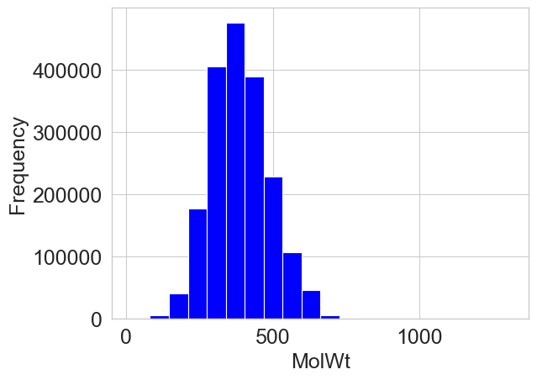
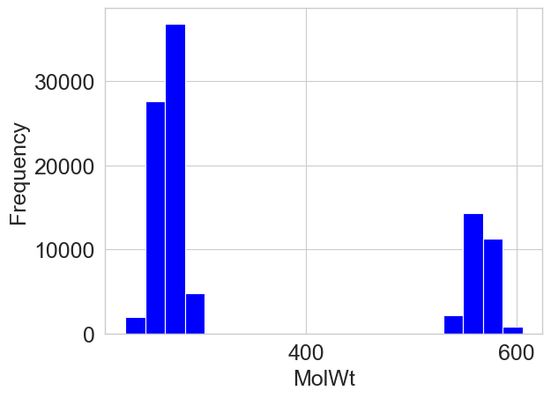
Approaches
Sampling training compounds which are extracted from distribution of two modes.
  4 properties: MW, TPSA, Ring count, QED
  modes (means) : 10 percentile, 95 percentile, std: sample std * 0.1 (narrow peaks)
  Distributions: Gaussian (mixture of Gaussians). Pseudo MCMC sampling (uniform distribution is assumed)
  # sample CPDs (SMILES): 10⁵
Example (MW)

Slide 4
LSTM experience
training/validation: 0.95: 0.05
Early stopping: patience: 10 epochs.
Total epochs: 50 epochs
LSTM structures: 3 layers, 256 hidden size, 256 embedding.

