Slide 2
Audio Noise Reduction Using Artificial Neural Networks

Slide 3
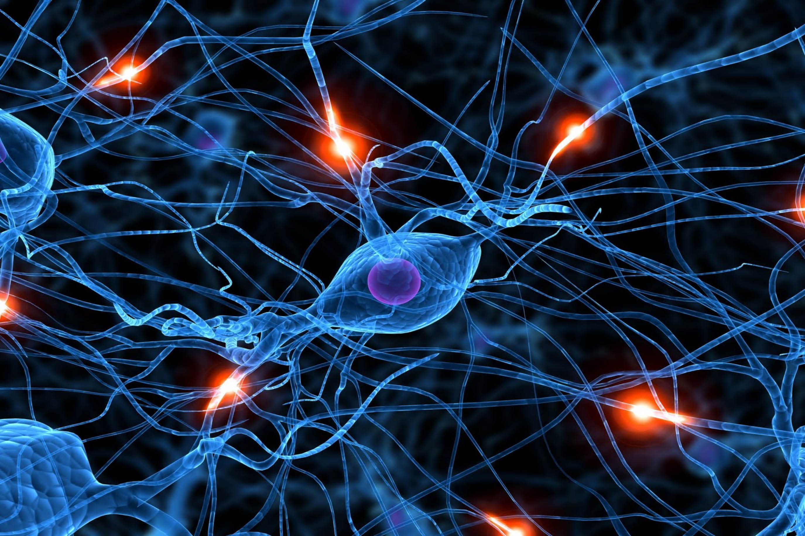
Overview
Team Members:
Abram Haich
Topic:
Audio noise reduction using Artificial Neural Networks

Slide 4
Problem

Slide 5


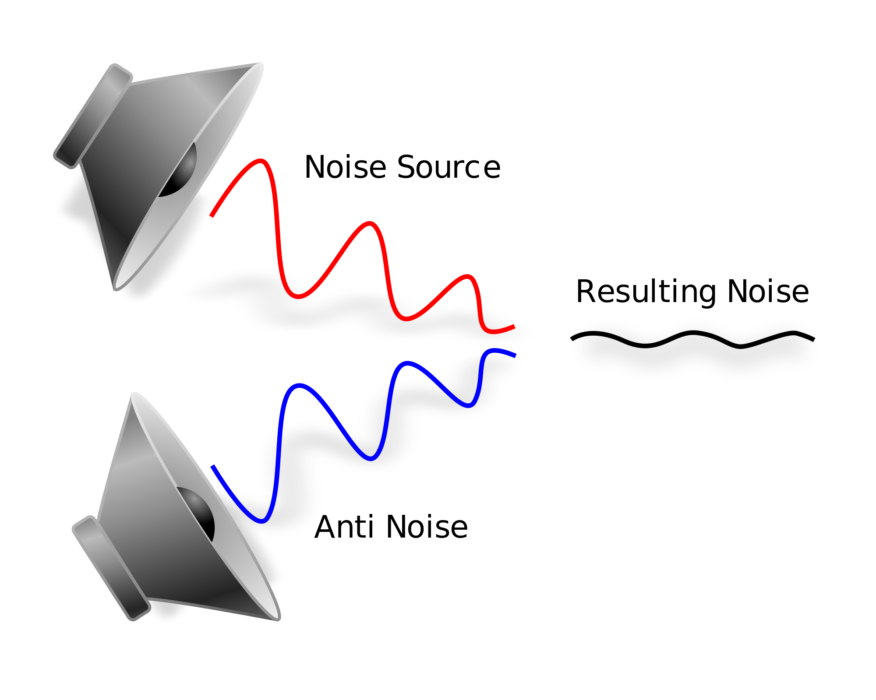
Applications
Passive:
Wav file for podcast
Reduce noise keep desired signals (speech)
Need to detect noise within sample
Active:
Predict curve of noise for noise cancellation:
Car Engine noise
Public locations noise (airports, coffee shops,etc)

Slide 6
Method Proposed
Supervised Learning
Prediction using training set
Artificial Neural Networks (ANN):
Function Unknown
Regression Problem
Noise + Speech
ANN
Speech
Error Calculation
Back Propagation

Slide 7
Existing Work
Removing Noise from Speech Signals Using Different Approaches of Artificial Neural Networks [Omaima N. A. Al-Allaf]
An Investigation of Spectral Restoration Algorithms for Deep Neural Networks based Noise Robust Speech Recognition [Bo Li1, Yu Tsao2, Khe Chai Sim1]

Slide 8
Project Milestones
Proposal
Coding
Training
Evaluation
Final Presentation

Slide 9
refs
https://upload.wikimedia.org/wikipedia/commons/thumb/7/7d/Active_Noise_Reduction.svg/2000px-Active_Noise_Reduction.svg.png

