Slide 2
Audio Noise Reduction Using Artificial Neural Networks

Slide 3
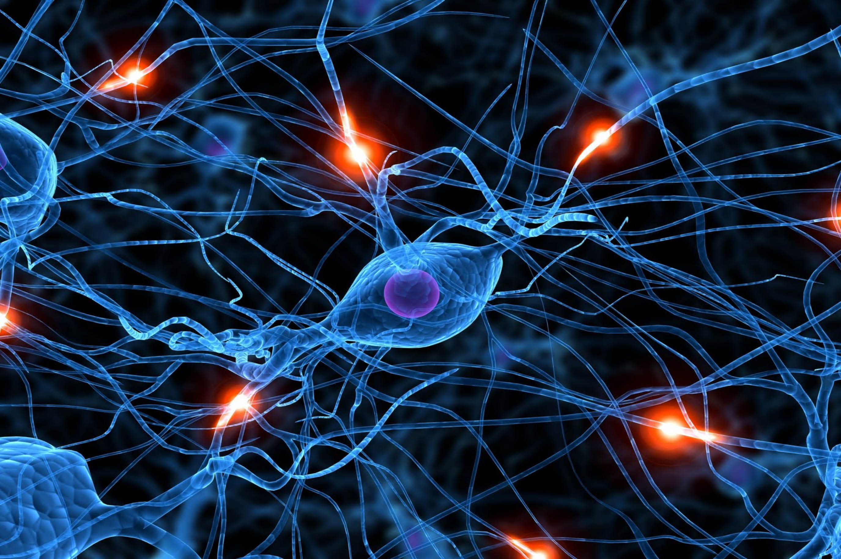
Introduction
Team Members:
Abram Haich
Topic:
Audio noise reduction using Artificial Neural Networks

Slide 4
Problem:

Slide 5
Methods
Dataset Generation
Preprocessing
Neural Network Construction
2000+ samples created using noise and speech
Keep track of noise and speech signals using xml file
Normalization of signals to range [0,1]:
$$X_{new}=\frac{X−X_{min}}{X_{max}−X_{min}}$$
𝑋_𝑛𝑒𝑤=(𝑋−𝑋_𝑚𝑖𝑛)/(𝑋_𝑚𝑎𝑥−𝑋_𝑚𝑖𝑛 )
Recurrent neural network stacked layers
Conversion to FFT

Slide 6


Methods continued…
Keras: Deep Learning library for Theano and TensorFlow
“Keras is a minimalist, highly modular neural networks library, written in Python and capable of running on top of either TensorFlow or Theano”

Slide 7
Neural Network:
Input
Embedding
LSTM
LSTM
LSTM
Time Distribution Density/merge
Activation Layer
Stacked Layers

Slide 8
Performance:
If Signal is simple:
MSE error less then 0.0002
Speech signals suffer very little degradation
If Signal is complex:
MSE error is sometimes as high as 0.99
Speech signals unrecognized
Takes awhile to build the net but not long to run through samples
Takes days to train on only a 100 samples from dataset.

Slide 9
Results:
Works very well for known signals

Slide 10
Improvements:
Larger window (currently only 256 points for 200Hz signals)
Remove LSTM was not useful in this case:
Instead of removing noise, network should predict noise and then remove from rest of signal

Slide 11
Summary:
Network written in Python preforms very well for simple signals
Does not preform well for complex signals
LSTM should be removed and other layers should be considered such as convolutional network structure.
FFT should really be discouraged since these would be difficult in dynamic environments

Slide 12
Questions?

Slide 13
refs
https://upload.wikimedia.org/wikipedia/commons/thumb/7/7d/Active_Noise_Reduction.svg/2000px-Active_Noise_Reduction.svg.png
http://www.dataminingblog.com/standardization-vs-normalization/
https://www.python.org/
http://keras.io/

