Slide 1
AI LAB HANDS-ON TRAINING • DAY 2 • SESSION 1 • 09:00 – 10:00
Python Dev Environment
& the AI Dev Stack (PyCharm)
Write locally, scale in the cloud — today we set up the workshop.

Slide 2
SESSION 1 • 09:00 – 10:00
Objectives & Outcomes
A professional local setup: Python, PyCharm, virtual environments
Understand why we start local before touching the cloud
Train a first tiny model on your own machine
Push working code to GitHub — the habit that carries all week
Evidence by 10:00
PyCharm project + virtual environment created
AI stack installed: numpy, pandas, scikit-learn, matplotlib
train_local.py runs and prints a prediction
Script committed and pushed to GitHub
AI Lab Training — Day 2, Session 1: Python Dev Environment
2

Slide 3
SESSION 1 • 09:00 – 10:00
Python Dev Environment — Key Terms
Python
The language of AI — it drives every tool this week, cloud and edge alike
Package & pip
Reusable code by others; pip installs it (pip install pandas)
Virtual environment
A private package folder per project — nothing breaks anything else
PyCharm
The Python-specialist IDE (free). Yesterday VS Code — now you know both
scikit-learn
Classic ML algorithms that train in seconds on small data
requirements.txt
The packing list that lets anyone rebuild your environment
AI Lab Training — Day 2, Session 1: Python Dev Environment
3

Slide 4
SESSION 1 • HANDS-ON LABS A & B
Set Up PyCharm, Then Train Locally
1. Install Python (tick “Add to PATH”) and PyCharm Community
2. New Project: day2-cloud-ai — PyCharm creates the venv
3. Terminal: pip install numpy pandas scikit-learn matplotlib
4. Create train_local.py → Run ▶
5. Push to GitHub: “Add local training script”
train_local.py — first local model
import pandas as pd
from sklearn.tree import DecisionTreeClassifier
url = "https://raw.githubusercontent.com/<you>/" \
"my-first-ai-lab/main/data/soldiers_fitness.csv"
df = pd.read_csv(url)
X = df[["age","pushups_per_min","run_5km_minutes"]]
model = DecisionTreeClassifier().fit(X, df["fitness_level"])
print(model.predict([[24, 48, 23]])[0]) # → 'high'
[ SCREENSHOT ]
New Project dialog with virtualenv selected — trainer's live capture
Same dataset you committed yesterday — same data, new tool.
AI Lab Training — Day 2, Session 1: Python Dev Environment
4

Slide 5
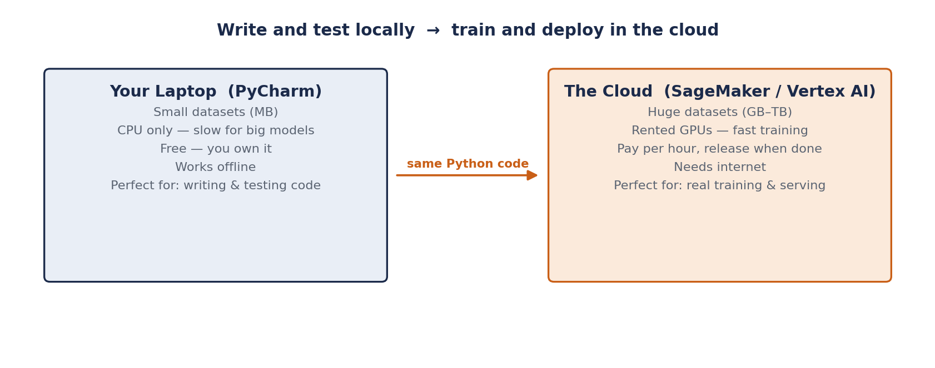
SESSION 1 • THE RULE OF THUMB
Write Locally, Scale in the Cloud
Five rows of data trained in milliseconds on your CPU. Five million rows would not — and that is where we go next.
AI Lab Training — Day 2, Session 1: Python Dev Environment
5

Slide 6
SESSION 1 • TROUBLESHOOTING
If Something Doesn't Work
“python not recognized”
PATH wasn't set during install — reinstall and tick the checkbox
pip install hangs/fails
Check your network connection; try again or use --user flag
Wrong interpreter in PyCharm
Settings → Project → Python Interpreter → select the venv folder
Import error at runtime
The package didn't install into this project's venv — reinstall inside PyCharm's terminal
git push rejected
Pull first (git pull --rebase), resolve conflicts, then push again
AI Lab Training — Day 2, Session 1: Python Dev Environment
6

Slide 7
SESSION 1 RECAP
The Workshop is Ready
Python + PyCharm + venv = a clean, repeatable project setup
You trained a model with 5 lines of scikit-learn, entirely on your laptop
Next: Session 2 takes this same pattern and moves it to the cloud

