Slide 1
AI LAB HANDS-ON TRAINING • DAY 2 • SESSION 2 • 10:15 – 12:15
Amazon SageMaker
Part 1 — Cloud ML Basics
Your notebook doesn't train — it launches.

Slide 2
SESSION 2 • 10:15 – 12:15
Objectives & Outcomes
Understand the cloud training pattern: storage → training job → model artifact
Create an S3 bucket and upload the training dataset
Launch a real SageMaker training job from a notebook
Read cloud console evidence: job status, billable time, output artifact
Evidence by 12:15
S3 bucket ai-lab-<username> containing data/soldiers_fitness.csv
SageMaker training job: status Completed
model.tar.gz artifact present in the S3 bucket
You can explain what “billable seconds” means
AI Lab Training — Day 2, Session 2: SageMaker Part 1
2

Slide 3
SESSION 2 • 10:15 – 12:15
AWS in Six Terms
AWS & Console
The largest cloud provider; console.aws.amazon.com manages your account
Region
A physical data-center location — pick one, build everything inside it
S3 & Bucket
AWS file storage; a bucket is a top-level folder with a unique name
IAM role
A badge that lets one AWS service act on your behalf
SageMaker
AWS's managed ML platform: notebooks, training, hosting, MLOps
Instance type
The machine you rent: ml.m5.large (CPU) → ml.p3.2xlarge (GPU)
AI Lab Training — Day 2, Session 2: SageMaker Part 1
3

Slide 4
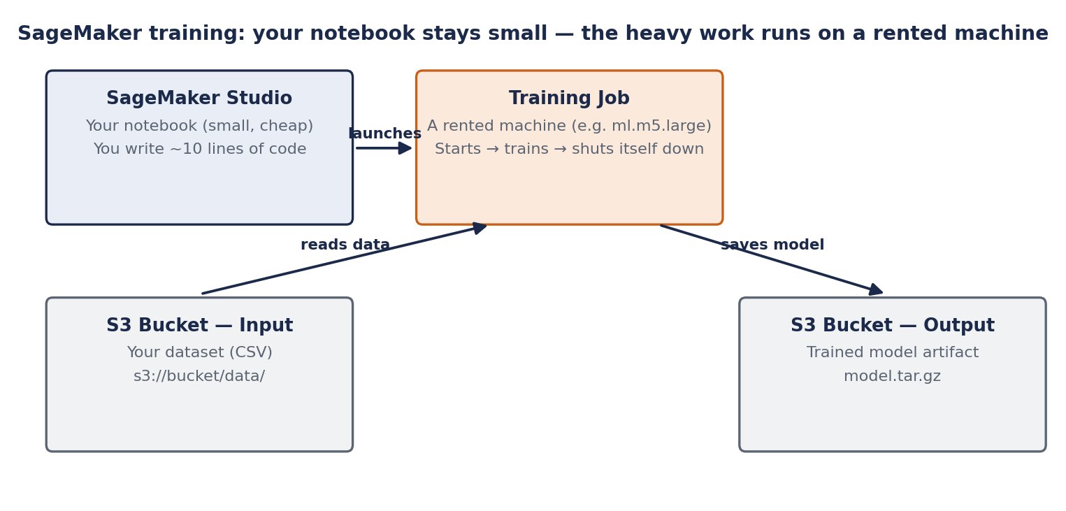
SESSION 2 • THE BIG IDEA
Your Notebook Doesn't Train — It Launches
Training job = rented machine: starts, trains, saves the model to S3, shuts itself down. You pay for minutes, not machines.
AI Lab Training — Day 2, Session 2: SageMaker Part 1
4

Slide 5
SESSION 2 • HANDS-ON LAB C
Your Data Moves to the Cloud (S3)
1. S3 → Create bucket: ai-lab-<your-username>
2. Create folder: data
3. Download soldiers_fitness.csv from your GitHub repo
4. Upload → Add files → the CSV → Upload
WHAT YOU SHOULD SEE: data/soldiers_fitness.csv inside your bucket
[ SCREENSHOT ]
S3 console: bucket list with ai-lab-<username>
[ SCREENSHOT ]
Upload succeeded: data/soldiers_fitness.csv
[ SCREENSHOT ]
Create-bucket form (defaults) — trainer's live capture
AI Lab Training — Day 2, Session 2: SageMaker Part 1
5

Slide 6
SESSION 2 • HANDS-ON LAB D
Launch a SageMaker Training Job
day2_sagemaker.ipynb — Cells 1–3
What you should see
import sagemaker
role = sagemaker.get_execution_role()
bucket = "ai-lab-<your-username>"
%%writefile train.py # runs on the RENTED machine
df = pd.read_csv(os.environ["SM_CHANNEL_TRAIN"] + "/soldiers_fitness.csv")
model = DecisionTreeClassifier().fit(X, y)
joblib.dump(model, os.environ["SM_MODEL_DIR"] + "/model.joblib")
from sagemaker.sklearn.estimator import SKLearn
est = SKLearn(entry_point="train.py", role=role,
instance_type="ml.m5.large", instance_count=1,
framework_version="1.2-1")
est.fit({"train": f"s3://{bucket}/data/"}) # ← launch!
“Starting” — the machine is being provisioned (~3 min)
Your script's print: “Training complete.”
“Billable seconds: ~120” — you rented 2 minutes
Console → Training jobs: status Completed
S3 bucket: model.tar.gz appeared
Honest note: for 5 rows, the cloud is slower & costs money. It wins when data outgrows the laptop.
AI Lab Training — Day 2, Session 2: SageMaker Part 1
6

Slide 7
SESSION 2 • TROUBLESHOOTING
If Something Doesn't Work
Bucket name already taken
S3 names are global — add more of your username or a random suffix
AccessDenied on upload/train
IAM role missing S3 permissions — check the SageMaker execution role
Training job stuck “Starting”
Normal for ~3 minutes while the instance provisions — wait it out
Training job Failed
Open CloudWatch Logs for the job — the Python traceback is at the bottom
Can't find model.tar.gz
Check the exact S3 output path shown in the job's summary tab
AI Lab Training — Day 2, Session 2: SageMaker Part 1
7

Slide 8
SESSION 2 RECAP
You Rented a Machine
Storage → training job → artifact: the cloud ML pattern, done once by hand
You paid for minutes of compute, not for owning a machine
Next: Session 3 turns that saved model into a live prediction service

